Slide 1




Unit 3 Communication and Platform Skills

Slide 2
Unit 3 Objectives
Upon completion of this unit, you will be able to do the following:
Describe the role of an instructor in training.
List and describe six words that will help you to be a good instructor.
more…
PPT 3-1

Slide 3
Unit 3 Objectives
cont’d.
3. Use interactive instructional communication.
PPT 3-2

Slide 4
Presentations
Plan
Prepare
Personal
Presentation
Presence
Participation
PPT 3-3

Slide 5
Plan
Content
Visual Aids
Exercises
PPT 3-4

Slide 6
Prepare
Lesson Plan
Visual Aids
Practise
PPT 3-5

Slide 7
Personal
Dress
Playthings
Attitude
Visualisation
Perception
PPT 3-6

Slide 8
PPT 3-7

Slide 9
PPT 3-8

Slide 10
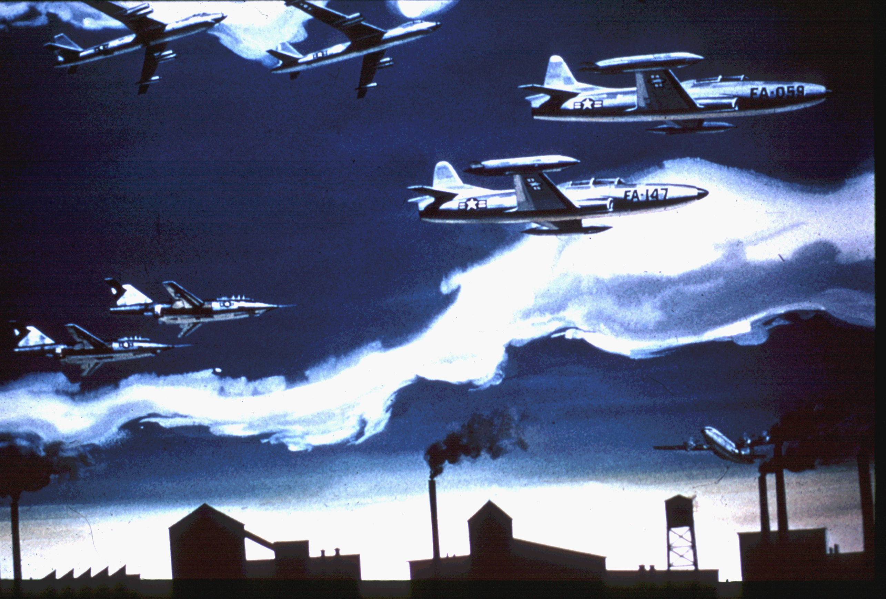
PPT 3-9

Slide 11
Presentation
Energy
Style
Activity
Equipment
Support Material
PPT 3-10

Slide 12
Presence
Voice
Vocabulary
Pace
Non-verbals
Communication
PPT 3-11

Slide 13
Participation
Exercises
Feedback
Active Listening
Instructions
PPT 3-12

Slide 14
Unit 3 Objectives
Upon completion of this unit, you will be able to do the following:
Describe the role of an instructor in training.
List and describe six words that will help you to be a good instructor.
more…
PPT 3-13

Slide 15
Unit 3 Objectives
cont’d.
Use interactive instructional communication.
PPT 3-14

Slide 16

THANK YOU

