Slide 1


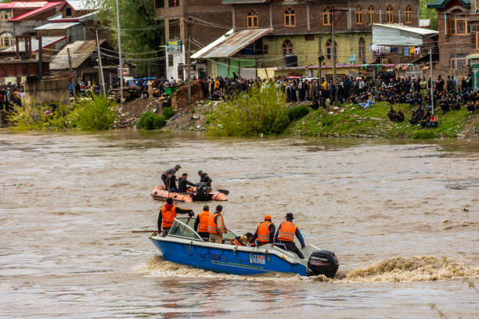
AQUATIC DISASTER IN GENERAL & SOP
Presented By:- Kamal Mehra,2IC

Slide 2
OBJECTIVE
Upon completion of this lesson you will be able to :-
Define Aquatic disaster
List Reasons of Aquatic disaster
Describe types of Aquatic disaster
List Dos and don’ts
Introduction of SOP and Aquatic disaster

Slide 3
DEFINITION OF AQUATIC DISASTER:-
Aquatic means relating to water, living in or near water or taking place in water.
Water related disaster is called aquatic disaster.
Aquatic disasters include flood, tidal waves, storm surge, tsunami etc.
Excess or low water availability creates the situation of aquatic disaster.

Slide 4
REASONS OF AQUATIC DISASTER
Enhance Water Level
Heavy Rain Fall
Climate Change
Break In Dam Or Pier
Cloud Burst
Excess Water Discharge From Dam
Uncertain change of river course

Slide 5
TYPES OF AQUATIC DISASTERS
Flood
Storm Surge
Tsunami
Tidal Waves

Slide 6
EFFECT OF AQUATIC DISASTER
• Loss of Human Life
• Injury
• Loss of Livelihood
• Displacement
• Spread of Disease

Slide 7
DO’S AND DON’TS BEFORE DISASTER
Ignore rumors, stay calm and don’t panic.
Keep your mobile phones charged for emergency communication.
Listen to radio; watch TV, read newspapers for weather updates.
Keep cattle/animals untied to ensure their safety.
Prepare an emergency kit with essential items for safety and survival.
Keep your documents and valuables in water-proof bags.

Slide 8
DO’S AND DON’TS BEFORE DISASTER
Know the safe routes to nearest shelter/raised pucca house.
Evacuate immediately to safe places when directed by government
officials.
Store enough ready-to-eat food and water for at least a week.
Be aware of flash flood areas such as canals, streams, drainage channels

Slide 9
DO’S AND DON’TS DURING DISASTER
Don’t enter floodwaters. In case you need to, wear suitable footwear.
Stay away from sewerage lines, gutters, drains, culverts, etc.
Stay away from electric poles and fallen power lines to avoid electrocution.
Mark any open drains or manholes with visible signs (red flags or
barricades).

Slide 10
DO’S AND DON’TS DURING DISASTER
Do not walk or drive in the flood waters.
Flood water can wash away vehicles as well.
Eat freshly cooked or dry food. Keep your food covered.
Drink boiled/chlorinated water.
Use disinfectants to keep your surroundings clean.

Slide 11
DO’S AND DON’TS DURING DISASTER
Don’t enter floodwaters. In case you need to, wear suitable footwear.
Stay away from sewerage lines, gutters, drains, culverts, etc.
Stay away from electric poles and fallen power lines to avoid
electrocution.
Mark any open drains or manholes with visible signs (red flags or
barricades).

Slide 12
DO’S AND DON’TS DURING DISASTER
Do not walk or drive in the flood waters.
Flood water can wash away vehicles as well.
Eat freshly cooked or dry food. Keep your food covered.
Drink boiled/chlorinated water.
Use disinfectants to keep your surroundings clean.

Slide 13
DO’S AND DON’TS AFTER DISASTER
Do not allow children to play in or near flood waters.
Don’t use any damaged electrical goods, get them checked.
If instructed, turn off utilities at main switches and unplug appliances.
Don’t touch electrical equipment if wet.
Watch out for broken electric poles and wires, sharp objects and debris.
Do not eat food that has been in flood waters.
Use mosquito nets to prevent malaria.
Be careful of snakes as snake bites are common during floods.
Don’t use the toilet or tap water if the water lines / sewage pipes are damaged.
Do not drink tap water until advised by the Health Department that the
water is safe to drink

Slide 14
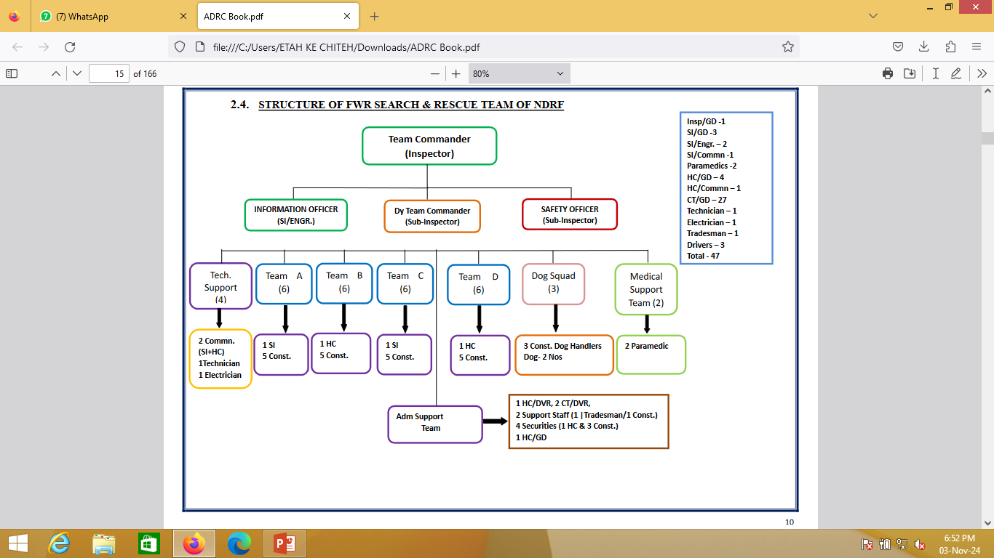
11

Slide 15
INTRODUCTION TO SOP OF FLOOD DISASTER RESPONSE
The Standard Operating Procedure (SOP) outlines the systematic approach to managing flood disasters.
It serves as a guide for organizations and agencies involved in disaster response.
Understanding this SOP is vital for effective coordination and execution during emergencies.

Slide 16
AIM OF SOP IN FLOOD RESPONSE
The primary aim is to minimize the impact of floods on affected communities.
It seeks to enhance the preparedness and response capabilities of organizations.
The aim also includes ensuring the safety and well-being of individuals during such disasters.

Slide 17
PURPOSE OF SOP
The purpose is to provide a clear framework for action during flood emergencies.
It is designed to enable quick decision-making and efficient resource allocation.
The SOP aims to establish roles and responsibilities for all stakeholders involved.

Slide 18
OBJECTIVES OF THE SOP
To facilitate timely and effective response operations.
To ensure the protection of life, property, and the environment during floods.
To includes promoting community awareness and preparedness for floods.

Slide 19
SCOPE OF THE SOP
The scope encompasses all phases of flood management, from preparedness to recovery.
It includes guidelines for response coordination among various agencies and organizations.
The SOP covers a variety of flood scenarios, including flash floods, river floods, and urban flooding.

Slide 20
PREPAREDNESS PHASE
The preparedness phase involves risk assessment and planning for potential flood events.
Training and drills are conducted to ensure readiness among responders.
Community engagement is crucial to fostering local preparedness initiatives.

Slide 21
EARLY WARNING SYSTEMS
Effective early warning systems are essential for timely flood alerts.
These systems should utilize technology for real-time data collection and dissemination.
Public education on interpreting warnings can significantly enhance community safety.

Slide 22
RESPONSE COORDINATION
Response coordination involves collaboration among local, state, and federal agencies.
Establishing a command center aids in streamlined operations during emergencies.
Clear communication channels are vital for effective coordination among responders.

Slide 23
RESOURCE MANAGEMENT
Efficient resource management ensures that necessary supplies and personnel are available.
Inventory tracking and logistics planning are key components of resource management.
Partnerships with NGOs and private sectors can bolster resource availability.

Slide 24
FIELD OPERATIONS
Field operations entail deploying teams to assess damage and provide aid.
First responders must prioritize life-saving measures in the immediate aftermath.
Regular updates and feedback loops are essential for adapting response strategies.

Slide 25
COMMUNITY ENGAGEMENT
Engaging the community fosters trust and cooperation during disaster response.
Local volunteers can play a critical role in providing immediate assistance.
Outreach programs can educate communities on flood safety and preparedness.

Slide 26
HEALTH AND SAFETY PROTOCOLS
Health and safety protocols must be established to protect responders and victims.
Personal protective equipment (PPE) should be made available to all personnel.
Mental health support services should be included for those affected by the disaster.

Slide 27
POST-DISASTER RECOVERY
Recovery efforts focus on rebuilding and restoring affected communities.
Long-term recovery plans should address infrastructure, housing, and public services.
Community involvement in recovery planning can enhance resilience and sustainability.

Slide 28
MONITORING AND EVALUATION
Regular monitoring and evaluation of response efforts are crucial for improvement.
Feedback from responders and affected communities helps identify areas for enhancement.
Lessons learned should be documented to inform future SOP revisions.

Slide 29
TRAINING AND CAPACITY BUILDING
Ongoing training and capacity building ensure that responders are well-prepared.
Simulations and workshops can enhance practical skills and knowledge.
Collaboration with educational institutions can strengthen training resources.

Slide 30
LEGAL AND REGULATORY FRAMEWORK
Understanding the legal framework governing disaster response is essential.
Compliance with local, state, and federal regulations ensures accountability.
The SOP should align with existing laws to facilitate effective implementation.

Slide 31
TECHNOLOGY INTEGRATION
Leveraging technology can enhance flood response efficiency and accuracy.
Geographic Information Systems (GIS) can aid in mapping flood-prone areas.
Social media can be used for real-time updates and community engagement.

Slide 32
CHALLENGES IN FLOOD RESPONSE
Common challenges include resource limitations and logistical hurdles during floods.
Communication breakdowns can hinder response efforts and coordination.
Addressing these challenges requires proactive planning and adaptive strategies.

Slide 33
FUTURE DIRECTIONS
The future of flood disaster response will likely involve innovative technologies.
Increased focus on climate resilience will shape preparedness and recovery efforts.
Collaborative approaches among stakeholders will enhance overall response effectiveness.

Slide 34
Roles And Responsibilities During Flood, Decision Of Deployment, execution Of Response, Administration,

Slide 35
INTRODUCTION TO FLOOD RESPONSE
Floods can cause widespread damage and require a coordinated response.
Understanding roles and responsibilities is crucial for effective management.
This presentation outlines key aspects of flood response administration.

Slide 36
OVERVIEW OF FLOOD RISKS
Floods can result from heavy rainfall, storm surges, or snowmelt.
They pose risks to life, property, and infrastructure.
Identifying flood-prone areas is vital for preparedness.

Slide 37
KEY STAKEHOLDERS IN FLOOD RESPONSE
Local, state, and federal agencies play significant roles in response efforts.
Non-governmental organizations (NGOs) often provide essential support.
Community volunteers are crucial for on-the-ground assistance.

Slide 38
EMERGENCY MANAGEMENT AGENCIES
Emergency management agencies coordinate disaster response efforts.
They develop plans, conduct training, and oversee resource allocation.
Their leadership is critical for effective communication during disasters.

Slide 39
LOCAL GOVERNMENT RESPONSIBILITIES
Local governments are the first responders to flood emergencies.
They are responsible for implementing evacuation orders and public safety.
Local officials must assess damage and request state or federal aid.

Slide 40
STATE GOVERNMENT ROLE
State governments provide resources and support to local agencies.
They coordinate regional response efforts and manage state resources.
State officials also play a key role in recovery and rebuilding.

Slide 41
FEDERAL GOVERNMENT INVOLVEMENT
The federal government offers financial assistance and resources.
Agencies like FEMA lead national response efforts and disaster declarations.
They provide expertise in logistics and long-term recovery planning.

Slide 42
NGOS AND COMMUNITY ORGANIZATIONS
NGOs provide immediate relief and recovery support during floods.
They often coordinate volunteer efforts and distribute supplies.
Their presence helps bridge gaps in government response capabilities.

Slide 43
ROLE OF THE MILITARY AND NATIONAL GUARD
The military can provide logistical support and personnel during floods.
National Guard units may assist in search and rescue operations.
They are trained to operate in challenging conditions and provide security.

Slide 44
PUBLIC INFORMATION AND COMMUNICATION
Clear communication is essential for effective flood response.
Agencies must provide timely updates on flood conditions and safety.
Public information campaigns can educate communities on preparedness.

Slide 45
DECISION-MAKING FRAMEWORK
Quick decision-making is key during flood emergencies.
Command structures should be established for efficient coordination.
Regular updates and assessments inform ongoing response strategies.

Slide 46
DEPLOYMENT OF RESOURCES
Rapid deployment of resources is critical during floods.
Agencies must assess needs and allocate personnel and equipment.
Logistics planning ensures supplies reach affected areas promptly.

Slide 47
COMMUNITY ENGAGEMENT
Engaging communities enhances resilience and preparedness.
Public meetings can inform residents of risks and response plans.
Local knowledge is valuable for identifying vulnerable populations.

Slide 48
TRAINING AND PREPAREDNESS DRILLS
Regular training ensures all stakeholders are ready for flood events.
Simulated drills can help refine response plans and coordination.
Continuous education keeps agencies updated on best practices.

Slide 49
RECOVERY PLANNING
Recovery planning should begin during the response phase.
Long-term recovery involves rebuilding infrastructure and support systems.
Collaboration among agencies is essential for effective recovery.

Slide 50
FUNDING AND RESOURCE MANAGEMENT
Adequate funding is necessary for emergency response and recovery.
Agencies must effectively manage resources to avoid shortages.
Financial planning supports sustained efforts in the aftermath of floods.

Slide 51
POST-FLOOD EVALUATION
Evaluating response efforts helps identify successes and areas for improvement.
Feedback from stakeholders can enhance future preparedness.
Lessons learned contribute to the development of better strategies.

Slide 52
LEGAL AND REGULATORY CONSIDERATIONS
Legal frameworks govern emergency response and resource allocation.
Compliance with regulations ensures accountability during disasters.
Understanding liability issues is crucial for all response agencies.

Slide 53
IMPORTANCE OF COLLABORATION
Collaboration among stakeholders enhances overall effectiveness.
Sharing resources and information leads to better outcomes.
Building partnerships strengthens community resilience and recovery.

Slide 54
CONCLUSION AND CALL TO ACTION
Effective flood response requires well-defined roles and coordinated efforts.
Continuous training and community engagement are vital for preparedness.
Together, we can build a more resilient society in the face of floods.

Slide 55
REVIEW
Now your are able to :-
Define Aquatic disaster
List Reasons of Aquatic disaster
Describe types of Aquatic disaster
List Dos and don’ts
Introduction of SOP and Aquatic disaster

Slide 56
ANY QUESITON

Slide 57


THANK YOU

