Slide 1
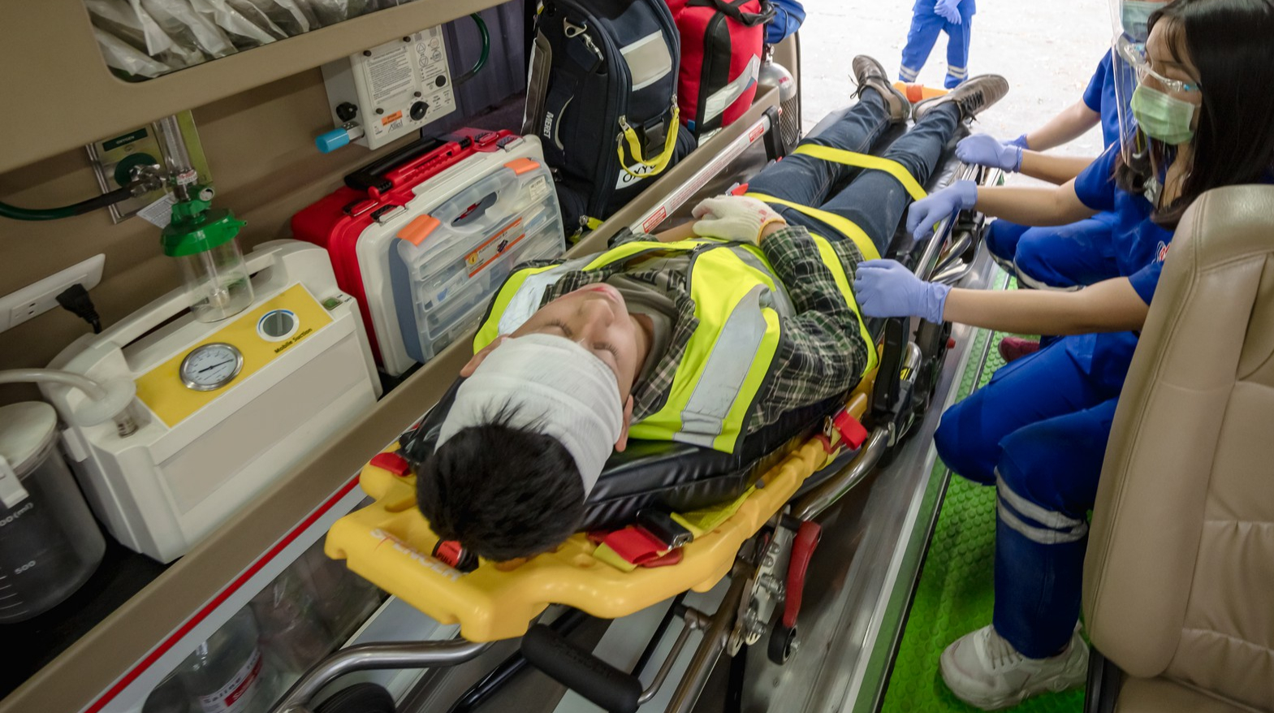







LESSON 22
Course Review
Photo Credit: Freepik
PEER | MFR | INDIA
PPT 22 -
PPT 22 - 1

Slide 2
OBJECTIVES
Upon completing this lesson, you will be able to:
1
To answer questions and resolve issues that were recorded in the “File” by participants.
To review the most important practical procedures that were demonstrated and practiced throughout the course.
2
PEER | MFR | INDIA
PPT 22 -

Slide 3
OBJECTIVES
Upon completing this lesson, you will become familiar with:
3
To outline what is expected in
the Final Practical Evaluation and answer any questions regarding the Evaluation.
PEER | MFR | INDIA
PPT 22 -

Slide 4



Photo Credit: Freepik
PEER | MFR | INDIA
PPT 22 -

Slide 5

THANK YOU

