Slide 1
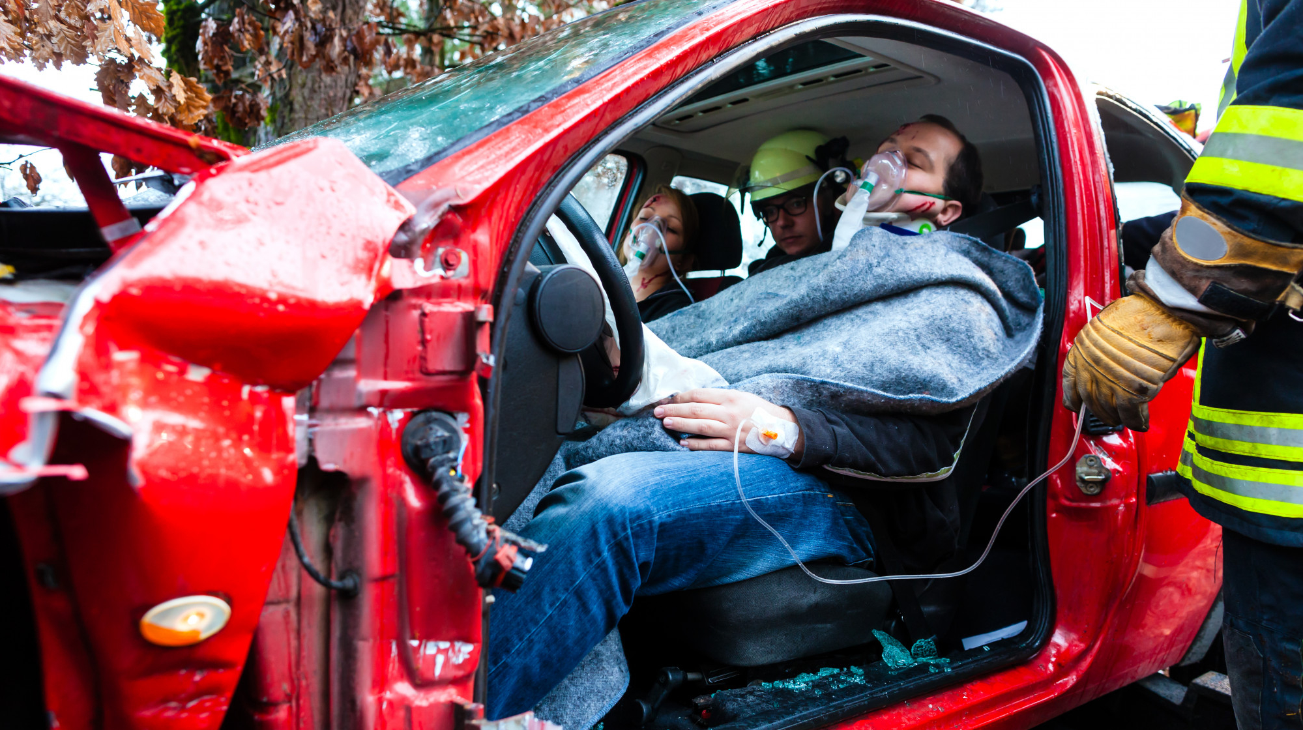






LESSON 21
Triage and Multiple Casualty Incidents
Photo Credit: Freepik
PEER | MFR | INDIA
PPT 21 -
PPT 21 - 1

Slide 2
OBJECTIVES
Upon completing this lesson, you will be able to:
1
  Define Incident Command System.
  List the five functions of the EMS sector of the Incident Command System.
  Define triage.
2
3
PEER | MFR | INDIA
PPT 21 -

Slide 3
OBJECTIVES
Upon completing this lesson, you will become familiar with:
4
  List the four categories of triage with their associated colours and briefly explain each category.
  List the three benchmarks of
  the S.T.A.R.T. system of triage.
  Correctly triage a simulated multiple casualty incident.
5
6
PEER | MFR | INDIA
PPT 21 -

Slide 4
Incident Command System (ICS)
A flexible system for managing people and resources.
PEER | MFR | INDIA
PPT 21 -

Slide 5



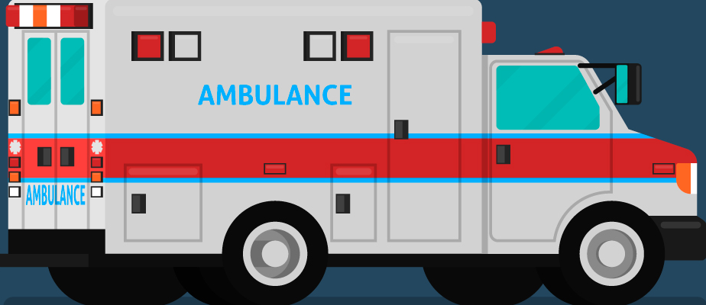
Outer Perimeter
Incident Command System (ICS)
Command Post
Comm.
Inner Perimeter
Security and Access Control
Incident Area
(Triage)
Collection and Treatment Area
for the Wounded
Transportation
Logistics
and Staging
Collection Area
for the Walking Wounded
H
PEER | MFR | INDIA
PPT 21 -

Slide 6
Triage
The process of sorting patients to determine the order in which they will receive care.
PEER | MFR | INDIA
PPT 21 -

Slide 7
START Categories
Priority 1 (RED)
Priority 2 (YELLOW)
Priority 1 (RED)
highest priority or immediate
Priority 2 (YELLOW)
second priority or delayed
Priority 3 (GREEN)
Priority 0 (BLACK)
Priority 3 (GREEN)
lowest priority or minor
Priority 0 (BLACK)
dead; no care required
PEER | MFR | INDIA
PPT 21 -

Slide 8
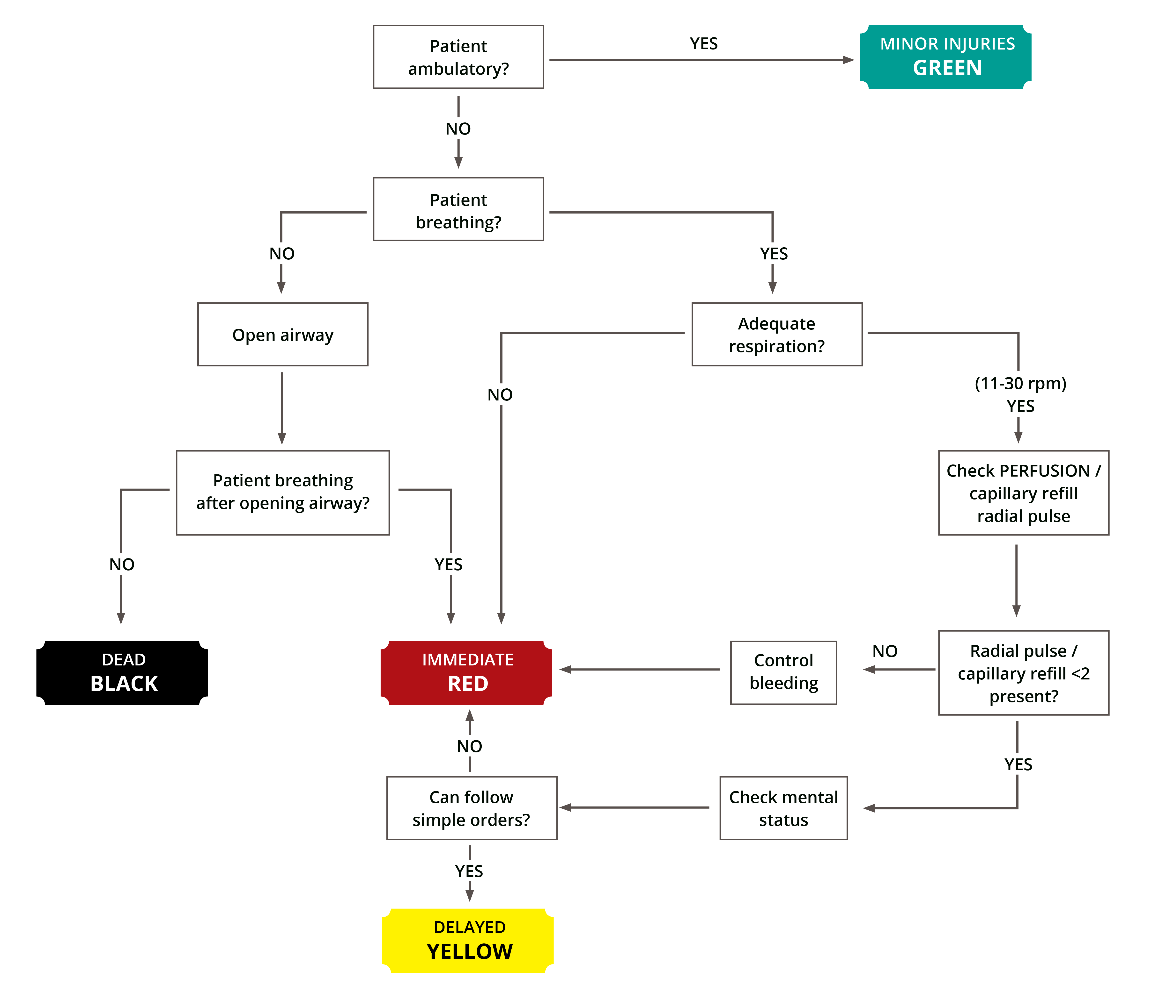
S.T.A.R.T.
Flowchart
PEER | MFR | INDIA
PPT 21 -

Slide 9

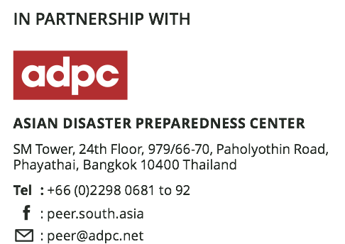

Photo Credit: Freepik
PEER | MFR | INDIA
PPT 21 -

