Slide 1
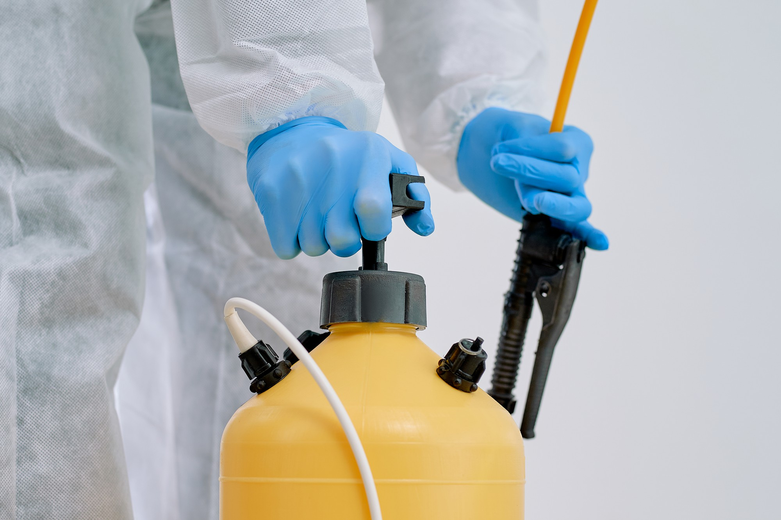







LESSON 20
Report Writing and Preparation for the Next Call
Photo Credit: Freepik
PEER | MFR | INDIA
PPT 20 -
PPT 20 - 1

Slide 2
OBJECTIVES
Upon completing this lesson, you will be able to:
1
Demonstrate how to record information about the patient’s condition and treatment given on the prescribed form.
List five steps to decontaminate the transport vehicle.
2
PEER | MFR | INDIA
PPT 20 -

Slide 3
OBJECTIVES
Upon completing this lesson, you will become familiar with:
3
List four steps to decontaminate the stretcher.
List three steps to decontaminate instruments.
List the three items for personal decontamination.
4
5
PEER | MFR | INDIA
PPT 20 -

Slide 4



Photo Credit: Freepik
PEER | MFR | INDIA
PPT 20 -

Slide 5

THANK YOU

