Slide 1


AQUATIC DISASTER RESPONSE COURSE-
INTRODUCTION
Presented By:- Kamal Mehra,2IC

Slide 2
OBJECTIVES
Upon completion of this lesson , you will be able to describe the following :-
Definition of Aquatic Disaster
Significance of water rescue training.
Safe water practices
Survival in Water
Self preservation
Recognizing an emergency
Assessment before and during rescue
Priorities for rescue
Use of bystander

Slide 3
DEFINITION OF AQUATIC DISASTER
Aquatic means relating to water, living in or near water or taking place in water.
Water related disaster is called aquatic disaster.
Aquatic disasters include flood, tidal waves, storm surge, tsunami etc.
Excess or low water availability creates the situation of aquatic disaster.

Slide 4
REASONS OF AQUATIC DISASTER
Enhance Water Level
Heavy Rain Fall
  Moderate rain- 2.5 to 10 mm per hour.
  Heavy rain- 10 mm to 50 mm per hour.
  Violent rain- > 50 mm per hour.
Climate Change Uncertain change of climate leads to heavy rain which causes flood.
Break In Dam

Slide 5
Cont…
Cloud burst
Excess Water Discharge From Dam
Uncertain change of river course

Slide 6
TYPES OF AQUATIC DISASTERS
Flood
Storm Surge
Tsunami
Tidal Waves

Slide 7
EFFECT OF AQUATIC DISASTER
Loss of Human Life
Injury
Loss of Livelihood
Displacement
Spread of Disease

Slide 8
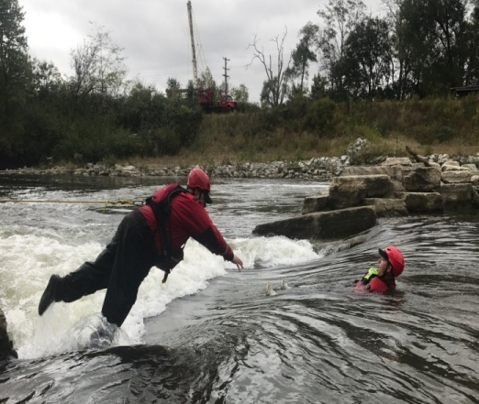
SIGNIFICANCE OF WATER RESCUE TRAINING
Life-Saving Skills: The primary goal of water rescue training is to prepare individuals to save lives during drowning or near-drowning incidents, floods, or other water-related emergencies.
Risk Reduction: Trained individuals are more capable of assessing dangers and employing the safest and most effective methods of rescue, reducing the risk to both the victim and the rescuer.

Slide 9
Cont…
Preparedness for Emergencies: Natural disasters such as floods, hurricanes, and tsunamis often involve water rescues. Training ensures responders can act quickly and efficiently under pressure.
Improved Response Time: With proper training, rescuers can respond faster and with greater confidence, which can be the difference between life and death in water emergencies.
Compliance with Safety Standards: For lifeguards, firefighters, coast guards, and other first responders, water rescue training is often required to meet professional standards and regulations.

Slide 10
Cont…
SIGNIFICANCE OF WATER RESCUE TRAINING
Team Coordination and Communication: Training enhances teamwork and communication skills, which are crucial in complex rescue operations involving multiple responders.
Use of Equipment: It familiarizes participants with rescue equipment like ropes, life vests, and rescue boards, ensuring effective usage during actual emergencies.
Community Safety: A well-trained water rescue team contributes to the overall safety and resilience of a community, especially those near bodies of water

Slide 11
SAFE WATER PRACTICE
Never Swim alone.
Only jump and dive where it is safe.
Learning and practicing water safety skills.
Stay A float for relax.
Do not push others under water.
Having appropriate equipment for rescue.
Reach to rescue by Pole, Rope etc.
Swim beside the edge.
Keep away from danger.
Entry and Exit from water slowly

Slide 12
SURVIVAL IN WATER
Stay Calm
Panic wastes energy and causes hyperventilation. Try to control your breathing and assess your surroundings.
Float, Don’t Flail
If you can’t swim or are too tired, lie on your back and float to conserve energy. Spread your arms and legs slightly and breathe steadily.
Signal for Help
Use a whistle, bright clothing, or hand signals. If you're in a group, stay together to increase visibility.

Slide 13
Cont…
Remove Heavy Clothing:
Clothing can become heavy when wet. Remove heavy boots and jackets, but keep lightweight layers that help with insulation.
Use the HELP Position (for Cold Water)
In cold water, assume the Heat Escape Lessening Posture by crossing your arms over your chest and pulling your knees up to your chest to retain body heat.

Slide 14
SELF PRESERVATION
Preserve energy do not exhausted while in water.
When exhausted try to float with less effort or try to grab some floating material.
Change position and stroke to lessen the muscular fatigue.
Keep your eye open to avoid loss of confidence.
Breath in regular and controlled manner to prolong endurance.
Attract attention of the Passer by or the rescuer by shouting or by waving hand for rescue.

Slide 15

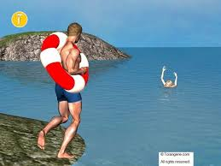
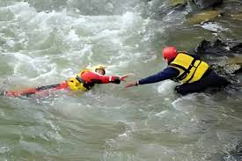
RECOGNIZING AN EMERGENCY
Person in water shouting for help.
Person going up and down in water.
Wild, uncontrolled splashing as the person tries to stay above water.
No Forward Progress While Swimming
Clutching at anything floating, including other people, in desperation.
Floating Face Down (Without Movement)

Slide 16
ASSESSMENT BEFORE RESCUE
Scene Safety Assessment
Check surroundings for hazards: strong currents, waves, debris, or electrical risks (e.g., downed wires).
Evaluate entry and exit points – choose the safest route.
Ensure self-safety – use flotation devices, ropes, or boats.
Victim Assessment From a Distance
Observe the victim’s behavior:
Is the person conscious or unconscious?
Are they struggling actively or motionless?
Are they calling for help, waving, or submerged?

Slide 17
Cont….
Cont….
Determine location and distance from shore or rescue point.
Decide on the best rescue method: reach, throw, row, or go (last resort).
Call for Help
Alert emergency services immediately (e.g., coast guard, EMS).

Slide 18
ASSESSMENT DURING RESCUE
Maintain Communication and Reassurance
If the victim is conscious, reassure them and give clear instructions:
"I'm here to help. Stay calm and float. I’m coming with a float.“
Approach With Caution
Use "Talk–Reach–Throw–Row–Go" principle:
Physical Condition Assessment (Once Reached):- Check if the victim is:
Responsive or unresponsive
Able to hold on to a flotation aid
Breathing normally or showing signs of distress

Slide 19
Cont…
If unconscious:
Maintain airway above water
Use a tow technique if safe, and get them to shore quickly

Slide 20
PRIORITIES FOR RESCUE
Non-swimmer
Weak swimmer
Injured Swimmer
Unconscious

Slide 21
USE OF BYSTANDER
ACRONYM:- ACT SAFE
Alert emergency services
Call for help and organize support
Throw or reach flotation aids
Stay calm and keep others calm
Assist trained rescuers when requested
First aid support if trained
Ensure clear access for EMS

Slide 22
REVIEW
Now you are able to :-
Definition of Aquatic Disaster
Describe Significance of water rescue training.
Describe Safe water practices
Describe Survival in Water
Describe Self preservation
Describe Recognizing an emergency
Describe Assessment before and during rescue
Describe Priorities for rescue
Describe Use of bystander

Slide 23


Slide 24
EVALUATION
a) Ques:-What is the first action a bystander should take in an aquatic emergency?
a)Jump into the water to help the victim
b)Call emergency services immediately
c)Wait for professional rescuers to arrive
d)Shout instructions to the victim from a distance.
b)Ques:What is the first step a rescuer should take before attempting a rescue in an aquatic disaster?
a)Jump into the water and save the victim immediately
b) Ensure the scene is safe and assess potential hazards
c) Start CPR immediately
d) Wait for emergency services to arrive

Slide 25


THANK YOU

