Slide 1




MEDICAL FIRST RESPONDER
LESSON 19
Lifting and Moving Patients
Presented by:- Pavan Dev Gaur, 2IC
CAPF | MFR | INDIA
-

Slide 2
OBJECTIVES
Upon completing this lesson, you will be able to:
1
List three emergency moves and two non-emergency moves for lifting and moving a patient.
Demonstrate the techniques for immobilising and transporting
a patient using a backboard.
2

Slide 3
OBJECTIVES
Upon completing this lesson, you will be able to:
3
Name five examples of situations that might require you to make
an emergency move with a patient.

Slide 4
Body Mechanics
The proper use of your body to facilitate lifting and moving, and to prevent injury.

Slide 5
Emergency Moves
Make an emergency move only when there is immediate danger to the patient.

Slide 6
Situations Requiring Emergency Moves
1
2
3
Inability to protect the patient
from hazards
Fire or
threat of fire
Explosion or threat of explosion

Slide 7
Situations Requiring Emergency Moves
Cont.
4
5
To gain access
to other patients who need care
Life-saving care cannot be given
at location

Slide 8
Moving Patients
Moves and Carries
Emergency Moves | Non-Emergency Moves
Shirt drag | Direct Ground Lift
Forearm / Shoulder | Extremity Lift
Blanket / Sheet drag
Cradle Carry
Firefighter Drag
One-rescuer Crutch

Slide 9
Basic rules for Lifting or Move
Plan your move.
Position your feet properly.
Lift with your legs.
Keep your back as straight as possible.
Try not to bend at the waist.
When lifting an object with one hand, avoid leaning to either side.
Bend your knees to grasp the object, and keep your back straight.
Keep the weight of the object as close to your body as possible.
Clearly & frequently communicate with your partner (Team) and with patient.

Slide 10
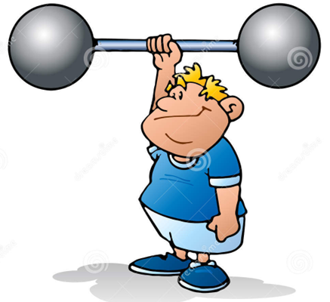
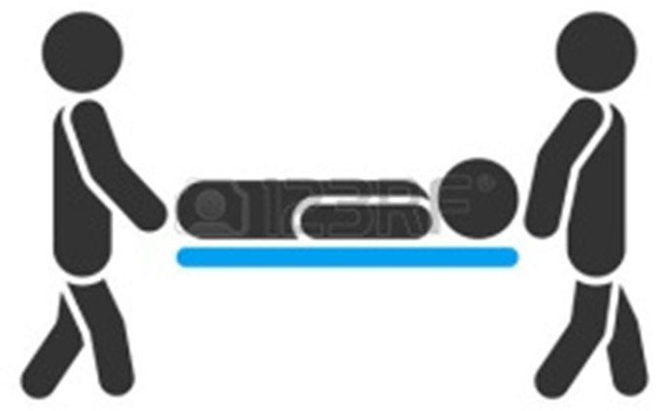
Basic rules for Lifting or Move
Eye Contact is an important component.
Verbally coordinate moves from beginning to end.

Slide 11
General Rule for Move
If there is no threat of injury, provide emergency care and then move the patient.
If the scene is potentially unsafe or poses an immediate threat, you may have to move the patient.

Slide 12
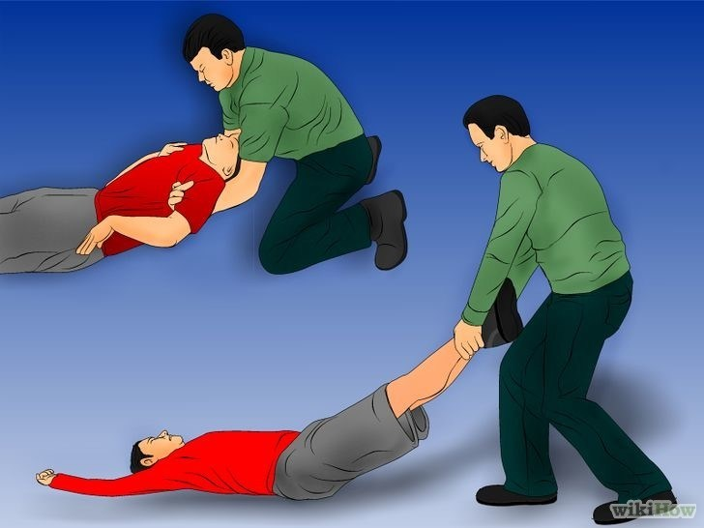
GROUND LEVEL RESCUE/ EVACUATION
Shoulder pull
ONE RESCUER
Evacuation techniques.
“Pull with your legs not your back”
Ankle pull(fastest and for smooth surface)

Slide 13
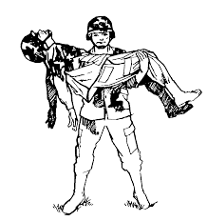
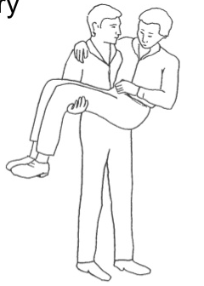
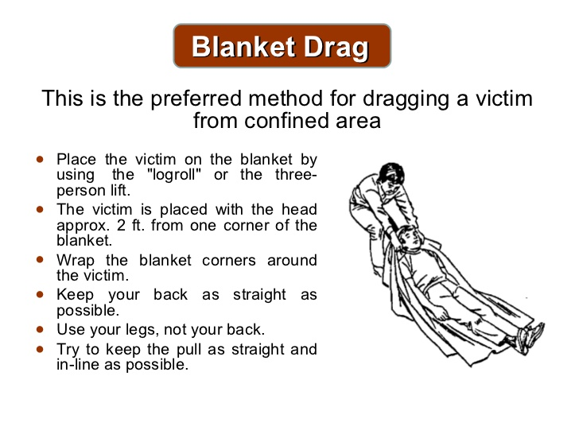
Cradle method
(one person arm carry)
Blanket Drag.
Preferred method for dragging victim in confined space
This only works with a child or a very light person.

Slide 14

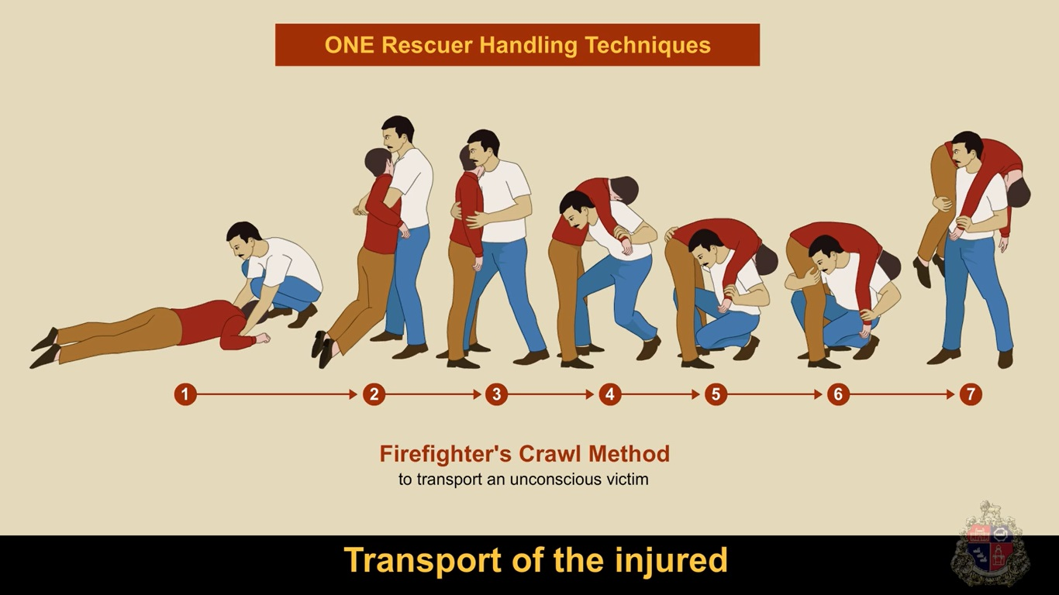
Firefighters carry.

Slide 15
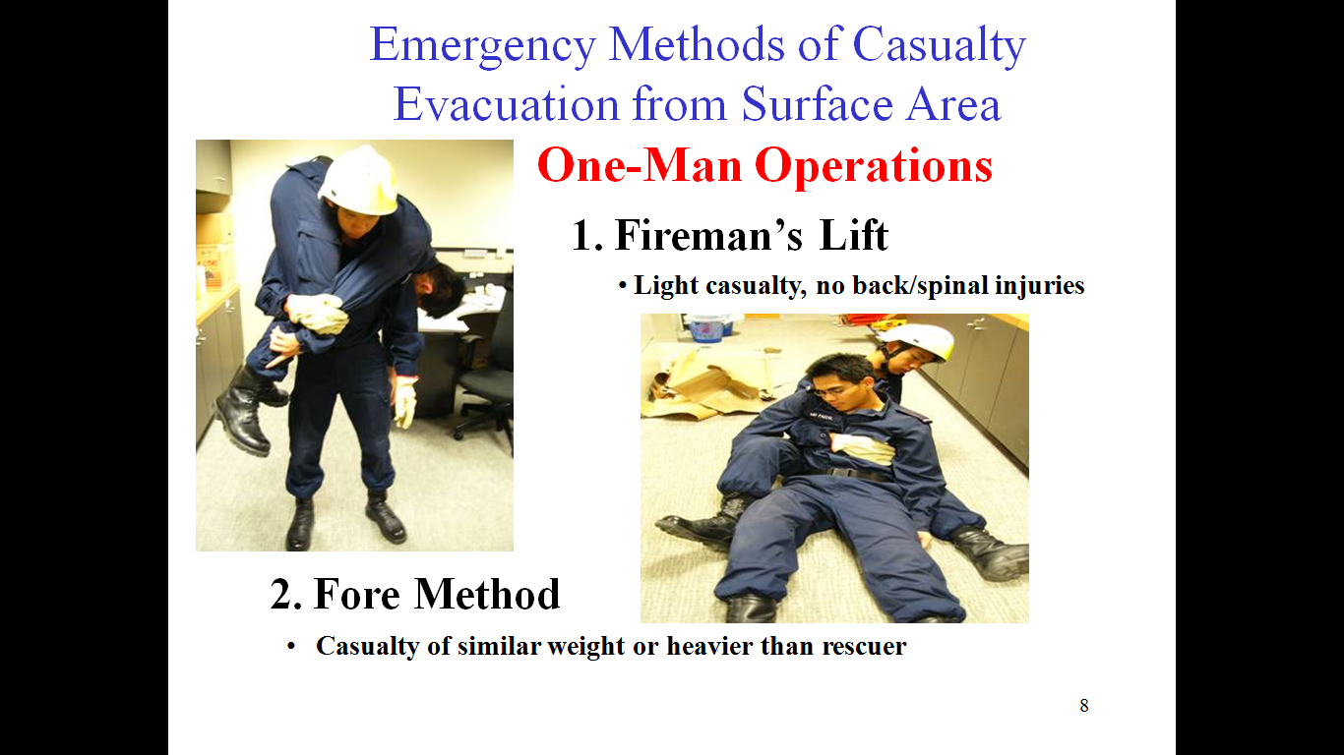
Emergency methods of casualty evacuation from surface area one-man operation:-
1. Fireman lift.
2. Fore Method
Casualties of similar weight/heavier.

Slide 16
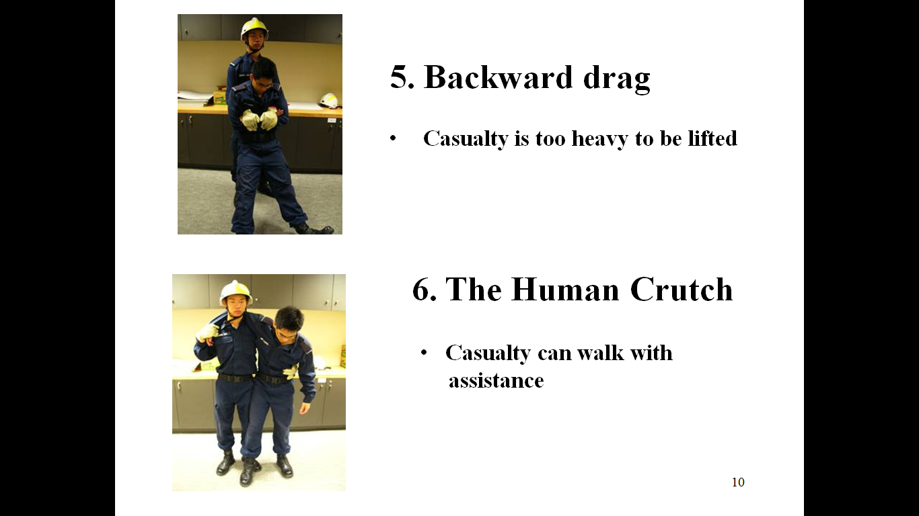
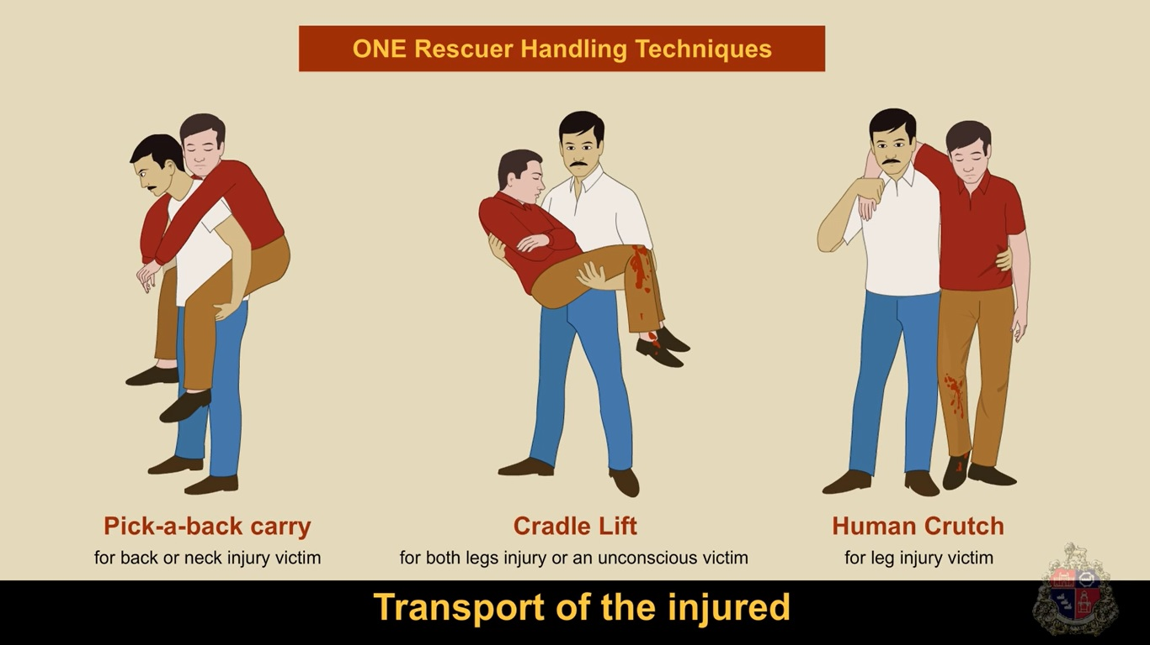
Backward Drag.
Human Crutch.
Casualty is too heavy to be lifted.
Casualty can walk with assistant.

Slide 17
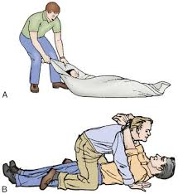
Pack-Strap Carry (Piggy Back Carry).
Tied Hand Crawl.
Used to drag an unconscious victim for a short distance. Not preferred as victim head is not supported.
For long distances to lift a victim safely.

Slide 18
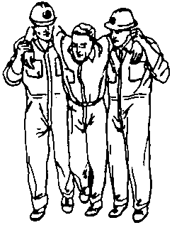
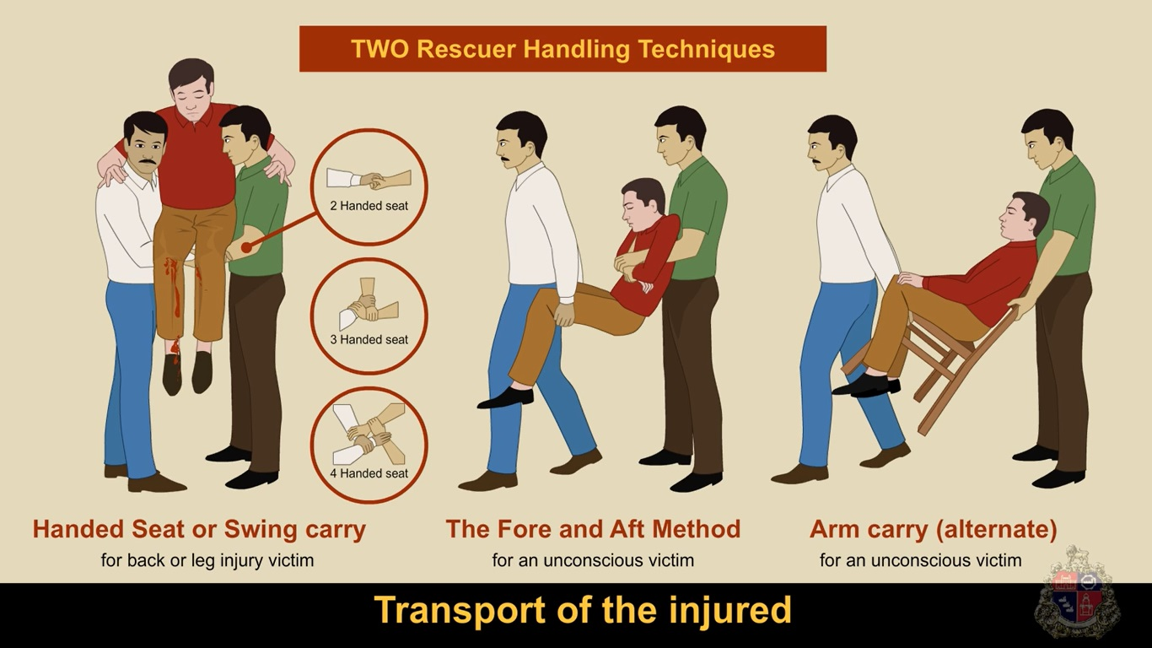
Two rescuer evacuation techniques
Two rescuer Human Crutch.
2. Two/Three/Four Handed seat.

Slide 19
3. The fore and Aft Method.
4.Chair carry.

Slide 20
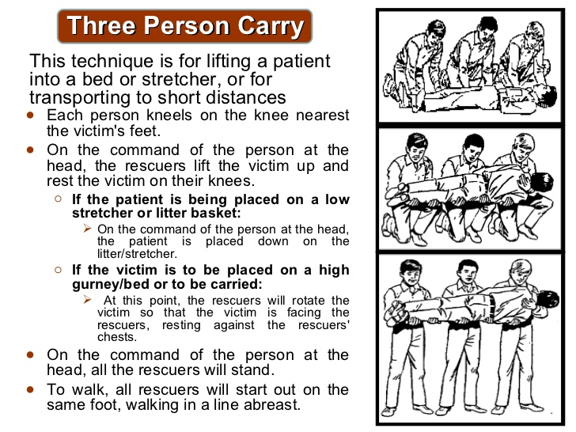
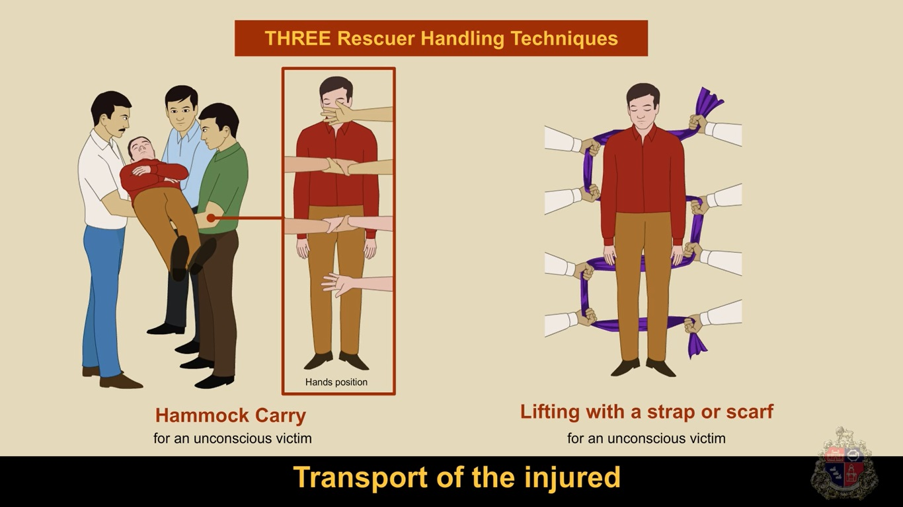
Three/more rescuers evacuation techniques.
2. Three person carry
(Three-person stretcher carry)
Hammock carry.

Slide 21
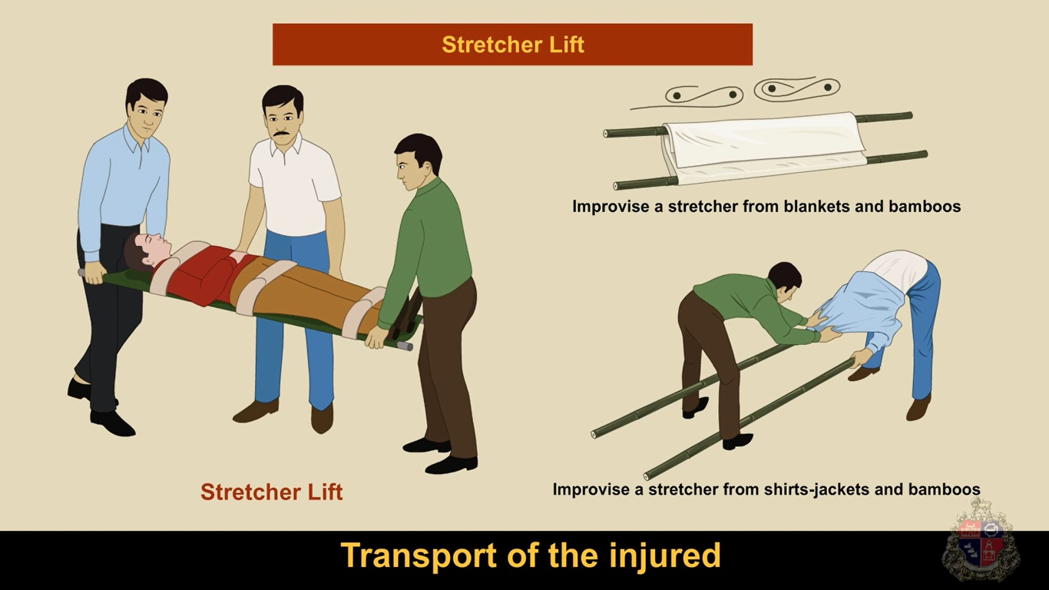
EMERGENCY STRETCHER
1. Improvised stretcher.
2. Blanket Stretcher.

Slide 22
Safety Measure in E.M.
Possibility of aggravating a spinal injury- Provide as much protection to the spine.
As possible, pull the patient in the direction of the long axis of the body.
Avoid bending or twisting the patient’s trunk
Try not to move the head away from the neck and shoulders and secure the hands and arms.
Moving patients away from a vehicle quickly and safely may be impossible.

Slide 23
Where there is no immediate threat to life, the patient should be moved only when ready for transport, using a non-emergency move.
Complete the on-scene assessment and treat the patient first.
Prevent additional injury and try to avoid causing discomfort and pain to the patient.
Where there is no immediate threat to life, the patient should be moved only when ready for transport, using a non-emergency move.
Complete the on-scene assessment and treat the patient first.
Non–Emergency Moves

Slide 24
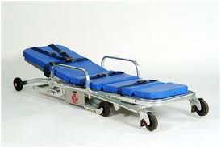
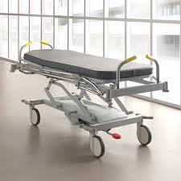
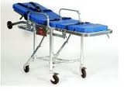
Patient Carrying Equipment
Wheeled stretchers

Slide 25
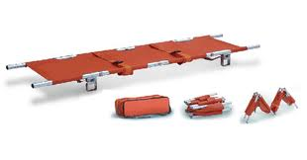
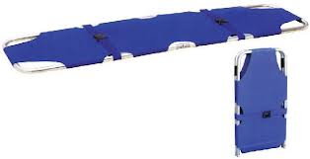
Patient Carrying Equipment
Folding stretchers

Slide 26
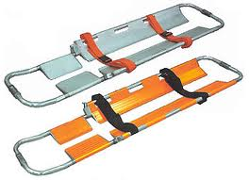
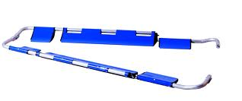
Patient Carrying Equipment
Scoop stretchers

Slide 27
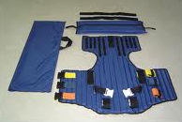
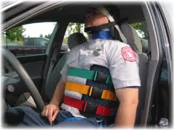
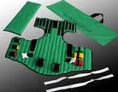
Patient Carrying Equipment
Vest-type extrication device

Slide 28
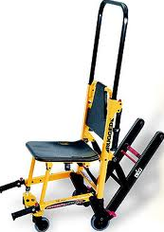
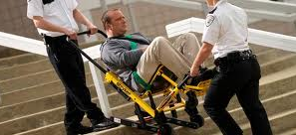
Patient Carrying Equipment
Stair chair

Slide 29
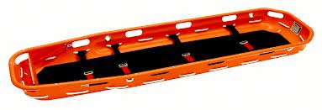
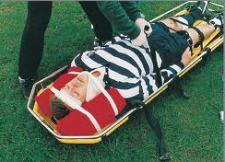
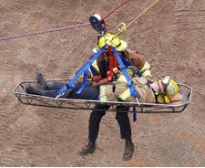
Patient Carrying Equipment
Basket stretcher

Slide 30
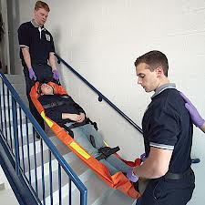
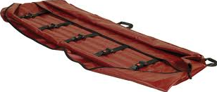
Patient Carrying Equipment
Flexible stretcher

Slide 31
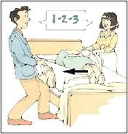
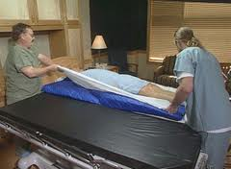
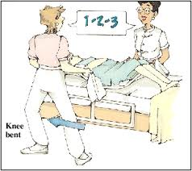
Patient Carrying Equipment
Draw Sheet

Slide 32


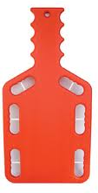
Patient Carrying Equipment
Backboards

Slide 33
Review
Now You are able to:
1
List three emergency moves and two non-emergency moves for lifting and moving a patient.
Demonstrate the techniques for immobilising and transporting
a patient using a backboard.
2

Slide 34
Review
Now You are able to:
3
Name five examples of situations that might require you to make
an emergency move with a patient.

Slide 35


THANK YOU

