Slide 1








LESSON 17
Seizures,
Diabetic Emergencies and Cerebral Vascular Accidents
Photo Credit: Freepik
PEER | MFR | INDIA
PPT 17 -
PPT 17 - 1

Slide 2
OBJECTIVES
Upon completing this lesson, you will be able to:
1
  Define seizures.
  List four steps for the pre-hospital treatment for seizures when arriving while the patient is still having a seizure.
2
PEER | MFR | INDIA
PPT 17 -

Slide 3
OBJECTIVES
Upon completing this lesson, you will become familiar with:
3
  List five additional steps for
  the pre-hospital treatment for seizures to take after the seizure is over.
  List seven signs and symptoms for hyperglycemia and list three steps
  for pre-hospital treatment.
4
PEER | MFR | INDIA
PPT 17 -

Slide 4
OBJECTIVES
Upon completing this lesson, you will become familiar with:
5
  List nine signs and symptoms hypoglycemia and describe
  pre-hospital treatment.
  List nine signs and symptoms for a cerebral vascular accident (CVA).
6
PEER | MFR | INDIA
PPT 17 -

Slide 5
Seizure
A sudden and temporary change in mental status cause by massive electrical discharge in the brain.
PEER | MFR | INDIA
PPT 17 -

Slide 6
Causes of Seizures
Brain Tumors
Head Trauma
Epilepsy
Hypoxia
CVA
Poisoning
Seizures
Fever (Children)
Hypoglycemia
Chronic medical conditions
Infection
Eclampsia
PEER | MFR | INDIA
PPT 17 -

Slide 7
Seizures
Aura phase:
The patient becomes aware that
the seizure is coming on, usually described as an unusual smell or flash of light, usually lasting only a second.
PEER | MFR | INDIA
PPT 17 -

Slide 8
Seizures
Cont.
Tonic phase:
Patient becomes unresponsive and collapses. All the muscles of the body contract.
The body becomes rigid and the patient may stop breathing. May become incontinent.
PEER | MFR | INDIA
PPT 17 -

Slide 9
Seizures
Cont.
Clonic phase:
The patient convulses violently.
May foam at the mouth or drool, and may become cyanotic.
PEER | MFR | INDIA
PPT 17 -

Slide 10
Seizures
Cont.
Postictal phase:
Begins when convulsions stop.
Patient gradually regains consciousness. Headache is common.
PEER | MFR | INDIA
PPT 17 -

Slide 11
Hyperglycemia
Signs and symptoms
Gradual onset
Sweet, fruity breath
Flushed, dry skin
Hunger or thirst
PEER | MFR | INDIA
PPT 17 -

Slide 12
Hyperglycemia
Signs and symptoms
Cont.
Rapid weak pulse
Frequent urination
Intoxicated appearance, staggering, slurred speech
PEER | MFR | INDIA
PPT 17 -

Slide 13
Hypoglycemia
Common Causes
Skipped meals
Vomiting
Strenuous exercise
Physical stress from extreme heat or cold
Emotional stress
Accidental overdose of insulin
PEER | MFR | INDIA
PPT 17 -

Slide 14
Hypoglycemia
Signs and symptoms
Rapid onset of altered mental status
Intoxicated appearance, staggering, slurred speech
Atypical behaviour
PEER | MFR | INDIA
PPT 17 -

Slide 15
Hypoglycemia
Signs and symptoms
Cont.
Combativeness and/or anxiety
Rapid pulse rate
Cool, clammy skin
Hunger
Headache
Seizures
PEER | MFR | INDIA
PPT 17 -

Slide 16
Cerebral Vascular Accident
A sudden loss of blood supply to the brain.
PEER | MFR | INDIA
PPT 17 -

Slide 17
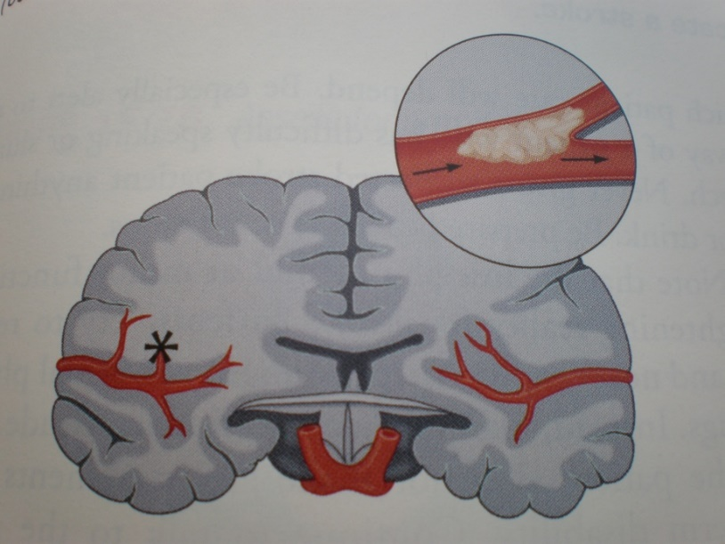
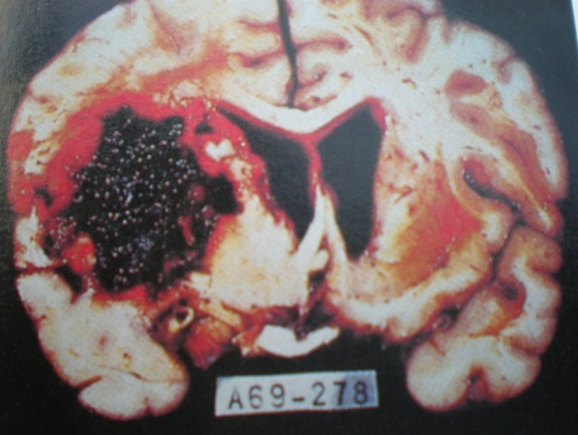
Cerebral Vascular Accident
Causes
Cerebral thrombosis
Cerebral hemorrhage
PEER | MFR | INDIA
PPT 17 -

Slide 18
Cerebral Vascular Accident
Signs and symptoms
Headache (may be the first and only symptom)
Fainting
Altered mental status
PEER | MFR | INDIA
PPT 17 -

Slide 19
Cerebral Vascular Accident
Signs and symptoms
Cont.
Tingling or paralysis of the extremities or face
Difficulty speaking
Blurred vision
PEER | MFR | INDIA
PPT 17 -

Slide 20
Cerebral Vascular Accident
Signs and symptoms
Cont.
Convulsions
Unequal pupils
Loss of bladder or bowel control
PEER | MFR | INDIA
PPT 17 -

Slide 21

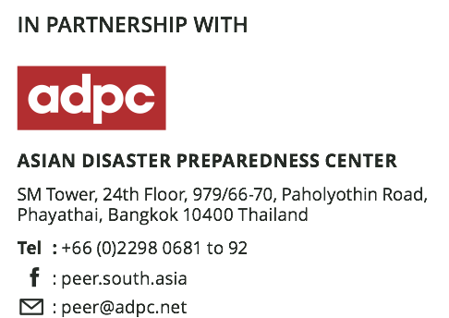

Photo Credit: Freepik
PEER | MFR | INDIA
PPT 17 -

Slide 22

THANK YOU

