Slide 1


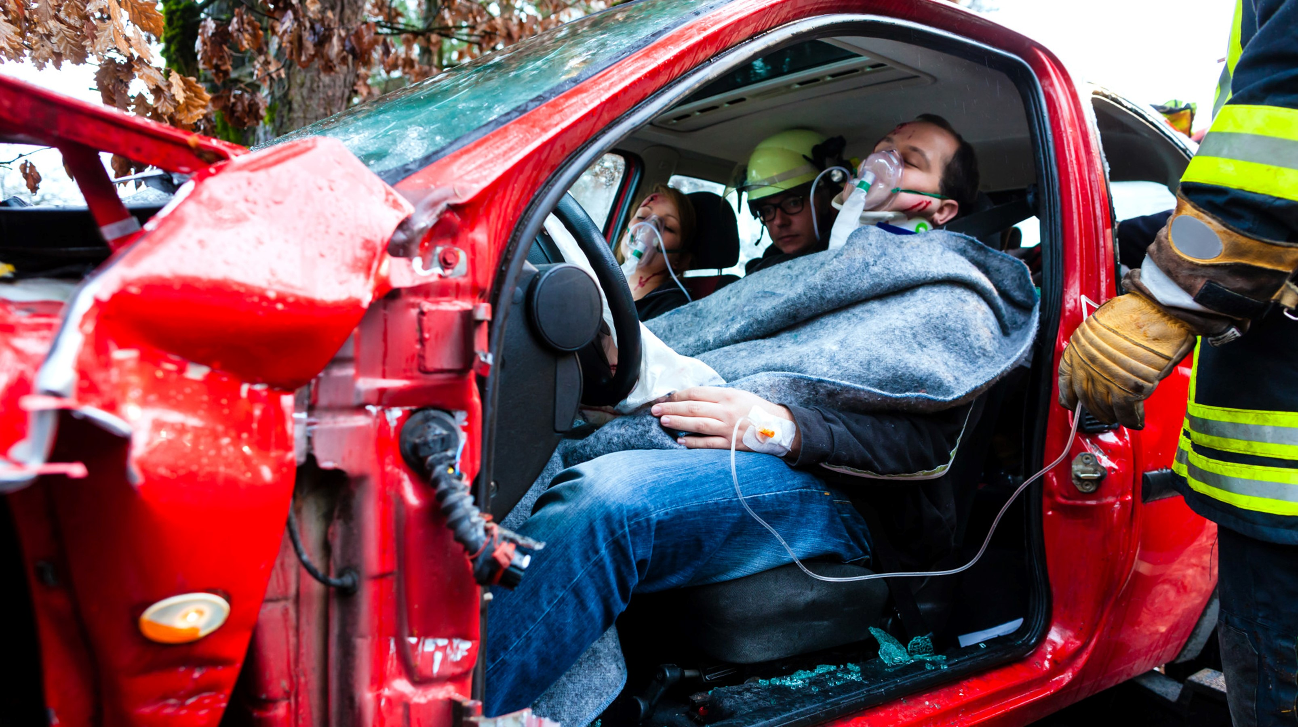

MEDICAL FIRST RESPONDER
Triage and Multiple Casualty Incidents
Presented by:- Kamlesh Dhoundiyal, 2IC
NDRF | MFR | INDIA
PPT 21 - 1

Slide 2
OBJECTIVES
Upon completing this lesson, you will be able to:
1
  Define Incident Command System.
  List the five functions of the EMS sector of the Incident Command System.
  Define triage.
2
3

Slide 3
OBJECTIVES
Upon completing this lesson, you will be able to:
4
  List the four categories of triage with their associated colours and briefly explain each category.
  List the three benchmarks of
  the S.T.A.R.T. system of triage.
  Correctly triage a simulated multiple casualty incident.
5
6

Slide 4
Incident Command System (ICS)
A flexible system for managing people and resources.

Slide 5



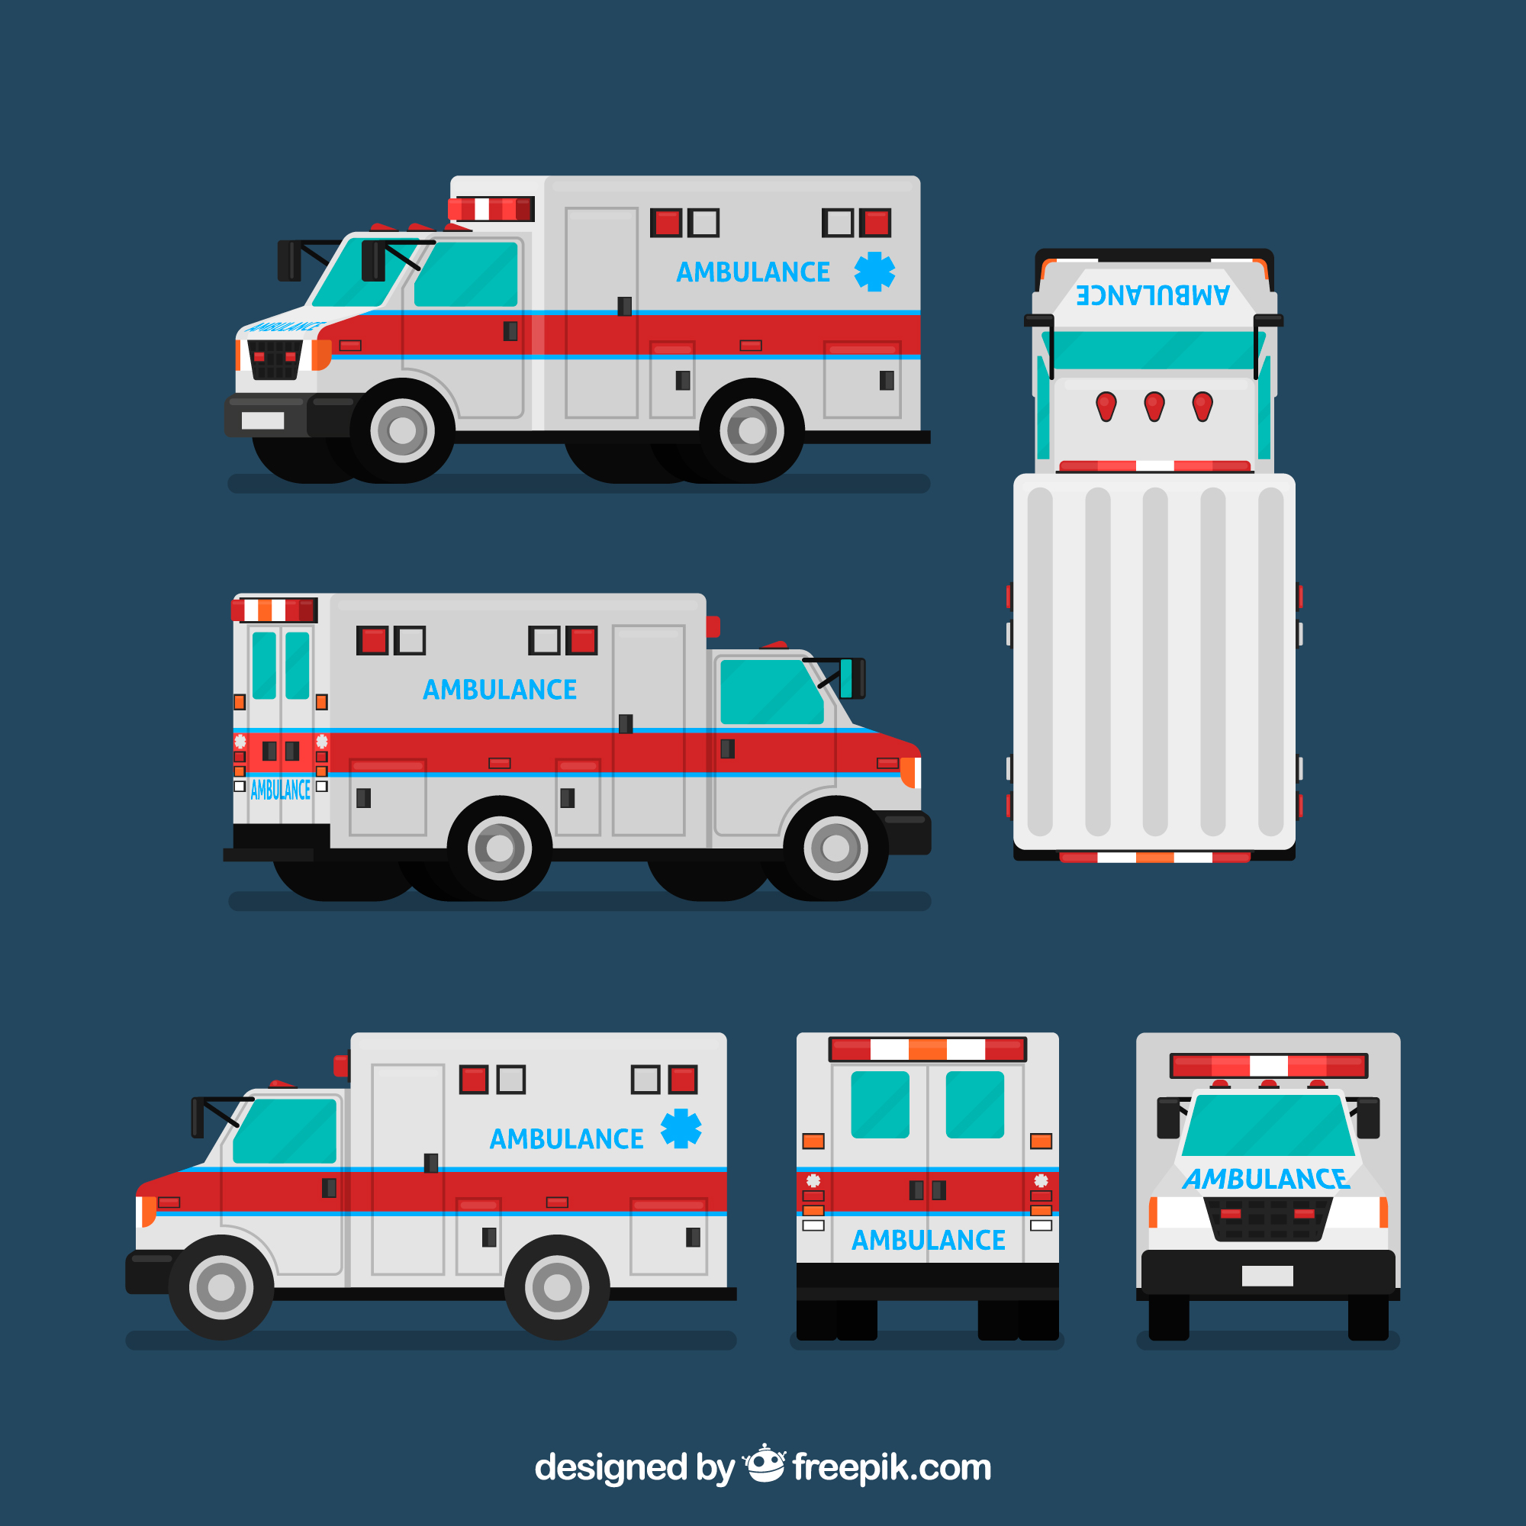
Incident Command System (ICS)
Outer Perimeter
Command Post
Comm.
Inner Perimeter
Security and Access Control
Incident Area
(Triage)
Collection and Treatment Area
for the Wounded
Transportation
Logistics
and Staging
Collection Area
for the Walking Wounded
H

Slide 6
Triage
The process of sorting patients to determine the order in which they will receive care.

Slide 7
START Categories
Priority 1 (RED)
Priority 2 (YELLOW)
Priority 1 (RED)
highest priority or immediate
Priority 2 (YELLOW)
second priority or delayed
Priority 3 (GREEN)
Priority 0 (BLACK)
Priority 3 (GREEN)
lowest priority or minor
Priority 0 (BLACK)
dead; no care required

Slide 8
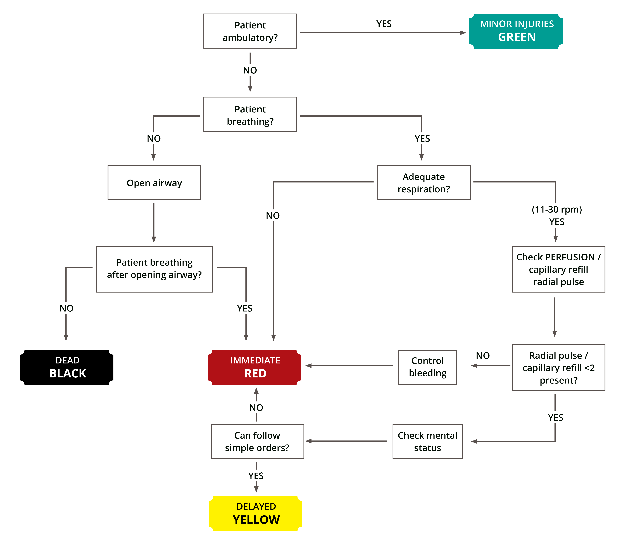
S.T.A.R.T.
Flowchart

Slide 9


THANK YOU

