Slide 1



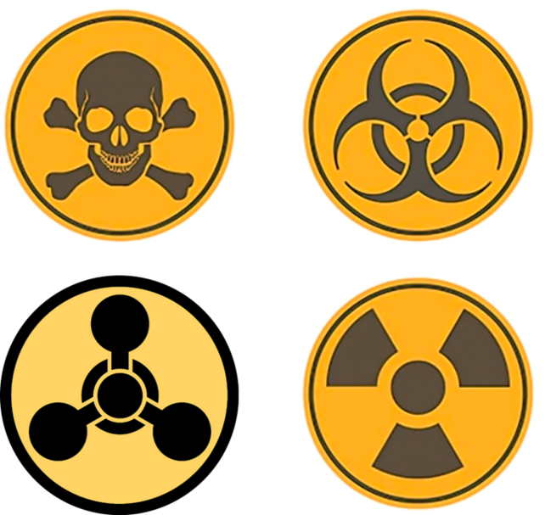
CBRN Module: CAPF
CASE STUDY HIROSHIMA & NAGASAKI
Presented by:- Pavan Dev Gaur, 2IC

Slide 2
OBJECTIVES
Upon completing this lesson, you will be able to:
1
know about Hiroshima know about Nagasaki Effects of atomic bombs Review
2
3
4

Slide 3
6th AUGUST 1945
08:15 MORNING
HIROSHIMA
PPT 2 -

Slide 4
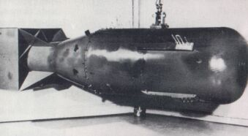
First nuclear weapon in the world,
Name : Little Boy
Type : Uranium gun-type fission
Weight : 4400 kg
Length : 10 ft, 6 in (3.2m)
Diameter : 29 in (0.737m)
Explosive yield :15 k tons of TNT
Casualty : 80 thousand appx
Hiroshima
PPT 2 -

Slide 5
Effect
The nuclear bomb was detonated at the height of 580 mtr above a hospital.
5 sq mile area completely converted into an ash and destroyed 76,000 buildings.
Blast waves-5 km (50%)
Thermal rays- 4 km (35%)
Radiation- 2.5 km (15%)
PPT 2 -

Slide 6
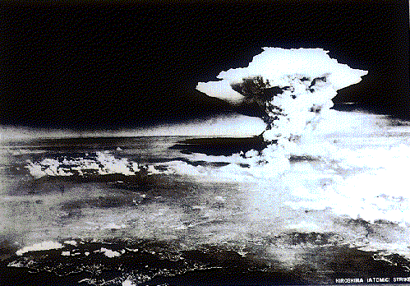
Aerial photograph from the 80 kilometers away of the inland sea, taken about 1 hour after the dropping.
PPT 2 -

Slide 7
9th AUGUST 1945
11:02 MORNING
NAGASAKI
PPT 2 -

Slide 8
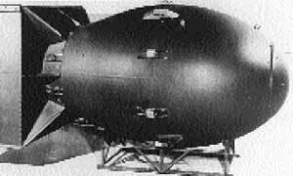
NAGASAKI BOMB
Name : Fat Man
Type : Plutonium fission
Weight : 4535 kg
Length : 11 ft, 4 inch
Diameter : 5 ft (1.52 m)
Explosive Yield :21 k tons of TNT
PPT 2 -

Slide 9
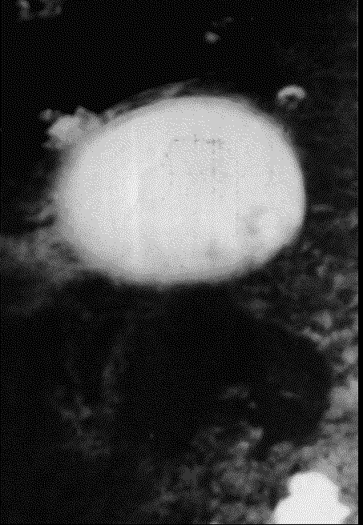
Nagasaki, Japan (August 9, 1945)
PPT 2 -

Slide 10
NAGASAKI
Nicknamed 'Fat Man‘ Bomb was dropped by parachute
at 1102 hours on 9 August 1945 by an American B29 bomber from the Pacific island of Tinian.
The aircraft's first target was the city of Kokura, now part of Kitakyushu, but as it was covered by heavy cloud the aircraft was diverted to its second target, Nagasaki.
PPT 2 -

Slide 11
NAGASAKI
Among the 270,000 people present when the bomb was dropped, about 2,500 were labour conscripts from Korea and 350 were prisoners-of-war.
About 73,884 were killed and 74,909 injured, with the affected survivors suffering the same long-term catastrophic results of radiation and mental trauma as at Hiroshima.
PPT 2 -

Slide 12
Effect
The devastation of Hiroshima and Nagasaki resulted in three main types of effects:
a) Blast.
b) Thermal Radiation.
c) Nuclear Radiation.
PPT 2 -

Slide 13
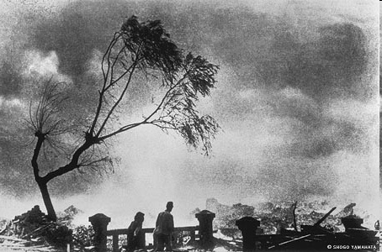
PPT 2 -

Slide 14
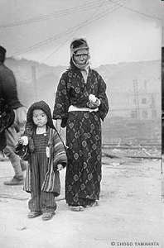
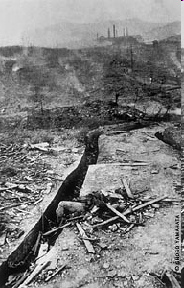
PPT 2 -

Slide 15
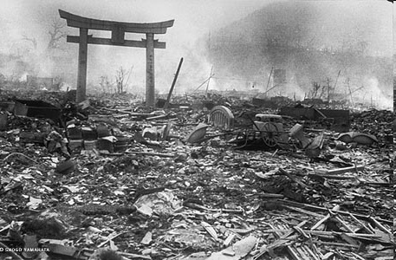
PPT 2 -

Slide 16
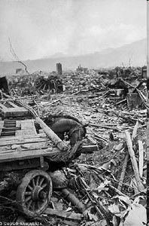
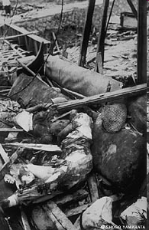
PPT 2 -

Slide 17
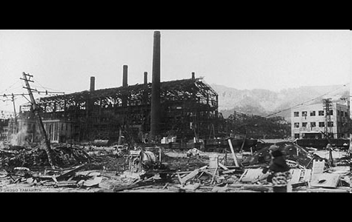
PPT 2 -

Slide 18
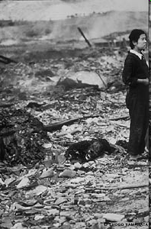
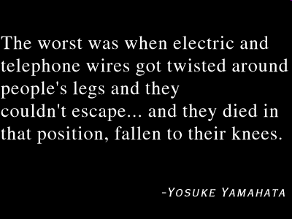
PPT 2 -

Slide 19
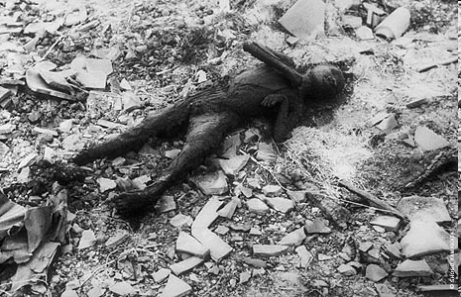
PPT 2 -

Slide 20
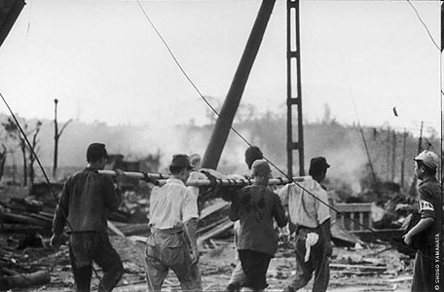
PPT 2 -

Slide 21
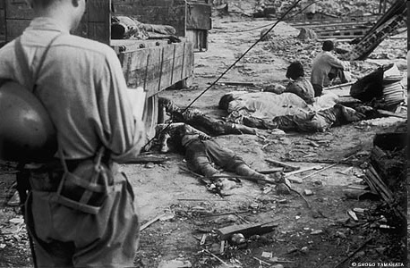
PPT 2 -

Slide 22
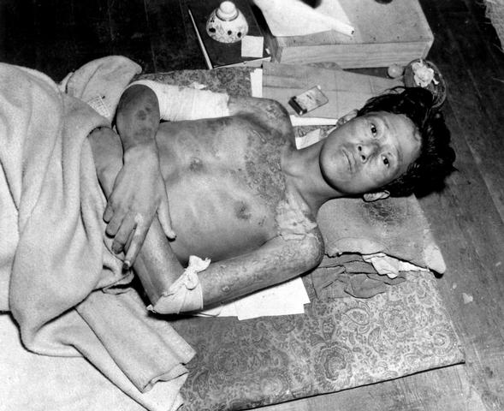
Victim of the Atom Bomb Explosion
PPT 2 -

Slide 23
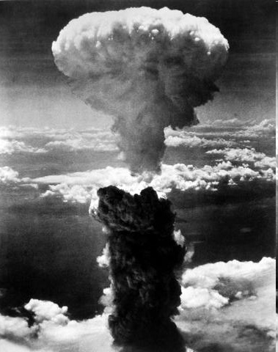
A dense column of smoke rises more than 60,000 feet into the air over the Japanese port of Nagasaki, the result of an atomic bomb, the second ever used in warfare, dropped
PPT 2 -

Slide 24
REVIEW
1. know about Hiroshima 2. know about Nagasaki 3. Effects of atomic bombs
4. Conclusion
PPT 2 -

Slide 25
ANY QUESTION ?
PPT 2 -

Slide 26


THANK YOU

