Slide 1


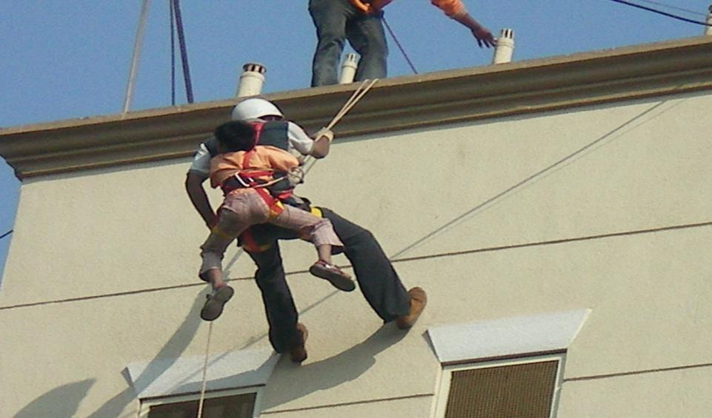
ROPES - KNOTS AND LASHING
Presented by:- Dileep Kumar, 2IC

Slide 2

Objective :
As knotting and lashing is to be done, on the spot, where the party is fighting against time, in darkness, in smoke, when people are killed or dying.
It is very necessary for everyone in he rescue party to learn knotting and lashing.

Slide 3

Requirements of Ropes
Two 200 feet length of 3 inch rope - these are principally used along with tackles and pulleys for raising or lowering persons or articles etc.
Ten 40 feet length 1½ inch lashings - these are used for securing casualties to stretchers. As guy ropes in the construction of derricks and sheers, as guide ropes etc.

Slide 4

Requirements of Ropes
Eight 15 feet length of 1 inch sash cord - used as short lashings for all general and light works.
One coil of steel wire rope 100 feet long 5/8 inch - used for heavy work such as demolition of dangerous buildings etc.

Slide 5

TYPES OF KNOTS
Over hand loop
Under handloop
Bight
Thumb knot
Figure of eight knots
Half hitch
Reef knot
Clove hitch
Chair knot
Draw hitch
Bowline

Slide 6

TYPES OF KNOTS
Over hand loop –
Standing part on the
running end.

Slide 7

TYPES OF KNOTS
2. Under hand loop –
Running end under the standing part.

Slide 8

TYPES OF KNOTS
3. Bight –
An open loop in a rope.

Slide 9

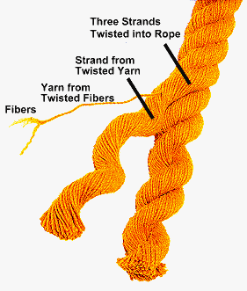

Slide 10

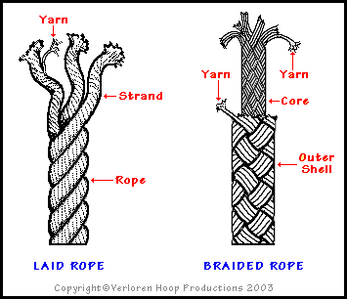

Slide 11

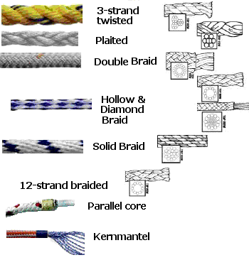

Slide 12

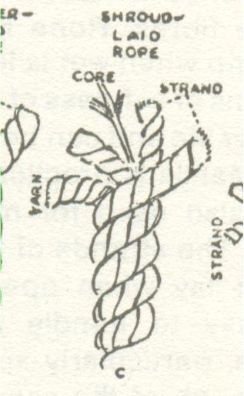

Slide 13

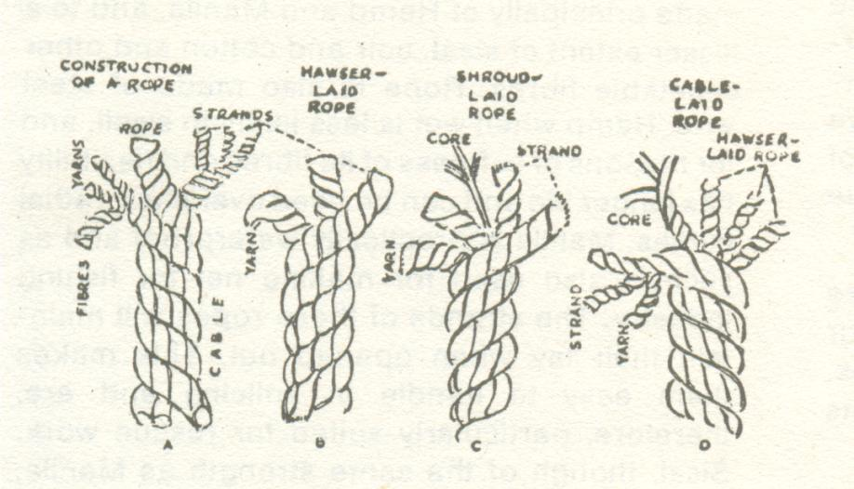

Slide 14

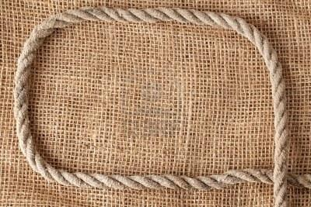

Slide 15

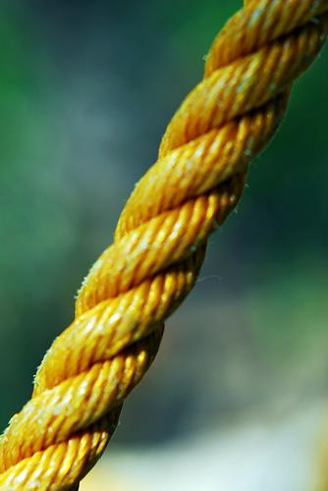

Slide 16

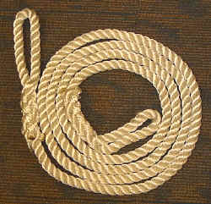

Slide 17


Slide 18

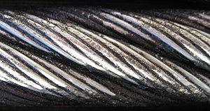

Slide 19
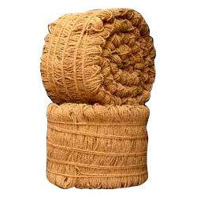


Slide 20

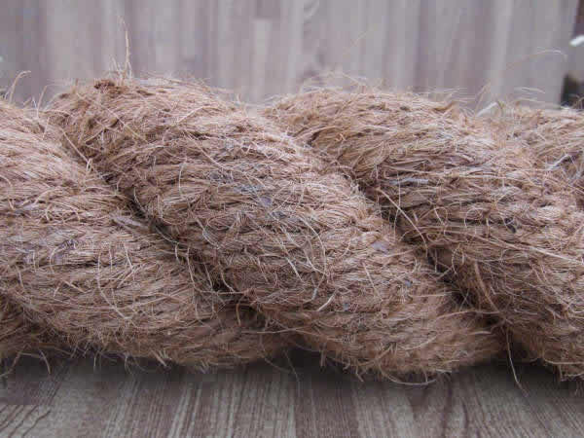

Slide 21
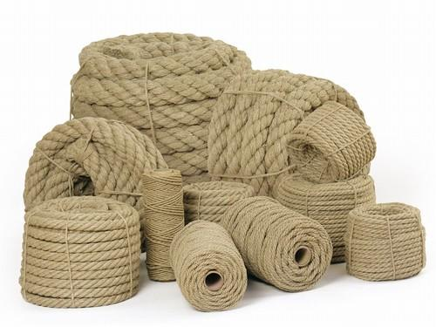


Slide 22

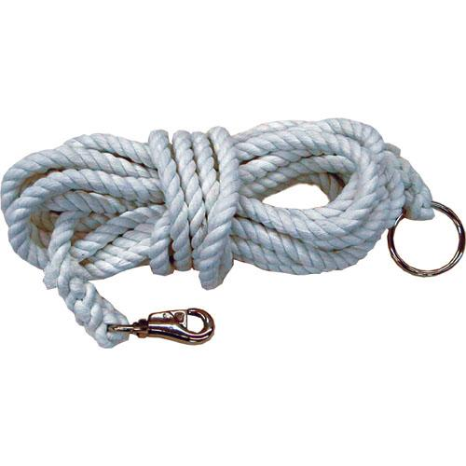

Slide 23

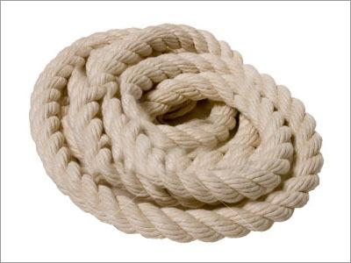

Slide 24

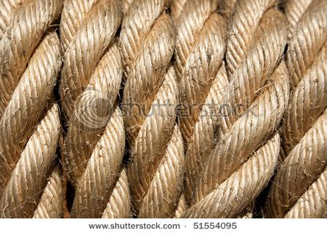

Slide 25
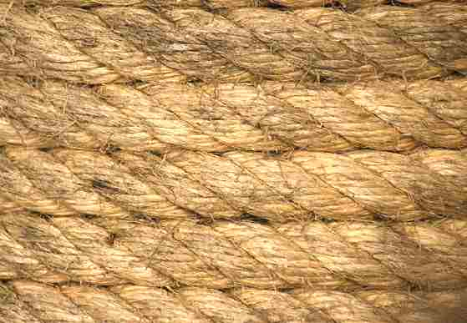

Slide 26

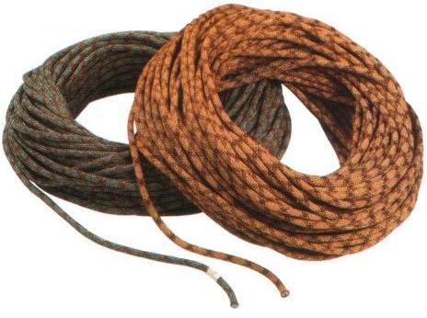

Slide 27

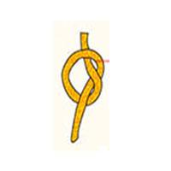
TYPES OF KNOTS
Thumb knot –
It is useful when tied at the end of a rope to prevent the rope from fraying, as a temporary measure or to stop it from passing through a pulley block.

Slide 28


TYPES OF KNOTS
Figure of eight knots –
This is formed by an over hand and an under hand knot overlapping each other with the loose end passed through the loop. When driven tight its resemblance is that of figure eight.

Slide 29

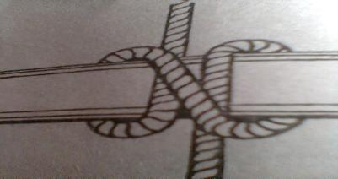
TYPES OF KNOTS
Half hitch –
This is formed by passing the short end of a rope around the spar or another rope and under the standing part. So that, when pulled, one part of the rope binds the other. In effect this forms the beginning of a timber hitch.

Slide 30


TYPES OF KNOTS
Reef knot –
This is useful for joining two ropes of equal sizes and also for general purposes. It should be used for joining 2 dry ropes of the same size, when the pull is constant.

Slide 31



TYPES OF KNOTS
Clove hitch –
This hitch is formed by forming two loops in the centre of rope. One in left hand and other in right, one oposit to the other in direction. Then the right hand one is passed in front of the spar and drawn tight. This is useful to hitch cylindrical object.

Slide 32

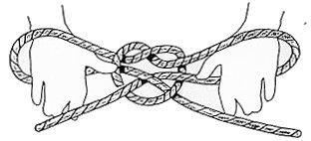
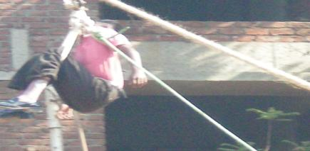
TYPES OF KNOTS
Chair knot –
Chair knot is used as a sling in which a person may readily be lowered from heights.
Chair knot may also be used as a stretcher sling, made by forming a chair knot complete with half hitches in the centre of a 40 feet lasing.

Slide 33

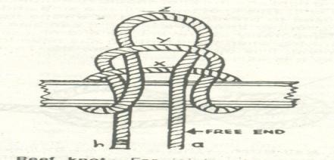
TYPES OF KNOTS
Draw Hitch –
This hitch will stand a considerable strain on the standing part and yet can be easily released by jerking the free end.
It enables the rope to be recovered from places where the knots can not be reached and untied by hand,

Slide 34


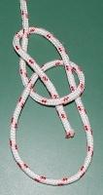
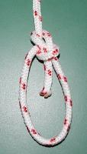
TYPES OF KNOTS
Bowline –
The bowline forms a non-slipping noose and is useful for lowering or raising purposes, and can also used to make a temporary eye in lines of all sizes.

Slide 35
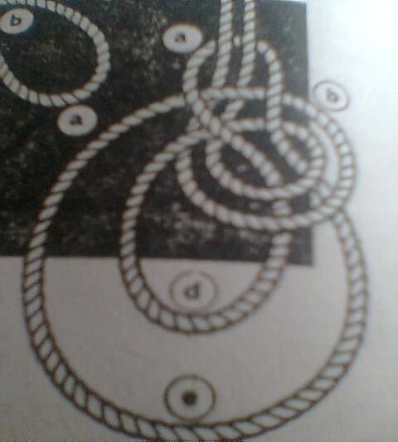

Slide 36

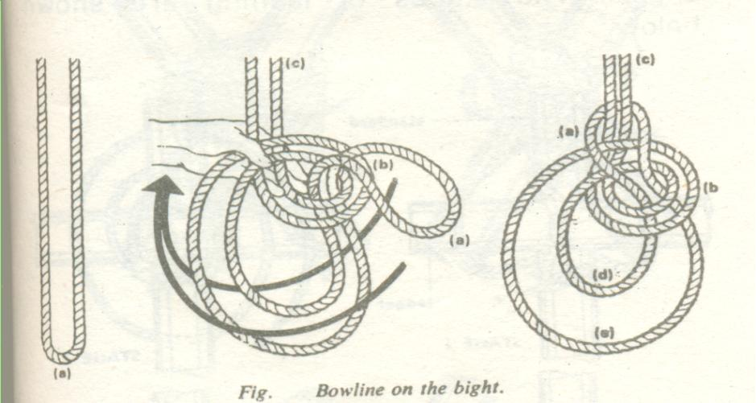

Slide 37

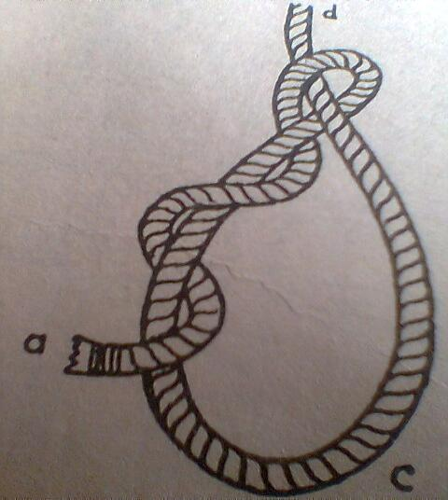

Slide 38

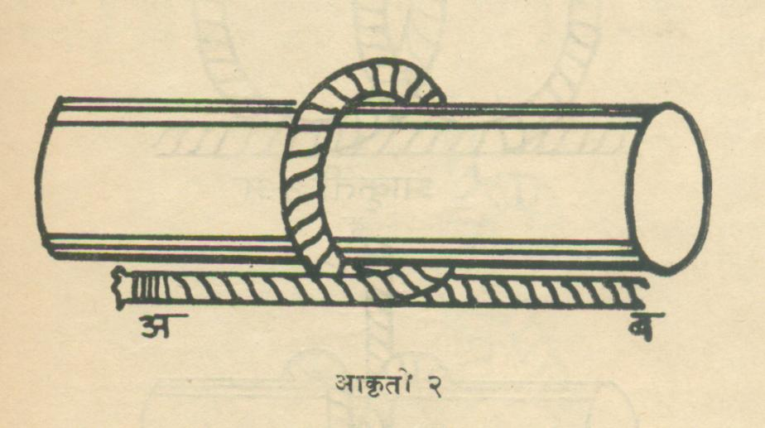

Slide 39

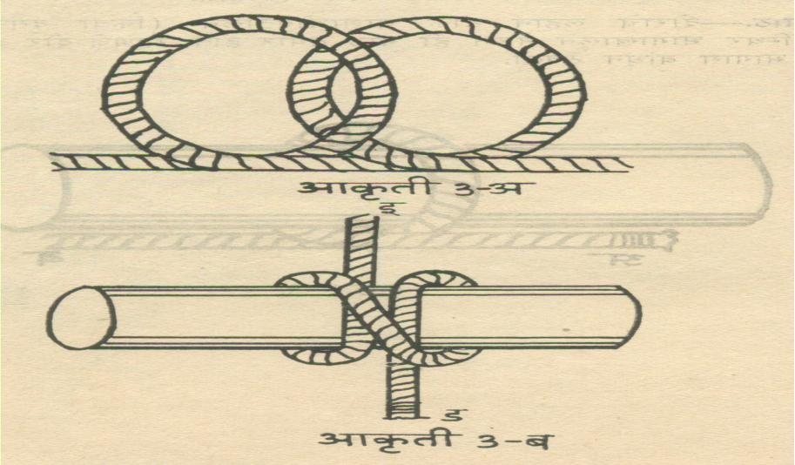

Slide 40

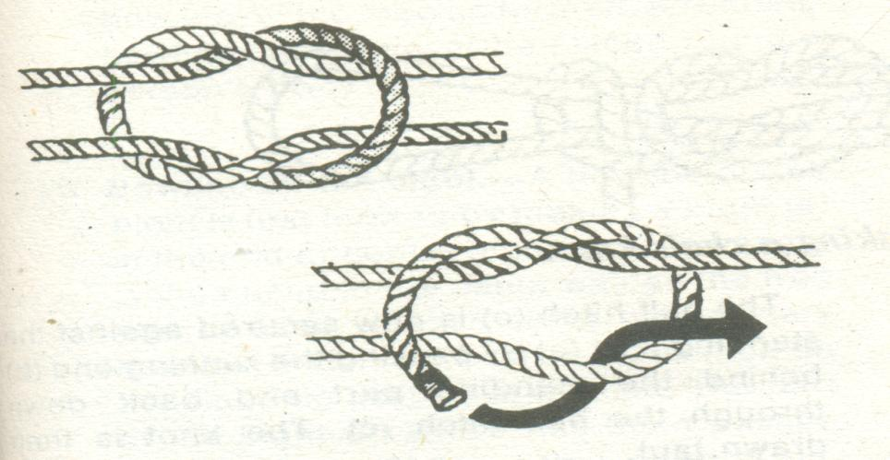

Slide 41

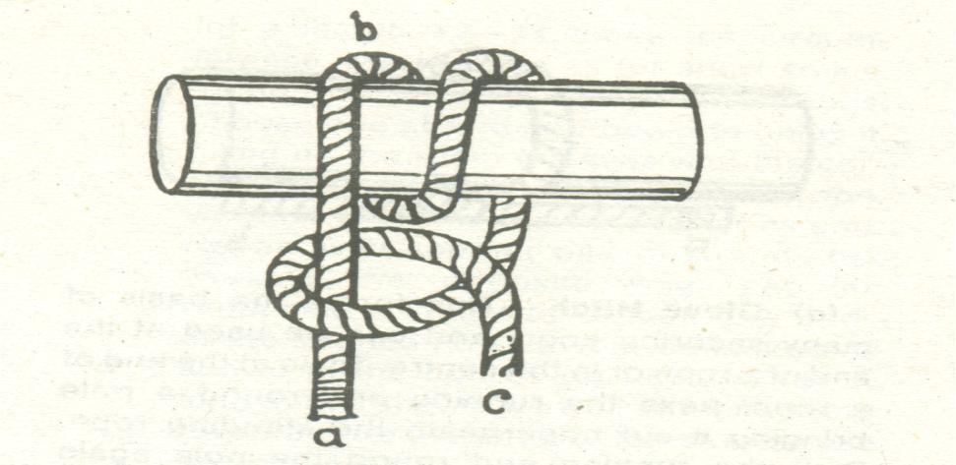

Slide 42

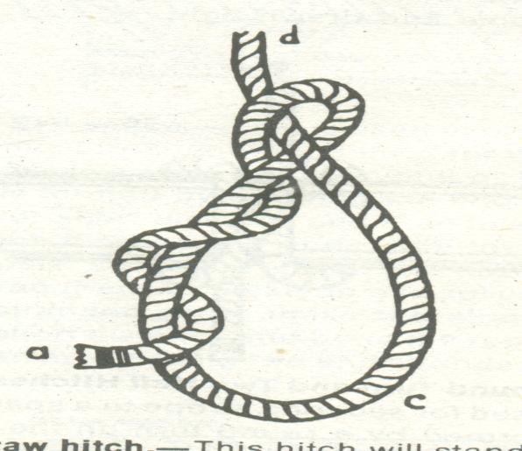

Slide 43

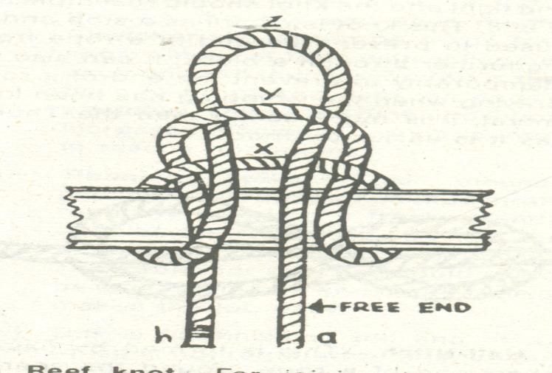

Slide 44

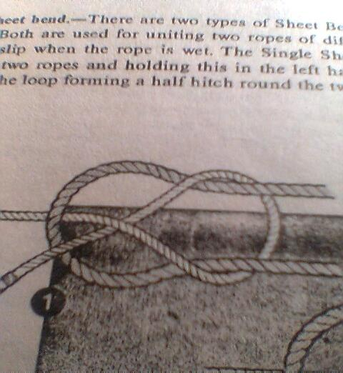

Slide 45

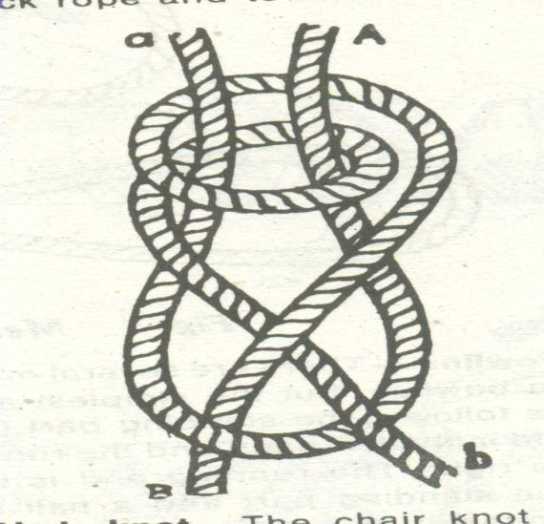

Slide 46

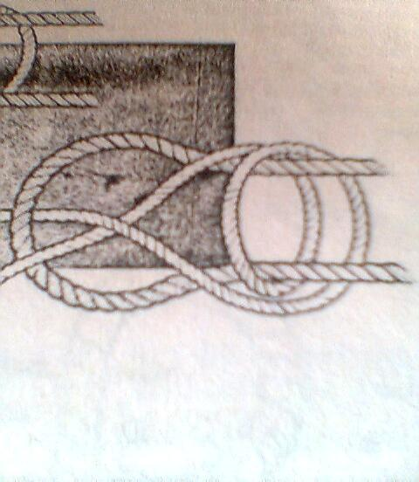

Slide 47

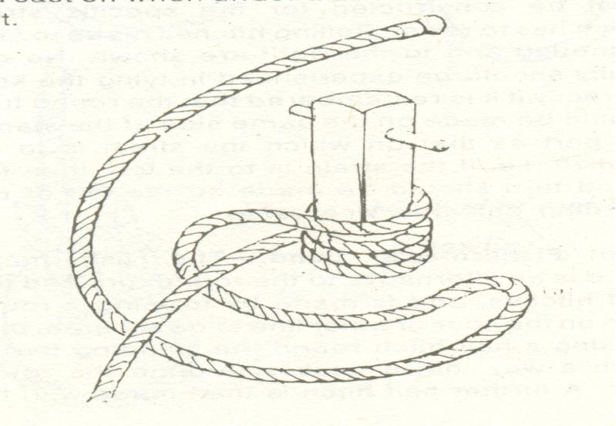

Slide 48
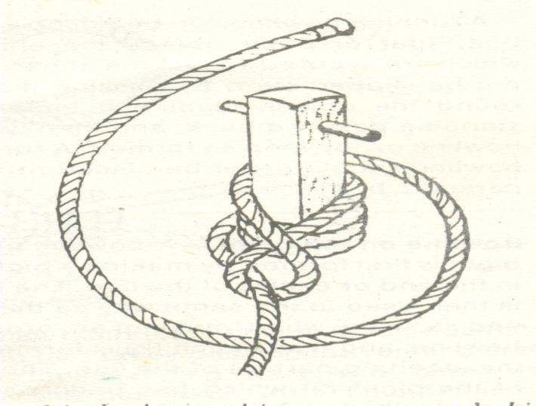

Slide 49

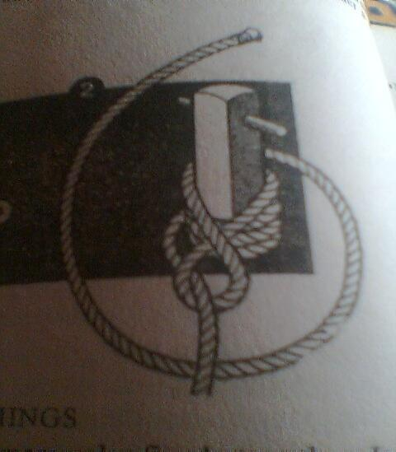

Slide 50

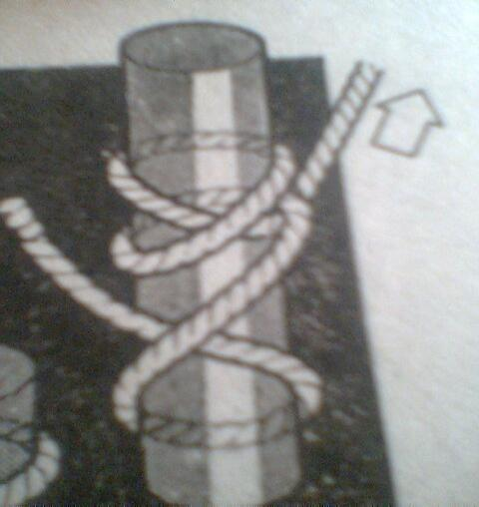

Slide 51

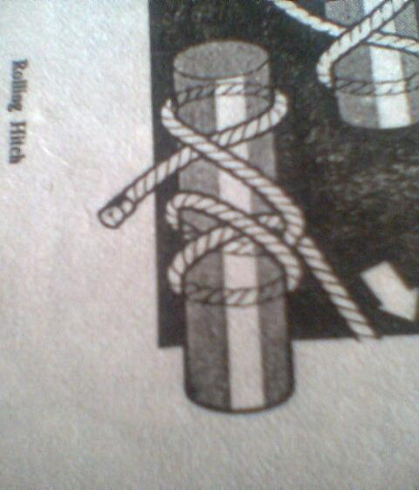

Slide 52

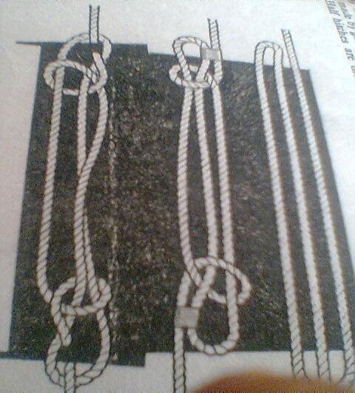

Slide 53

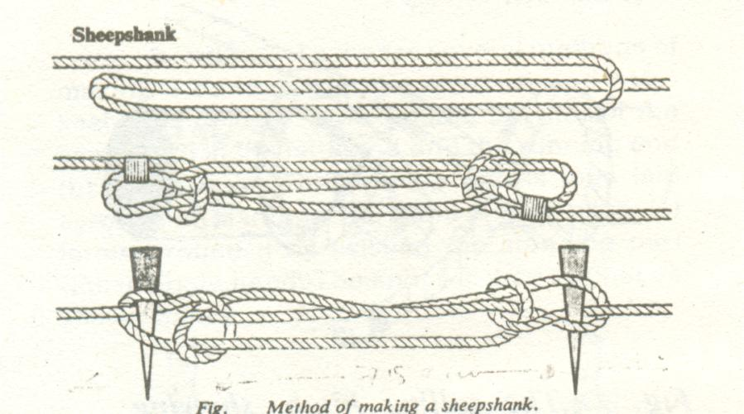

Slide 54

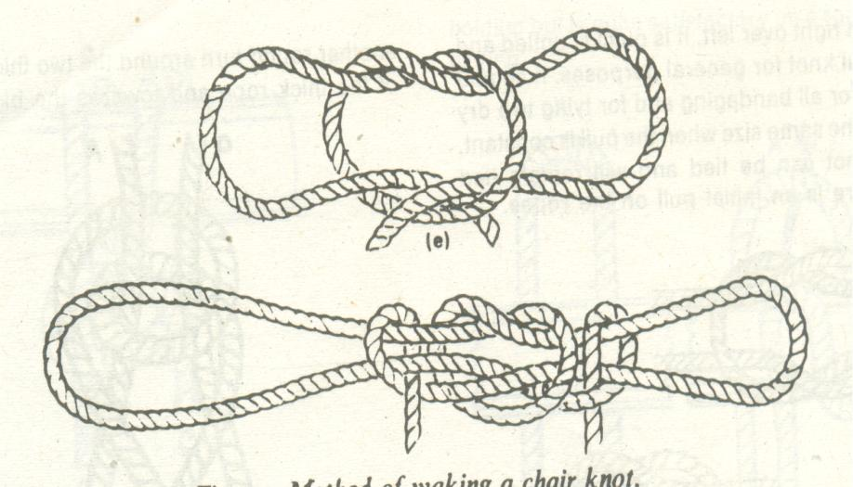

Slide 55

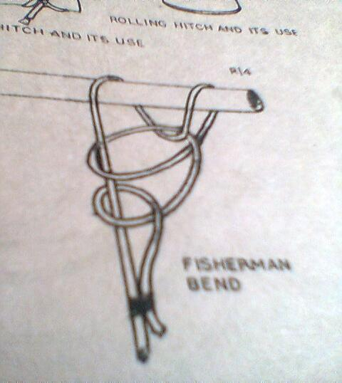

Slide 56
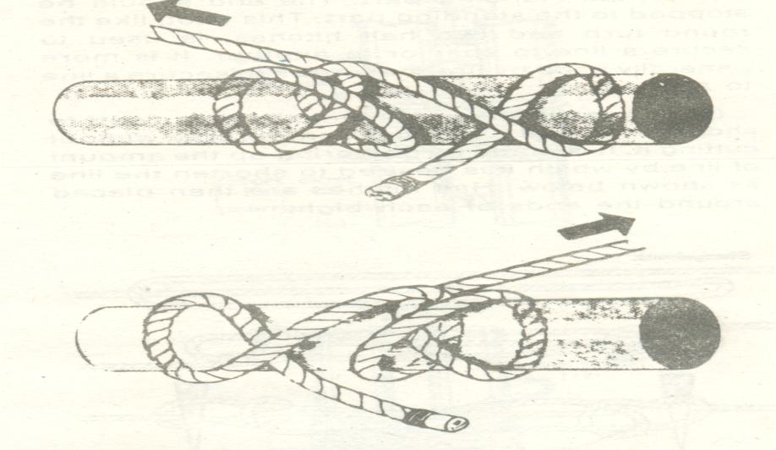

Slide 57
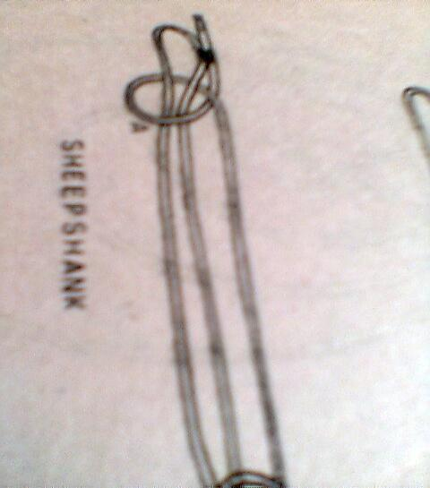

Slide 58

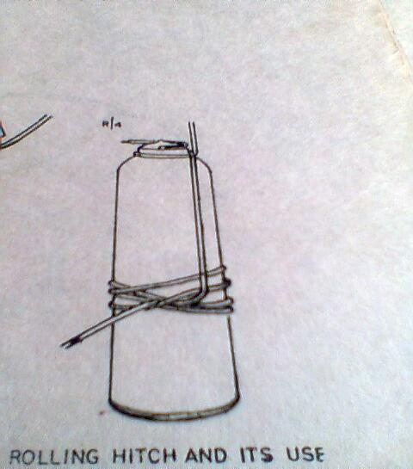

Slide 59
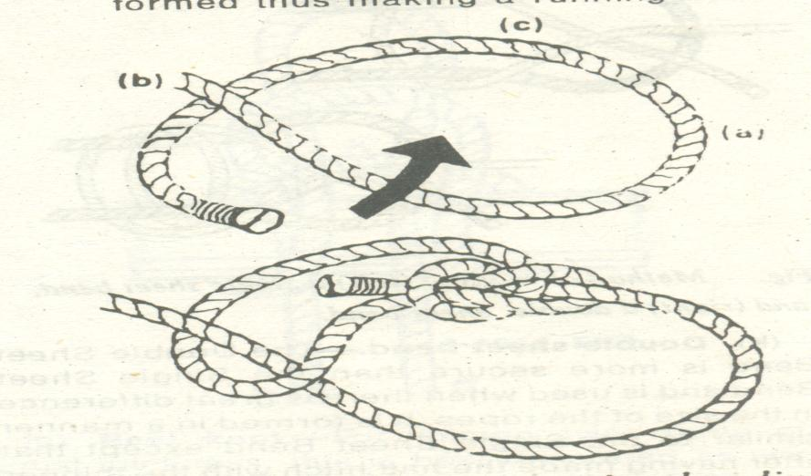

Slide 60


Slide 61


Slide 62



Slide 63


Slide 64



Slide 65



Slide 66


Slide 67


Slide 68



Slide 69



Slide 70


Slide 71



Slide 72


Slide 73

Lashings (²ÖÖÓ²Öæ ²ÖÖ¬ÖÖß )
These are mainly used to lash or secure two or more poles together.
There are four common types of Lashings.
SQUARE LASHING- This is used for lashing together two
poles that touch and cross at right angles;
cross head a and the derrick spar; ledger and
gyn legs.

Slide 74


Slide 75


Slide 76


Slide 77



Slide 78


Slide 79



Slide 80


Slide 81


Slide 82


Slide 83


Slide 84



Slide 85



Slide 86



Slide 87



Slide 88



Slide 89


Slide 90



Slide 91



DIAGONAL&ROUNDLASHING
Diagonal Lashing :- This is used for lashing two poles
úÖÔ ²ÖÖ¬ÖÓÖß where they cross at an angle and the
poles are likely to spring apart
when put under load or strain.
Round Lashing :- this is used for lashing two poles
ÖÖê»ÖÖ Ö¸ü ²ÖÖÓ¬ÖÖß. Together, when they are lept paralled to
each other sheer legs. This is also
called sheer lashing.

Slide 92


FIGURE OF EIGHT LASHING
Figure of Eight Lashing :- This is used for lashing three †Öšü †Ö Ö¸Ö“Öß ²ÖÖÓ¬ÖÖß .. Poles together to from a . tripod or gyn

Slide 93



Slide 94



Slide 95


THANK YOU

