Slide 1








LESSON 14
Poisoning
Photo Credit: Freepik
PEER | MFR | INDIA
PPT 14 -
PPT 14 - 1

Slide 2
OBJECTIVES
Upon completing this lesson, you will be able to:
1
List the signs and symptoms of poisoning, and steps for pre-hospital treatment.
List four specific signs and symptoms of ingested poisons.
2
PEER | MFR | INDIA
PPT 14 -

Slide 3
OBJECTIVES
Upon completing this lesson, you will be able to:
3
List four specific signs and symptoms of inhaled poisons.
List four specific signs and symptoms of absorbed poisons.
List the signs and symptoms of injected poisons, including snakebites, and the steps for pre-hospital treatment.
4
5
PEER | MFR | INDIA
PPT 14 -

Slide 4
OBJECTIVES
Upon completing this lesson, you will be able to:
6
List the signs and symptoms for alcohol abuse and the steps for pre-hospital treatment.
List the signs and symptoms for drug abuse and the steps for pre-hospital treatment.
7
PEER | MFR | INDIA
PPT 14 -

Slide 5
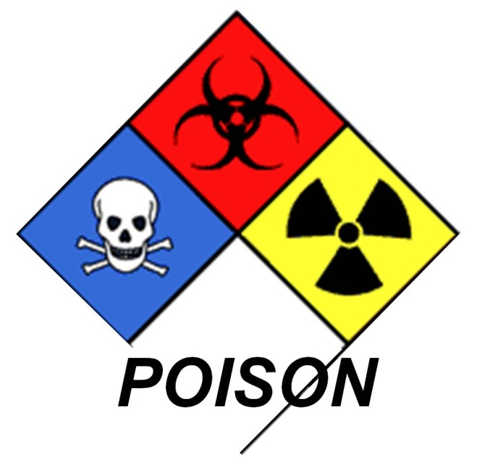
Poison
Any substance that can impair or cause death of cell structure or function.
PEER | MFR | INDIA
PPT 14 -

Slide 6
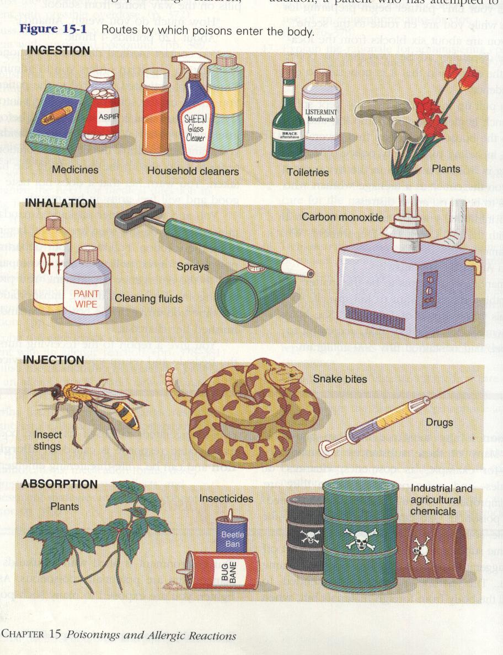
Poisons
Can enter the body in four ways:
Ingestion
Inhalation
Injection
Absorption
PEER | MFR | INDIA
PPT 14 -

Slide 7
Poisoning
General signs and symptoms
Nausea and/or vomiting
Headache
Abdominal pain
Altered mental status or coma
PEER | MFR | INDIA
PPT 14 -

Slide 8
Poisoning
General signs and symptoms
Cont.
Seizures
Rapid or slow heart rate
High, normal or low blood pressure
Possible dilation or constriction of pupils
PEER | MFR | INDIA
PPT 14 -

Slide 9
Poisoning
General signs and symptoms
Cont.
Shortness of breath
Injury to skin (discoloration, burns, injection marks, swelling)
Diarrhea
PEER | MFR | INDIA
PPT 14 -

Slide 10
Ingested Poisons
Specific signs and symptoms
Burns, swelling or stains around the mouth
Abnormal breathing
Diaphoresis
Excessive salivation or foaming at the mouth
PEER | MFR | INDIA
PPT 14 -

Slide 11
Inhaled Poisons
Specific signs and symptoms
History of inhalation abuse
Chest pain or tightness
Burning sensation in the chest or throat
Coughing, wheezing or rales
PEER | MFR | INDIA
PPT 14 -

Slide 12
Absorbed Poisons
Specific signs and symptoms
History of exposures
Liquid or residue on the skin
Itching or irritation
Rash or blisters
PEER | MFR | INDIA
PPT 14 -

Slide 13
Injected Poisons
Specific signs and symptoms
Needle tracks
Pain, swelling or redness at the injection site
History of bites or stings
PEER | MFR | INDIA
PPT 14 -

Slide 14
Injected Poisons
Specific signs and symptoms
Cont.
Bite marks or embedded stinger
Numbness at the injury site
Other symptoms similar to ingested poisons
PEER | MFR | INDIA
PPT 14 -

Slide 15
Snake Bites
Specific signs and symptoms
Nausea and vomiting
Weakness and paralysis
Seizures or decreased level of consciousness
PEER | MFR | INDIA
PPT 14 -

Slide 16
Snake Bites
Specific signs and symptoms
Cont.
Puncture wound
Pain and/or burning sensation around bite mark
Blood oozing from the bite mark
Discoloration and swelling
PEER | MFR | INDIA
PPT 14 -

Slide 17
Criteria for Administering Anti-venin
Specificity (appropriate to the snake species)
Appropriate quantity
Within the shortest possible time
PEER | MFR | INDIA
PPT 14 -

Slide 18
Alcohol Abuse / Poisoning
Specific signs and symptoms
Smell of alcohol on breath/clothes
Staggering
Slurred speech
Nausea and vomiting
Redness of the face
Altered behaviour
PEER | MFR | INDIA
PPT 14 -

Slide 19
Drug Categories
Stimulants
Depressants
Analgesic narcotics
Hallucinogens
Volatile chemicals (vapours)
PEER | MFR | INDIA
PPT 14 -

Slide 20
Drug Abuse
General signs and symptoms
Excitability
Drowsiness and slow reflexes
Reduced pulse and breathing
Accelerated pulse and breathing
Relaxed muscles
PEER | MFR | INDIA
PPT 14 -

Slide 21
Drug Abuse
General signs and symptoms
Cont.
Constricted or dilated pupils
Distorted perception
Aggressive behaviour
Euphoria
PEER | MFR | INDIA
PPT 14 -

Slide 22


THANK YOU

