Slide 1


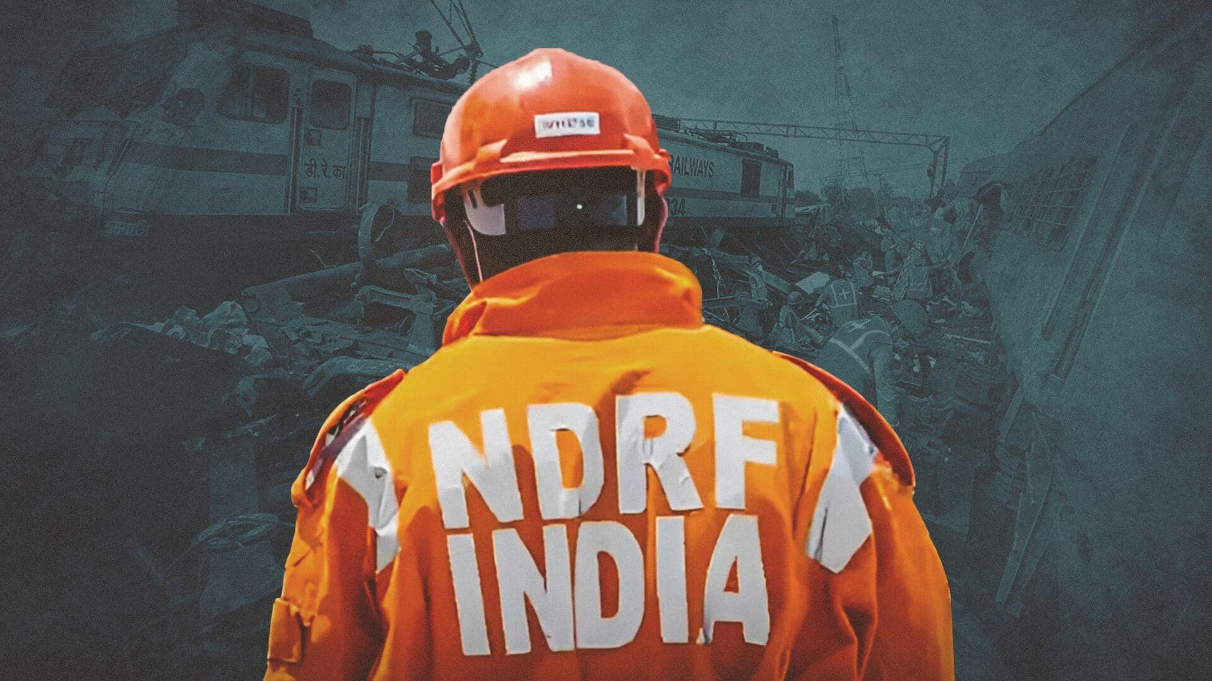


CADRE
FINAL PRACTICAL EXERCISE
EARTHQUAKE
Presented By:- Pavan Dev Gaur,2IC

Slide 2



OBJECTIVES
Understand the operational sequence of a community responder, secure the wellbeing of your family if possible, and decide whether you can join the community response team
Gather information and formulate a plan of action to search and locate possible trapped victims
Conduct C-QRST, evacuate and transport victims safely in the event of an emergency or a disaster.
1
Upon completion of this lesson, you will be able to :-
2
3

Slide 3


Your family and neighbors were awakened in your sleep when you felt vibration and movement of the ground.
Hanging objects swing. Dinner plates, glasses, windows and doors rattle. Floors and walls of wood-framed buildings creak.
What will be your First reaction?
SCENARIO

Slide 4
You again felt movement of the ground. The strength of movement frightened your family members prompting them to run outside of the house. Upon reaching the front of your house you see a lot of people outside.
Hanging objects swing violently. Dinning utensils clatter and clink, some are broken. Some figurines and decors fell. Light cabinets topple over.
SCENARIO

Slide 5
You heard from the news that 8.2 earthquake happened at 10:00am today with the epicenter located at Paneba City. There were buildings that are reported to have collapsed.
What will you do to prepare your family in this situation?
GENERAL SCENARIO

Slide 6
As a Community Responder, you decided to report to your Community Action Disaster Center (CADRE). Upon arrival you discover that some houses in your community collapsed and there were a number of people who needs help.
SCENARIO

Slide 7
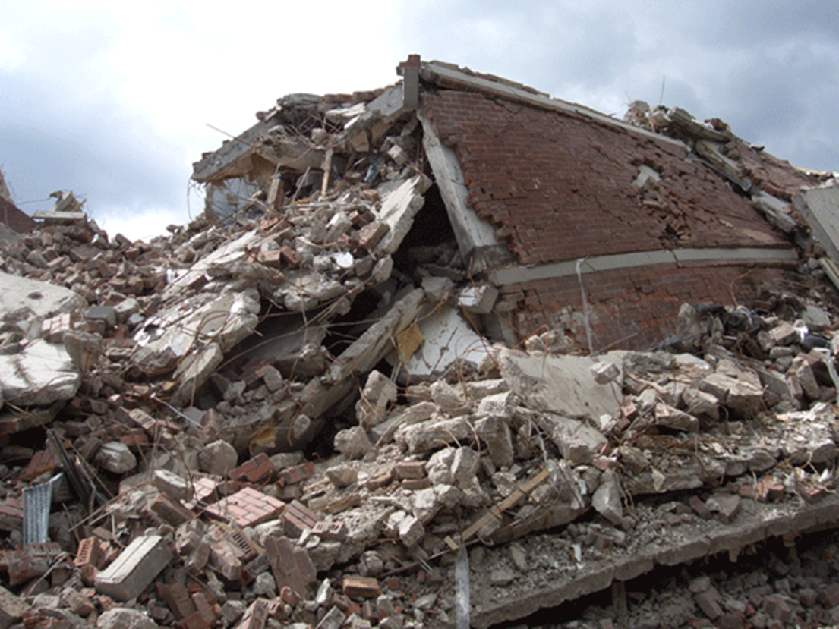
SCENARIO

Slide 8
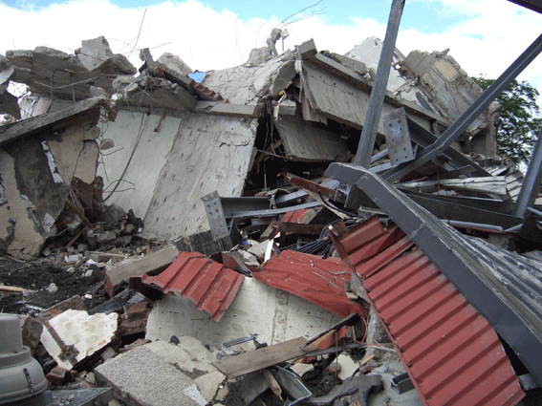
SCENARIO

Slide 9


PREPARE FOR RESPONSE!

Slide 10
REVIEW
Understand the operational sequence of a community responder, secure the wellbeing of your family if possible, and decide whether you can join the community response team
Gather information and formulate a plan of action to search and locate possible trapped victims
Conduct C-QRST, evacuate and transport victims safely in the event of an emergency or a disaster.
1
Now you will be able to :-
2
3

Slide 11



THANK YOU

