Slide 1

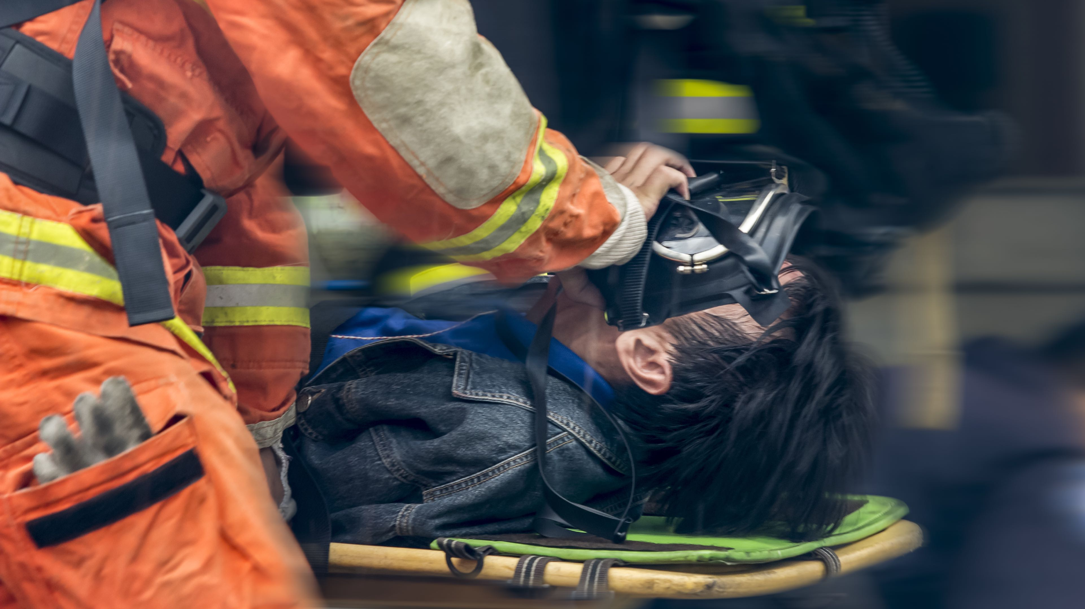






LESSON 12
Course Review
Photo Credit: Freepik
Presented By:- Sohel Lakhani. DC
PEER | CSSR | INDIA
PPT 12 -
PPT 12 - 1

Slide 2

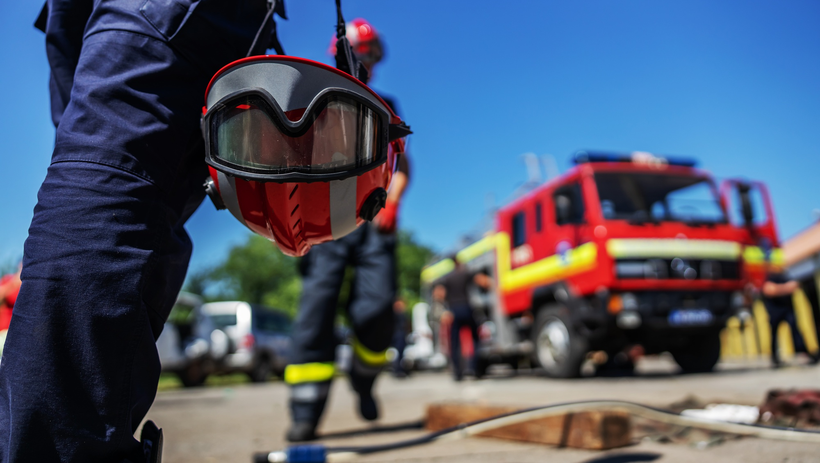

LESSON 2
Organising and Starting
a CSSR Operation
Photo Credit: Freepik
PPT 2 -
PEER | CSSR | INDIA
PPT 2-1

Slide 3
OBJECTIVES
Upon completing this lesson, you will be able to:
1
Define a collapsed structure search and rescue operation.
Describe the structure of a CSSR squad and the positions within it.
List five phases of a CSSR operation.
2
3
PEER | CSSR | INDIA
PPT 2 -

Slide 4
OBJECTIVES
4
List the six stages of
the Operations Phase.
List the five steps of
the initial assessment.
Describe how a CSSR squad fits into the Incident Response System.
Name the four levels in the scope of operations as they pertain to CSSR.
Upon completing this lesson, you will be able to:
5
6
7
PEER | CSSR | INDIA
PPT 2 -

Slide 5
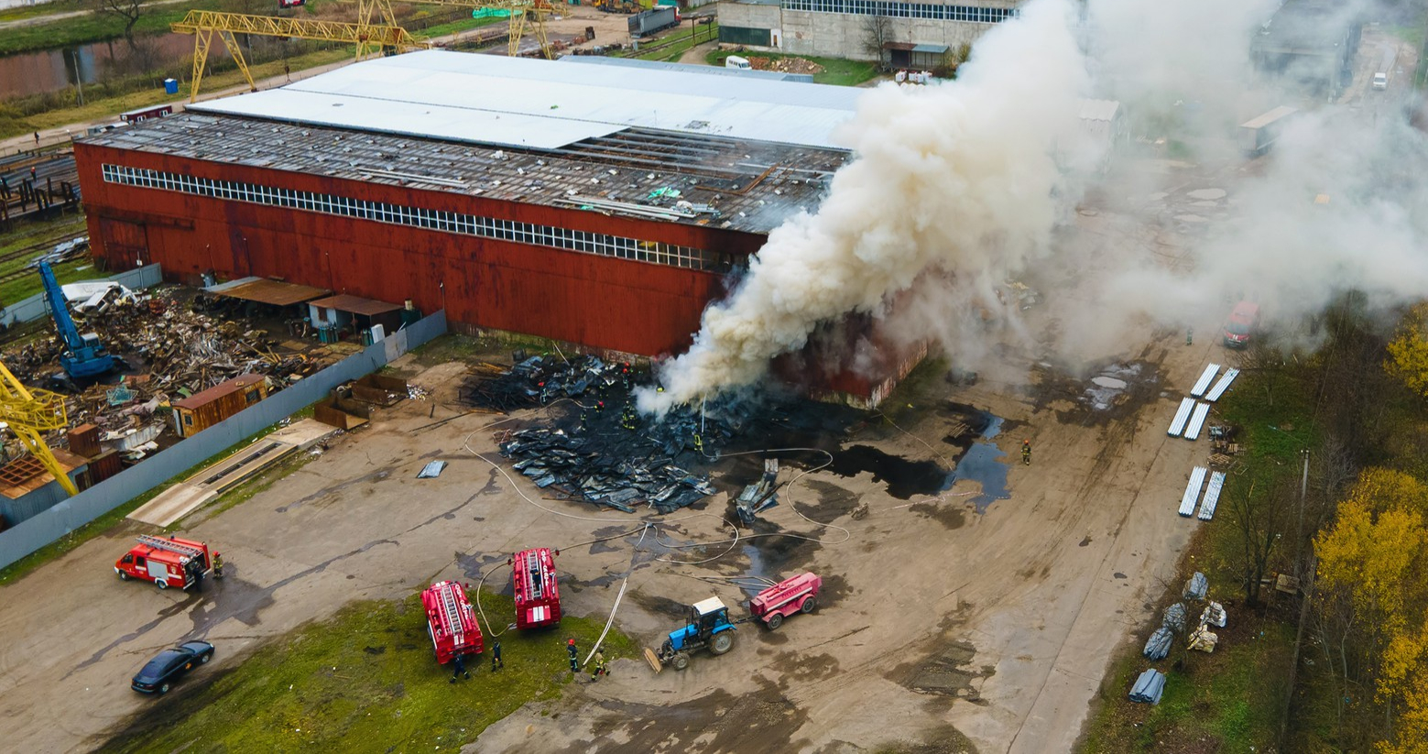
LESSON 3
Construction Materials,
Structures and
Damage Types
Photo Credit: Freepik
PPT 3 -
PEER | CSSR | INDIA
PPT 3-1

Slide 6
OBJECTIVES
Upon completing this lesson, you will be able to:
1
Define construction materials and classify them by their composition types and uses.
List and describe three forces that can affect construction materials.
List three properties of each material: concrete, steel and wood.
Describe two methods of construction.
2
3
4
PEER | CSSR | INDIA
PPT 3 -

Slide 7
OBJECTIVES
Upon completing this lesson, you will be able to:
5
List four types of structures.
List at least three characteristics of
a building in each of the following
four categories:
general
architecture
structural elements
non-structural elements
6
PEER | CSSR | INDIA
PPT 3 -

Slide 8
OBJECTIVES
Upon completing this lesson, you will be able to:
7
List and describe two types of damage in a structure and their potential resulting failures.
Name and describe the four basic collapse patterns.
8
PEER | CSSR | INDIA
PPT 3 -

Slide 9
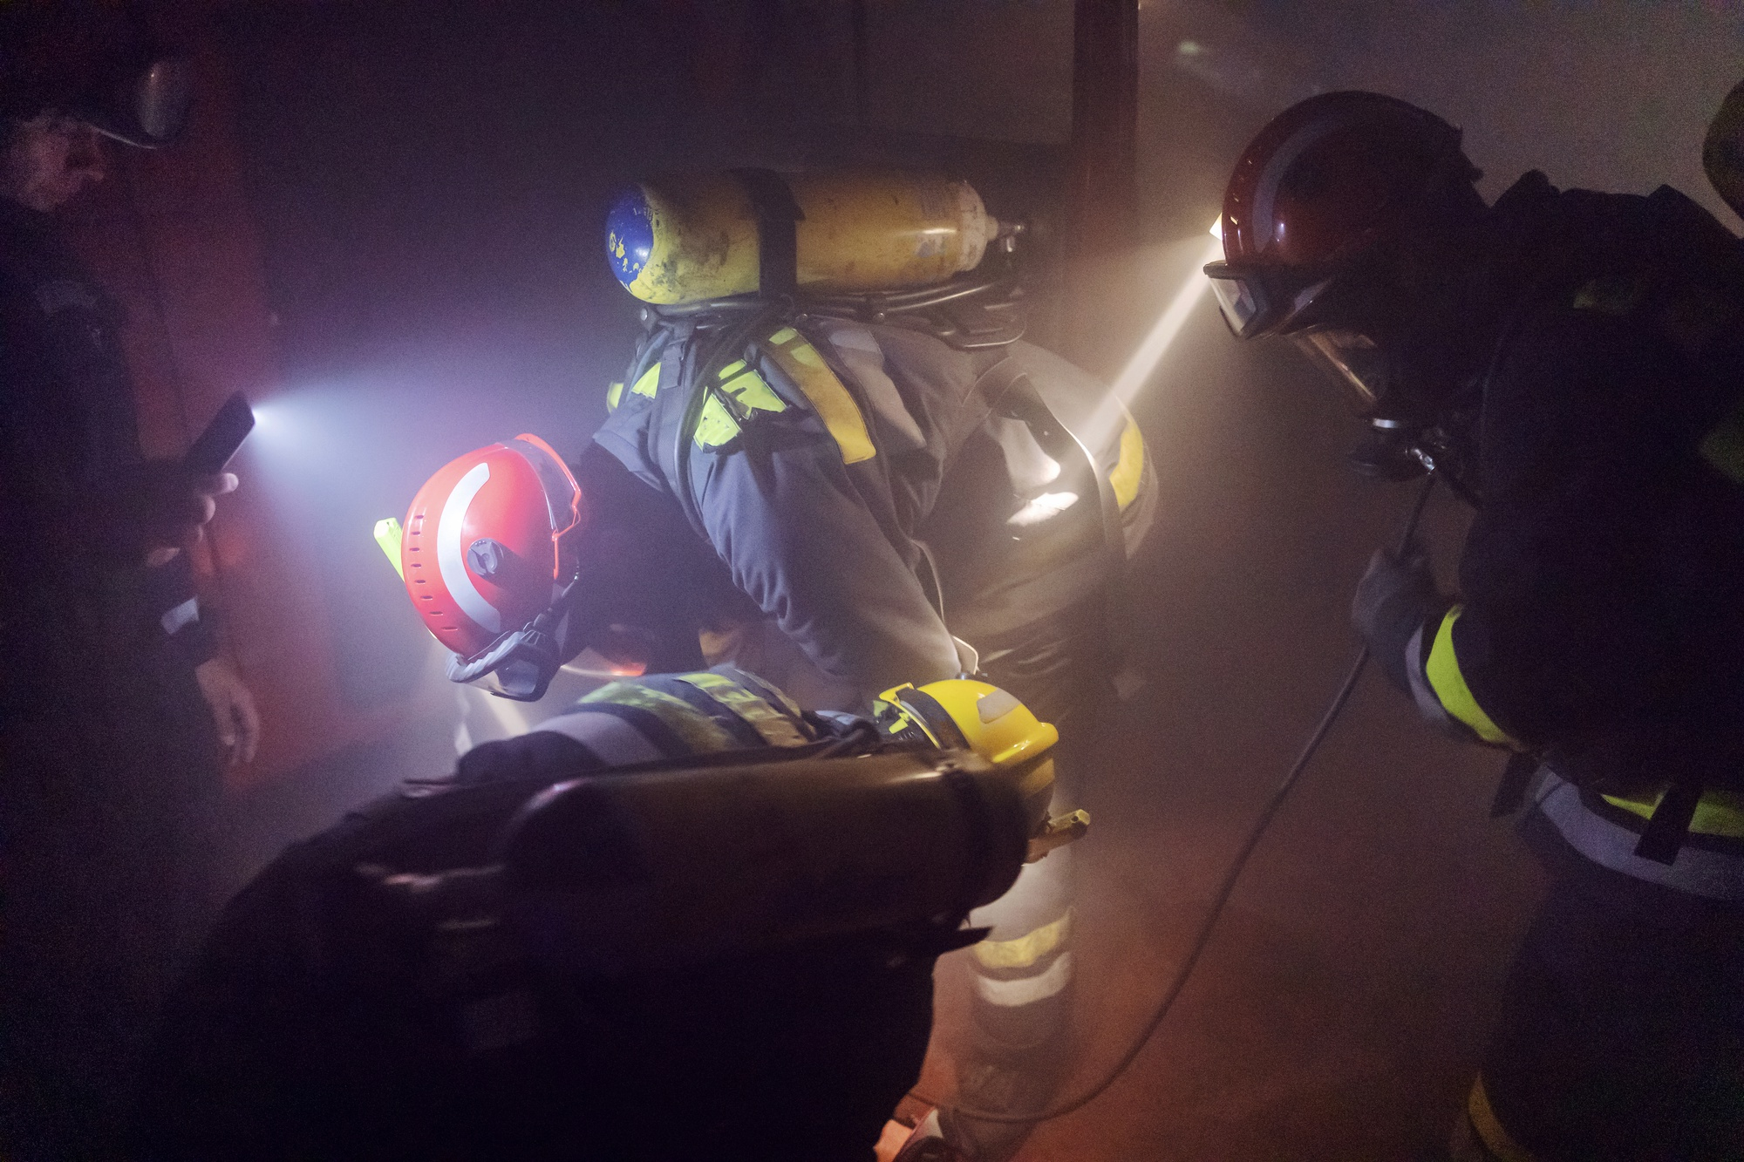
LESSON 4
Structural Triage and
INSARAG Marking System
Photo Credit: Freepik
PPT 4-1
PEER | CSSR | INDIA
PPT 4 -

Slide 10
OBJECTIVES
Upon completing this lesson, you will be able to:
1
Define Sectorization, its identification and five ASR Levels.
List four categories of Worksite Triage.
List at least 8 factors to consider in worksite triage.
2
3
PEER | CSSR | INDIA
PPT 4 -

Slide 11
OBJECTIVES
Upon completing this lesson, you will be able to:
4
Define the INSARAG marking system, list and describe 8 categories of INSARAG Marking System
PEER | CSSR | INDIA
PPT 4 -

Slide 12
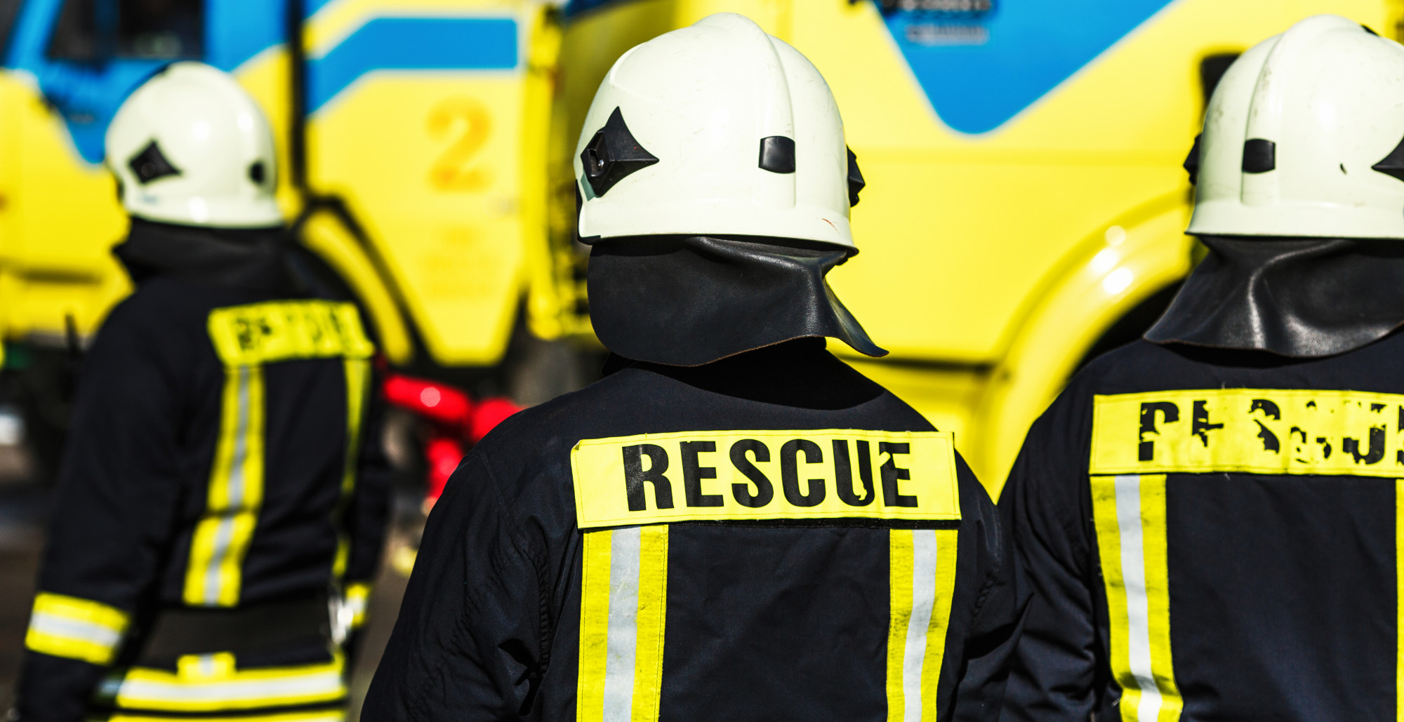
LESSON 5
Operational Safety
Photo Credit: Freepik
PPT 5 -
PEER | CSSR | INDIA
PPT 5-1

Slide 13
OBJECTIVES
Upon completing this lesson, you will be able to:
1
List at least five dangers a rescuer
faces in a CSSR operation.
Identify unsafe actions and unsafe conditions.
Identify the CSSR Course safety rules.
2
3
PEER | CSSR | INDIA
PPT 5 -

Slide 14
OBJECTIVES
Upon completing this lesson, you will be able to:
4
Identify the four parts of a CSSR safety plan and briefly describe each one.
Describe the purpose of the Safety Briefing and list its eight components.
5
PEER | CSSR | INDIA
PPT 5 -

Slide 15
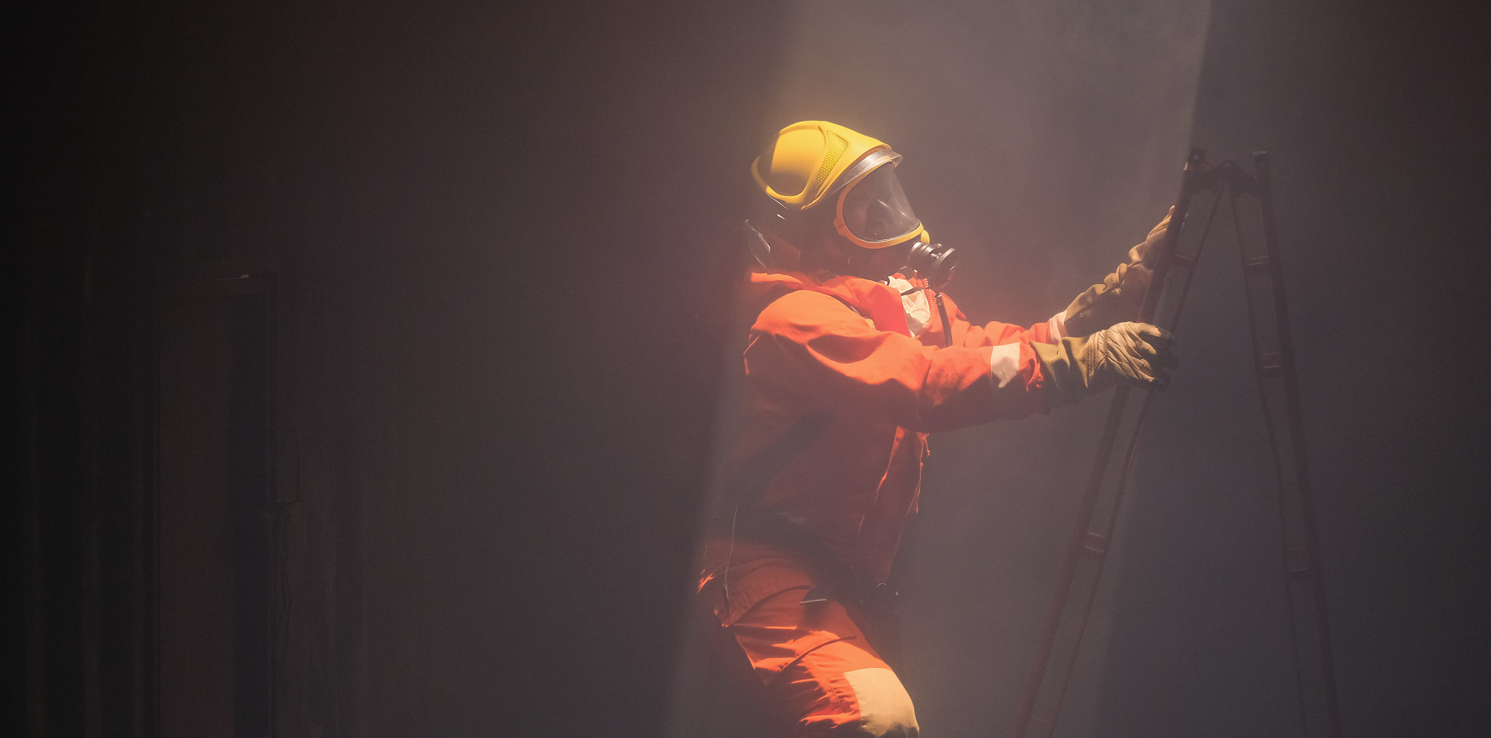
LESSON 6
Search and Location Techniques
Photo Credit: Freepik
PPT 6 -
PEER | CSSR | INDIA
PPT 6-1

Slide 16
OBJECTIVES
Upon completing this lesson, you will be able to:
1
Define search and location and describe its importance in the success of a CSSR operation.
Describe the composition of a search team and the basic equipment used.
List and describe the steps for searching and locating.
2
3
PEER | CSSR | INDIA
PPT 6 -

Slide 17
OBJECTIVES
Upon completing this lesson, you will be able to:
4
Define void space and identify probable locations in the four basic collapse patterns.
List and describe the steps for searching and locating.
Demonstrate in two practical exercises the steps for a physical search and location, using two different patterns.
5
6
PEER | CSSR | INDIA
PPT 6 -

Slide 18
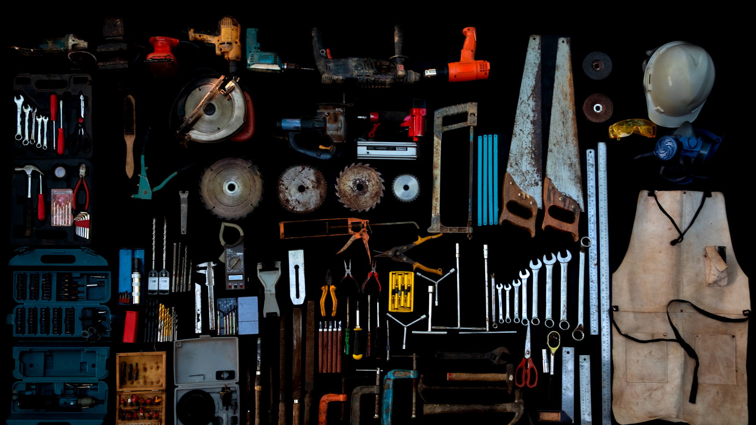
LESSON 7
Tools and Location Techniques
Photo Credit: Freepik
PPT 7 -
PEER | CSSR | INDIA
PPT 7-1

Slide 19
OBJECTIVES
Upon completing this lesson, you will be able to:
1
Define tools, equipment and accessories (TEA).
List four categories of TEA according to their use.
List five power sources for equipment and tools.
2
3
PEER | CSSR | INDIA
PPT 7 -

Slide 20
OBJECTIVES
Upon completing this lesson, you will be able to:
4
List the general steps for use and maintenance of tools and equipment (before, during and after their use).
Demonstrate in four practical exercises the correct use of TEA.
5
PEER | CSSR | INDIA
PPT 7 -

Slide 21
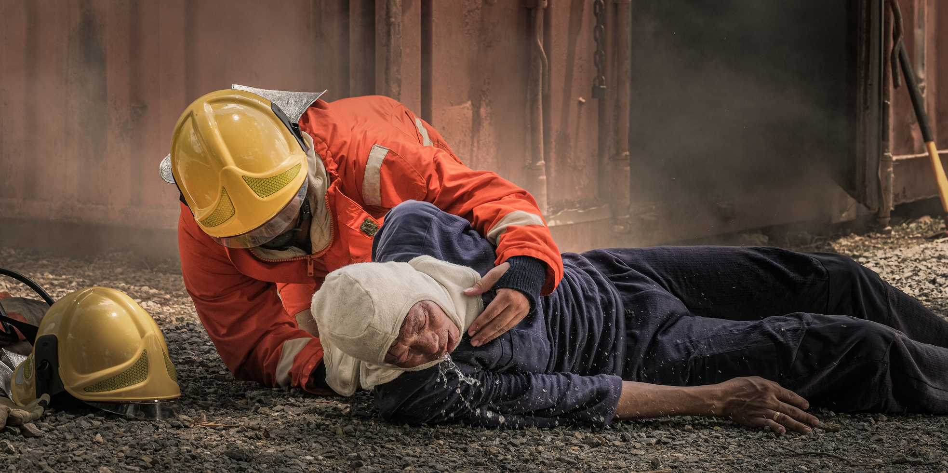
LESSON 8
Rescue Strategies and Techniques
Photo Credit: Freepik
PPT 8 -
PEER | CSSR | INDIA
PPT 8-1

Slide 22
OBJECTIVES
Upon completing this lesson, you will be able to:
1
Describe the two ways of approaching a located trapped victim.
List the four techniques for accessing and rescuing a victim.
List the five factors to analyse when evaluating access conditions.
2
3
PEER | CSSR | INDIA
PPT 8 -

Slide 23
OBJECTIVES
Upon completing this lesson, you will be able to:
4
Describe the procedures for penetrating five different materials: wood, metal, concrete, brick and cinder block.
Demonstrate in a practical exercise
the procedure for cutting and penetrating the five materials listed above, correctly using the required TEA.
List the steps for removing rubble.
5
6
PEER | CSSR | INDIA
PPT 8 -

Slide 24
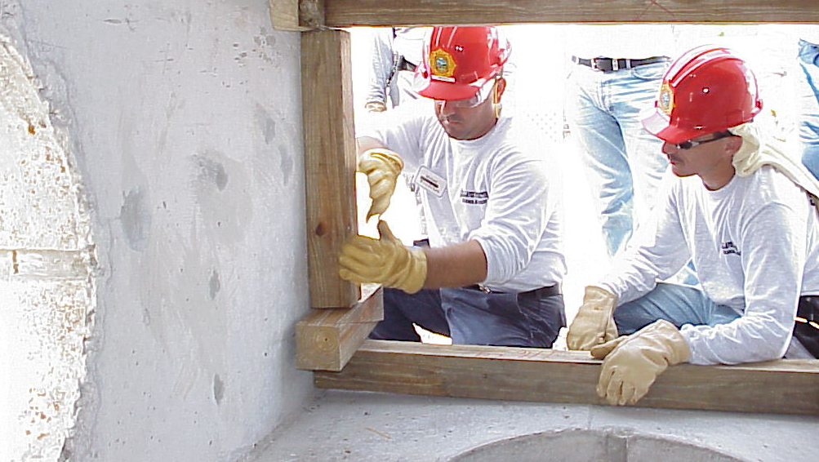
LESSON 9
Shoring Methods
Photo Credit: PEER South Asia/ADPC
PPT 9 -
PEER | CSSR | INDIA
PPT 9 - 1

Slide 25
OBJECTIVES
Upon completing this lesson, you will be able to:
1
Define shoring and identify its components.
List the factors that determine
the design and method of shoring.
Describe four types of shoring.
2
3
PEER | CSSR | INDIA
PPT 9 -

Slide 26
OBJECTIVES
Upon completing this lesson, you will be able to:
4
List the positions and functions of
the members of a shoring team.
List the procedures for building
a window/door shore and a vertical shore. Demonstrate these procedures in a practical exercise.
5
PEER | CSSR | INDIA
PPT 9 -

Slide 27
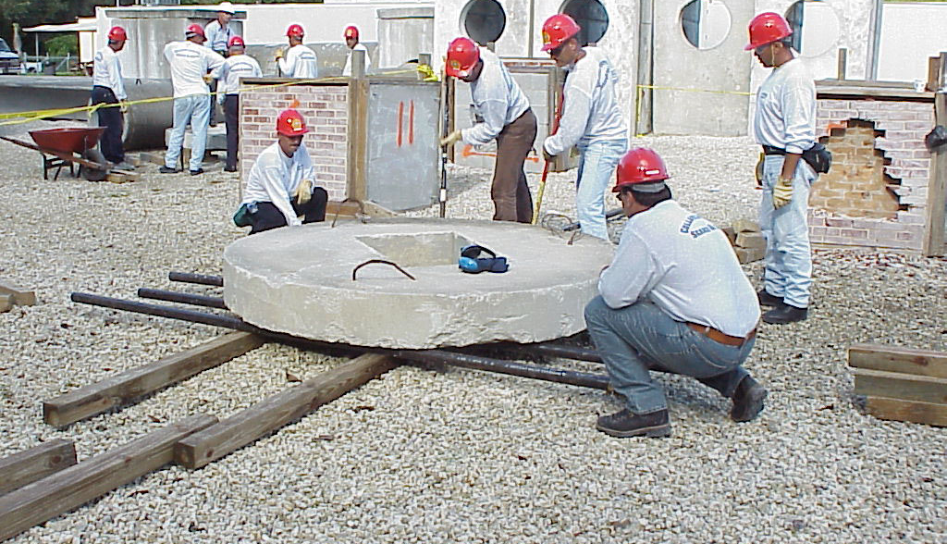
LESSON 10
Lifting and Stabilizing
Photo Credit: PEER South Asia/ADPC
PEER | CSSR | INDIA
PPT 10 -
PPT 10 - 1

Slide 28
OBJECTIVES
Upon completing this lesson, you will be able to:
1
List three factors that you must determine before lifting a load.
List and describe three methods for lifting a load.
Define a lever, its three components and the three classes of a lever.
2
3
PEER | CSSR | INDIA
PPT 10 -

Slide 29
OBJECTIVES
Upon completing this lesson, you will be able to:
4
List at least three applications of
the hoist.
List two types of cribbing used to stabilise a load.
List the five steps to build cribbing
for lifting and stabilising a load.
5
6
PEER | CSSR | INDIA
PPT 10 -

Slide 30
OBJECTIVES
Upon completing this lesson, you will be able to:
7
List the steps to roll a load using pipes.
Demonstrate in three practical stations the techniques for lifting, stabilising and rolling loads.
8
PEER | CSSR | INDIA
PPT 10 -

Slide 31
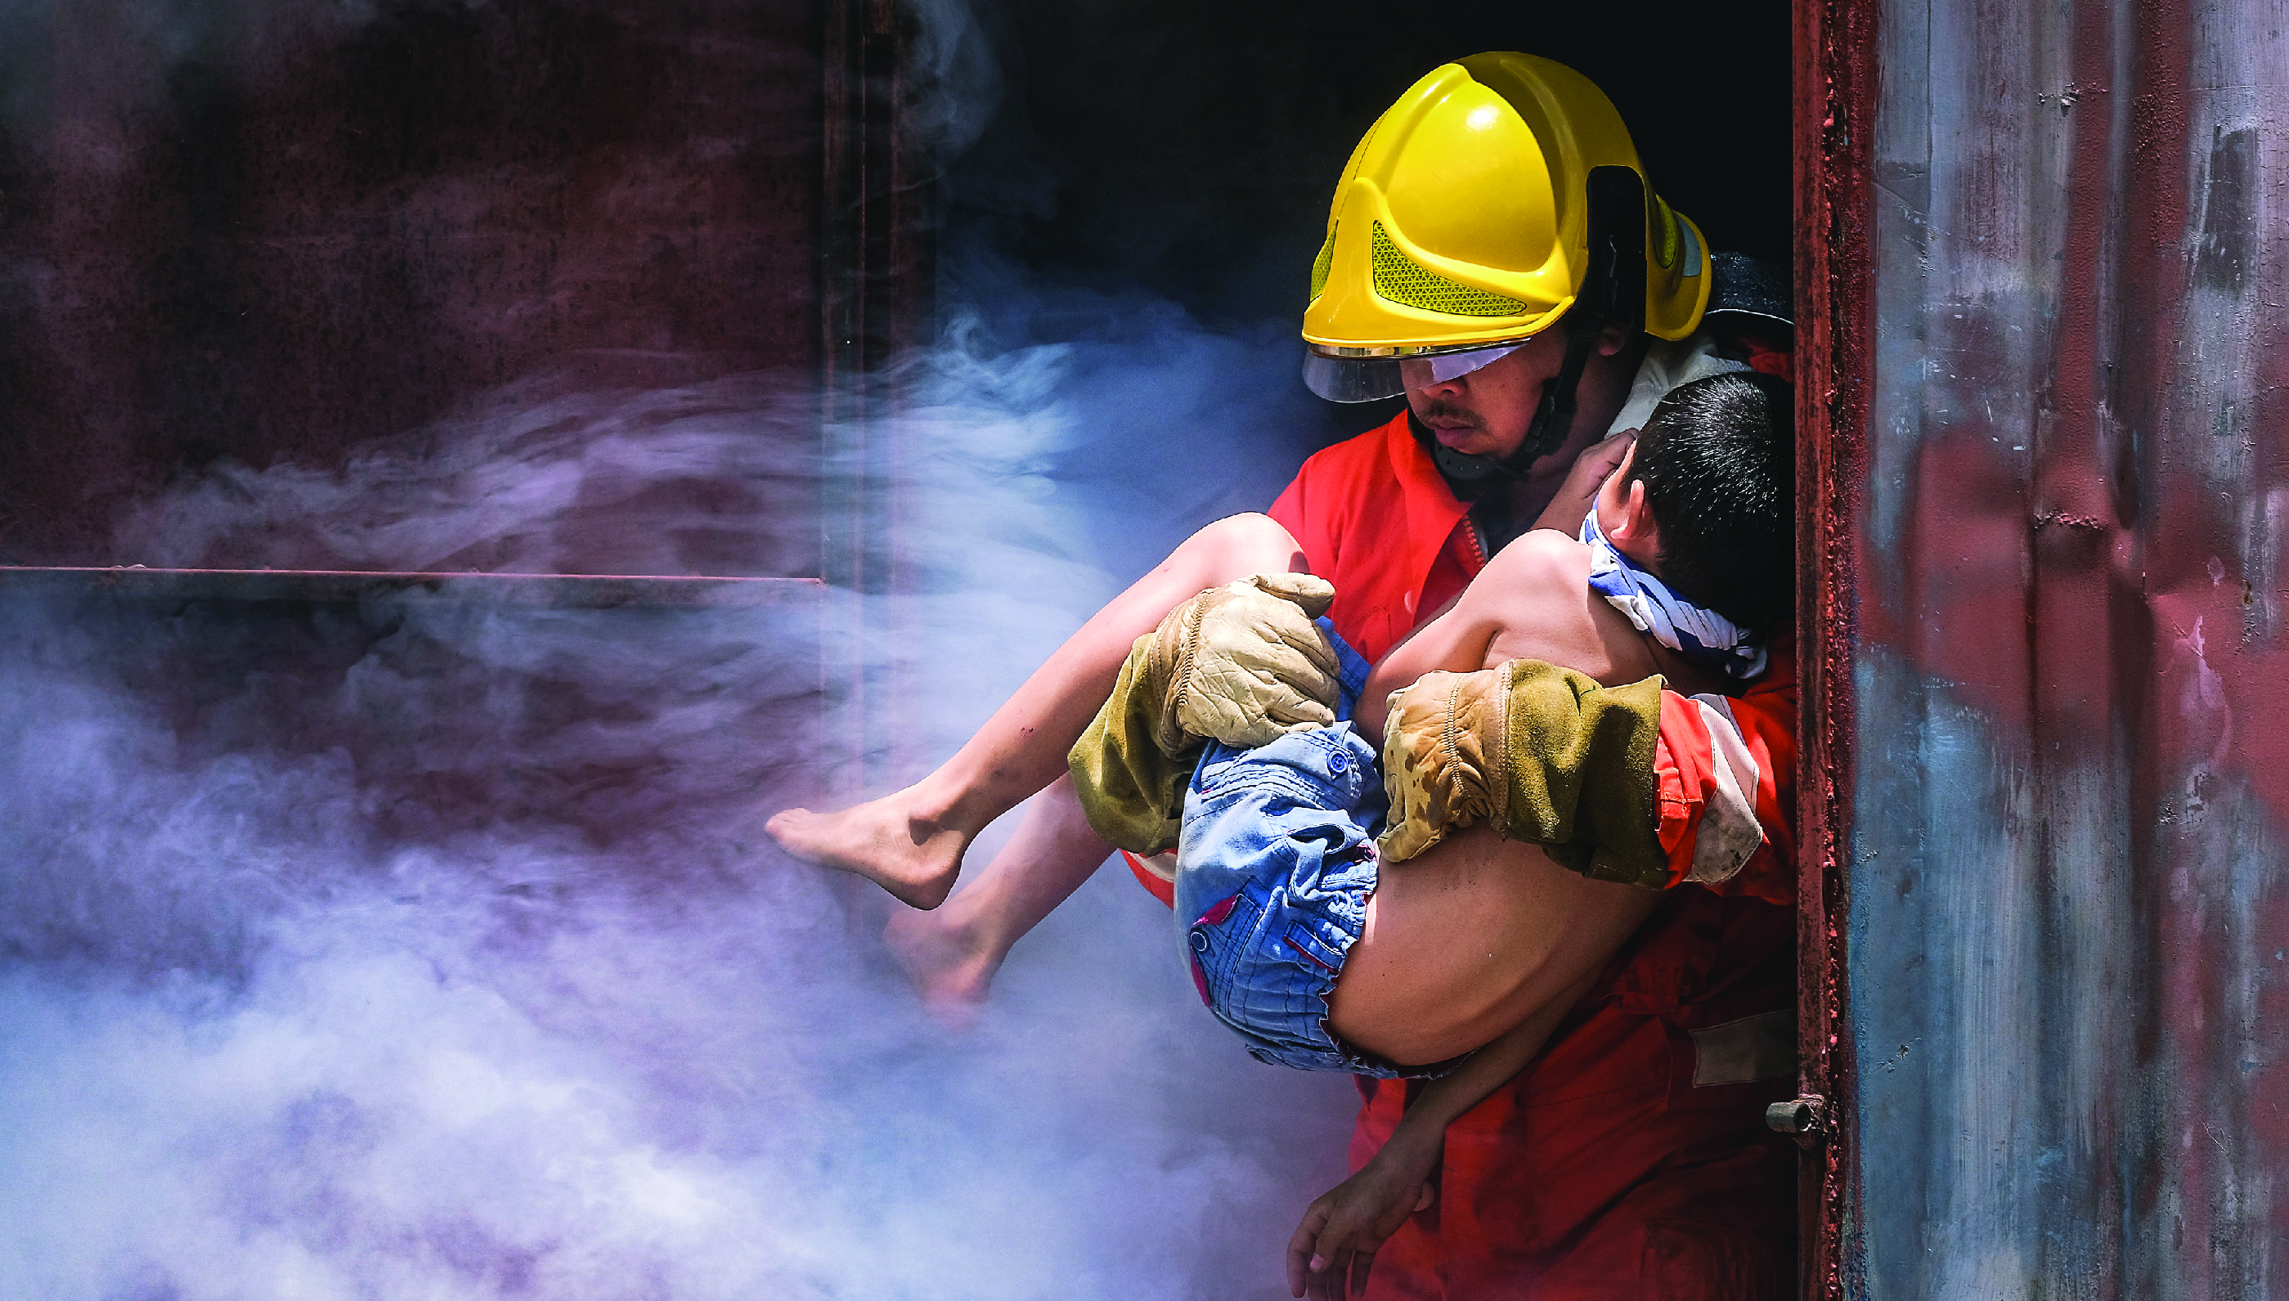
LESSON 11
Pre-hospital Treatment
Photo Credit: PEER South Asia/ADPC
PEER | CSSR | INDIA
PPT 11 -
PPT 11 - 1

Slide 32
OBJECTIVES
Upon completing this lesson, you will be able to:
1
Identify the possible mechanisms of injury in a structural collapse.
List the potential injuries that could be expected in a structural collapse.
2
PEER | CSSR | INDIA
PPT 11 -

Slide 33
OBJECTIVES
Upon completing this lesson, you will be able to:
3
Describe the conditions in a patient that might indicate the presence of crush syndrome or compartment syndrome.
PEER | CSSR | INDIA
PPT 11 -

Slide 34


LESSON 13
Final PRACTICAL EXERCISE
Photo Credit: Freepik
PEER | CSSR | INDIA

Slide 35
Purpose
To demonstrate the knowledge, techniques and skills learnt in the CSSR course.

Slide 36
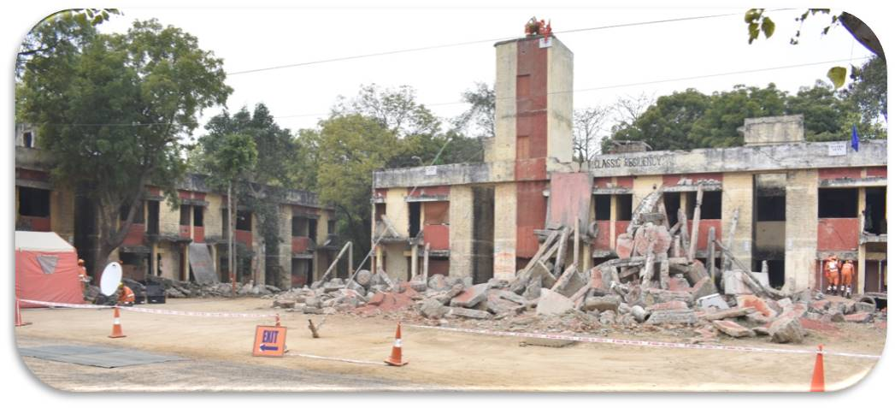
Scenario (Simulated Collapsed Structure)

Slide 37
Information
Simulated collapsed structure
Simulated victims
As scenario will develop

Slide 38
Phases
Preparation (1815 hrs onward)
Activation and mobilisation (As per information)
Operation

Slide 39
Expectation (Group A & B)
List of required TEA & Logistics
Proper Loading & mobilisation on time
Assessment of scene
Establishment of base of operation
Proper safety briefing
Correct search technique & location of victim
INSARAG Marking (Work site & Victim)
Gain Assess to victim (Removing rubble, Shoring, cutting & penetration)
Stabilisation
Extrication
Proper documentation

Slide 40
Additional Expectation (Group A & B)
Proper rotation & hydration
Change of group leader
Safety of all

Slide 41

THANK YOU

