Slide 1


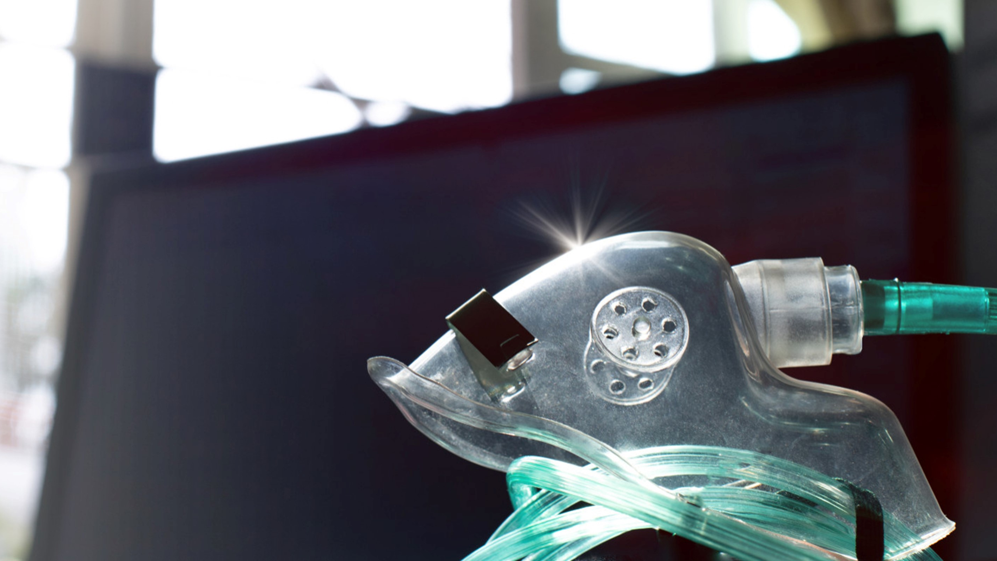

MEDICAL FIRST RESPONDER
Respiratory Emergencies
Presented by:- Kamlesh Dhoundiyal, 2IC
NDRF | MFR | INDIA
PPT 16 - 1

Slide 2
OBJECTIVES
Upon completing this lesson, you will be able to:
1
  Define respiratory distress.
  List four causes of respiratory distress.
  List seven signs and symptoms of respiratory distress.
2
3

Slide 3
OBJECTIVES
Upon completing this lesson, you will be able to:
4
  List five steps for pre-hospital treatment of respiratory distress.
  List eight signs and symptoms of toxic product inhalation.
  List five steps for pre-hospital treatment of toxic product inhalation.
5
6

Slide 4
Respiratory Distress
Shortness of breath or a feeling of air hunger with labored breathing.

Slide 5
Respiratory Distress
Pre-hospital Treatment
Move the patient away from the contaminated area
Assess patient’s breathing to determine if adequate
Position the responsive patient in a comfortable position
PPT 16 -

Slide 6
Respiratory Distress
Pre-hospital Treatment (Cont.)
Administer oxygen per local protocol.
Comfort and reassure the patient by providing emotional support.
Transport the patient as soon as possible.
PPT 16 -

Slide 7
Anaphylactic Shock
A life-threatening reaction of the body caused by something to which the patient is extremely allergic.

Slide 8
Causes of Anaphylactic Shock
Insect bites, including wasp and bee stings
Foods and spices (especially shellfish)
Inhaled substances, including dust and pollen

Slide 9
Causes of Anaphylactic Shock
Cont.
Chemicals inhaled or in contact with the skin
Medications injected or taken by mouth, including penicillin

Slide 10
Hyper-
ventilation
Pre-hospital Treatment
Calm and reassure the patient
Administer oxygen per local protocol
Use caution if using the paper bag method
PPT 16 -

Slide 11
Toxic Product Inhalation
Signs and symptoms
Irritation and inflammation of air passages, eyes and nose
Altered frequency and depth of breathing
Possible cardio-respiratory arrest

Slide 12
Toxic Product Inhalation
Signs and symptoms
Cont.
Singed nasal hairs
Dusty grey spittle
Wheezing and noisy breathing
Coughing
Hoarseness

Slide 13
Toxic Product Inhalation
Pre-hospital Treatment
Remove the patient from the contaminated area.
Conduct initial assessment and apply basic life support as necessary.
PPT 16 -

Slide 14
Toxic Product Inhalation
Pre-hospital Treatment (Cont.)
If the patient is breathing and does not have any signs of neck or spinal trauma, place the patient in a comfortable seated position.
Administer oxygen per local protocol.
Treat for shock.
PPT 16 -

Slide 15


THANK YOU

