Slide 1



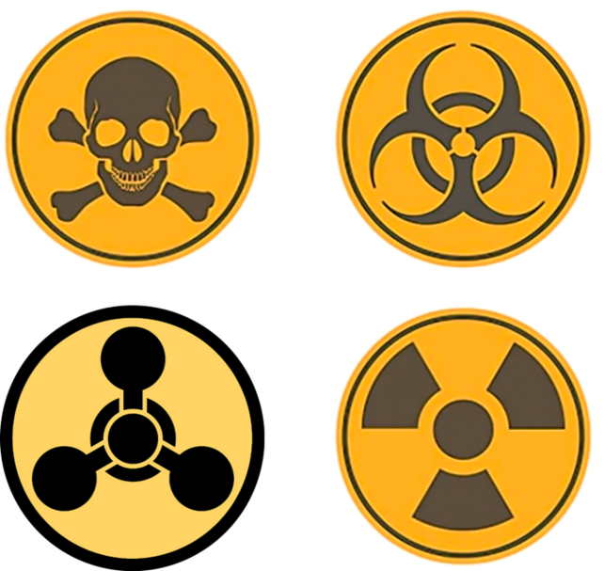
CBRN Module: CAPF
CASE STUDY OF FUKUSHIMA
Presented by:- Pavan Dev Gaur, 2IC

Slide 2
OBJECTIVES
Upon completing this lesson, you will be able to:
1
Where is Fukushima Daiichi Nuclear power plant.
Information about Fukushima nuclear power plant.
Reason of the accident.
Daily event of the accident.
2
3
4

Slide 3
OBJECTIVES
5
Effects on alive.
Effects on social life.
Effects on environment.
Conclusion
6
7
8

Slide 4
WHERE IS FUKUSHIMA DAIICHI NUCLEAR POWER PLANT
Japan Have 05 major I-Land.
1. Hokkaido
2. Honshu
3. Shikoku
4. Kyushu
5. Okinawa
In Above 05 I-land Fukushima Nuclear Power Plant Located in Honshu I-Land
PPT 2 -

Slide 5
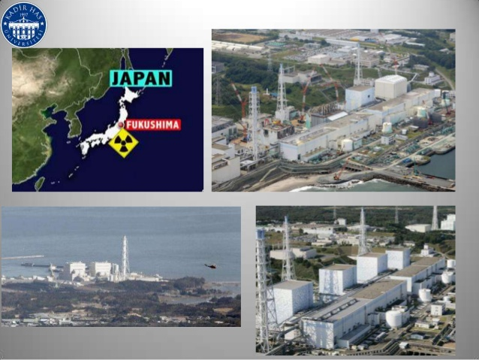
PPT 2 -

Slide 6
Fukushima nuclear power plant start constructed in | 25th of July 1967
Fukushima nuclear power plant commission date | 26th of march 1971
Total Number of Plant | 06
At the time of accident number of reactor in working Condition | Reactor no 1-3
Condition of remaining Reactor 4-6 | Shutdown due to maintenance
Type of Reactor | BWR
De-commission Date | 11th March 2011
Operated by | Tokyo electric power company
INFORMATION ABOUT FUKUSHIMA NUCLEAR POWER PLANT
PPT 2 -

Slide 7
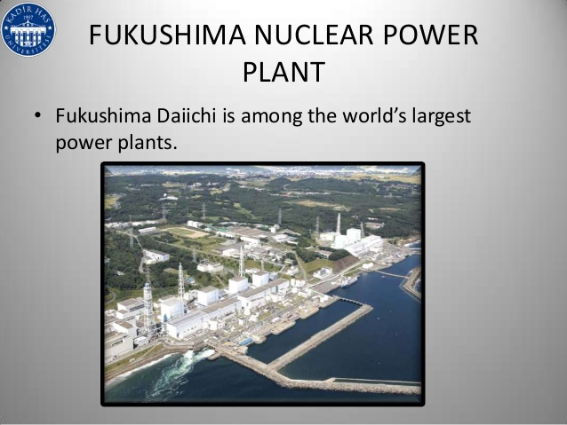
PPT 2 -

Slide 8
On March 11, 2011, a massive 9.0 magnitude Earthquake and powerful tsunami slammed the north-eastern region of Japan.
Huge seismic activities knocked out the power at the Fukushima Nuclear Power Plant,
Due to Tsunami about 15 mtr high tidal waves appear near Fukshima Nuclear plant and all power supply and cooling system with backup generators of active reactor are failed.
REASON OF THE ACCIDENT
PPT 2 -

Slide 9
This triggered a series of hydrogen explosions and released dangerously high levels of radioactive particles into the atmosphere.
The Japanese government declared a nuclear emergency.
The worst nuclear crisis in Japanese history, and decided to evacuate 430,000 residents within twenty kilometres of the plant to various relocation centres. These natural events caused extensive damage to coastal communities.
REASON OF THE ACCIDENT
PPT 2 -

Slide 10
REASON OF THE ACCIDENT
Due to this Nuclear disaster about 5178 deaths and 8913 missing persons (National Police Agency of Japan , 2014).
PPT 2 -

Slide 11
Accident cause
11/03/2011, 2:46 p.m. local time near the Japanese island of Honshu was an Earthquake and Tsunami (TOHOKU )of 9.0 on the Richter scale.
The quake had an impact on section of north-east coast of Japan where they are located a series of nuclear power plants (NPP).
PPT 2 -

Slide 12
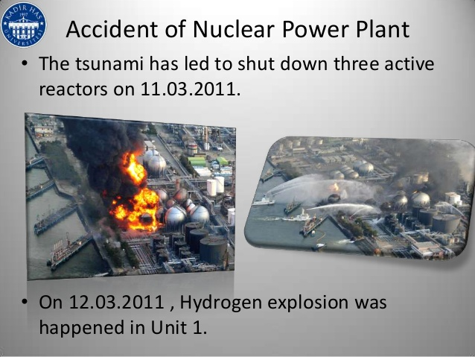
Units 4-6 in shut down status for periodic maintenance and refueling
Units 1-3 were stopped automatically after the quake
Reactor buildings and the containment successfully resist to the earthquake
All reactor were disconnected from the external AC supply
Backup sources (diesel generators) started
EVENT DISCRIPTION 11.03.2011
PPT 2 -

Slide 13
At approximately one hour after the earthquake tsunami hit the site
destroyed fuel tanks of the diesel generators
flooded the diesel generator building
(10m protection wall was not sufficient)
Mobile generators were sent to the site in a short time but they ran out of fuel
Hydrogen Explosion Unit 1
Evacuation of population from the area of 20km Daiichi NPP and 10km Daina NPP (approx. 200 000 person
On-site radioactivity increased
EVENT DISCRIPTION 11.03.2011
PPT 2 -

Slide 14
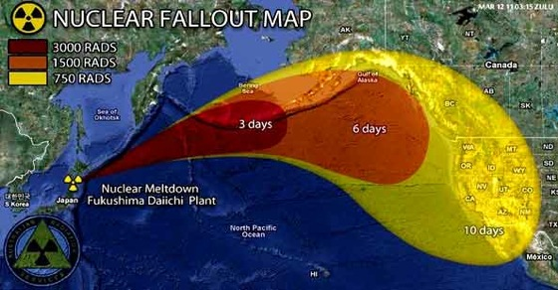
PPT 2 -

Slide 15
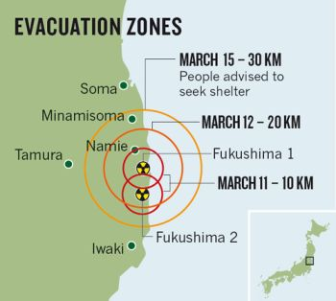
PPT 2 -

Slide 16
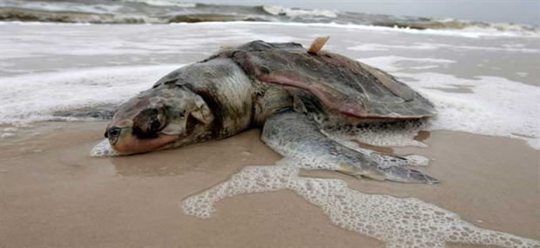

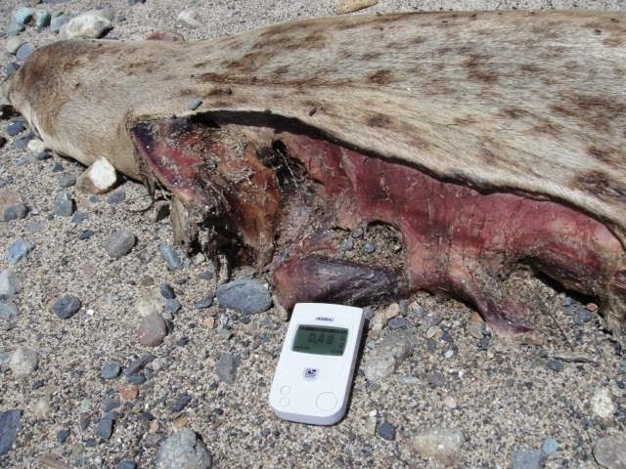
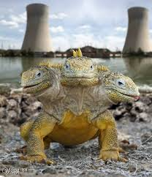
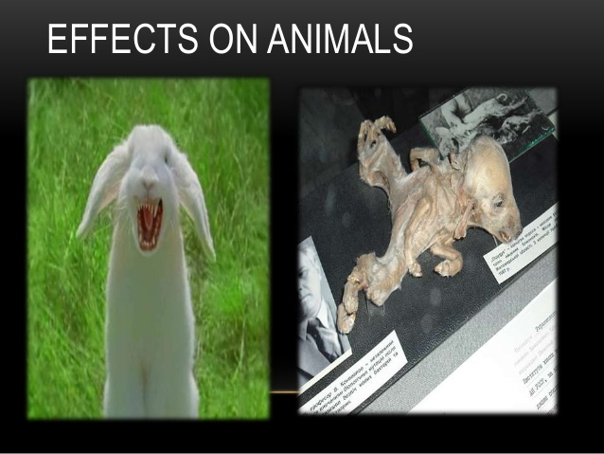
Effect on Marine life and Animals
PPT 2 -

Slide 17
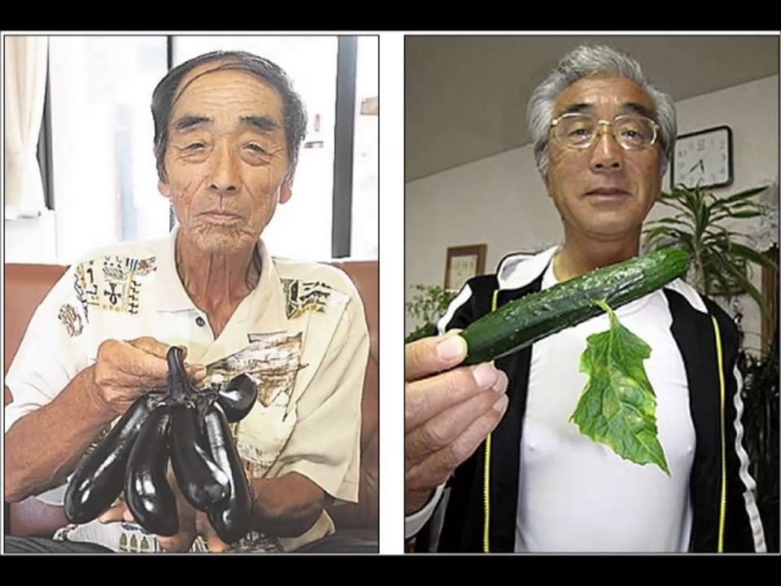

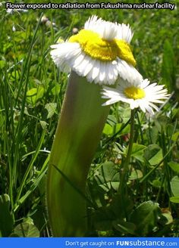

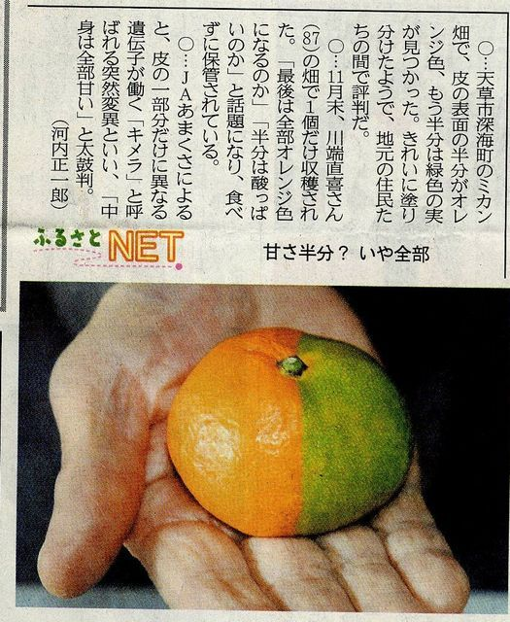
Effect on plants
PPT 2 -

Slide 18
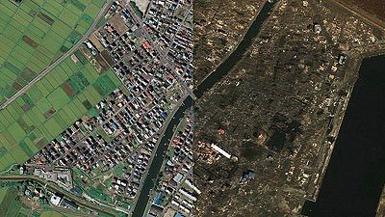
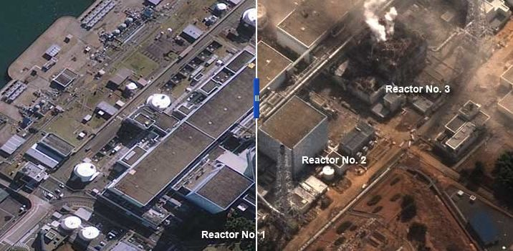
BEFORE and AFTER
PPT 2 -

Slide 19
Review
Where is Fukushima Daiichi Nuclear power plant.
Information about Fukushima nuclear power plant.
Reason of the accident.
Daily event of the accident.
Effects on alive.
Effects on social life.
Effects on environment.
PPT 2 -

Slide 20
ANY QUESTION ?
PPT 2 -

Slide 21


THANK YOU

