Slide 1




MEDICAL FIRST RESPONDER
LESSON 13
Burns and Environmental Emergencies
Presented by:- Pavan Dev Gaur, 2IC
CAPF | MFR | INDIA
-

Slide 2
OBJECTIVES
Upon completing this lesson, you will be able to:
1
  Match the signs and symptoms for each of the three types of burns according to their depth.
  Apply the “Rule of Nines” to determine the Total Body Surface Area (TBSA) burnt on a patient when given a specific part of the body.
2

Slide 3
OBJECTIVES
Upon completing this lesson, you will be able to:
3
  List three steps for pre-hospital treatment of chemical burns.
  List three steps for pre-hospital treatment of electrical burns.
  List three signs and symptoms of heat cramps, heat exhaustion and heat stroke and describe pre-hospital treatment for each.
4
5

Slide 4
OBJECTIVES
Upon completing this lesson, you will be able to:
6
  List four signs and symptoms of lightening injuries and describe pre-hospital treatment
  List three signs and symptoms of both mild and severe hypothermia and list six steps for pre-hospital treatment.
  List three signs and symptoms of frostbite and three steps for pre-hospital treatment.
7
8

Slide 5
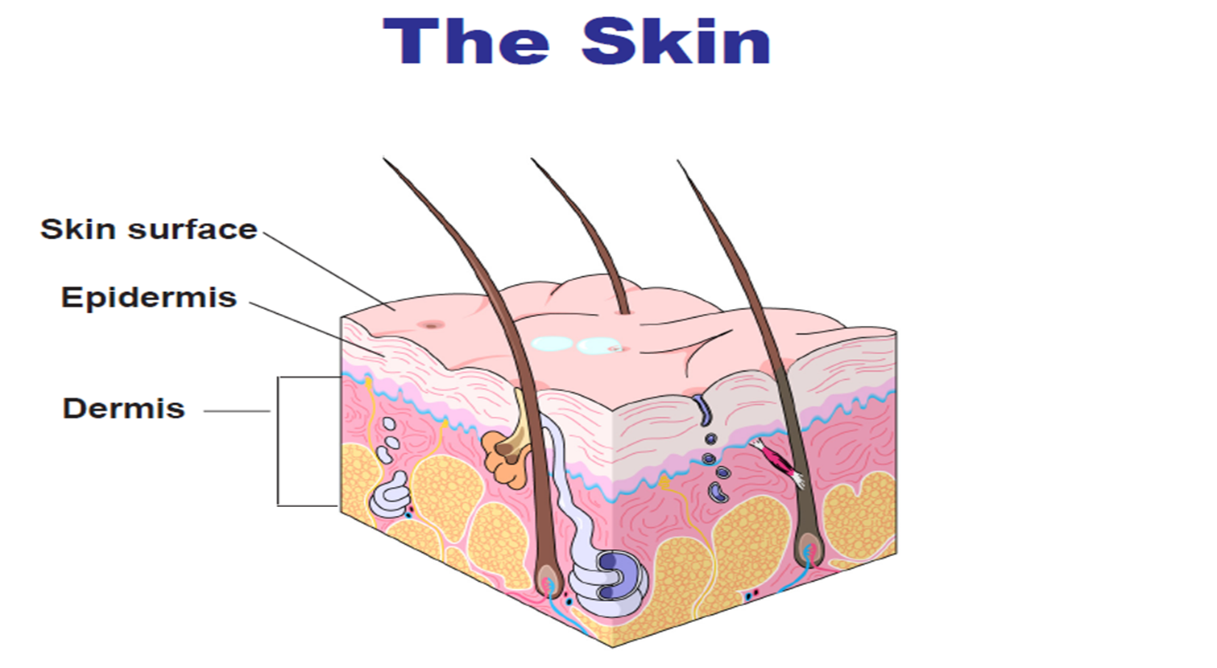
Burns
Injuries caused by exposure to excessive heat from thermal, chemical, electrical or radiation.
PPT 13 -

Slide 6
CAUSES OF BURNS
1) Thermal: heat (fire, vapour and hot objects) and cold (freezing and frozen objects).
2) Chemical: includes several caustics such as acids and alkalis.
3) Electrical: electricity i.e. house current, lightning.
4) Radiation: ultraviolet rays (including sunlight) and radioactive agents.
PPT 13 -

Slide 7
Burn Classifications
(By depth)
Superficial - I degree
Partial thickness - II degree
Full thickness - III degree
PPT 13 -

Slide 8
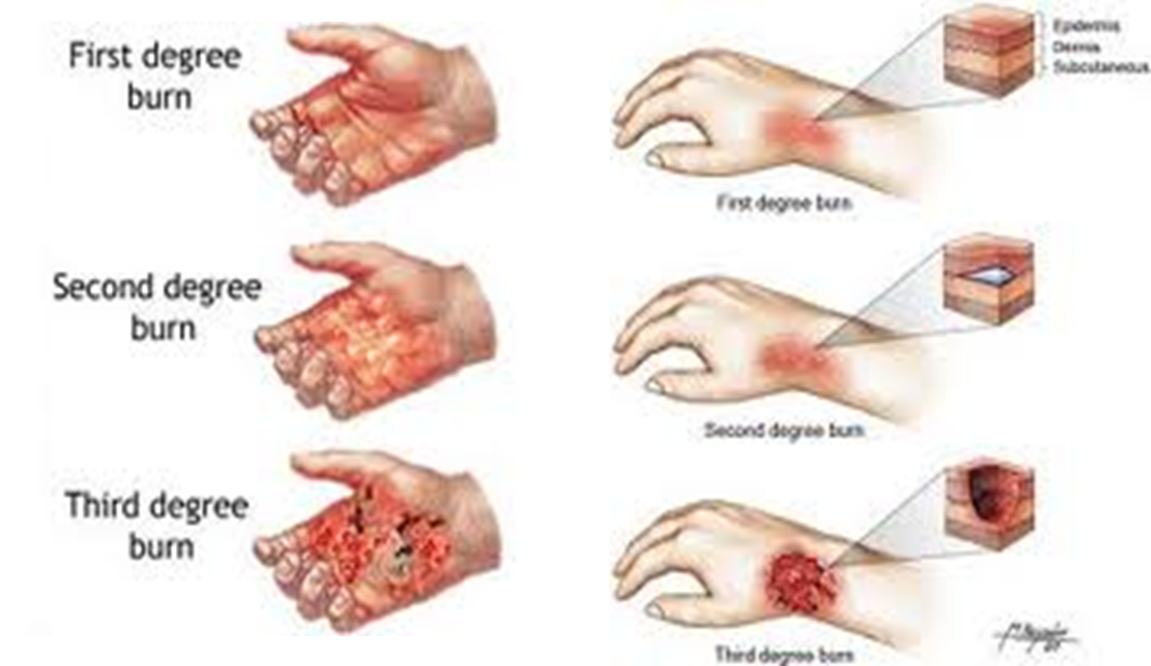
BURN CLASSIFICATION

Slide 9
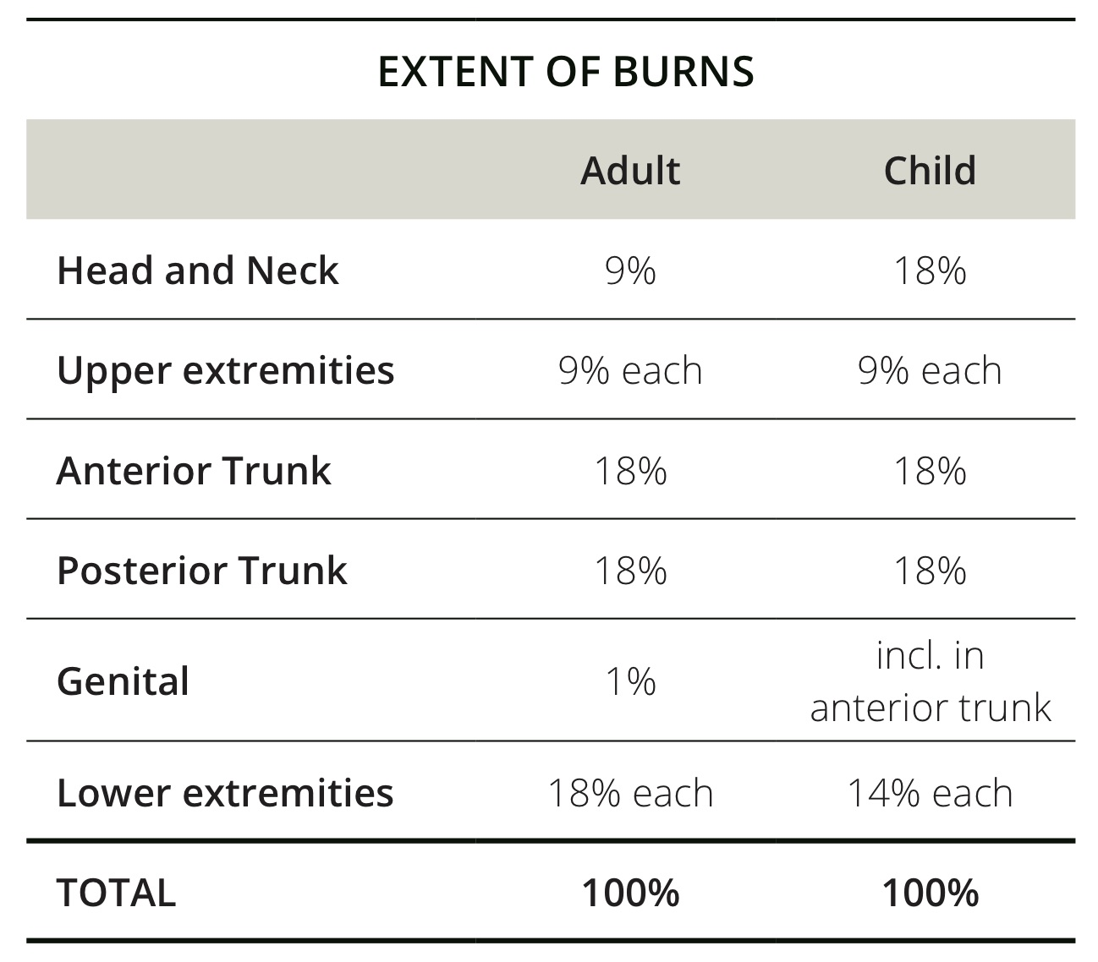
Rule of Nines
(% Body
Surface Area)

Slide 10
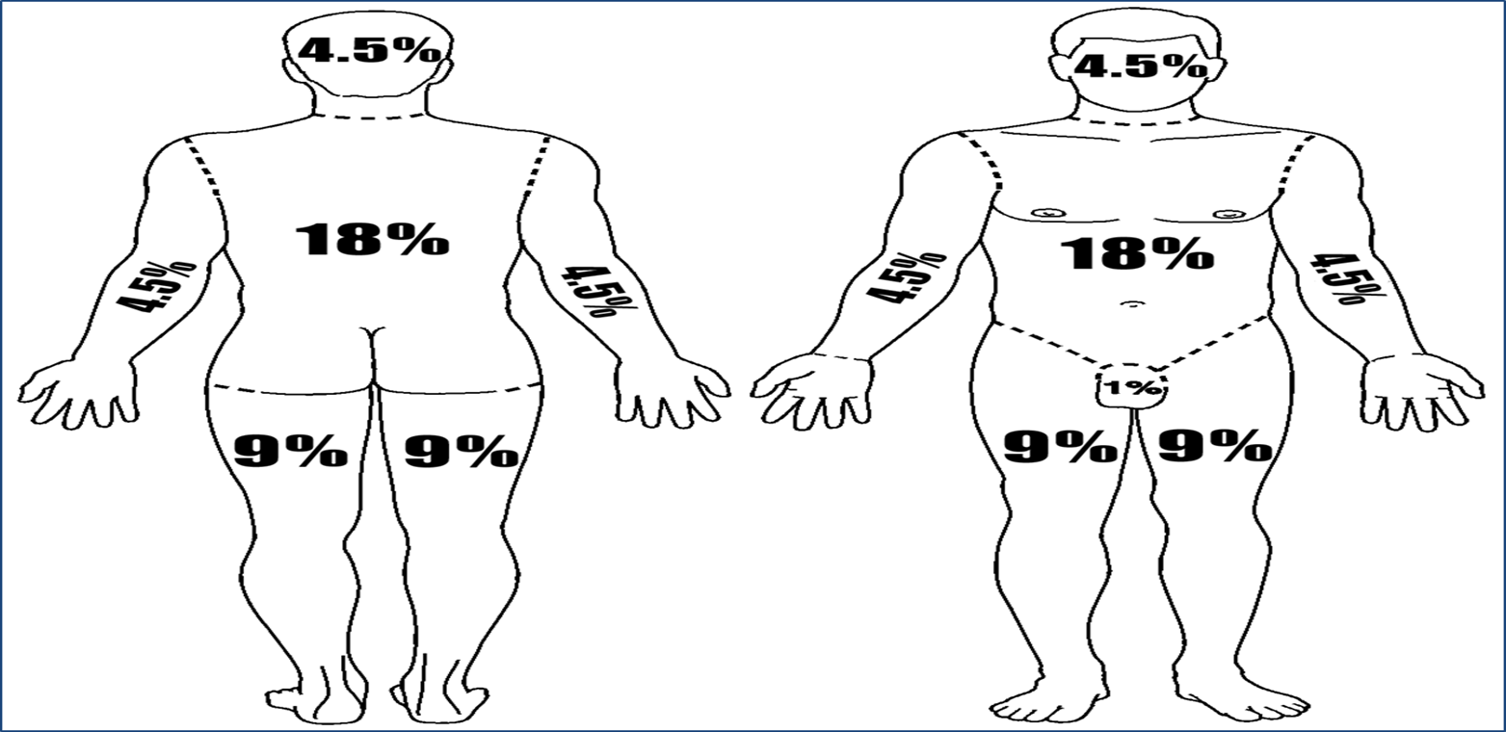
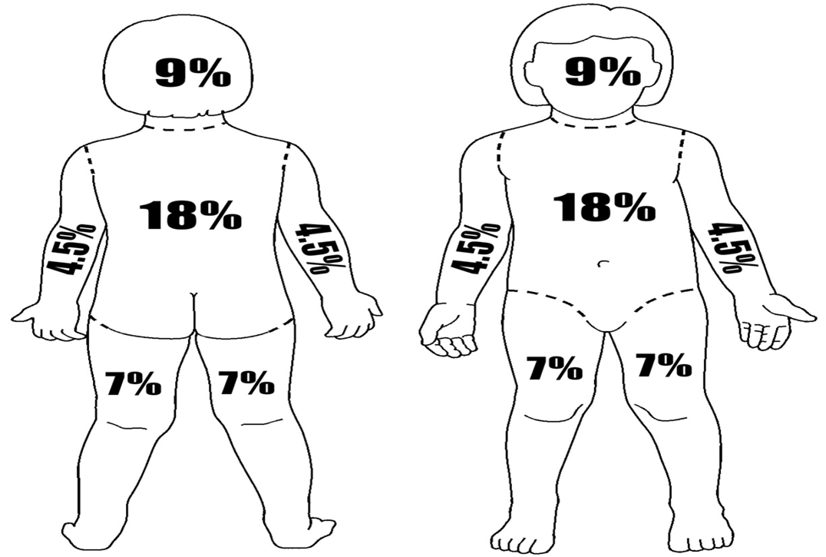
Rule of Nines
(% Body
Surface Area)

Slide 11
MINOR BURNS
Full-thickness burns of less than 2% BSA, excluding face, hands, feet, genitalia, or respiratory tract
Partial thickness burns of less than 15% BSA.
Superficial burns of 50% BSA or less.
MODERATE BURNS
Full-thickness burns of 2% to 10% BSA, excluding face, hands, feet, genitalia, or respiratory tract
Partial thickness burns of 15% to 30% BSA.
Superficial burns over 50% BSA
BURN SEVERITY

Slide 12
CRITICAL BURNS
• All burns complicated by injuries of the respiratory tract, other soft-tissue injuries, and injuries of the bones.
• Partial- or full-thickness burns involving the face, hands, feet, genitalia, or respiratory tract.
• Full-thickness burns of more than 10% BSA.
• Partial-thickness burns of more than 30% BSA.
• Burns complicated by musculoskeletal injuries.
• Circumferential burns
BURN SEVERITY

Slide 13
ADDITIONAL CONSIDERATIONS
Source of the burn :
Electrical – can cause small surface injury while causing severe internal damage
Chemical – chemicals may remain on the skin and continue burning for extended period and / or enter the blood stream

Slide 14
Use universal precautions, secure the scene and alert EMS
Stop the burning process. Run cold water over the scald burns. Flush away chemicals with water for 20 minutes or more.
Remove any smoldering clothing and jewelry.
If you meet any resistance or if you see pieces melted into the skin, cut around the area.
Do not try to remove them
Perform initial assessment
PRE HOSPITAL TREATMENT FOR BURNS

Slide 15
Most victims die from blocked airway, inhaled toxins or other trauma rather than from the burn itself.
Treat life threatening injuries
Administer oxygen per local protocol. If your patient's breathing is inadequate, provide ventilation with supplemental oxygen
Determine the severity of burns, using the rule of nines
PRE HOSPITAL TREATMENT FOR BURNS

Slide 16
Cover the burns. Use dry sterile dressings or a disposable sterile burn sheet.
Do not use grease or fat, ointment, lotion, antiseptic, or ice on the burns
Do not break any blisters. If a burn involves the eye, be sure to cover both eyes.
Fingers with second or third degree burns require dressing each finger individually
Keep the patient warm and treat for shock .
PRE HOSPITAL TREATMENT FOR BURNS

Slide 17
Use universal precautions, secure the scene and alert EMS
Brush off dry chemicals, such as lime powder, before flushing with water
Rinse the area with water for at least 20 minutes or more
Remove and set aside clothes and jewelry while the patient is being washed off.
Apply a sterile dressing to the affected area
Treat for shock
CAUTION :If patient is contaminated , wash off the person from a distance to avoid exposing yourself to the chemicals
PRE HOSPITAL TREATMENT FOR BURNS

Slide 18
PRE HOSPITAL TREATMENT FOR BURNS
Rinse the eyes immediately with water for at least 20 minutes.
Maintain a flow of water on the affected eye from a faucet (low pressure), bottle, glass or other source.
Keep the patient’s eyelid(s) open.

Slide 19
The more serious problems related to electric burns are respiratory and / or cardiac arrest, damage to the nervous system and injury to internal organs.
Use universal precaution, secure the scene
Alert EMS
Follow local protocols
“prolonged CPR should be performed on electrical injury victims as they can remain viable for a longer period than with other types of injuries”.
ELECTRIC BURN

Slide 20
ELECTRIC BURN
Perform initial assessment.
Evaluate burn and look for at least two burn area.
Apply a dry , sterile dressing to the burns.
Treat for shock.

Slide 21
Inhalation Injury
Signs and Symptoms
Singed nasal hair
Burns to the face
Specks of soot in the sputum
Sooty or smoky smell on the breath
Respiratory distress

Slide 22
Inhalation Injury
Cont.
Signs and Symptoms
Hoarseness, cough, or difficulty speaking
Restricted chest movement
Cyanosis

Slide 23
Heat
Cramps
Signs and Symptoms
Severe muscle cramps
Exhaustion
Nausea
Periods of fainting

Slide 24
PHT FOR HEAT CRAMPS
Move the patient to a cool area.
Give the patient water(salt water). The muscle cramp should be alleviated after drinking water.
“The patient needs the water more than the salt do not delay giving water to look for salt. Commercial electrolytes or oral rehydrate on solution (ors) can also be used”

Slide 25
Heat Exhaustion
Signs and Symptoms
Rapid, shallow breathing
Weak pulse
Cold, clammy and pale skin
Weakness
Dizziness

Slide 26
PHT FOR HEAT EXHAUSTION
Move the patient to a cool place to rest.
Remove or loosen clothing as necessary to cool the patient without causing chills.
Place the patient in a supine position with legs elevated 20 to 30 cm.
Administer oxygen per local protocol
Give water, but not to an unconscious patient.

Slide 27
Heat
Stroke
Signs and Symptoms
Deep, rapid breathing
Rapid pulse fluctuating in strength
Dry, hot skin
Dilated pupils
Loss of consciousness
Convulsions or muscular tremors

Slide 28
Cool the patient quickly in any way possible . Move the patient away from the source of heat . Remove his / her garments and wrap the patient with wet sheets
Place cold bags or ice packs below each armpit, behind the knees and around the ankles and one on each side of the neck
Look for a large container or bathtub and submerge the patient in cold water up to the neck
PHT FOR HEAT STROKE

Slide 29
Lightening Injuries
Signs and Symptoms
Loss of conscience
Loss of circulation
Loss of respiration
Disorientation
Superficial burns

Slide 30
Mild Hypothermia
Signs and Symptoms
Chills
Drowsiness
Rapid breathing, slow pulse
Loss of vision
Sluggish pupils
Uncontrollable shivering

Slide 31
Severe Hypothermia
Signs and Symptoms
Extremely slow breathing
Extremely slow pulse
Unresponsiveness
Fixed, dilated pupils
Rigid extremities

Slide 32
Conduct initial assessment and physical exam.
Remove the patient from the cold environment.
Maintain open airway and administer oxygen per local protocol.
Remove any wet clothing and cover patient with a blanket. Keep the patient dry.
If the patient is alert, offer warm liquids (non-stimulant) slowly.
Constantly assess vital signs
PHT FOR HYPOTHERMIA

Slide 33
Review
Now you are able to:
1
  Match the signs and symptoms for each of the three types of burns according to their depth.
  Apply the “Rule of Nines” to determine the Total Body Surface Area (TBSA) burnt on a patient when given a specific part of the body.
2

Slide 34
Review
Now you are able to:
3
  List three steps for pre-hospital treatment of chemical burns.
  List three steps for pre-hospital treatment of electrical burns.
  List three signs and symptoms of heat cramps, heat exhaustion and heat stroke and describe pre-hospital treatment for each.
4
5

Slide 35
Review
Now you are able to:
6
  List four signs and symptoms of lightening injuries and describe pre-hospital treatment
  List three signs and symptoms of both mild and severe hypothermia and list six steps for pre-hospital treatment.
  List three signs and symptoms of frostbite and three steps for pre-hospital treatment.
7
8

Slide 36



THANK YOU

