Slide 1


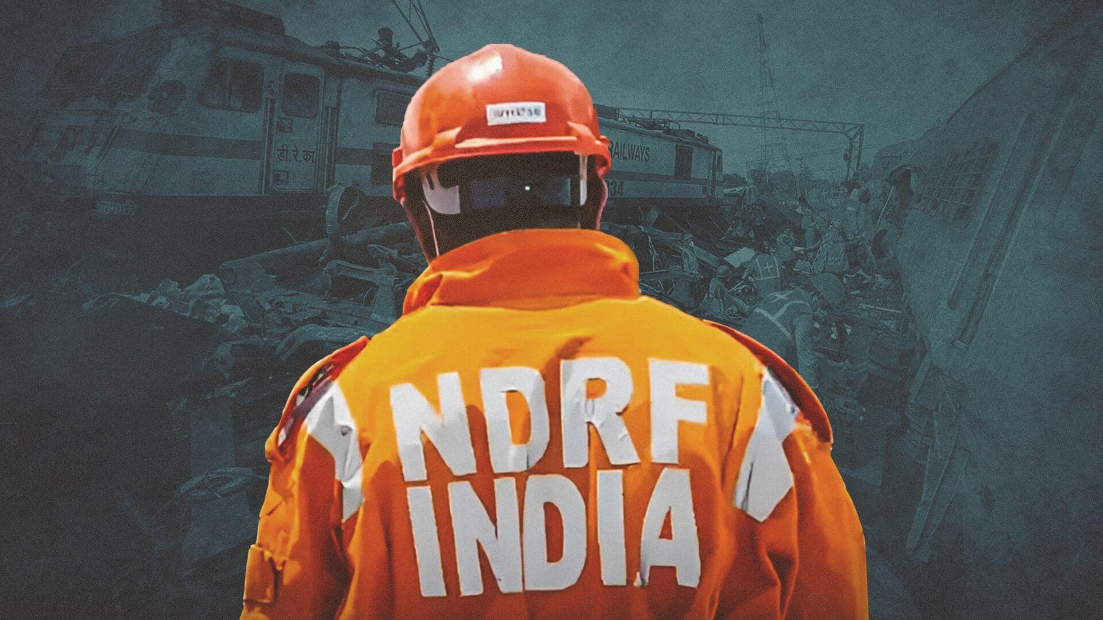

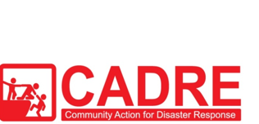
CADRE
FINAL PRACTICAL EXERCISE
TSUNAMI
Presented By:- Pavan Dev Gaur,2IC

Slide 2



OBJECTIVES
Understand the operational sequence of a community responder, secure the wellbeing of your family if possible, and decide whether you can join the community response team
Gather information and formulate a plan of action to search and locate possible trapped victims
Conduct C-QRST, evacuate and transport victims safely in the event of an emergency or a disaster.
1
Upon completion of this lesson, you will be able to :-
2
3

Slide 3


11:00pm
Without warning, a series of large sea waves hits your town at around 11pm. Your family and neighbors are awakened, and you can hear water rushing through the ground level of your house and through the streets, bringing down trees and small wooden houses.
Vehicles and debris are swept away by the fast current caused by a giant wave reaching a height of more than 10 feet…
WHAT IS YOUR FIRST REACTION?
SCENARIO

Slide 4
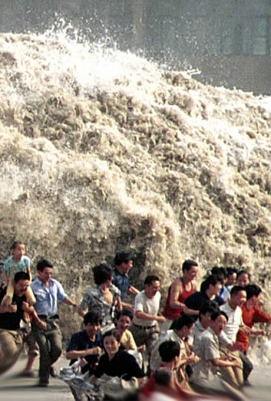
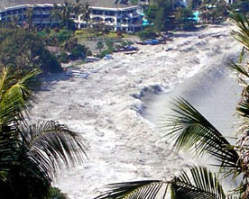
SCENARIO

Slide 5
12:00pm
Looking outside your window, you see several bodies floating, and most of the vehicles are either submerged or floating. People on the roofs are crying out for help. It’s clear that it will take a long time for the water to recede.
INJECT

Slide 6
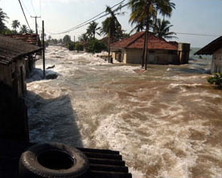
SCENARIO

Slide 7


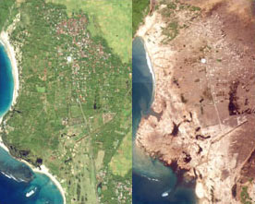
GENERAL SCENARIO
An earthquake struck in central Negros in the Tulos Sea creating a Tsunami with sea waves reaching a height of about 20-30 meters. Struck the nearby towns across a 100-kilometer coastline.
At about 0600H, water finally receded. Injuring and drowning a number of people and leaving several neighbors missing.

Slide 8
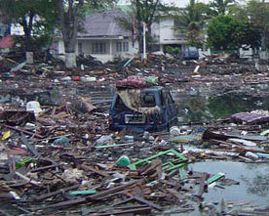
SCENARIO

Slide 9
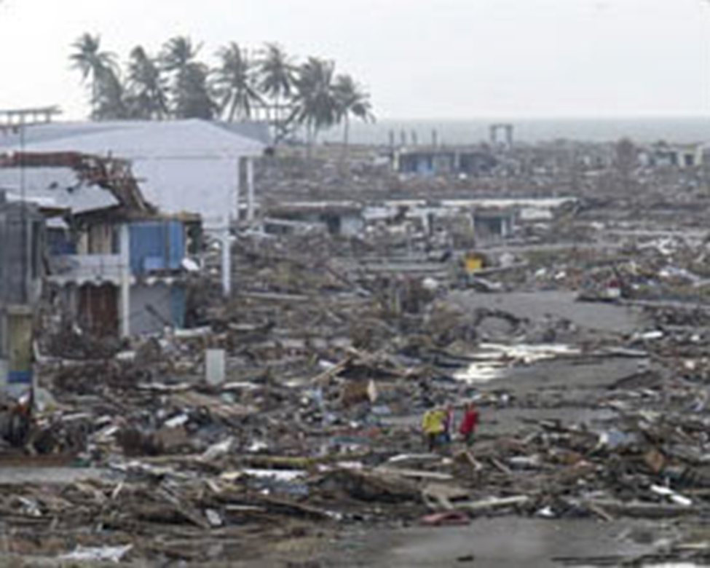
SCENARIO

Slide 10
What will you do to prepare your family in this situation?
What shall you do to help your neighbors?
QUESTIONS

Slide 11
As a Community Responder, you decide to report to your Community Action Disaster Center (CADC).
On arrival you discover that some houses in your community are destroyed and there are a number of people who need help.
QUESTIONS

Slide 12
PREPARE FOR RESPONSE!

Slide 13
REVIEW
Understand the operational sequence of a community responder, secure the wellbeing of your family if possible, and decide whether you can join the community response team
Gather information and formulate a plan of action to search and locate possible trapped victims
Conduct C-QRST, evacuate and transport victims safely in the event of an emergency or a disaster.
1
Now you will be able to :-
2
3

Slide 14



THANK YOU

