Slide 1


FIRE FIGHTING
Presented By:- Kamlesh Dhoundiyal,2IC

Slide 2
OBJECTIVE
Upon completion of this lesson, you will be able to:
What is fire and Type
Fire fighting technique
Types of Combustion, Mode of spread of fire and Stages & Phases of burning
Type of Fire Extinguisher in details
Fire Extinguishing Safety Techniques And procedure
Advantages and disadvantages
IV. Operation, care & maintenance, standard test,
V.Demonstrator of method of recharging

Slide 3
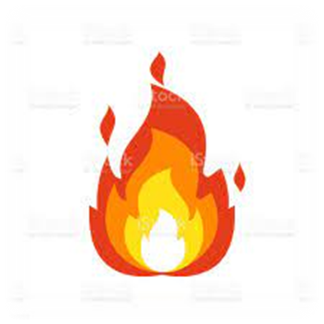
FIRE
A process in which substances combine chemically with oxygen from the air and typically give out bright light, heat and smoke.
Fuel+O2 CO2 + CO

Slide 4
FIRE AND ITS ELEMENTS: FIRE TRIANGLE
“Three things must be present at the same time to produce fire”
Enough OXYGEN to sustain combustion.
Enough HEAT to reach ignition temperature.
Some FUEL or combustible material.
Together, they produce a CHEMICAL REACTION that results in what we term a “FIRE”.

Slide 5
FIRE TETRAHEDRON
For combustion to occur, four components are necessary
Heat (Source)
Fuel
Air (Oxygen
Self Sustaining Chemical Chain Reaction

Slide 6
Class A :
Fire involving solid combustible materials of organic nature such wood, paper, rubber, plastic, cloth which requires cooling effect.
Class B :
Fire involving inflammable liquids or liquefiable solids such as petrol, kerosene, acids, solvent etc.
CLASSIFICATION OF FIRE

Slide 7

Class C :
Fire involving inflammable gases under pressure including liquefied gases such as methane, hydrogen, acetylene, LPG etc.
Class D :
Fire involving combustible metals, such as magnesium, zinc, sodium, aluminum, potassium, radioactive material etc. When the burning metals are reactive to water.
CLASSIFICATION OF FIRE

Slide 8
FIRE EXTINGUISHING TECHNIQUE:
Extinguishing fire involve the elimination or removal of one or more of the four elements
COOLING:
Removal of heat from the burning material/fire area.

Slide 9
2. SMOOTHERING:
Cutting the supply of oxygen from the f ire area.
3. STARVATION:
Removal of un-burnt material or fuel.
4. BREAKING OF CHAIN REACTION:
Interrupt the chain reaction between fuel, heat and oxygen.

Slide 10
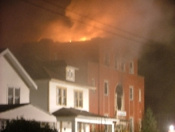
TYPES OF COMBUSTION :
Slow or incipient combustion- in which the amount of heat & light emitted is feeble.
Rapid or active combustion- in which a considerable amount of heat & light is emitted within a short time

Slide 11
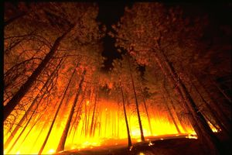
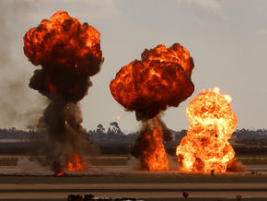
TYPES OF COMBUSTION
Deflagration –
which takes place with a considerable rapidity, evolving heat & light.
Explosion -
a very rapid combustion with a loud noise within an extremely short time with generation of very high pressure & temperature.

Slide 12
RATE OF COMBUSTION
It is the rate of burning of any substance and measured in length over time like millimeters per sec.
A rate of combustion or the spread of fire would depends on :
The area of solid/liquid in contact with air.
The amount of heat generated to raise the temperature of un-burnt portion.

Slide 13
RATE OF COMBUSTION
The ability of materials to conduct heat away.
Atmospheric humidity.
Wind velocity.
Temperature.
Atmospheric pressure.

Slide 14
Conduction:
The process by which heat is directly transmitted through the material of a substance when there is a difference of temp bet adjoining regions.
It occurs only in solids i.e. metallic objects.
MODES OF SPREAD OF FIRE

Slide 15
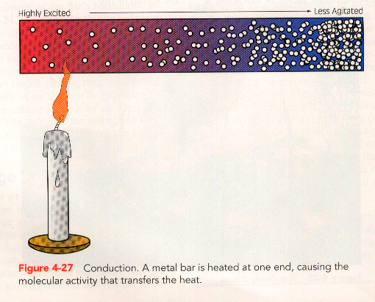
CONDUCTION
Heat energy is passed on
from one molecule to the
next
The molecule vibrates
above its mean position
Pass on heat energy by
colliding with their
neighbors
The ability to conduct
heat varies between
materials.
Highly Excited
Less Agitated

Slide 16
Convection:
Transfer of heat by the movement of a fluid (liquid) or gas bet areas of different temp.
It occurs both in liquids & gases
MODES OF SPREAD OF FIRE

Slide 17
MODES OF SPREAD OF FIRE
Radiation :
It is neither conduction nor convection. These are heated rays emanating from the hot object.
It travels at the speed of light.

Slide 18
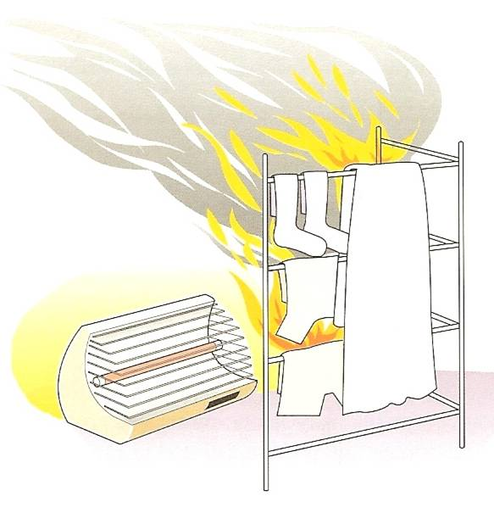
RADIATION
It does not involved
any contact between
bodies
It is independent of
any material in the
intervening space
These are the heated
rays, travels in
straight line in all
directions with same
intensity

Slide 19
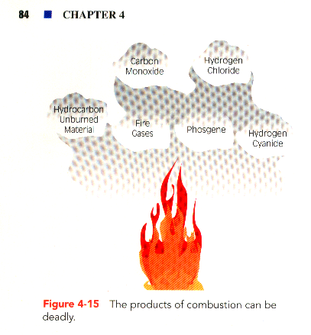
Incipient or beginning phase
Free burning phase
Smoldering phase
THREE PROGRESSIVES STAGES OF BURNING

Slide 20
PHASES OF BURNING
It depends on the following factors
The amount of time the fire has burnt.
The ventilation characteristics of the confining structure
The amount and type of combustibles present.

Slide 21
INCIPIENT OR BEGINNING PHASE
Oxygen plentiful
Temperature has not built
up to high peak
Thermal updraft rises,
accumulates at highest point
Breathing not difficult
Fire extinguishments :
Direct application of water at base of fire.

Slide 22
FREE BURNING PHASE
Fire has involved more fuel
Oxygen supply is being
depleted
Heat accumulated at upper
areas
Breathing difficult : Masks
recommended
Fire extinguishments is
reaching the area of major
involvement
Good steam production

Slide 23
SMOLDERING PHASE
Oxygen supply not equal to demands of fire
Temperature throughout
building is very high
Normal breathing is not
possible
Maximum steam
production from water fog

Slide 24
SUITABILITY OF FIRE EXTINGUISHING MEDIA
Class A :
Water
Dry Chemical
Class B:
Mechanical Foam
Dry Chemical
Carbon Di-oxide

Slide 25
SUITABILITY OF FIRE EXTINGUISHING MEDIA
Class C:
Carbon Dioxide
Dry Chemical
Class D :
Special Dry Powder

Slide 26
TYPES OF PORTABLE FIRE EXTINGUISHERS
Water
Gas cartridge
Stored pressure
Mechanical Foam
Gas cartridge
Stored pressure

Slide 27
TYPES OF PORTABLE FIRE EXTINGUISHERS…
Dry Chemical
Gas cartridge
Stored pressure
Carbon Dioxide/Clean Agent
Stored pressure

Slide 28
CHARACTERISTICS OF FIRE EXTINGUISHER:
In order that fire extinguishers are effective, they should:
be portable/light weight,
operate instantly,
have adequate throw,
have adequate quantity of extinguishant, and
have long shelf-life.

Slide 29
SELECTION OF FIRE EXTINGUISHER: (AS PER BIS)
The basic types of fires can be grouped into following four classes:
Class A Fires: Fires involving solid combustible materials of organic nature such as wood, paper, rubber, plastics, etc,
Class B Fires: Fires involving flammable liquids or liquefiable solids or the like where a blanketing effect is essential.
Class C Fires: Fires involving flammable gases under pressure including liquefied gases.
Class D Fires: Fires involving combustible metals, such as magnesium, aluminum, zinc, sodium, potassium, etc,

Slide 30
Material on Fire | Indian standard | UK/ Europe | US | Australia
Solid combustible materials of organic nature | Class A | Class A | Class A | Class A
Flammable liquids | Class B | Class B | Class B | Class B
Flammable gases under pressure | Class C | Class C | Class B | ClassB
Combustible metals | Class D | Class D | Class D | ClassD
Cooking media (Kitchen Fire) | Class F | Class F | Class K | Class F
Energised electrical conductors/ equipment | No class | No class | Class C | Class E
FIRE EXTINGUISHER

Slide 31
NUMBER AND SIZE OF FIRE EXTINGUISHERS
Considerations:
Severity of incipient fire anticipated
Rapidity of fire spread
Intensity of heat
Accessibility to fire
Type of extinguishers
The smoke contributed by burning materials
Special features of building construction
Nature of occupancy (single or mixed)
Electrical fitting, equipment installed

Slide 32
WATER
Effective on class A fires
Advantage of being inexpensive, harmless, and relatively easy to clean up
has high heat capacity (4.2 J/g•K) and high latent heat of vaporization (2442 J/g) can absorb a significant quantity of heat from flames and fuels (cooling)
Water also expands 1700 times when it evaporates to steam, results in the dilution of the surrounding oxygen and fuel vapours

Slide 33
FOAM
Applied to fuel fires as either an aspirated (mixed & expanded with air in a branch pipe) or;
Non-aspirated form to form a frothy blanket or seal over the fuel,
Preventing oxygen reaching it (smothering)
Foam can be used to progressively extinguish fires without flashback.

Slide 34
WATER/FOAM (GAS CARTRIDGE) EXTINGUISHER
Water for Class A fires and AFFF for Class A and B fires.
Spray nozzle
Polyester powder coating
Controlled discharge
Brass nickel plated head valve with simple squeeze operation
Rechargeable and easy maintenance
Capacity 9 litre, cylindrical shape
Upright operation
Rubber braided hose

Slide 35
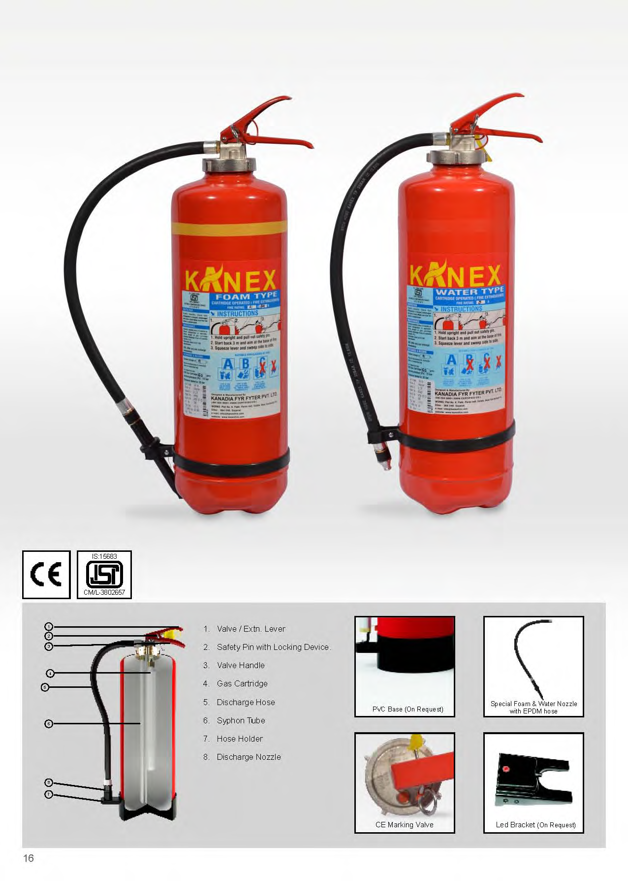
WATER/FOAM (GAS CARTRIDGE) FIRE EXTINGUISHER
Valve/extn. lever
Safety pin with locking device
Valve handle
Gas cartridge
Discharge hose
Siphon tube
Hose holder
Discharge nozzle/foam branch pipe

Slide 36
WATER/FOAM (GAS CARTRIDGE) FIRE EXTINGUISHER
Data | Water | Foam
Capacity | 9 litre | 9 litre
Average discharge time | 42 seconds | 40 seconds
Jet Length | 6 meters | 6 meters
Working pressure | 14 Bars | 14 Bars
Empty weight | 6.20 Kgs. | 6.20 Kgs.
Filled weight | 15.20 Kgs. | 15.20 Kgs.
Test pressure | 35 Bars | 35 Bars

Slide 37
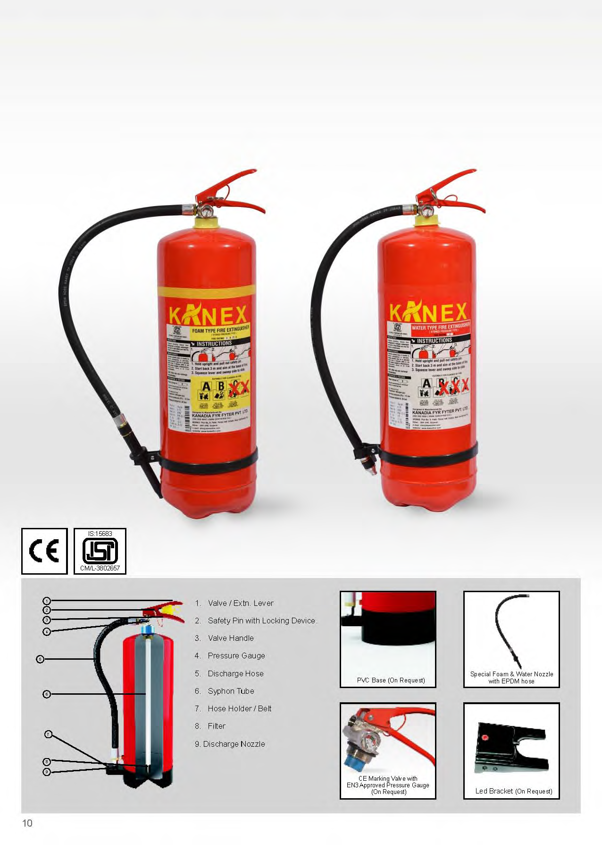
WATER/FOAM (STORED PRESSURE) FIRE EXTINGUISHER
Valve/extn. lever
Safety pin with locking device
Valve handle
Pressure gauge
Discharge hose
Siphon tube
Hose holder/belt
Filter
Discharge nozzle/foam branch pipe

Slide 38
WATER/FOAM (STORED PRESSURE) FIRE EXTINGUISHER
Data | Water | Foam
Capacity | 9 litre | 9 litre
Average discharge time | 42 seconds | 40 seconds
Jet Length | 6 meters | 6 meters
Working pressure | 14 Bars | 14 Bars
Empty weight | 4.18 Kgs. | 4.18 Kgs.
Filled weight | 13.18 Kgs. | 13.18 Kgs.
Test pressure | 35 Bars | 35 Bars

Slide 39
DRY CHEMICAL POWDER
This is a powder based agent that extinguishes by separating the four parts of the fire Tetrahedron.
It prevents the chemical reactions involving heat, fuel, and oxygen and halts the production of fire sustaining "free-radicals", thus extinguishing the fire.
There are different types of Dry chemical and dry powder

Slide 40
DRY CHEMICAL POWDER
Mono-ammonium phosphate
Sodium Bicarbonate
Potassium Bicarbonate
Potassium Bicarbonate & Urea (Monnex/Powerex)
Met-l-kyl/Pyrokil

Slide 41
DRY CHEMICAL POWDER
a. Mono-ammonium phosphate, also known as "tri-class", "multipurpose" or "ABC" dry chemical
used on class A, B, and C fires.
more corrosive than other dry chemical agents.
Pale yellow in color

Slide 42
DRY CHEMICAL POWDER
b. Sodium Bicarbonate, "regular" or "ordinary" used on class B and C fires
in the heat of a fire, it releases a cloud of carbon dioxide that smothers the fire.
white or blue in color

Slide 43
DRY CHEMICAL POWDER
c. Potassium Bicarbonate
(Purple-K), used on class B and C fires
about two times as effective on class B fires as sodium bicarbonate
preferred dry chemical agent of the oil and gas industry.
colored violet to distinguish it.

Slide 44
DRY CHEMICAL POWDER
d. Potassium Bicarbonate & Urea
(Monnex/Powerex)
used on class B and C fires.
more effective than all other powders due to its ability , in the flame zone creating a larger surface area for free radical inhibition.
grey in color.

Slide 45
DRY CHEMICAL POWDER
e. MET-L-KYL/PYROKIL: is a specialty variation of sodium bicarbonate
used for fighting pyrophoric liquid fires (ignite on contact with air).
it also contains silica gel particles.
the sodium bicarbonate interrupts the chain reaction of the fuel and the silica soaks up any unburned fuel, preventing contact with air.
it is effective on other class B fuels as well.
blue/red in color.

Slide 46
DRY POWDER FOR METAL FIRES
Sodium Chloride (Super-D, Met-L-X) contains sodium chloride salt, which melts to form an oxygen-excluding crust over the metal
useful on most alkali metals including sodium and potassium, and other metals including magnesium, titanium, aluminium, and zirconium.
Ternary Eutectic Chloride (TEC) contains chlorides of barium, sodium and potassium, which melts and forms fused skin over burning metal and absorbs heat and cut-off oxygen to fire.

Slide 47
DRY POWDER FOR METAL FIRES
C. Graphite-based-
contains dry graphite that smothers burning metals
Developed, designed for magnesium, works on other metals as well
Can be used on very hot burning metal fires such as lithium
Acts as a heat sink to dissipate heat as well as smothering the metal fire.

Slide 48
DRY POWDER FOR METAL FIRES
d. Sodium Carbonate-based (Na-X)
used where stainless steel piping and equipment could be damaged by sodium chloride based agents to control sodium, potassium, and sodium-potassium alloy fires.
limited use on other metals. Smothers and forms a crust.

Slide 49
DRY CHEMICAL (GAS CARTRIDGE) EXTINGUISHER
Polyester powder coating
Controlled discharge
Brass nickel plated head valve with simple squeeze operation
Rechargeable and easy maintenance
Capacity from 1 to 9 kg, cylindrical shape
Rubber braided hose
Upright operation

Slide 50
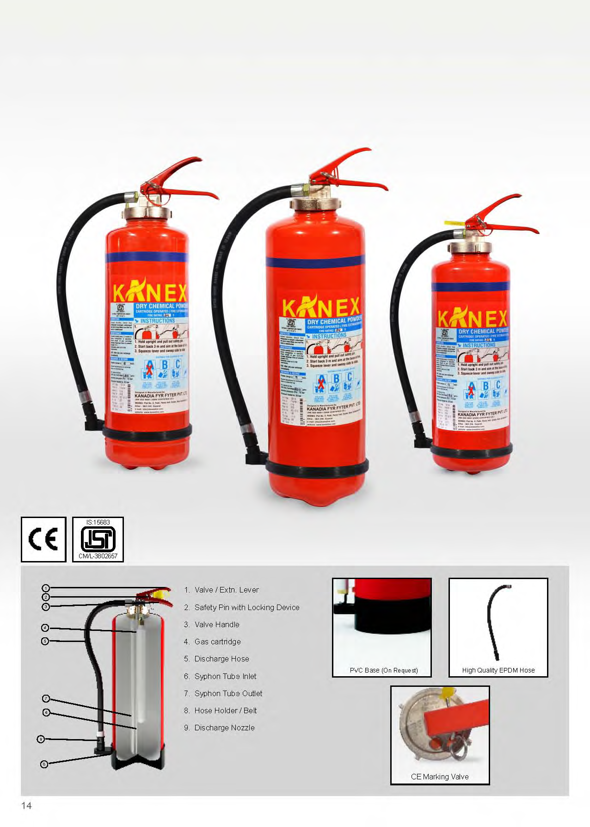
DRY CHEMICAL (GAS CARTRIDGE) EXTINGUISHER
Valve/extn. lever
Safety pin with locking device
Valve handle
Gas cartridge
Discharge hose
Siphon tube inlet
Siphon tube outlet
Hose holder/belt
Discharge nozzle

Slide 51
DRY CHEMICAL (GAS CARTRIDGE) EXTINGUISHER
SPECIFICATIONS
Dry Chemical (GC) Extinguisher Data
Capacity | 4 Kg | 6 kg | 9 Kg
Ave. discharge time | 18 sec | 21 sec | 23 sec
Jet Length | 2 meters | 4 metres | 6 meters
Working pressure | 15 Bars | 15 Bars | 15 Bars
Empty weight | 4.6 Kgs. | 4.8 | 6.20 Kgs.
Filled weight | 8.6 Kgs. | 10.8 | 15.20 Kgs.
Test pressure | 35 Bars | 35 Bars | 35 Bars

Slide 52
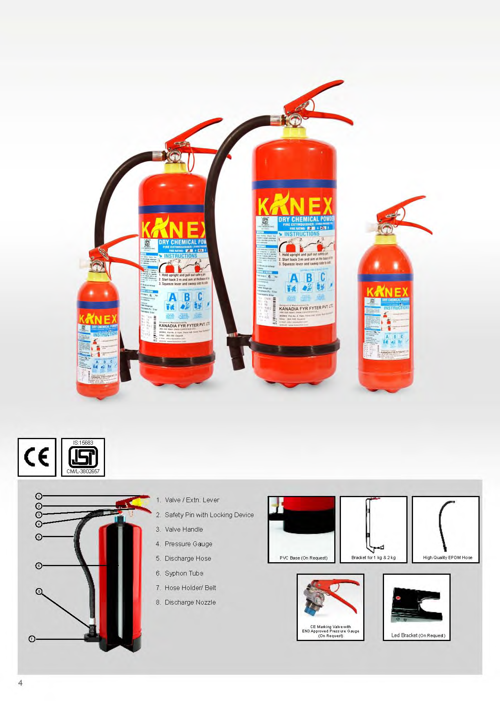
DRY CHEMICAL (STORED PRESSURE) EXTINGUISHER
Valve/extn. lever
Safety pin with locking device
Valve handle
Pressure gauge
Discharge hose
Siphon tube
Hose holder/belt
Discharge nozzle

Slide 53
DRY CHEMICAL (STORED PRESSURE) EXTINGUISHER
SPECIFICATIONS
Dry Chemical (SP) Extinguisher Data
Capacity | 1 Kg | 2 kg | 4 Kg | 6 kg | 9 Kg
Ave. discharge time | 9 s | 14 s | 18 s | 21 s | 23 s
Jet Length | 1 m | 1 m | 2 m | 4 m | 6 m
Working pressure | 15 Bars | 15 Bars | 15 Bars | 15 Bars | 15 Bars
Empty weight | 1.1 kg | 1.4 | 2.7 Kg. | 3 kg | 4.18 Kg.
Filled weight | 2.1 kg | 3.4 kg | 6.7 Kg. | 9 kg | 13.18 Kg.
Test pressure | 35 Bars | 35 Bars | 35 Bars | 35 Bars | 35 Bars

Slide 54
CARBON DIOXIDE FIRE EXTINGUISHER
CHARACTERISTICS:
it is a gas at standard temperature and pressure
carbon dioxide is colorless, non-toxic and odorless,
heavier than air, displaces oxygen (smothering)
non conductor of electricity,
non-residual gas - (clean agent) because they do not leave any residue after discharge

Slide 55
CARBON DIOXIDE FIRE EXTINGUISHER
CHARACTERISTICS:
This is ideal for sensitive electronics and documents.
This is not intended for class a fires, as the high-pressure cloud of gas can scatter burning materials.
CO₂ is not suitable for use on fires containing their own oxygen source, metals or cooking media
Although it can be rather successful on a person on fire

Slide 56
CARBON DIOXIDE FIRE EXTINGUISHER
Made of Manganese steel
Controlled discharge
Brass nickel plated head valve with simple squeeze operation
Rechargeable and easy maintenance
Capacity from 2 to 4.5 kg, cylindrical shape
Upright operation
Swivel horn with no cold burns

Slide 57
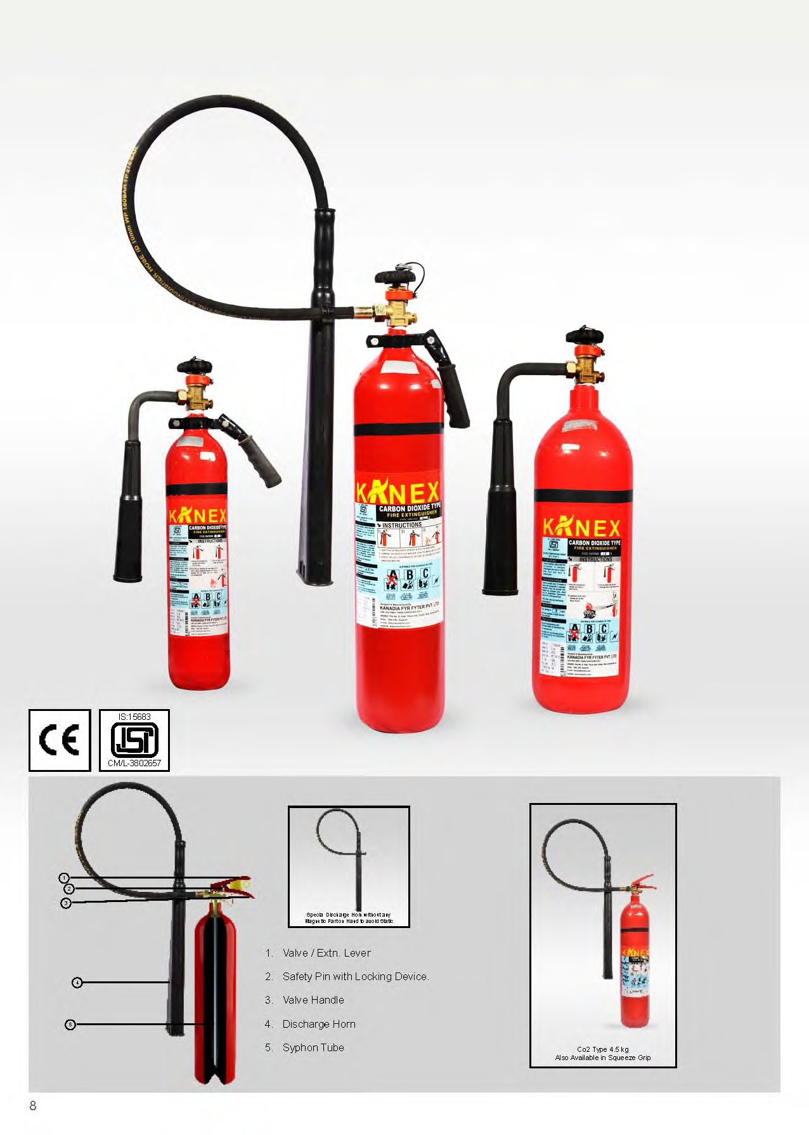
CARBON DIOXIDE FIRE EXTINGUISHER
Valve/extn. lever
Safety pin with locking device
Valve handle
Discharge hose and horn
Siphon tube

Slide 58
CARBON DIOXIDE FIRE EXTINGUISHER
SPECIFICATIONS
Carbon Dioxide Fire Extinguisher Data
Capacity | 2 kg | 3 Kg | 4.5 kg
Ave. discharge time | 9.5 s | 10.5 s | 12 s
Jet Length | 1 m | 2 m | 3 m
Working pressure | 60-70 Bars | 60-70 Bars | 60-70 Bars
Empty weight | 6.5 kg | 8.7 kg | 12.1 kg
Filled weight | 8.5 kg | 11.7 kg | 16.6 kg
Test pressure | 250 Bars | 250 Bars | 250 Bars

Slide 59
CLEAN AGENT FIRE EXTINGUISHERS
They are labelled clean agents because they do not leave any residue after discharge which is ideal for sensitive electronics and documents.
Removes heat from the combustion zone (Halotron, FE-36)
Inhibits chemical chain reaction (Halons)

Slide 60
CLEAN AGENT FIRE EXTINGUISHERS
SPECIFICATIONS
Clean Agent (SP) Extinguisher Data
Capacity | 1 Kg | 2 kg | 4 Kg | 6 kg
Ave. discharge time | 11 s | 12 s | 14 s | 22 s
Jet Length | 1 m | 1 m | 2 m | 4 m
Working pressure | 9 Bars | 9 Bars | 9 Bars | 9 Bars
Empty weight | 1.1 kg | 1.4 | 2.7 Kg. | 3 kg
Filled weight | 2.1 kg | 3.4 kg | 6.7 Kg. | 9 kg
Test pressure | 35 Bars | 35 Bars | 35 Bars | 35 Bars

Slide 61
WATER MIST + CAFS
CAFS—compressed Air Foam System
The term "water mist" refers to fine water sprays in which 99% of the volume of the spray is in drops with diameters less than 1000 microns
Is very efficient in controlling liquid and solid fuel fires, and suppressing hydrocarbon mist explosions, and Live Electrical Fire up to 1000 Volts
no toxic, asphyxiation and environmental problems;
low system cost; limited or no water damage
high efficiency in suppressing certain fires.

Slide 62
WATER MIST + CAFS…
Primary extinguishment mechanism
heat extraction
cooling of fire plume
wetting/cooling of the fuel surface
displacement
displacement of oxygen
dilution of fuel vapour

Slide 63
MODULAR EXTINGUISHER
Provides concentrated fire protection for vital equipment
Highly cost effective compared to fixed fire protection system
Portable unit
Automated and reliable security round the clock
Provides security in case of fire and power failure without power back-up
Rechargeable and easy to service

Slide 64
FIRE EXTINGUISHING BALL
Several modern ball or "grenade" style extinguishers are on the market.
They are manually operated by rolling or throwing into a fire.
The modern version of the ball will self-destruct once in contact with flame, dispersing a cloud of ABC dry chemical powder over the fire which extinguishes the flame.

Slide 65
FIRE EXTINGUISHING BALL…
The coverage area is about 5 square meters.
One benefit of this type is that it may be used for passive suppression. The ball can be placed in a fire prone area and will deploy automatically if a fire develops, being triggered by heat.
Most modern extinguishers of this type are designed to make a loud noise upon deployment

Slide 66
ADVANTAGES OF FIRE EXTINGUISHERS
Sl No | Advantages | Remarks
1. | Portable
2. | Easy to use
3 | They’re better for the environment
4. | Life-saving
5. | Quick response
6. | Versatile
7. | Cost-effective

Slide 67
DISADVANTAGES OF FIRE EXTINGUISHERS
Sl No | Advantages | Remarks
1. | Limited coverage
2. | Limited use
3 | Limited capacity
4. | Requires maintenance
5. | Limited protection

Slide 68
REFILLING SCHEDULE OF EXTINGUISHERS
Sl. No | Types of Extinguishers | Time
1 | Water (gas cartridge) type | 5 years
2 | Water (stored pressure) type | 2 years
3 | Foam (gas cartridge) type | 5 years
4 | Foam (stored pressure) type | 2 years
5 | Powder (gas cartridge) type | 3 years
6 | Powder (stored pressure) type | 3 years
7 | Carbon dioxide type | 5 years
8 | Clean agent type | 5 years

Slide 69
LIFE OF FIRE EXTINGUISHERS
Sl. No | Types of Extinguishers | Life time
1 | Water type | 10 years
2 | Foam type | 10 years
3 | Powder type | 10 years
4 | Carbon dioxide type | 15 years
5 | Clean agent type | 10 years

Slide 70
HYDRO PRESSURE TEST
Extinguisher | Hydraulic pressure test
Type | Years | Kg/cm² | Duration
Water | 3 | 35 | 2 min
Mechanical foam | 3 | 35 | 2 min
Dry chemical | 3 | 35 | 2 min
Carbon Dioxide | 5 | 250 | 2 min

Slide 71
REVIEW
After completion of this lesson, now you are able to:
What is fire and Type
Fire fighting technique
Types of Combustion, Mode of spread of fire and Stages & Phases of burning
Type of Fire Extinguisher in details
Fire Extinguishing Safety Techniques And procedure
Advantages and disadvantages
IV. Operation, care & maintenance, standard test,
V.Demonstrator of method of recharging

Slide 72



THANK YOU

