Slide 1


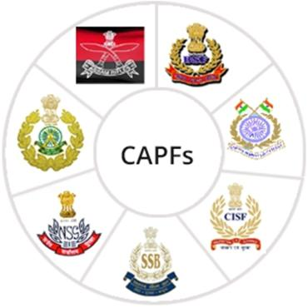
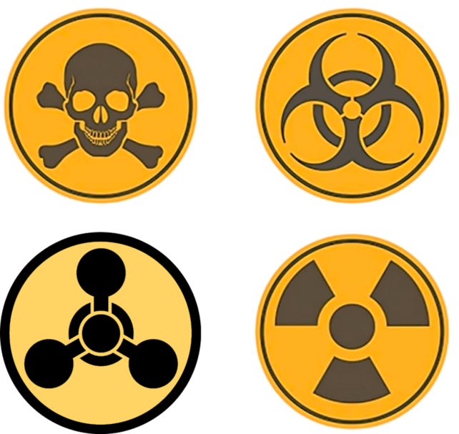
CBRN Module: CAPF
MAYAPURI RADIOLOGICAL
ACCIDENT
Presented by:- Pavan Dev Gaur, 2IC

Slide 2
OBJECTIVES
1
About Mayapuri, New Delhi
Introduction to Mayapuri Radiological accident
Chronology and victim
Phases of handling the accident
Green peace report
Factors of accident
Radiation safety recommendation
Upon completing this lesson, you will be able to:
2
3
4
5
6
7
8

Slide 3
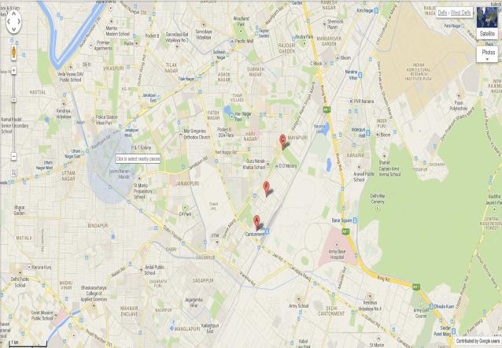
MAYAPURI INDUSTRIAL AREA, NEW DELHI
PPT 2 -

Slide 4
About Mayapuri, New Delhi
Mayapuri is a locality in West Delhi. It used to be a major hub of small scale industries, but following recent government sanctions, most of the heavy metal industries moved out. The place is now a combination of residential flats, metal scrap market, metal factories and automobile service stations.
PPT 2 -

Slide 5
A campus committee of chemists concluded that the Gammacell’s Cobalt-60 source was "manageable", and the unit was auctioned on 26 February 2010 to a scrap metal dealer.
April 2010, serious radiological accident at Mayapuri.
Orphan source in Scrapyard.
Unauthorized handling of the Radioactive source.
Eight persons directly exposed to the gamma-rays of the Co-60
One has died while two others are severely affected.
Consequences: 1 fatality, 7 injuries
INTRODUCTION
PPT 2 -

Slide 6
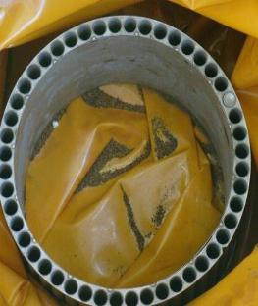
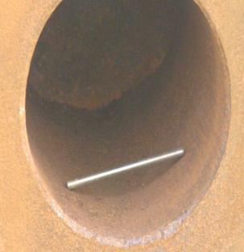
PHOTOGRAPHS OF ACTUAL SOURCE CAGE AND PENCIL RECOVERED
PPT 2 -

Slide 7
10th March: First symptoms vomiting and got some treatment from local doctor
13th March: blackening of fist and applied some skin screen prescribed by the skin doctor
26th March: One side blackened up to abdomen and epilation (hair fall one side)
03rd April: Admitted in Kalyani hospital Moti bagh
04th April: Shifted to Apollo at that time, TLC-100, Platelet 700
27th April: Platelet count shows a sharp drop, bone marrow is significantly suppressed and his condition is quite serious
20th May: Shifted to R& R hospital
Chronology of Victim A
PPT 2 -

Slide 8

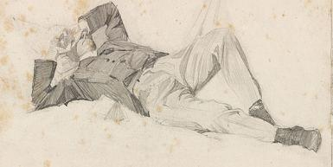
Victim A
The shop owner used to sleep in this position near the table containing Co-60 pencil
PPT 2 -

Slide 9
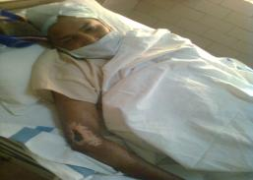
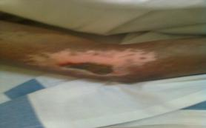
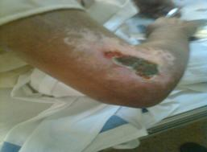
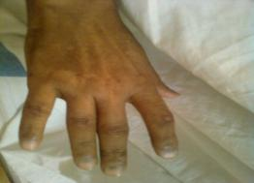
Victim A
PPT 2 -

Slide 10
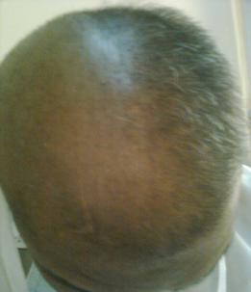
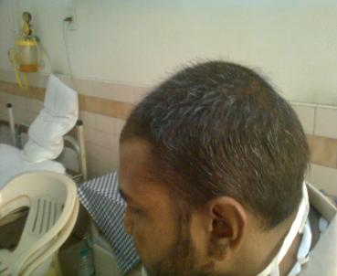
Victim A
PPT 2 -

Slide 11
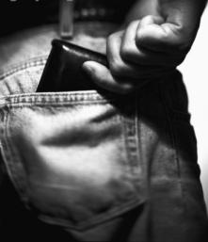
Victim B
A man got some Co-60 pellets of silver white color from the shop owner for checking
He just kept the source in wallets for about 10 -15 days
PPT 2 -

Slide 12
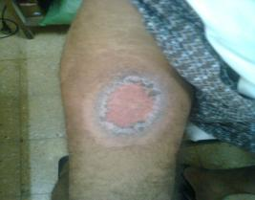
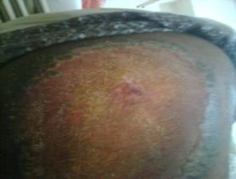
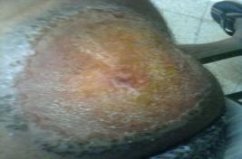
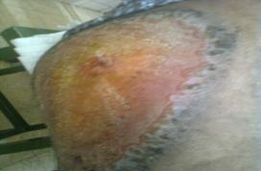
Victim B
PPT 2 -

Slide 13


The person one who actually opened the shielding by breaking the pencil
Died due to multi organ failure
Dose received :- 4–6 Sv (400–600 rem) with increased intensity
Mr. Rajender died due to internal bleeding
Victim C
PPT 2 -

Slide 14
Accident Handling –Three Phases
Sr. No. | Phase of emergency | Action
1 | Initial phase | Emergency first response
2 | Accident control phase | Radiation protection
3 | Post-emergency phase | Clean-up
PPT 2 -

Slide 15
INITIAL PHASE
April 7, 2010 (Afternoon)- Message received by the AERB, from a reputed hospital located in New Delhi, stating that one person, aged 32 years, owner of a metal scrap shop in Mayapuri Industrial Area, New Delhi had been admitted on April 4, 2010. The message also stated that the patient had symptoms indicative of suspected exposure of radiation and requested advice on further course of action.
Advised on proper medical management of the radiation victims based on the symptoms, bio-dosimetry and follow-up.
Officers from AERB visited the place immediately with radiation detection equipment and monitored the radiation levels at various locations (scrap shops)
PPT 2 -

Slide 16
RADIATION LEVEL OBSERVED
Location | Radiation level (mSv/h)
On the entrance of identified scrap shop | 10 - 15
Inside a shop adjacent to identified scrap shop | 0.25 - 0.45
Inside a shop located rear side of identified shop | 20
Inside of another scrap shop located about 300 m from identified shop | 15-45
PPT 2 -

Slide 17
April 8, 2010 –
On site planning for Emergency handling as various agencies involved
Suitable radiation monitoring instruments ( Teletector, radiation survey monitors, Isotope identifier, etc.)
Personnel dosimeters
Personnel Protective Equipments, Decontamination kits, First Aid Box, etc.
Source handling equipments, Source container (shielded flask), etc.
Identification of area
Identification of source location (close proximity)
Cordoning off area
Verification of radioisotope identified (Co-60)
Accident Control Phase
PPT 2 -

Slide 18
Source recovery Operation (Phase –I, April 8-9, 2010)
Radioactive sources recovered-
- 4 pencils sources,
-3 gunny bags and
-one drum containing radioactive scrap
This operation started at night of April 8, 2010 and continued till the afternoon of April 9, 2010
All these recovered radioactive material was transported to the nearest authorised waste disposal agency for safe storage and further investigation.
Accident Control Phase - I
PPT 2 -

Slide 19
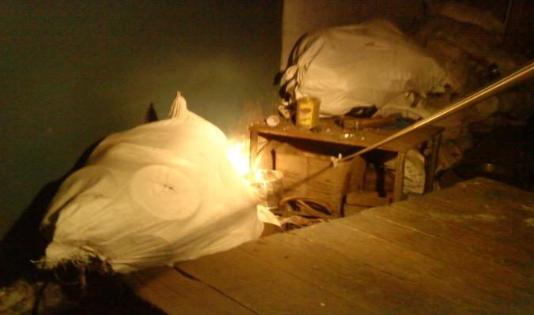
SOURCE SEARCH OPERATION 0:30 hrs, April 9,2010
PPT 2 -

Slide 20
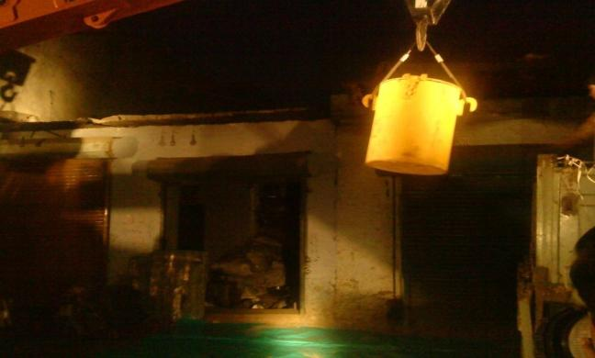
SHIELDED FLASK BEING BROUGHT CLOSER TO SOURCE USING CRANE FOR SAFE TRANSFER, 5:40, APRIL 9, 2010
PPT 2 -

Slide 21
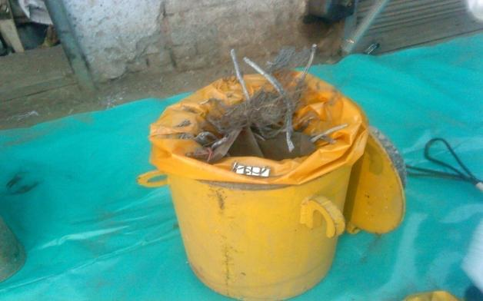
SCRAP WITH SOURCE TRANSFERRED IN SHIELDED FLASK, 6:15, APRIL 9, 2010
PPT 2 -

Slide 22
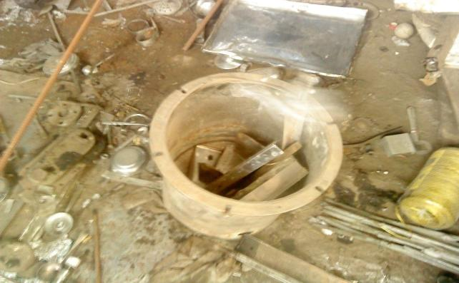
Another source found in a vessel, 9:00 Hrs, April 9, 2010
PPT 2 -

Slide 23
Source recovery Operation (Phase –II, April 13-14, 2010)
Radioactive sources recovered- -One pencil source,
-one cylindrical source cage of dia. ~25 cm with a source pencil still in intact condition in one of the slots one drum containing radioactive scrap
This operation started at night of April 13, 2010 and continued till early morning of April 14, 2010
All these recovered radioactive material was transported to the nearest authorized waste disposal agency for safe storage and further investigation.
ACCIDENT CONTROL PHASE -II
PPT 2 -

Slide 24
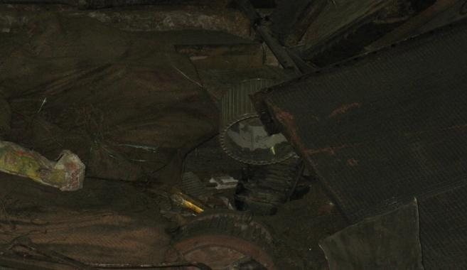
Source cage identified, 03:00 hrs , April 14, 2010
PPT 2 -

Slide 25
Accident Control Phase -III
Source recovery Operation (Phase –III, April 16-17, 2010)
Radioactive source recovered- -One Co-60 slug from a wallet,
This source was transferred into shielded flask using remote handling tong safe and transported to the nearest authorised waste disposal agency for safe storage and further investigation.
PPT 2 -

Slide 26
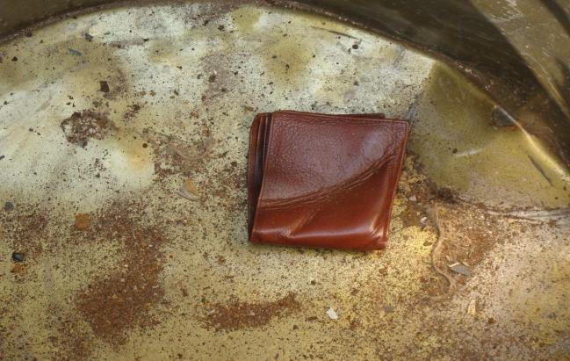
Wallet containing Co-60 slug, 02:00 hrs April 17, 2010
PPT 2 -

Slide 27
Because of cutting of Co-60 slugs, there was a spread of radioactive contamination around the identified shop
Operation carried out in three phases:
Phase I May 15-16, 2010
Phase II May 22-24, 2010 and
Phase III June 14-18, 2010
In this entire operation more than 400 kg of contaminated soil and 100 kg of scrap were recovered and safely disposed off at nearest authorised disposal site
Post Emergency Phase – Decontamination Operation
PPT 2 -

Slide 28
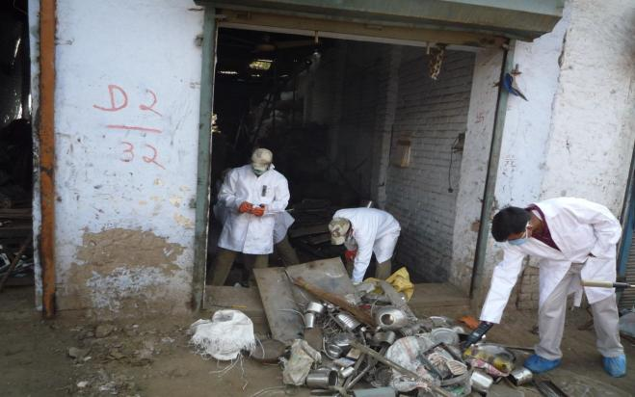
SCRAP BEING CHECKED FOR CONTAMINATION, MAY 15- 16, 2010
PPT 2 -

Slide 29
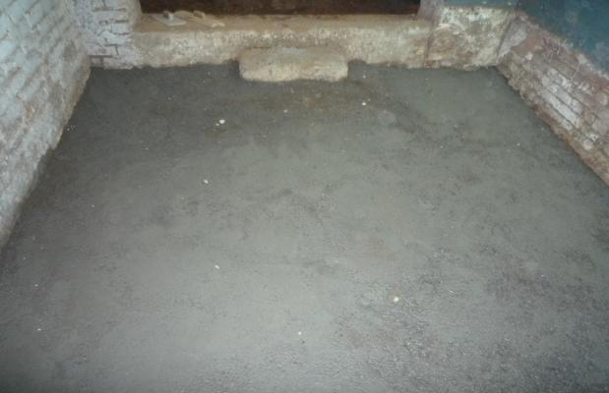
CONCRETIZED 3” THICK INSIDE THE AFFECTED SHOP, MAY 16, 2010
PPT 2 -

Slide 30
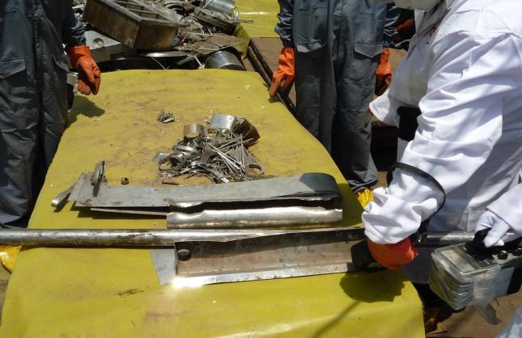
SCRAP BEING SCANNED, MAY 22-24, 2010
PPT 2 -

Slide 31
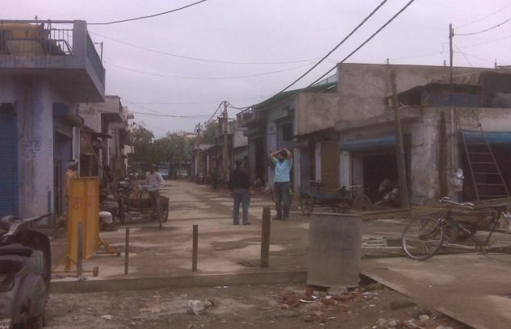
AFFECTED ROAD CONCRETIZED AFTER DECONTAMINATION, JUNE 14-18, 2010
PPT 2 -

Slide 32
Before decontamination – spots (10-50Sq cm.)
-41 spots (100-500 μSv/hr on contact) – on road
-5 spots ( 1000-2000 μSv/hr on contact) – inside the shop
After decontamination and concretization – Background level
Radiation level observed in decontamination operation
PPT 2 -

Slide 33
Negligence of the management of the licencee
Non-compliance with the National Regulations
Unauthorized disposal of radiation source violating statute for safe disposal of radiation sources by the University
An eye opener for users of radiation sources in the country and particularly the academic institutions, the regulatory body, other concerned agencies and the general public
Conclusion
PPT 2 -

Slide 34
ANY QUESTION ?
PPT 2 -

Slide 35

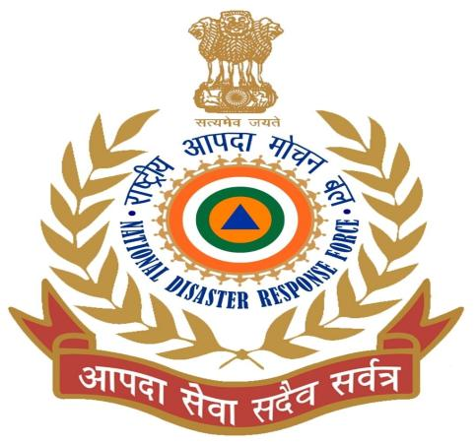
THANK YOU

