Slide 1

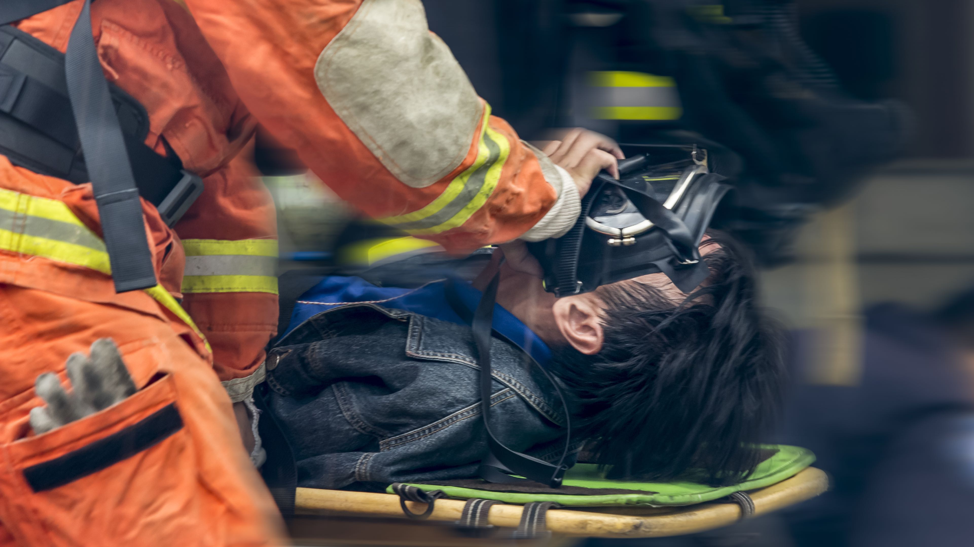






LESSON 12
Course Review
Photo Credit: Freepik
Presented By:- Sohel Lakhani. DC
PEER | CSSR | INDIA
PPT 12 -
PPT 12 - 1

Slide 2
OBJECTIVES
Upon completing this lesson, you will be able to:
1
Answer questions and resolve issues that were recorded in the “File” by
the participants.
Review the most important practical procedures that were demonstrated and practiced throughout the course.
2
PEER | CSSR | INDIA
PPT 12 -

Slide 3
OBJECTIVES
Upon completing this lesson, you will be able to:
3
To outline what is expected of
the Final Practical Exercises and answer any questions regarding the evaluation.
PEER | CSSR | INDIA
PPT 12 -

Slide 4


THANK YOU

