Slide 1


RESCUE IN RUNNING WATER
Presented By:- Kamal Mehra,2IC

Slide 2
OBJECTIVES
Upon completion of this lesson, you will be able to describe:-
Dos and Don’ts while crossing river.
Current Measurement
Negotiation tactic while crossing river
Challenge faced.

Slide 3
INTRODUCTION
Rescue operations in running water are among the most dangerous and technically demanding tasks carried out by the National Disaster Response Force (NDRF).
Such operations typically occur during floods, heavy rains, or dam breaches, where fast-moving water poses significant risks to both victims and rescuers.
NDRF teams must act swiftly, conducting a thorough assessment of the water’s depth, speed, and potential hazards before initiating the rescue.
Equipped with specialized gear like life jackets, helmets, throw bags, and inflatable rescue boats, only trained personnel are deployed for direct contact with the water.

Slide 4
Cont…
The rescue strategy prioritizes non-contact methods such as reaching or throwing rescue lines before attempting physical entry.
Coordination, communication, and safety remain the cornerstones of these operations, ensuring the successful retrieval of victims while minimizing risk to the team.
Regular training in swiftwater rescue techniques ensures that NDRF personnel remain prepared to respond efficiently and effectively in these life-threatening situations.

Slide 5
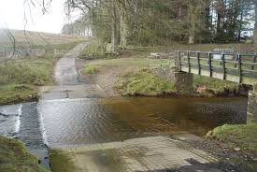
DO’S WHILE CROSSING RIVER
Do Plan Ahead- Assess the river’s width, depth, current speed, and weather conditions before crossing. Look for shallow or calmer areas to cross.
Cross at a Recognized Crossing Point- Always try to cross at a designated or natural crossing point, such as a ford, bridge, or area with calmer water.
Gradually enter the river and let your body adjust to the current. Don’t jump or rush in.

Slide 6
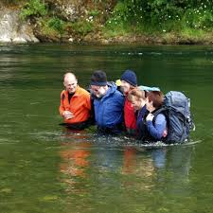
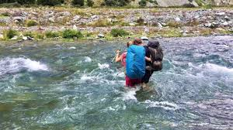
Cont…
Cross with a Partner or Group- Crossing with others provides added safety.
Cross Diagonally (if the Current is Strong- In fast-moving water, cross at a diagonal angle to better counter the current's force.

Slide 7
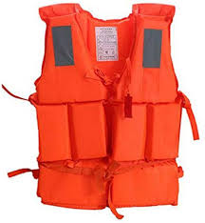
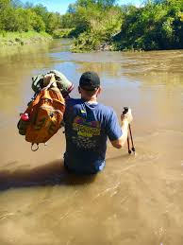
Cont…
Use Safety Gear (Life Jacket or PFD)
Test the Depth with Your Stick or Foot First
Move Slowly and Steadily
Wait for the Water to Settle if the Current is Too Strong

Slide 8
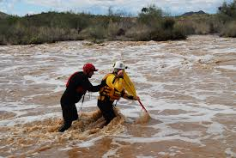
DONT’S WHILE CROSSING RIVER
Don’t Cross in High Water Condition
Don’t Enter the Water with a Heavy Load.
Don’t Cross at a Narrow or Constricted Spot.

Slide 9
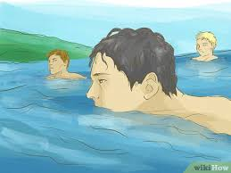
Cont…
Don’t Ignore Water Hazard
Don’t Cross if You're Too Tired or Weak
Don’t Cross Without Testing the Depth and Current
Don’t Let Children Cross Without Adult Supervision

Slide 10
CURRENT MEASUREMENT
Float Method - Drop a floating object (e.g., stick) over a measured distance (like 10 meters).
Time how long it takes to travel the distance.
Use the formula: Current Speed (m/s)=Distance (m)/Time (s).
Visual Judgment- Estimate based on how the water moves:
Calm = slow
Ripples/visible flow = moderate
Whitewater = fast/dangerous

Slide 11
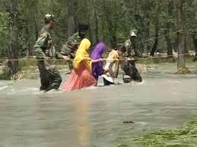
NEGOTIATION TACTIC WHILE CROSSING RIVER
Look for the safest point
Use Diagonal Crossing
Use a Wading Staff
Rope-assisted Crossing
Cross in Groups (Linked Arms)
Time Your Crossing

Slide 12
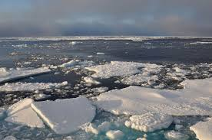
CHALLENGES FACED
Strong Currents-Risk of falling, getting swept away.
Deep Water- Reduced footing, possible drowning.
Cold Water-Hypothermia or muscle cramps.

Slide 13

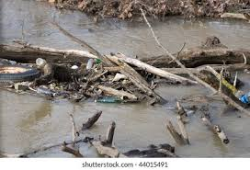
Cont…
Slippery Rocks- Falls and injuries.
Debris in Water- Can strike or entangle you.
Changing Water Levels- Flash floods can increase risk quickly.

Slide 14
Cont…
Fatigue- Weak muscles = less balance = more risk.
Poor Visibility- Can’t see obstacles or sudden drop-offs.
Panic or Poor Judgment-Leads to accidents, especially under pressure.

Slide 15
REVIEW
Now are able to describe:-
Dos and Don’ts while crossing river.
Current Measurement
Negotiation tactic while crossing river
Challenge faced.

Slide 16
ANY QUESTION ?

Slide 17
EVALUATION
Ques: What is a safe practice when approaching a person stranded in fast-moving water?
Walk directly through the water to get to them
Approach from downstream and secure their location
Communicate and throw a line or flotation device
Swim upstream of them to redirect the current
Ques: In swift water rescue, what does “reach, throw, row, go” imply?
Go into the water as the first option
Always use a helicopter before entering the water
Attempt the safest, least risky rescue methods first
Let the current help in reaching the victim

Slide 18


THANK YOU

