Slide 1

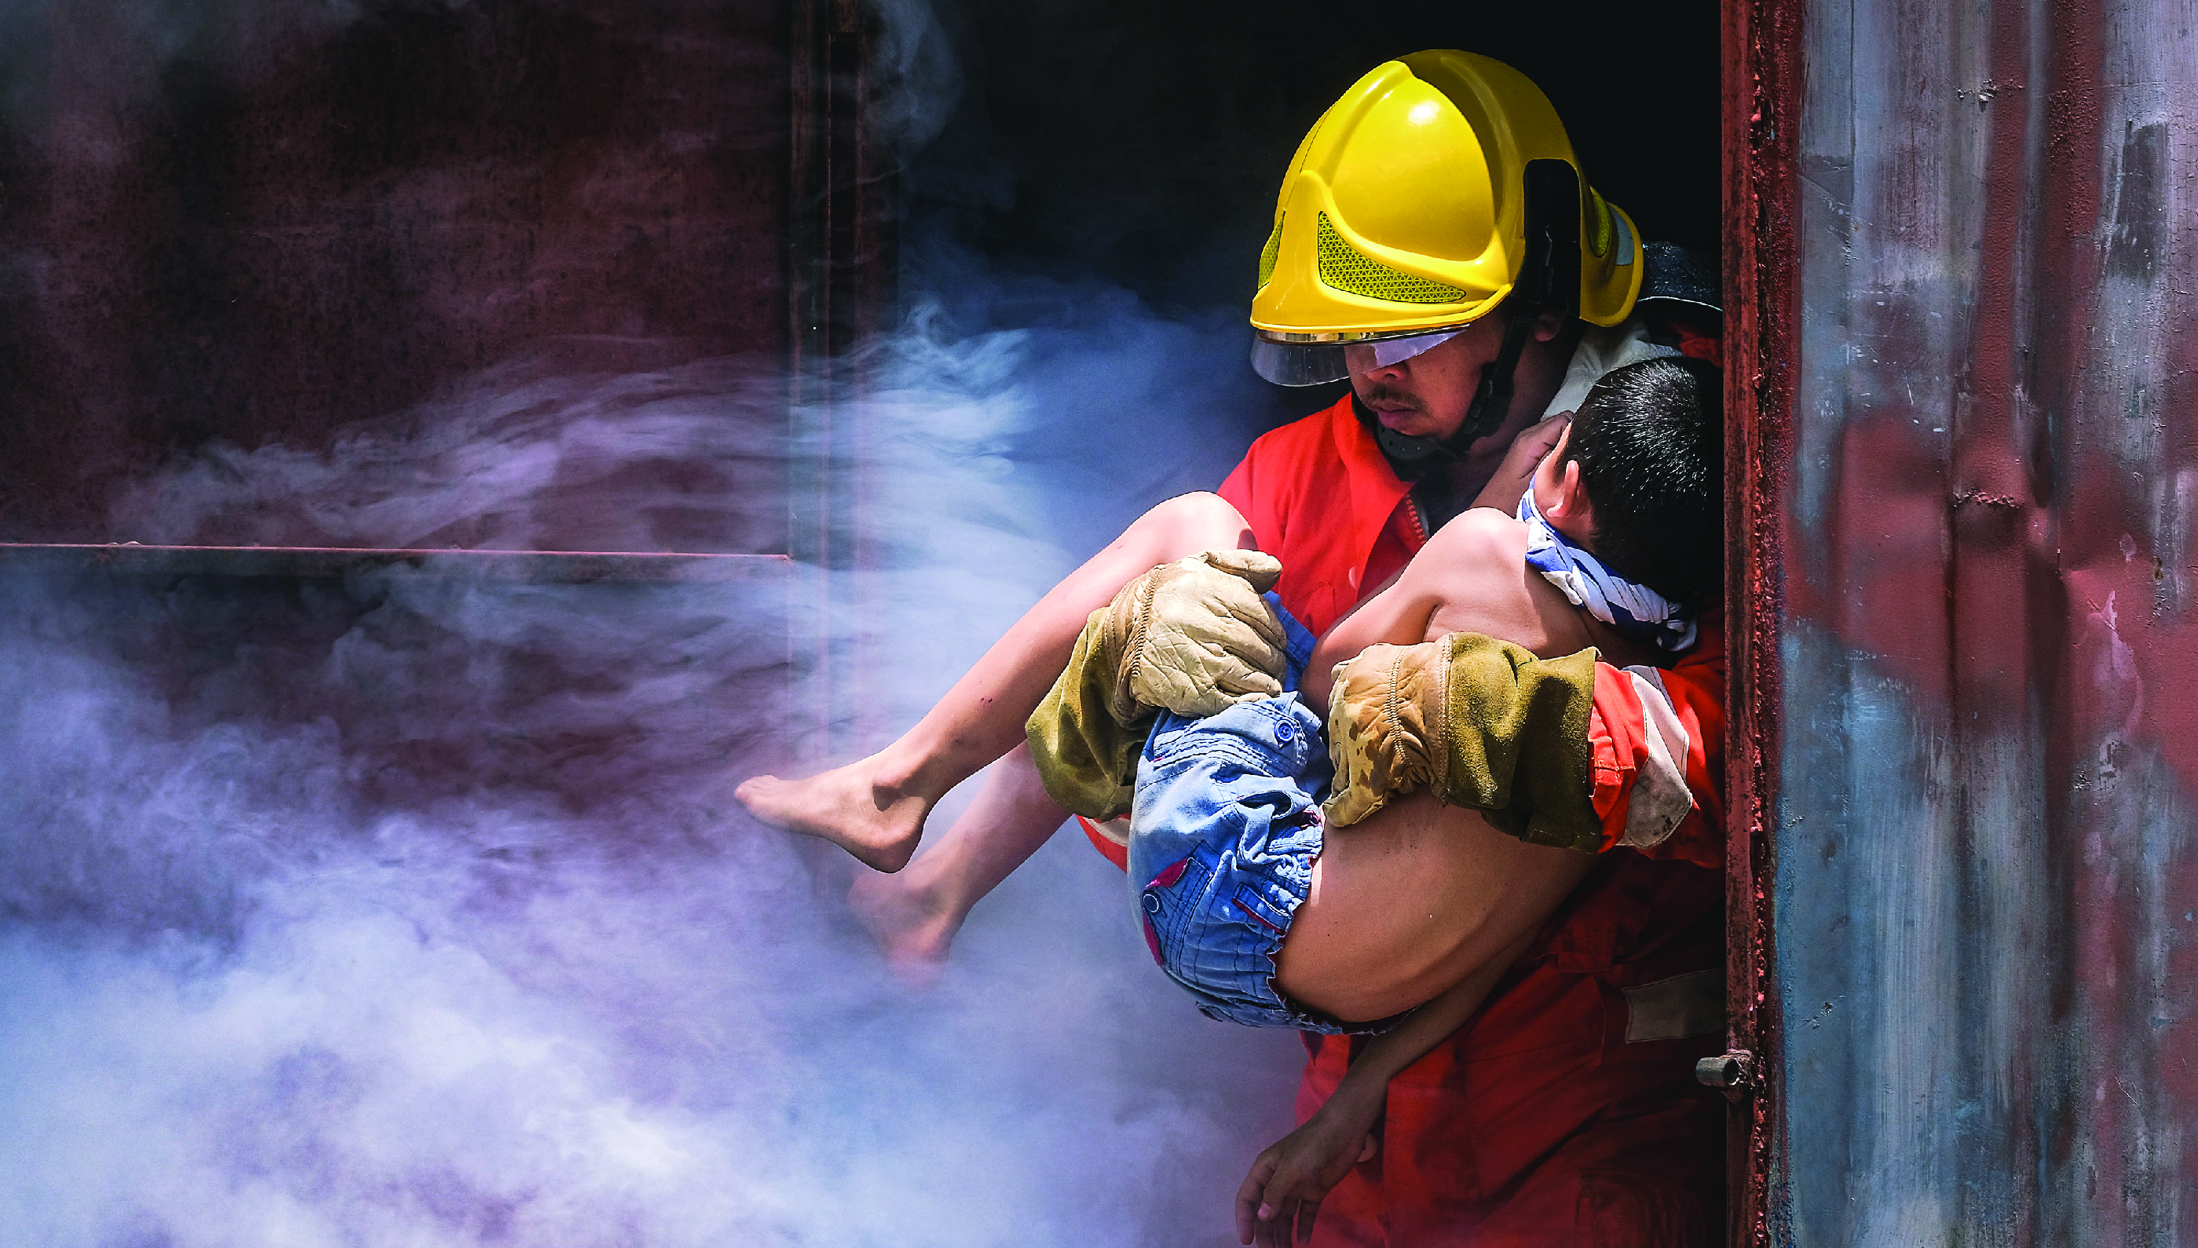






LESSON 11
Pre-hospital Treatment
Photo Credit: PEER South Asia/ADPC
Presented By:- Sohel Lakhani. DC
PEER | CSSR | INDIA
PPT 11 -
PPT 11 - 1

Slide 2
OBJECTIVES
Upon completing this lesson, you will be able to:
1
Identify the possible mechanisms of injury in a structural collapse.
List the potential injuries that could be expected in a structural collapse.
2
PEER | CSSR | INDIA
PPT 11 -

Slide 3
OBJECTIVES
Upon completing this lesson, you will be able to:
3
Describe the conditions in a patient that might indicate the presence of crush syndrome or compartment syndrome.
PEER | CSSR | INDIA
PPT 11 -

Slide 4
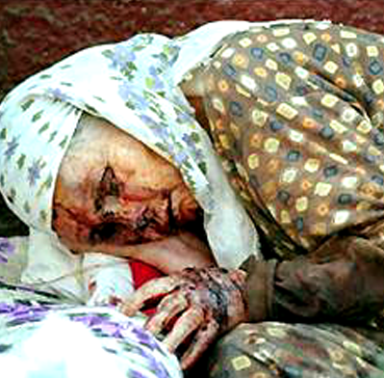
Mechanisms of Injury
Prolonged isolation and desperation
Crushing or compression
Falls
Lack of food and water
Contaminated air
Low temperatures
Blunt trauma
PEER | CSSR | INDIA
PPT 11 -

Slide 5
Crush Syndrome
Compressed for an extended period of time
Blood toxicity
Fatal results
PEER | CSSR | INDIA
PPT 11 -

Slide 6
Compartment Syndrome
Sustained compression in the closed space of the muscle
Destruction of muscle fibres and nerves
PEER | CSSR | INDIA
PPT 11 -

Slide 7
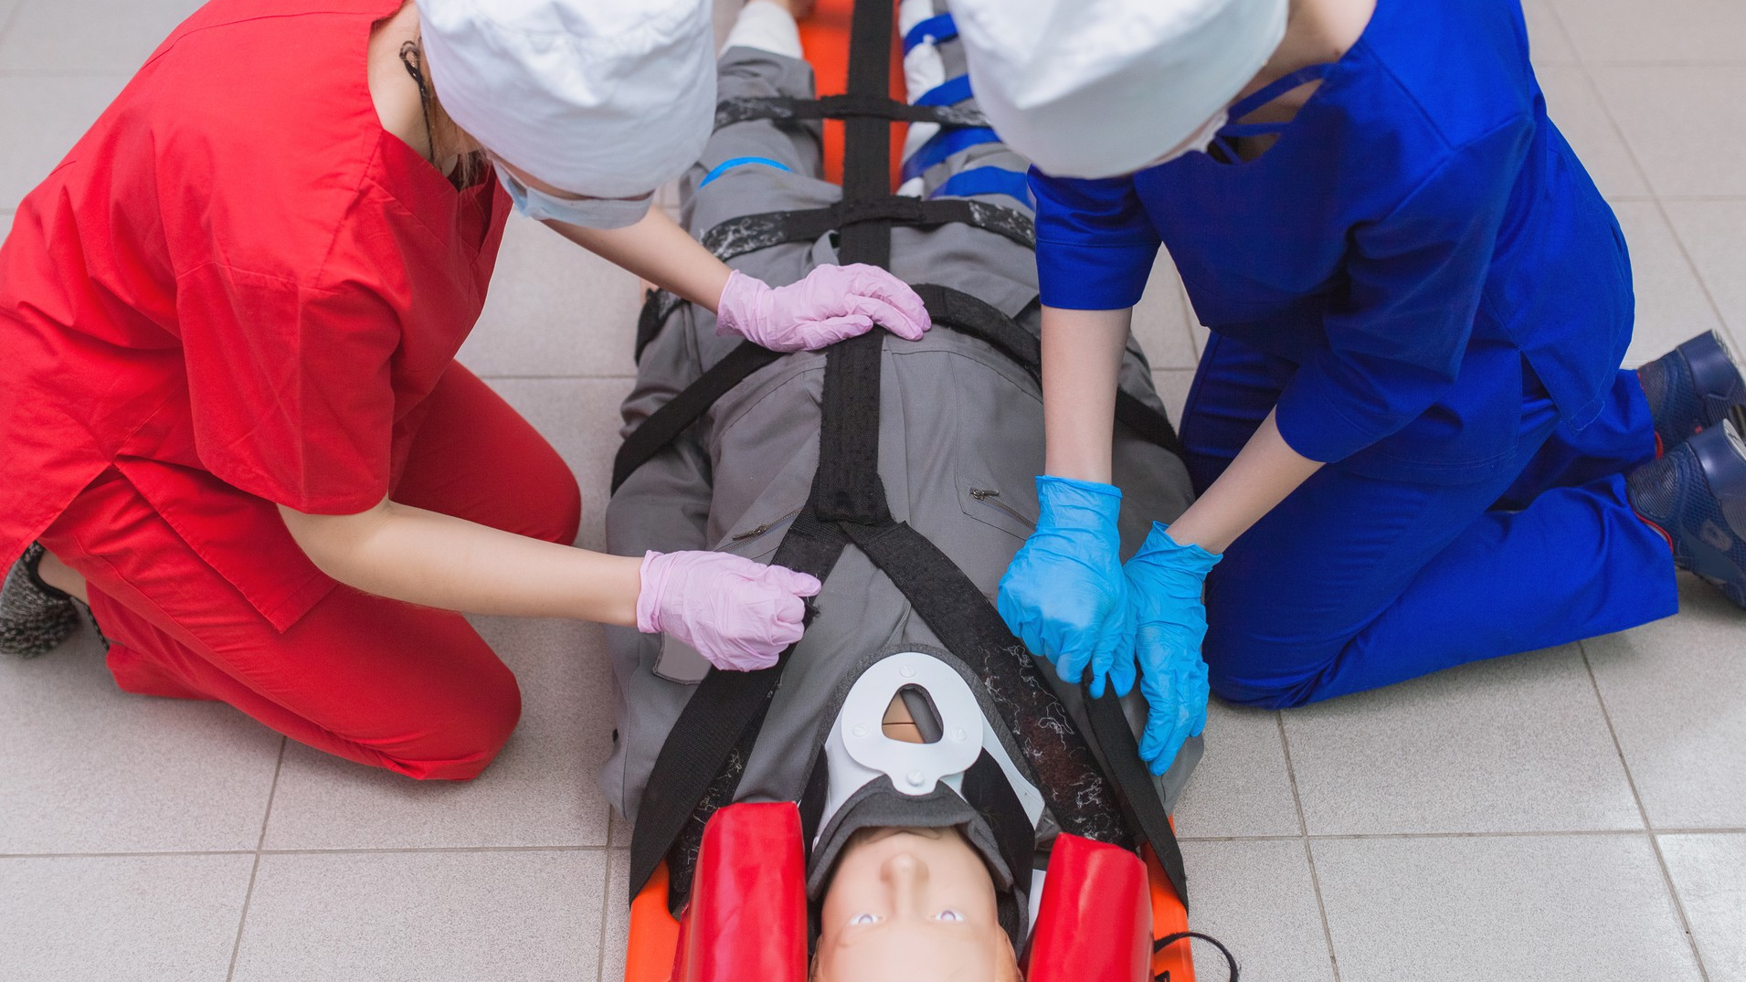

The primary objective of a CSSR Operation is to…
Save Lives!
PEER | CSSR | INDIA
PPT 11 -

Slide 8


THANK YOU

