Slide 1
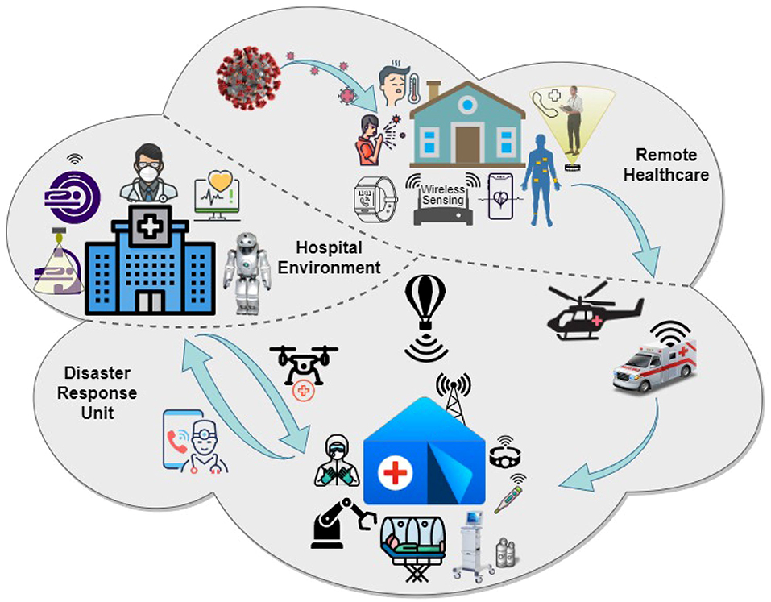
INCIDENT RESPONSE SYSTEM
Presented by:- Dileep Kumar, 2IC

Slide 2
OBJECTIVES
Upon completion of this lesson, you will be able to :
Describe the need for IRS.
Explain the origin of IRS.
Describe the basic IRS concept.
Describe all role and responsibilities of officers.

Slide 3
Multi-jurisdictional incidents
Shortages of resources requiring greater use of mutual aid
Accountability requiring standard incident mngt. system
Greater life and property loss risk reduction from natural and man-made disasters
NEED FOR IRS

Slide 4
Sophisticated media coverage demanding immediate answers
A well managed response process by providing answers to vital questions such as “who’s in charge?” & “what’s my job?”
NEED FOR IRS

Slide 5
DRAWBACKS EXPERIENCED IN DM
Too many people reporting to one supervisor.
Lack of reliable incident information.
Inadequate & incompatible comn.
No mech for coordinated planning between agencies.
Unclear lines of authority.
Terminology differences between agencies.
Unclear or unspecified incident objectives.

Slide 6
ORIGIN OF IRS
The government of India took a decision to adopt world’s best practice for disaster management
As Incident Command System was one of the world’s best practices and adapted by countries like, Australia, Canada, United Kingdom, etc. The government of India decided to adopt ICS in 2003

Slide 7
In 2007 the NDMA felt that ICS should be adapted and authentic guidelines should be released in the country for its successful implementation
NDMA Issued Guideline on “Incident Response System” In July 2010.
ORIGIN OF IRS

Slide 8
WHAT IS IRS ?
Single standardized, on-scene, all hazard incident management system used by all emergency response disciplines.
Provides accurate information, strict accountability, planning, cost effective operations and logistical support for any incident.

Slide 9
BASIC IRS CONCEPTS
Can be used to manage all Emergency Incident
Can be used for both small and large events.
System can grow or shrink to meet differing needs.
Cost effective & efficient management system.

Slide 10
The IRS envisages and lays down various tasks that may need to be performed by the existing administrative machinery at various levels.
It also recommends prior identification of officers for the performance of different tasks and getting them trained in their respective roles, and
Provides a structure under which all departments will function in tandem with the District and State administration.
BASIC IRS CONCEPTS

Slide 11
In the IRS, a need was felt to clearly identify a designated authority responsible and accountable by law to respond to disasters and therefore a position of Responsible Officer (RO) has been introduced.
Incident response management may however not always require the direct intervention of the RO.
On the ground, the management will be done by the IC to whom powers will have to be delegated by the RO.
The CSs and the District Magistrates/DCs will perform the role of ROs
BASIC IRS CONCEPTS

Slide 12
The chairperson of the NCMC / NEC will function as Chief Coordinator for the management of disasters at the National level.
The chairperson may designate a Nodal Officer (NO) for this purpose.
Various Ministries/Departments of Government may also nominate NOs to perform the task of Emergency Support Functionaries (ESFs) which may be required in a particular incident.
BASIC IRS CONCEPTS

Slide 13
INCIDENT COMMAND SYSTEM
INCIDENT COMMANDER
COMMAND STAF
F
OPERATIONS
FINANCE &
ADMINISTRATION
PLANNING & INTELLIGENCE
LOGISTICS

Slide 14
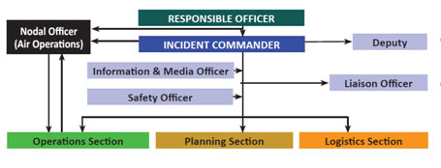
INCIDENT RESPONSE SYSTEM

Slide 15
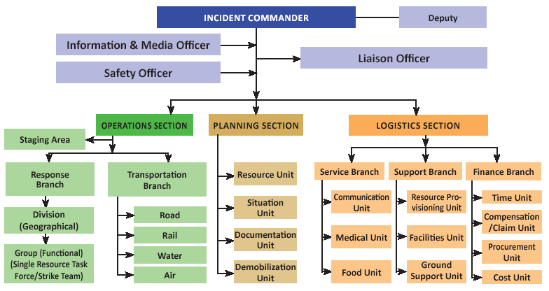
STATE LEVEL
IRT

Slide 16
The organizational structure of IRS at the State level shown in Fig. is not necessarily to be activated in the management of all types and scales of disasters.
For monitoring and support of the incident response, the RO will involve all required Emergency Support Functionaries(ESF) and headquarters IRT to support the on-scene IC.
The IC will work in close coordination with EOC and report to RO.
INCIDENT RESPONSE SYSTEM

Slide 17
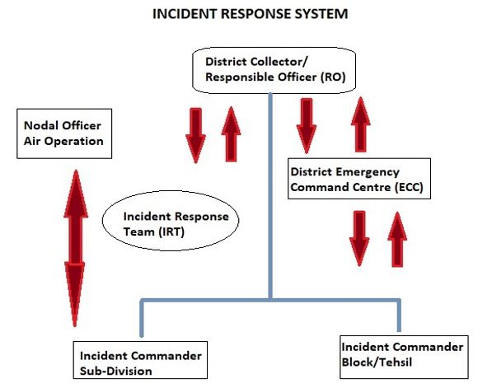
DISTRICT LEVEL IRT

Slide 18
The complete IRS organizational structure at District level is depicted in Fig. The structure depicted above may be activated as and when required.
For monitoring and support of the incident response, the RO will involve all required ESF and headquarter IRT to support the on-scene IC.
In case when central teams (NDRF, Armed Forces) are deployed, the RO will ensure resolution of all conflicts.
DISTRICT LEVEL IRT

Slide 19
IRS functions through incident response teams in the field.
An IRT is a team comprising all positions of IRS organization headed by Incident Commander (IC).
On receipt of early warning, RO shall activate the Incident Response Teams.
In case of a disaster without any warning, local IRT will respond and contact RO for further support, if required.
IRTs pre-designated shall function actively at all levels (i.e. District, Sub-Division and Tehsil/Block).
INCIDENT RESPONSE TEAM (IRT)

Slide 20
Incident Response Teams at the lowest administrative unit (Sub-Division /Tehsil/Block) shall be the first responder.
If the incident becomes complex and beyond the control of local IRTs, higher level IRTs will be informed to take over the response management.
In such cases, the lower level IRT will merge with higher level IRTs.
When lower level IRT merge with higher level IRT, IC of lower level may play the role of Dy IC.
INCIDENT RESPONSE TEAM (IRT)

Slide 21
The grouping of governmental and certain private sector capabilities into an organizational structure to provide support, resources, program implementation, and services
that are most likely needed to save lives, protect property and the environment, restore essential services and critical infrastructure, and
help victims and communities return to normal following domestic incidents.
EMERGENCY SUPPORT FUNCTIONS (ESFS)

Slide 22
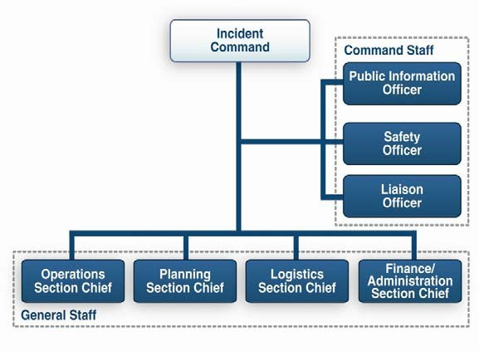
IC & COMMAND STAFF

Slide 23
INCIDENT COMMANDER
Overall command of the incident.
•
Must be fully qualified to manage incident
May be assigned by responsible jurisdiction or agency.
May have one or more deputies, who must be equally qualified.
•
May assign personnel for both command staff and general staff.

Slide 24
DEPUTY INCIDENT COMMANDER
A Deputy Incident Commander may be designated to:
  Perform specific tasks as requested by the Incident Commander.
  Perform the incident command function in a relief capacity.
  Represent an assisting agency that shares jurisdiction.

Slide 25
INFORMATION & MEDIA OFFICER (IMO)
Advises Incident Commander on information dissemination and media relations. Incident Commander approves information that the IMO releases.
Obtains information from and provides information to Planning Section.
Obtains information from and provides information to community and media.

Slide 26
SAFETY OFFICER
Advises Incident Commander on issues regarding incident safety.
Works with Operations to ensure safety of field personnel.
Ensures safety of all incident personnel.

Slide 27
LIAISON OFFICER
Assists Incident Commander by serving as point of contact for agency representatives who are helping to support the operation.
Provides briefings to and answers questions from supporting agencies.

Slide 28
GENERAL STAFF
Incident
Commander
Information &
Media Officer
Liaison
Officer
Command Staff
Safety
Officer
General
Staff
Operations
Section
Planning
Section
Logistics
Section

Slide 29
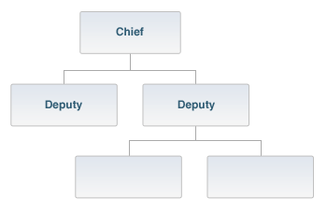
GENERAL STAFF
•
General Staff are called Section Chiefs
•
These are Operations, Planning, Logistics,
•
Each Section Chief may have one or more deputies.
•
Deputies must be as qualified as Section Chief

Slide 30
OPERATIONS SECTION CHIEF
The Operations Section Chief:
  Develops and implements strategy and tactics to carry out the incident objectives.
  Organizes, assigns, and supervises the tactical field resources.
  Supervises air operations and those resources in a Staging Area.

Slide 31
OPERATION SECTION
  The Operations Section:
  Directs and coordinates all incident tactical operations.
  Is typically one of the first organizations to be assigned to the incident.
  Has the most incident resources.
  Have Staging Areas .
Incident
Commander
Operations
Section
Staging
Area
Rescue
Group
Investigation
Group

Slide 32
OPERATION SECTION: DIVISIONS
Operations Section
Planning Section
Division A
Division B
  Divided geographically based on the needs of the incident.
  Labeled using alphabet characters (A, B, C, etc.).
  Managed by a Supervisor.

Slide 33
OPERATION SECTION: GROUPS
  Established based on the needs of an incident.
  Labeled according to the job that they are assigned.
  Managed by a Supervisor.
  Work wherever their assigned task is needed and are not limited geographically.
Operations Section
Health & Safety
Group
Public Works
Group

Slide 34
OPERATIONS SECTION: SINGLE RESOURCES
Single Resources may be:
  Individuals.
  A piece of equipment and its personnel complement.
  A crew or team of individuals with an identified supervisor.
Operations Section
Task Force
Strike Team
Single Resource

Slide 35
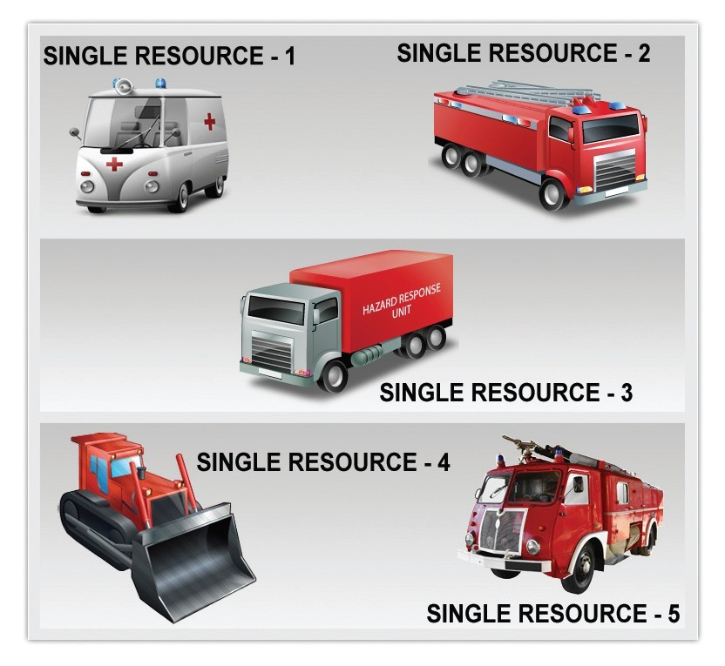
SINGLE RESOURCE
In IRS, “resources” refers to personnel, supplies, and equipment.

Slide 36
OPERATION SECTION: STRIKE TEAMS
Operations Section
Task Force
Strike Team
Single Resource
Strike Teams are a set number of resources of the same kind and type with common communications operating under the direct supervision of a Strike Team Leader.

Slide 37
OPERATION SECTION: TASK FORCES
Operations Section
Task Force
Strike Team
Single Resource
Task Forces are a combination of mixed resources with common communications operating under the direct supervision of a Task Force Leader.

Slide 38

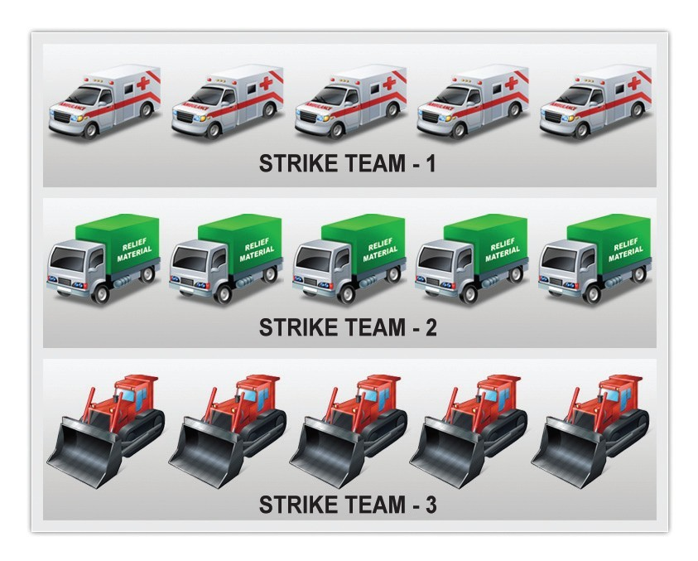
TASK FORCE
STRIKE TEAM

Slide 39
PLANNING SECTION
  Maintains resource status.
  Maintains and displays situation status.
  Prepares the Incident Action Plan.
  Provides documentation services.
  Prepares the Demobilization Plan.

Slide 40
PLANNING SECTION CHIEF
The Planning Section Chief:
  Gathers, analyzes, and disseminates information and intelligence.
  Manages the planning process.
  Compiles the IAP
  Manages Tech Specialists.

Slide 41
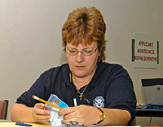
PLANNING SECTION: RESOURCES UNIT
Planning Section
Resources
Unit
Demobilization
Unit
Situation
Unit
Documentation
Unit
  Conducts all check-in activities and maintains the status of all incident resources.
  Plays a significant role in preparing the written Incident Action Plan.

Slide 42
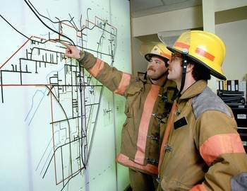
PLANNING SECTION: SITUATION UNIT
Planning Section
Resources
Unit
Demobilization
Unit
Situation
Unit
Documentation
Unit
  Collects and analyzes information on the current situation.
  Prepares situation displays and situation summaries.
  Develops maps and projections.

Slide 43
PLANNING SECTION: DOCUMENTATION UNIT
Planning Section
Resources
Unit
Demobilization
Unit
Situation
Unit
Documentation
Unit
  Provides duplication services, including the written Incident Action Plan.
  Maintains and archives all incident-related documentation

Slide 44
LOGISTICS SECTION
Responsible for:
  Communications.
  Medical support to incident personnel.
  Food for incident personnel.
  Supplies.
  Facilities.
  Ground support.
  Finance Branch (3rd Branch): [Time, Compensation, Procurement, & Cost Units]
Logistics Section
Service
Branch
Support
Branch
Commun.
Unit
Resource
Provisioning
Unit
Medical
Unit
Facilities
Unit
Food
Unit
Ground
Unit

Slide 45
LOGISTICS SECTION CHIEF
The Logistics Section Chief:
  Provides resources and services required to support incident activities.
  Provides Finance & Administration functions
  Develops portions of Incident Action Plan and forwards them to Planning Section.
  Contracts for and purchases goods and services needed at the incident.

Slide 46
FINANCE BRANCH DIRECTOR
The Finance Branch Director:
  Is responsible for financial and cost analysis.
  Oversees contract negotiations.
  Tracks personnel and equipment time.
  Processes claims for accidents and injuries.
  Works with other Logistics Branches to ensure resources are procured.

Slide 47
INCIDENT FACILITIES
  Incident Command Post (ICP)
  Emergency Operation Center (EOC)
  Incident Base
  Camps
  Relief Camp (RC)
  Staging Areas
  Helibase
  Helispots

Slide 48
INCIDENT COMMAND POST (ICP)
Location where ICP oversees all operations.
There is only one ICP for each incident.
Should be located as close and as safe as possible to the incident.
•
•

Slide 49
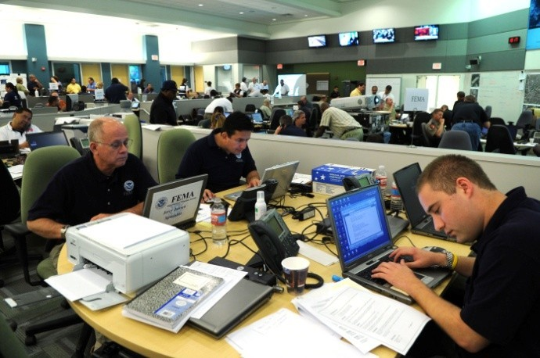
EMERGENCY OPERATION CENTER(EOC)
The Emergency Operations Center is the central direction, control, and coordination point for emergency operations. It is the place to decide what specific information should go to persons carrying out an ‘emergency service’ operation.

Slide 50
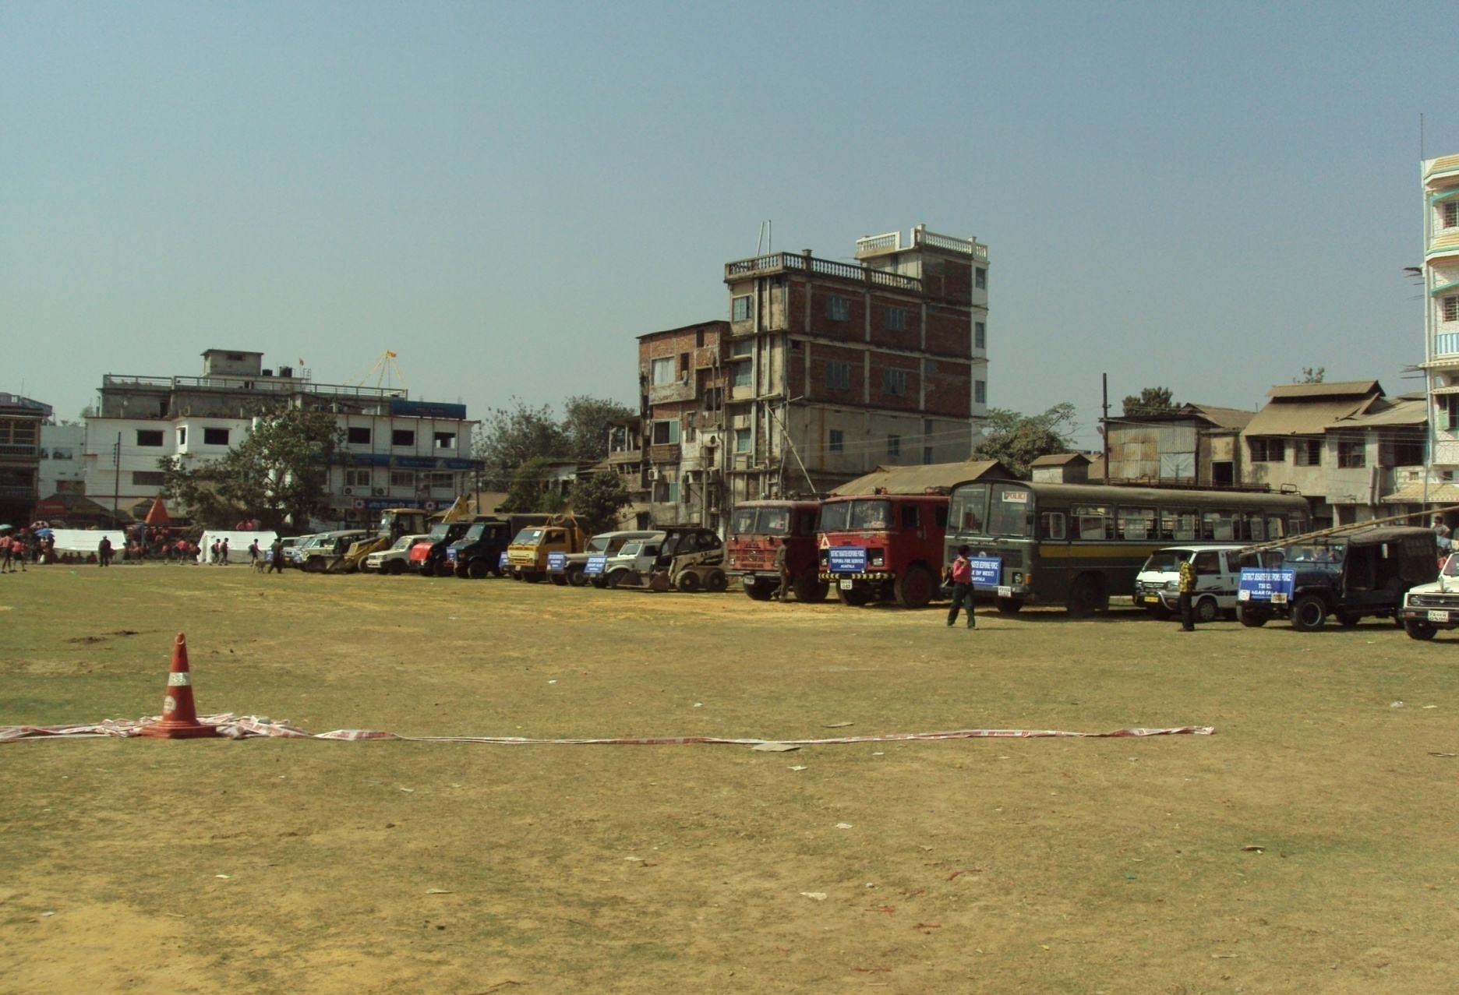
STAGING AREA

Slide 51
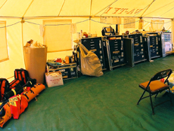
INCIDENT LOCATIONS & FACILITIES
ICP
Base
Staging
Area
R Camp

Slide 52
REVIEW
Upon completion of this lesson, you are able to :
Describe the need for IRS.
Explain the origin of IRS.
Describe the basic IRS concept.
Describe all role and responsibilities of officers.

Slide 53
ANY QUESTION?

Slide 54
EVALUATION
Q. What is the full form of ICP.
Incident Command Post.
Q. Write the name of General staff.
Operation section, Planning section and Logistic section.
Q. What is the full form of EOC?
A. Emergency Operation Centre.

Slide 55


THANK YOU

