Slide 1




MEDICAL FIRST RESPONDER
LESSON 11
Musculoskeletal Injuries
Presented by:- Pavan Dev Gaur, 2IC
CAPF | MFR | INDIA
-

Slide 2
OBJECTIVES
Upon completing this lesson, you will be able to:
1
Define an open fracture and closed fracture, and list four signs and symptoms.
Define a dislocation, a sprain, and a strain and list four signs and symptoms.
2

Slide 3
OBJECTIVES
Upon completing this lesson, you will be able to:
3
Give two reasons for immobilizing
a fracture, a sprain or a strain on a patient.
Demonstrate the pre-hospital treatment of fractures and dislocations of
the extremities, hips and shoulder.
4

Slide 4
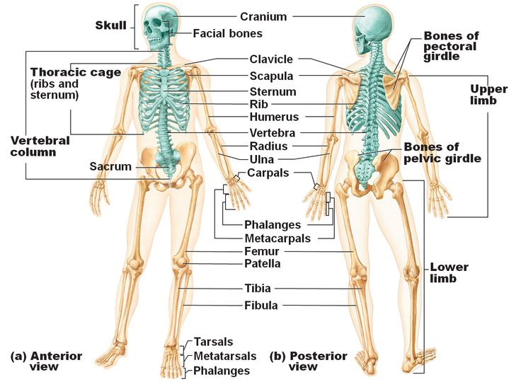
Skeletal System

Slide 5
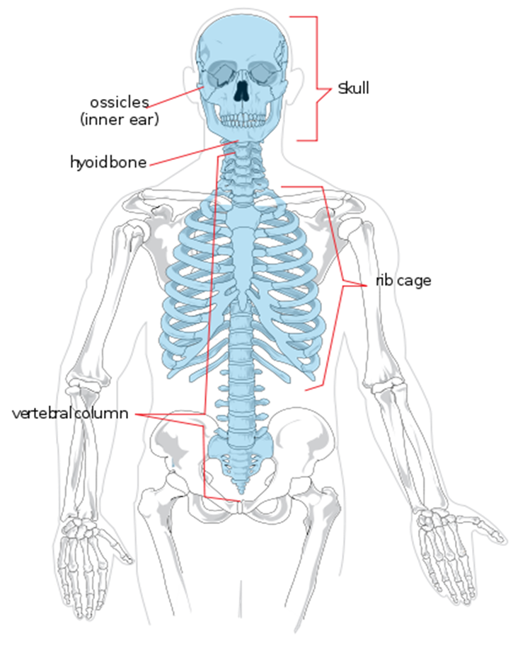
Skeletal System
The axial skeleton: consists of 80 Bones including
SKULL-22(HEAD-08,FACE-14)
Thorax-25 (Ribs-12pair,Sternum-1)
Vertebra/spinal column-33(Cervical-7,Thoracic-12,Lumber-5,Sacrum-5,Coccy-4)

Slide 6
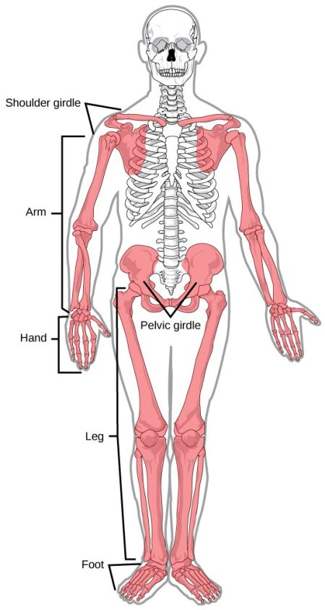
Appendicular skeleton. Consist of 126 bones:
Skeletal System
Shoulder -2+2(clavicle -1+1 & scapula-1+1)
Upper extremities-30X2 (Humerus-1, Radius-1,Ulna-1,Carpal-8, Metacarpal-5, Phalanges-14)
Pelvis ( Hips)-2
Lower extremities-30+2 (Femur-1,Patella-1,Tibia-1,Fibula-1,Tarsal-7,Metatarsal-5,Phalanges-14)

Slide 7
FUNCTION OF SKELETAL SYSTEM
Any break in Provide framework for the body.
Protects vital organs.
Provide for body movement.
Produces red blood cells.
continuity of a bone.
PPT 11 -

Slide 8
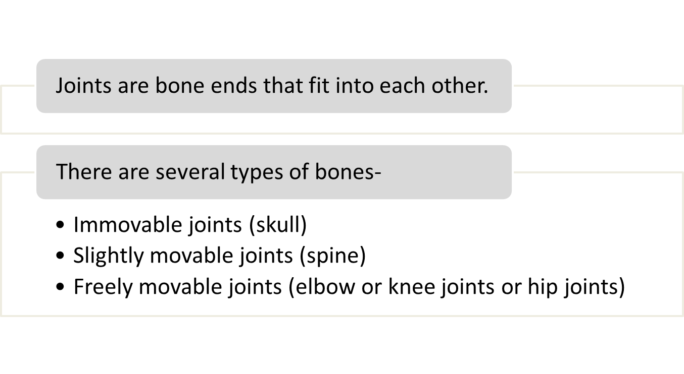
JOINTS (ARTICULATIONS)
PPT 11 -

Slide 9
Fracture
Any break in the continuity of a bone.
PPT 11 -

Slide 10
Dislocation
Injury in which a bone is moved out of its normal position in
a joint and remains that way.
PPT 11 -

Slide 11
Sprain
Injury in which ligaments are stretched or partially torn, commonly associated with joint injuries.
PPT 11 -

Slide 12
Strain
Injury in which a muscle, or a muscle and tendon, are over-extended.
PPT 11 -

Slide 13
Fractures, Dislocations and Sprains
Signs and Symptoms
Deformity or angulation
Pain and tenderness
Crepitus (grating)
Swelling

Slide 14
Fractures, Dislocations and Sprains
Cont.
Signs and Symptoms
Bruising or discoloration
Exposed bone ends
Joint locked in position
Numbness or paralysis
Compromised circulation

Slide 15
Splinting
Applying a device to stabilize any painful, swollen or deformed body part.
PPT 11 -

Slide 16
Reasons for Splinting
Prevent motion of bone fragments or dislocated joints
Reduce pain and suffering
Minimize damage to soft tissues
Prevent closed fracture from becoming open fracture
Minimize blood loss or shock
PPT 11 -

Slide 17
Pre-Hospital Treatment
Initial assessment: identify and treat life-threatening problems
Physical examination
Stabilize injury
Expose injury
Treat open wounds
for suspected fractures, dislocations and sprains/ strains
PPT 11 -

Slide 18
Pre-Hospital Treatment
Prepare splinting materials
Splint injuries / immobilize body
Reassess P.M.S.
Apply cold packs or ice
Treat for shock
for suspected fractures, dislocations and sprains/ strains
Cont.
PPT 11 -

Slide 19
Review
Now you are able to:
1
Define an open fracture and closed fracture, and list four signs and symptoms.
Define a dislocation, a sprain, and a strain and list four signs and symptoms.
2

Slide 20
Review
Now you are able to:
3
Give two reasons for immobilizing
a fracture, a sprain or a strain on a patient.
Demonstrate the pre-hospital treatment of fractures and dislocations of
the extremities, hips and shoulder.
4

Slide 21


THANK YOU

