Slide 1
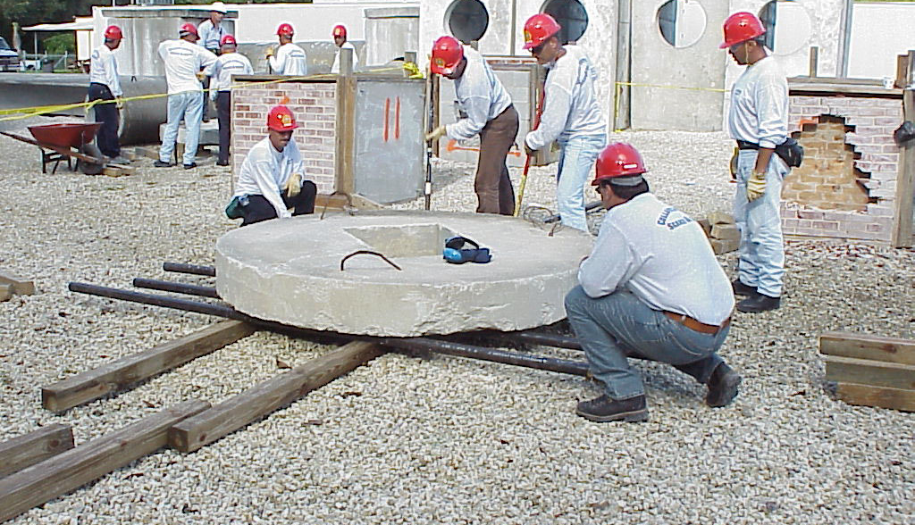





COLLAPSED STRUCTURE SEARCH AND RESCUE
LESSON 1
COURSE INTRODUCTION
LESSON 2
Organizing and Starting
a CSSR Operation
LESSON 10
Lifting and Stabilizing
Presented By:- Kamlesh Dhoundiyal,2IC
NDRF | CSSR | INDIA
PPT 10-1

Slide 2
OBJECTIVES
Upon completing this lesson, you will be able to:
1
List three factors that you must determine before lifting a load.
List and describe three methods for lifting a load.
Define a lever, its three components and the three classes of a lever.
2
3
PEER | CSSR | INDIA
PPT 10 -
NDRF | CSSR | INDIA

Slide 3
OBJECTIVES
Upon completing this lesson, you will be able to:
4
List at least three applications of
the hoist.
List two types of cribbing used to stabilise a load.
List the five steps to build cribbing
for lifting and stabilising a load.
5
6
PEER | CSSR | INDIA
PPT 10 -
NDRF | CSSR | INDIA

Slide 4
OBJECTIVES
Upon completing this lesson, you will be able to:
7
List the steps to roll a load using pipes.
Demonstrate in three practical stations the techniques for lifting, stabilising and rolling loads.
8
PEER | CSSR | INDIA
PPT 10 -
NDRF | CSSR | INDIA

Slide 5
Before lifting a load consider:
Weight
Consequences
Method
PEER | CSSR | INDIA
PPT 10 -
NDRF | CSSR | INDIA

Slide 6
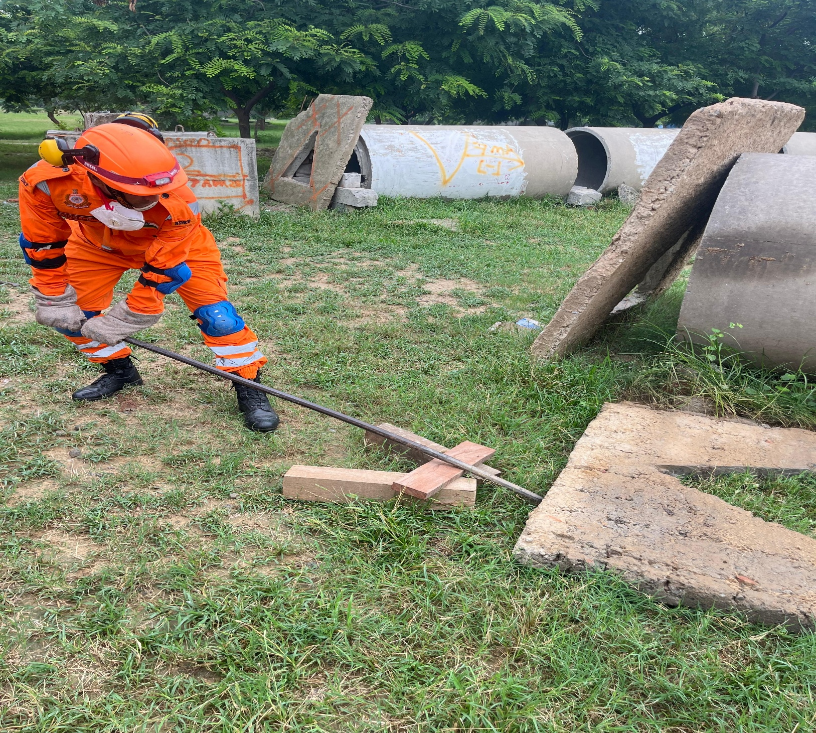
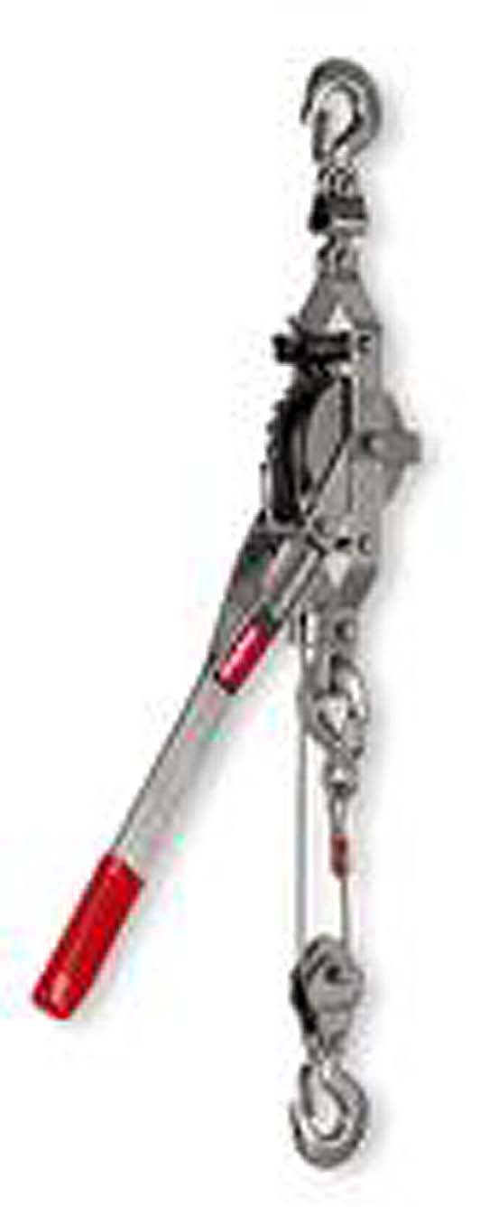
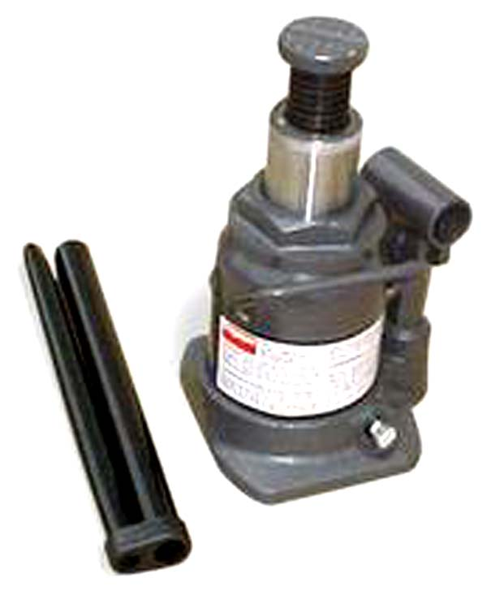
Methods for Lifting Loads
Levers
Come-along
Jacks
PEER | CSSR | INDIA
PPT 10 -
NDRF | CSSR | INDIA

Slide 7
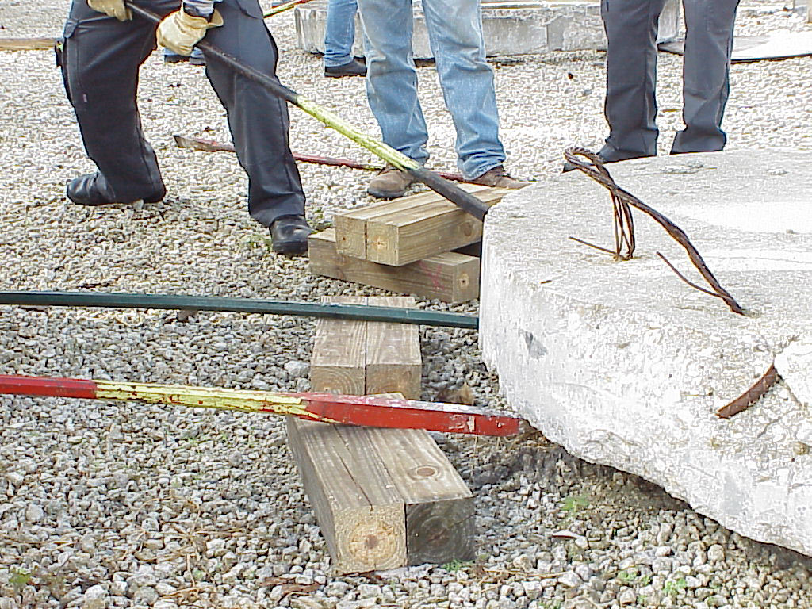
Lever
A lever is a rigid bar, either straight or bent, that is free to move on a fixed point called a fulcrum.
PEER | CSSR | INDIA
PPT 10 -
NDRF | CSSR | INDIA

Slide 8
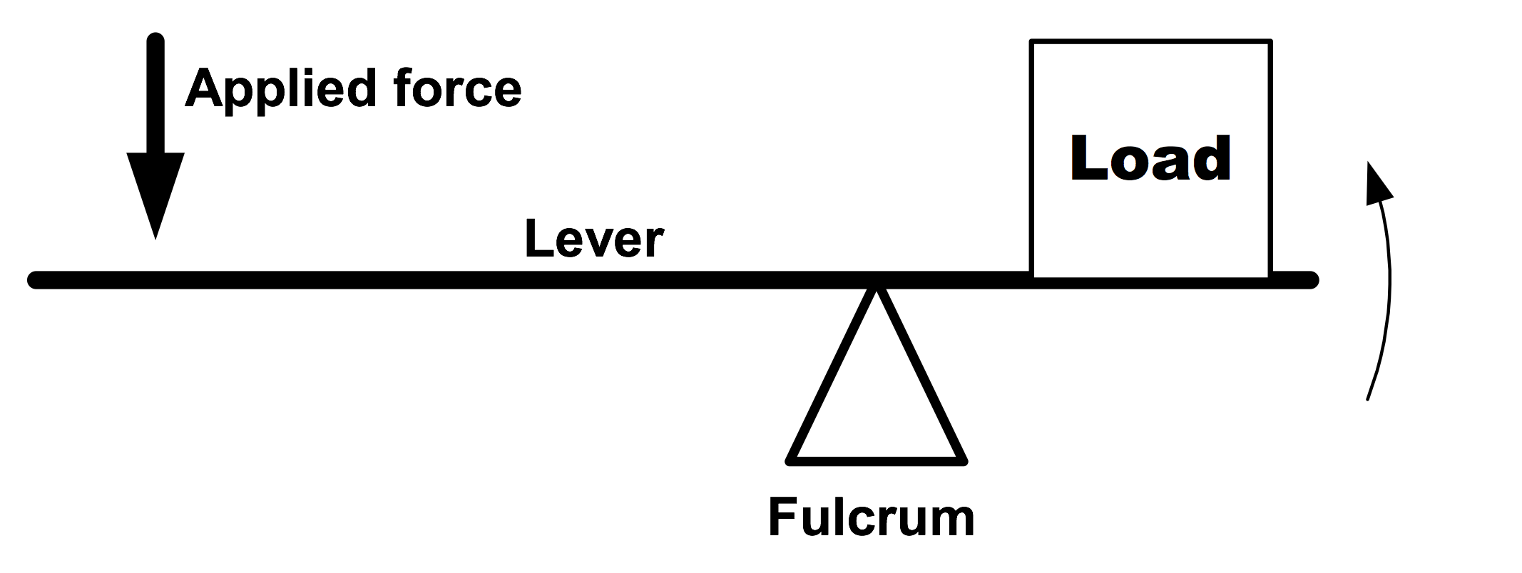
Components of a Lever
PEER | CSSR | INDIA
PPT 10 -
NDRF | CSSR | INDIA

Slide 9

Class 1 Lever
Upward force
Load
Downward force
Fulcrum
PEER | CSSR | INDIA
PPT 10 -
NDRF | CSSR | INDIA

Slide 10
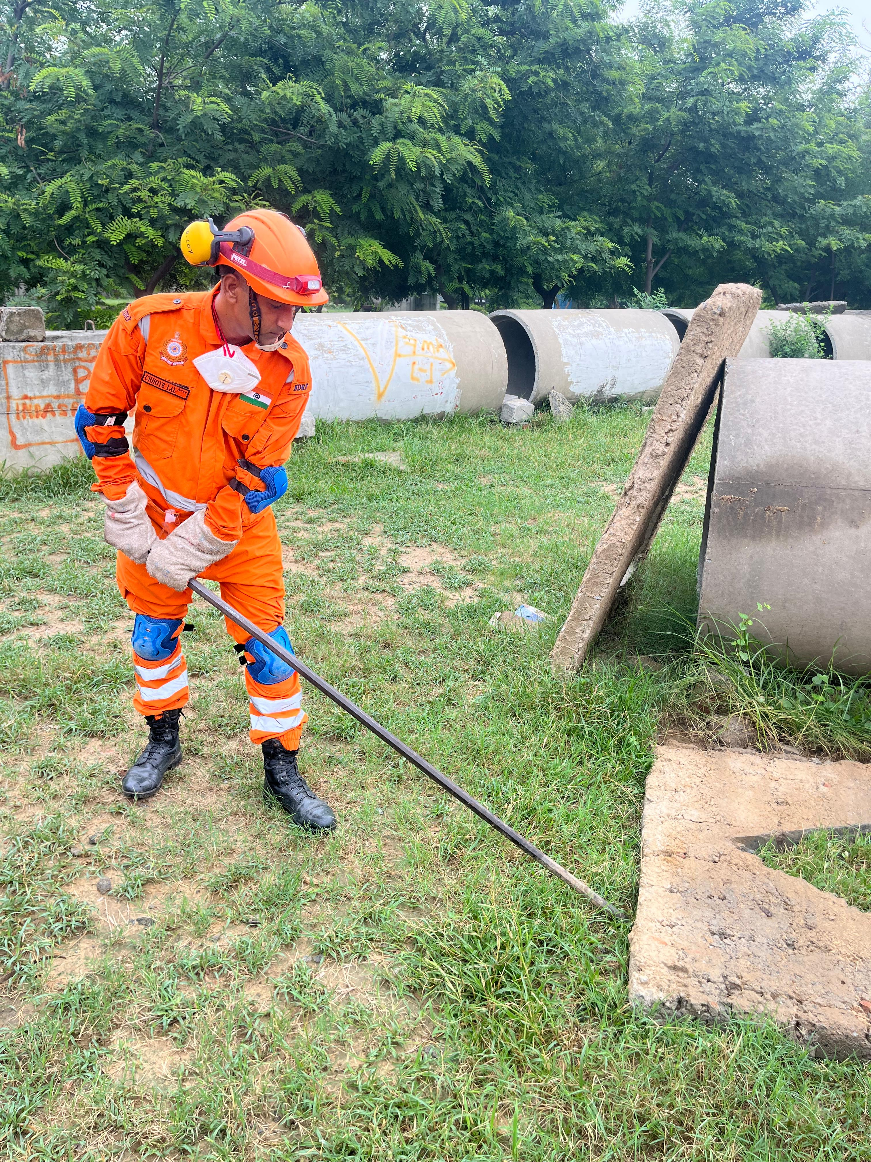
Class 2 Lever
Upward force
Load
Fulcrum
PEER | CSSR | INDIA
PPT 10 -
NDRF | CSSR | INDIA

Slide 11
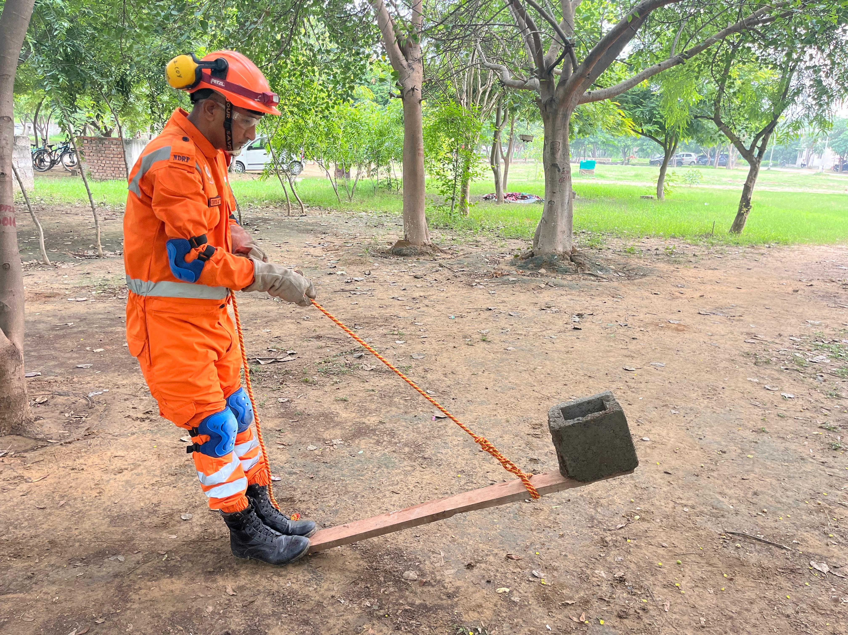
Class 3 Lever
Upward force
Load
Fulcrum
PEER | CSSR | INDIA
PPT 10 -
NDRF | CSSR | INDIA

Slide 12
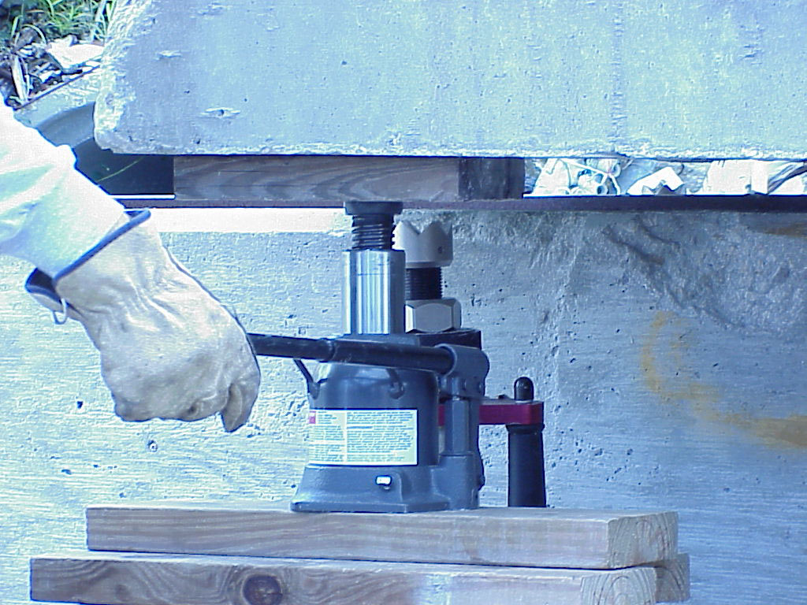
Hydraulic Jack
PEER | CSSR | INDIA
PPT 10 -
NDRF | CSSR | INDIA

Slide 13
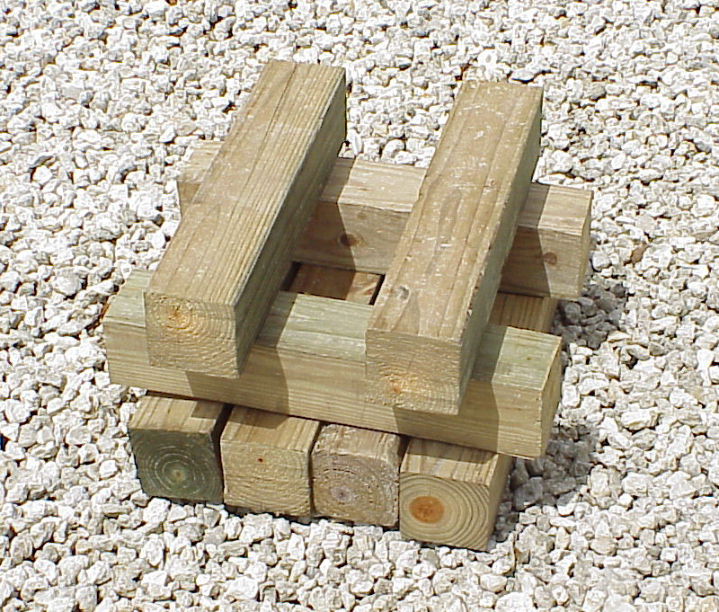
Box Cribbing
PEER | CSSR | INDIA
PPT 10 -
NDRF | CSSR | INDIA

Slide 14
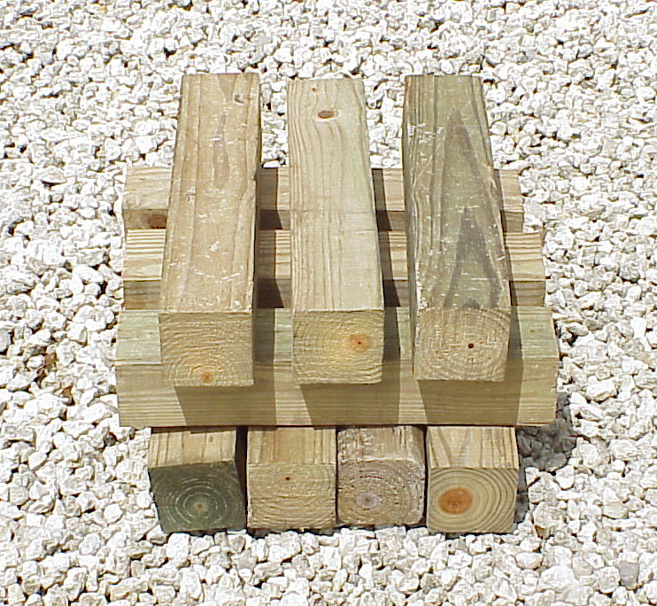
Platform Cribbing
PEER | CSSR | INDIA
PPT 10 -
NDRF | CSSR | INDIA

Slide 15
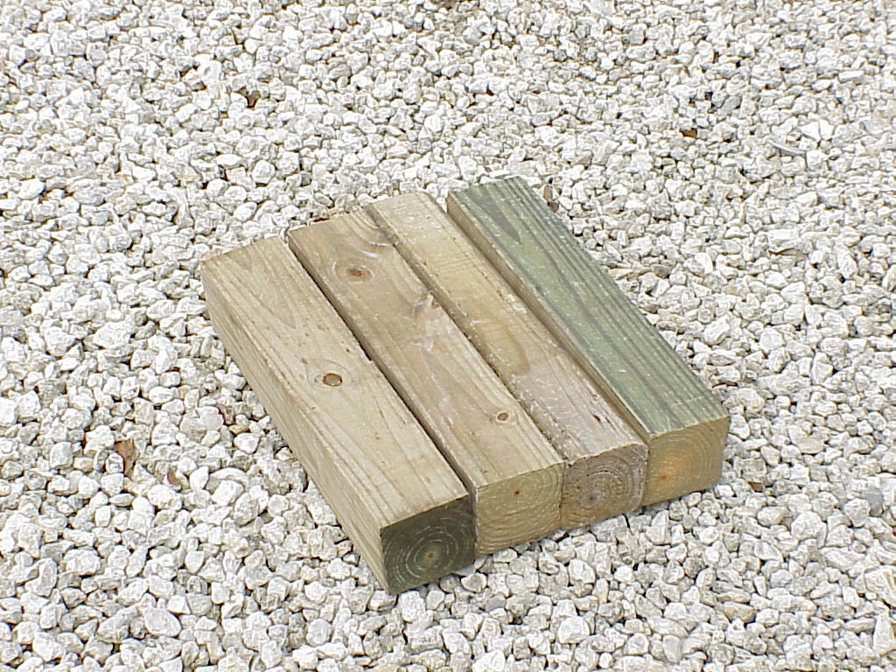
Cribbing Solid Base
PEER | CSSR | INDIA
PPT 10 -
NDRF | CSSR | INDIA

Slide 16
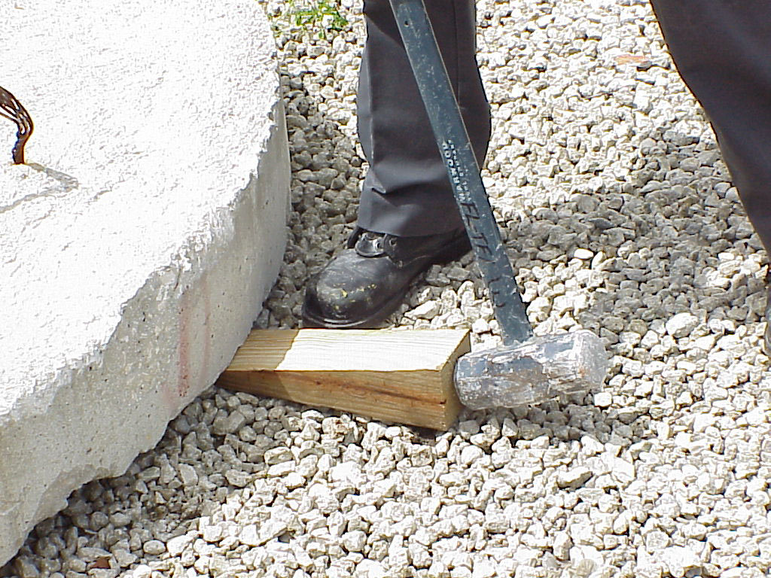
Inserting a wedge to initiate cribbing
PEER | CSSR | INDIA
PPT 10 -
NDRF | CSSR | INDIA

Slide 17
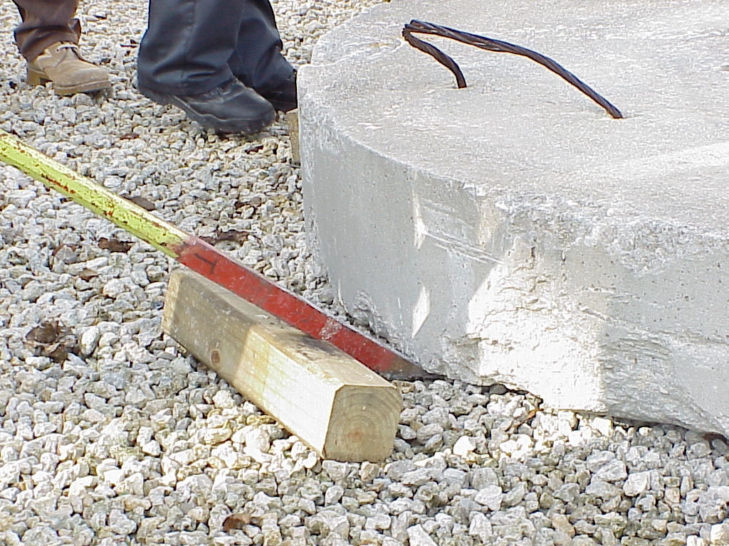
PEER | CSSR | INDIA
PPT 10 -
NDRF | CSSR | INDIA

Slide 18
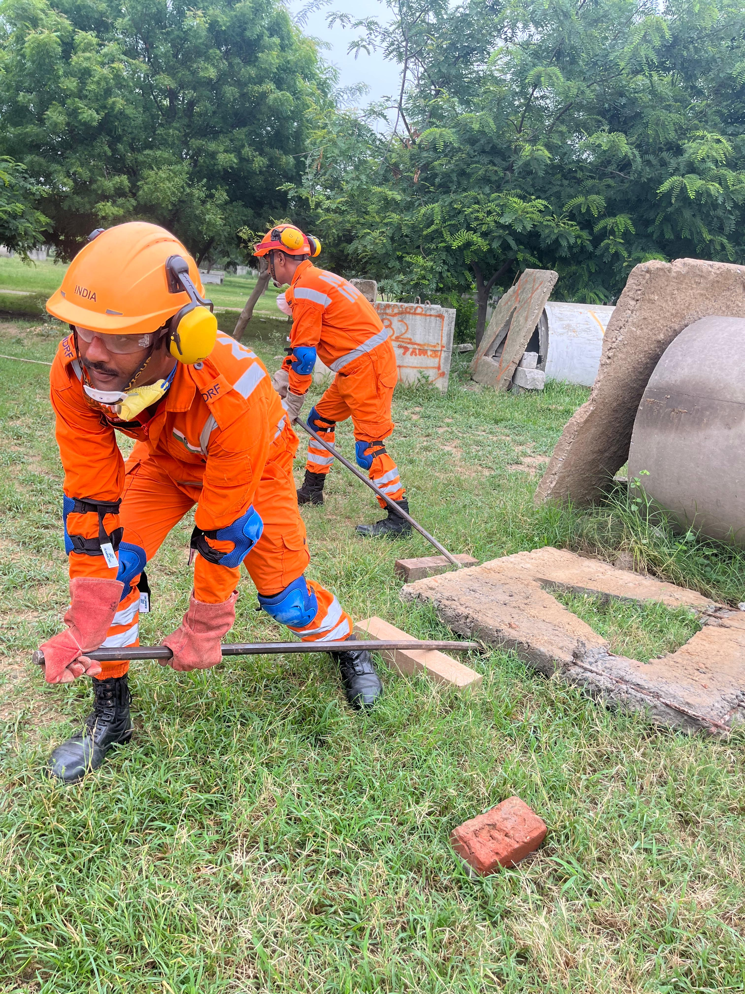
PEER | CSSR | INDIA
PPT 10 -
NDRF | CSSR | INDIA

Slide 19
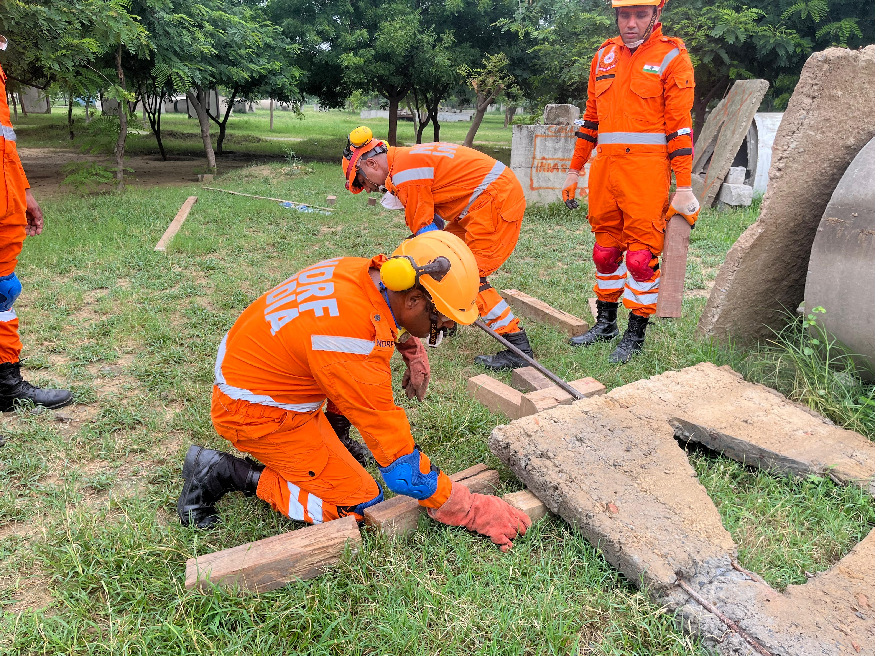
PEER | CSSR | INDIA
PPT 10 -
NDRF | CSSR | INDIA

Slide 20
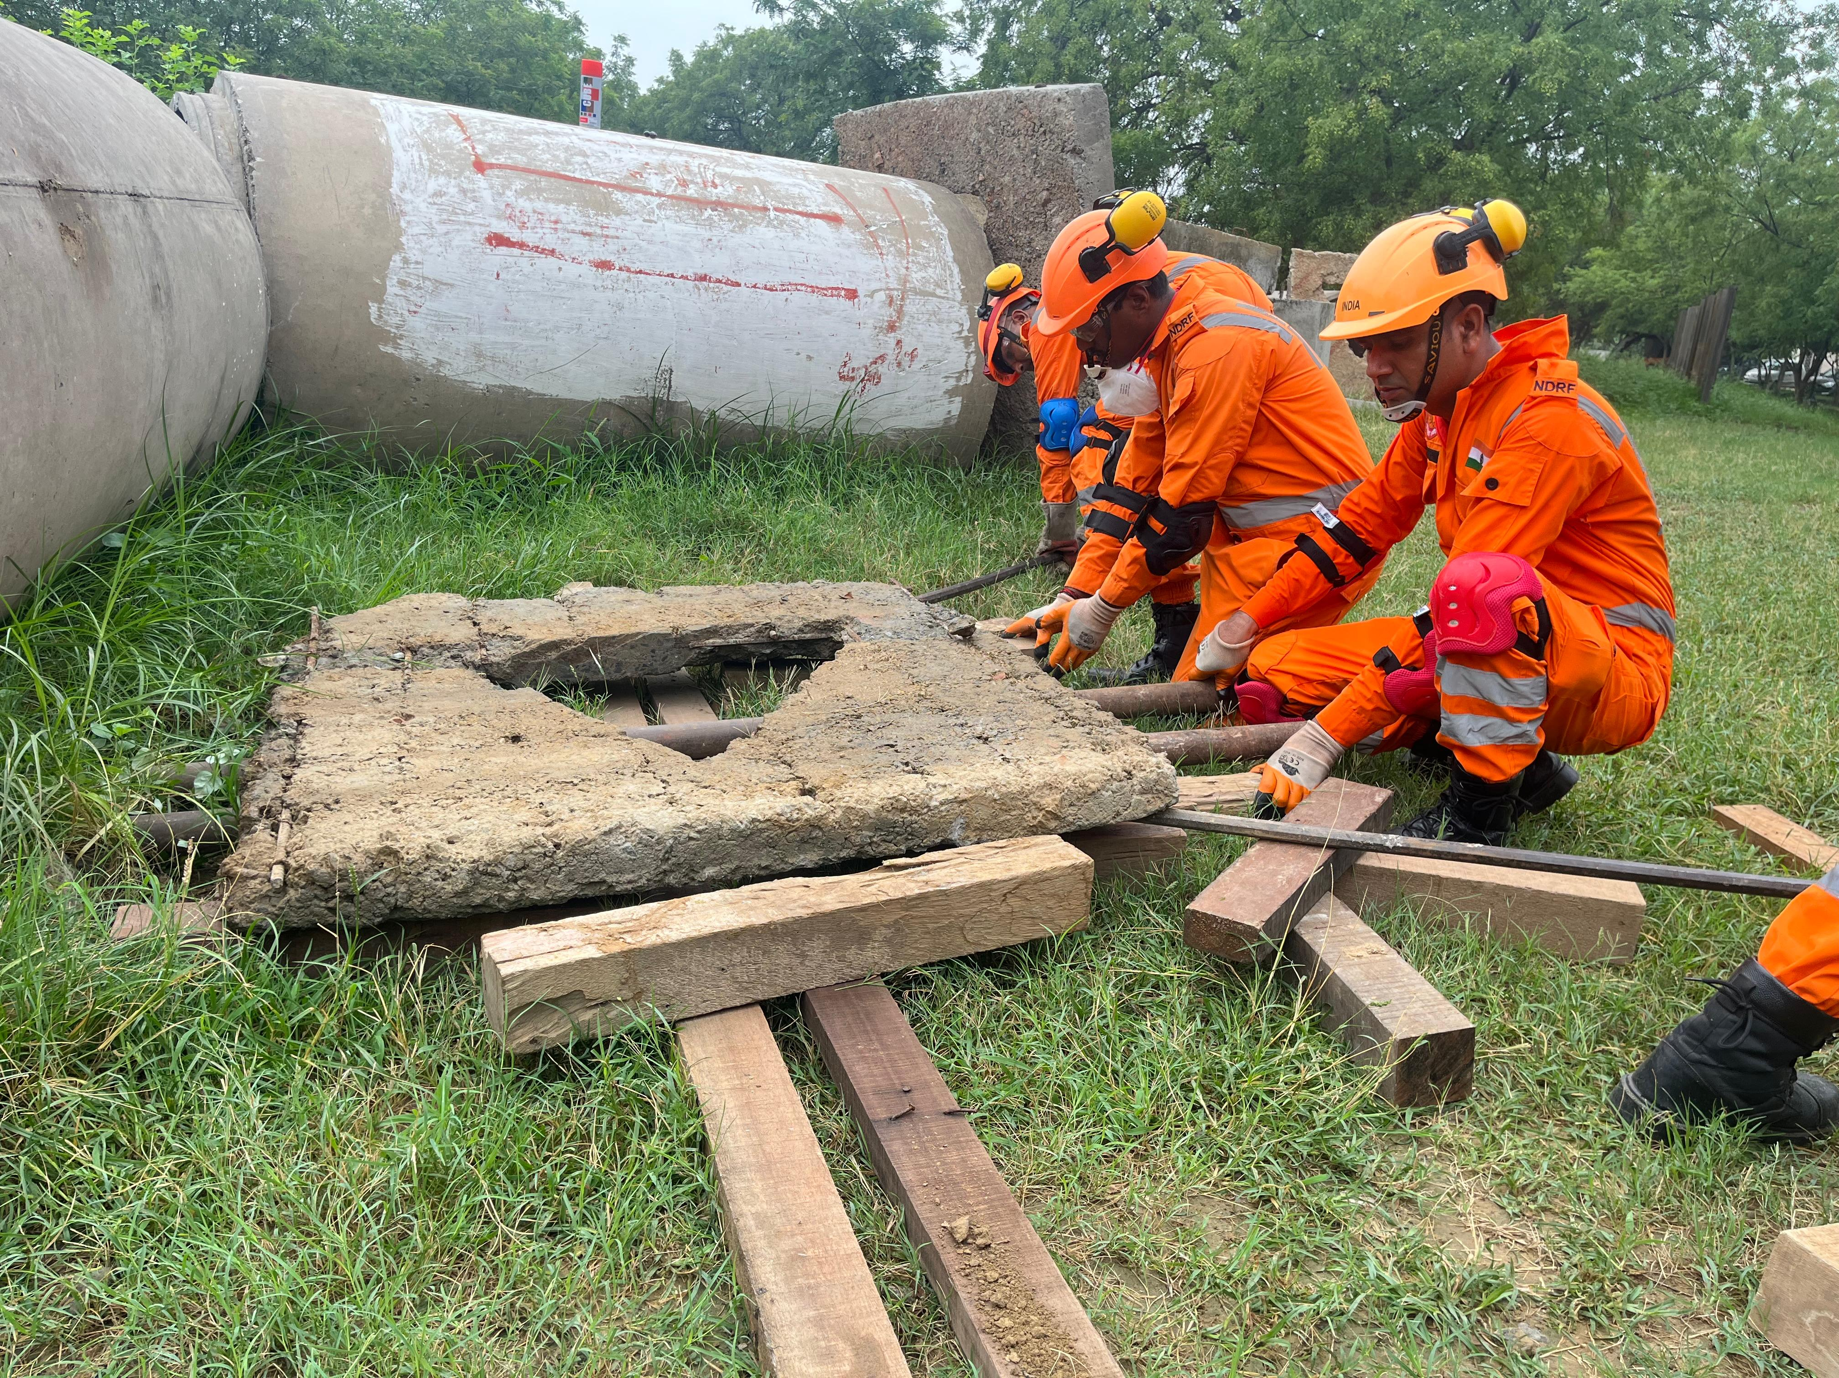
PEER | CSSR | INDIA
PPT 10 -
NDRF | CSSR | INDIA

Slide 21
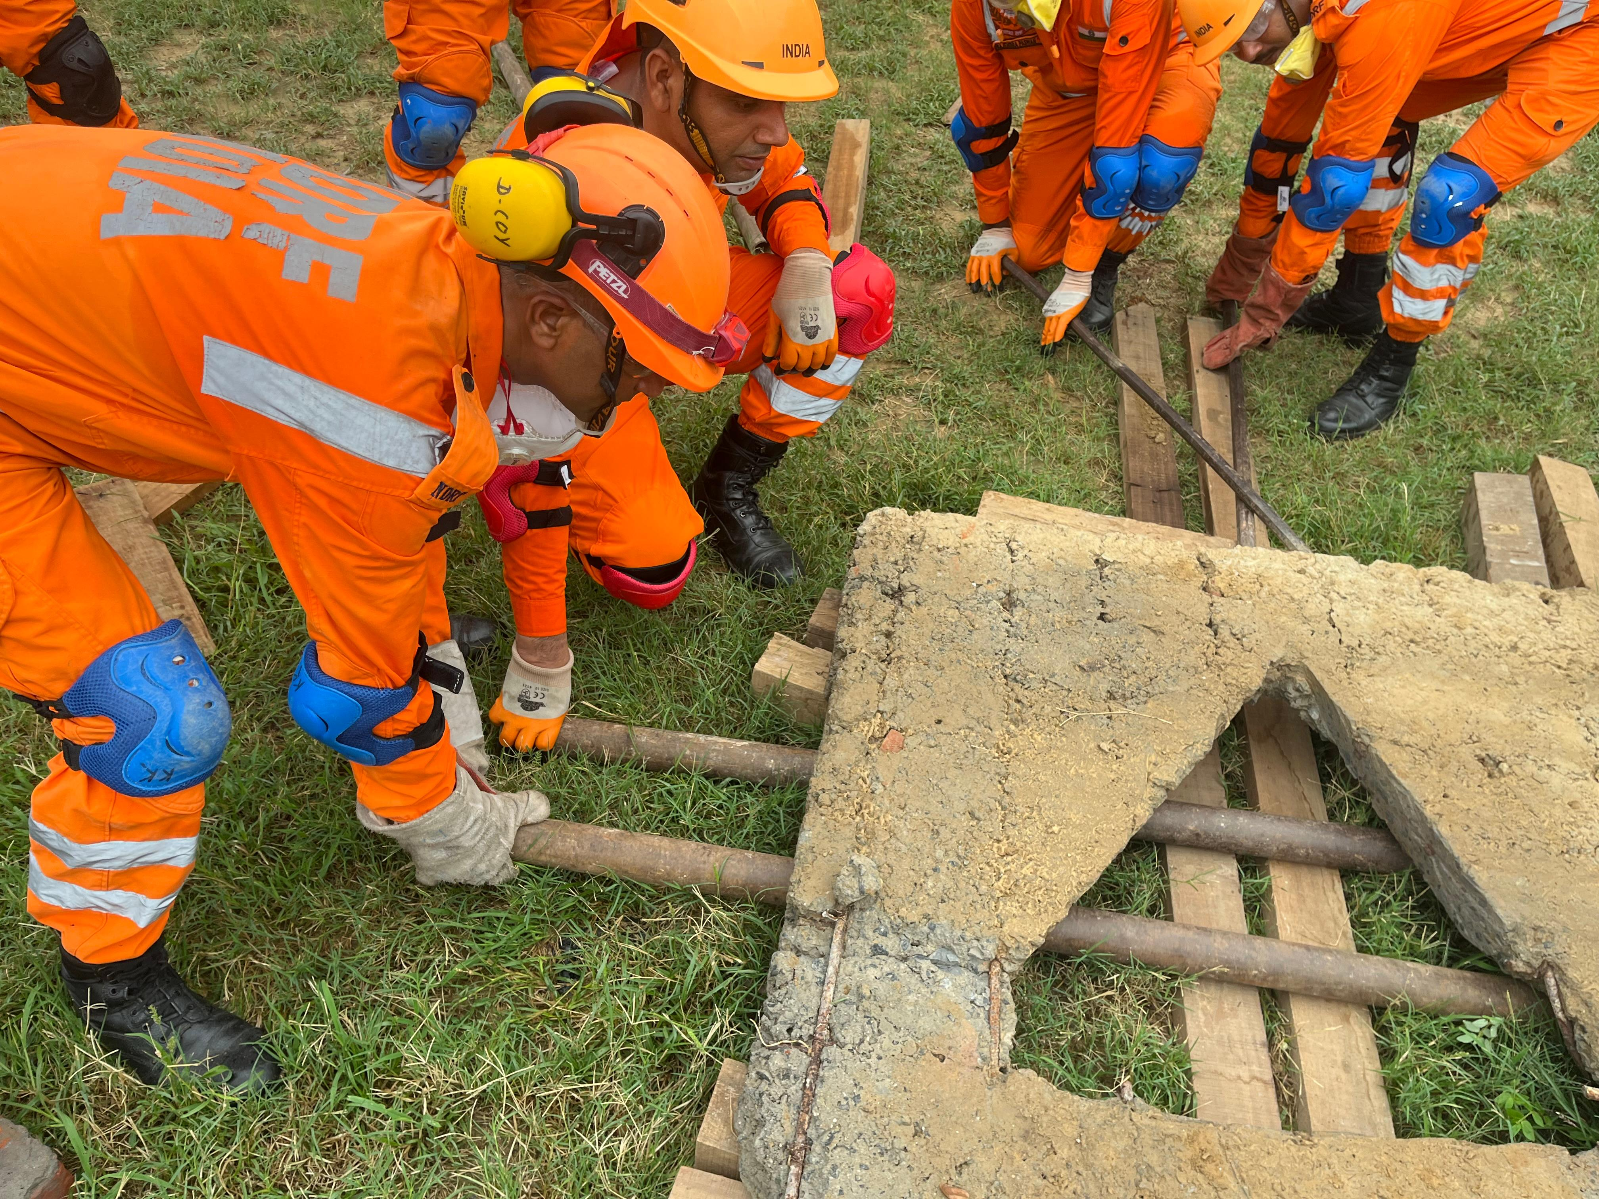
Lifting to insert tubes for rolling
PEER | CSSR | INDIA
PPT 10 -
NDRF | CSSR | INDIA

Slide 22
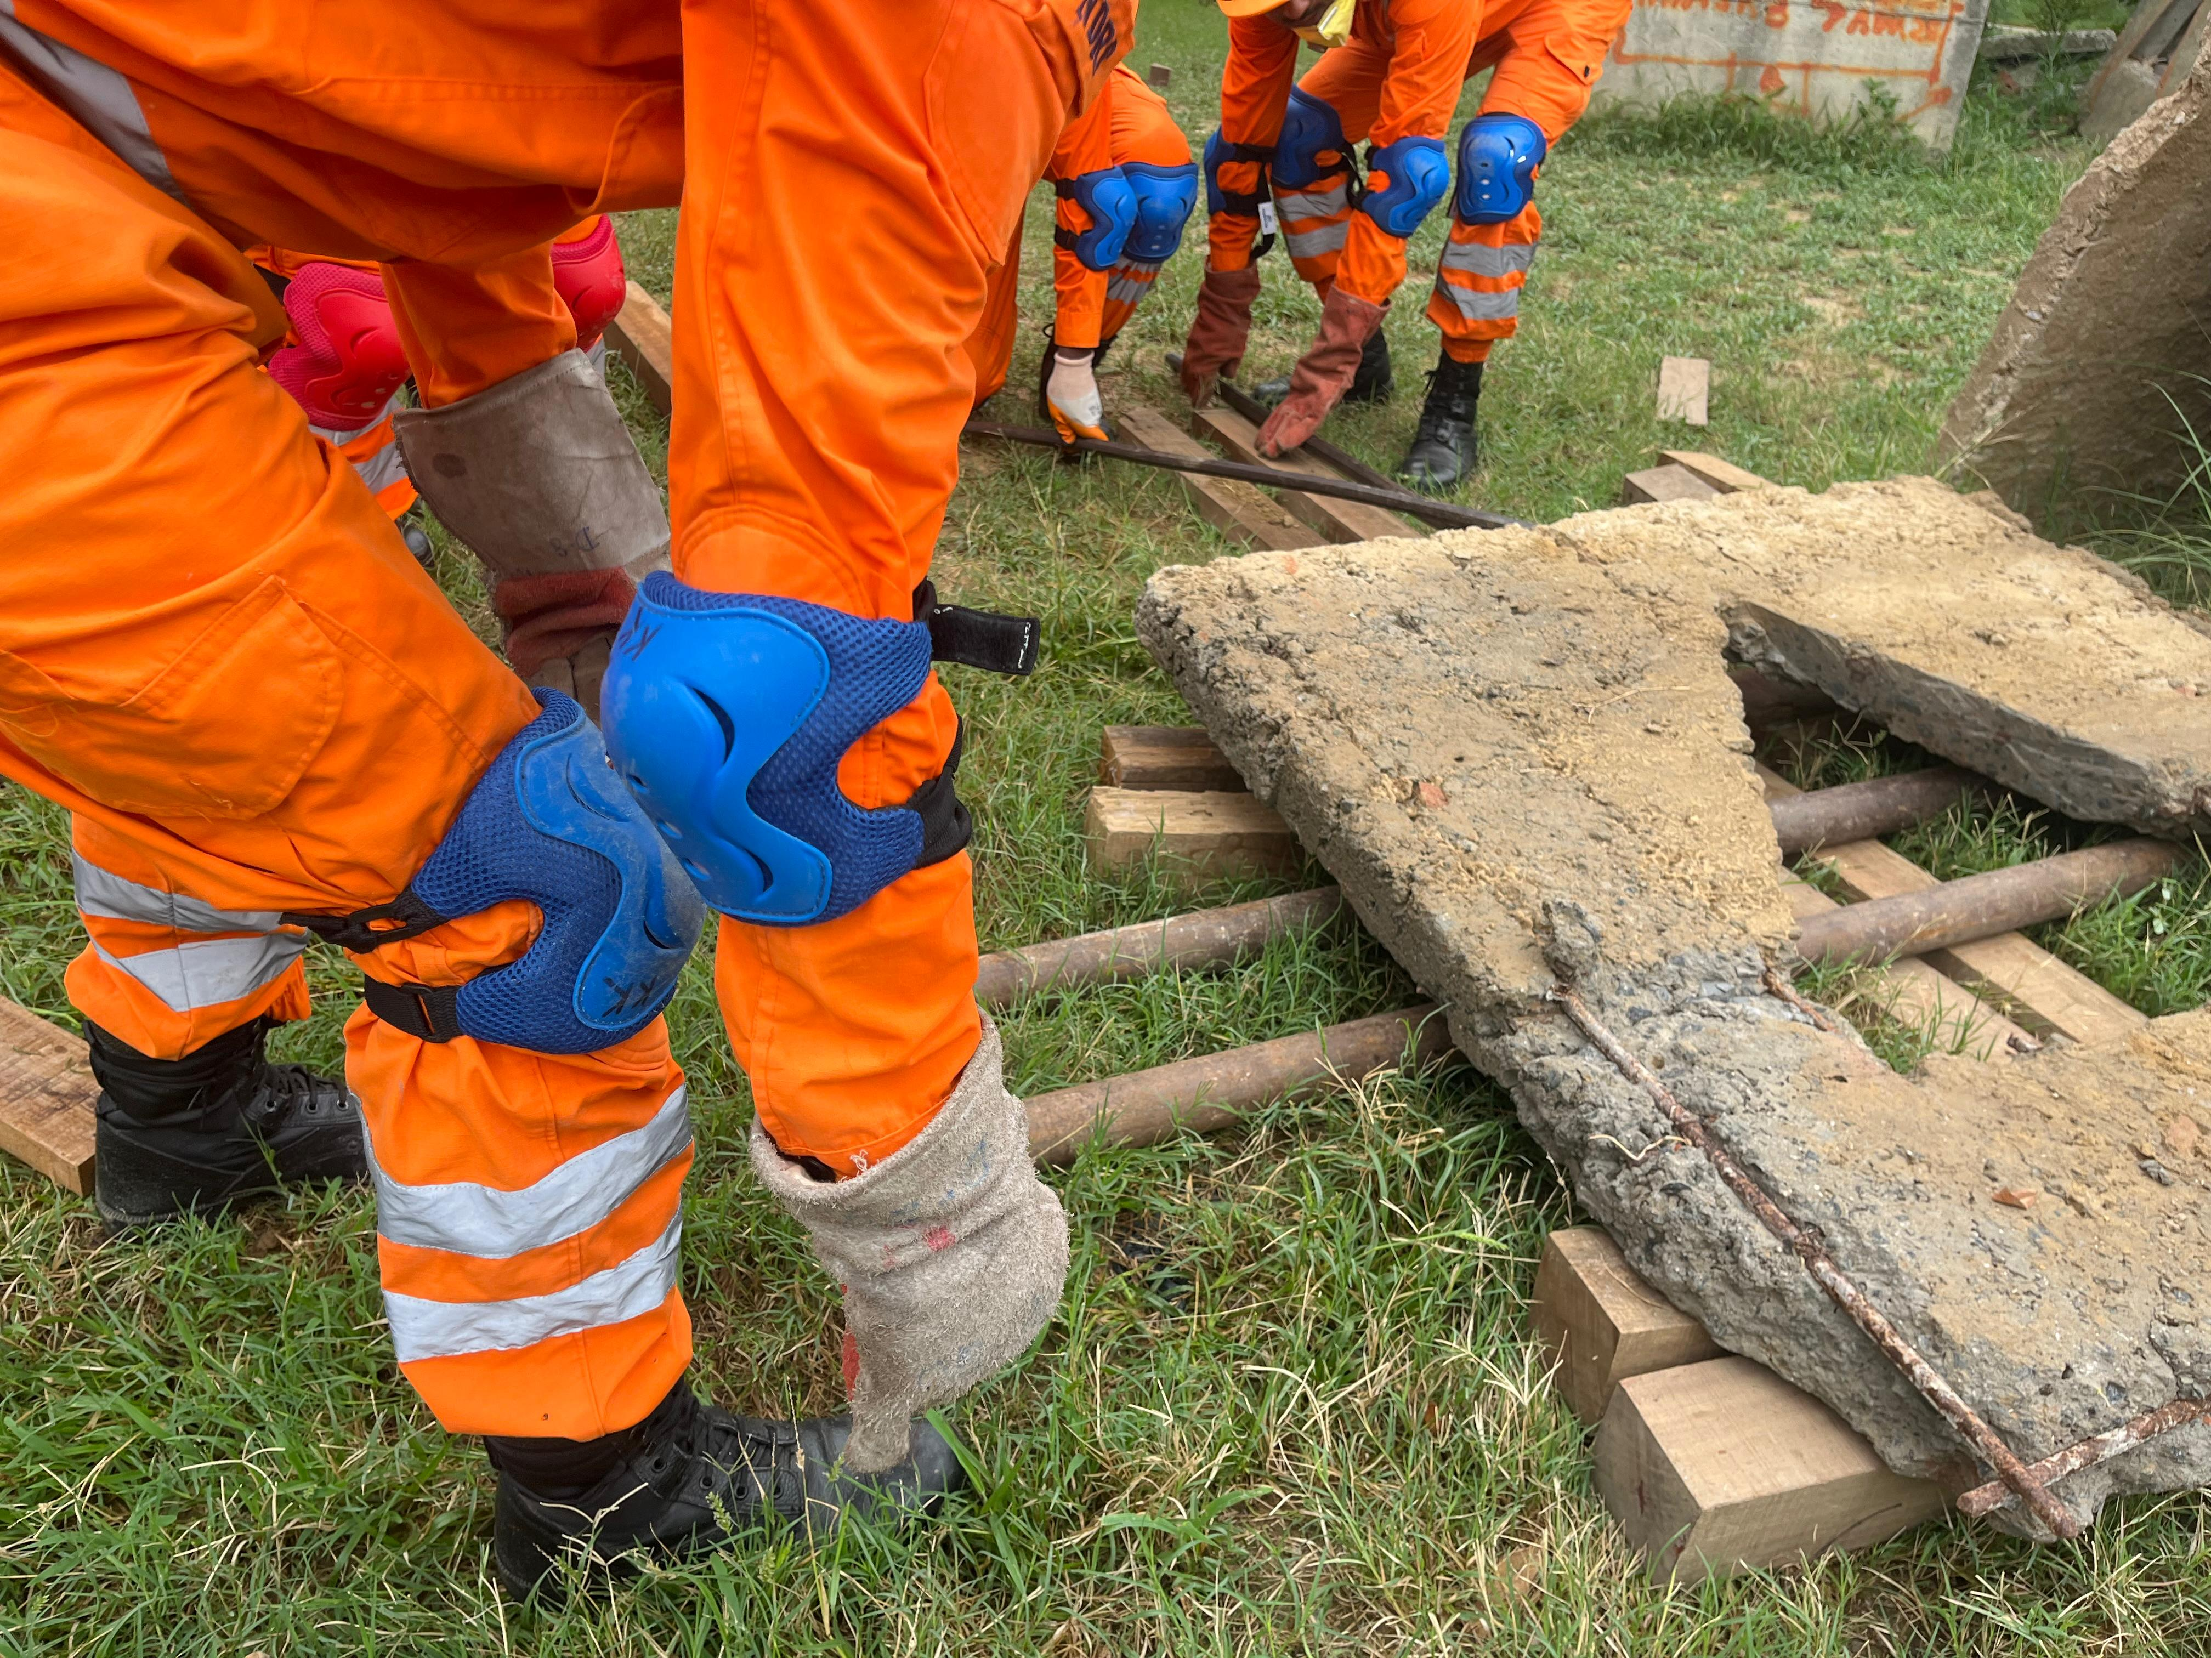
PEER | CSSR | INDIA
PPT 10 -
NDRF | CSSR | INDIA

Slide 23
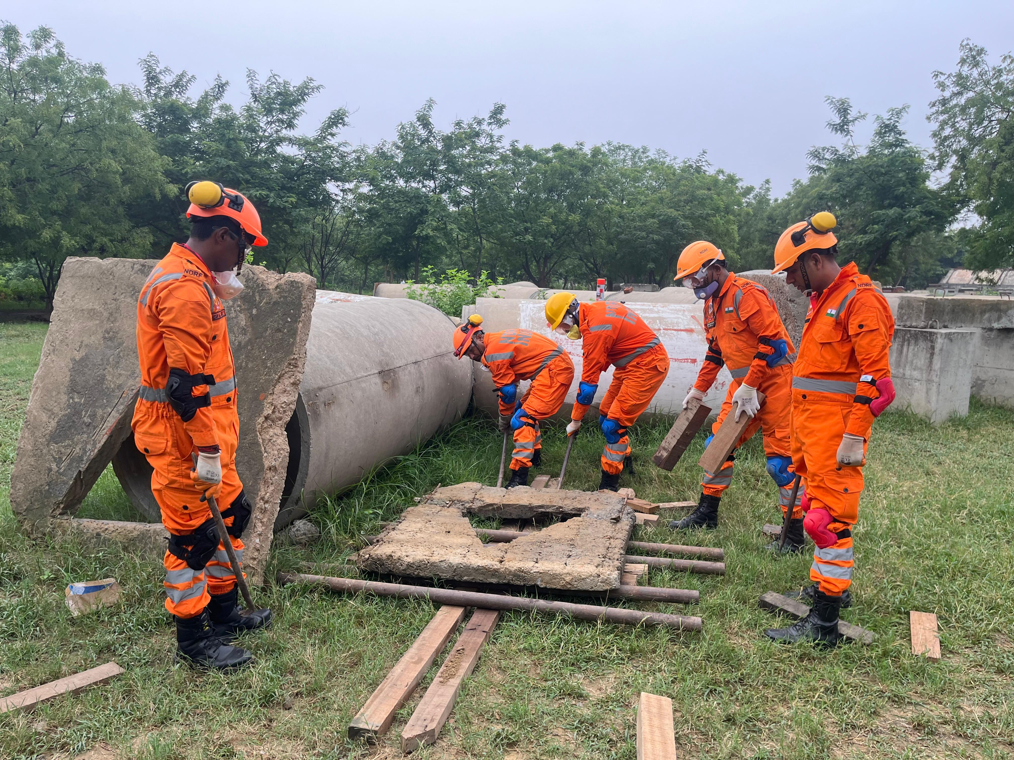
PEER | CSSR | INDIA
PPT 10 -
NDRF | CSSR | INDIA

Slide 24
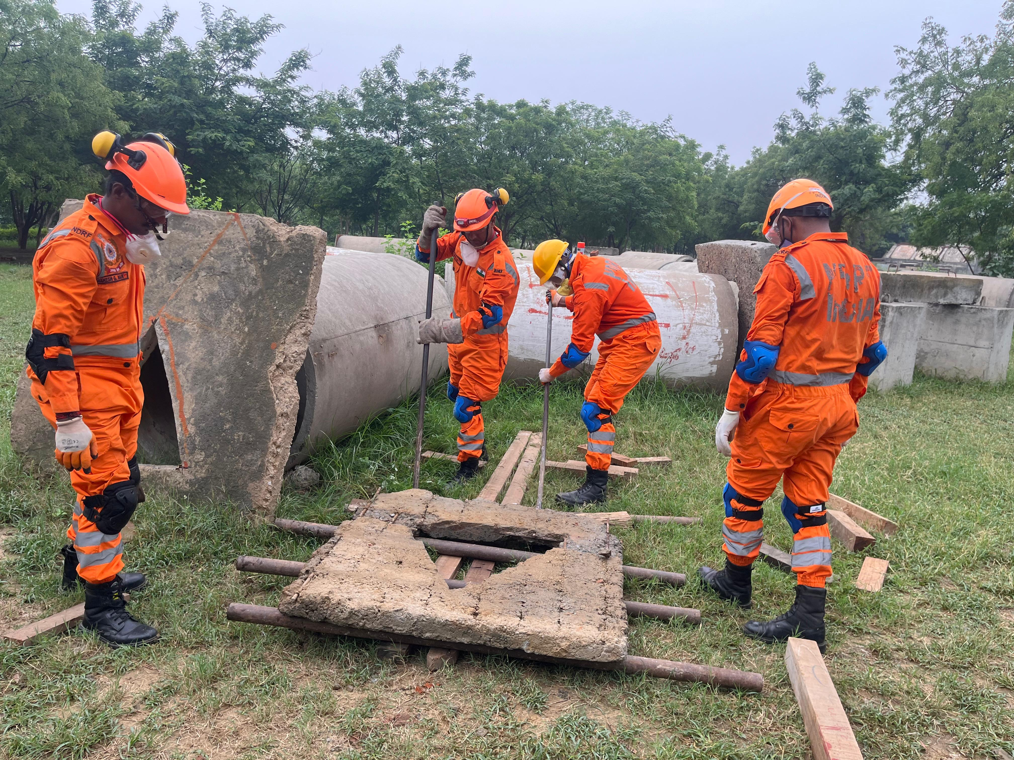
Tubes fanned for turning load
PEER | CSSR | INDIA
PPT 10 -
NDRF | CSSR | INDIA

Slide 25



THANK YOU

