Slide 1
CASE STUDIES

Slide 2
OBJECTIVES
Upon completing this lesson, you will be able to learn about:-
Chennai Urban Flooding-2015
Kerala Flood- 2018
Analysis of death of rescuers in FWR Trg/ops including Mundali, ODRAF incident

Slide 3
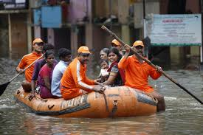
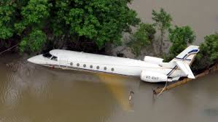
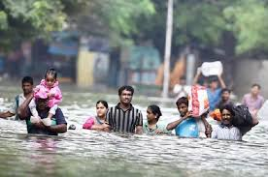
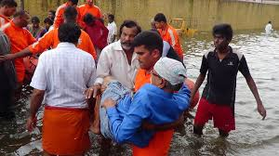
CHENNAI FLOOD - 2015

Slide 4
FLOOD
Floods have been a recurrent phenomenon in India
Causing huge losses to lives, properties, livelihood systems, infrastructure and public utilities.
India’s high risk and vulnerability is highlighted by the fact that 40 million hectares out of a geographical area of 3290 lakh hectares is prone to floods.
On an average every year, 75 lakh hectares of land is affected, 1600 lives are lost and the damage caused to crops, houses and public utilities is Rs. 1805 crores due to floods.

Slide 5
CAUSES
Due to heavy rain during monsoon season, the rivers bring heavy sediment load from the catchments.
These, coupled with inadequate carrying capacity of the rivers are responsible for causing floods
Drainage congestion
Erosion of river-banks
Cyclones, cyclonic circulations and cloud bursts cause flash floods and lead to huge losses

Slide 6
DAMAGES CAUSED BY FLOODS
Loss of life and damage to property
The sense of insecurity and fear in the minds of people living in the flood plains is a cause of great concern.
The after-effects of floods
The agony of survivors
Spread of epidemics
Non availability of drinking water, essential commodities and medicines
Loss of the dwellings etc

Slide 7
Cont.
Flooding in the cities and the towns is a recent phenomenon caused by:-
Increasing incidence of heavy rainfall in a short period of time
Indiscriminate encroachment of waterways
Inadequate capacity of drains and
Lack of maintenance of the drainage

Slide 8
IMD REPORT
The IMD vide its warning dated 26.11.2015 reported that a low pressure area is forming over South East Bay of Bengal.
IMD in its report dated 29.11.2015 informed that another low-pressure area would form over Southwest Bay of Bengal. The above low-pressure areas brought widespread rains in the districts of Chennai, Tiruvallur, Kancheepuram, Cuddalore, Viluppuram, Nagapattinam and Thoothukudi Districts.
Particularly on 1.12.2015, rainfall of more than 400 mm was witnessed at Tambaram (494.20 mm), Chembarambakkam (475 mm),
Thirukazhukundram (441.40 mm), Marakkanam (421 mm)

Slide 9
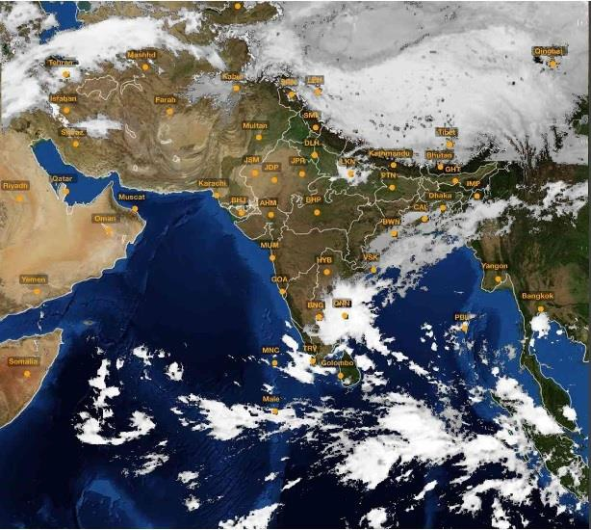
SATELLITE IMAGE OF LANDFALL OF LOW-PRESSURE AREA ON 01.12.2015

Slide 10
Cont.
Many parts of Tamil Nadu received unprecedented torrential rains in the first week of December, 2015, leading to a deluge in the Chennai Metropolitan area and in the adjoining Districts of Kancheepuram and Tiruvallur as well as Cuddalore, Thoothukudi and Thirunelveli.

Slide 11
DISTRICT WISE RAINFALL RECEIVED DURING THE PERIOD FROM 1.12.2015 TO 5.12.2015
Sl. No. | District | Actual rainfall for 5 days |  | Normal rainfall for 5 days | Excess %
 |  | (in mm)
1 | Chennai | 399.0 | 40.6 |  | + 883 %
2 | Kancheepuram | 467.2 | 34.5 |  | + 1254 %
3 | Tiruvallur | 335.2 | 34.8 |  | + 863 %
4 | Cuddalore | 274.8 | 49.9 |  | + 451%
5 | Nagapattinam | 263.1 | 73.9 |  | + 256 %
6 | Villupuram | 240.0 | 27.8 |  | + 764 %
In the districts of Chennai, Kancheepuram and Tiruvallur, it had rained about 2.5, 3.8 & 3.2 times normal levels of rainfall respectively.
Cuddalore district received 1.9 times normal rainfall, while Nagapattinam & Villupuram received over 2.5 times normal rainfall.

Slide 12
Cont.
The outcome of this unprecedented level of downpour was immediate and disastrous with major water bodies getting filled and flowing into major rivers, Adayar, Coovum and Kosathalaiar coupled with the heavy downpours in the city which could not drain into the Adayar river.
This transformed the densely populated areas of Chennai City into islands of houses in vast expanse of water that filled roads and streets for many feet.

Slide 13
Cont.
This flood put a large number of urban populace of these areas in great difficulty and has caused severe damages to public and private property.
Flood waters entered into a large numbers of houses in many areas of Chennai and other districts and remained so for few days, forcing the inhabitants to evacuate from the houses and move to higher floors or safer areas.

Slide 14
Cont.
This has caused complete loss of furniture, cars, two wheelers and other domestic durable assets.
Widespread flooding shut down the airport and factories of top automobile companies, and stopped trains packed with passengers on submerged tracks.
The Indian Navy’s air base at Arakkonam -- 70 km west of Chennai – was readied for commercial flights to evacuate hundreds of passengers stranded at the civil airport, which has been shut till December.

Slide 15
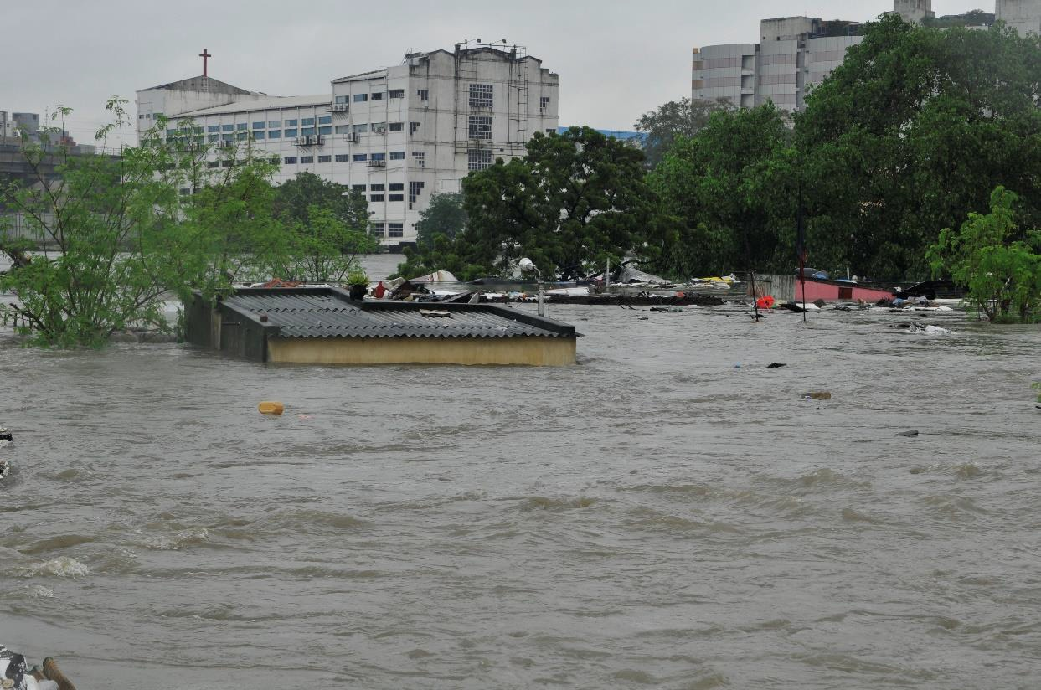
SUBMERGED HOUSES NEAR ADAYAR RIVER

Slide 16
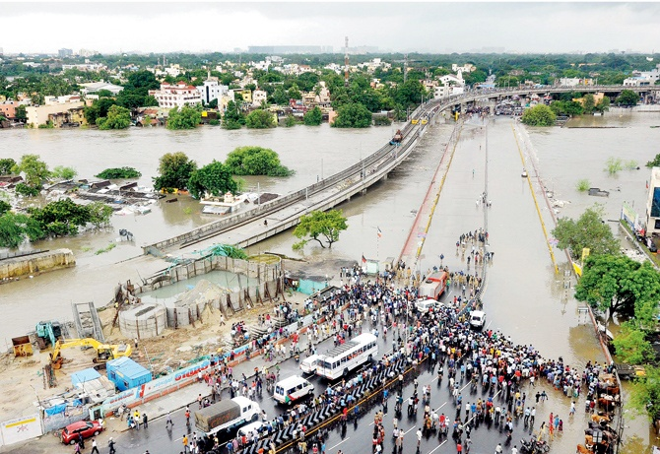
SAIDAPET OVERBRIDGE SUBMERGED IN FLOODS

Slide 17
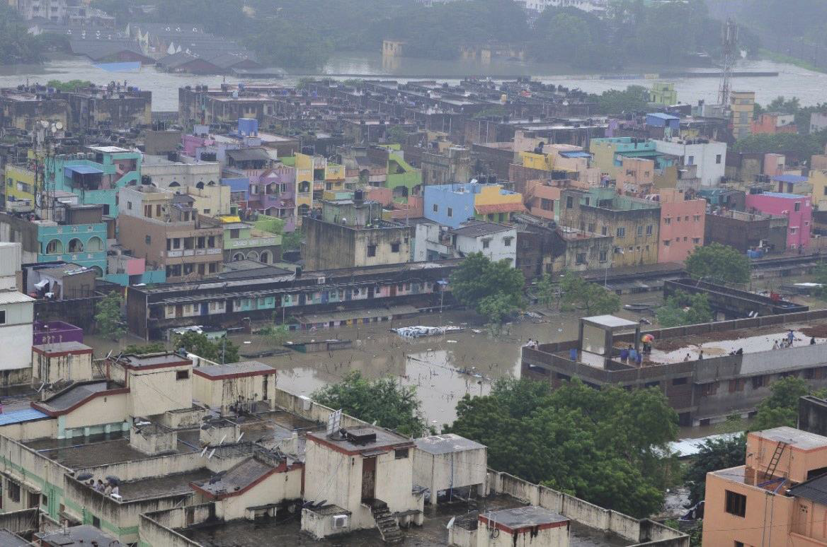
INUNDATED HOUSES IN KOTTURPURAM

Slide 18
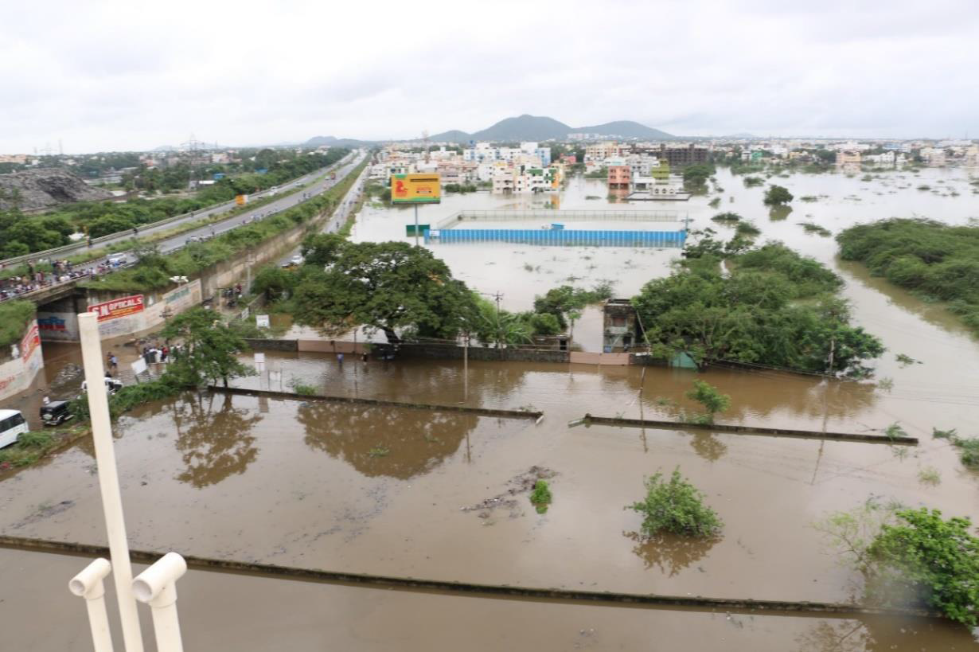
WATER INUNDATION DUE TO FLOOD IN PERUNGALATHUR

Slide 19
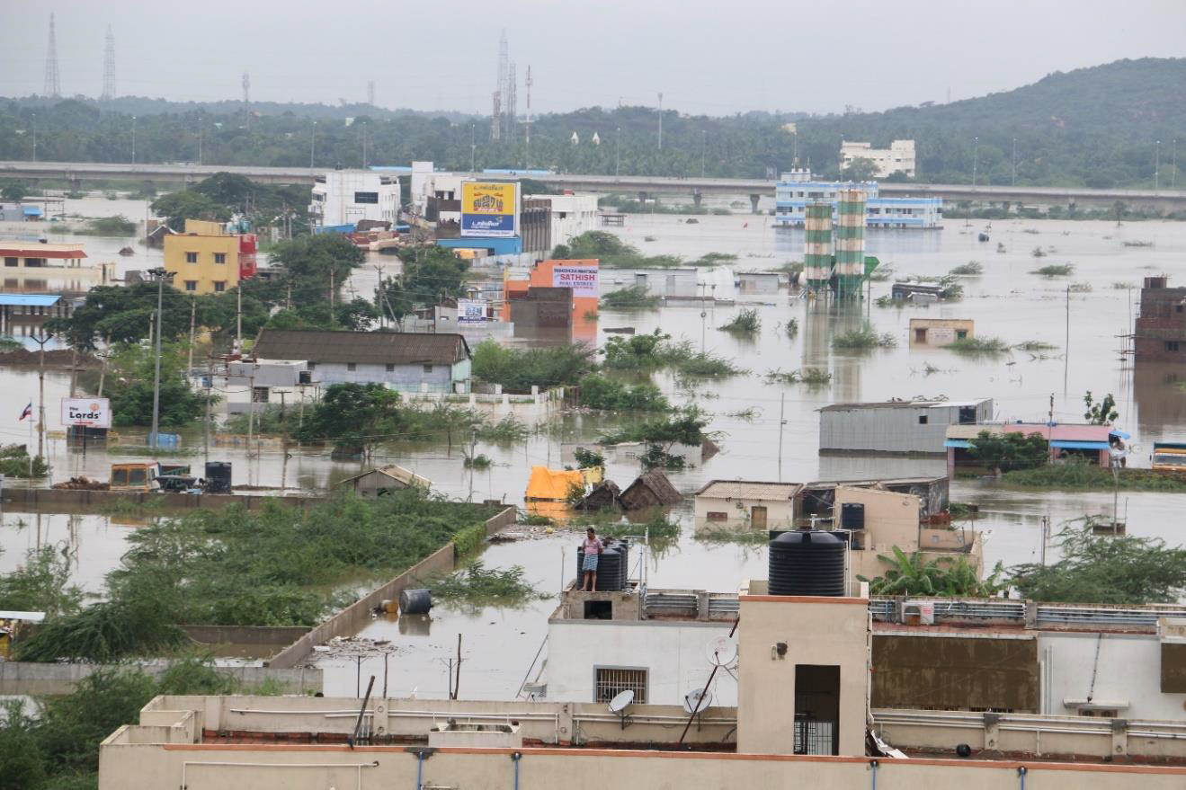
SUBMERGED HOUSES IN TAMBARAM

Slide 20
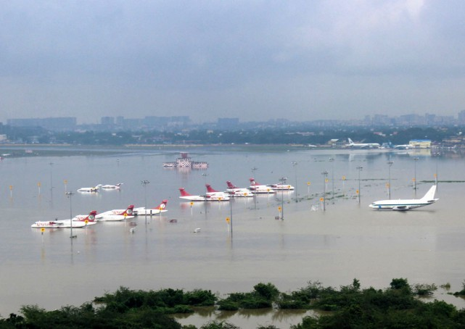
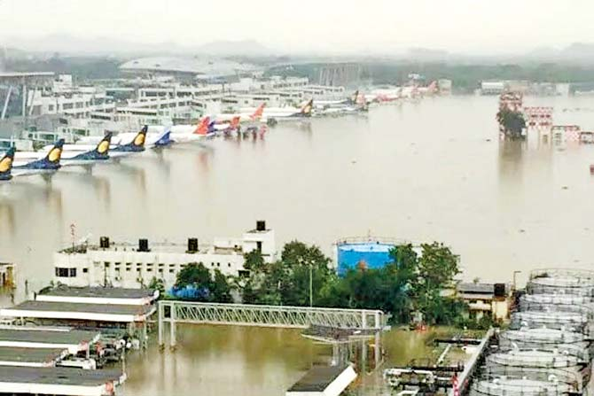
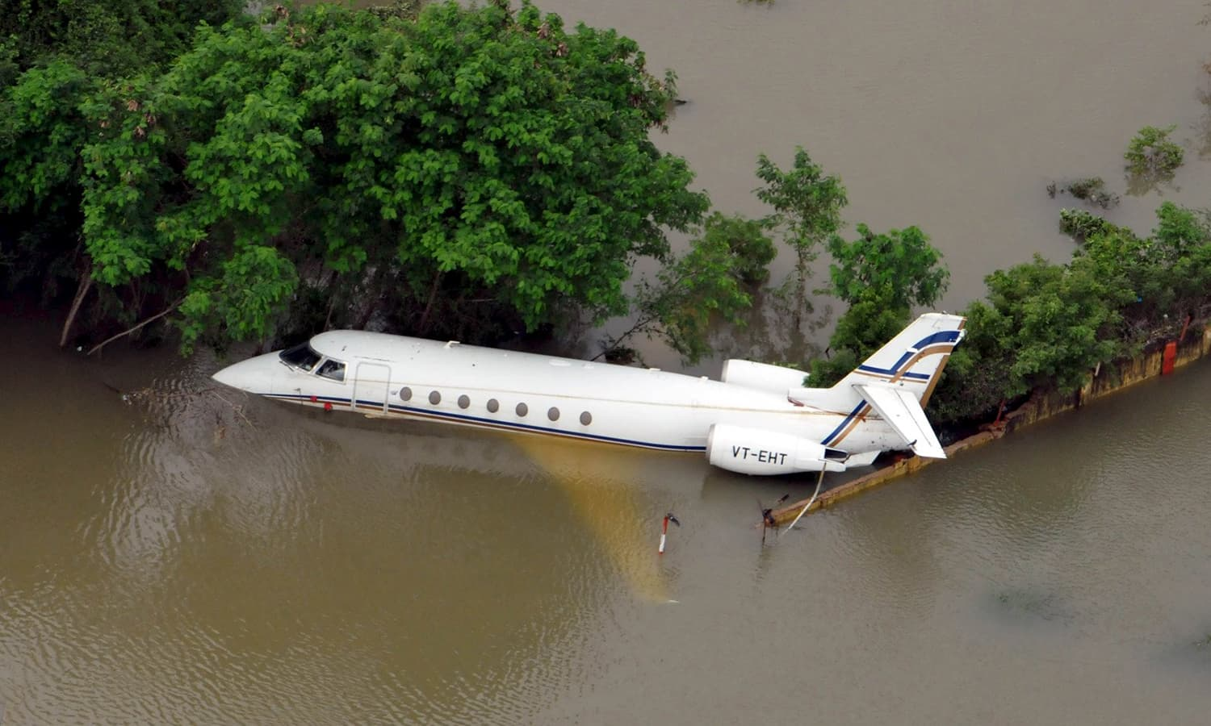
FLOODED CHENNAI AIRPORT

Slide 21
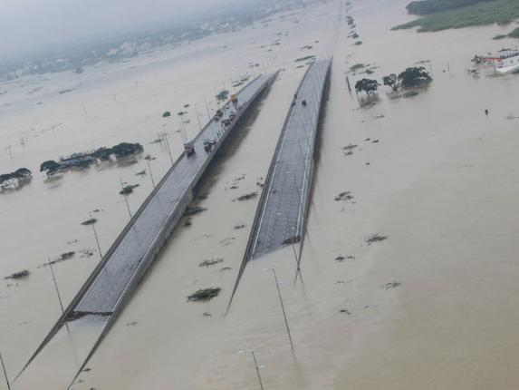
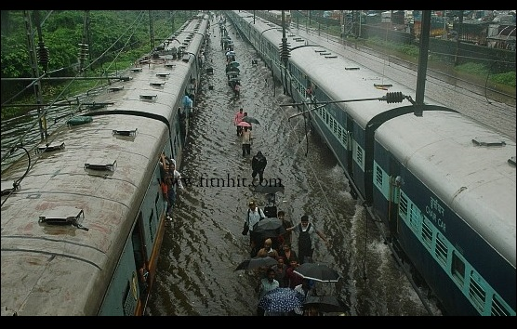
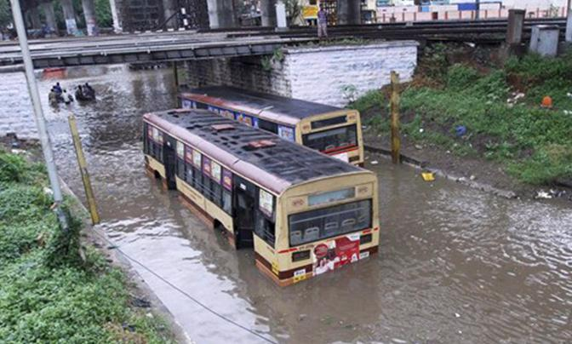
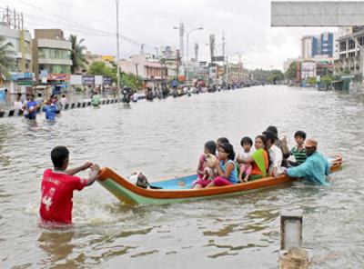
DISRUPTION OF TRANSPORTATION

Slide 22
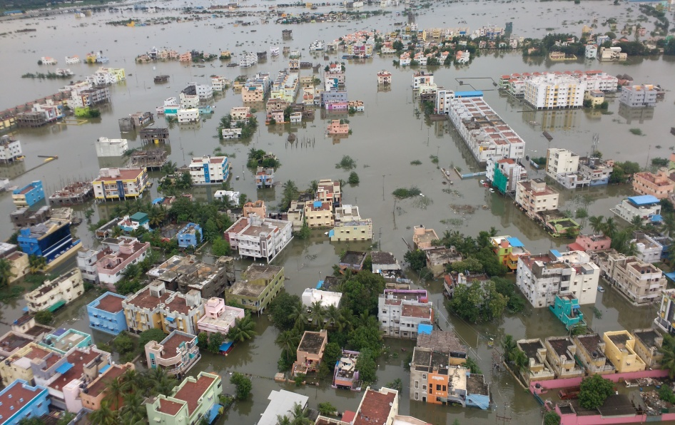
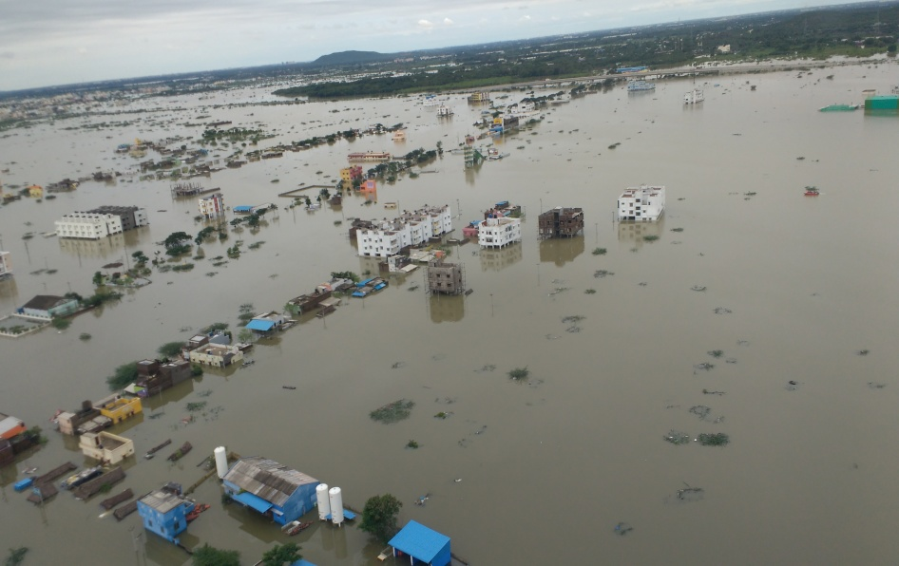
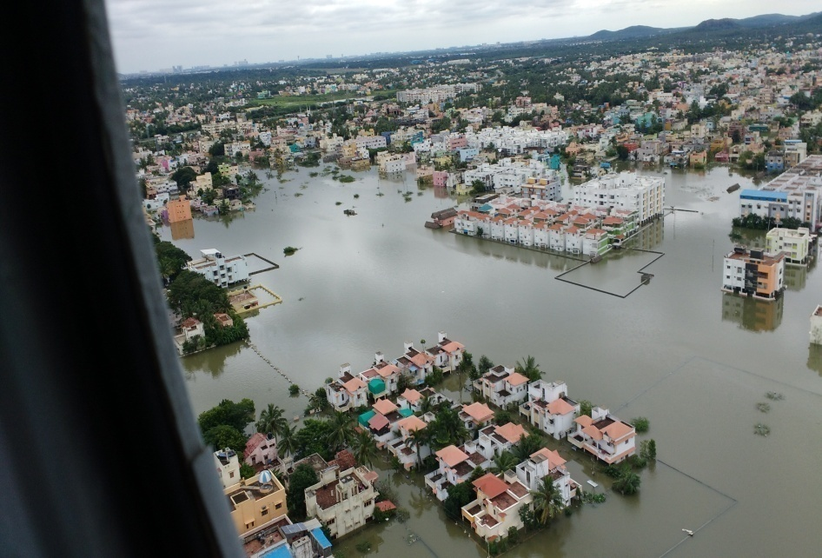
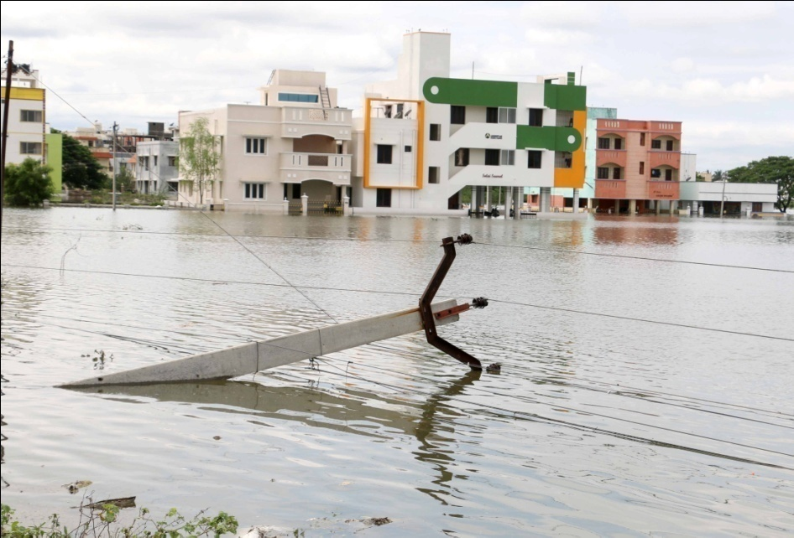
FLOOD DAMAGES IN KANCHEEPURAM DISTRICT

Slide 23
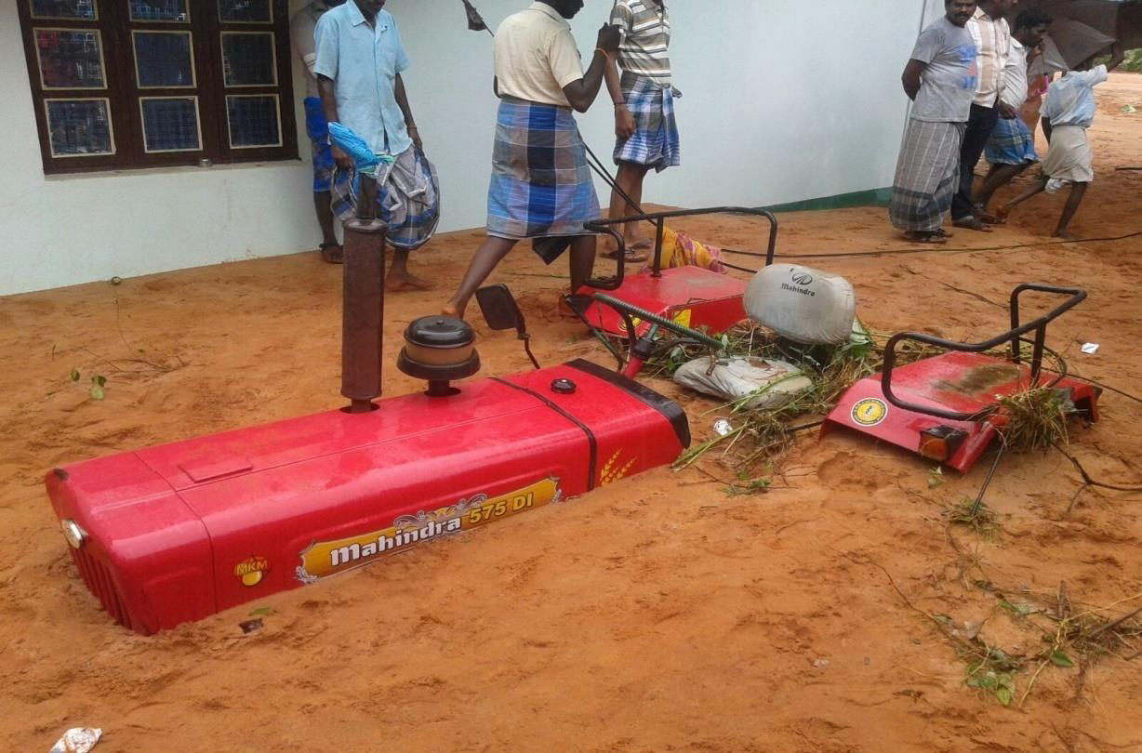
FLOODING AT VISOOR IN PANRUTI , CUDDALORE DISTRICT

Slide 24
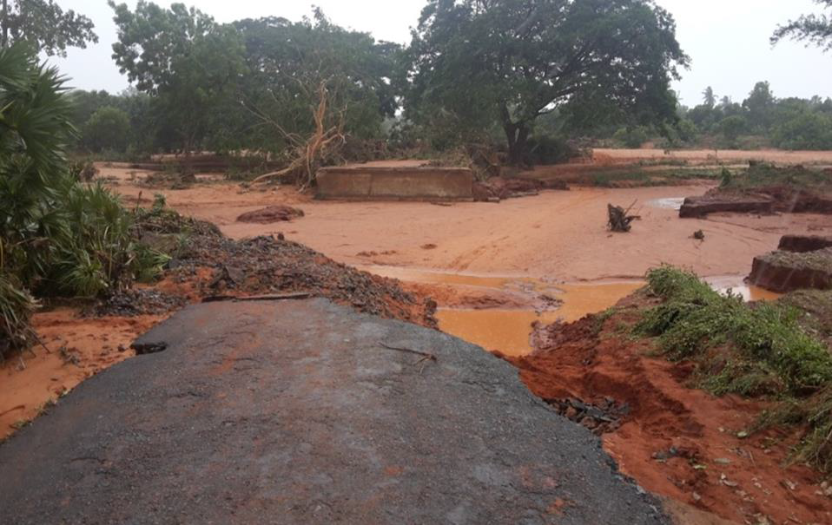
BREACH IN MELIRUPPU TO KEELIRUPPU ROAD AT CUDDALORE

Slide 25
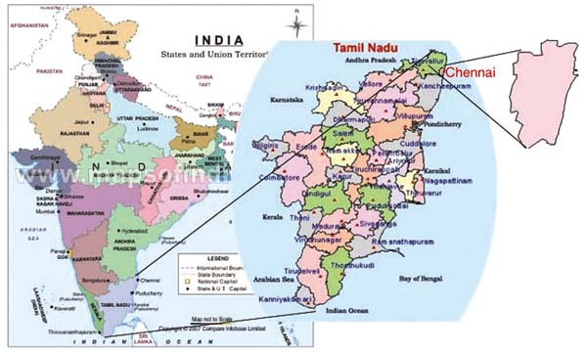
CHENNAI DISTRICT

Slide 26
GEOGRAPHICAL FEATURE
Area of Chennai city | 426 Sq.Km
Major Water ways | Adyar River , Coovum River, Kosasthalaiar River, Mambalam Canal, Captain Cotton Canal, Otteri Nullah, Virugambakkam Canal.
Storm Water Drain | 7,351 Drains
Annual average rainfall | 958.5mm / Year
Average Rainfall in November | 513.9mm

Slide 27
RAINFALL
November 2015 is recorded as the wettest month of last 100 years with 1113.80. mm of rainfall. Way back in 1918 Chennai has received 1088.40 mm which remains maximum till date.
Maximum Rainfall Recorded 319.60mm on 02.12.2015.
Normal life affected due to high rise of water level in Coovum river, Adyar river, Buckingham Canal and Kosasthalaiar river basin as a result of surplus water released from Chembarambakkam, Red hills and Poondi reservoir during 17.11.2015 and 01.12.2015.

Slide 28
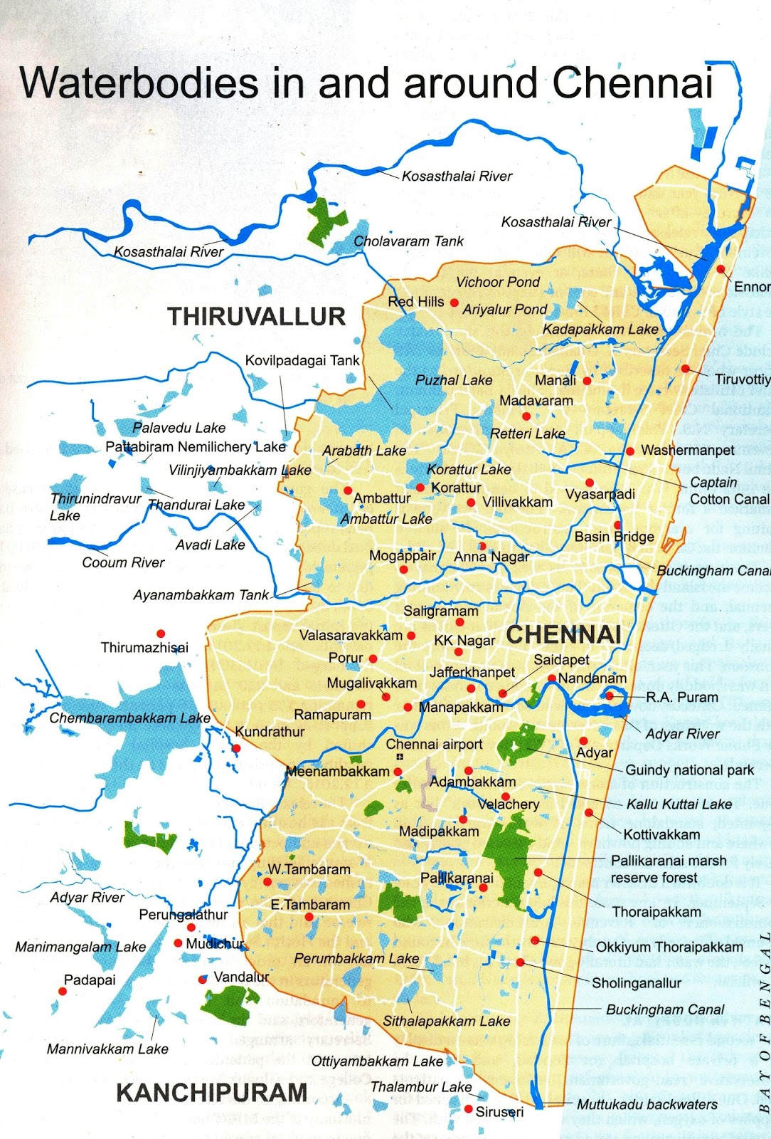
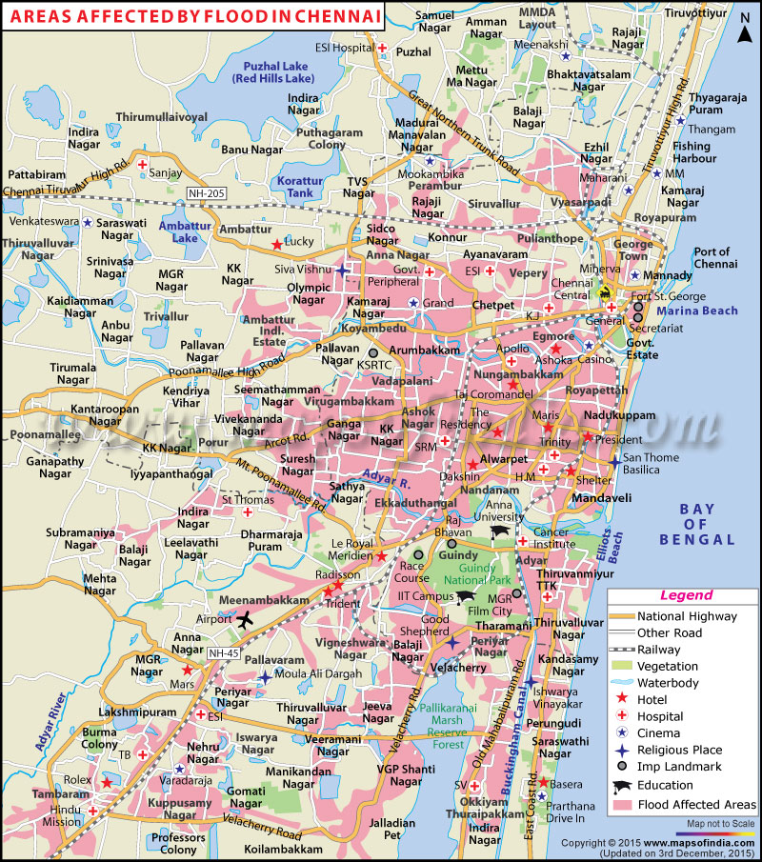
FLOOD AFFECTED AREA OF CHENNAI

Slide 29
DAMAGE CAUSED IN CHENNAI DISTRICT & KANCHEEPURAM DISTRICT
Loss of Human Life | 38
Cattle Loss | 1
Huts Damaged | 18
Houses inundated | 529505
Partly Damaged Catamarans | 47
Fully Damaged Catamarans | 2
Fully Damaged FRP Vallams | 2
Partly Damaged FRP Vallams | 58
Partly Damaged Mechanized Boats | 6
Fully Damaged Mechanized Boats | 313
Fishing Nets | 5
OBM Engine | 1030
Breaches in Water Bodies | 24
Roads | 39.6 Km
Loss of Human Life | 72
Cattle Loss | 3213
Huts Damaged | 8643
Houses inundated | 325637
Agriculture Crops | 11783
Horticulture Crops | 301
Partly Damaged Catamarans | 140
Partly Damaged FRP Vallams | 52
Fishing Nets | 2676
OBM Engine | 77
Fish Farms & Shrimp Farms Affected | 60
Breaches in Water Bodies | 1513
Roads | 1747 Km
Culverts & Bridges | 1062
Electrical Poles | 203
Transformers | 358

Slide 30
DAMAGE CAUSED IN TIRUVALLUR DISTRICT & THOOTHUKUDI DISTRICT
Human Loss | 54
Cattle Loss | 2302
Houses/Huts Damages | 25408
Houses Inundated | 200321
Agricultural Crop | 19282.25 Ha
Horticulture Crop | 1514 Ha
Fishing Boats | 725
Road length | 1258 km
Bridges/Culverts/causeways | 62
Tank Breaches | 127
Electric Poles | 278
Transformer | 1
Loss of Human Life | 4
Cattle Loss | 101
Huts Damaged | 2421
Houses inundated | 17800
Pucca Houses Partly Damaged | 76
Agriculture Crops | 30210 Ha
Horticulture Crops | 9527 Ha
Roads | 688.91 km
Bridges, Culverts and Causeways | 96
Breaches to Tanks | 13
Electrical Poles | 116

Slide 31
NDRF DEPLOYMENT
This year’s Northeastern Monsoon can be delineated in 02 phases based on severity of rainfall and havoc wreaked. The first phase extended from 9th Nov to 19th Nov 2015; while the 2nd phase from 01st Dec to 08th Dec 2015.
As per telephonic requests received by Commandant 04 Bn and DIG/SZ from Office of CRA/State Relief Commissioner, Shri Atulya Mishra, IAS, a total of 15 teams were deployed in the first phase; including 11 teams from 04 Bn Arakkonam and 04 teams from Guntur.

Slide 32
RESOURCES AVAILABLE WITH NDRF
OBM with capacity of 25 HP
Life Jackets
Life Buoys
Rescue ropes
Floating pumps
Inflatable lighting towers for lighting support in the operational area
CSSR Equipments
Generator Sets
MFR Kits

Slide 33
FIRST PHASE OF NDRF DEPLOYMENT
Sl No. | Team No | Team Leader | Location | Date
 |  |  |  | From | To
1 | 4A | SI/E Md.Warsi | Chennai | 16.11.15 | 18.11.15
2 | 4C | Insp/E A.K.Amar | Neyveli, Cuddalore | 09.11.15 | 16.11.15
 |  |  | Tambaram | 17.11.15 | 18.11.15
3 | 4D | Insp/E S.K.Datekar | Maruthavallipuram, Tiruvallur | 09.11.15 | 10.11.15
4 | 4E | Insp/E P.K.Piyasi | Mangalam(Kedilum river) Chidhambaram, Cuddalore | 09.11.15 | 16.11.15
 |  |  | Tambaram | 17.11.15 | 18.11.15
5 | 4F | Insp/E Vijaya Kumar | Panruti, Kurinjipadi of Cuddalore | 09.11.15 | 16.11.15
 |  |  | Tambaram | 17.11.15 | 18.11.15
6 | 4F-2 | SI/E Mukesh Kumar | Kurinjipadi,Cuddalore | 09.11.15 | 16.11.15
7 | 4G | Insp/E K.K.Roy | Chenglepet,Kanchipuram | 13.11.15 | 18.11.15
8 | 4H-1 | Insp/E Ganesh Prasad | Minjur, Tiruvallur | 14.11.15 | 25.11.15
9 | 4H-2 | SI/E Vikas | Manali, Andarkupam,Ponneri of Tiruvallur | 14.11.15 | 25.11.15
10 | 4 I | Insp/E S.K.Datekar | Cuddalore | 14.11.15 | 16.11.15
 |  |  | Mudhichur, Tambaram | 17.11.15 | 18.11.15
11 | 4J | Insp/E B.Biswal | Tambaram, Kanchipuram | 16.11.15 | 18.11.15
12 | 10B | SI/E Balvir Singh | Basin Bridge, Chennai | 16.11.15 | 18.11.15
13 | 10F | SI/E Samuel P.T | Tambaram & Manali New Town | 16.11.15 | 18.11.15
14 | 10D | SI/E Rahul Dixit | Varatharajapuram, Sriperumbudur | 16.11.15 | 18.11.15
15 | 10E | SI/E T.N.Tiwari | Tambaram | 16.11.15 | 18.11.15

Slide 34
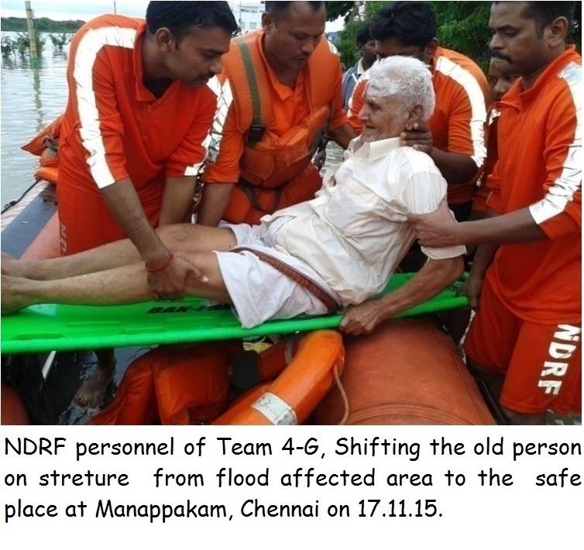

Slide 35
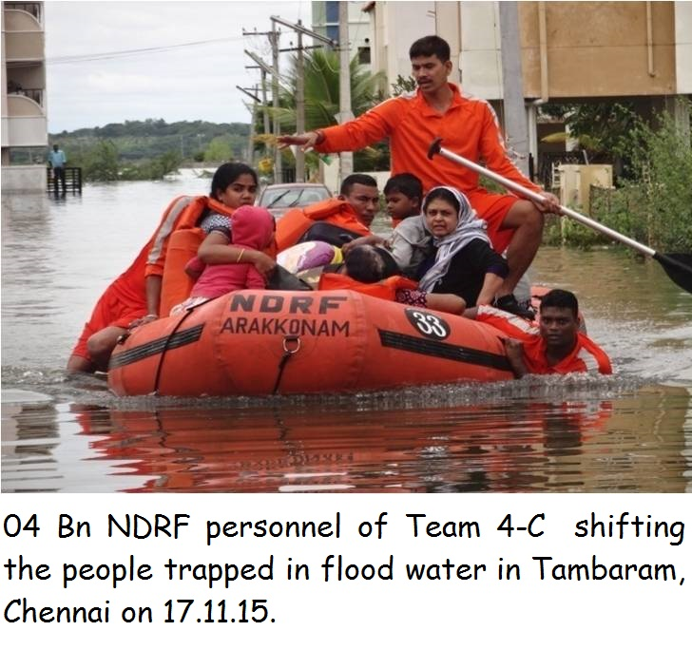

Slide 36
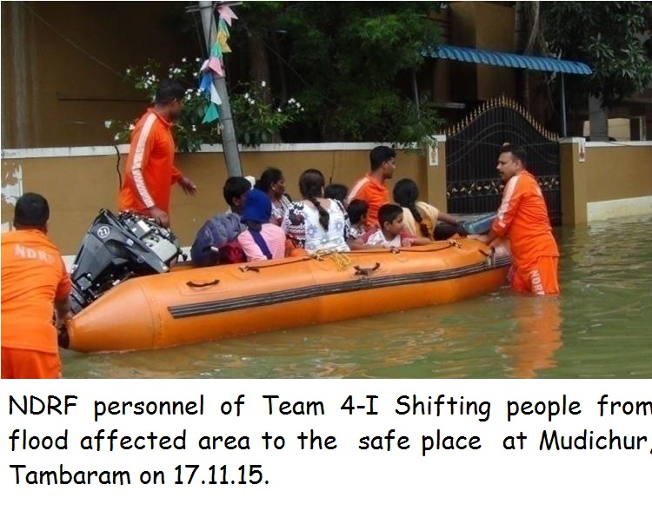

Slide 37
SECOND PHASE OF NDRF DEPLOYMENT
The teams were gradually withdrawn until the 2nd phase of monsoon necessitated second round of deployment.
Deployment was started on 01.12.15 where 11 teams (including 02 pre-positioned teams) were deployed in Chennai limits and Kanchipuram and Tiruvallur Districts.

Slide 38
The enormity of the problems necessitated moving further teams across Tamil Nadu. As such, 19 total teams were moved in on 2nd Dec 15 as given below:-
Bn | No. of teams | Location | Date
 |  |  | From | To
03rd | 10 | Puducherry | 02.12.15 | 15.12.15
 |  | Meenambakkam | 02.12.15 | 15.12.15
 |  | Manali New Town,Chennai | 02.12.15 | 15.12.15
 |  | Manali, Red Hills, Chennai | 02.12.15 | 15.12.15
 |  | Ambattur | 02.12.15 | 15.12.15
 |  | Thuraipakkam | 02.12.15 | 15.12.15
 |  | Guduvamchery, Knchipuram | 02.12.15 | 15.12.15
 |  | Neyveli | 02.12.15 | 15.12.15
 |  | Velachery, Chennai | 02.12.15 | 15.12.15
 |  | Karaikal, Pondicherry | 02.12.15 | 15.12.15
08th | 04 | Kodambakkam, Chennai | 02.12.15 | 15.12.15
 |  | Saidapet | 02.12.15 | 15.12.15
 |  | Nandanam | 02.12.15 | 15.12.15
 |  | Nandanam | 02.12.15 | 15.12.15
10th | 05 | Tiruputty Nagar,Chennai | 02.12.15 | 14.12.15
 |  | Annanagar,Chennai | 02.12.15 | 14.12.15
 |  | Kuttupuram,Chennai | 02.12.15 | 14.12.15
 |  | Zaffarpet,Chennai | 02.12.15 | 14.12.15
 |  | Kuttupuram,Chennai | 02.12.15 | 14.12.15

Slide 39
Cont.
SETTING UP OF OPS CONTROL ROOM ADJACENT TO SEOC
On the early morning of 02.12.15, OPS Control Room of NDRF was set up at SEOC Chennai with full communication back up including QDA, FAX, and Computers etc. Dedicated team of officers was detailed to man the control room round the clock.
One Officer was especially detailed to liaise with State Government for logistic requirement such as providing transport and accommodation for troops’ arrival from far flung battalions and to also ensure presence of Liaison Officer(s) from State Government with each team.

Slide 40
Cont.
Additional induction of 20 teams on 4-12-2015
With 30 teams on the ground, the scope and magnitude of the problems confronting the State, prompted the Hon’ble Chief Minister to approach the Centre for assistance in the form of additional manpower.
20 additional teams of NDRF were air lifted into Tamil Nadu on 04.12.15 to assist in rescue work. The details of these additional teams are given below:-
Battalion | No. of teams | Place of deployment (District)
1st | 05 | Chennai, Vellore
5th | 05 | Chennai, Tuticorin, Tirunelveli
7th | 05 | Chennai, Tiruvallur, Kanchipuram
9th | 05 | Chennai, Kanchipuram

Slide 41
Cont.
SETTING UP OF RDC
Since Chennai International Airport was closed for operations as it was adversely affected by the flood with total flooding of runway the air lifted teams were landed in the Naval Air base INS Rajali at Arakonam.
To facilitate the arrival, transfer and further deployment of these teams an RDC was set up at INS Rajali.
The RDC also co-ordinated with the local police to ensure suitable transport was available in a timely manner with RDC with LOs from Local Police in the rank of SI to accompany the teams to the deployment point and to assist in case of language problems.
The RDC also ensured that each Liaison officer carried two working R/T sets of the local Police channel to facilitate communication until such time that the teams could set up their own HF communication.

Slide 42
Cont.
In addition to Chennai City, teams have covered the following districts of Tamil Nadu and Puducherry:-
Tiruvallur Dist.
Kanchipuram Dist
Cuddalore Dist
Nagapatinam Dist
Tirunelveli Dist.
Vellore Dist
Tuticorin Dist
Karaikal (Puducherry)
Puducherry.

Slide 43
MASSIVE MOBILIZATION OF TEAMS
Battalion | No of teams | Conveyance from battalion | Deployed from | Deployment
4th Bn Arakkonam | 11 teams | By road | 01.12.15 | Deployed at Chennai, Kanchipuram and Thiruvallur Districts. Later 3 teams moved to Cuddalore
1st Bn Guwhati | 5 teams | Airlifted to INS Rajali | 04.12.15 | Deployed at Chennai, Vellore
3rd Bn Mundali | 10 teams | Airlifted to INS Rajali | 02.12.15 | Deployed at Chennai, Kanchipuram, Tiruvallur, Cuddalore, Puducherry, Karaikkal
5th Bn Pune | 5 teams | Airlifted to INS Rajali | 04.12.15 | Deployed at Chennai. Later moved to Tirnelveli, Tuticurin
7th Bn Bhatinda | 5 teams | Airlifted to INS Rajali | 04.12.15 | Deployed at Chennai, Tiruvallur, Kancheepuram
8th Bn Ghaziabad | 4 teams | Airlifted to INS Rajali | 02.12.15 | Deployed at Chennai
9th Bn Bhita | 5 teams | Airlifted to INS Rajali | 04.12.15 | Deployed at Chennai, Kanchipuram
10th Guntur | 5 teams | By road | 02.12.15 | Deployed at Chennai

Slide 44
Rescue operations were carried out in earnest from 1st (2) Dec 2015 to 05/ 06 Dec 2015. The overall figures are given below:-
RESCUE OPERATION DETAILS
Date | Rescued lives | Dead body recovered | Pets recovered
02.12.15 | 2632 | 02 | 02
03.12.15 | 6527 | 03 | NIL
04.12.15 | 7169 | 01 | 28
05.12.15 | 655 | 01 | NIL
06.12.15 | 5467 | 02 | NIL
Total | 22450 | 09 | 30

Slide 45
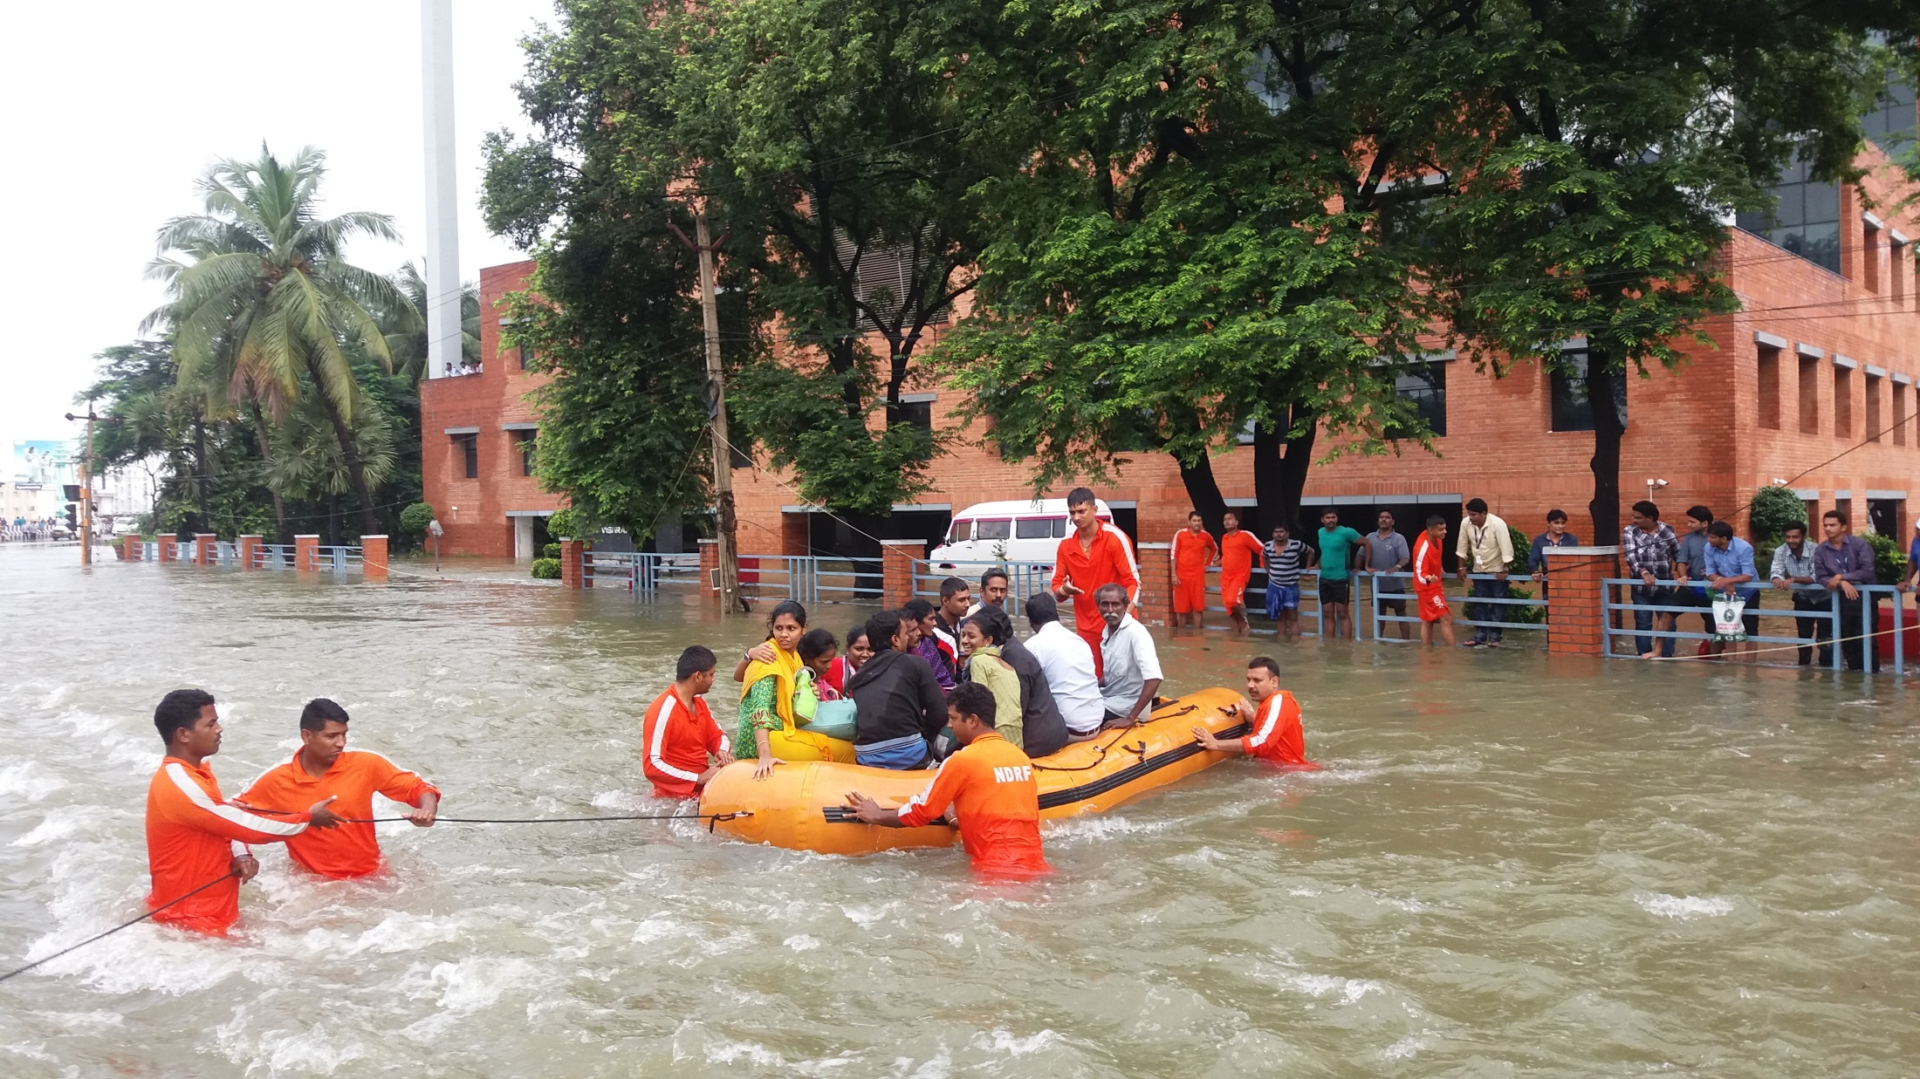
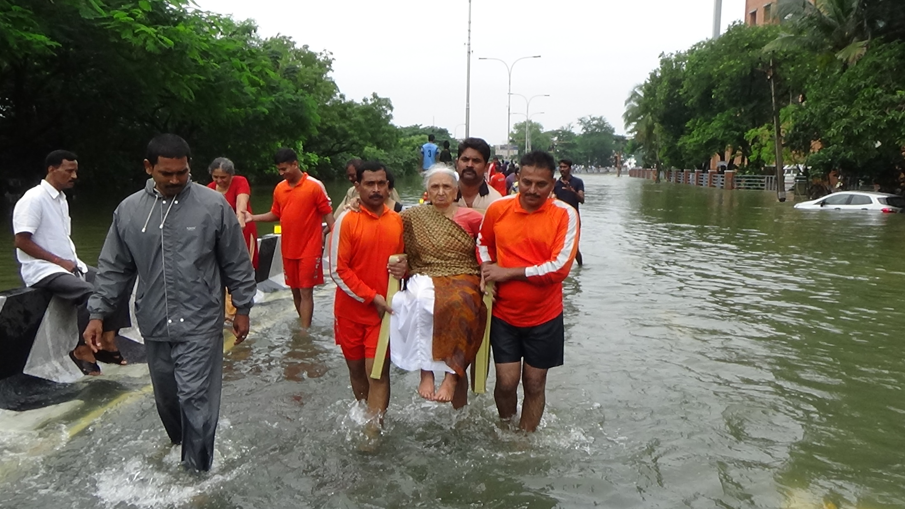
Cont.

Slide 46
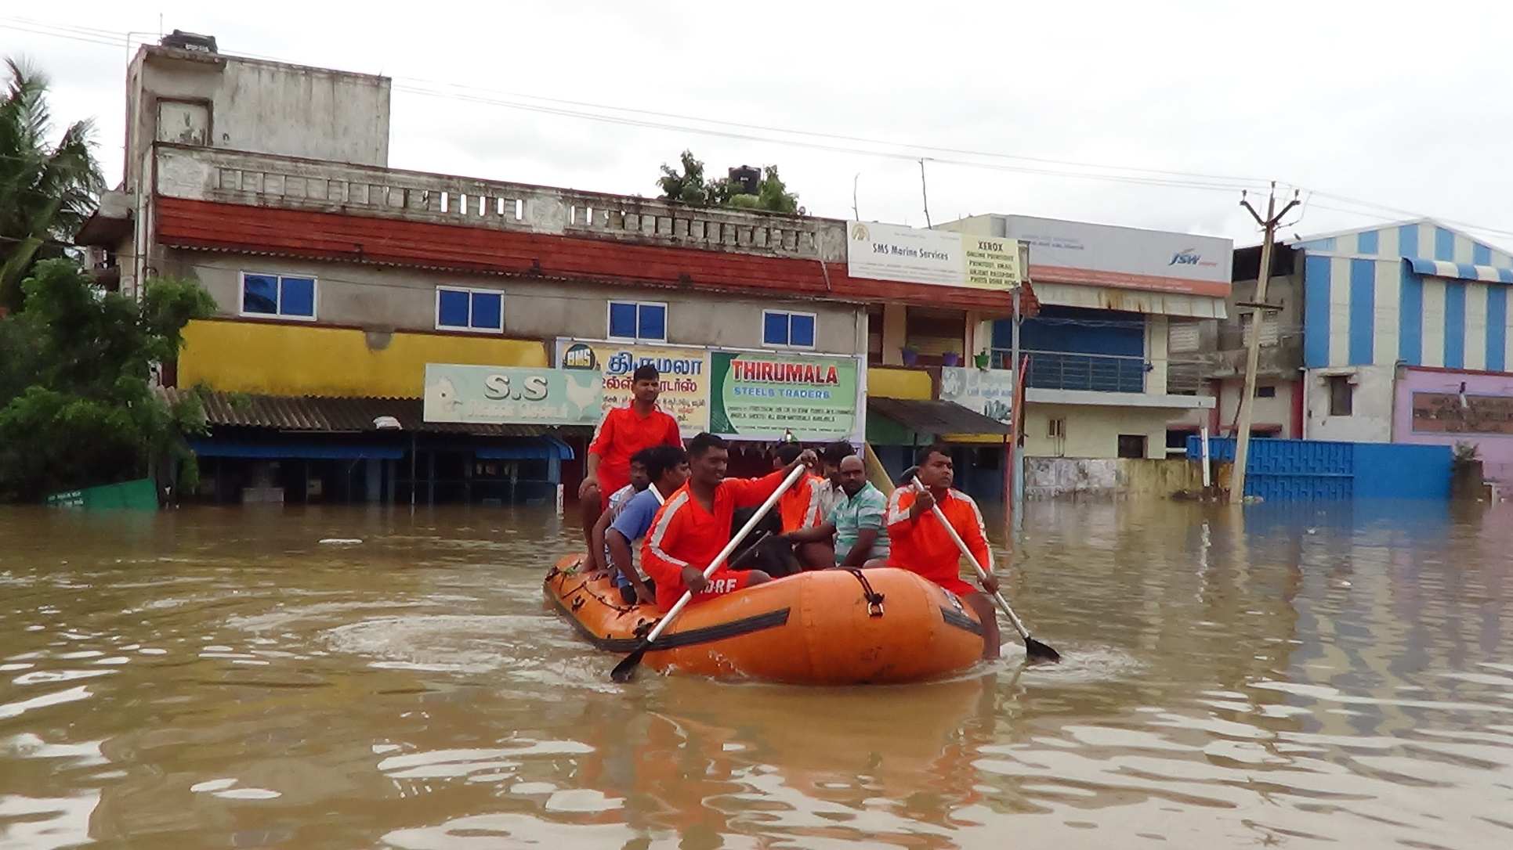
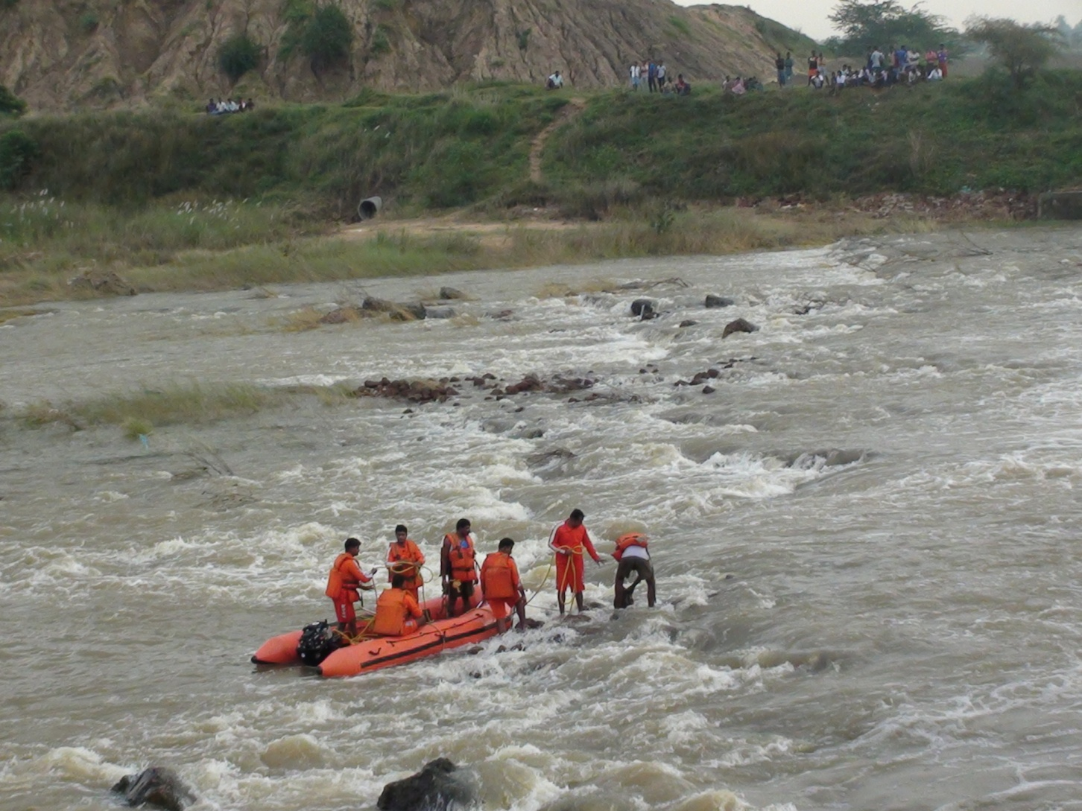
Cont.

Slide 47
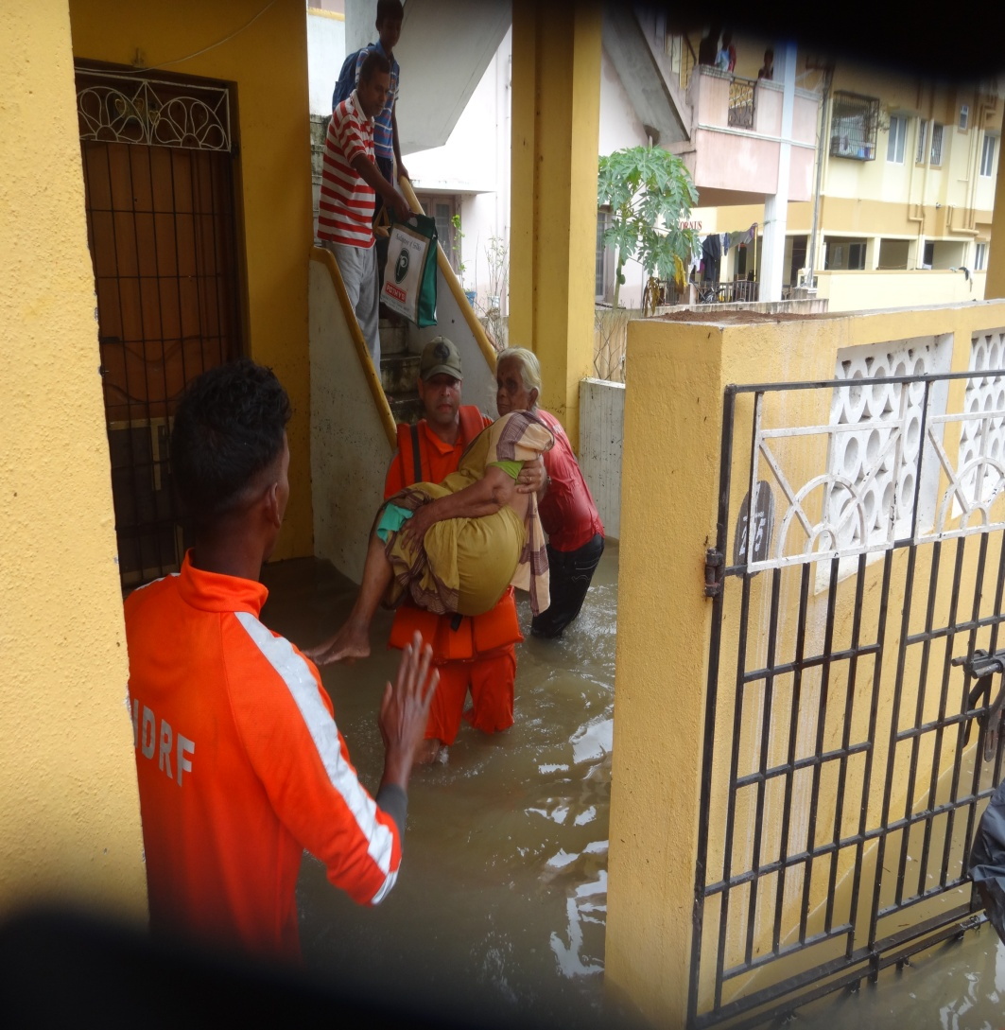
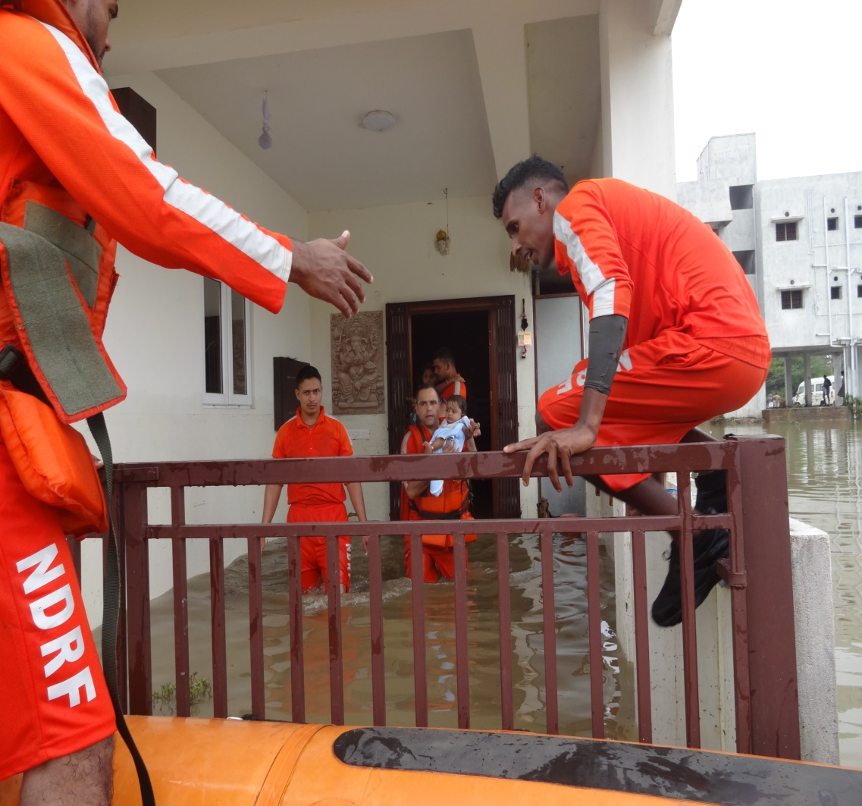
Cont.

Slide 48
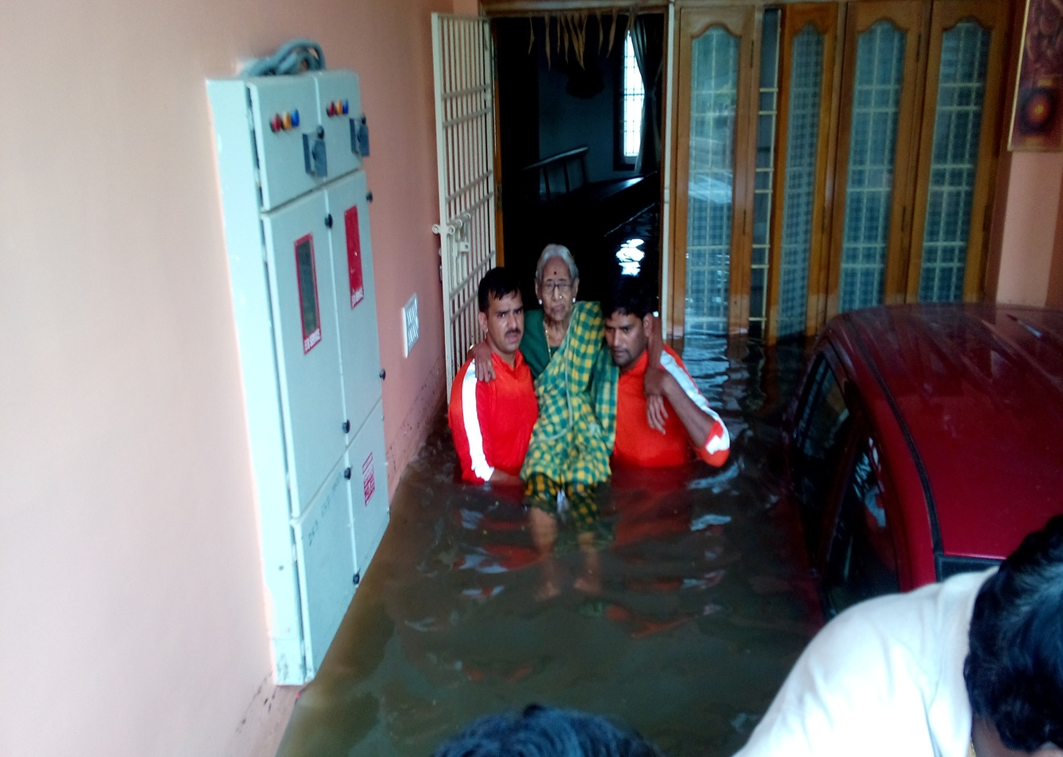
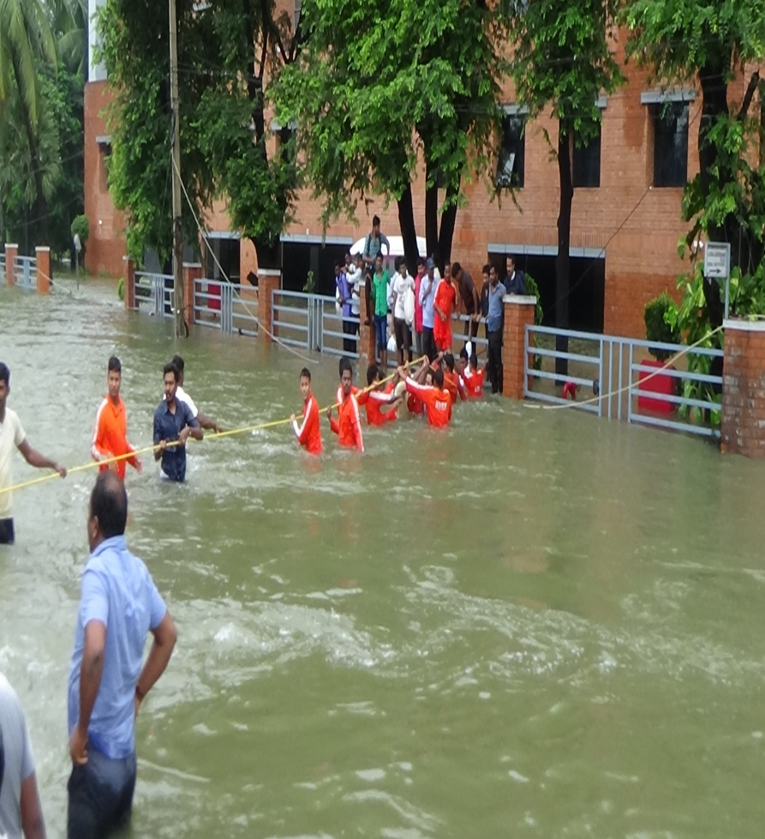
Cont.

Slide 49
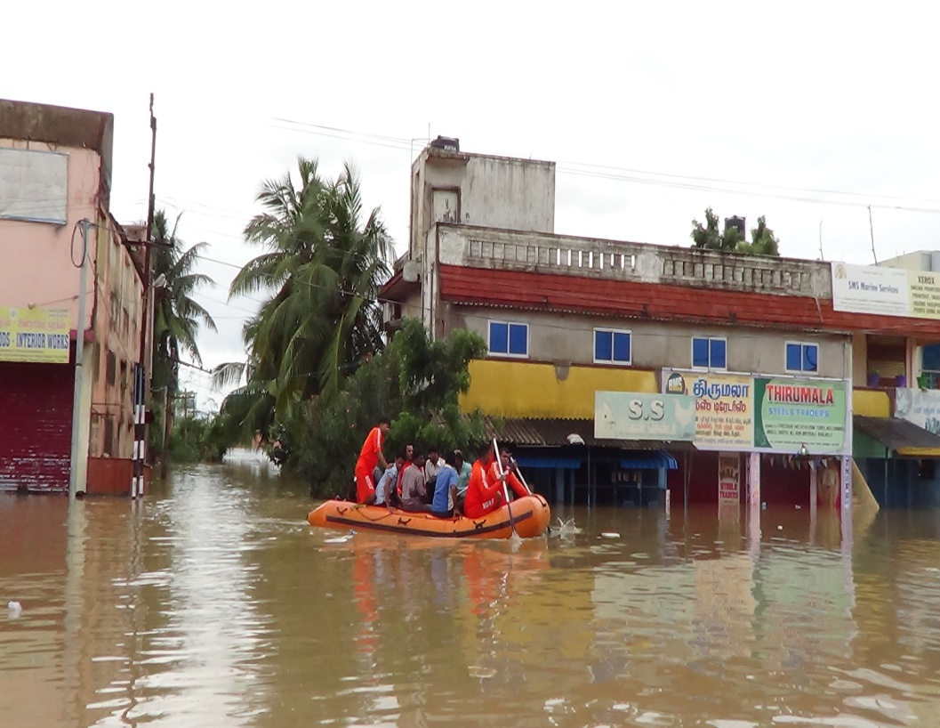
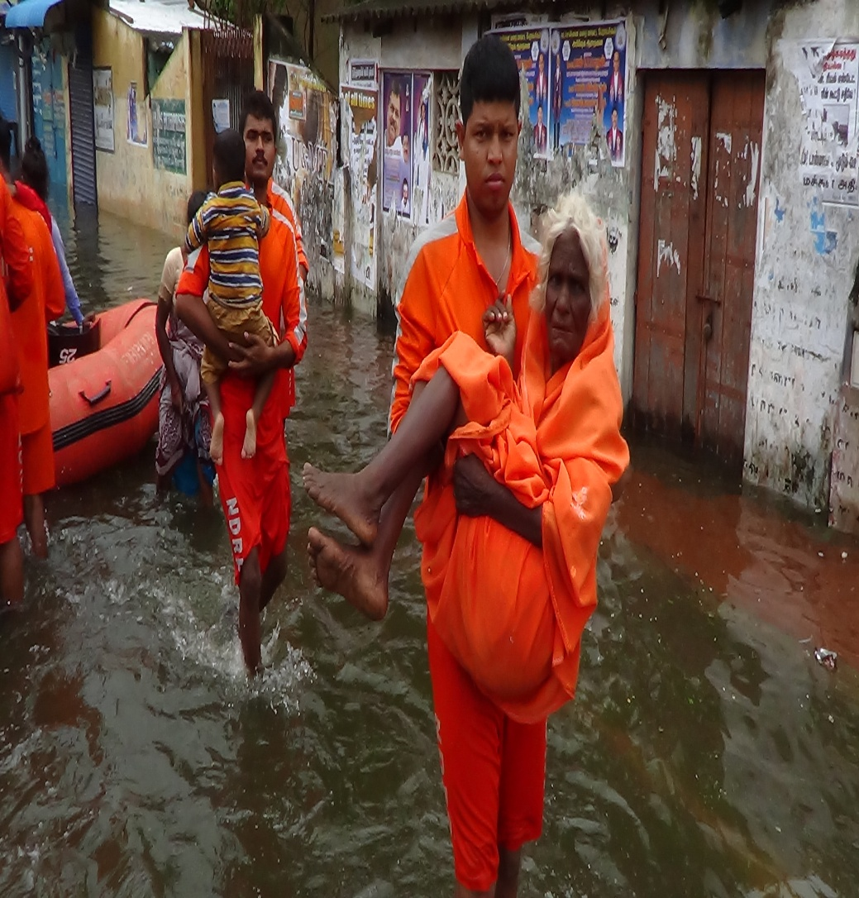
Cont.

Slide 50
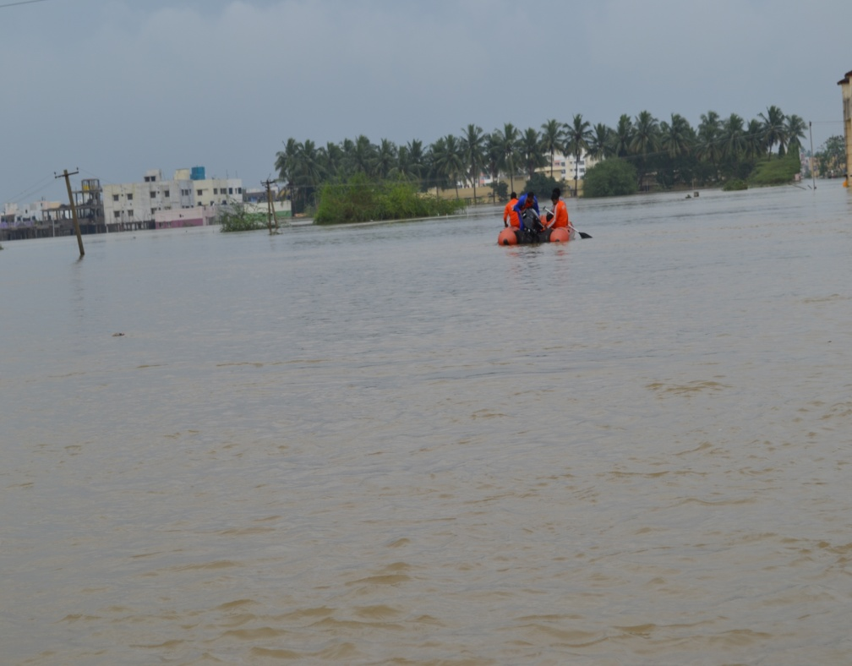
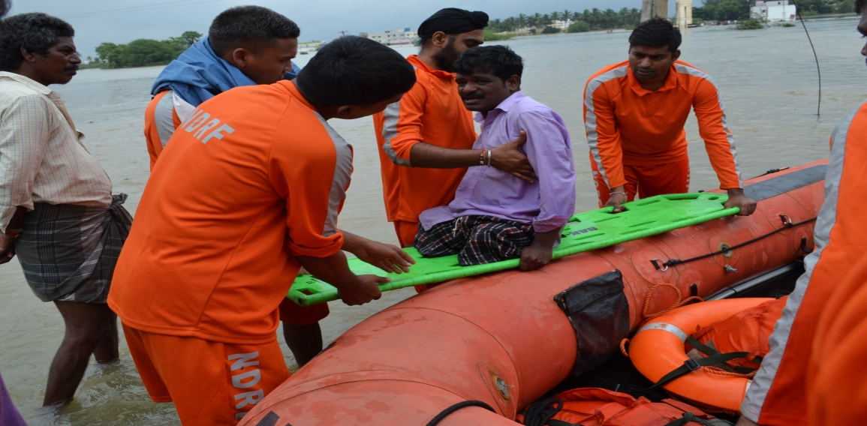
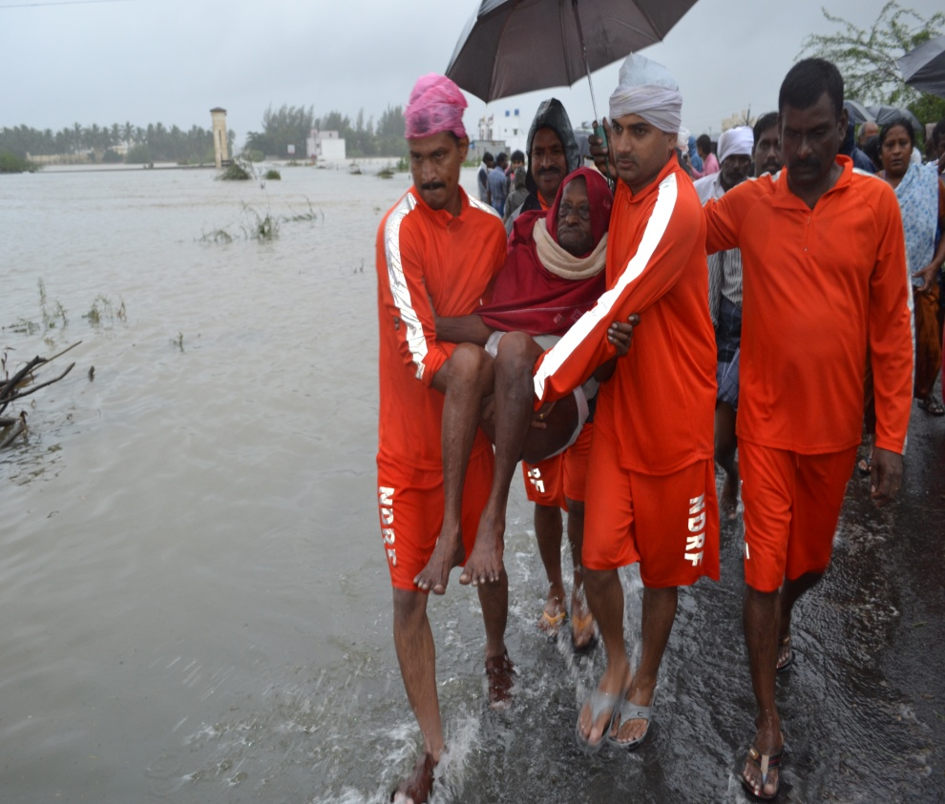
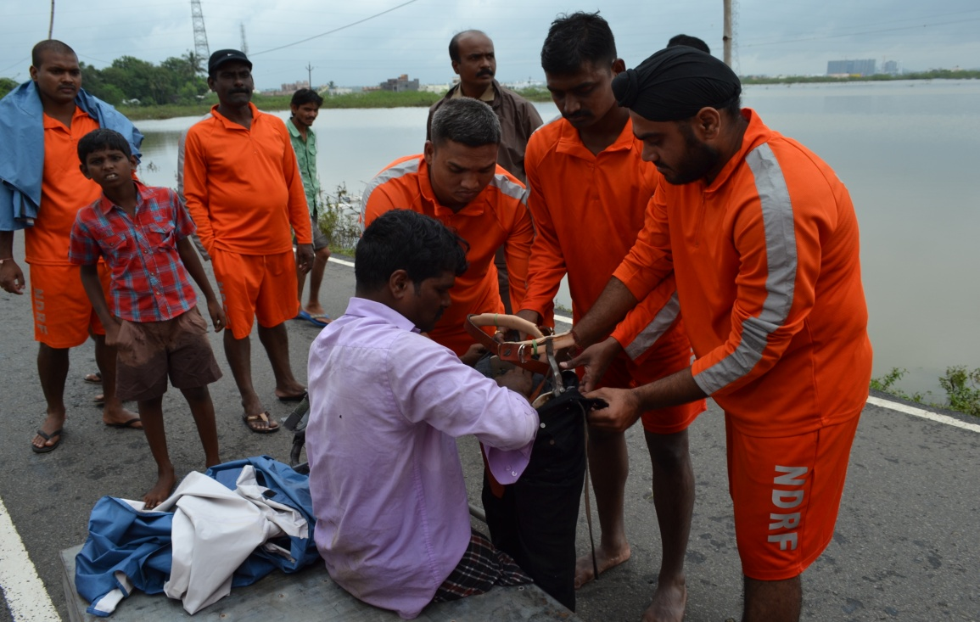
Cont.

Slide 51
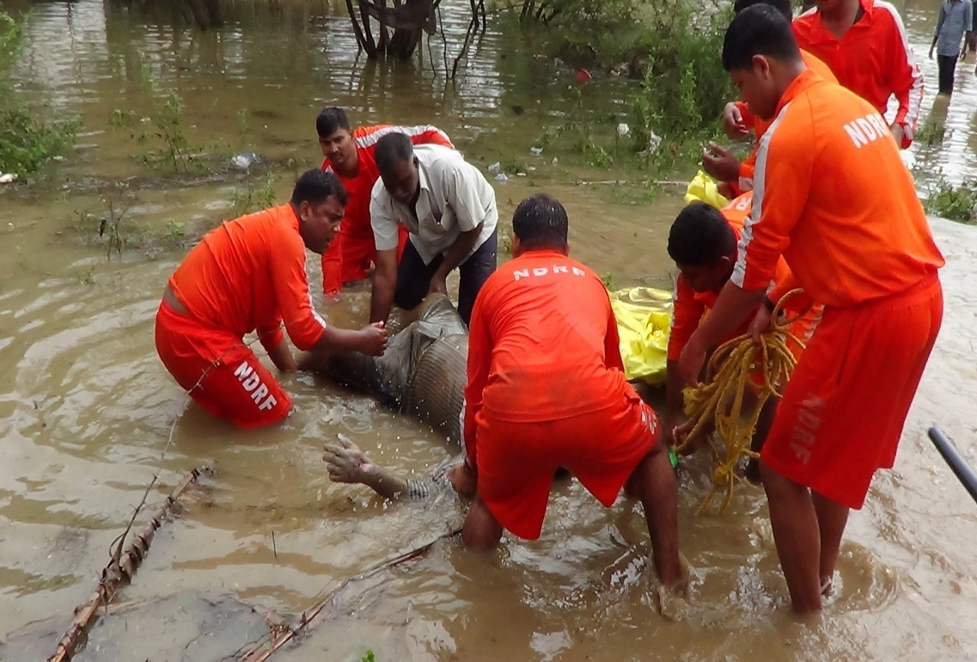
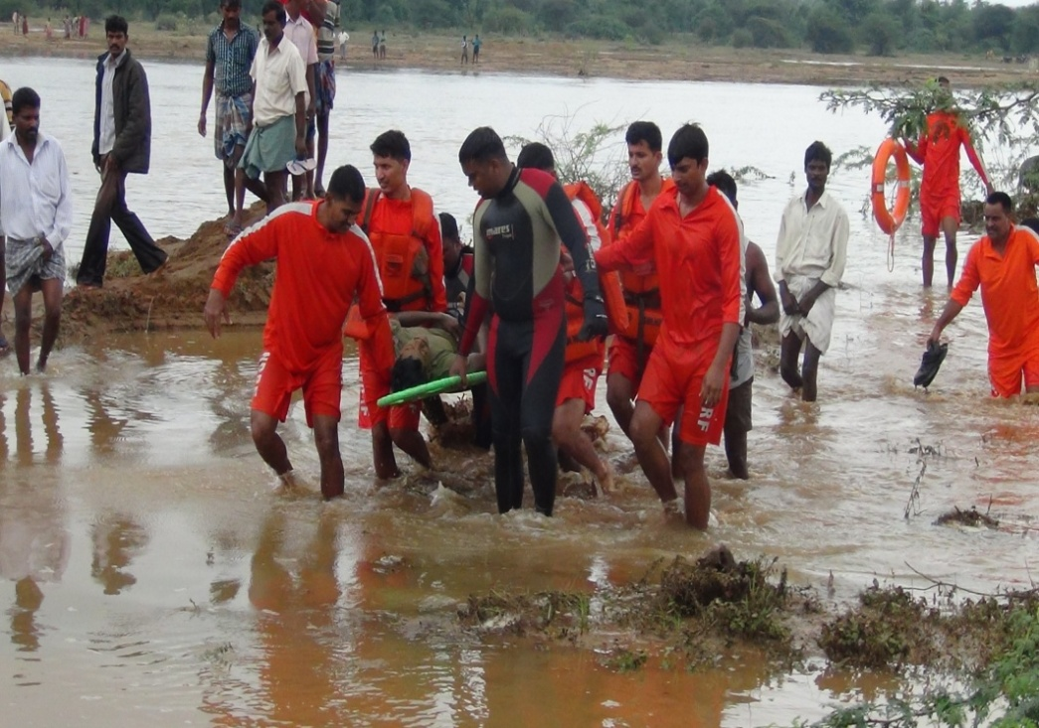
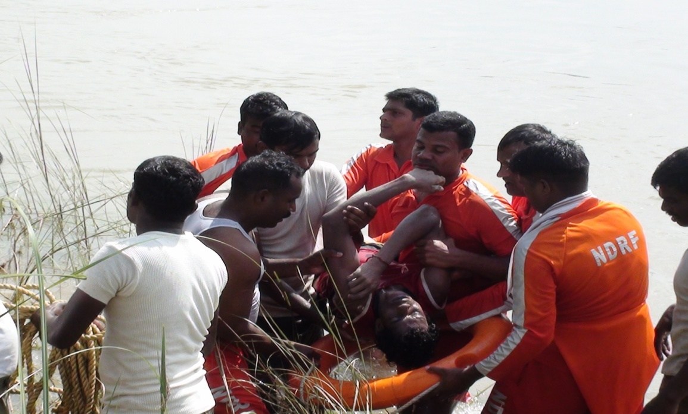
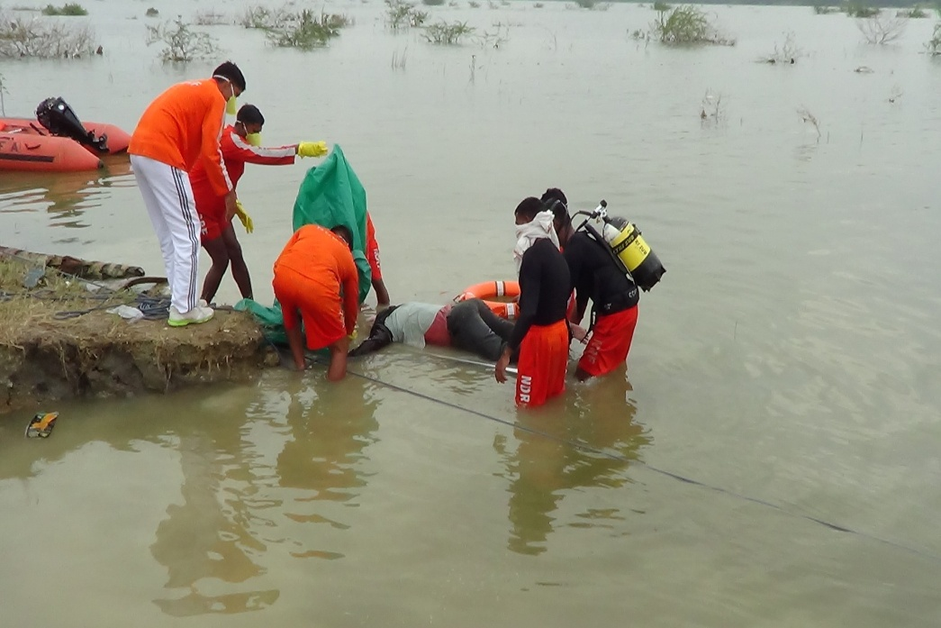
RECOVERY OF DEAD BODY OF DROWNED VICTIMS

Slide 52
Cont.
Date | Food and water | un-cooked foods | clothes & blankets
03.12.15 | 3200 Food packet + one truck load
04.12.15 | 16265 Food packets + 16002 Water packets
05.12.15 | 29012 Food packets + 27901 Water packets | 2548(Milk packets) | 1730
06.12.15 | 72459 Food packets + 9483 Water packets | 1600(Milk Packets) 5000 (Misc packets) | 4770
07.12.15 | 65703 Food packets+ 93225 Water Packets | 11638 (Milk packets) 3275 Kg (Rice) 1800 Kg (Atta) 1800 (Misc Packets) 4581 kg (Misc food items) | 22945
08.12.15 | 16782 Food packets + 39148 Water packets + 3 Truck food materials. | 3800 – Milk Packets 3800 – Misc Food | 8482
09.12.15 | 2818 Food packets + 5568 Water packets` | 2600 – Milk Packets 1000 kg – Atta 1875 kg – Rice 100 – Misc Food items 140 kg – Sugar 60 ltr - Oil | 768 + 110 mattresses.
10.12.15 | 13450 Food packets + 16580 Water packets | 4520 – Misc items | 4520
11.12.15 | 7465 Food packets + 2465 Water packets | 4500 – Misc items | 1000
12.12.15 | 14050 Food packets | Nil | 12750
TOTAL | 2.38 Lakh pkts each food + water

Slide 53
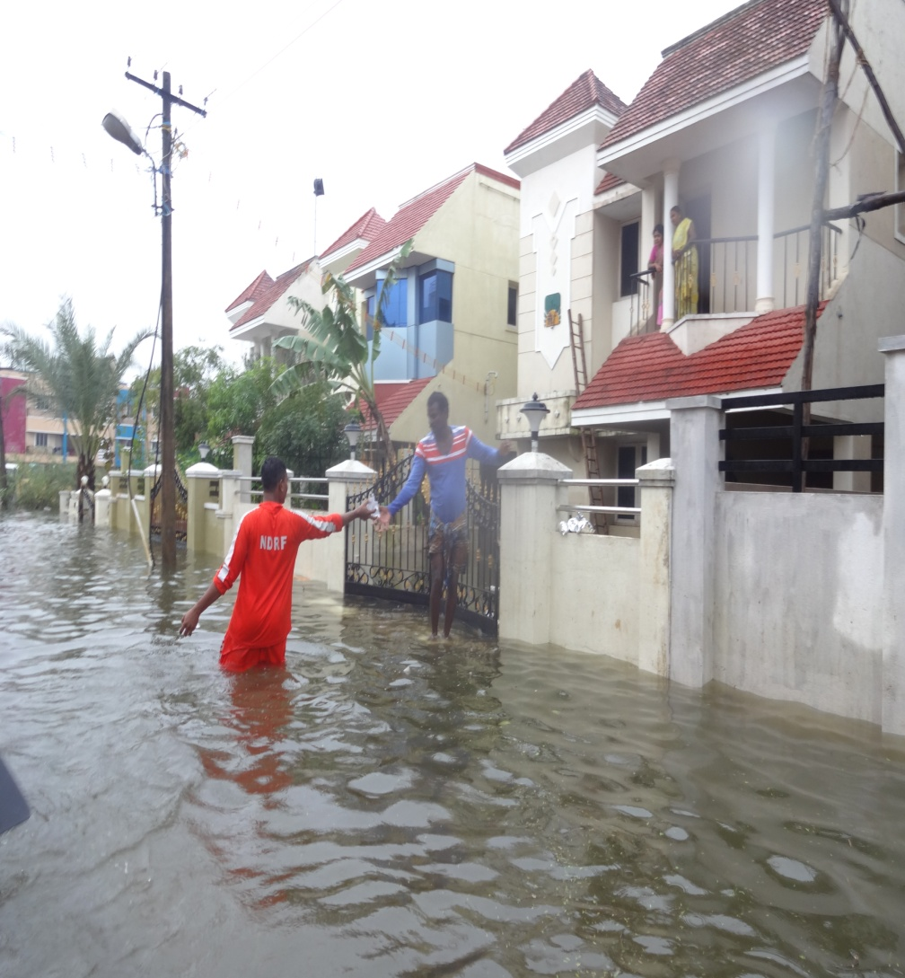
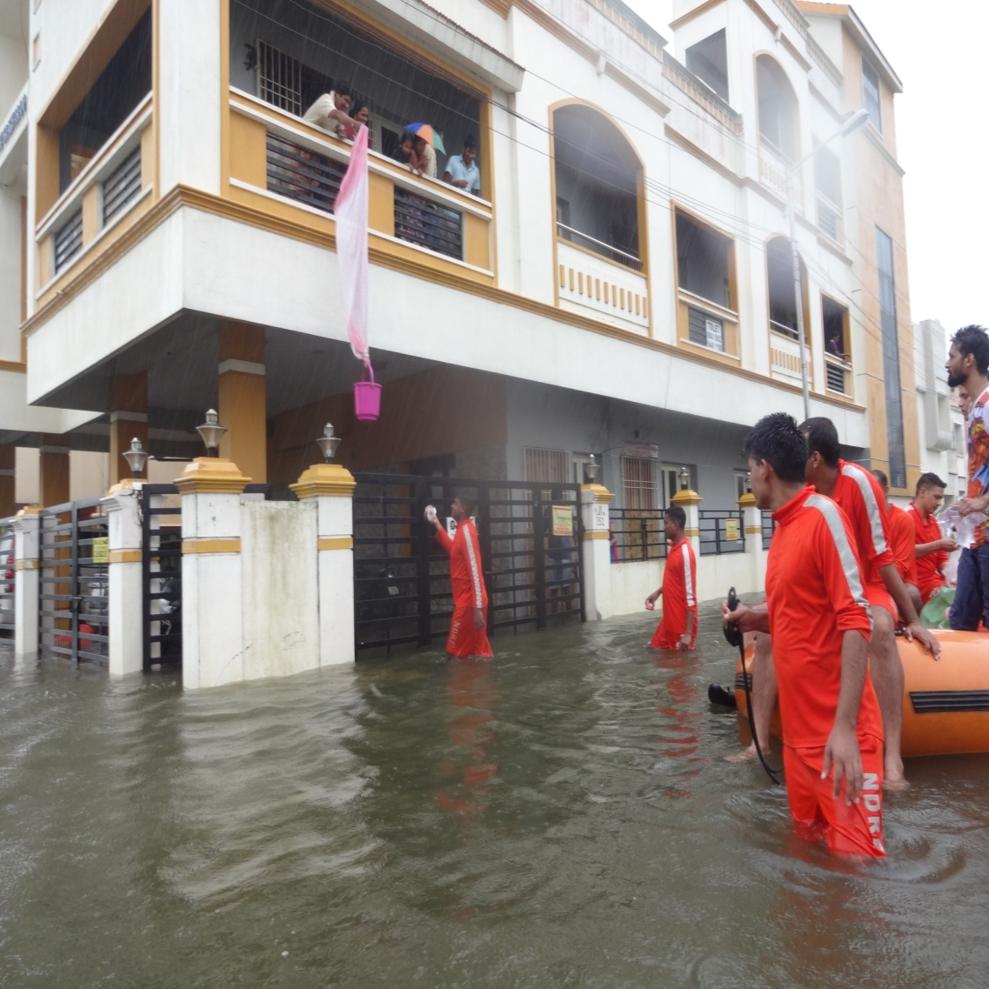
RELIEF DISTRIBUTION

Slide 54
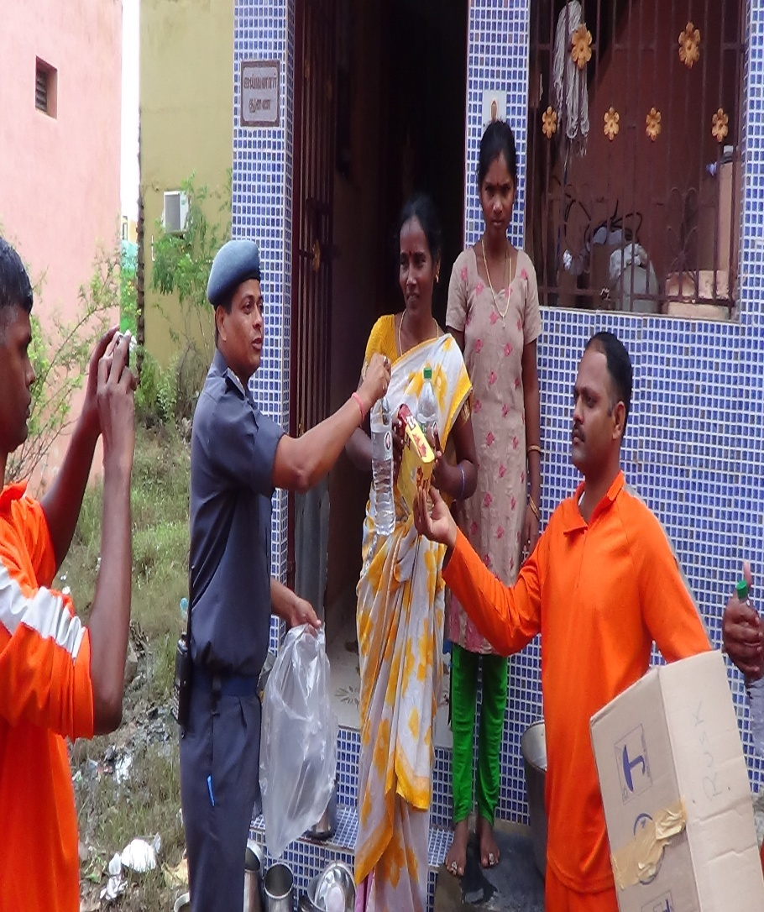

RELIEF DISTRIBUTION

Slide 55


RELIEF DISTRIBUTION

Slide 56


RELIEF DISTRIBUTION

Slide 57

DG NDRF SHRI O.P.SINGH INTERACTING WITH THE TEAMS AT KOTTURPURAM

Slide 58




EFFECTIVE CO-ORDINATION BETWEEN AGENCIES

Slide 59
MEDICAL ASSISTANCE
NDRF teams, in conjunction with State medical officers also conducted medical camps. Details of the same are given below:-
359 persons treated in Medical camps.
46 boxes of medicines was distributed to public.

Slide 60
DE-INDUCTION OF TEAMS
DE-INDUCTION OF TEAMS
Rescue and relief operations ground to a halt on 12.12.15.
On the request of State authorities, teams were retained on the ground in standby mode for additional 02/03days, in anticipation of any unprecedented, unexpected problems especially in South Tamil Nadu.

Slide 61
SWAT ANALYSIS OF OPERATION
STRENGTHS
Communication:-
When the entire city was reeling under break down of mobile and landline telephone communication systems, the teams of NDRF established excellent communication systems by developing multi- layer communications.
HF sets, QDA communication, land line telephones, mobile communications and two R/T sets of the local state Police wireless network per team were made available to establish fail safe communication.

Slide 62
Cont.
Co-ordination, Co-operation with State Authorities:-
Excellent co-ordination was achieved with the state authorities at various levels starting from the office of the Commissioner Revenue Administration to the District Revenue Officers at the cutting-edge ground level.
Unity of command and communication was achieved by stream-lining all deployment and related communications at the level of office of SRC only and ensuring that intermediate level officers did not intervene or issue directions to the teams in the field.
This improved efficiency and directionality of effort.

Slide 63
Cont.
Totally trained, dedicated, effective men:-
The single greatest strength which came to light was the extremely heartening sight of highly trained, disciplined, extremely committed NDRF men who came forward enthusiastically to discharge their duties, without hesitation in the face of daunting weather challenges.

Slide 64
Cont.
Effective/ Excellent RDC, OSSOC:-
An excellent and functionally efficient OSSOC was established in the early hours of 2nd Dec itself adjacent to the SEOC.
It functioned round the clock and remained in close touch with the office of the SRC at Chennai; the teams in the field and the NDRF HQRS.
It monitored deployment, ensured logistic support to the teams by liaising with the state administration; collected and collated rescue and relief data and accomplished hiccough up free de- mobilization.
Similarly, the RDC set up at Rajali Naval Base was successful in co-ordinating between state police, transport dept, naval authorities and OSSOC Chennai and ensured that teams were met and dispatched without undue discomfort to the teams.
RDC also ensured that responsible Liaison officers were made available with each team to assist in guiding the route and establishing communication with the local police for deployment.

Slide 65
Cont.
WEAKNESSES
Transportation:-
This Battalion has a limitation on the number of vehicles it holds.17 nos. of vehicles have even passed condemnation requirements.
In such scenario, it became a necessity to rely heavily upon state facilities for transportation.
While state authorities were extremely responsive and made available vehicles, during transportation on daily basis, it was seen that wherever private buses and trucks were put to use, the owners caused trouble by refusing to refuel vehicles in a timely manner & also demanded teams to pay for fuel in isolated cases.
However, Dy. Commissioner Transport Mr. Sridhar Chowdhary needs to be appreciated for exerting himself night and day and assisting each & every team above and beyond the call of his duties and minimizing transport related problems.

Slide 66
Cont.
Accommodation:-
Some of the teams were housed in schools and marriage halls.
While this arrangement was acceptable while the problem was at its peak; it degenerated into embarrassment in quite a few cases, when schools restarted and our teams were ingloriously asked to leave by school authorities independent of state authorities.
Similarly, marriage halls had to be vacated to make space for marriages which had been booked months in advance.
It would have been better to house teams in large stadiums or even to the extent possible in police barracks/lines once teams moved into stand-by mode.
In the instant case, the teams had to be moved to group centre of CRPF on the initiative of the NDRF Officers independent of state authorities.

Slide 67
Cont.
Connectivity to Bn:-
The main access route from the Battalion Campus to NH 4 is via Takkolam and across Kallaru River. During the recent TN floods, it was seen that even though distress call was received by the unit Control Room and teams responded and left the campus within 15 minutes, it took over 01 hour to traverse 3-4 kms just to cross Kallaru River and Takkolam area since the bridge across river Kallaru washed away.
This problem became even more critical when Chennai International Airport was closed due to heavy flooding and teams had to be flown into the Naval base at Arakonam and travel from Arakonam to the city which should have taken 4 hours took 10 hours.
(Note : The problem faced was promptly brought into the notice of the State Relief Commissioner and was assured of early action for construction of new bridge)

Slide 68
Cont.
Opportunities/Lessons Learnt
While it is a sad and sorrowful experience for the country to be faced with such large levels of destruction of properties and loss of valuable lives which cannot be ignored; it has also proven to be a tremendous learning opportunity for the teams which were deployed in the recent TN floods.
This was one of the worst e.g. of urban flooding with all concomitant complications which our teams were exposed to and got to learn from.

Slide 69
Cont.
Image Building:-
This experience has resulted in tremendous respect and good will being generated at the ground level for the Men in Blue.
There have been several instances where the local Chennai, the population has communicated to officers and men of NDRF thanking them for selflessly diving into the flood situation and saving their lives.
This good will was also noticed at the various relief centers where locals have gone out of their way to thank NDRF personnel for services rendered.

Slide 70
Cont.
Improved Co-ordination with State:-
NDRF was deployed in 9 districts in two states. This necessitated co-ordination down to the level of the DROs of the districts and officers at Taluks.
While excellent co-ordination was established at the highest echelons of state Administration, it was heartening to see that decisions taken at the top were being passed down to the lower-level functionaries and implemented in proper manner.
In this process, the inter agency co-ordination was also established and worked efficiently.

Slide 71
Identified areas where performances can be improved
This experience has given us a road map of our strengths and weaknesses. It has also opened eyes to areas where NDRF can improve its own performance and give better service to the citizens of our country. The main points which emerge from the brainstorming session are as follows:-
Insufficient boats of good quality- many of the boats held are damaged and need to be replaced.
Insufficient buses and trucks/ troop carriers.- while a minimum of 12 teams are available with each battalion; sufficient vehicles are not available, and battalions are dependent on state to move troops for emergencies leading to avoidable delays.
More QDAs are required.- each team should be equipped with QDA for improved communications.

Slide 72




KERALA FLOODS - 2018

Slide 73
KERALA FLOOD INTRODUCTION
Kerala Floods of 2018 was one of the biggest disasters to hit the country in recent years.
In terms of scope, it covered almost the entire state, affecting all aspects of life.
The floods accounted for the loss of 474 lives and destruction of Rs. 18,900 Crore in properties.

Slide 74
Cont.
Not less than 16,000 Km of arterial roadways have been permanently damaged and require to be rebuilt from scratch.
Nearly 30% of all habitations have sustained structural damages
Nearly 10% of all homes have been rendered unsafe for habitation.

Slide 75
FLOOD PRONE AREA MAP KERALA STATE

Slide 76
Cont.
All 14 districts of the state were placed on red alert.
According to the Kerala government, one-sixth of the total population of Kerala had been directly affected by the floods and related incidents.
The Union government had declared it a Level 3 Calamity or 'Calamity of a severe nature.
Thirty-five out of the forty-two dams within the state were opened for the first time in history.

Slide 77
Cont.
All five overflow gates of the Idukki dams largest arch dams in Asia were opened at the same time, for the first time in 26 years.
Besides, more than 24 dams across the state have also been opened to drain out excess water.
Heavy rains in Wayanad and Idukki have caused severe landslides and have left the hilly districts isolated.
Kerala state disaster management authority issued a red alert to make necessary preparations for the authorities for evacuation of people in vulnerable areas in case of a water surge.

Slide 78


OUT LOOK ON WEATHER FORECAST

Slide 79


OUT LOOK ON WEATHER FORECAST

Slide 80

OUT LOOK ON WEATHER FORECAST

Slide 81
THE RIVERS WHICH WERE MOSTLY AFFECTED DURING FLOOD
PERIYAR:- Periyar is the longest river and the river with the largest discharge potential in the Kerala.
It generates a significant proportion of Kerala's electrical power via the Idukki Dam and flows along a region of industrial and commercial activity.
The reservoirs with substantial live storage capacity in Periyar sub-basin are Idukki, Idamalyar and Mulla Periyar.
During the rainfall event of 15-17, August 2018, the total release during three days from Idukki reservoir was about 345 MCM (spill) and 30 MCM (powerhouse going to Muvattupuzha river) against the inflow volume of 435 MCM.
Hence, about 60 MCM of flood runoff was absorbed by Idukki reservoir during 15-17 August.
During the Kerala flood 2018 most affected cities by Periyar overflow were Kochi, Aluva, Ernakulum, Idduki, neriamangalam, Kalady, Malayattor, Thrissur etc.

Slide 82
Cont.
BHARATHAPUZHA:- Bharathapuzha is the second longest (209 km) west flowing river that drains into the Arabian Sea in Kerala.
The catchment area of Bharatpuzha is about 3852.04 sq.km.
The total length of the river is about 209 km.
The Gayathripuzha, Kalpathipuzha and Pulanthode, are the three major tributaries.
All the three tributaries rise in the Western slopes of the different ranges of the Western Ghats and drains a major parts of the Palghat, Trichur and Malapuram districts. The route way district of this river is mostly affected.

Slide 83
Cont.
COMBINED RUNOFF OF PAMBA, MANIMALA, MEENACHIL AND ACHENKOVIL RIVERS
Four major west flowing rivers namely Achenkovil (128 km), Pamba(176 km), Manimala(90 km) and Meenachil (78 km) drain directly into the southern part of Vembanad Lake while a southern branch of Periyar (further north of Muvattupuzha) drains into Cochin Kayal and finally into the Arabian sea through Kochi outlet.
The Vembanad Lake is bordered by Alappuzha (Alleppey), Kottayam and Ernakulam districts of Kerala covering an area of about 200 sq km and extending 80 km in a NW-SE direction from Munambam in the north to Alleppey in the south.
The width of the lake varies from 500 m to 4 km and the depth from 1m to 12m. Pathnamthitta, Kottayam and Alapuzha districts are the most affected during this Monsoon season flood by these rivers.

Slide 84
Cont.
CHALAKUDI:- Chalakudy River(130 km) is the fifth longest river in Kerala.
The Chalakudy river is formed by the confluence of five streams, Parambikulam, Kuriarkutty, Sholayar, Karappara and Anakkayam, all of them originating in the Anamalai Hills of the Western Ghats.
The total drainage area of the river is 1404 sq.km in Kerala.
Chalakudi tahasil, Mala Taluk, Aluva, Ernakulum, Palakkad, Thrissur area was the mostly affected by this river’s overflow in this Monsoon season.

Slide 85
Cont.
KABANI:- River Kabani(240 km) is one of the major tributaries of Cauvery river in southern India.
It originates in the Western Ghats of Wayanad district of Kerala by the confluence of Panamaram and Mananthavady rivers.
The catchment area of Kabini is 1934.5 km.
It flows eastwards to join the Cauvery river at Tirumakudalu in Karnataka.
The Banasura Sagar Dam is a stone masonry constructed on Karamanathodu tributary of the Kabini river.

Slide 86
The outflow from the Kabini reservoir in H.D. Kote reached a record level of 80,000 cusecs, inundating low-lying areas in H.D. Kote, Nanjangud, Suttur, and other towns.
This was caused by heavy rains in Wayanad, Kerala, which is the upper catchment area of the Kabini.
Cont.

Slide 87
FLOOD DAMAGE ASSESSMENT (ASPER SEOC KERALA REPORT)
Kerala experienced the largest disaster of flood and land slide after 1924.
The torrential rain since 10th May in sporadic place in Kerala and continuous rain
Since August first week accumulate huge rain water in several dams.
Finally, 10th August few of the dams were opened by the Kerala government.
The state government informed, electronic media, print media and public address system to all the house door to door notice regarding release the water.

Slide 88
FLOOD DAMAGE ASSESSMENT (ASPER SEOC KERALA REPORT)
 | Rainfall (mm) | 1873.78 mm (Average)
 | No. of districts affected with name | Kannur, Kollam, Kasaragod, Alappuzha, Thrissur Kozhikode,Palakad, Malappuram, Pathanamthitta, Ernakulam,Kottayam, Idukki, Thiruvanthapuram, Wayanad
 | No. of village affected | 776
 | Population affected | 5411712
 | Human lives lost | 474
 | No. of missing | 15
 | No. of Injured | 140

Slide 89
FLOOD DAMAGE ASSESSMENT (ASPER SEOC KERALA REPORT)
 | Houses damage | Fully:1822 Partially: 21695
 | Animal deaths | 46,867 (Goat, Buffalo, Cow) 17202457 (Poultry)
 | No. of persons evacuated | 280679
 | No. of relief camp opened | 5645

Slide 90
FLOOD DAMAGE ASSESSMENT (ASPER SEOC KERALA REPORT)
1. | Rainfall (mm) | 1873.78 mm (Average)
2. | Inmates in the relief camps | 14,52,425
3. | Total crop area affected (in hectares). | 43727.73Ha Cash crops:983 no Tree uprooted:4920No Plantain tree with fruit-17,517 No Plantain tree without fruit-15,000 No

Slide 91
PHASE-I OF KERALA FLOOD RESCUE OPERATION
The flood rescue operations conducted in Kerala can be delineated in three phases based on severity of rainfall and disaster wreaked.
Type of Operation | date |  | Location | Teams Involved |  | Rescue figures
 | From | To |  | Team No | Strength
Search and Rescue | 14/06/18 | 19/06/18 | Kattippara-Kozhikode | Team 4c AND 4D | 85 | 14 Dead bodies recovered
Cattle Rescue | 13/07/18 | 14/07/18 | Thirunavaya Malappuram | Team 4C | 40 | 12 Cattles rescued

Slide 92
Cont.
LAND SLIDE AT KATTIPARA, KOZHIKHODE, KERALA FROM 14.06.18 TO 18.06.18:
In the early morning on 14.06.2018, a massive landslide wiped out at Karinchola, Kattippara village, Thamassery taluk, Kozhikode district, Kerala.
The location of incident was around 40 km from Kozhikode.
The landslide occurred due to continuous heavy rain along with possible overflow of water from check dam atop hill.
Under the impact of landslide, 05 houses located at foothill trapped completely under the mound of mud and debris that came down from a nearby hillock.

Slide 93
Cont.
Final death toll was 14 when the rescue operation was closed.
Some of the key facts to note are heavy rainfall before the landslide and heavy downpour throughout the following days.

Slide 94


Cont.
Aerial view of landslide site sketch prepared by NDRF for other agencies

Slide 95
Cont.
Induction of NDRF team : - Date of Incident: 14th June 2018
Initial Response: Local community and state agencies conducted preliminary rescue efforts.
SEOC Request: SEOC Kerala requested deployment from 4th Battalion NDRF (A).
NDRF Team Mobilized: Team 4C, pre-positioned at Thrissur, was mobilized to Kozhikode.
Distance to Site: Approximately 125 km from Thrissur to Karinchola, Kozhikode.

Slide 96
Cont.
Challenges Faced: Heavy rainfall and damaged roads en route.
Arrival Time: Team reached incident site at approx. 1520 hrs on 14.06.2018.
Initial Report by Authorities:5 houses washed away in mudflow & 14 persons suspected trapped in debris
Search Area Mapping: Search zones marked with help of local residents.
Team Division:Team 4C divided into two sub-teams (15 personnel each):
4C-1 led by SI/Exe N. S. Meena
4C-2 led by SI/Exe Rajiv M. K.

Slide 97
Cont.
Operation Strategy:
Area divided into sectors
Teams briefed and deployed accordingly
Addl. Reinforcement : One more team deputed under Insp. B. Biswal
Local Support: Local administration deputed personnel to assist NDRF teams.

Slide 98
Cont.
Surface search was carried out to find live surface victims using following methods:-
Canine search by using 6 sniffer dogs of Kerala police supervised by NDRF.
Technical search by using life detectors of NDRF.
Manual search by NDRF personnel with tools and search lights.
Search with the help of heavy machines like cutters, hitachi etc. supervision by NDRF.
Aerial monitoring by heli-cam.

Slide 99
Cont.
In secondary phase search was carried out by using heavy earth moving equipment's like excavators, bulldozers etc.
Operational output:-
During the search and rescue operation, total 14 dead bodies were recovered by the rescue agencies, out of which 10 were recovered by NDRF teams.

Slide 100
Cont.
On 13th July 2018 at 1310 hrs, SEOC Kerala reported that rising water levels in the Bharathapuzha river had stranded cattle on midlands in Naduvattam, Thruprangottu, and Thirunavaya villages, Malappuram.
Due to strong currents and flood threat, NDRF assistance was requested. An NDRF team with equipment was immediately mobilized, and after coordinating with local authorities, the rescue operation began.
The NDRF team inspected the area and deployed four boats, locating 12 cattle stranded on separate land masses in the river.

Slide 101
Cont.
With continuous rainfall submerging the land, the animals faced a serious life threat.
Using boats, ropes, and safe handling techniques, all 12 cattle were rescued and shifted to safety over two days.
Their eyes were covered with cloth to calm them, and NDRF personnel changed into normal clothes to avoid provoking the animals.
The cattle were safely handed over to local authorities.

Slide 102
SECOND PHASE OF OPERATION
In response:
Two NDRF teams from the pre-positioned location at Thrissur were deployed to Kottayam and Alappuzha.
Vide Letter No. DM/938/2018/SDMA(2) dated 29.07.2018, the State Government requested deployment of three additional teams at:Ernakulam, Thrissur, Idukki
This action was prompted by heavy rainfall in the upstream region of the Idukki Reservoir, which was nearing full reservoir level. The Idukki Dam, being the largest arch dam in Asia, posed a significant risk under the prevailing conditions.

Slide 103
SECOND PHASE OF OPERATION
Flood Situation Report – Alappuzha & Kottayam
The Government of Kerala declared Alappuzha and Kottayam districts as flood-affected due to the rare severity of calamities triggered by the southwest monsoon.
The declaration was issued by State Relief Commissioner P.H. Kurian, following the recommendation of the State Executive Committee of the Kerala State Disaster Management Authority (KSDMA).
Both districts were found to be severely impacted, with extensive property damage and disruption of normal life.

Slide 104
Cont.
Building Collapse – Palakkad, Kerala (02.08.2018)
On 2nd August 2018 at 1340 hrs., a report was received from the Deputy Collector, Palakkad regarding a building collapse near Palakkad Railway Station and Municipal Bus Stand.
In response:
FAMEX team, comprising 12 personnel (2 SOs and 10 ORs) under the command of Insp./Exe B.S. Singh, was immediately deployed to the incident site and commenced search and rescue operations.

Slide 105
Cont.
Additionally, a 35-member NDRF team (2 SOs and 33 ORs) from the pre-positioned unit at Thrissur, led by SI/Exe N. S. Meena, was mobilized to support the operation.
Both teams worked in coordination to carry out search and rescue efforts at the site.

Slide 106
Cont.
Type of Operation | Date |  | Location | Teams Involved |  | Rescue figures
 | From | To |  | Team No. | Strength
Flood water Rescue operations | 17/07/18 | 29/07/18 | Kottayam and Alappuzha | 4C & 4F | 82 | Evacuation250 Dead bodies recovered -02 PHT 03 and Relief activities
Pre- positioning | 29/07/18 | 08/08/18 | Thrissur Idukki Ernakulam and Alappuzha | 4C,4F,4D & 4G | 162 | Reccee in Periyar river banks, Familiarisation Cheruthoni, Idukki, Idamalayar Dam area
Building Collapse | 02/08/18 | 03/08/18 | Palakkad | 4F | 46 | 02 Live victims rescued

Slide 107
THIRD PHASE OF OPERATION
Heavy Rainfall & Flood Emergency – Kerala (08–09 August 2018)
On the evening of 8th August 2018, Kerala received 310 mm of rainfall within 24 hours, leading to rapid filling of major dams across the state. As a result, almost all dams were opened, causing flooding in surrounding low-lying areas.
By 9th August 2018, multiple regions were severely affected.
Wayanad and Kozhikode districts faced widespread flooding and landslides, overwhelming local response capabilities.

Slide 108
THIRD PHASE OF OPERATION
The State Emergency Operations Centre (SEOC) requested immediate NDRF assistance in these districts.
Pathanamthitta, Alappuzha, Ernakulam, and Thrissur were among the worst-affected districts, experiencing severe flood disaster conditions.
The State Emergency Operations Centre (SEOC) requested immediate NDRF assistance in these districts.
Pathanamthitta, Alappuzha, Ernakulam, and Thrissur were among the worst-affected districts, experiencing severe flood disaster conditions.

Slide 109
THIRD PHASE OF OPERATION
Establishment of OPS Control Room – Battalion HQ (09.08.2018)
On the morning of 9th August 2018, an OPS Control Room was established at the NDRF Battalion Headquarters with full communication support including QDA, fax, and computer systems, to provide real-time operational assistance and coordination for deployed teams.

Slide 110
THIRD PHASE OF OPERATION
Key arrangements:
A dedicated team of officers was deployed to operate the control room 24×7.
A remote e-Control Room was also operated from Tamil Nadu to monitor team movements and respond to distress calls in Kerala.
All operational reports and returns were coordinated through the Battalion Control Room.
A liaison officer was specifically assigned to coordinate with the State Government for logistics, including transport, accommodation for incoming troops, and ensuring State Liaison Officers were attached to each NDRF team.

Slide 111

THIRD PHASE OF OPERATION
DEPLOYMENT OF VARIOUS AGENCIES:-
FORCE | DEPLOYMENT | MANPOWER
ARMY | 23 COLUMNS, 104 BOATS | $$1700$$
NAVY | 81 TEAMS, HELECOPTER-06 & DONNIER-02 | $$462$$
AIR FORCE | HELICOPTER-29 & FIXED WING-18, | $$0$$
COAST GUARD | 36 TEAMS, HELECOPTER-02 & DONNIER-04, GEMINI BOATS-22 AND LIFE CRAFT-04 | $$575$$
CRPF |  | $$116$$
BSF |  | $$130$$
 | TOTAL | $$2983$$

Slide 112
THIRD PHASE OF OPERATION
DEPLOYMENT OF NDRF Teams:-
DATE | INDUCTION OF NDRF TEAMS IN F.W.R OPERATIONS | REQUISITION | DISTRICTS
09-08-18 | 03 TEAMS PROCEEDED FROM BN HQ BY ROAD | SEOC/MISC/99/2012 DATED 09-08-2018 | PATHANAMTHITTA, IDUKKI, WAYANAD, ERNAKULAM, THRISSUR & KOZHIKODE
09-08-18 | 04 TEAMS AIRLIFTED FROM INS RAJALI TO TRIVANDRUM AIRPORT | SEOC/MISC/99/2012 (2) DATED 09-08-2018
10-08-18 | 04 TEAMS AIRLIFTED FROM INS RAJALI TO TRIVANDRUM AIRPORT | SEOC/MISC/99/2012 DATED 10-08-2018 | PATHANAMTHITTA, IDUKKI, WAYANAD, ERNAKULAM, THRISSUR, ALAPPUZHA & KOZHIKODE
10-08-18 | 15 PERSONNEL OF 10TH BN AIRLIFTED FROM VIJAYAWADA AIRPORT TO TRIVANDRUM AIRPORT | 10TH BN D.III-4/2018-19/OPS DATED 10 AUG’2018
15-08-18 | 04 TEAMS OF 05TH BN AIRLIFTED FROM PUNE AIRPORT TO TRIVANDRUM AIRPORT | AS PER HQ NEW DELHI MESSAGE NO.I-17018/ OPS/MONSOON/HQ NDRF/ 2018-44 DATED 16 AUG’2018 | PATHANAMTHITTA, IDUKKI, WAYANAD, ERNAKULAM, THRISSUR, ALAPPUZHA & KOZHIKODE

Slide 113
THIRD PHASE OF OPERATION
DEPLOYMENT OF NDRF Teams:-
DATE | INDUCTION OF NDRF TEAMS IN F.W.R OPERATIONS | REQUISITION | DISTRICTS
16-08-18 | 06 TEAM OF 08TH BN AIRLIFTED FROM HINDON AIRBASE TO COIMBATORE | AS PER HQ NEW DELHI MESSAGE NO.I-17018/ OPS/MONSOON/HQ NDRF/ 2018-6211 DATED 16 AUG’2018 | PATHANAMTHITTA, IDUKKI, WAYANAD, ERNAKULAM, THRISSUR, ALAPPUZHA & KOZHIKODE
17-08-18 | 06 TEAMS OF 2ND BN AIRLIFTED FROM KOLKATA AIRPORT TO TRIVANDRUM AIRPORT | AS PER HQ NEW DELHI MESSAGE NO.I-17018/OPS/MONSOON/HQ NDRF/2018-6191 DATED 16 AUG’2018 | PATHANAMTHITTA, IDUKKI, ALAPUZZHA, WAYANAD, ERNAKULAM, MALAPURAM, THRISSUR & KOZHIKODE
17-08-18 | 06 TEAMS OF 3RD BN AIRLIFTED FROM BHUBANESWAR AIRPORT TO CALICUT AIRPORT | AS PER HQ NEW DELHI MESSAGE NO.I-17018/OPS/ MONSOON/HQ NDRF/2018-6201 DATED 16 AUG’2018
17-08-18 | 06 TEAMS OF 6TH BN. AIRLIFTED FROM AHMADABAD AIRPORT TO TRIVANDRUM AIRPORT | AS PER HQ NEW DELHI MESSAGE NO.I-17018/OPS/ MONSOON/HQ NDRF/2018-6210 DATED 16 AUG’2018

Slide 114
DEPLOYMENT OF NDRF TEAMS:-
DATE | INDUCTION OF NDRF TEAMS IN F.W.R OPERATIONS | REQUISITION | DISTRICTS
17-08-18 | 03 TEAMS OF 7TH BN AIRLIFTED FROM BHAISAINI AIRPORT TO TRIVANDRUM AIRPORT | AS PER HQ NEW DELHI MESSAGE NO.I-17018/OPS/ MONSOON/HQ NDRF/2018-6200 DATED 16 AUG’2018 | PATHANAMTHITTA, IDUKKI, ALAPUZZHA, WAYANAD, ERNAKULAM, MALAPURAM, THRISSUR & KOZHIKODE
17-08-18 | 03 TEAMS OF 9TH BN AIRLIFTED FROM PATNA AIRPORT TO CALICUT AIRPORT | AS PER HQ NEW DELHI MESSAGE NO.I-17018/OPS/ MONSOON/HQ NDRF/2018-6209 DATED 16 AUG’2018
17-08-18 | 01 TEAM OF 4TH BN. AIRLIFTED FROM INS RAJALI TO TRIVANDRUM AIRPORT | AS PER DIRECTION OF NDRF HQ
17-08-18 | 03 TEAMS OF 9TH BN AIRLIFTED FROM PATNA AIRPORT TO CALICUT AIRPORT | AS PER HQ NEW DELHI MESSAGE NO.I-17018/OPS/ MONSOON/HQ NDRF/2018-6209 DATED 16 AUG’2018

Slide 115
DEPLOYMENT OF NDRF TEAMS:-
DATE | INDUCTION OF NDRF TEAMS IN F.W.R OPERATIONS | REQUISITION | DISTRICTS
18-08-18 | 03 TEAMS OF 5TH BN AIRLIFTED FROM PUNE AIRPORT TO TRIVANDRUM AIRPORT | AS PER HQ NEW DELHI MESSAGE NO.I-17018/ OPS/MONSOON/HQ NDRF/ 2018-44 DATED 16 AUG’2018 | PATHANAMTHITTA, IDUKKI, ALAPUZZHA, WAYANAD, ERNAKULAM, THRISSUR, KOZHIKODE, MALAPURAM, THIRUVANANTHAPURAM & KOTTAYAM
18-08-18 | 02 TEAMS OF 7TH BN AIRLIFTED FROM BHAISAINI AIRPORT TO TRIVANDRUM AIRPORT | AS PER HQ NEW DELHI MESSAGE NO.I-17018/OPS/ MONSOON/HQ NDRF/2018-6200 DATED 16 AUG’2018
19-08-18 | 01 TEAM OF 10TH BN AIRLIFTED FROM VIJAYAWADA AIRPORT TO TRIVANDRUM AIRPORT ALONG WITH NERS ITEMS | AS PER DIRECTION OF NDRF HQ
Total 58 Teams 207 Boats along with other FWR & CSSR equipment.

Slide 116
THIRD PHASE OF OPERATION
OVERALL RESCUE FIGURES
Rescue - 535
Evacuation - 18077
Assistance in terms of ferry of affected person in search of their relatives -6613
Rescue/Evacuation/Ferry (1+2+3) = 25225
Livestock - 119
Pre-Hospital Treatment - 4700
Dead bodies -10

Slide 117
THIRD PHASE OF OPERATION
Medical Camps by NDRF & CAPF Doctors (From 20.08.2018)
In addition to rescue operations, NDRF doctors and paramedics played a crucial role in rehabilitation efforts. Following the directions from the Director General, NDRF, they launched medical camps in various flood-affected areas including Patanamthitta, Alappuzha, Kottayam, and Thrissur starting 20th August 2018.
Personnel Deployed:
20 doctors (including CMOs and SMOs)
28 paramedics and pharmacists

Slide 118
DETAILS OF MEDICAL CAMP CONDUCTED BY CAPF DOCTORS AS FOLLOWS
 | 1.MUTHUR ORTHODOX CHURCH, 2. GOVT. MPS MUTHUR 3. SALISA ARMY SCHOOL THIRUVALLA , PATHANMTHITTA | DR. ABHIJIT MUKHERJEE | 16
2. | OTAPURAM VIKASH AUDITORIUM KOTTAPURAM, THRISSUR | 1. DR. AJIT MOHAN, CMO 2. DR. SUDHIR KUMAR, SMO+6 | 90
3. | 1. CHURCH OF GOD MULAKUZHA, VILLAGE PUTHENCAVU, 2.VILLAGE -PERINGALA, 3.VILLAGE- ALA TALUK CHENGANNUR, ALAPPUZHA DISTRICT | DR. S. PRATHIBAN, CMO+2 | 146
4. | CHEGNASERRY, KOTTAYAM AND ALAPUZHA 04 RELIF CAMPS | DR VIVEK KUMAR +2 | 200

Slide 119
THIRD PHASE OF OPERATION
DETAILS OF MEDICAL CAMP CONDUCTED BY CAPF DOCTORS AS FOLLOWS
 | MMAR, ANGADICAL, GOVT HS SCHOOL, ANGADICAL, THRIOHIKKATTU, MARUPPALA | DR. S RANBIR SINGH DR. RAJESH KUMAR DR. AC SHAHI | 146
 | THIRUVALLA, PATHNAMTHITTA | DR. PARKASH SWAMINATHAN CMO SG DR. ABHISHEK PANDEY MO+1 | 250
 | MURINAGAR, CHALKAGUDI | DR. AJIT MOHAN, CMO +6 | 150
 | MUNNAR, THRISSUR | DR. SUDHIR KUMAR, CMO+4 | 60
 | AMBALAPPUZHA, ALAPPUZHA | DR. S. PRATHIBAN, CMO+5 | 195
 | CHEGNASERRY,, KOTTAYAM | DR VIVEK KUMAR +2 | 130

Slide 120
THIRD PHASE OF OPERATION
Details of medical camp conducted by CAPF Doctors as follows:-
 | PHC BINANIPURAM ERNAKULAM | DR. RAJAN KUMAR DR. HEGARE DR. PALAV | 50
2. | DISTRICT HOSPITAL THIRSSUR | DR. S K SINGH | 252
3. | THIRUVALLA, PATHNAMTHITTA | DR. PARKASH SWAMINATHAN DR. ABHISHEK PANDEY DR. AJIT MOHAN, +4 | 150
4. | KOTTAYAM | DR. DEEPAK (ANAESTTHETIST) | 22
 | TOTAL |  | 2017

Slide 121

THIRD PHASE OF OPERATION
SOME DARING RESCUE MISSIONS BY TEAM MEMBERS
RESCUE OPERATION – CHERUTHONI, IDUKKI DISTRICT (10.08.2018)

Slide 122
THIRD PHASE OF OPERATION
On 10th August 2018 at 1100 hrs, Team 4I of 4 BN NDRF was deployed at Cheruthoni, Idukki District, Kerala, near the Cheruthoni Bridge over the Periyar River.
Following the opening of shutters at the Idukki Dam and Cheruthoni Dam, water levels in the Periyar River rose rapidly, flooding Gandhinagar Colony and threatening the Cheruthoni Bridge, a vital lifeline for residents on both sides.
By 1130 hrs, the situation had worsened, with water starting to flow over the bridge. A crowd gathered on both ends in panic.

Slide 123
THIRD PHASE OF OPERATION
At this time, three people, including a sick child, appeared on the Gandhinagar side of the bridge and pleaded for urgent medical help.
CT/GD Kanhaiya Kumar and CT/GD Kripal Singh, stationed on that side, assessed the risk and quickly executed a rescue operation.
CT/GD Kanhaiya Kumar took the child and crossed the bridge under imminent danger of submersion.
The child was successfully rescued and sent to the hospital for treatment.
Within minutes, the bridge was fully submerged, making further access impossible.
The bravery and timely action of the NDRF personnel was widely appreciated by the local community and administration.

Slide 124
THIRD PHASE OF OPERATION
Rescue Operation – Poovathussery, Ernakulam District (17–18.08.2018)
On 17th August 2018 at 2330 hrs, a distress message was received regarding an emergency rescue requirement at Poovathussery–Parakkadavu (P.O.), Ernakulam District.
Shri G. Vijayan, Dy. Commandant, along with three NDRF rescuers, was immediately deputed. The sub-team departed from Aluva, using Google Maps and local inputs from DEOC Ernakulam for navigation.
The team traveled 15 km by road to reach the waterlogged zone, then launched a rescue boat at night, navigating 7 km through the overflowing Chalakkudy River under high current conditions.

Slide 125
THIRD PHASE OF OPERATION
Upon reaching Poovathussery, the officer communicated the situation to district authorities, providing coordinates and landmarks for air-dropping food and water to isolated residents.
Helicopters arrived, and the team distributed food packets and water bottles to locals.
The team also responded to a reported death, navigating through high currents to recover the deceased from a flooded home, and safely transferred the body to St. Joseph’s Church, handing it over to priests for cremation.
The team displayed exceptional courage, dedication, and professionalism, resulting in the successful completion of the operation under hazardous conditions.

Slide 126


THIRD PHASE OF OPERATION

Slide 127
THIRD PHASE OF OPERATION
Rescue Operation – Urakkam, Thrissur District (17.08.2018)
On 17th August 2018, following heavy flooding from the Karuvannur River, the area of Urakkam in Thrissur District became submerged, with fast-flowing waters cutting off access to multiple locations. The NDRF team, led by Insp. Avi N. S., was the first government agency to reach the scene.

Slide 128
THIRD PHASE OF OPERATION
Key Events:
Local bystanders reported that 12 volunteers attempting to rescue 10 stranded persons became themselves trapped in a half-submerged bus, caught 1 km into the flooded area.
NDRF launched a night rescue mission using boats, despite dangerous currents, heavy rainfall, total darkness, and unfamiliar geography.

Slide 129
THIRD PHASE OF OPERATION
Key Events:
The boat team, including Constables Ojha (pilot), Mullaiyah, and Om Prakash, navigated submerged roads using rooftops and coconut trees as markers, with constant risk of capsizing and boat damage.
Rescuers lost communication after 1 km but continued the operation based on teamwork and field judgment.
The team reached the bus, successfully rescued three individuals, and returned safely. Two more boats were immediately launched to rescue the remaining victims.

Slide 130
THIRD PHASE OF OPERATION
Key Events:
Based on input from rescued victims, 10 more people were rescued from a similar situation nearby.
Challenges Faced:
Strong river currents, eddies, submerged obstacles, poor visibility, and psychological pressure from bystanders and victims.
The boat capsized twice without damage, and rescuers manually anchored it multiple times using coconut trees.

Slide 131
THIRD PHASE OF OPERATION
Impact:
The operation restored community confidence, with locals expressing deep gratitude.
The mission highlighted the bravery, coordination, and resilience of the NDRF under extreme conditions.

Slide 132

THIRD PHASE OF OPERATION
Rescue of 20 days infant girl at Parapokara:-

Slide 133
THIRD PHASE OF OPERATION
During a rescue operation in Parapokara village, the NDRF team from the 8th Battalion was conducting a search when they spotted a lady with a baby crying for help.
Sub-inspector Vikas Mehra quickly steered the boat towards the lady’s home, fighting the strong current, and anchored the boat to a coconut tree.
Two rescuers stood in the unstable boat, lifting a third rescuer onto their shoulders.

Slide 134
THIRD PHASE OF OPERATION
The rescuer then carefully took the baby into his arms and handed her over to the team in the boat.
The mother was rescued shortly after.
Once safe in the boat, the mother, Karthika, embraced her baby, kissed her passionately, and tears streamed down her face.
Sub-inspector Vikas wiped his eyes discreetly, hiding his emotions from the rest of the team.
Grateful for their help, Karthika thanked the NDRF team, saying she had witnessed "God riding in a boat" in their orange uniforms.

Slide 135



THIRD PHASE OF OPERATION
Kerala Flood Rescue Work In The Sight Of Print Media:-

Slide 136


THIRD PHASE OF OPERATION
Kerala Flood Rescue Work In The Sight Of Print Media:-

Slide 137
DETAILS OF DE MOBILISATION OF TEAMS
BN. NAME | DEPARTURE DATE/TIME | MODE OF JOURNEY | FROM | TO | REMARKS
2ND | 21/08/18 1710 HRS | GUWAHATI EXP | TVM | HOWRAH
3RD | 23/08/18 1655 HRS | SHALIMAR EXP | TVM | BHUBNESHWAR
05TH | 23/08/18 0645 HRS | JAYANTI JAYANTA EXP | KANYAKUMARI | CSTM
06TH | 22/08/18 2025 HRS | OKHA EXP | ERNAKULAM | GANDHINAGAR
07TH | 22/08/18 0915 HRS | BY FLIGHT | TVM | CHANDIGARH
08TH | 22/08/18 1140 HRS & 1150 HRS | BY FLIGHT | TVM | HINDON | 02 TEAMS BY 1ST FLIGHT & 04 TEAMS BY 2ND FLIGHT.
09TH | 21/08/18 1715 HRS | PATNA-ERNAKULAM EXP | ERNAKULAM | PATNA
10TH | 22/08/18 0850 HRS | ERNAKULAM-BILASPUR EXP | ERNAKULAM | VIJAYWADA

Slide 138
DEPARTURE DETAILS OF 04 BN AFTER KERALA FLOOD 2018
TEAM NO. | DEPARTURE DATE/TIME | MODE OF DEPARTURE | FROM | TO | REACHED DATE/TIME
4C | 23/08/18 1940 HRS | BY ROAD | PATINAMTHITTA | PREPOSITIONING TEAM THRISSUR | 24/08/18 0105 HRS
4D | 23/08/18 1657 HRS | BY ROAD | IDUKKI | 04 BN NDRF (A) | 24/08/18 1130 HRS
4F | 23/08/18 1020 HRS | BY ROAD | KOZHIKODE | PREPOSITIONING TEAM THRISSUR | 23/08/18 2145 HRS
4G | 23/08/18 0840 HRS | BY ROAD | ERNAKULAM | 04 BN NDRF (A) | 23/08/18 2335 HRS
4H | 24/08/18 0510 HRS | BY TRAIN | THRISSUR | 04 BN NDRF (A) | 25/08/18 1235 HRS
4I | 23/08/18 1230 HRS | BY ROAD | IDUKKI | 04 BN NDRF (A) | 24/08/18 0850 HRS
4J | 23/08/18 1850 HRS | BY ROAD | WAYANAD | 04 BN NDRF (A) | 24/08/18 0852 HRS
4K | 24/08/18 0900 HRS | BY TRAIN | PATINAMTHITTA | 04 BN NDRF (A) | 25/08/18 1235 HRS

Slide 139
TEAM NO. | DEPARTURE DATE/TIME | MODE OF DEPARTURE | FROM | TO | REACHED DATE/TIME
4L | 24/08/18 0630 HRS | BY TRAIN | THRISSUR | 04 BN NDRF (A) | 25/08/18 1235 HRS
4M | 24/08/18 0800 HRS | BY TRAIN | PATINAMTHITTA | 04 BN NDRF (A) | 25/08/18 1235 HRS
4N | 23/08/18 1604 HRS | BY TRAIN | ALAPPUZHA | 04 BN NDRF (A) | 24/08/18 1120 HRS
4O | 23/08/18 1850 HRS | BY ROAD | WAYANAD | 04 BN NDRF (A) | 24/08/18 0852 HRS
4P | 23/08/18 1815 HRS | BY TRAIN | ALUVA | 04 BN NDRF (A) | 24/08/18 1120 HRS
4Q | 23/08/18 1657 HRS | BY ROAD | IDUKKI | 04 BN NDRF (A) | 24/08/18 1120 HRS
4R | 26/08/18 | BY ROAD | ALAPPUZHA | 04 BN NDRF (A) | 28/08/18 1205 HRS

Slide 140

OPERATION GAJRAJ- 2021

Slide 141

On dated 24.09.2021 an elephant was stuck in Mahanadi River at Mundali Barrage while crossing the river.
The elephant is one among seven others of a herd that were swept away by heavy currents while crossing the Mahanadi river.
Locals spotted the elephant on hearing its trumpeting sound and immediately informed to ODRAF.

Slide 142
MANTLE OF NDRF
Bn. Control room IC informed to Commandant and DC/Ops regarding the situation while watching NEWS channels.
Commandant 03 BN. NDRF Mundali directed the DC/Ops to visit the incident site (approx. 4km from Bn. Hqrs) and do recce if any requisition of NDRF was required.
At about 1030hrs DC/Ops along with Insp/Ops and 2 constables went to the incident site where DFO and Fire team were in action.

Slide 143
Cont.
On enquiry, the DC/Ops was assured that the DFO would inform NDRF whenever required.
After certain period of time, the DC/OPS briefed the two constables to keep watch on activities and returned to Bn.
Meanwhile, the ODRAF (Odisha Disaster Rapid Action Force) team was mobilized and immediately rescue operation was launched.

Slide 144
Cont.
A team consisting of 07personnel (5 ODRAF & 2 journalists) moved by rubber boat near to the elephant.

Slide 145
Cont.
At about 1315hrs, the NDRF personnel who were detailed at the incident site informed that the Rubber boat of ODRAF rescuer team was capsized due to the strong water current.
Forthwith, a team 3B under the supervision of Commandant 3rd Bn NDRF Mundali, 2I/C, DC/Ops and team commander Insp/GD S K Shanti left Bn HQ at 1328hrs and reached the spot at 1340hrs.
Out of 07 personnel, 06 personnel were rescued in which one OTV chief reporter was found dead.
Simultaneously, on learning that a person was missing, the team started search & rescue operation at 1420 hrs of the missing person of 06Bn. ODRAF

Slide 146
Cont.
However, inspite of putting the best efforts and intensive search by using various techniques, the victim could not be traced. Subsequently, due to darkness, the search operation was closed at 1813hrs.
On dated 25.09.2021, 08teams of 3rd Bn Mundali were mobilised in which 04teams were kept reserved in Bn HQ while were deployed for search operation in various location at 0625hrs.
During the search operation, an unknown dead body was recovered by team 3A at Naraj, Cuttack. However, ODRAF verified and confirmed that the dead body was not the missing person i,e Sitaram Murmu.

Slide 147
Cont.
Furthermore, as per the requisition from Special Relief Commissioner (SRC) in view of impending Cyclone Gulab in the state of Odisha, the search operation was closed at 1156hrs.
On the following day, i, e dated 26.09.2021 as per the media sources, after several hours of search operation, the dead body of the deceased who went missing after the Mundali boat tragedy was found and retrieved out of the river at Kakhadi area of Athagarh in Cuttack district, Odisha.
Also the tusker that was trapped in Mahanadi at Mundali bridge was found dead at Jobra barrage on the same day.

Slide 148
ANY QUESTIONS?

Slide 149
REVIEW
You have now learnt about :-
Chennai Urban Flooding-2015
Kerala Flood- 2018
Analysis of death of rescuers in FWR Trg/ops including Mundali, ODRAF incident

Slide 150
EVALUATION
Ques:- When did the Chennai Flood of 2015 occur?
November 2015
December 2015
October 2015
January 2015

Slide 151
EVALUATION
Ques:-When did the Kerala Floods of 2018 occur?
June 2018
August 2018
September 2018
October 2018

Slide 152
THANK YOU

