Slide 1


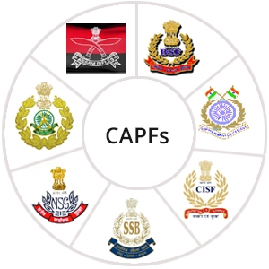

MEDICAL FIRST RESPONDER
LESSON 10
Soft-tissue Injuries
Presented by:- Pavan Dev Gaur, 2IC
CAPF | MFR | INDIA
-

Slide 2
OBJECTIVES
Upon completing this lesson, you will be able to:
1
List two steps to treat a closed wound.
List six steps to treat an open wound.
List the steps for pre-hospital treatment for eye, ear, nose and mouth injuries.
2
3

Slide 3
OBJECTIVES
Upon completing this lesson, you will be able to:
4
List the steps for pre-hospital treatment of abdominal and genital injuries.
Demonstrate the use of dressings and bandages to control bleeding when given a specific area of the body.
5

Slide 4
OBJECTIVES
Upon completing this lesson, you will be able to:
6
Demonstrate the pre-hospital treatment for the following:
Impaled object in the eye or cheek
Bleeding neck injuries

Slide 5
Soft-Tissue Injury
(Also known as “wound.”)
Injury to the skin, muscle, nerves, and blood vessels.
PPT 10 -

Slide 6
Closed Wound
Injury to the soft-tissue beneath unbroken skin.
PPT 10 -

Slide 7
Open
Wound
A soft-tissue injury resulting in breaking of the skin.
PPT 10 -

Slide 8
Types of
Open Wounds
Scratches and abrasions
Lacerations – regular and irregular
Penetration and puncture wounds
Avulsions
Amputations
Crushing injury
Gunshot wounds
Impaled object
PPT 10 -

Slide 9
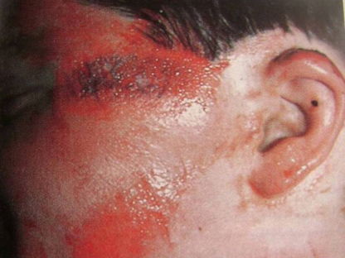
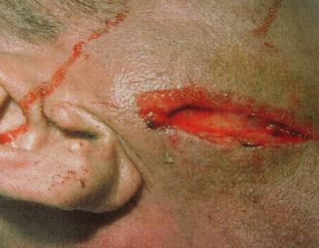
Types of Wounds
Lacerations –
regular and irregular
Scratches and abrasions

Slide 10
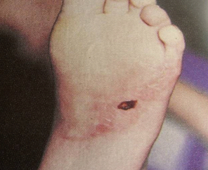
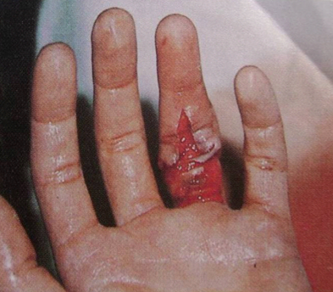
Types of Wounds
Penetration and puncture wounds
Avulsions

Slide 11
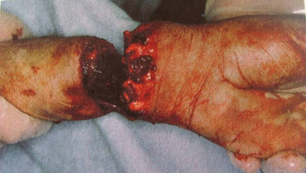
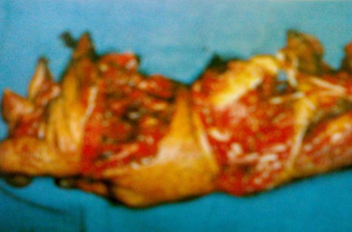
Types of Wounds
Amputations
Crushing injury

Slide 12
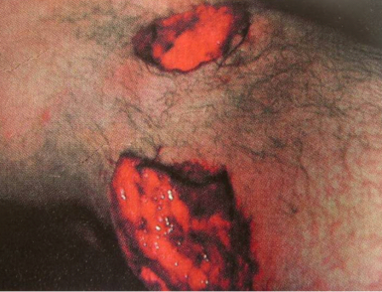
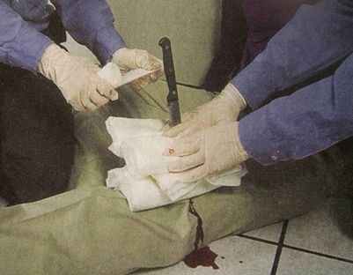
Types of Wounds
Gunshot wounds
Impaled object

Slide 13
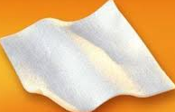
Dressing
Any material used to cover a wound that helps control bleeding and also aids in the prevention of additional contamination.
PPT 10 -

Slide 14
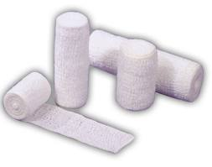
Bandage
Any material used to hold a dressing in place
PPT 10 -

Slide 15
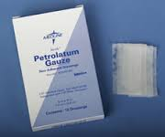
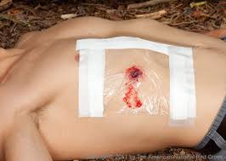
Occlusive Dressing
Any water-resistant material (plastic or waxed paper) that is applied to a wound to prevent the entry of air and loss of moisture from internal organs.
PPT 10 -

Slide 16
Bulky Dressing
Multiple stacked dressings made to form single dressing 2-3 cm thick, such as a thick sanitary napkin or any similar material.
PPT 10 -

Slide 17
PHT OF CLOSED WOUND
Use universal precautions and secure the scene—
Apply “RICE” method
Monitor the patients and check vital sign
Treat for shock
Transport the patient to the EMS as soon as possible.
PPT 10 -

Slide 18
Applying Dressings and Bandages
Control bleeding.
Apply the dressing using aseptic technique.
Cover the wounds completely.

Slide 19
Applying Dressings and Bandages
Cont.
Ensure that the dressing and the bandage are firm, fixed and comfortable, but not so tight as to affect circulation.
Ensure there are no loose ends that can get caught.
Avoid covering the fingertips.

Slide 20
Wounds
to the Ear
Never probe the ear.
Never pack it to stop bleeding from the ear canal.
Place a loose, clean dressing across the opening to absorb the fluids.
Do not apply pressure.

Slide 21
Wounds
to the eye
Close the BEST ONE EYE to restrict the movement of injured eye.
Close the best one eye to the unconscious patient before dressing to secure the BLINDNESS of the patient.
Apply the cup or card board to the EXTRUDED EYE patient and never try to enter that eye in same place.

Slide 22
Injuries
to the Neck
Visible lacerations or other wounds can produce massive bleeding or air embolism
Difficulty speaking; loss of voice
Airway obstructions without foreign bodies in mouth, nose, or airway; often caused by inflammatory process (subcutaneous emphysema)

Slide 23
Injuries
to the Neck
Cont.
Tracheal deviation
Deformities and depressions
Immobilize the patient if you suspect a spinal injury

Slide 24
Abdominal Injury
Signs and Symptoms
Pain or cramps in the abdominal area, local or diffuse
Guarding the abdomen or lying down in fetal position
Tenderness of the abdomen

Slide 25
Abdominal Injury
Cont.
Signs and Symptoms
Signs of shock
Rigid, tense or distended abdomen
Mild discomfort progressing to intolerable pain
Deep, penetrating pain in the pelvis or lower back

Slide 26
Abdominal Injury
Cont.
Signs and Symptoms
Pain radiating to a shoulder or both shoulders
Vomiting blood: bright red or like coffee grounds
Blood in the stool: bright red or tarry black

Slide 27
REVIEW
Now you are able to:
1
List two steps to treat a closed wound.
List six steps to treat an open wound.
List the steps for pre-hospital treatment for eye, ear, nose and mouth injuries.
2
3

Slide 28
REVIEW
Now you are able to:
4
List the steps for pre-hospital treatment of abdominal and genital injuries.
Demonstrate the use of dressings and bandages to control bleeding when given a specific area of the body.
5

Slide 29
REVIEW
Now you are able to:
6
Demonstrate the pre-hospital treatment for the following:
Impaled object in the eye or cheek
Bleeding neck injuries

Slide 30


THANK YOU

