Slide 1


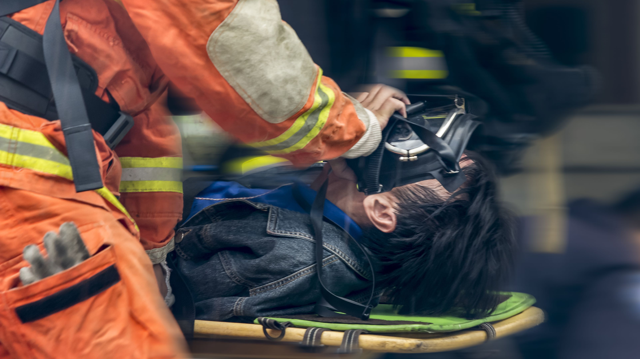





LESSON 1
COURSE INTRODUCTION
Photo Credit: Freepik
Presented By:- Sohel Lakhani. DC
PEER | CSSR | INDIA
PPT 1-1

Slide 2
OBJECTIVES
Upon completing this lesson, you will become familiar with:
1
Names and background information of the course coordinator, instructors, assistants, support staff and the other participants.
PEER | CSSR | INDIA
PPT 1-2

Slide 3
OBJECTIVES
2
Upon completing this lesson, you will become familiar with:
The following aspects of the course will be covered in this lesson:
Expectations
Purpose
Objectives
Methodology
Testing
Materials
Logistics and Agenda
Course overview and its relation to the OFDA First Responder Program.
PEER | CSSR | INDIA
PPT 1-3

Slide 4
Purpose of the Course
To train the participant in the techniques and methods necessary for searching, locating, stabilising, and extricating victims trapped in collapsed structures, using the safest and most appropriate procedures for the rescuer as well as the victim.
PEER | CSSR | INDIA
PPT 1-8

Slide 5
Course Materials
PWB
Participant Workbook
RM
Reference Material
PW
Pre-Work
HO
Handouts
PEER | CSSR | INDIA
PPT 1-9

Slide 6
Facilities
and Ground Rules
Classroom Etiquette
Meals
Housing and Expenses
Travel
Safety
PEER | CSSR | INDIA
PPT 1-10

Slide 7
Safety Rule
Safety is of utmost concern
in the CSSR course.
Participants will be given two warnings only with the third as ground for expulsion.
PEER | CSSR | INDIA
PPT 1-11

Slide 8
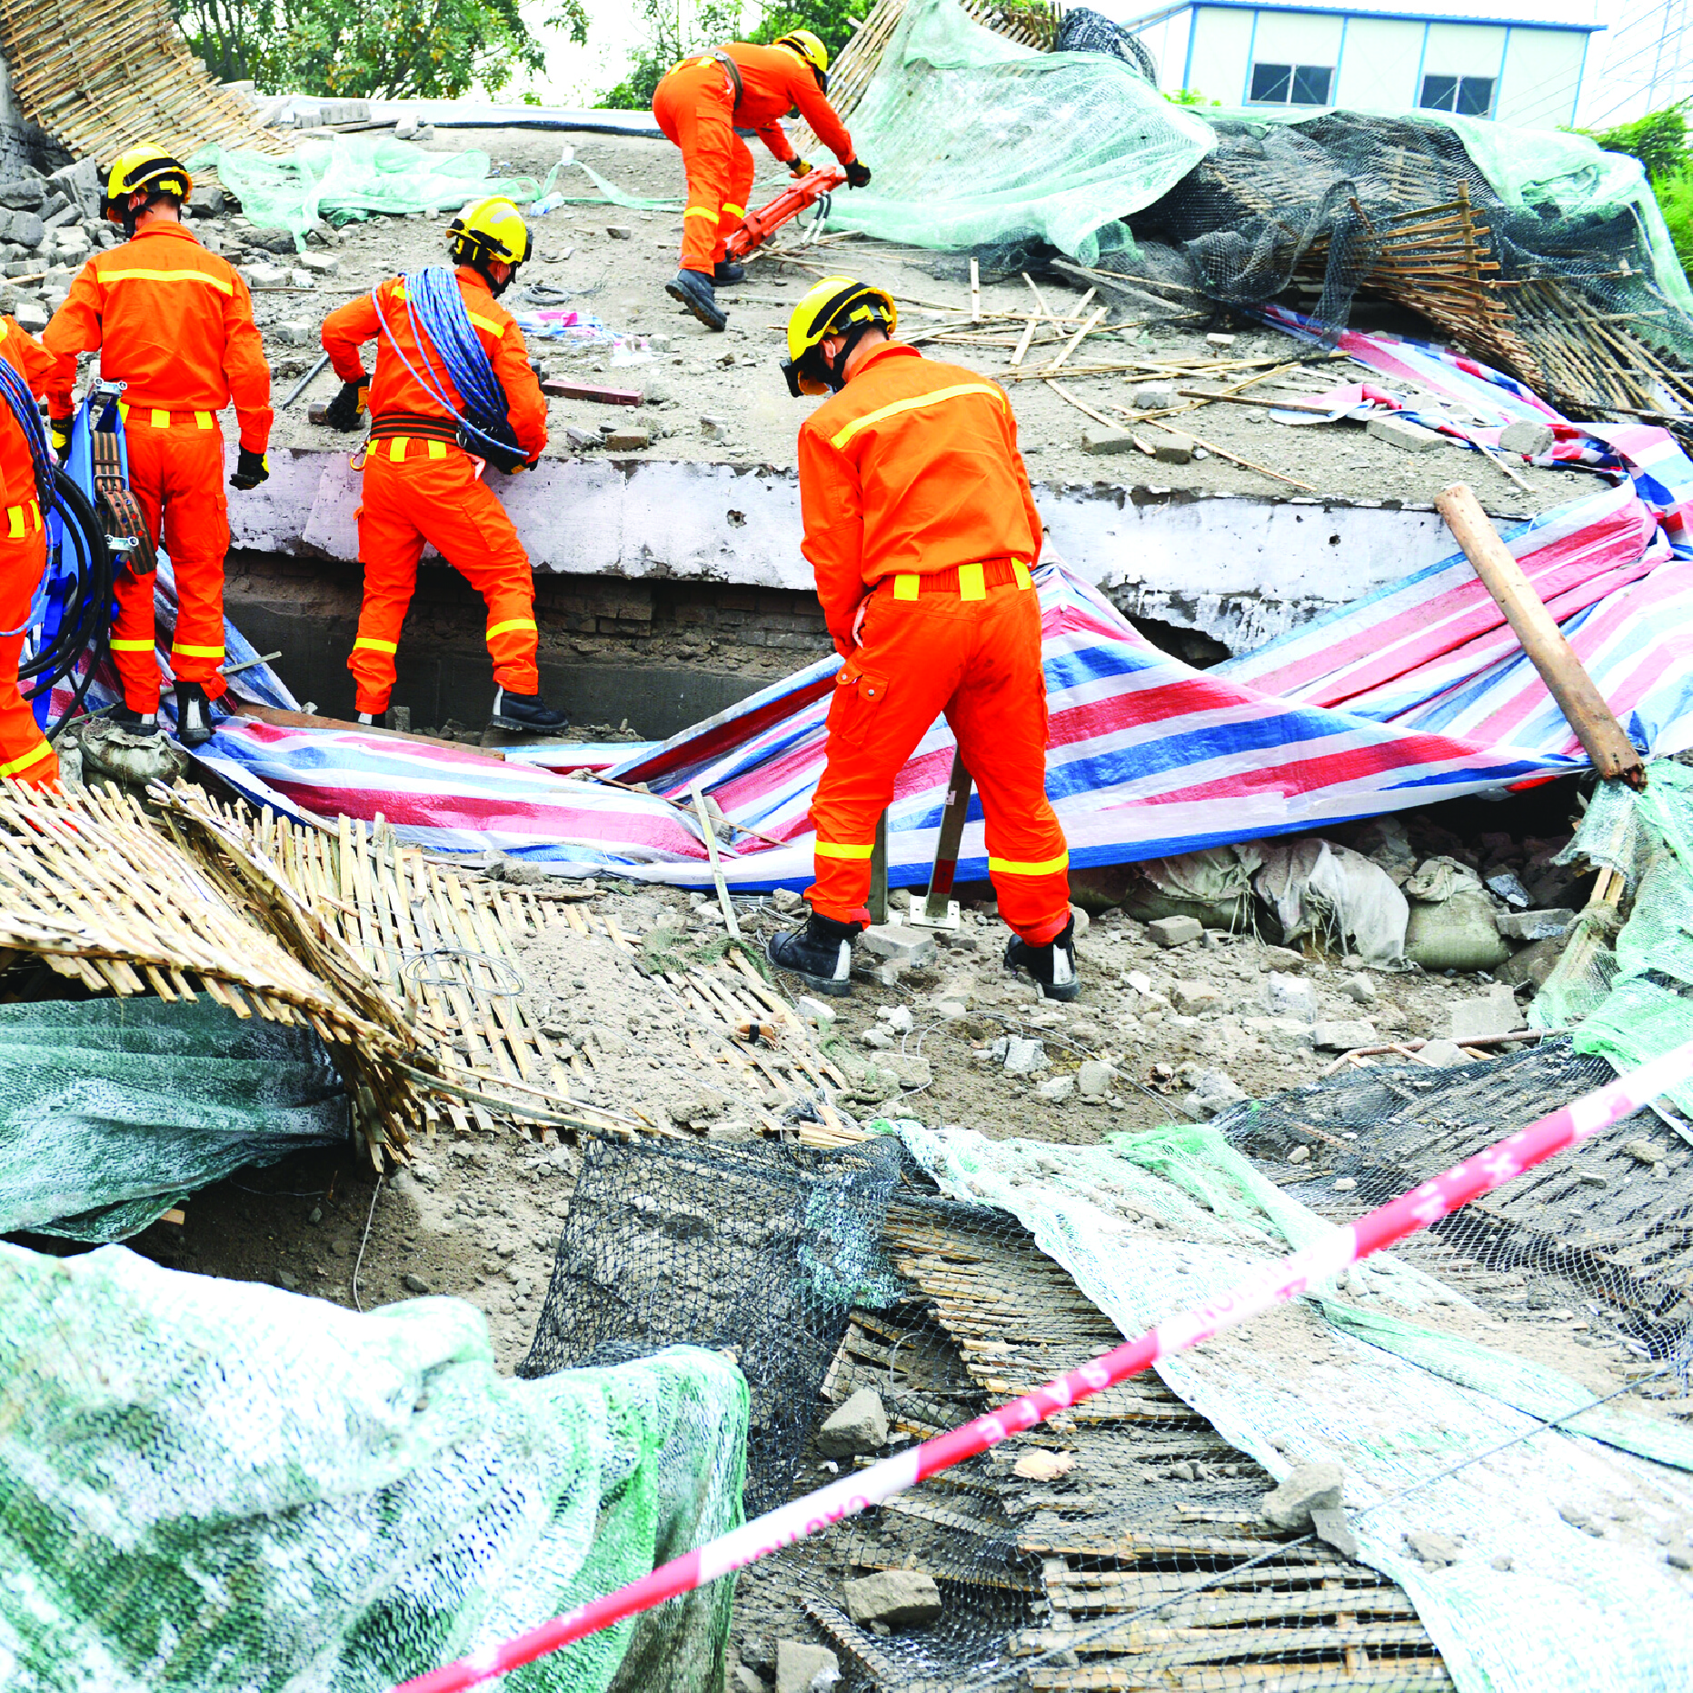


PEER | CSSR | INDIA

Slide 9
PPT 1-10

Slide 10

THANK YOU

