Slide 1
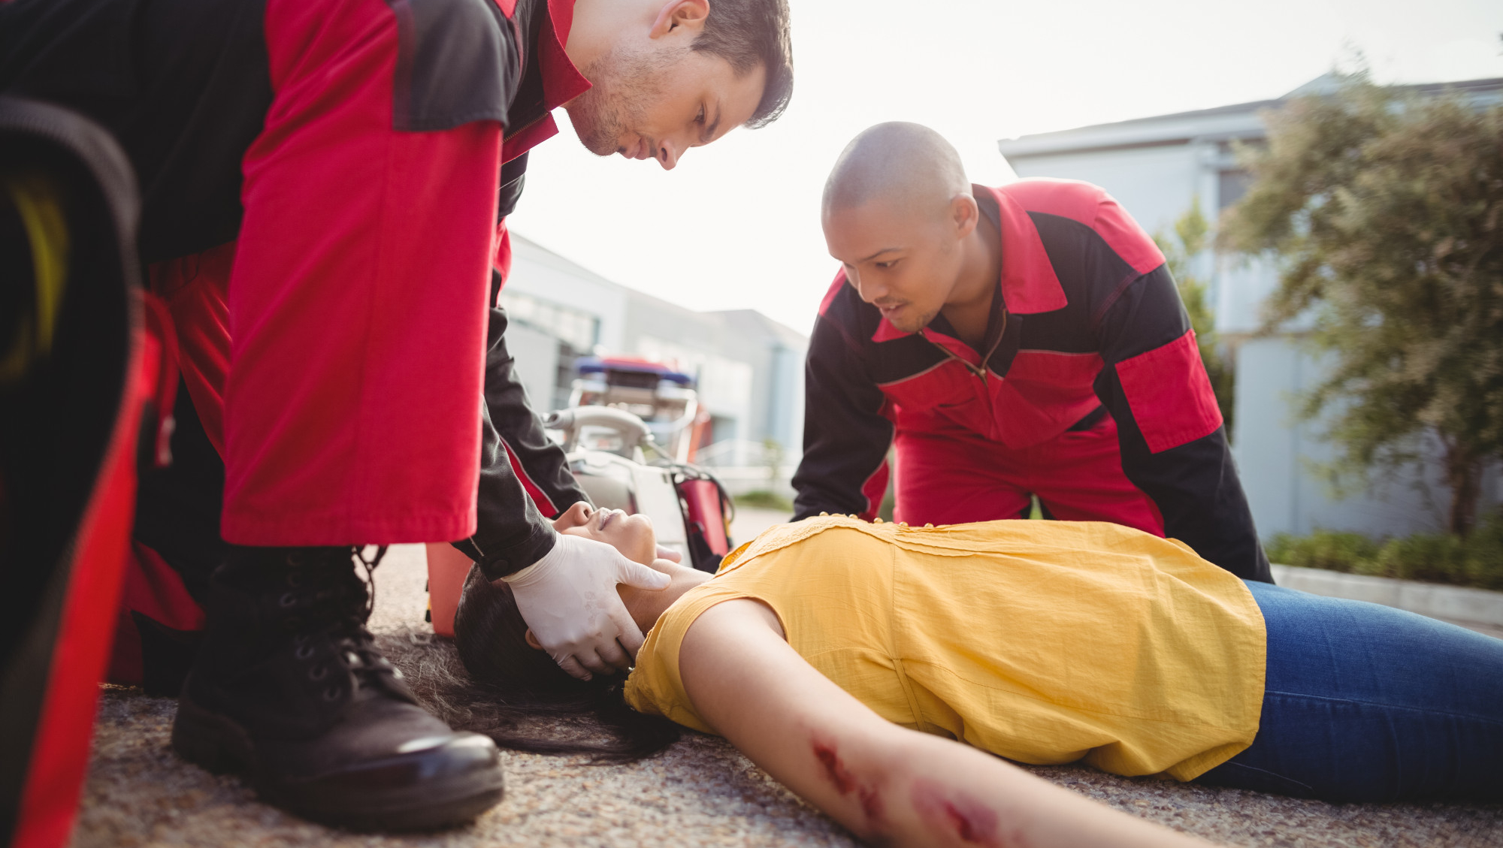





LESSON 1
COURSE INTRODUCTION
Photo Credit: Freepik
PPT 1 -
PEER | MFR | INDIA
PPT 1 - 1

Slide 2
OBJECTIVES
Upon completing this lesson, you will become familiar with:
1
Other participants and the organizations they represent, the course coordinator, the instructors and the support staff.
The following aspects of the course: Purpose, objectives, evaluation and methodology, materials to be used, course schedule, facilities and ground rules.
2
PEER | MFR | INDIA
PPT 1 -

Slide 3
Course Purpose
To provide the participant the knowledge and skills needed to render aid on-site to sick or injured persons, stabilize their condition and prepare them for transport to a medical facility.
PEER | MFR | INDIA
PPT 1 -

Slide 4
REVIEW
Now you are familiar with:
1
Other participants and the organizations they represent, the course coordinator, the instructors and the support staff.
The following aspects of the course: Purpose, objectives, evaluation and methodology, materials to be used, course schedule, facilities and ground rules.
2
PEER | MFR | INDIA
PPT 1 -

Slide 5



PEER | MFR | INDIA
PPT 1 -

