Slide 1
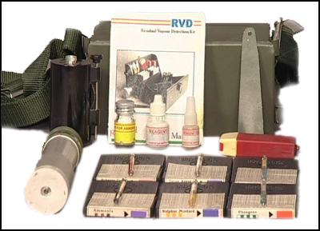





RESIDUAL VAPOUR DETECTION KIT (RVD)
Presented By:- Amit Kumar, AC

Slide 2
About Residual Vapor Detection Kit.
Purpose of RVD Kit.
Parts Identification of RVD.
RVD Kit Test Procedure.
Care and maintenance.
OBJECTIVES
Upon completion of this lesson you will be able to:

Slide 3
INTRODUCTION
(RVD)
The RVD kit is designed to detect CW agents in field.
The kit comprises of six different types of specially made tubes with reagents to give color change upon reaction with CW agents.
This kit meets the requirement of the detection of CW agents up to 10 ppm.

Slide 4
INTRODUCTION
(RVD)
Kit caters for 10 tests each for
  Blister
  Nerve
  Phosgene
  Cyanogen Chloride
  Hydrogen Cyanide.
Ammonia for training purpose.
Presence of agents is indicated by change in color of the tube material.

Slide 5
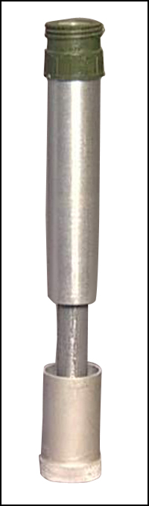
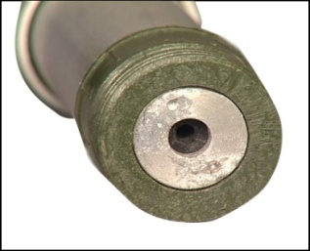
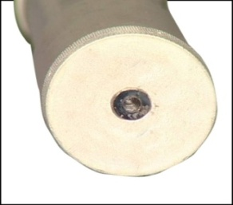
SAMPLING PUMP
(RVD)

Slide 6
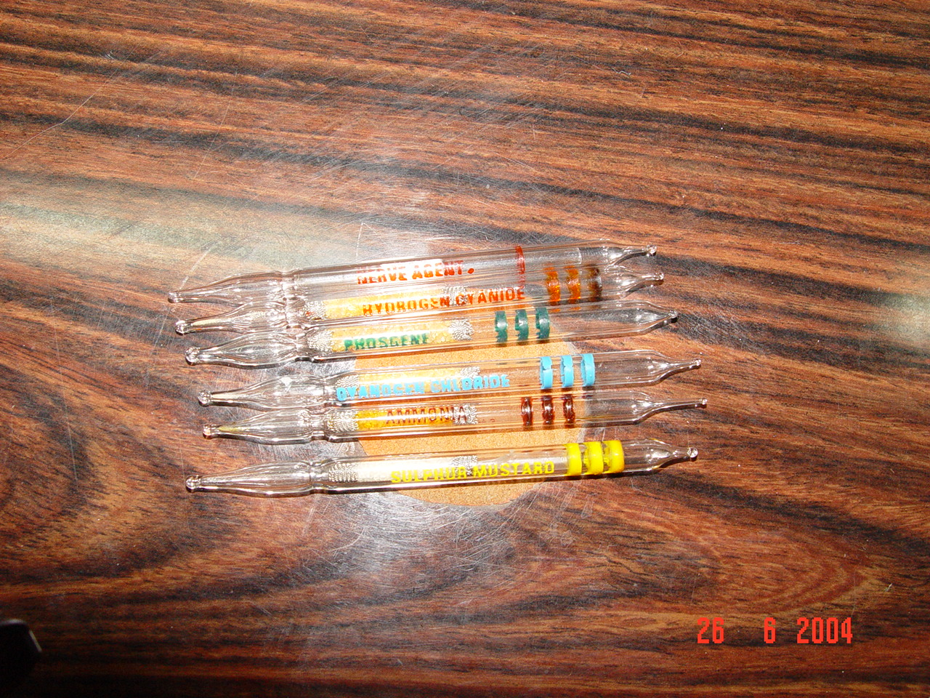
DETECTOR TUBES
(RVD)

Slide 7
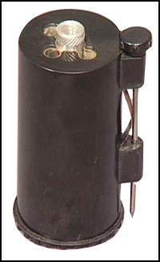
CHEMICAL HEATER
(RVD)

Slide 8
NAME OF PARTS
(RVD)
Sr.no | Particulars | Qty (No)
01 02 03 04 05 06 07 08 09 10 11 | Kit box Sampling Pump Detector Tubes Ammonia Cyanogen chloride Hydrogen cyanide Sulphur Mustard Nerve Agents Phosgene Heating Device Reagent Bottles for Ammonia Heater Nerve Agents Spatula Poker Torch Torch Cell Belt Users Hand Book | 1 1 10 10 10 10 10 10 1 1 1 1 1 1 1 2 1 1

Slide 9
TEST PROCEDURE
(CYANOGEN CHLORIDE)
3 Blue bands.
Insert end into pump.
Suck in CA.
Color change Yellow to Pink

Slide 10
TEST PROCEDURE
(AMMONIA)
NH₃ (3 Chocolate bands).
Insert non-coded end in pump.
Suck NH₃ by opening the test Ammonia bottle.
Color- Yellow to Violet.

Slide 11
TEST PROCEDURE
(HYDROGEN CYANIDE)
3 Red band.
Non coded end into pump.
Suck in CA.
Color change Yellow to Pink.

Slide 12
TEST PROCEDURE
(PHOSGENE)
3 Green bands.
Insert non coded end into pump.
Suck in CA.
Color change Yellow to Brick Red.

Slide 13
TEST PROCEDURE
(SULPHUR MUSTARD)
3 Yellow bands (Ampule inside).
Insert non-coded end into pump.
Suck chem agent.
Heat for 2 min in chem heater using heating solution.
Break glass ampule inside with poker.
Color change to light blue.
white

Slide 14
TEST PROCEDURE
(NERVE AGENTS)
1 Red band - 1 Red dot.
Insert non-coded end into pump.
Suck in chem agent.
Break ampule inside plastic vial
Add 1 drop of solution (reagent) to tube.
Blue color persists positive.

Slide 15
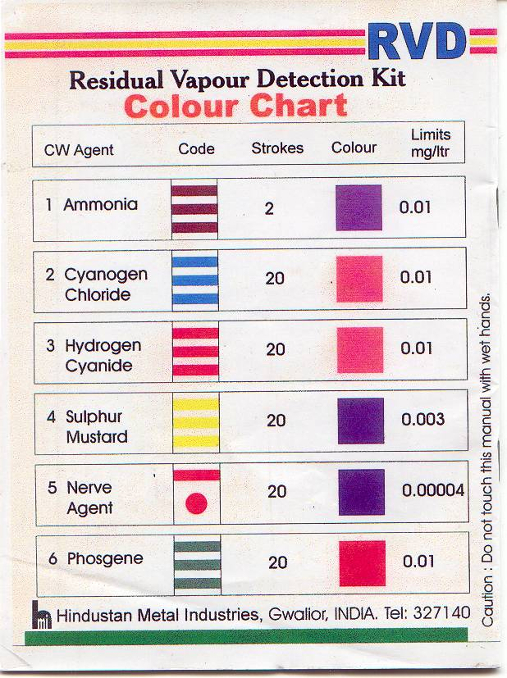
COLOR CHART
(RVD KIT)

Slide 16
CARE
& MAINTENANCE
(1) Detector tubes and Reagents
(a) Replenish the reagents and tubes when
(i) Exhausted (ii) Date expired.
(2) Chemical Heater
(a) Wash properly with plain water and dry after every use.
(b) Replace the aluminum tube if starts leaking.
(3) Keep the reagent bottles tightly closed to prevent any leakage.
Replace immediately any leaking bottle particularly Heater Reagent.

Slide 17


About Residual Vapor Detection Kit.
Purpose of RVD Kit.
Parts Identification of RVD.
RVD Kit Test Procedure.
Care and maintenance.
REVIEW

Slide 18

ANY QUESTION?

Slide 19


How many tests cater for Nerve agents
by each RVD Kit?
Ans- 10 tests
2. What is full form of RVD?
Ans- Residual Vapor Detection Kit
EVALUATION

Slide 20



THANK YOU

