Slide 1
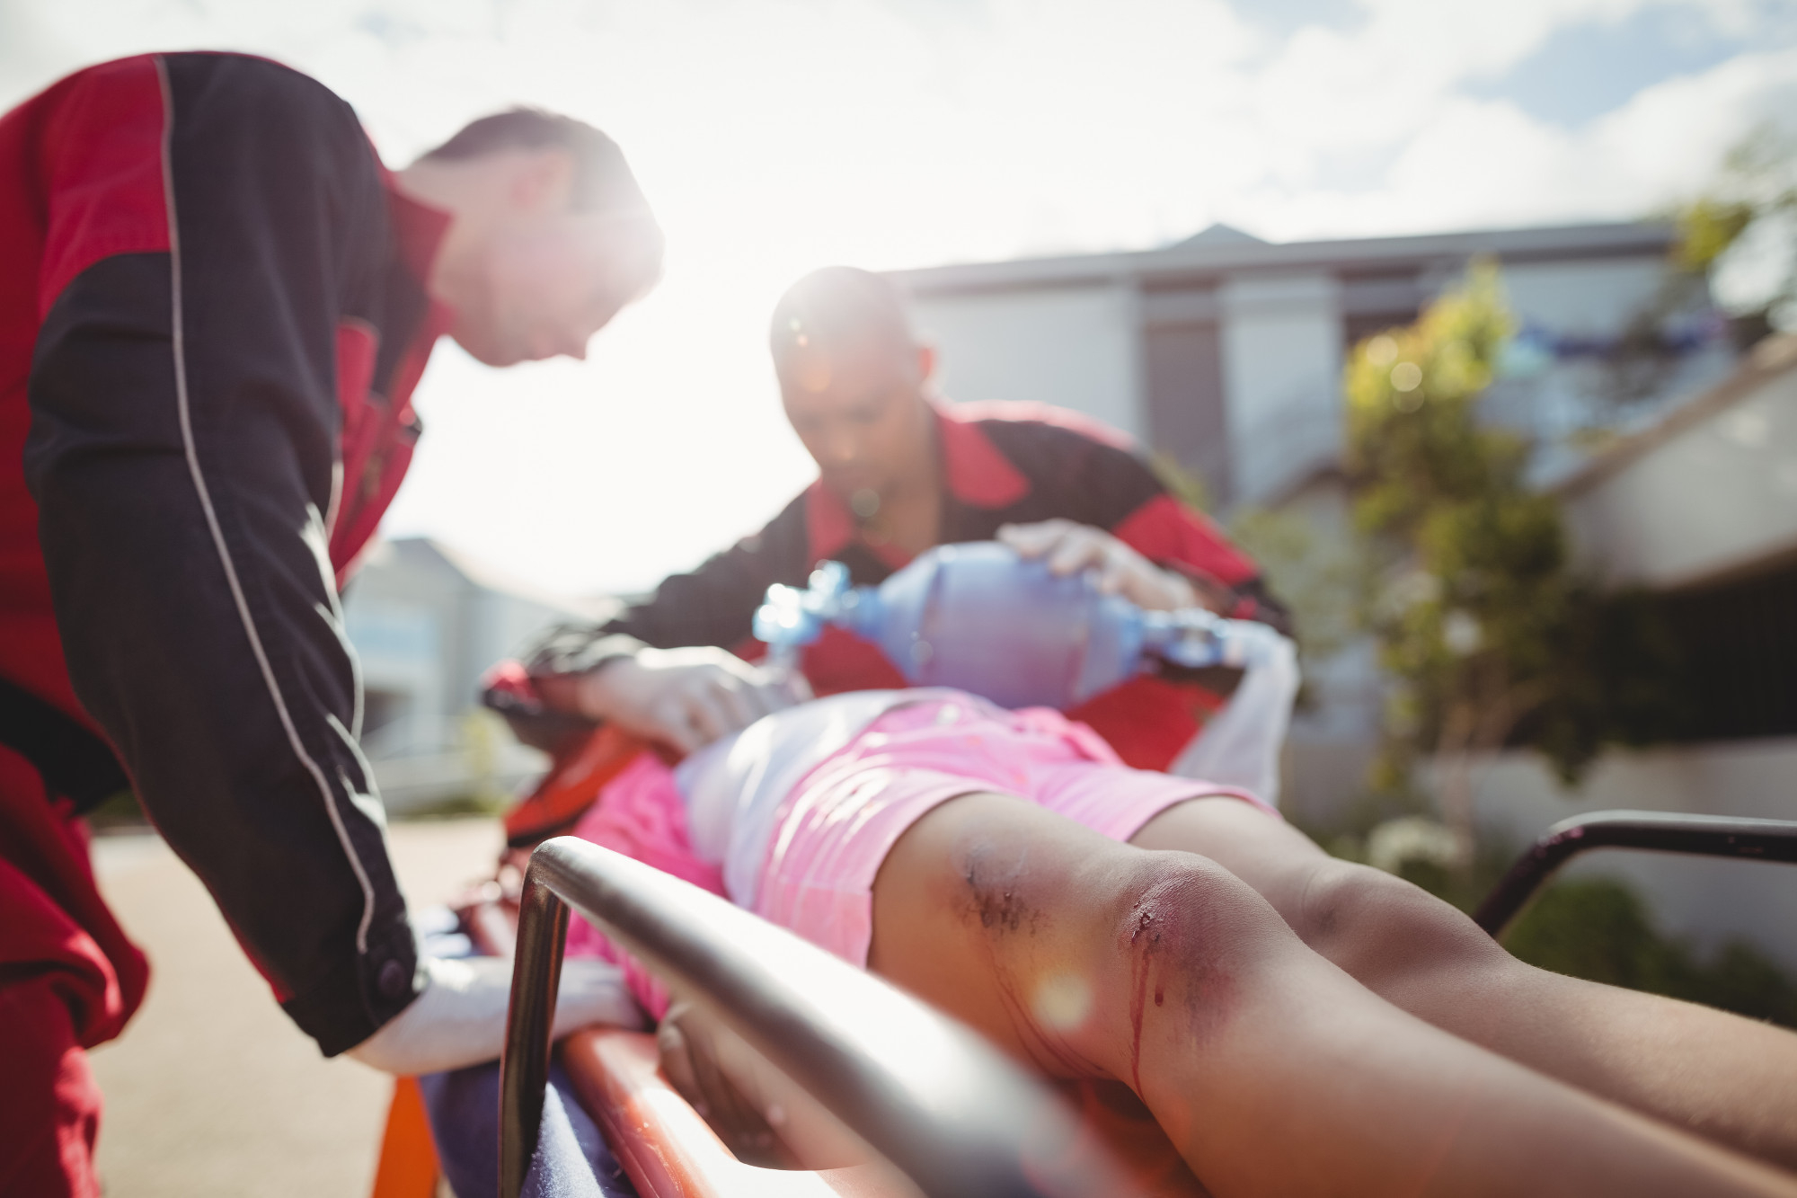



Soft-tissue Injuries
Presented by:- Kamlesh Dhoundiyal, 2IC
Photo Credit: Freepik
PPT 10 -

Slide 2

OBJECTIVES
Upon completing this lesson, you will be able to:
1
List two steps to treat a closed wound.
List six steps to treat an open wound.
List the steps for pre-hospital treatment for eye, ear, nose and mouth injuries.
2
3
PEER | MFR | INDIA
PPT 10 -

Slide 3
OBJECTIVES
Upon completing this lesson, you will become familiar with:
4
List the steps for pre-hospital treatment of abdominal and genital injuries.
Demonstrate the use of dressings and bandages to control bleeding when given a specific area of the body.
5
PEER | MFR | INDIA
PPT 10 -

Slide 4
OBJECTIVES
Upon completing this lesson, you will become familiar with:
6
Demonstrate the pre-hospital treatment for the following:
Impaled object in the eye or cheek
Bleeding neck injuries
PEER | MFR | INDIA
PPT 10 -

Slide 5
Soft-Tissue Injury
(Also known as “wound.”)
Injury to the skin, muscle, nerves, and blood vessels.
PEER | MFR | INDIA
PPT 10 -

Slide 6
Closed Wound
Injury to the soft-tissue beneath unbroken skin.
PEER | MFR | INDIA
PPT 10 -

Slide 7
Open Wound
A soft-tissue injury resulting in breaking of the skin.
PEER | MFR | INDIA
PPT 10 -

Slide 8
Types of
Open Wounds
Scratches and abrasions
Lacerations – regular and irregular
Penetration and puncture wounds
Avulsions
Amputations
Crushing injury
Gunshot wounds
Impaled object
PEER | MFR | INDIA
PPT 10 -

Slide 9
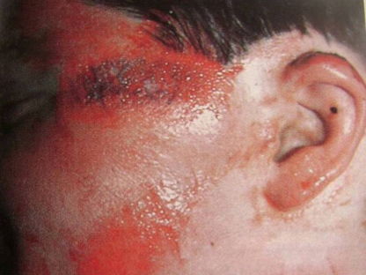
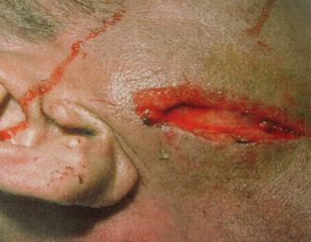
Types of Wounds
Lacerations –
regular and irregular
Scratches and abrasions
PEER | MFR | INDIA
PPT 10 -

Slide 10
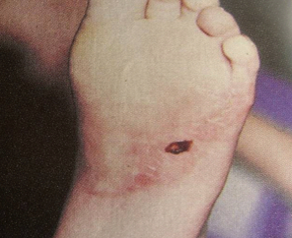
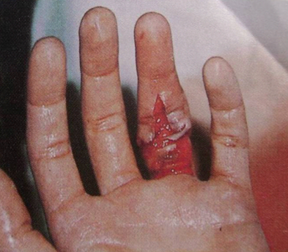
Types of Wounds
Penetration and puncture wounds
Avulsions
PEER | MFR | INDIA
PPT 10 -

Slide 11
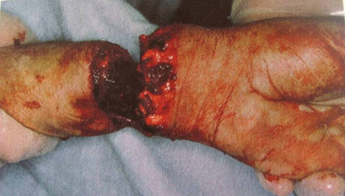
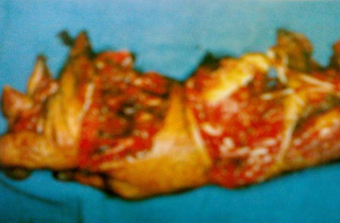
Types of Wounds
Amputations
Crushing injury
PEER | MFR | INDIA
PPT 10 -

Slide 12
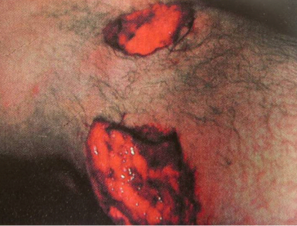
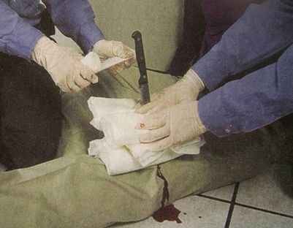
Types of Wounds
Gunshot wounds
Impaled object
PEER | MFR | INDIA
PPT 10 -

Slide 13
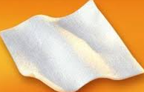
Dressing
Any material used to cover a wound that helps control bleeding and also aids in the prevention of additional contamination.
PEER | MFR | INDIA
PPT 10 -

Slide 14
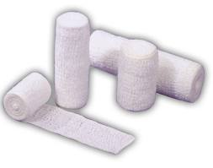
Bandage
Any material used to hold
a dressing in place
PEER | MFR | INDIA
PPT 10 -

Slide 15
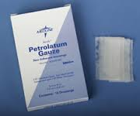
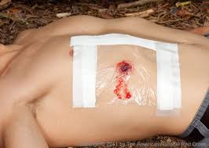
Occlusive Dressing
Any water-resistant material (plastic or waxed paper) that is applied to a wound to prevent the entry of air and loss of moisture from internal organs.
PEER | MFR | INDIA
PPT 10 -

Slide 16
Bulky Dressing
Multiple stacked dressings made to form single dressing 2-3 cm thick, such as a thick sanitary napkin or any similar material.
PEER | MFR | INDIA
PPT 10 -

Slide 17
Applying Dressings and Bandages
Control bleeding.
Apply the dressing using aseptic technique.
Cover the wounds completely.
PEER | MFR | INDIA
PPT 10 -

Slide 18
Applying Dressings and Bandages
Cont.
Ensure that the dressing and the bandage are firm, fixed and comfortable, but not so tight as to affect circulation.
Ensure there are no loose ends that can get caught.
Avoid covering the fingertips.
PEER | MFR | INDIA
PPT 10 -

Slide 19
Wounds
to the Ear
Never probe the ear.
Never pack it to stop bleeding from the ear canal.
Place a loose, clean dressing across the opening to absorb the fluids.
Do not apply pressure.
PEER | MFR | INDIA
PPT 10 -

Slide 20
Injuries
to the Neck
Visible lacerations or other wounds can produce massive bleeding or air embolism
Difficulty speaking; loss of voice
Airway obstructions without foreign bodies in mouth, nose, or airway; often caused by inflammatory process (subcutaneous emphysema)
PEER | MFR | INDIA
PPT 10 -

Slide 21
Injuries
to the Neck
Cont.
Tracheal deviation
Deformities and depressions
Immobilize the patient if you suspect a spinal injury
PEER | MFR | INDIA
PPT 10 -

Slide 22
Abdominal Injury
Signs and Symptoms
Pain or cramps in the abdominal area, local or diffuse
Guarding the abdomen or lying down in fetal position
Tenderness of the abdomen
PEER | MFR | INDIA
PPT 10 -

Slide 23
Abdominal Injury
Cont.
Signs and Symptoms
Signs of shock
Rigid, tense or distended abdomen
Mild discomfort progressing to intolerable pain
Deep, penetrating pain in the pelvis or lower back
PEER | MFR | INDIA
PPT 10 -

Slide 24
Abdominal Injury
Cont.
Signs and Symptoms
Pain radiating to a shoulder or both shoulders
Vomiting blood: bright red or like coffee grounds
Blood in the stool: bright red or tarry black
PEER | MFR | INDIA
PPT 10 -

Slide 25


THANK YOU

