Slide 1




MEDICAL FIRST RESPONDER
LESSON 9
Hemorrhage and Shock
Presented by:- Pavan Dev Gaur, 2IC
CAPF | MFR | INDIA
-

Slide 2
OBJECTIVES
Upon completing this lesson, you will be able to:
1
List three methods of controlling external hemorrhage.
List ten signs and symptoms of shock.
2

Slide 3
OBJECTIVES
Upon completing this lesson, you will be able to:
3
List the five steps for pre-hospital treatment of shock.
List the three steps for pre-hospital treatment for internal haemorrhage.
4

Slide 4
The Heart
The heart is a hollow muscular organ.
The Right side of heart receives blood from the body & pumps it to lungs for oxygenation.
The left side of heart receives oxygenated blood from the lungs & pumps it through out the body.
PPT 7 -

Slide 5
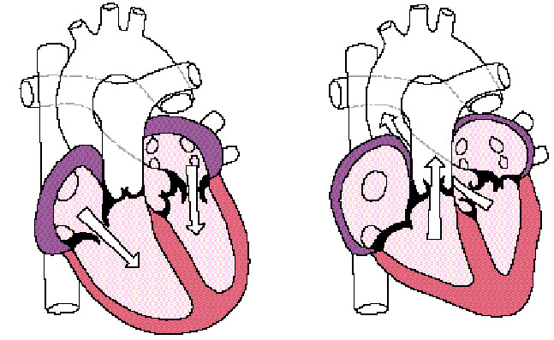
Heart Circulation
Aorta
Pulmonary
veins
Pulmonary
arteries
Left
Atrium
Left
Ventricle
Right Atrium
Vena Cava
Right Ventricle

Slide 6
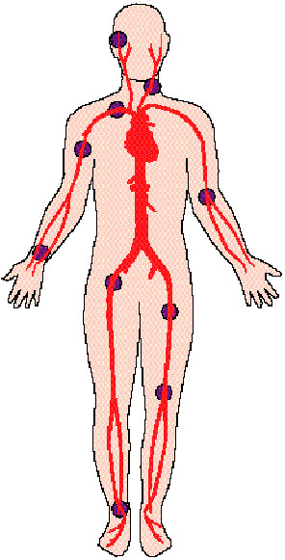
Carotid
Pulse Locations
Brachial
Radial
Femoral
Dorsalis Pedis

Slide 7
Blood
The solid portion of the blood consists of white blood cells, red blood cells and platelets.
The liquid portion of blood is called plasma.
The normal adult has approximately five to six liters of blood.
PPT 7 -

Slide 8
Perfusion
The circulation of blood throughout an organ.
PPT 7 -

Slide 9
Functions
Blood transports oxygen as well as cells that combat infection and eliminate waste products.
Blood also has the capacity to clot (solidify); this process usually takes
6 to 7 minutes.
PPT 7 -

Slide 10
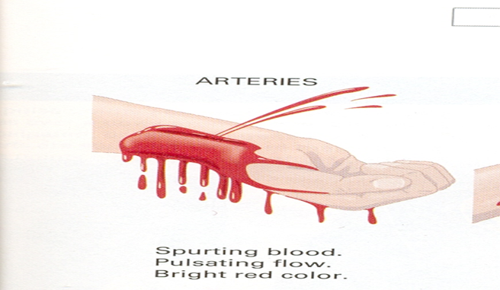
Arteries
The arteries are the blood vessels that transport the blood to the body. They are of different diameters ranging from very thick to medium and small. Arterial bleeding is characterized by bright red colour.
PPT 7 -

Slide 11
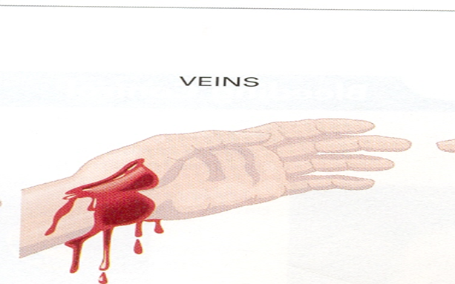
VEINS
Veins are blood vessels that carry blood back to the heart. Veins do not have much pressure as the arteries. Venous bleeding is characterized by a dark red colour
PPT 7 -

Slide 12
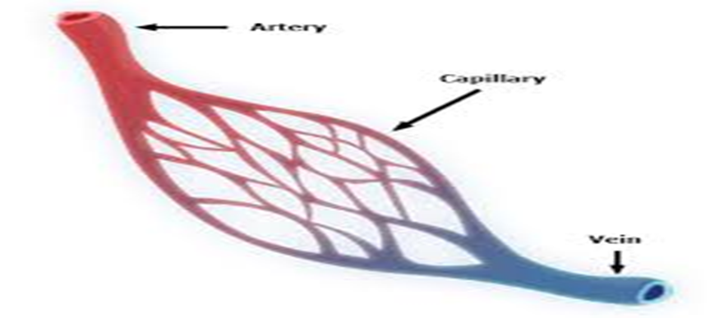
Capillaries
Each artery is divided into smaller transport vessels until they narrow down into capillaries, the tiny vessels closest to the skin.
Through their thin walls, the exchange of oxygen and carbon dioxide takes place.
PPT 7 -

Slide 13
Haemorrhage
The loss/ escaping of blood from the circulatory system termed as hemorrhage.
It can be classified
External
Internal
PPT 7 -

Slide 14
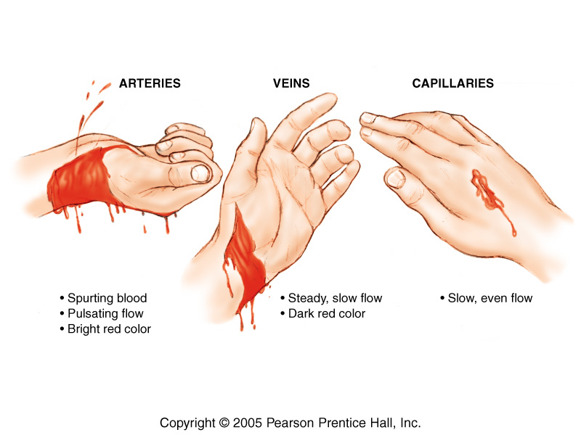
Haemorrhage
PPT 7 -

Slide 15
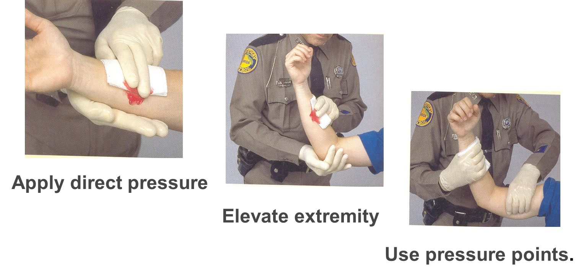
Pre-hospital Treatment for External Hemorrhage
PPT 7 -

Slide 16
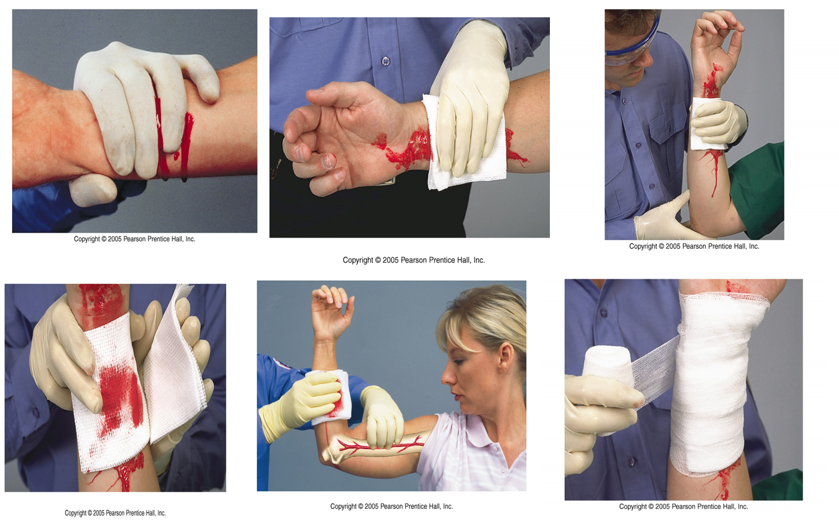
Pre-hospital Treatment for External Hemorrhage
PPT 7 -

Slide 17
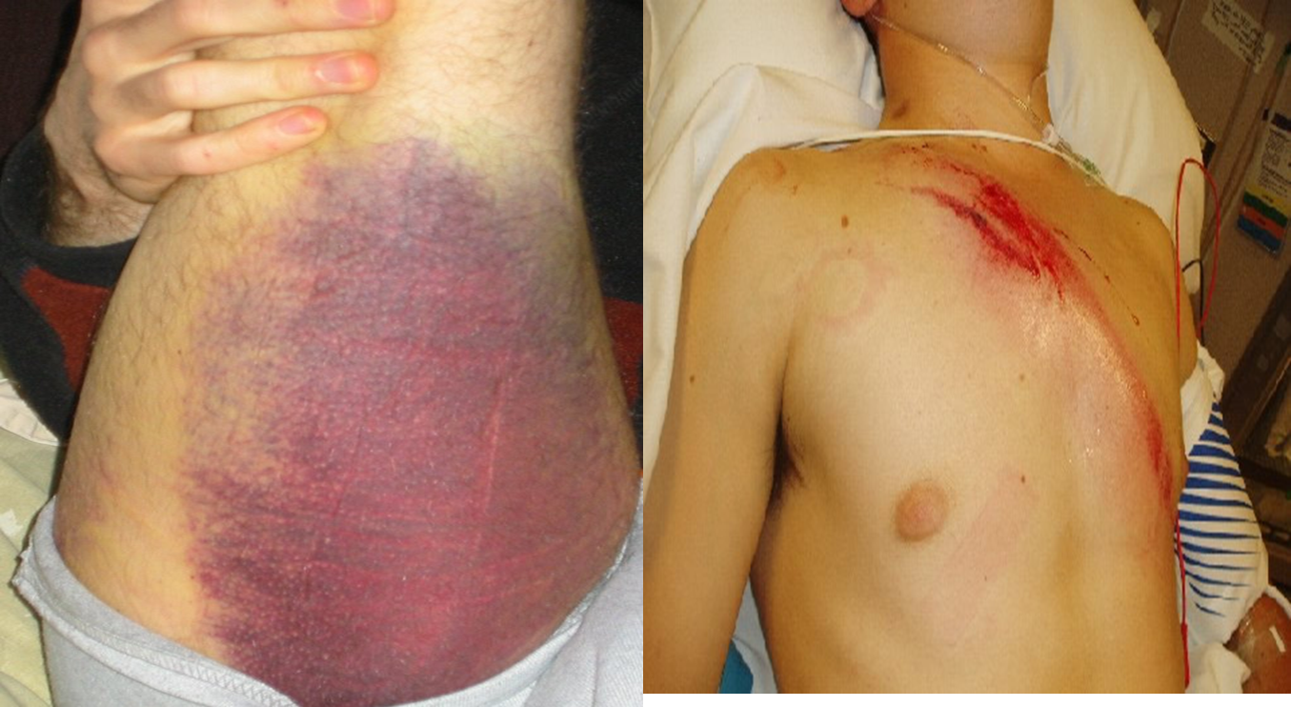
INTERNAL BLEEDING
PPT 7 -

Slide 18
Maintain an open airway and provide high-flow oxygen per local protocol.
Keep the patient warm, but be careful not to overheat him/her.
Treat for shock.
Transport the patient as soon as possible.
Report the possibility of internal bleeding as soon as more highly trained EMS personnel arrive at the scene
Pre-hospital Treatment for Internal Haemorrhage
PPT 7 -

Slide 19
Shock
Failure of the circulatory system to provide adequate oxygenated blood supply throughout the body (inadequate tissue perfusion).
PPT 7 -

Slide 20
Causes of Shock
Inability of the heart to pump enough blood through the organs
Severe loss of blood; insufficient blood in the system
Excessive dilation of blood vessels. Blood volume will be insufficient to fill them and shock will develop.
PPT 7 -

Slide 21
Types of shock
Cardiogenic shock
Hypovolemic shock
Hemorrhagic shock
Neurogenic shock
Anaphylactic shock
Septic shock
PPT 7 -

Slide 22
Signs of Shock
Breathing: Shallow and rapid
Pulse: Rapid and weak
Skin: Pale, cool and clammy
Face: Pale, often with blue colour (cyanosis) in the lips, tongue and ear lobes
Eyes: Lack lustre, pupils dilated
PPT 7 -

Slide 23
Symptoms of Shock
Nausea and possible vomiting.
Thirst
Weakness
Vertigo
Uneasiness and fear – in some patients these symptoms can be the first sign of shock.
PPT 7 -

Slide 24
Pre-hospital Treatment for Shock
Carry out primary assessment.
Seek medical attention (make sure EMS are on route).
Maintain open airway. If breathing is inadequate, Prevent further blood loss (by using direct pressure, elevation or pressure points administer oxygen).
PPT 7 -

Slide 25
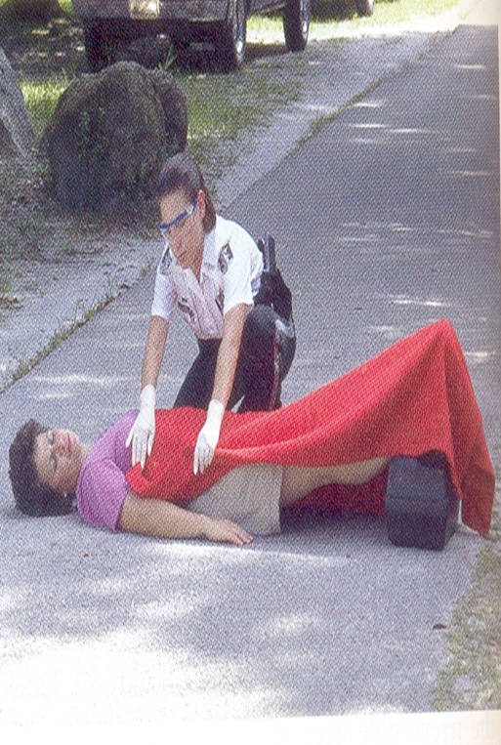
Elevate the lower extremities 20-30 cm, only if there are no suspected spinal, neck, chest or abdominal injuries.
If any one these injuries is suspected, keep the patient supine (face up).
Pre-hospital Treatment for Shock
PPT 7 -

Slide 26
Pre-hospital Treatment for Shock
Keep the patient warm, but do not overheat.
Undertake a secondary assessment.
Provide care for specific injuries.
Rest and reassure.
Transport the patient immediately.
PPT 7 -

Slide 27


THANK YOU

