Slide 1





CADRE
Lesson 8
BASIC SEARCH AND RESCUE
Presented By:- Pavan Dev Gaur,2IC

Slide 2



OBJECTIVES
  Define community light search and rescue.
  Describe the most common techniques in searching a structure.
  Demonstrate in practical exercise the safe methods and techniques in lifting and stabilizing a load.
1
Upon completion of this lesson, you will be able to :-
2
3

Slide 3


A first response search and rescue operation designed to:
  Provide an initial search of buildings affected by a disaster or emergency or located in a zone affected by disaster or emergency.
  Locate and assist trapped people and assist those with minor or no injuries.
  Help people requiring assistance to exit from lightly damaged buildings and move to a safer location.
Community Light Search and Rescue

Slide 4
Size up
Search
- Locate Victims
- Document Location of Victims
Rescue
Light Search and Rescue Operations

Slide 5
Gather Facts
Assess Damage
Consider Probabilities
Assess Situation
Establish Priorities
Light Search and Rescue Size-up

Slide 6
Make Decisions
Develop Plans of Action
Take Action
Evaluate Progress
Light Search and Rescue Size-up

Slide 7


Member 2
N
Member 3
Squad Leader
Member 1
Member 4

Slide 8

Indicates rescuer location
Prevents duplication of effort
Effective Search Methodology

Slide 9
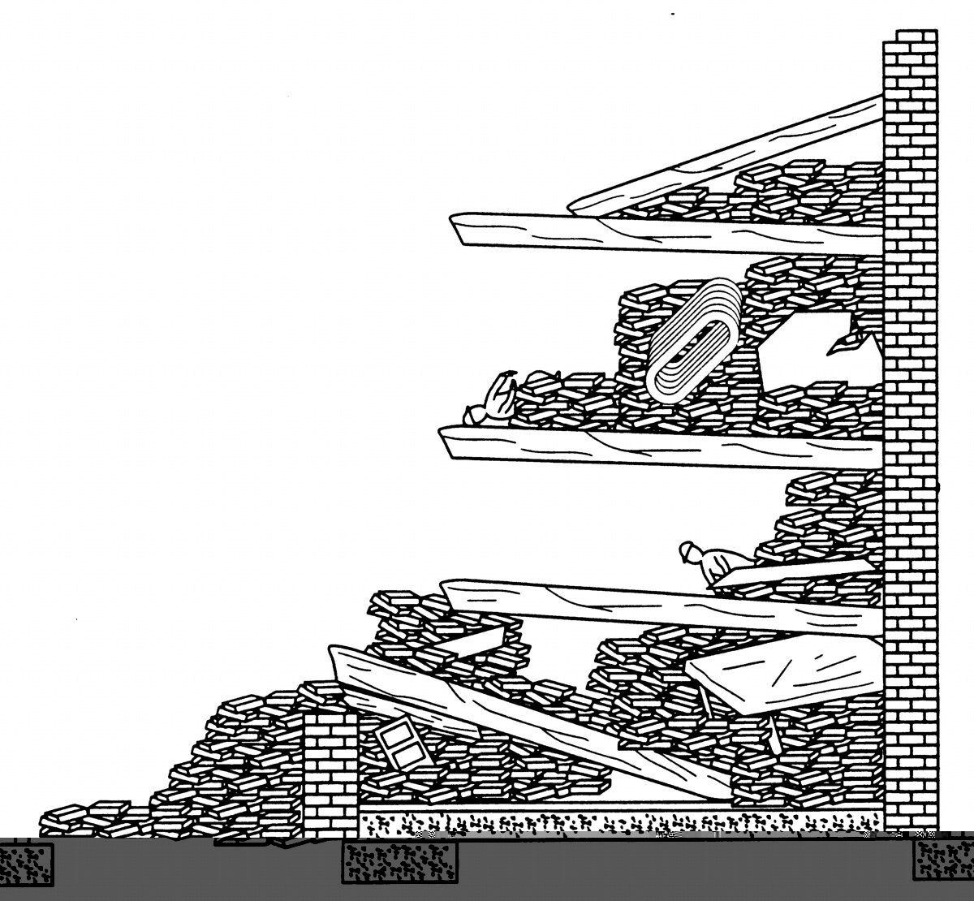
Cantilever
Conducting Search Operations

Slide 10
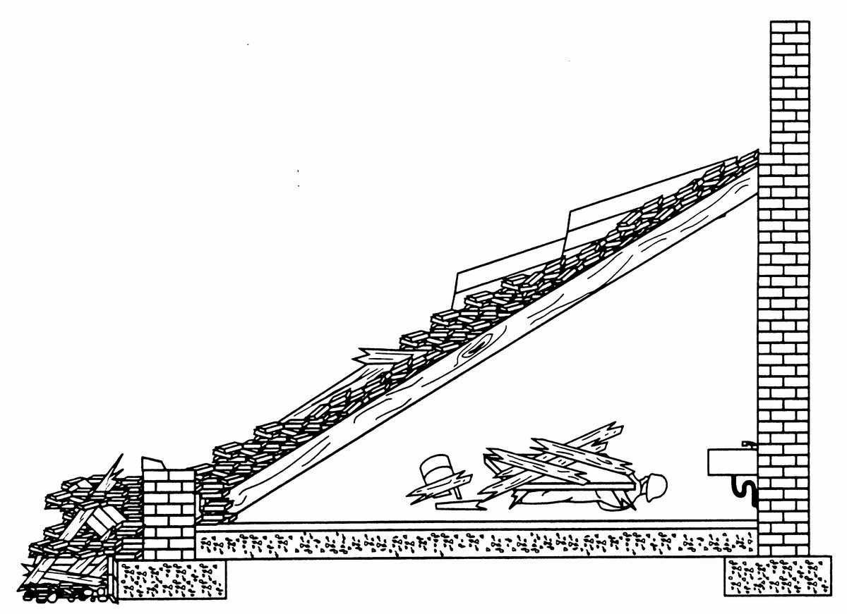
Lean To
Conducting Search Operations

Slide 11
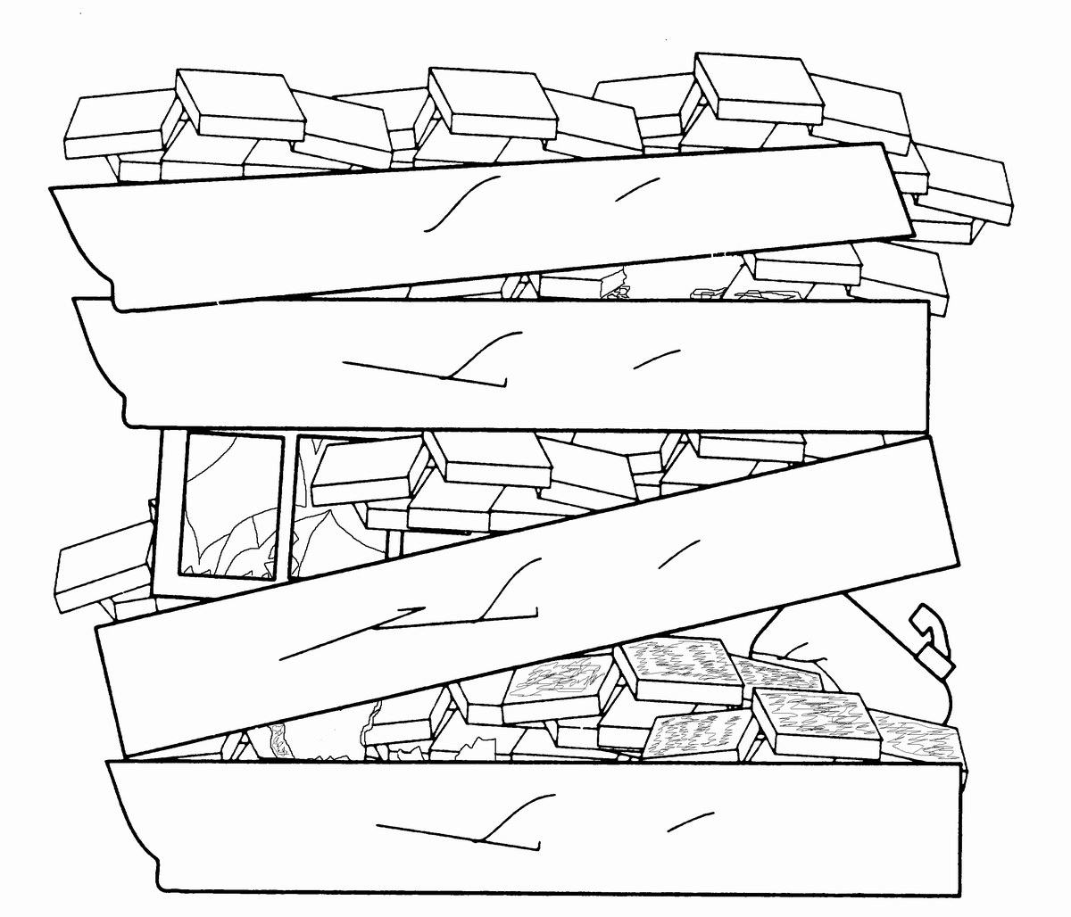
Pancake
Conducting Search Operations

Slide 12
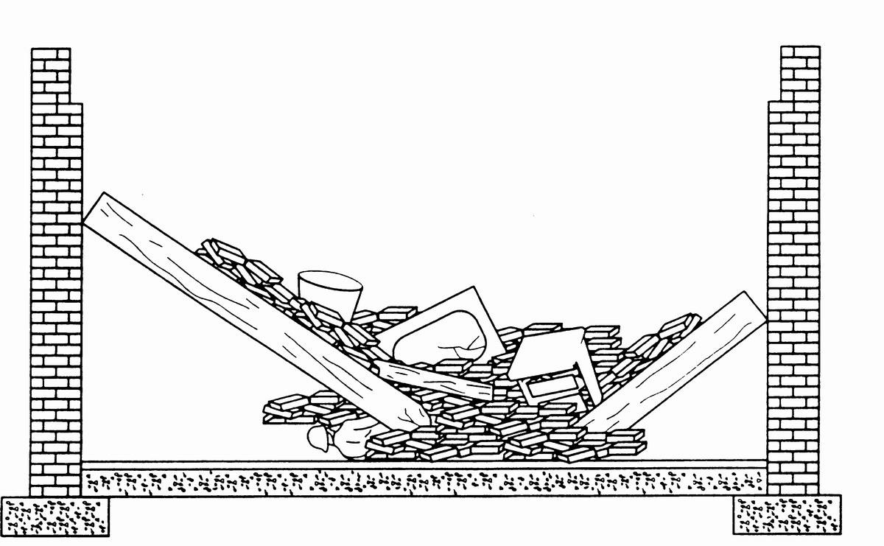
V Shape
Conducting Search Operations

Slide 13
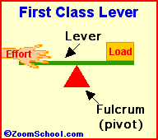
FIRST CLASS LEVER

Slide 14
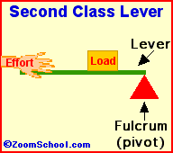
SECOND CLASS LEVER

Slide 15
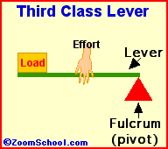
THIRD CLASS LEVER

Slide 16
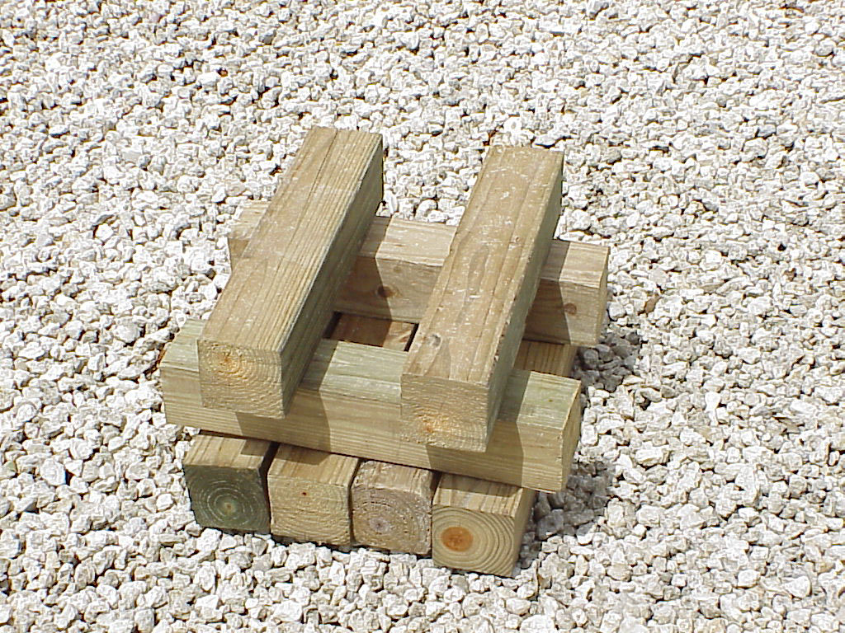
BOX CRIBBING

Slide 17
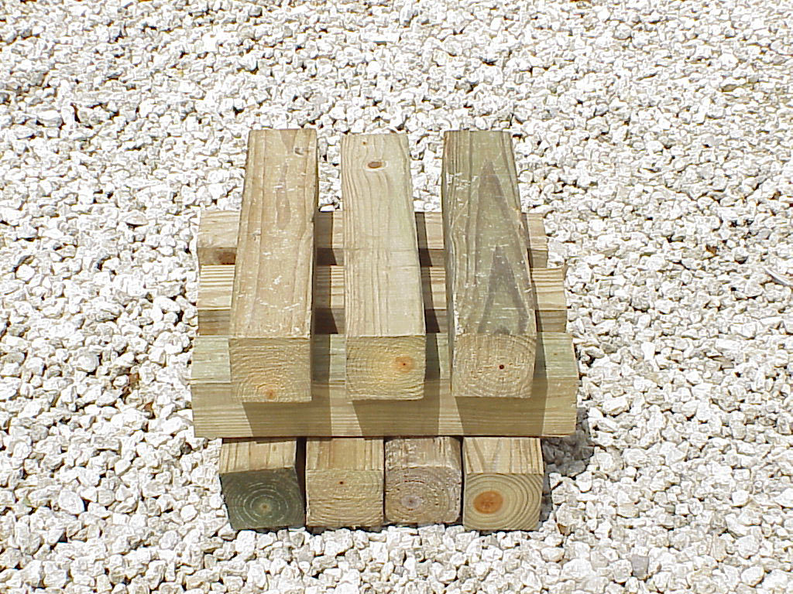
PLATFORM CRIBBING

Slide 18
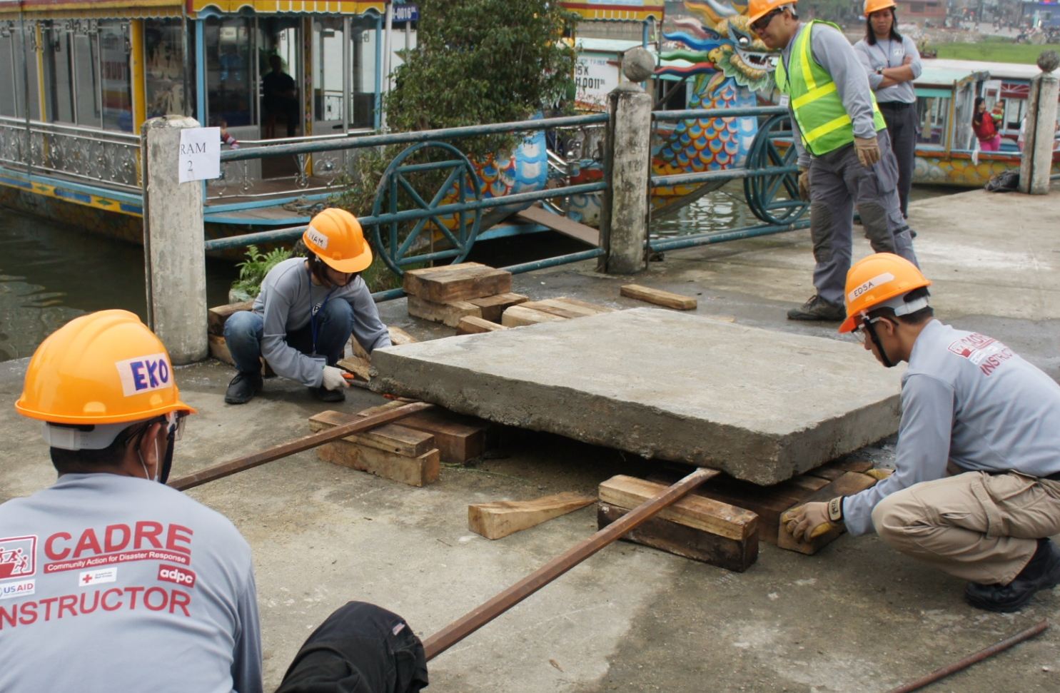
CRIBBING

Slide 19
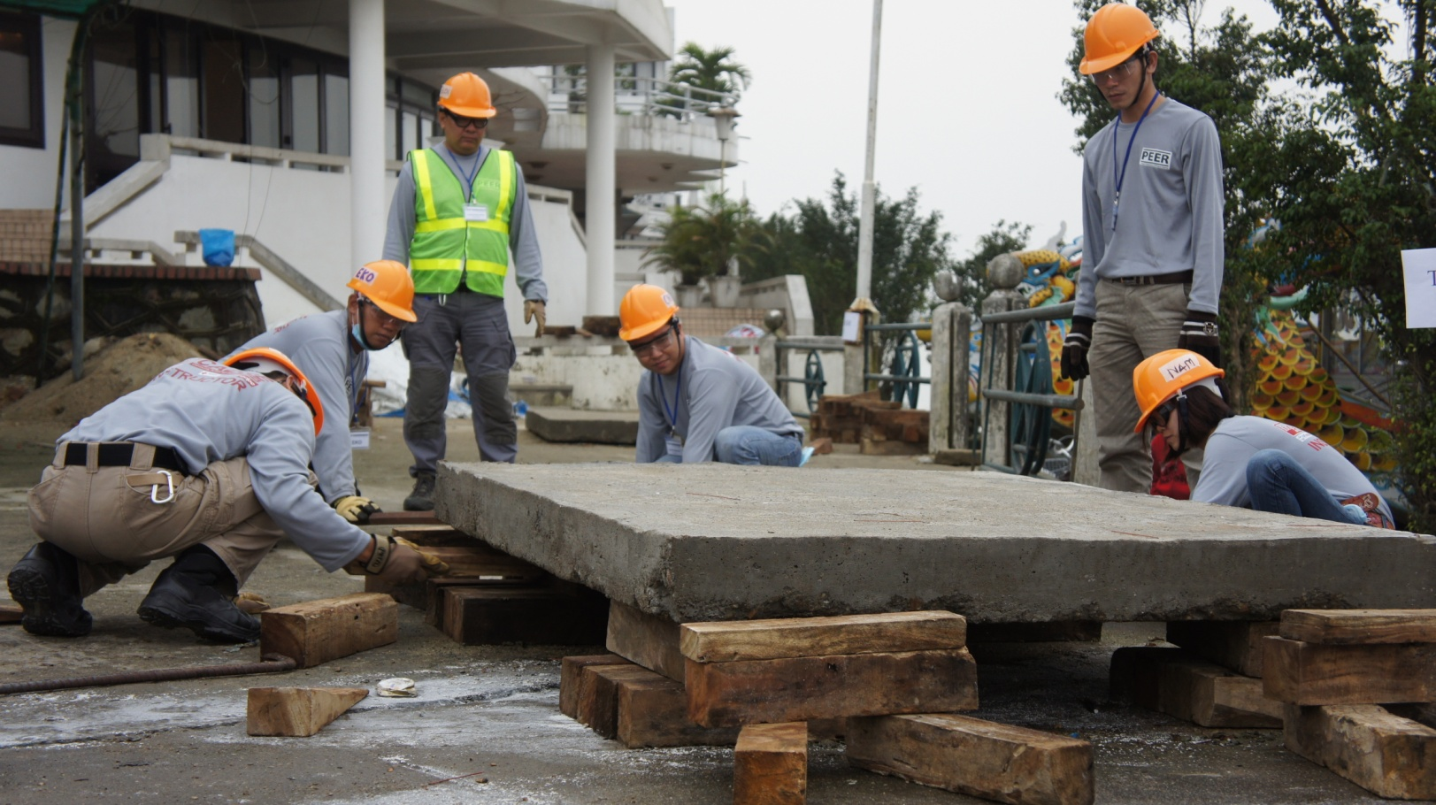
CRIBBING

Slide 20
REVIEW
  Define community light search and rescue.
  Describe the most common techniques in searching a structure.
  Demonstrate in practical exercise the safe methods and techniques in lifting and stabilizing a load.
1
Now you are able to :-
2
3

Slide 21



THANK YOU

