Slide 1
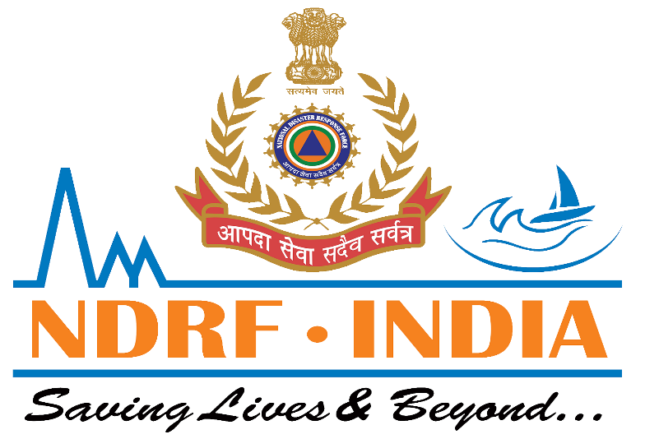

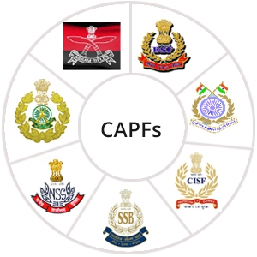

MEDICAL FIRST RESPONDER
LESSON 8
Oxygen Therapy
Presented by:- Pavan Dev Gaur, 2IC
CAPF | MFR | INDIA
-

Slide 2
OBJECTIVES
Upon completing this lesson, you will be able to:
1
Name five situations in which
the application of oxygen is indicated.
Describe an oropharyngeal airway, a CPR mask, a bag valve mask and demonstrate their uses.
List four key pieces of equipment in
an oxygen delivery system.
2
3

Slide 3
IMPORTANCE
Human can survive without food for 1 to 2 weeks, without water 1 to 2 days, but can not survive without oxygen even for a few hours. Brain cell starts dying after 8 to 10 min.
PPT 8 -

Slide 4
Oxygen Therapy
Heart failure/heart attack
Respiratory deficiency
Bleeding
Complications of childbirth
Poisoning
PPT 8 -

Slide 5
Hazards Associated with Oxygen
1
2
3
Explosion
(oil, grease)
Fire
Valve damage

Slide 6
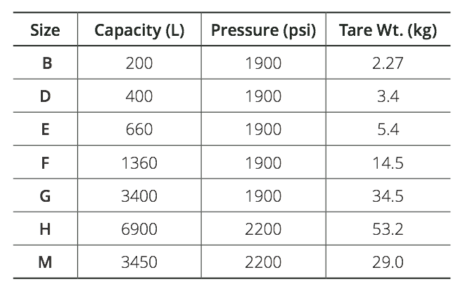
Cylinder Types

Slide 7
Precautions When Giving Oxygen
Reduce the pressure to 40-70 psi before administering oxygen. The pressure in a full cylinder is 2,000-2,200 psi.
Use a flow meter and pressure regulator.
PPT 8 -

Slide 8
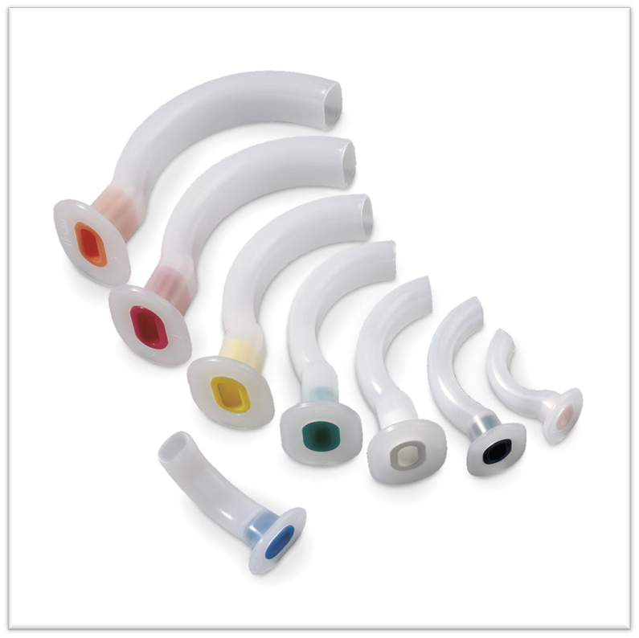
Select proper size.
-Open the patient’s mouth.
-Insert upside down.
-Advance adjunct gently.
-Turn 180 degree.
-Advance until flanges rest
On teeth, then secure it with tape.
OROPHARYNGEAL AIRWAY
PPT 8 -

Slide 9
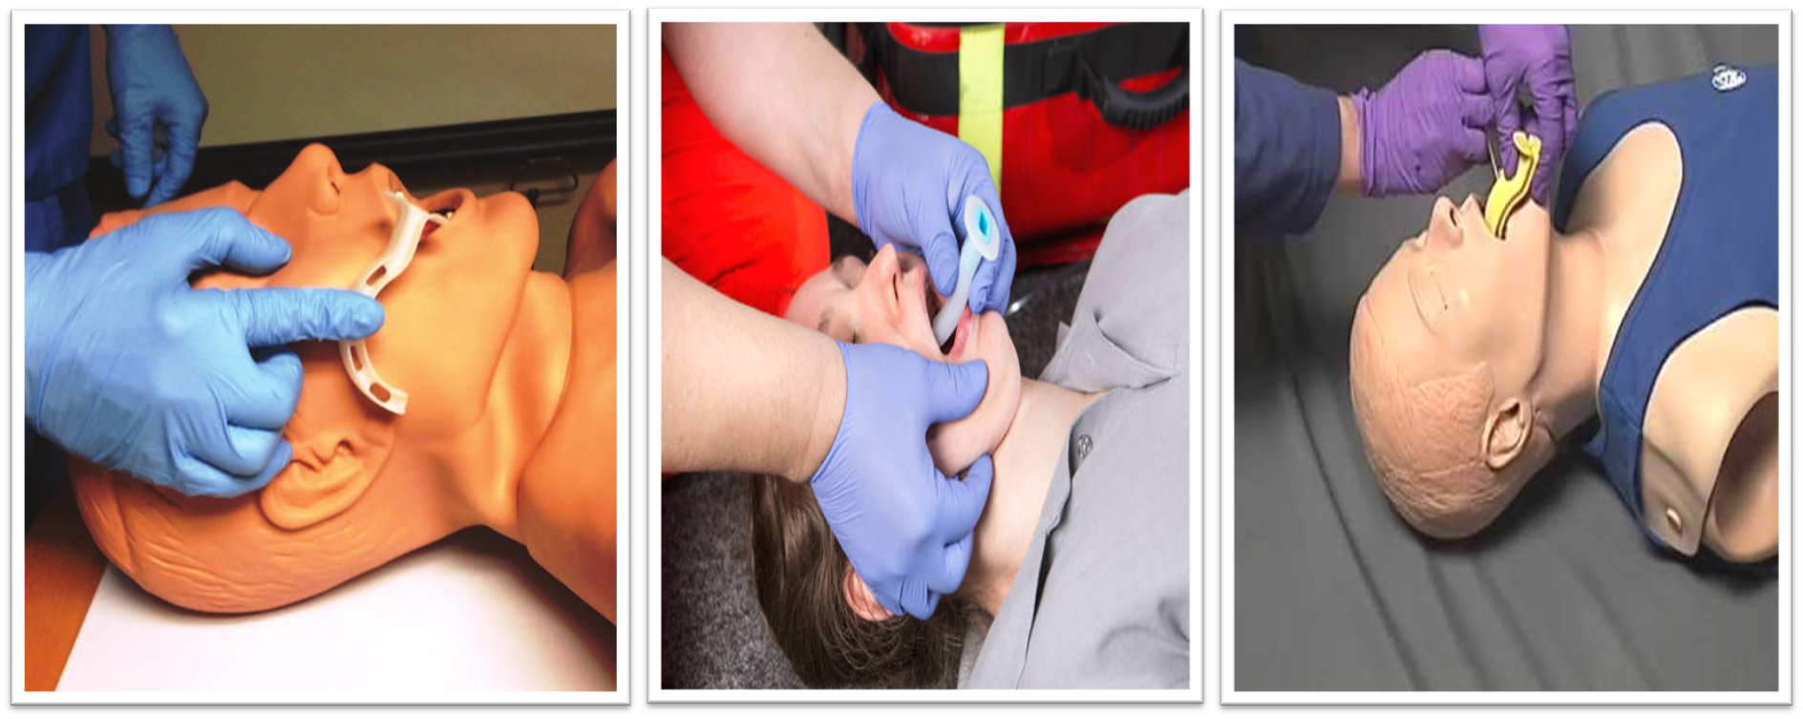
PROCEDURE FOR INSERTING AIRWAY
PPT 8 -

Slide 10
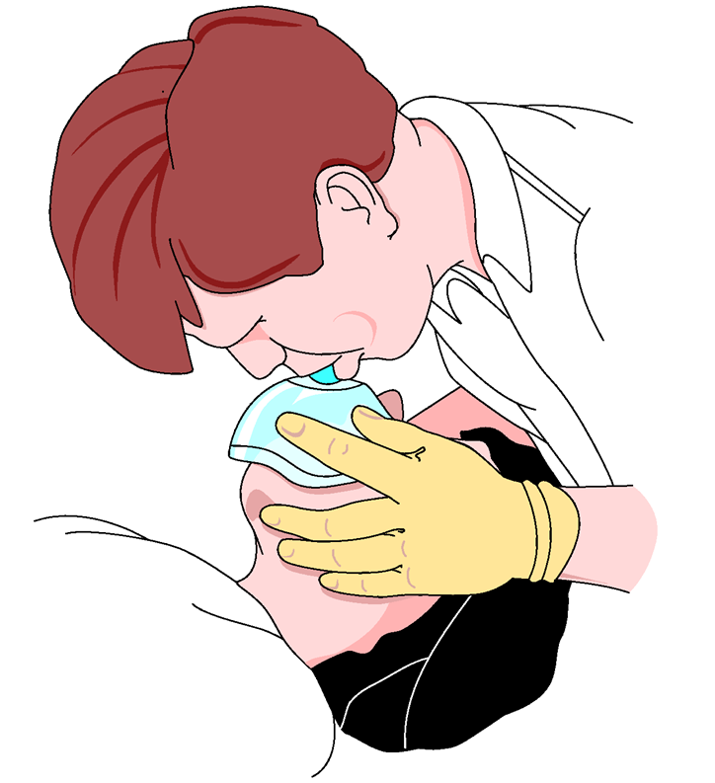
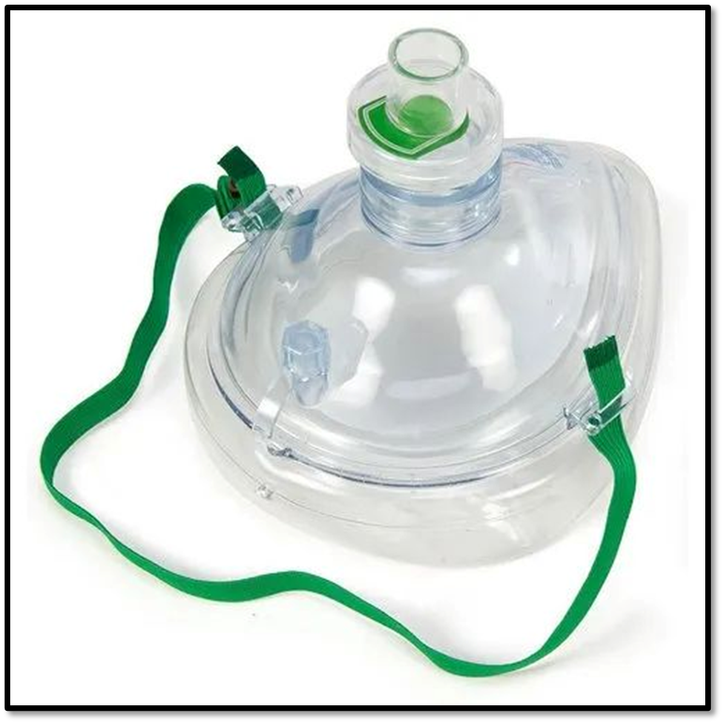
The pocket face mask is designed to aid the rescuer when providing ventilation during CPR. It is made of soft
plastic with or without
oxygen inlet.
-Its use, avoids direct
contact with the patient’s
Mouth and decreases the
chances of contamination.
CPR/POCKET MASK
PPT 8 -

Slide 11
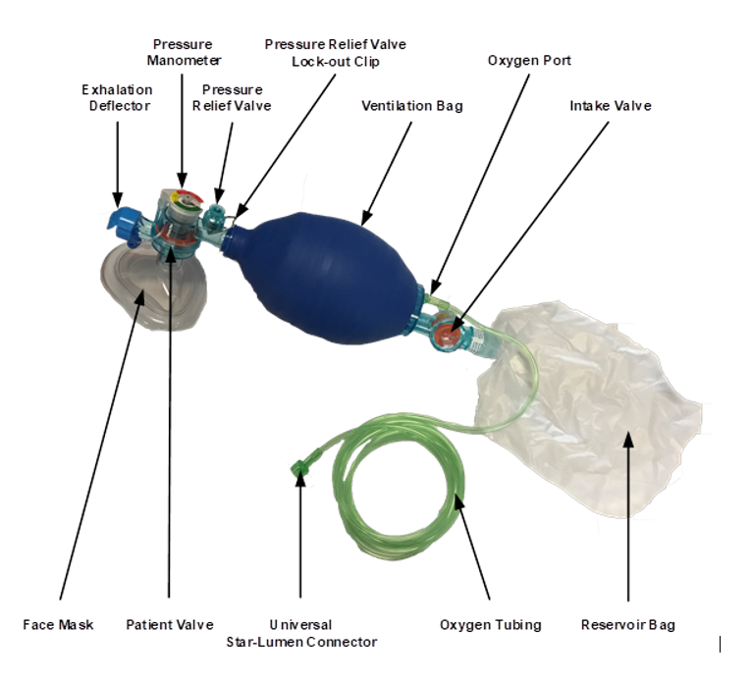
BAG VALVE MASK
Type of Manual resuscitator.
BVM is a hand held device you squeeze to ventilate a patient.
It comes in adult, child, infant sizes.
PPT 8 -

Slide 12
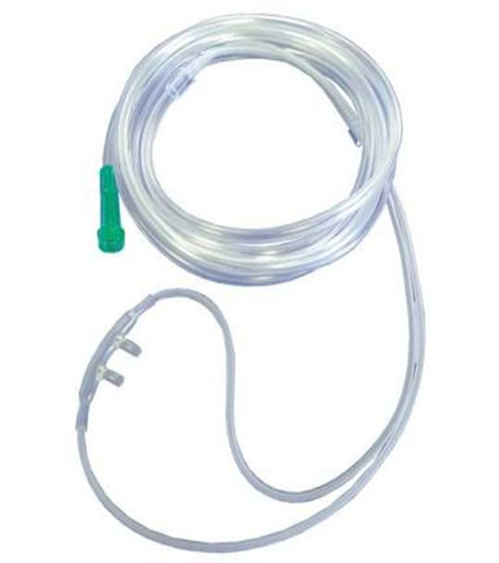
It has two stems for patient’s nostrils.
Mostly used in Hospital set up.
Most patient tolerates it well.
Used to administer low concentration of O2
Cause nasal mucus membrane to dry at higher flow rates.
Appropriate for patients who cannot tolerate a mask
Flow Rate 1-6 lpm (24-44% concentration of O2)
NASAL CANNULA
PPT 8 -

Slide 13
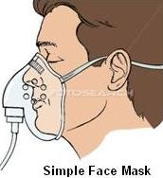
SIMPLE MASK
SFM can deliver higher flow rates than Nasal cannula (6-10 lpm) of 40-60% oxygen.
Both SFM ans Nasal Cannula are described as low flow delivery system.
PPT 8 -

Slide 14
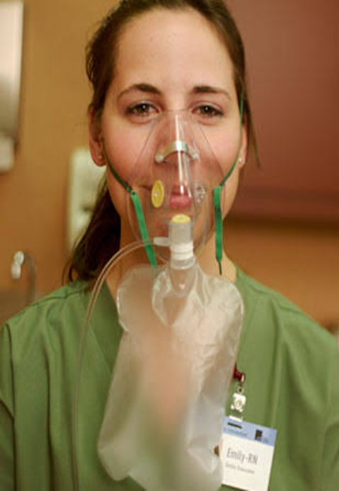
NON-REBREATHER MASK
Flow rate 12-15 lpm
Concentration 80-90% of O2.
It contains enough O2, so it does not deflate by more than 1/3rd when patient inhales.
PPT 8 -

Slide 15
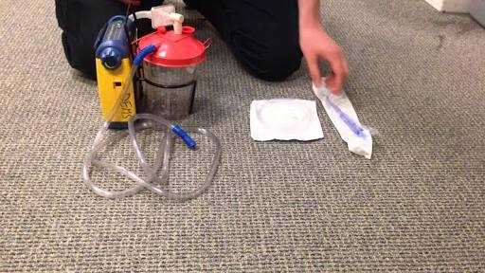
MECHANICAL SUCTION
Maintain airway at all time-keep free of blood, vomit, secretions etc.
PPT 8 -

Slide 16
Review
Now you are able to:
1
Name five situations in which
the application of oxygen is indicated.
Describe an oropharyngeal airway, a CPR mask, a bag valve mask and demonstrate their uses.
List four key pieces of equipment in
an oxygen delivery system.
2
3

Slide 17
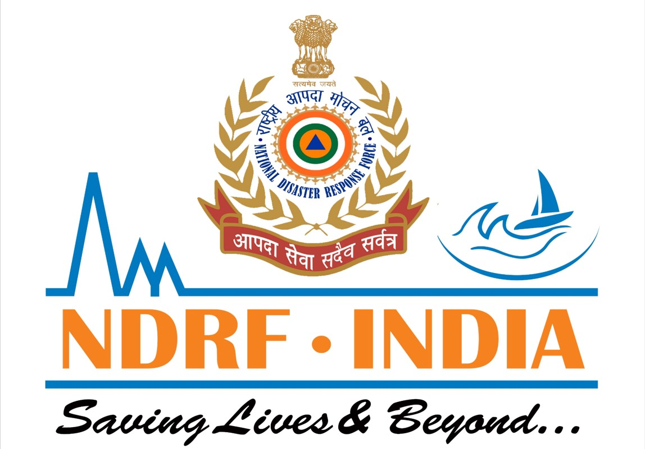
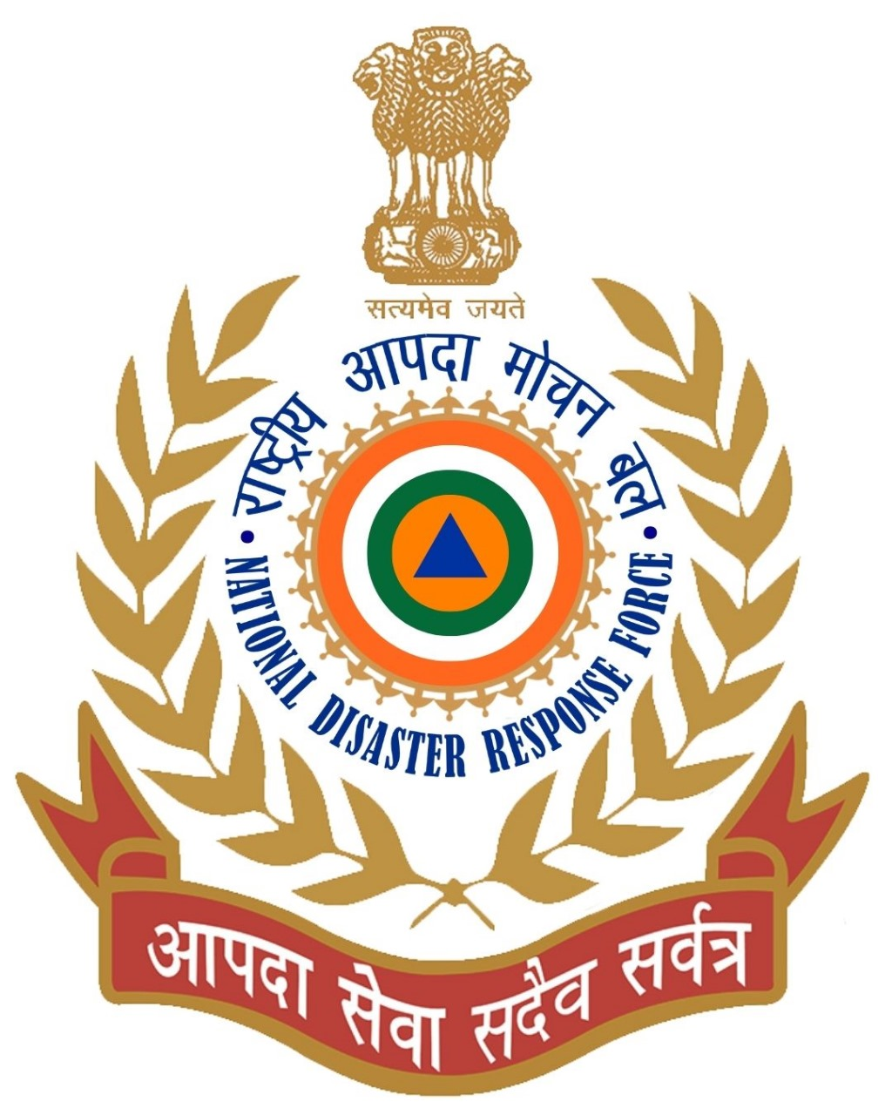
THANK YOU

