Slide 1
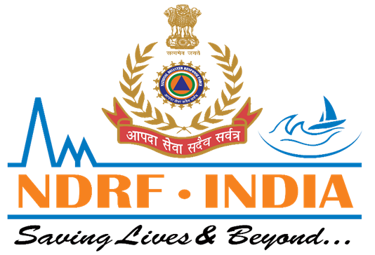
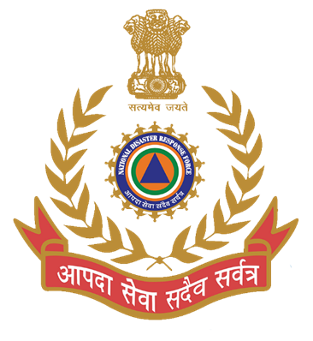
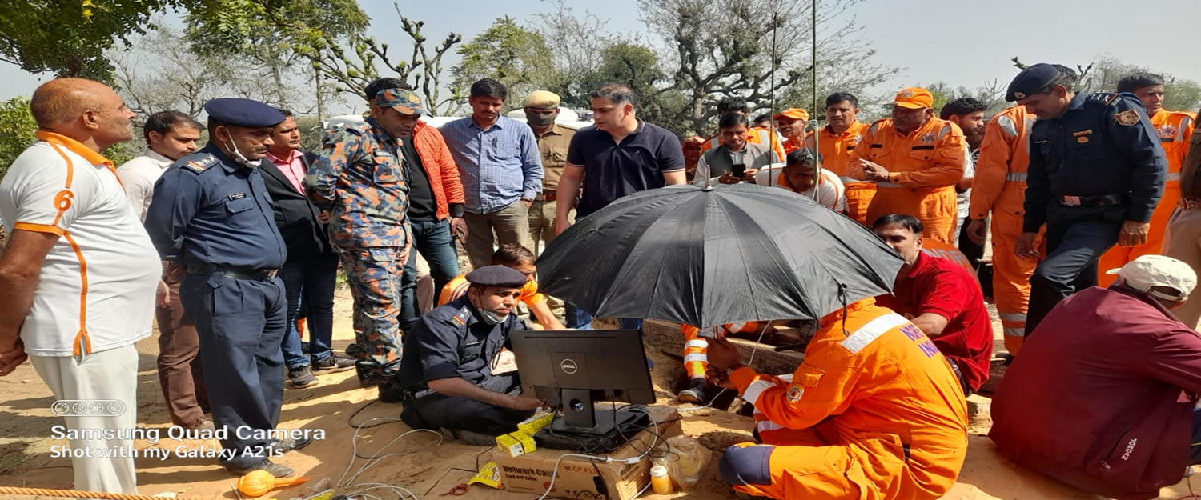

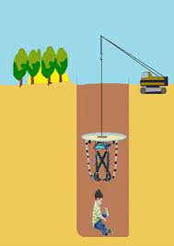
BOREWELL RESCUE
CASE STUDY-01
BORE WELL RESCUE OPS AT NADA CHARANWAS, SUB-TEH DANTA RAMGRAH, DISTT- SIKAR (RAJASTHAN)ON- 24-25/02/022
Presented By:- Pavan Dev Gaur,2IC

Slide 2
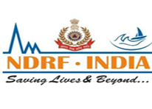
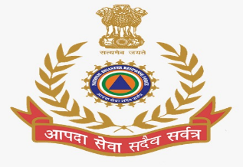
Preparation phase
Activation & Mobilization phase
Operation phase
Deactivation & Demobilization phase
Post operational Activities
Phases of Bore Well rescue Operation

Slide 3
NDRF Team always keeps alert and team members divided and placed in sub teams. Accordingly, team members depute in sub teams i.e. CSSR team, Technical Search team , MFR Team and Adm. support team.
Team members always gone rotational basis training through out the year for any type of disaster .
PPE :- MFR and CSSR PPE which have been permanently issued to team members.
Maintenance of equipment being Maintenance on daily/weekly basis.
Transportation :- Team having sufficient number of vehicles for transportation .
Preparation Phase

Slide 4
Date & Time: 24/02/2022, 1640 Hrs
Information Received By: OC E/06 BN NDRF
Source of Information:
  Shri Vijender Singh (OSD), SDMA
  Shri Dhara Singh (DM), Sikar, Rajasthan
Incident: Boy child Ravinder (Age: 05 yrs, S/o Sh. Girdhari Lal) fell into a bore well
Time of Incident: ~1340 Hrs
Location: Bijarniyo ki Dhani, Village Nada Charnawas, Sub-Tehsil Danta Ramgarh, Distt. Sikar (Rajasthan)
Distance from Coy HQ (Nareli, Ajmer): ~160 Kms
ACTIVATION & MOBILIZATION PHASE
(Incident Information)

Slide 5
Requisition Received From:
  OSD, SDMA Jaipur
  District Collector, Sikar
Instruction By: Shri A.K. Tiwari, Commandant, 06 Bn NDRF
Task: Rescue of boy child trapped in bore well
Requisition & Instructions

Slide 6
First Team:
  Already on way, returning to RRC Ajmer from Alwar (after mock CBRN exercise)
Second Sub-Team:
  Departed from E/06 Coy Nareli, Ajmer at 1655 Hrs.
  Movement by road with Govt. vehicles
  Equipped for bore well rescue.
Deployment of Teams

Slide 7
Main Team (35 personnel):
  GOs – 01
  Inspectors – 02
  Sub Inspectors – 02
  ASIs – 03
  ORs – 27
Sub-Team (08 personnel):
  Inspector – 01
  ORs – 07
Total Strength: 43 personnel
Under Command: Sh. Yogesh Kumar Meena (A/C)
Team Composition

Slide 8
Special rescue equipment
Deep diving set
CSSR equipment
Medical First Responder (MFR) items
Sheltering items
All packed & loaded in Govt. vehicles
Equipment & Resources

Slide 9
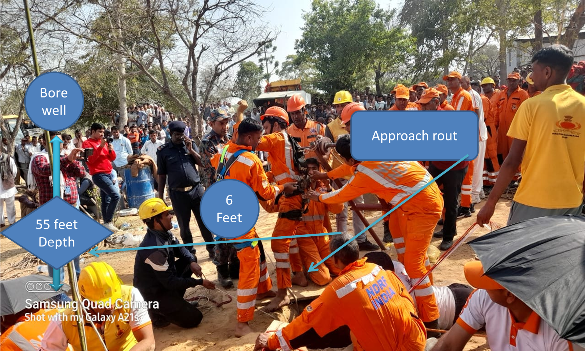
INCIDENT SITE

Slide 10
Securing the scene.
Established command, communication and medical post.
Medical assistance for boy.
Technical search & locate.
Approaching route/procedure
a)use of bore well rescue equipment
b)manually
Extricate of victim.
OPERATION PHASE

Slide 11
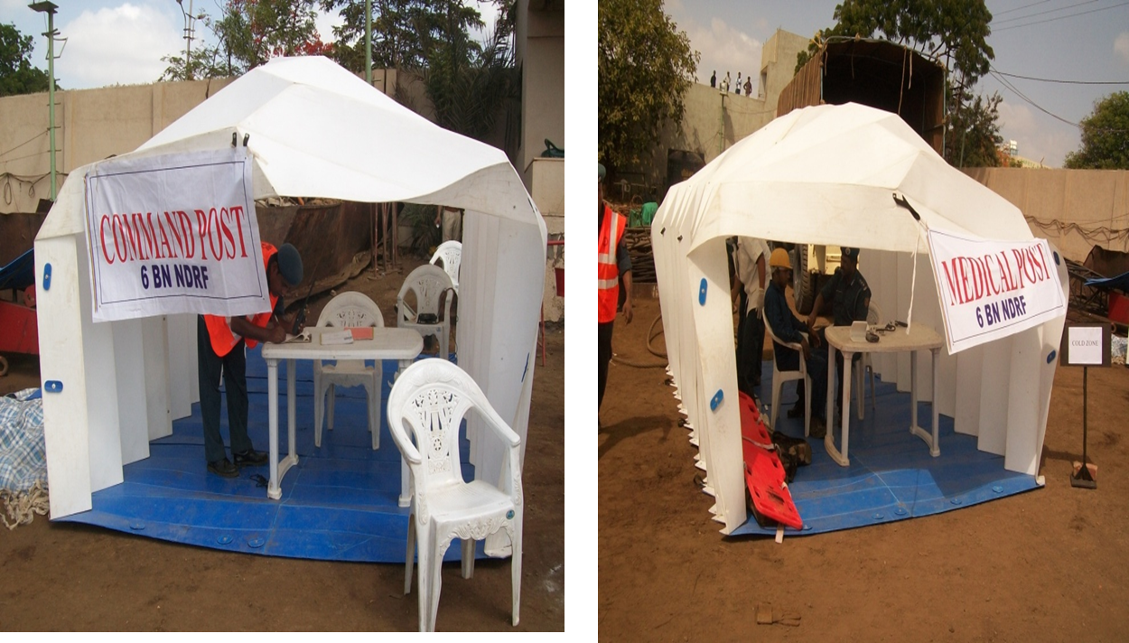
ESTABLISED COMMAND,COMM.&MEDICAL POST

Slide 12
Ravindra was regularly monitoring, from top of the bore well . Our MFR Team and Govt Hospital Medical Staff khatoo shyam ji were regularly monitoring victim and supply of oxygen continuously giving to victim .
Team Commander provided emotional support to victims’ parents and took help of the elder sister for safe rescue of Ravindra.
MEDICAL ASSISTENCE

Slide 13
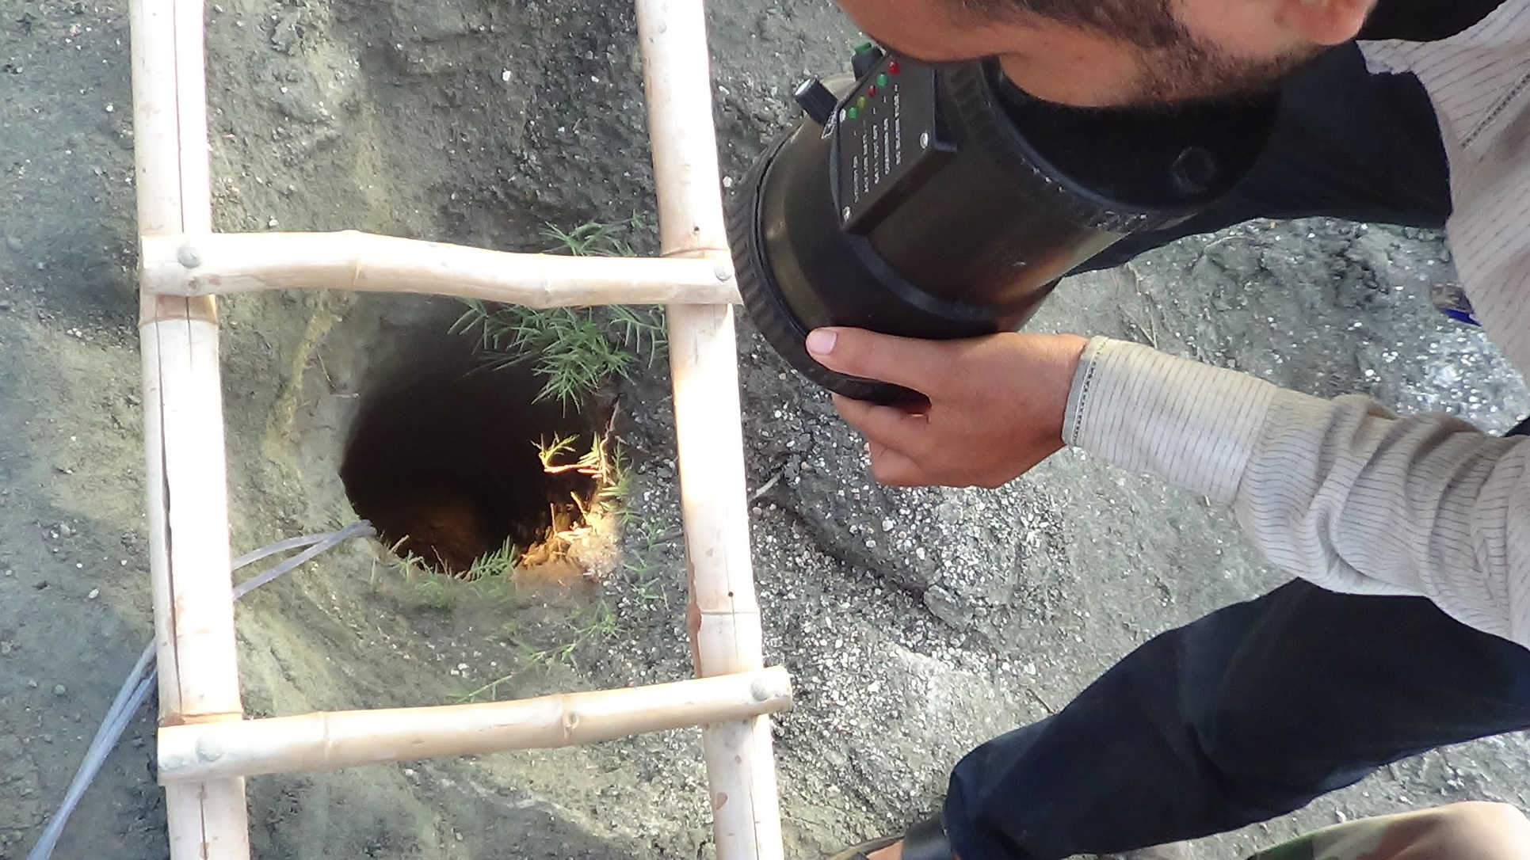
Bore well
Ledar for measurement
Oxygen was supplied with help of two plastic pipe by medical team
Dragon light for watch movement of victim.

Slide 14
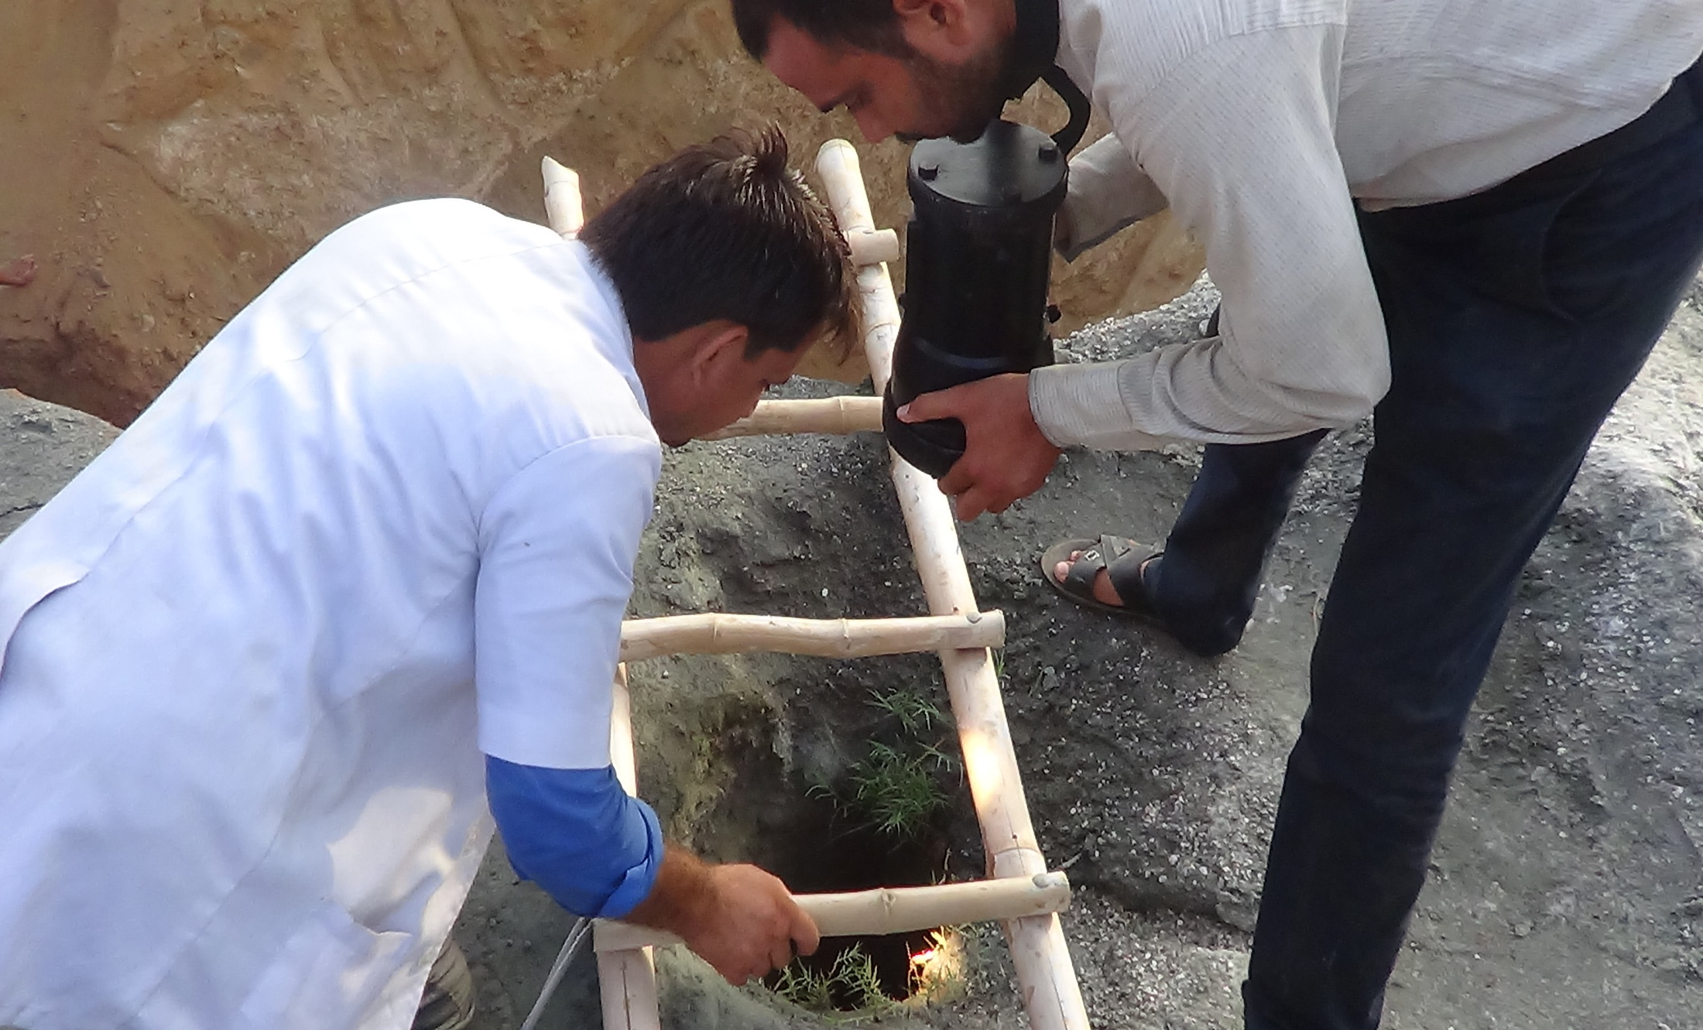
REGULAR MONITORING BY MEDICAL TEAM

Slide 15
Decision by Team Commander: Launch technical search using VLC (Victim Locating Camera)
Sub-Team Lead: Insp. Kuldeep Singh
Action:
  Technical search initiated with VLC
  Multiple efforts made to locate victim
Contact with Victim
Team approached halfway with VLC Established:
  Verbal contact
  Visual contact
Assurance given to Civil Administration for safe rescue
Victim Status:
  Found alive
  Located at approx. 52 feet depth inside bore well
  Victim’s voice heard through VLC
Oxygen Supply Arrangement
Ensured by: Medical Team
Method:
  Oxygen supplied regularly through plastic pipe connected to large oxygen cylinders
Technical Search Operation

Slide 16

TECHNICAL SEARCH WITH HELP OF VLC

Slide 17
Fresh Approach Route & Use of Bore Well Rescue Equipment
Earlier approach route: Unsafe for rescuer & victim
Decision: Fresh digging ordered by Team Commander
Sub-Team Lead: Insp. Anil Dhadich
Action Taken:
  Started fresh digging at 1610 hrs
  Manual digging at 5 feet east side of bore well
  Created proper approach route
Use of Bore Well Rescue Equipment:
Rescue operations initiated with camera & bore well rescue tools
Challenges Faced:
  Child had Down Syndrome (not obeying rescuers)
  Responded only to sister’s voice
  Bore well shape: wide at bottom, narrow at top
  Child hiding in wide bottom space → difficult to trap with L-type ring & hook device
APPROACHING ROUTE/PROCEDURE

Slide 18
Manual Rescue Efforts (Parallel Pit Digging)
Rescue work continued manually alongside equipment
Method:
  Dug 2.5 feet dia pit at 6 feet parallel to bore well
  Depth: 55 feet vertical digging
  After 35–40 feet depth, soil found loose/soft
Safety Measures:
  200 litre iron drums welded & tied with ropes
  Drums lowered inside pit to prevent collapse
  Bottom-most drum cut in U-shape for horizontal approach
Final Stage:
  After 55 feet excavation → made 6 feet horizontal tunnel towards victim
APPROACHING ROUTE/PROCEDURE

Slide 19
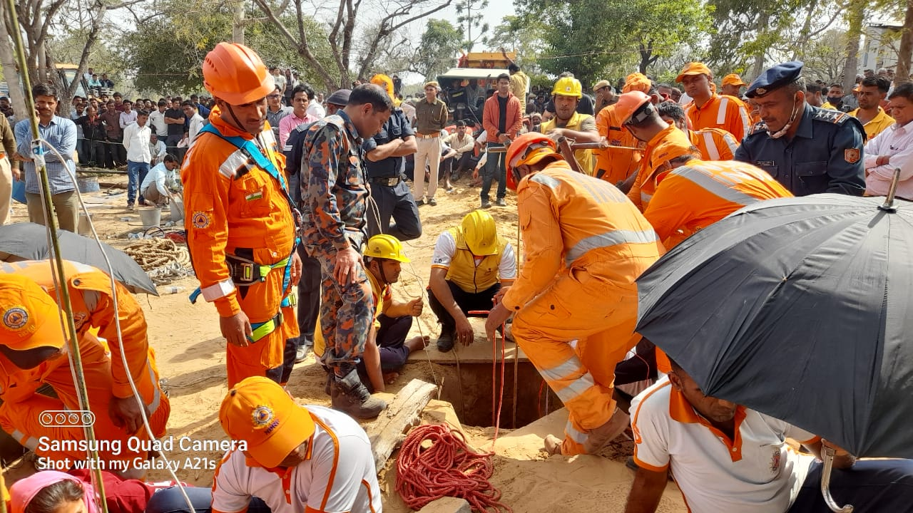
MAKING APPROACH ROUTE

Slide 20
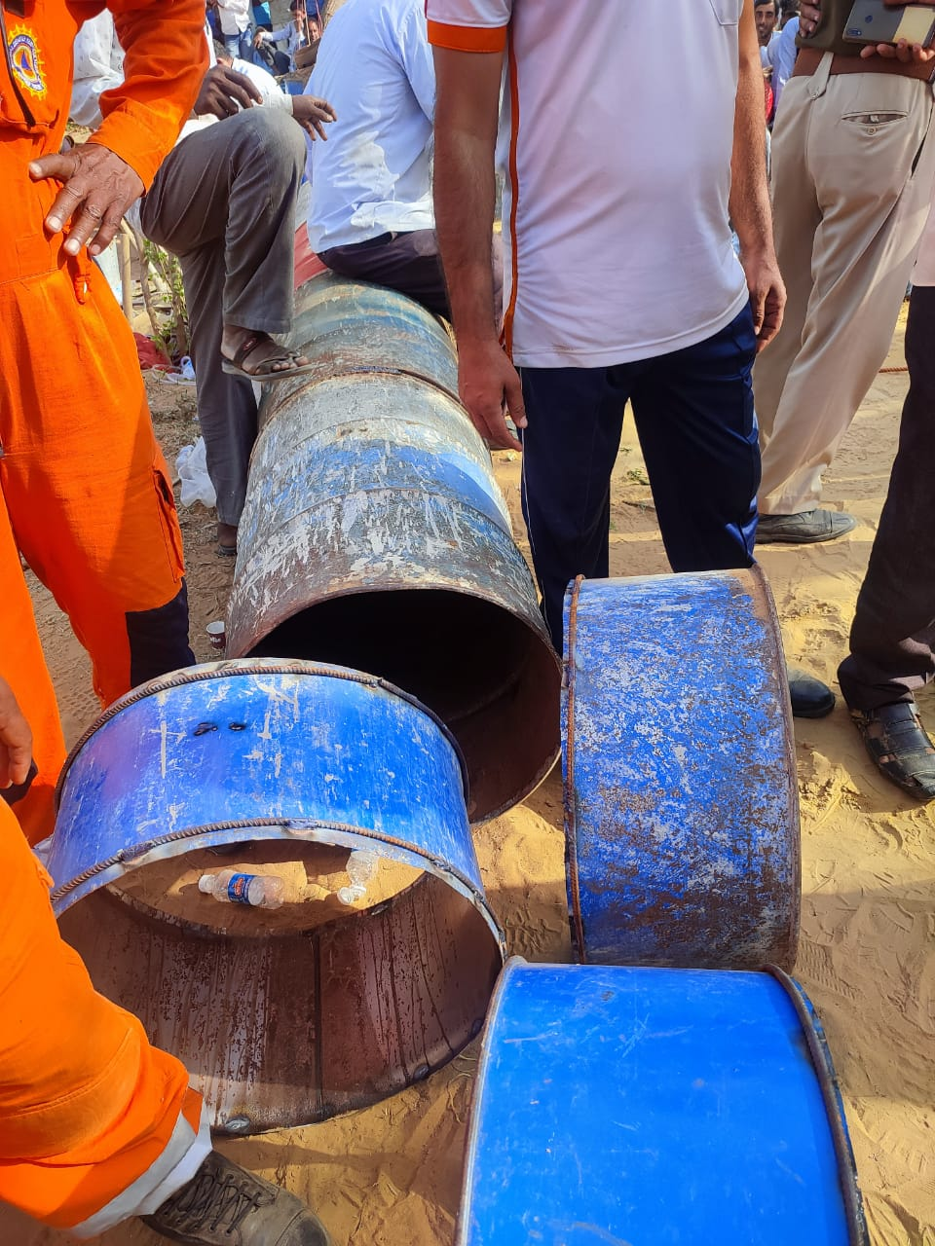
Use of drum for making approach

Slide 21
Extricate of victim
Finally rescue team reached near the victim and made one small hole in the bore well . This time victim position was upwards from the hole .
For safety of victim, the team inserted crowbar horizontally in the bore well and a drum was also inserted on the crowbar.
For more safety purpose of victim, a wide wooden Board was also placed on the steel plate. Now victim was fully safe .
After it, the Rescuers made a big hole upward in bore well & rescued the victim Ravinder in supine position.
Team rescued the victim at 1730 hrs. on Dated 25/02/022 .
FINAL ACTION OF RESCUE TEAM-

Slide 22
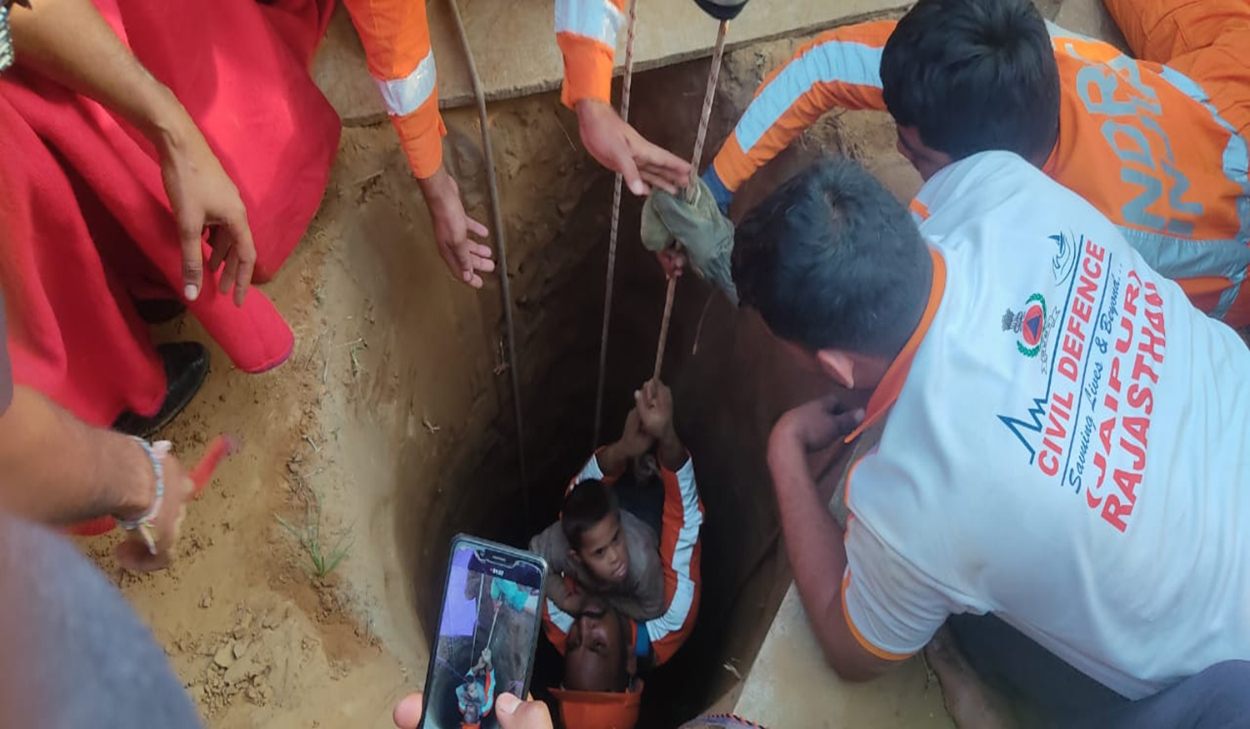
Safely rescue Ravinder and H/O to Civil Administration by NDRF team.

Slide 23
Team commander confirm no further operation is needed.
Team CQMH account and ensure of all TEA.
Team members account personnel items.
Team arranged and loaded all eqpt., for transportation and returned to coy location Nareli, Ajmer(Raj.).
DEACTIVATION
& DEMOBILISATION

Slide 24
Critical Incident Stress Management (CISM) was provided by DM Sikar for all rescuers and civil administration.
After rescue operation NDRF team went for Medical Physical exam.
NDRF Team completed maintenance and rehabilitation their Equipment after rescue operation.
Team commander debriefed his team after rescue Operation.
After rescue operation team commander submitted report for institutional management in writing to the Unit HQ , NDMA and Civil Administration .
POST OPERATION ACTIVITIES :-

Slide 25
Team commander made a media management after technical search.
Team commander detailed a team for media management under self supervision.
Team commander detailed 02 ORS for media management.
Team commander made Media Management from time to time during the rescue operation and interacted with the press / media about successful rescue ops.
MEDIA MANAGEMENT

Slide 26
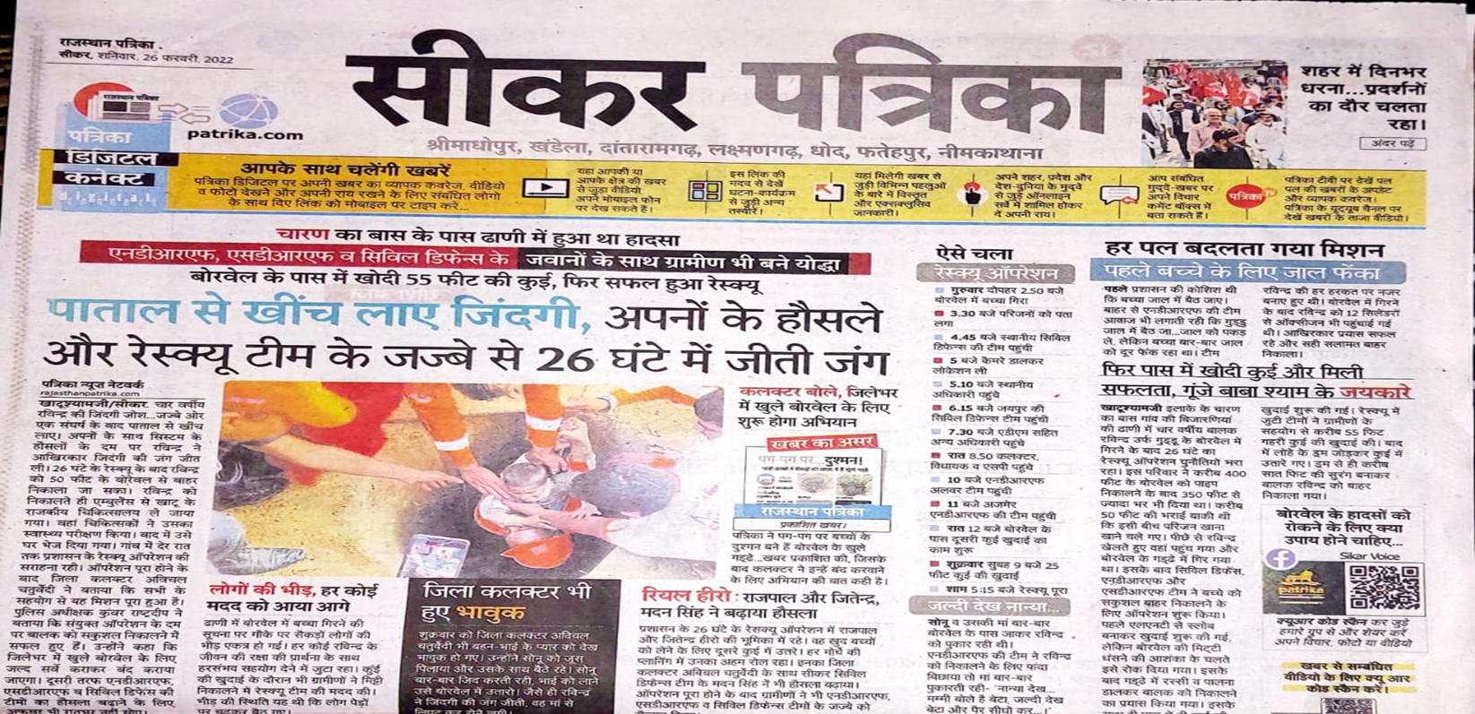
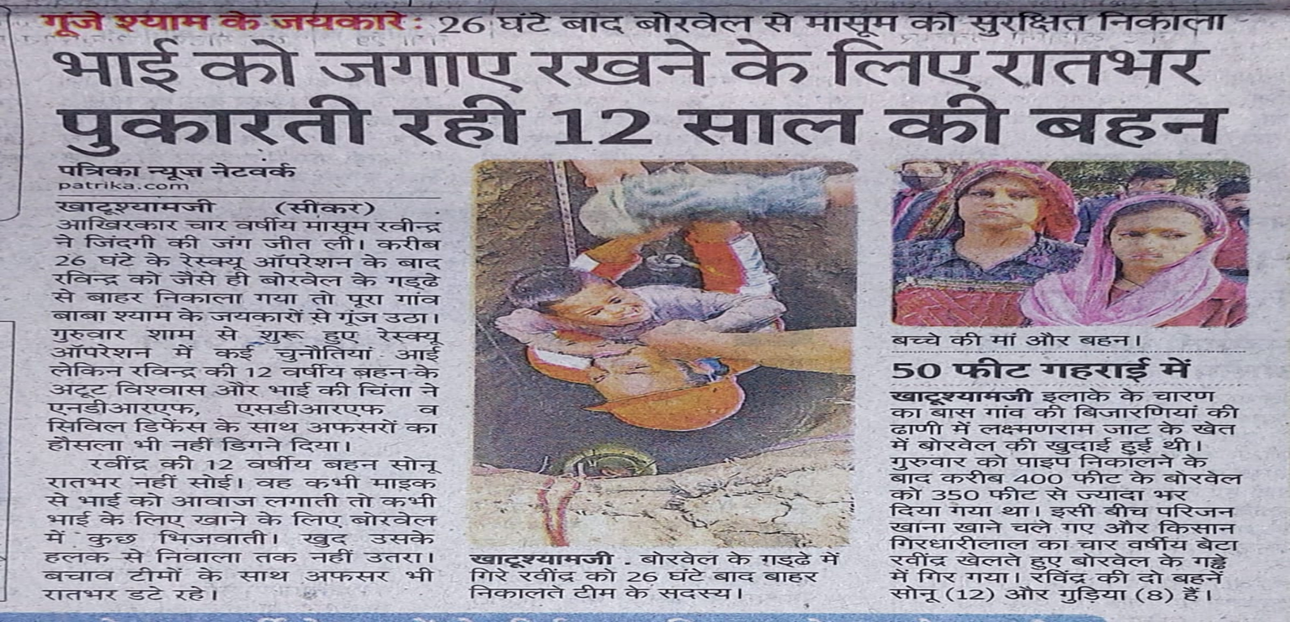
NEWS PAPER CUTTING reg.RESCUE OPS

Slide 27
The first assessment and quick decision on arrival at the operation site.
No matter how complex the rescue work is but the team’s coping ability and determination definitely brings the success.
The local help and expertise be sought in the operation without hesitation, if required.
LESSON LEARNT

Slide 28
Each team should have at least one dragon light .
The team should have oxygen cylinder and 100m×10mm plastic pipes for providing oxygen to victim.
The team should have an Aluminum Folding Stair for rescue ops.
The team should have a measuring tap for measurement in operation .
Empty barrel should be with the team for bore well operation.
Long Chisel nos. 06 and medium hammer 06 nos. should be with the team.
Team should have souring material for soil slide i.e. Iron plates /wooden plates size 4 × 4 04 Nos , 3 × 6 =04 Nos.
Air Compressor Rock Breaking Machine.
REQUIREMENT/NECESSASITY OF NON- AVAILABLE EQPTS .

Slide 29
Any Question ?

Slide 30
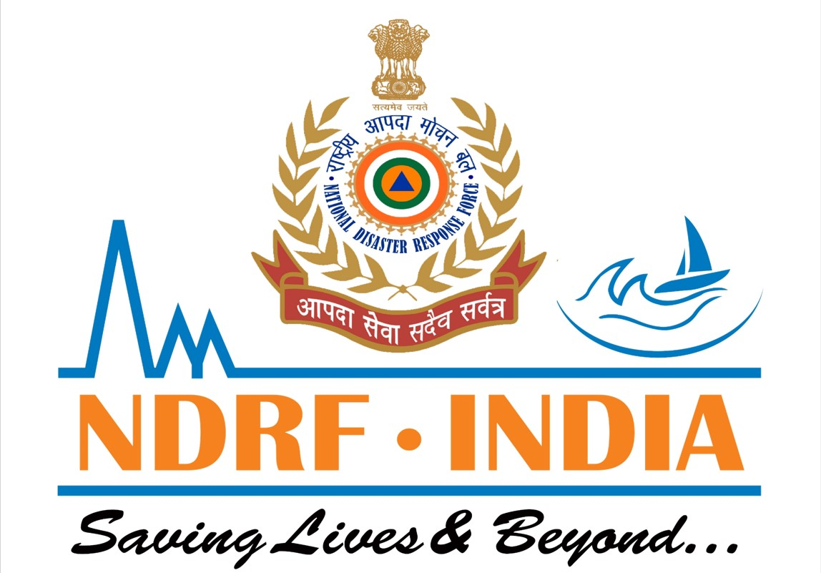
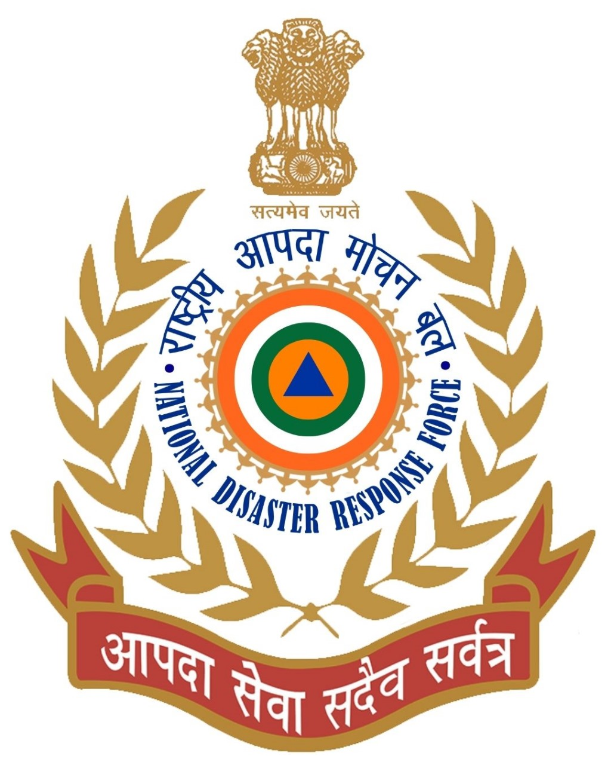
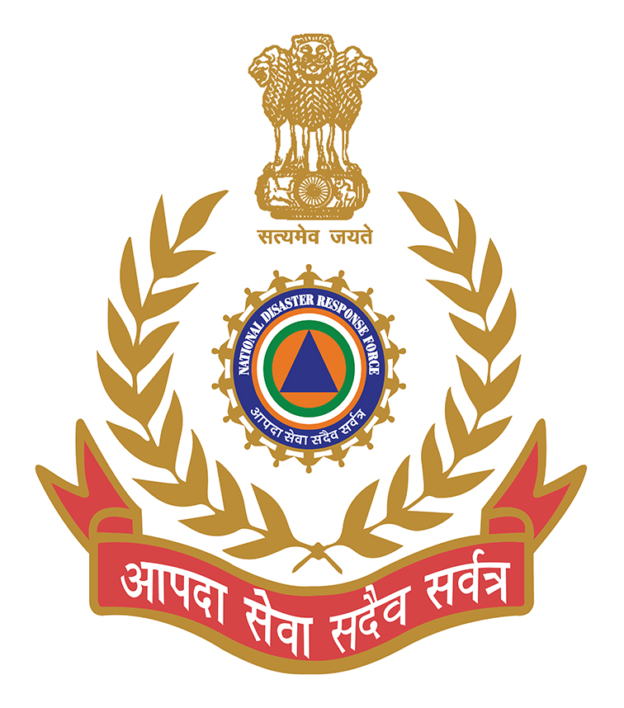
THANK YOU

