Slide 1


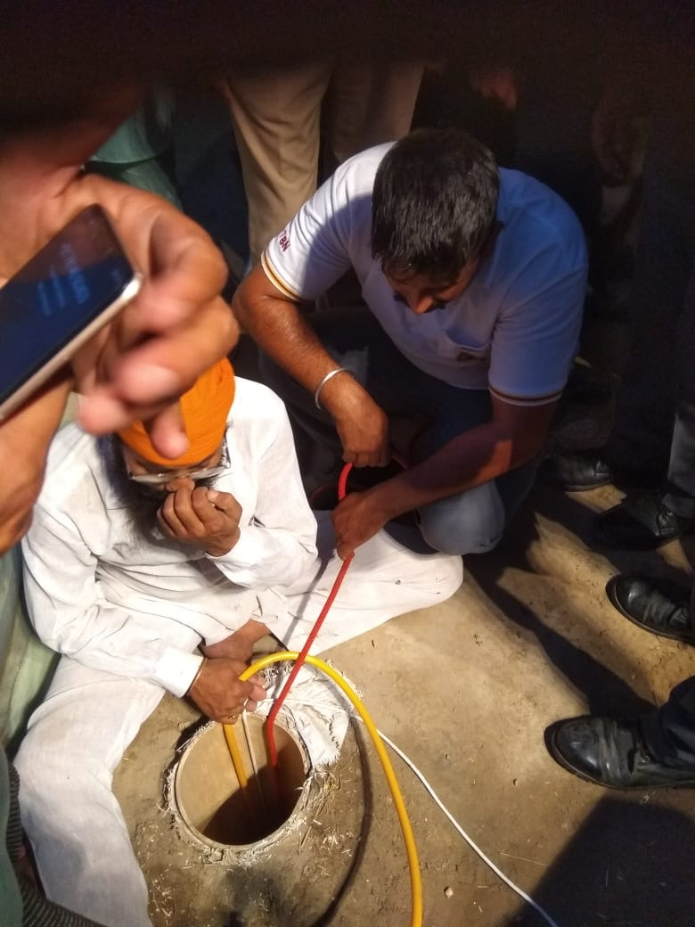
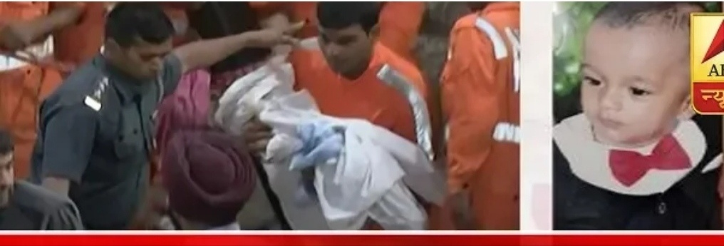
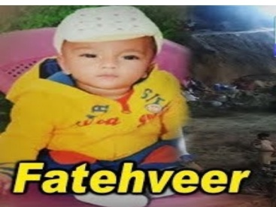
BORE WELL-2019 SANGRUR , PUNJAB
A CASE STUDY
Presented by:- Sohel Lakhani, DC

Slide 2
OBJECTIVE
Introduction
Aim
General Profile Of Sangrur District .
Deployment Of 07 Bn NDRF
Search And Rescue Operation
Lesson Learnt

Slide 3
INTRODUCTION
A bore-well is a deep ,narrow hole drilled into the ground from which water is drawn through a pipe and pump.
Borewell are typically small in diameter ---ranging from 4.5(low capacity bore-well) inches to 12 inches(high capacity borewell).

Slide 4
Cont…..
Bore-well technology was first introduced in India in the 1970 as a measure to counter water scarcity.
Since water is a state subject, there exists no national –level database of abandoned bore-wells.

Slide 5
CAUSE OF INCIDENT
About all parts of country Punjab are prone to bore well due to extensively used by farmer to irrigate the land.
when a bore-well dries up and is no longer in use ,its cover, Usually made of cast iron ,is removed and the pvc pipe pulled out , leaving behind a naked hole.

Slide 6
Cont…
Some people even dig bore-wells outside the house ,because of which children fall into it while playing & walking.

Slide 7
AIM OF CASE STUDY
To evaluate the facts and causes of Borewell incident and response by 07th Bn NDRF search and rescue team in Sangrur Distt.
Prepare database of national level bore-well incident for future response.
Structural and formal training to bore-well rescue ops.

Slide 8
SANGRUR GENERAL PROFILE
Sangrur district is in the state of Punjab in northern India. It is one of the five districts in Patiala Division in Indian state of Punjab. Neighbouring districts are Malerkotla (north), Barnala(west), Patiala(east), Mansa(southwest) and Fatehavbad Haryana and Jind,Haryana(south).

Slide 9
Cont..
Sangrur consists of the cities of Dhuri, Lehragaga,Sangrur and Sunam. Other cities are Bhawanigarh, Dirba, Khanauri, Longowal, Cheema and Moonak. There are 7 sub-divisions, being Sangrur, Dhuri, Sunam, Lehragaga, Moonak, Bhawanigarh and Dirba.

Slide 10
Cont..
Till 2006, barnala was also a part of Sangrur district, but now it is a separate district.
In 2021, a new district Malerkotla district, consisting of Malerkotla and Ahmedgarh subdivisions and the Amargarh sub-tehsil, was formed out of Sangrur district.

Slide 11
Cont..
According to the 2011 census Sangrur district (including Malerkotla district) had a population of 1,655,169 of which male and female were 878,029 and 777,140. This gives it a ranking of 300st in India (out of a total of 640).

Slide 12
Cont..
The district has a population density of 449 inhabitants per square kilometre (1,160/sq mi). Its population growth rate over the decade 2001-2011 was 12.3%. Sangrur has a sex ratio of 885 females for every 1000 males, and a literacy rate of 67.99%.

Slide 13
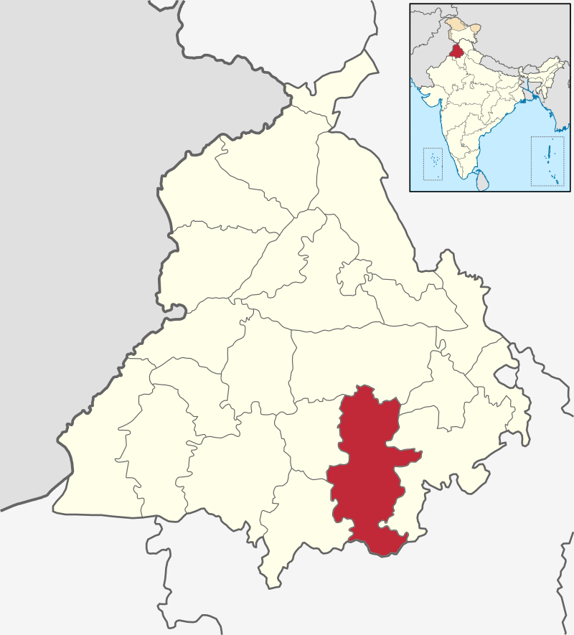
SANGRUR DISTRICT MAP

Slide 14
DEPLOYMENT OF 07th BN NDRF
07th Bn NDRF deployed one search and rescue team named 7-R along with all necessary rescue equipment under the command of Sh. AJAY VERMA, Asstt. Comdt. At Bhagwanpur sangrur on 06th June ’2019.

Slide 15
Cont..
The team (Officer-01, SOs-02, Other Personnel-22) left BHQ at 17.35 hrs.
Incident site was 97 Km from the BHQ Bathinda.

Slide 16
SAR EXECUTED BY 07th BN NDRF
The team arrived at the site at about 1907 hrs and report to Incident commander.
The team commander inspected the machinery available on the spot and informed the team personnel about the incident.

Slide 17
Cont..
Oxygen pipes and CCTV cameras were provided by the District Civil Administration, Local Police and DSS (Dera Sacha Saudha) on the spot before reaching the rescue team to ensure accurate monitoring of the health and condition of the child.

Slide 18
Cont..
The CCTV cameras showed that the child had two hands upwards and had sack fragments and soils all around him and no other part of the child's body was visible.

Slide 19
Cont..
The team worked hard and managed to rope the baby's First hand at 2135 06.06.19 & second hand at 04.10 a.m. on 07.09.19 and now the child had a rope in both hands and was tried but the child did not come up.

Slide 20
Cont..
On 07.06.19 a meeting was carried out by all the Rescue Teams and Civil Administration to ensure that a second parallel borewell with existing borewell be dug out so that the child can be rescued.

Slide 21
Cont..
On 08.06.19, the Second-in- Command (Shri Shashi Chandra Jha)from BHQ reached at incident site for monitoring and coordination of the rescuing work also went to the spot and took full view and interacted with other agencies and Civil administration officials regarding the incident.

Slide 22
Cont..
In the same order, on 09.06.19, the unit Commandant Sh. Ravi Kumar also visited the spot and consulted rescue team and civil administration and took detailed information from the team personnel and looked at the rescue operations.

Slide 23
Cont..
The team was continuously working for about 79 hours without any stop and the team personnel were very tired and were very exhausted due to extreme heat.
Commandant decided that existing team may be changed.

Slide 24
Cont..
On 10.06.19, at 0615 hrs, another team led by Shri Om Prakash Bishnoi, AC from BHQ left for the venue and arrived at the spot at 0755 hrs and replaced the team which was already working on the ground.

Slide 25
Cont..
The Army team was called on the spot by the DC to assist in the operation, in which ARMY team reached the site of the incident under the leadership of a Major Rank Officer of the Army.

Slide 26
Cont..
The action to pull the child upstairs was carried out under the control of team leader (AC) at spot and by 0510 am 11.06.19 the child was pulled out from the borewell after a relentless effort, which was reported to the Civil Administration.

Slide 27
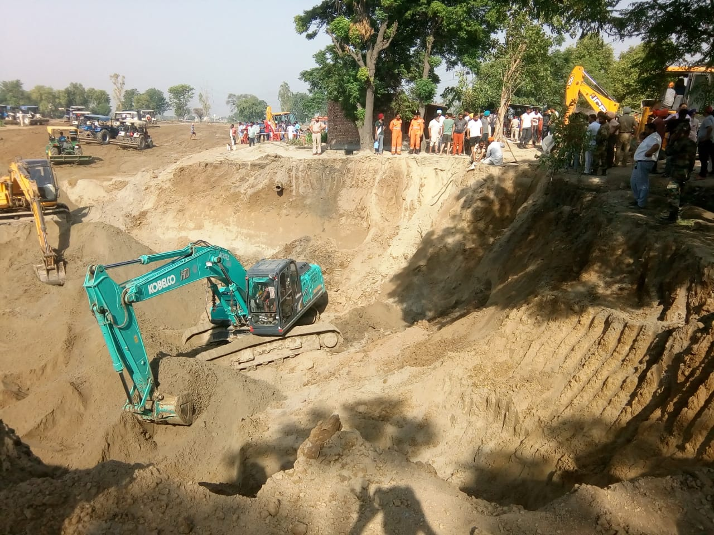
GLIMPSE OF
RESCUE OPERATION

Slide 28
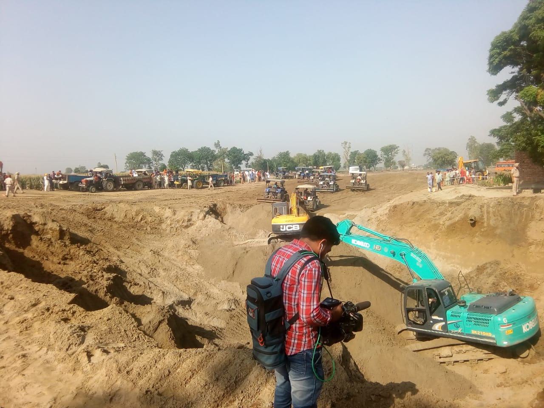
GLIMPSE OF
RESCUE OPERATION

Slide 29
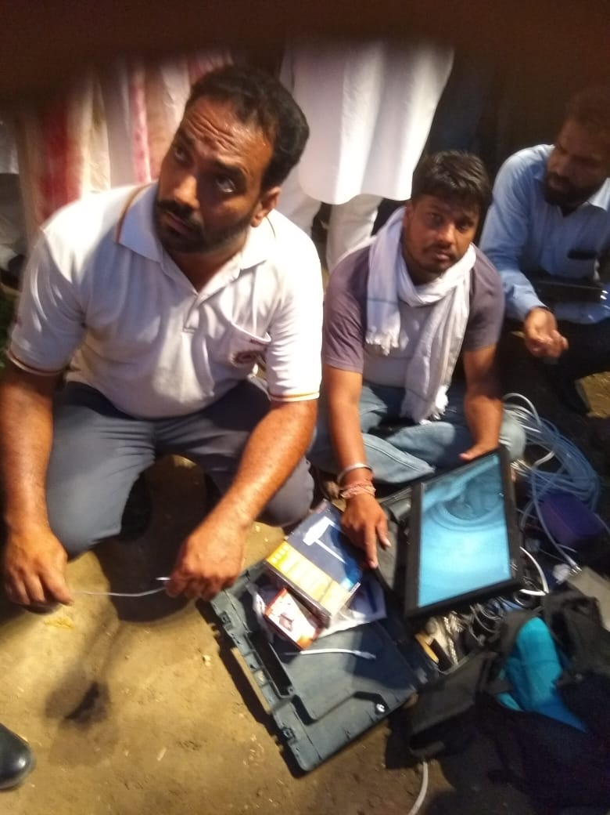
GLIMPSE OF
RESCUE OPERATION

Slide 30
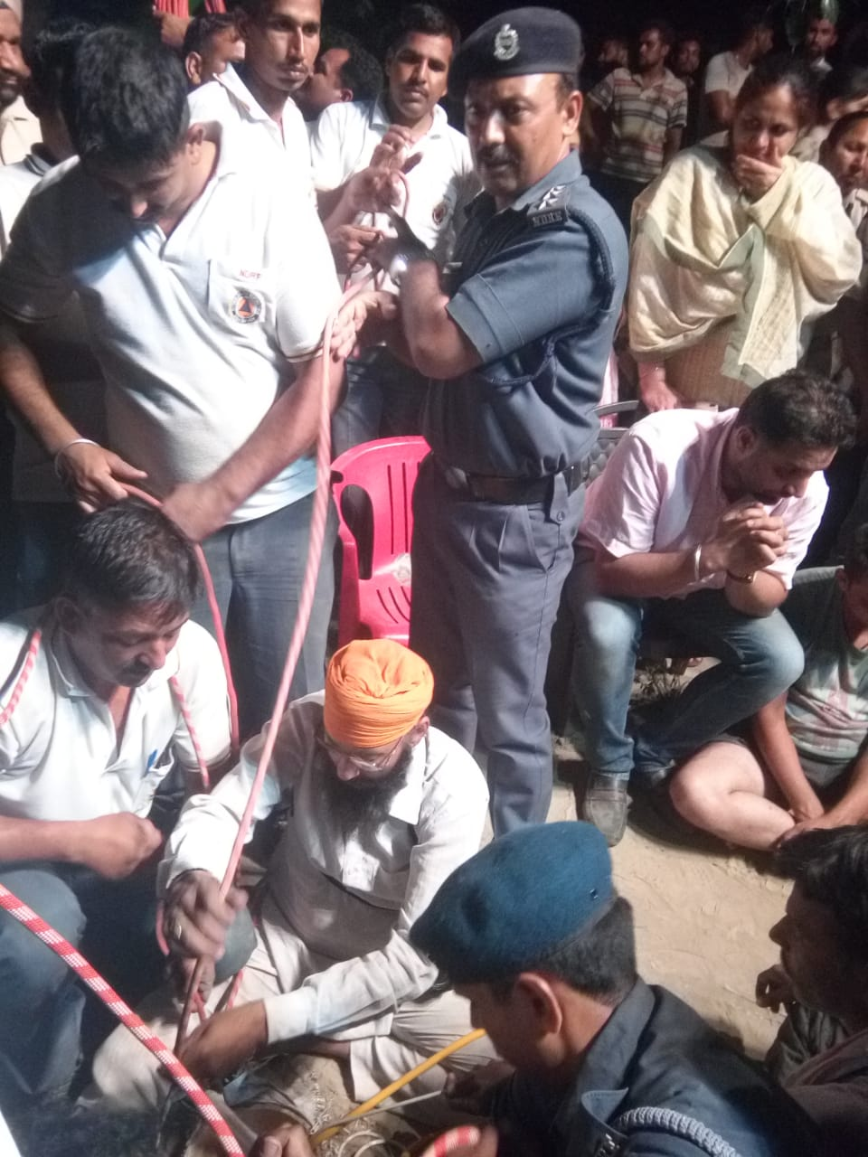
GLIMPSE OF
RESCUE OPERATION

Slide 31
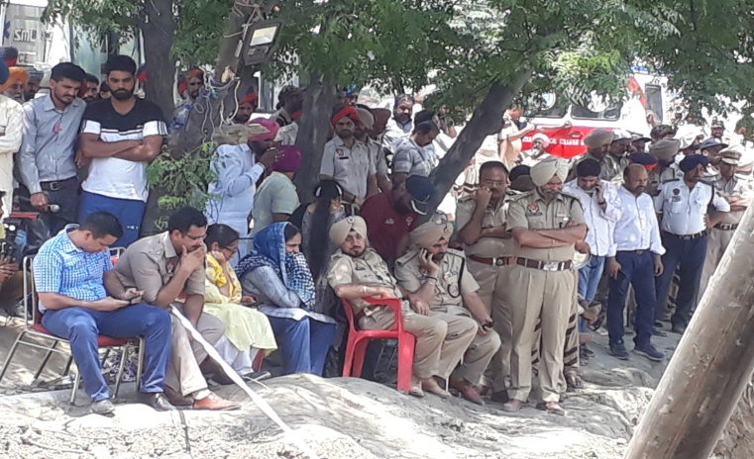
GLIMPSE OF
RESCUE OPERATION

Slide 32
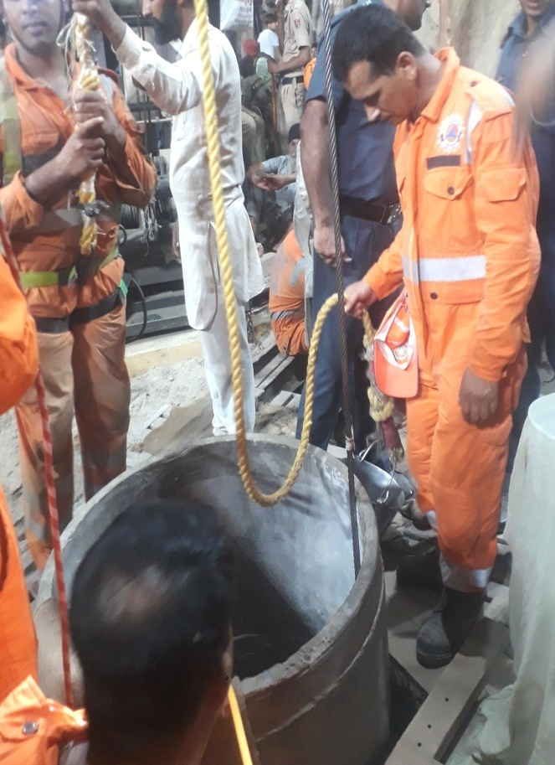
GLIMPSE OF
RESCUE OPERATION

Slide 33
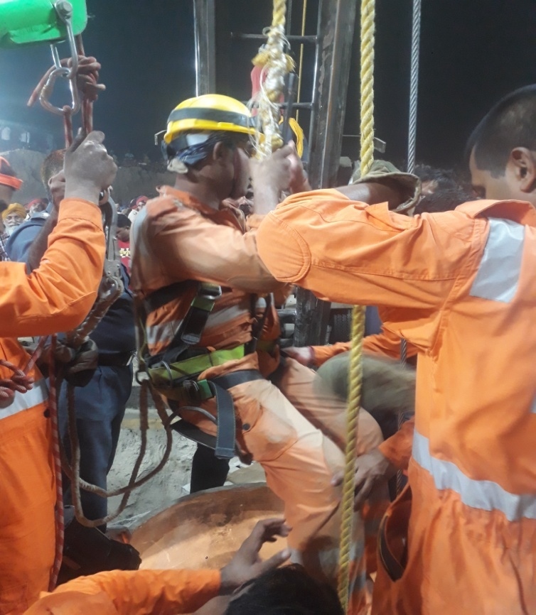
GLIMPSE OF
RESCUE OPERATION

Slide 34
LESSON LEARNT
The rescue ops itself was very difficult and risky in which the child was trapped in bore well at the depth of 128 ft under the ground with sack fragments and soil all round .

Slide 35
Cont..
Rescuer had to work in very confined space under the ground .Age of child in this case was less than 02 year .

Slide 36
Cont..
One common solution may not fit for every bore well operations .
Position of child inside the bore like in this case can very difficulty for the rescuer .

Slide 37
Cont..
Since such operations are not routine, use of common sense has to be made and directions for the same must rest with the incident commander only, however, NDRF should suggest as much as the knowledge and experience it has.

Slide 38
Cont..
More and more mock drills with difficult to most difficult situations may be carried out very frequently by creating similar scenario.

Slide 39
Cont..
Similar operations worldwide carried out need to be studied and to find out the best practices.

Slide 40
REVIEW
Introduction
Aim
General Profile Of Sangrur District.
Deployment Of 07 Bn NDRF
Search And Rescue Operation
Lesson Learnt

Slide 41



ANY QUESTION ?

Slide 42


THANK YOU

