Slide 1

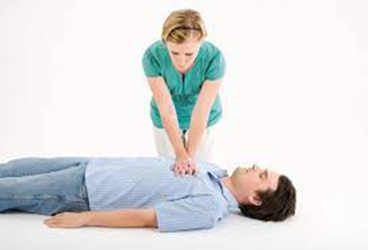

FIRST AID AND BASIC LIFE SUPPORT
Presented by:- Dileep Kumar, 2IC

Slide 2
INTRODUCTION
First Aid:
Immediate assistance and initial care given to an injured or ill person.
Aim to stabilize and prevent worsening of the condition until professional help arrives.
Basic Life Support (BLS):
Critical life-saving skills to respond to cardiac arrest and other life-threatening emergencies.
Includes chest compressions, rescue breaths, and defibrillation.

Slide 3
OBJECTIVES
Upon completion of this lesson, you will be able to:
Define first aid
Describe BLS
Describe FBAO
List the steps of control bleeding
Describe fracture
Describe splinting

Slide 4

FIRST AID
First aid is the first and immediate assistance given to any person with either a minor or serious illness or injury, with care provided to preserve life, prevent the condition from worsening, or promote recovery until medical services arrive.

Slide 5
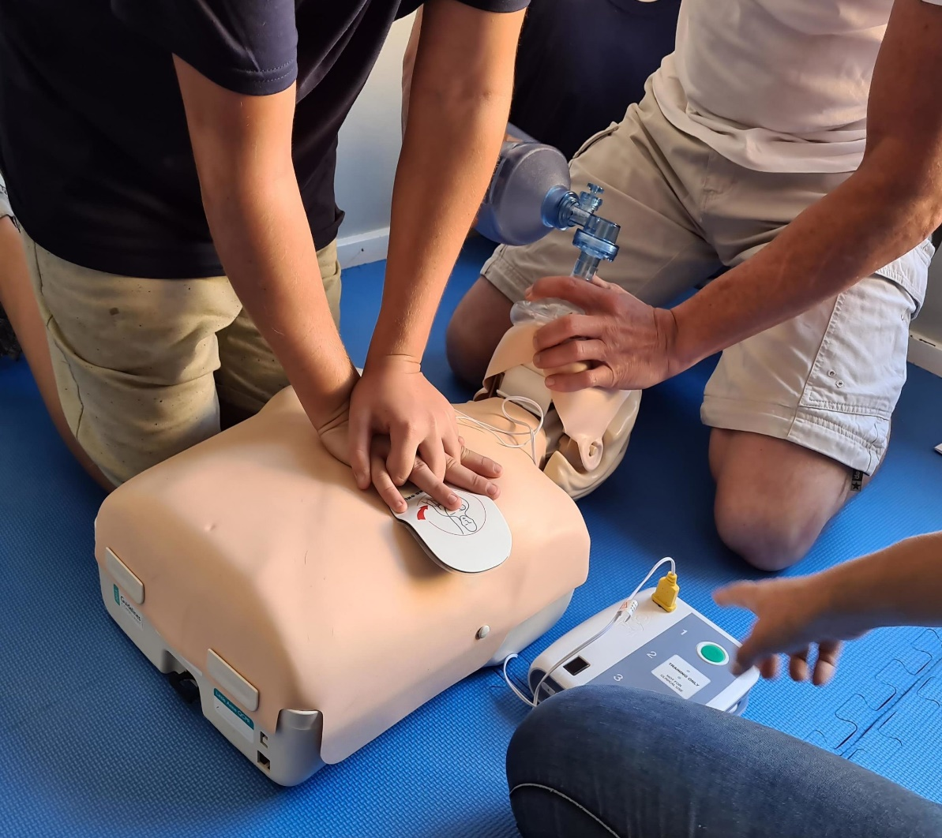
BLS & CPR
BLS- Basic Life Support generally refers to the type of care that first responders and healthcare providers provide to anyone who is experiencing cardiac arrest, respiratory distress or an obstructed airway.
CPR is an important part of BLS
General population has poor BLS skills

Slide 6
CPR PROCEDURE
Circulation – Check carotids plus.
Airway – Open Airway and check for any obstructions.
Breathing – Look, listen and feel

Slide 7
CPR PROCEDURE
Give 30 compressions and 02 breaths for 5cycles
Compression depth 1 ½ - 2 inchs
100 compression per minute

Slide 8
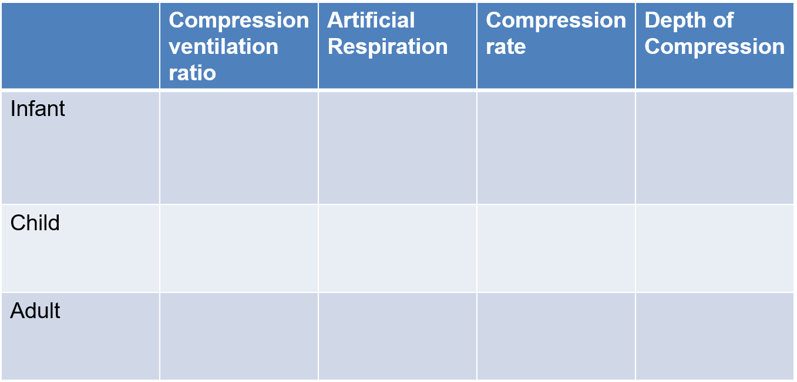
30:2
1 breath every 3 sec. (0 breaths for 2
minutes)
100 compression per minute
½ to 1 inch
1 breath every 3 sec. (40 breaths for 2 minutes)
100 compression per minute
1 to 1 ½ inch
30:2
30:2
1 breath every 5 sec. (12 breaths for 2 minutes
80-100 compression per minute
1 ½ to 2 inch

Slide 9
F.B.A.O.
Definition:
FBAO is a life-threatening emergency that can quickly lead to suffocation if not addressed punctually.
In children: Small toys, food, or objects they may put in their mouth.
In adults: Chunks of food, small objects, or accidental inhalation of objects.

Slide 10

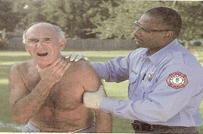
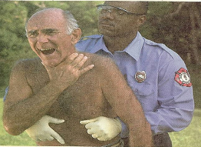
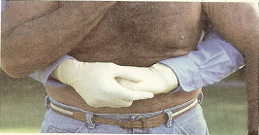
F.B.A.O.
UNIVERSAL SIGN OF CHOKING
ENCOURAGE VICTIM TO COUGH
REMOVE THE HAND FROM NECK
APPLY HEIMLICH MANEUVER

Slide 11
SIGNS OF COMPLETE OBSTRUCTION
Pale skin to Bluish discoloration of the face
Unusual sounds; shrill
Unable to cough
May clutch neck with thumb and finger known as the universal sign of choking.

Slide 12
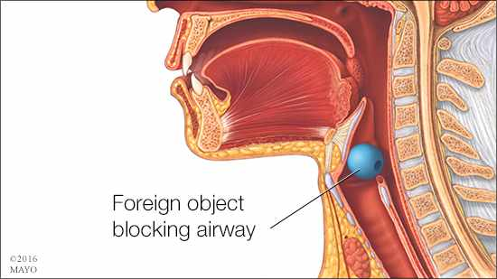
CAUSES OF AIRWAY OBSTRUCTION
Foreign Body
Tongue
Tissue damage
Acute epiglottis
Illness

Slide 13
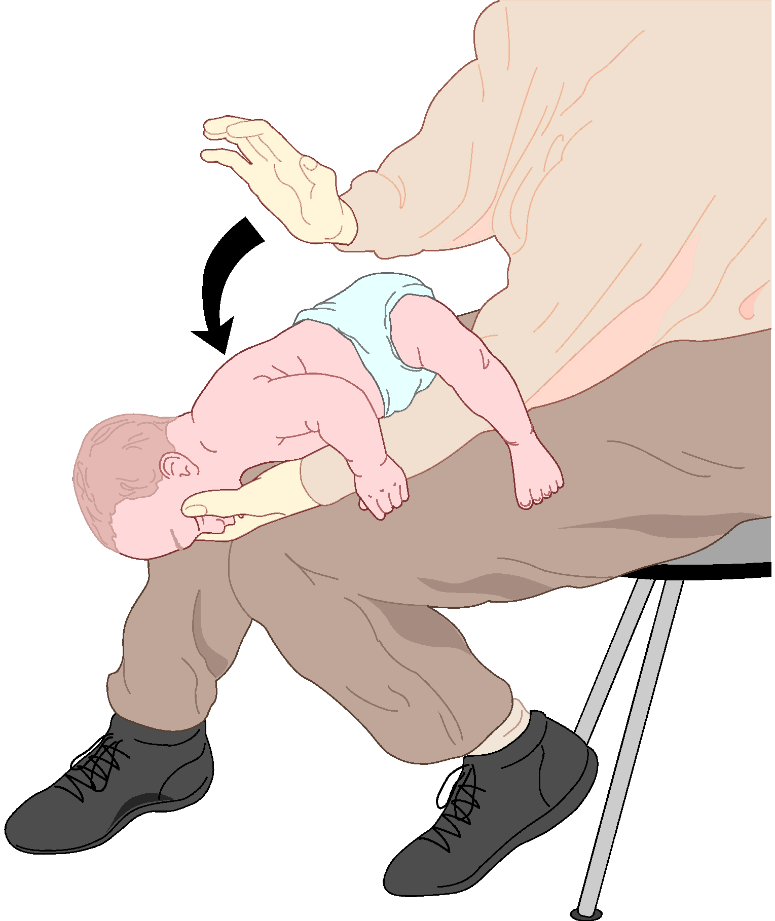
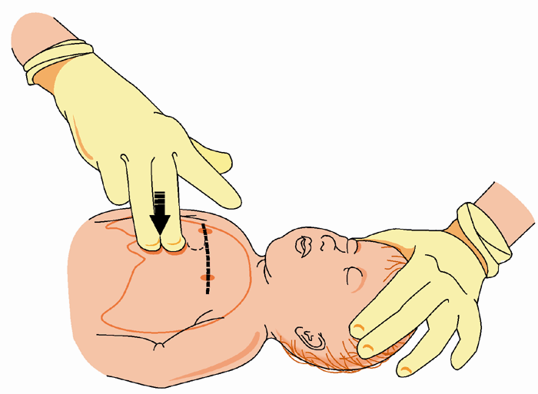
MANAGING FBAO IN INFANTS

Slide 14
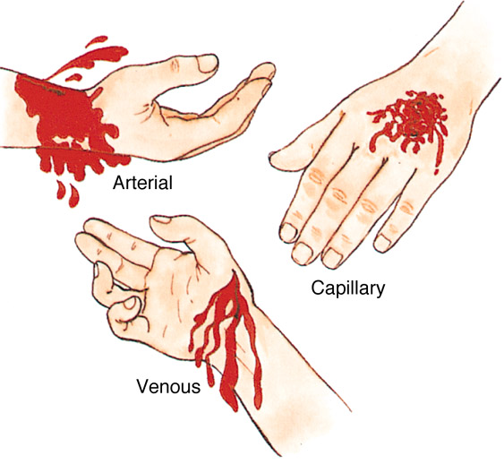
TYPE OF BLEEDING

Slide 15
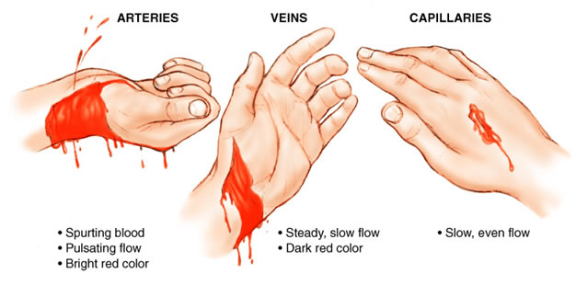

Slide 16
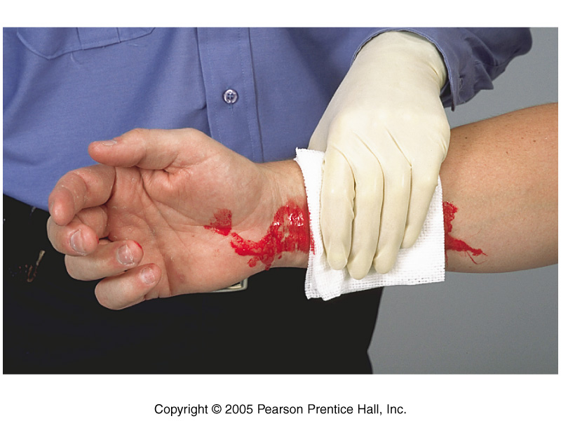
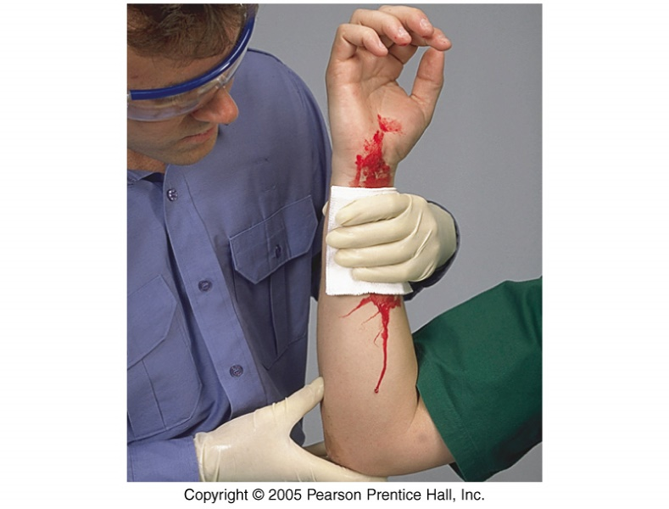
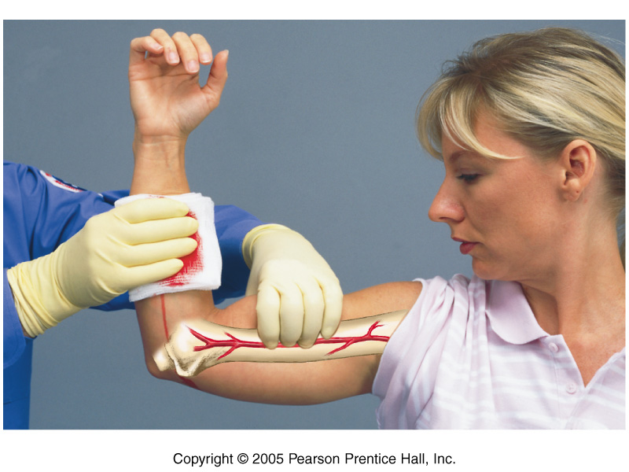
PROCEDURE TO CONTROL BLEEDING
Direct Pressure
Elevation
Pressure Points

Slide 17
PRESSURE POINTS MOST OFTEN USED ARE THE
Brachial point in the arm.
Femoral point in the leg.

Slide 18
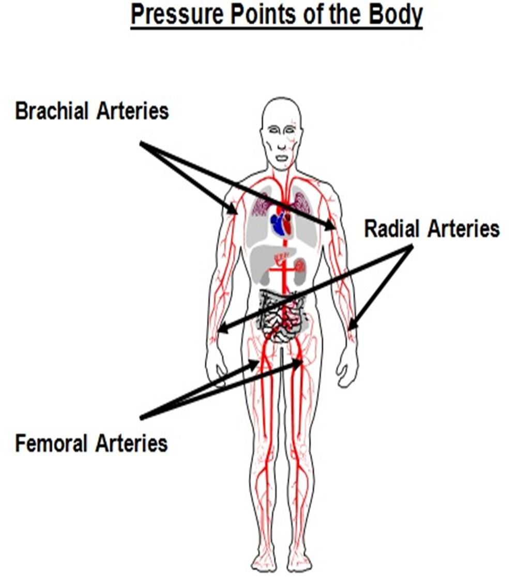

Slide 19
SIGNS OF SHOCK
Rapid and shallow breathing.
Capillary refill of greater than 2 seconds.
Failure to follow simple commands, such as, “Squeeze my hand.”
Changes in skin color.

Slide 20
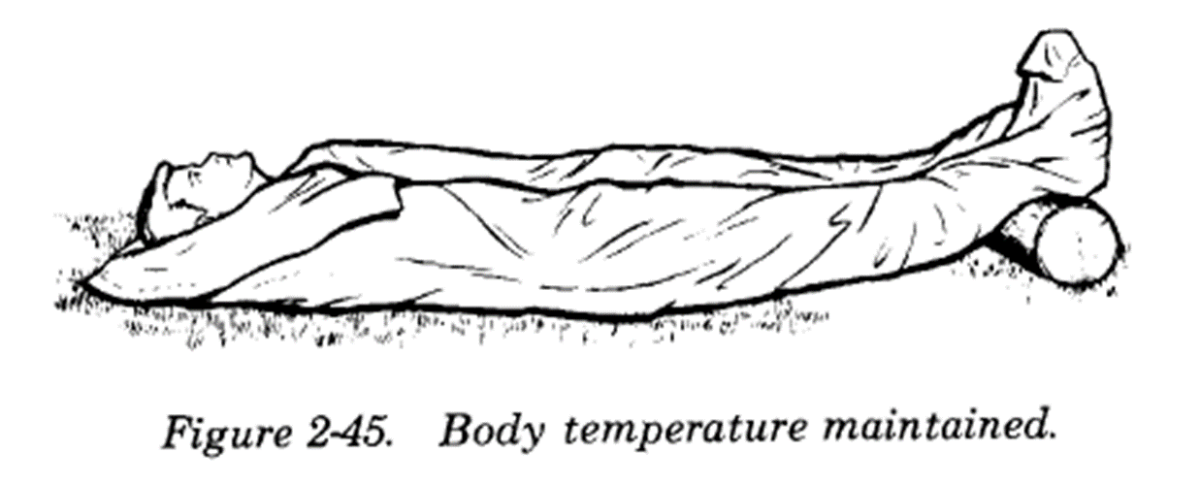
TREATMENT FOR SHOCK

Slide 21

TREATMENT FOR WOUNDS

Slide 22
DIFFERENCE A DRESSING AND A BANDAGE
A dressing is applied directly to the wound.
A bandage holds the dressing in place.

Slide 23
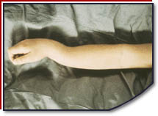
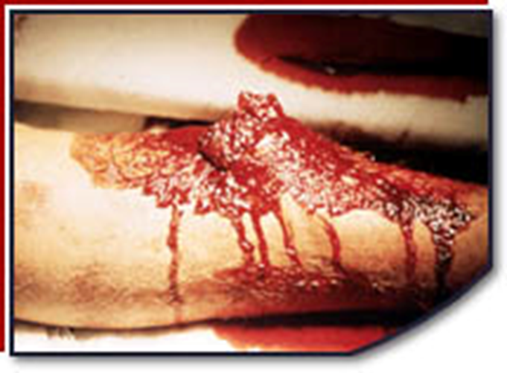
CLOSED AND OPEN FRACTURES

Slide 24
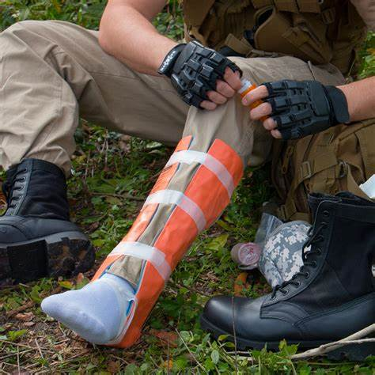
SPLINTING
The most common procedure for immobilizing an injury
Cardboard is the material most commonly used for splints
Soft materials: Towels, blankets, or pillows, tied with bandaging materials of soft cloths
Rigid materials: a board, metal strip, folded magazine or newspaper, or other rigid item.

Slide 25
VICTIMS HAS THE RIGHT TO REFUSE TREATMENT. THEN
Pay careful attention.
Look, listen, and feel for anything unusual.

Slide 26
ONGOING ASSESSMENT
Completing the assessment in the same way every time will make the procedure quicker and more correct. Check your own hands for patient bleeding as you complete the head-to-toe assessment. Perform an whole assessment before beginning any treatment. Also treat all unconscious victims as if they have a spinal injury.

Slide 27
SIGNS OF A SPINAL INJURY
Sudden change in consciousness.
Inability to move one or more body parts.
Severe pain or pressure in the head, neck, or back.
Tingling or numbness in extremities.
Difficulty breathing or seeing.

Slide 28
REVIEW
Define first aid
Describe BLS
Describe FBAO
List the steps of control bleeding
Describe fracture
Describe splinting

Slide 29


Slide 30
EVALUATION
Q1. Full form of FBAO.
Ans. Foreign Body Airway Obstruction.
Q2. How many types of fractures?
Ans. 2 types, Close and Open fracture

Slide 31


THANK YOU

