Slide 1


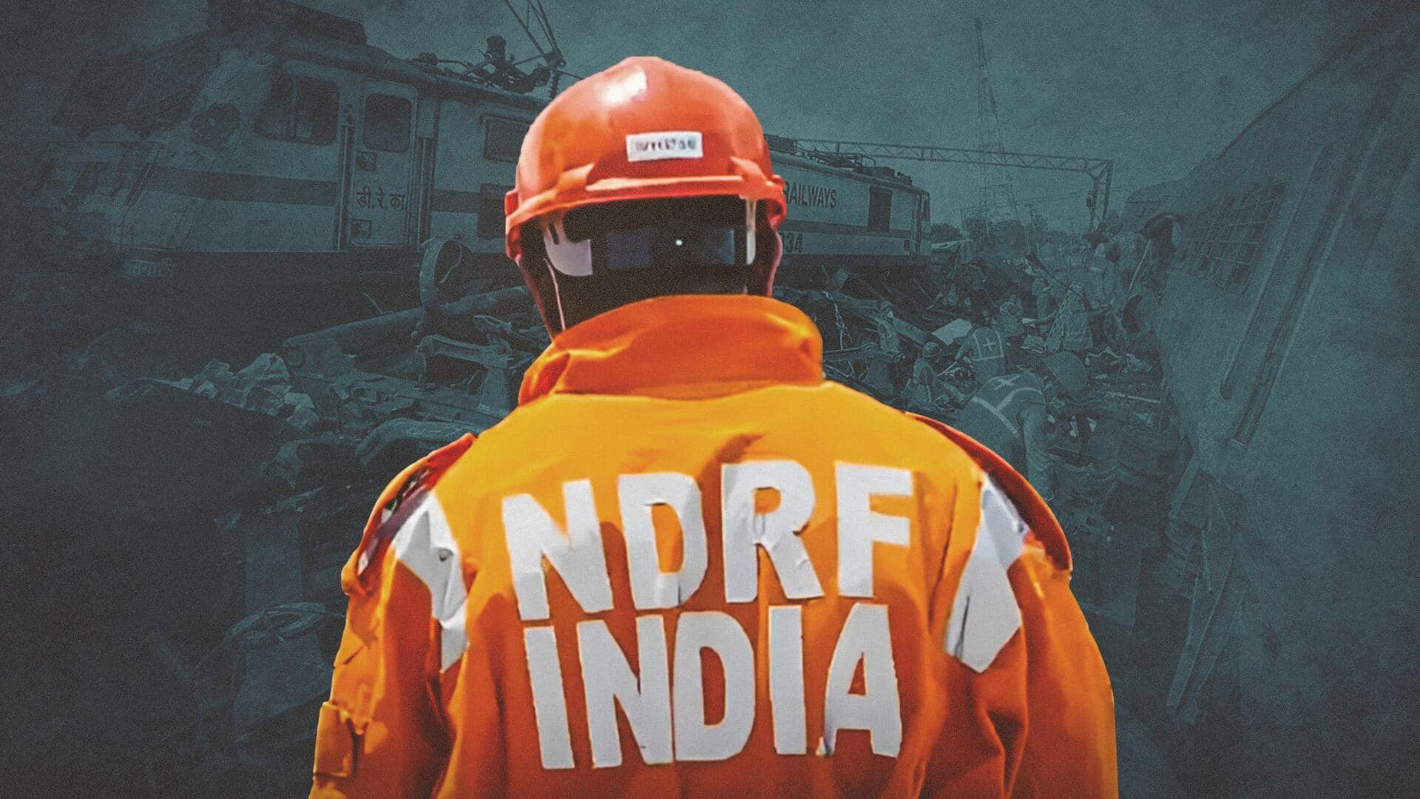

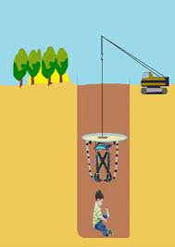
BOREWELL RESCUE
LESSON 06
BOREWELL CHILD CARE
Presented By:- Pavan Dev Gaur,2IC

Slide 2


OBJECTIVES
How to identify & prepare Victim’s (child) profile?
How to establish contact with the victim, victim’s mother/family and Victim with his/her mother/family?
How to provide Care to the victim?
How to overcome possible Medical complication of victim?
How to perform continuous monitoring of victim and vital signs?
1
Upon completion of this lesson, you will be able to :-
2
3
4
5

Slide 3
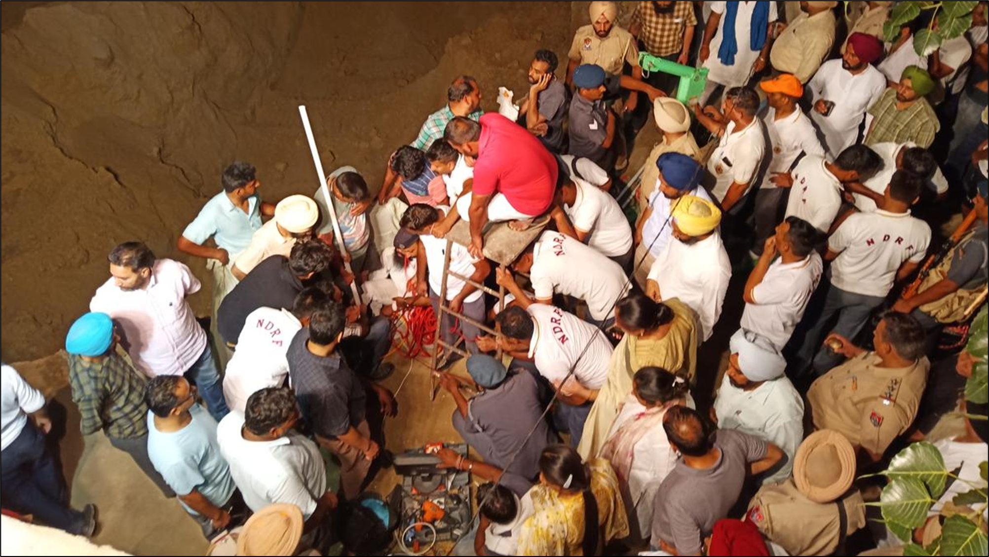
Reports say that starting from 2009 to 2017 more than 40 children fell into the bore well consecutively. 70 % of conventional child rescue operation goes to fail.
The most mournful fact in that figure is that 92% of that victim is under the age of 10.
INTRODUCTION

Slide 4
Name, Age, Sex
History of any Medical case
Mental status of Victim (determine victim’s vulnerability)
Physical status and physical description
Details of incident? (time, location – depth from ground, etc)
Preparing victim’s Profile

Slide 5
Is the victim conscious/unconscious?
- If conscious, can he/she move around, position – upright / inverted?
Is the victim old enough to communicate verbally and understand you?
ESTABLISHE CONTACT

Slide 6
Talk to victim’s family & help them to understand the situation.
Get any additional information about victim (that will help in updating victim’s profile)
Comfort the family & ask for their full cooperation.
Ensure victim’s family stays close to the incident sites.
Establish contact with Victim’s mother / family member:

Slide 7
Set up means of communication (directly speaking if it is audible / use Audio-video equipment)
Ask victim’s family to provide emotional support to victim and continue to communicate.
Establish contact with Victim’s mother / family member:

Slide 8
Provide oxygen support to the victim
Provide food and water to the victim
Read victim’s vital signs and his/her condition
Ensure the presence of Medical specialist is at the incident sites
Check whether rescue operation does not cause victim’s health deterioration.
PROVIDING CARE TO VICTIM:

Slide 9
Medical complications arising from chronic medical case.
Panic attack – Fear, racing Heartbeat, Dizziness, Trembling/shaking.
Loss of conscious due to lack of proper nutrition and oxygen.
Hypoxia – lack of adequate oxygen
Possible medical complications

Slide 10
Hypoxia is a condition in which the body or a region of the body is deprived of adequate oxygen supply at the tissue level.
Generalized hypoxia occurs in healthy people when they ascend to high altitude, where it causes altitude sickness leading to potentially fatal complications.
HYPOXIA

Slide 11
Some Other Causes of HYPOXIA –
Lung Diseases such as COPD (Emphysema & Chronic Bronchitis)
Strong pain medicines and other drugs that hold back breathing
Heart problems
Anemia (number of red blood cells or the hemoglobin concentration within them is lower than normal.)
HYPOXIA

Slide 12
Shortness of breath
Wheezing
Frequent cough
Bluish discoloration of the skin
Fatigue, headache, confusion etc.
Symptoms of HYPOXIA

Slide 13
The immediate treatment for HYPOXIA is to Raise the level of Oxygen in the body by administering oxygen.
Treatment for HYPOXIA

Slide 14
Find a way to monitor victim’s vital signs (through body sensor etc.)
Note down the readings, look out for any changes and continues to do so.
Continue to establish verbal communication (if possible).
Upon extrication – Medical representatives may examine for any kind of other complications.
Monitoring of vital signs

Slide 15
ANY QUESTIONS ???

Slide 16
Review
How to identify & prepare Victim’s (child) profile?
How to establish contact with the victim, victim’s mother/family and Victim with his/her mother/family?
How to provide Care to the victim?
How to overcome possible Medical complication of victim?
How to perform continuous monitoring of victim and vital signs?
1
Now you are able to :-
2
3
4
5

Slide 17



THANK YOU

