Slide 1




CBRN Module: CAPF
LESSON 06
OVERVIEW OF CBRN EMERGENCY
Presented by:- Pavan Dev Gaur, 2IC

Slide 2
OBJECTIVES
Upon completing this lesson, you will be able to:
1
  What is CBRN Emergency?
  Management of HAZMAT Transportation accident.
  Role and Procedure during offsite Emergency.
  Info about CBRN Eqpts, Wiser/ERG apps.
  Monitoring of threats in cities/towns with MAH Units.
  Conclusion.
2
3
4
5
6

Slide 3

TYPES OF CBRN EMERGENCY
Chemical, biological, radiological, nuclear and explosive (CBRN) events refer to the uncontrolled release of chemicals, biological agents or radioactive contamination into the environment or explosions that cause widespread damage. CBRN events can be caused by accidents or by terrorist acts.
PPT 2 -

Slide 4
WHAT IS CBRN EMERGENCY
CHEMICAL HAZARDS.
BIOLOGICAL HAZARDS.
NUCLEAR AND RADIOLOGICAL HAZARDS.
PPT 2 -

Slide 5
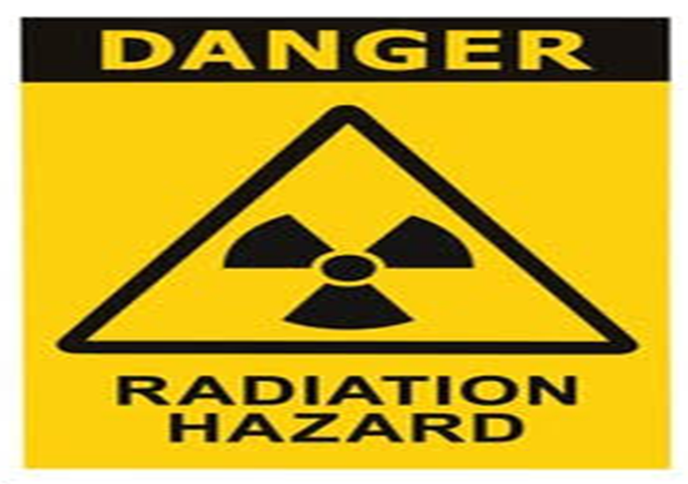
NUCLEAR AND RADIOLOGICAL HAZARDS
Radiological dispersal device(RDD)
Radiological exposure device(RED)
Industrial Accidents
Transportation Accidents
Nuclear Weapons and Improvised Nuclear device
PPT 2 -

Slide 6
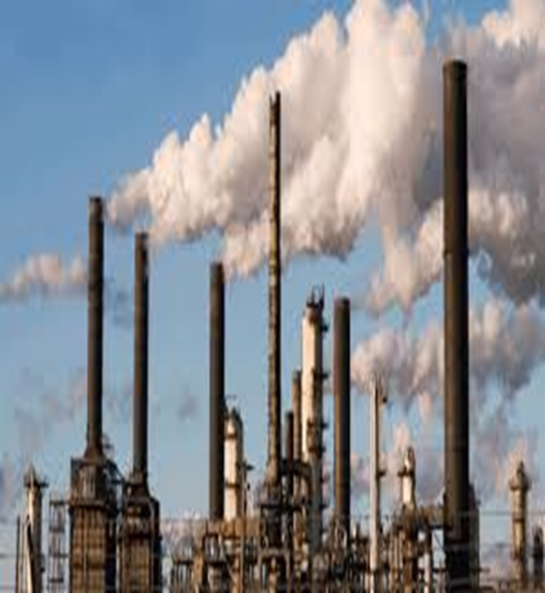
TOXIC INDUSTRIAL CHEMICALS
TIC Are any substances that produced and used by industries for various purpose and that, because of their chemical and physical properties pose a potential risk of life, health and environment when not properly contained.
Toxic industrial chemical can be in Solid, Liquid, or Gaseous state.
PPT 2 -

Slide 7
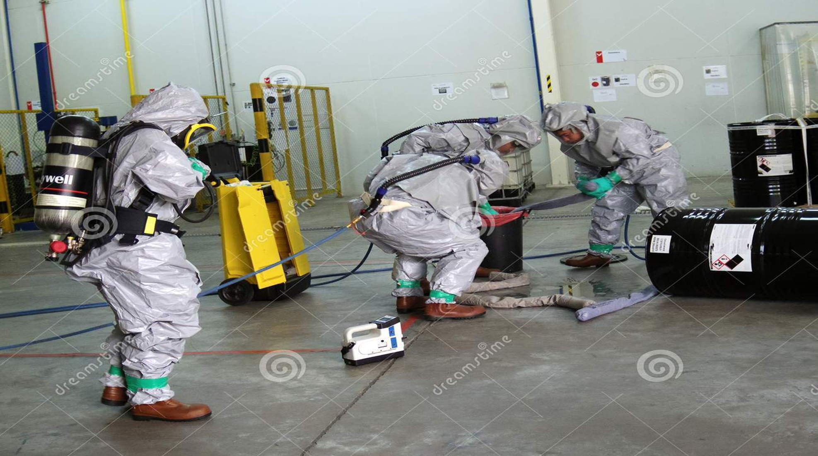
PPT 2 -

Slide 8
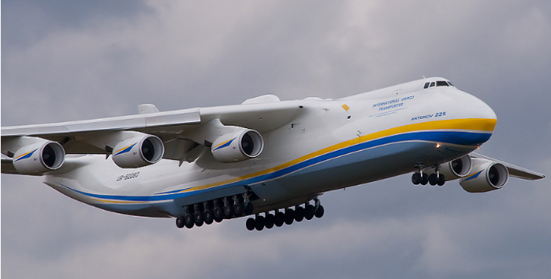
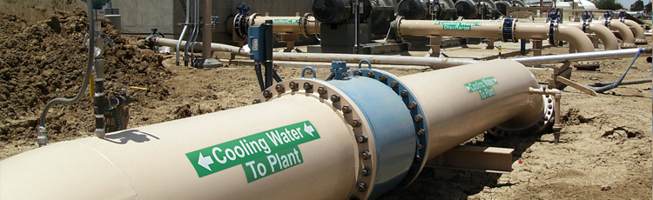
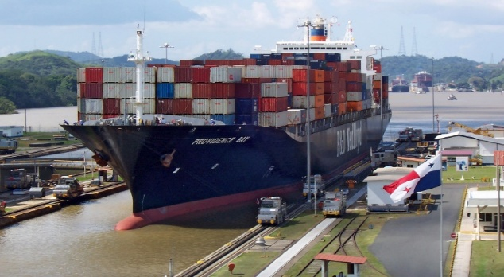
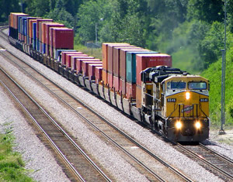
MODE OF TRANSPORTATION OF HAZMAT
Taps ( pipe line )
Plane (air ways )
Ship (water transport )
Train (rail transport )
Motor vehicle (road transport)
PPT 2 -

Slide 9
Preparation and Planning
Immediate Response
Containment and Control
Evacuation and Shelter-in-Place
Medical Response
Environmental Protection
Communication
Investigation and Documentation
Recovery and Cleanup
MANAGING HAMAT TRANSPORTATION ACCIDENTS
PPT 2 -

Slide 10
MANAGING HAMAT TRANSPORTATION ACCIDENTS
Is an integral part of any major hard control system.
Base on those accidents, which could affect people and the environment outside the workers.
Based on those events which are most likely to occur.
A good off-site emergency plan has the flexibility in its application to emergencies other than those specifically included in the formation of the plan.
PPT 2 -

Slide 11
Site location – road/ railway stations
Brief details of manufacturing processes and materials handled.
Hazard potential.
Basic control system and communications.
Material safety data sheets of important hazardous chemicals handled.
Responsibilities and duties of key personnel.
OFF-SITE EMERGENCY PLAN- PART-1
( INDIVIDUAL INDUSTRIES)
PPT 2 -

Slide 12
Sectorial division of emergency planning zone
( Direction/distance/Sectors giving details of villages and approximate population)
Emergency committees.
Notification of off-site emergency.
Responsibilities and duties of Govt. and other agencies.
Annexures containing details of telephone numbers. Contact address safety professionals of the area, Medical facilities etc.
OFF-SITE EMERGENCY – PLAN-2
(COMMON OFF-SITE EMERGENCY PLAN)
PPT 2 -

Slide 13
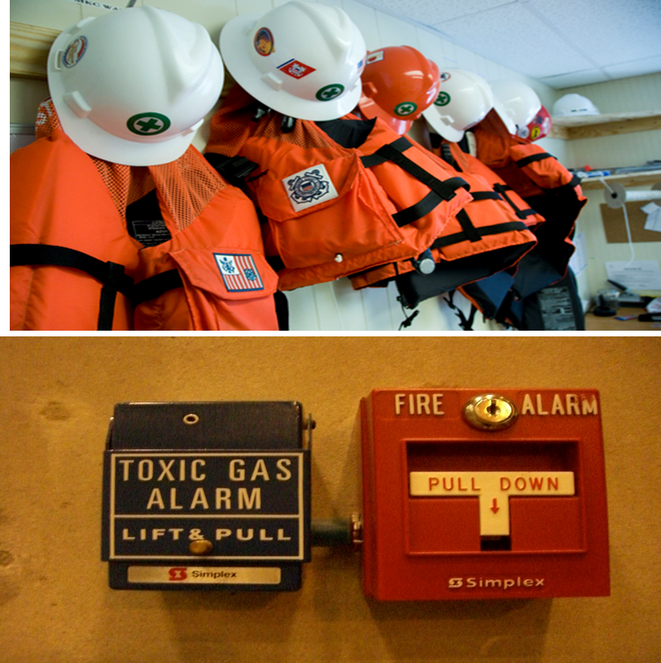
Respirators.
Gum boot.
Safety helmets.
Asbestos Rubber hand gloves
Google and face shield.
Toxic gas measuring instrument.
Explosive meter.
Oxygen measuring instrument.
Wind direction indicator
SAFETY EQUIPMENT
PPT 2 -

Slide 14

PPT 2 -

Slide 15
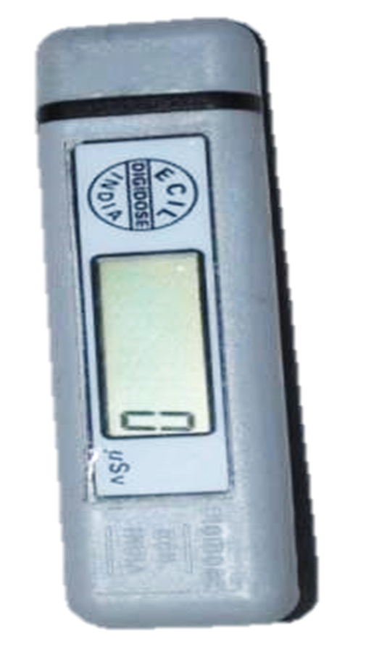
DETECTOR :- Gamma & x-ray (Dose)
PRINCIPLE :- Semi-conductor
RANGE :- 1uSv to 999999 uSv
DISPLAY :- 6 digit LCD
ACCURACY :- (±)15%
BATTERY :- Lithium Ion Cell (03 volts)
Used for 1000 hrs
It records instantaneous dose
It is temporary record
ELECTRONIC DOSIMETER
PPT 2 -

Slide 16
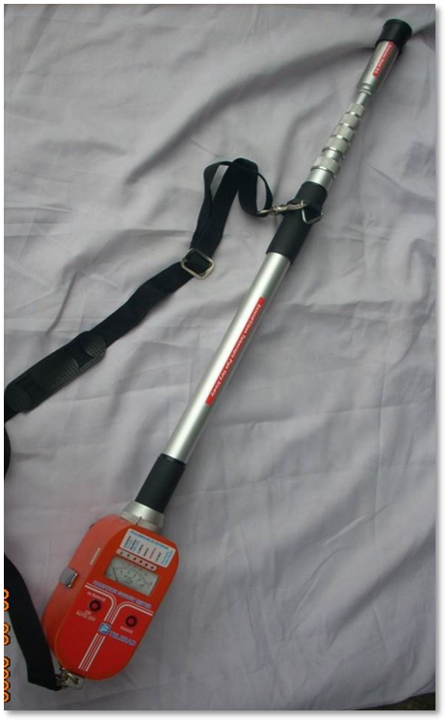
PURPOSE : Beta/ Gama / X-Ray detection
ADVANTAGE : 4 Mtr long Telescopic Probe
WORKS ON : GMT (D1&D2)
RANGE : (X-Ray & Gamma Ray) 0 to1000 R/hr
Beta : 0 to 900 CPS
BATTERY : (1.5 V) 5 Pencil Cells
PRINCIPLE : Gas Filled Detector
ACCURACY : (+/-) 15%
TELETECTOR (TELERAD)
PPT 2 -

Slide 17
TELETECTOR (TELERAD)
NO | RANGES | SCALE | LED | RADIATION | DETECTOR
01 | 0-1000R | RED | RED | X &Gamma | D-2
02 | 0-50R | BLACK | RED | X &Gamma | D-2
03 | 0-2.5R | BLACK | RED | X &Gamma | D-2
04 | 0-50mR/ 900CPS | BLACK | GREEN | X, Gamma&Beta | D-1
05 | 0-2.5mR/ 45cps | BLACK | GREEN | X, Gamma&Beta | D-1
PPT 2 -

Slide 18
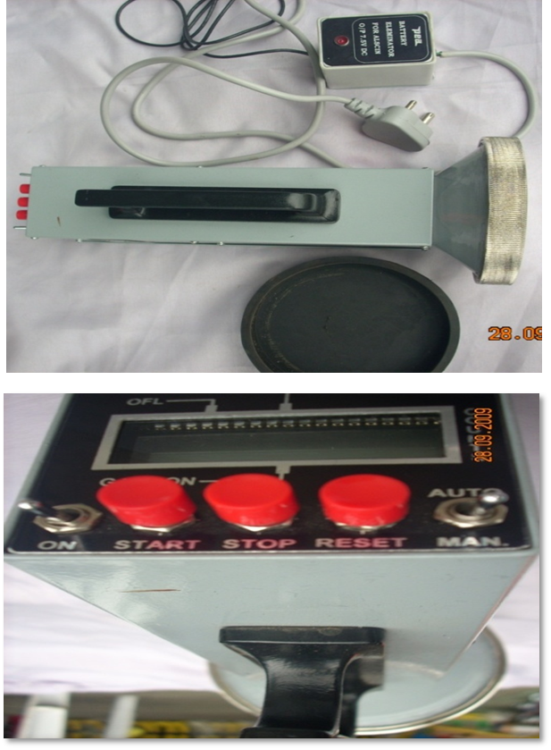
PORTABLE DEVICE TO MEASURE ALPHA CONTAMINATION LEVEL
PURPOSE : Detects Alpha particle
ADVANTAGE : Portable & Accurate Device
READING : In PPS (Particles per Second)
PRINCIPLE : Scintillator detector(PMT)
RANGE : 4-5cms
DISPLAY : 4 digit LCD
MODES : Auto & Manual
WORKING TIME : 1 Min (in Auto Mode)
: Continuous (in Manual Mode)
BATTERY : (1.5V) DC-R14 size 05 cells (medium battery)
ALSCIN MONITOR
PPT 2 -

Slide 19
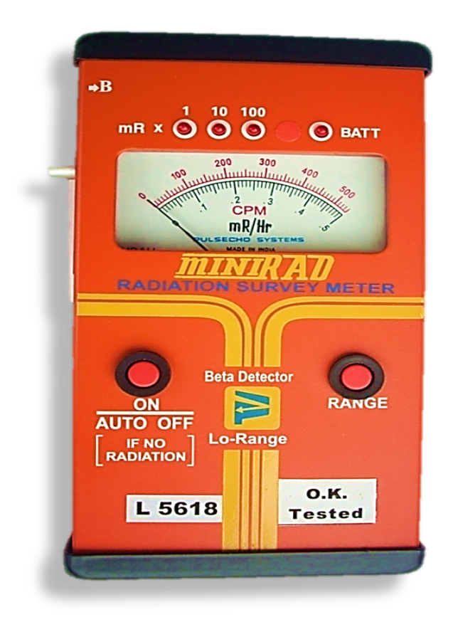
PORTABLE DEVICE TO MEASURE LOW RANGE X-RAY, BETA & GAMMA RADIATION
PURPOSE : Beta/ Gama / X-Ray detection
ADVANTAGE : Light, Portable, gives Fast &
Accurate measurement.
READING : 4 LED Display to indicate
* Range
* Incident RADIATION
* Low Battery
PRINCIPLE : (Gas Filled Detector) GM Tube
LOW RANGE : 0 – 50 mR/Hr, 0 – 54000cpm
BATTERY : 05 Pencil Cells (1.5V)
ACCURACY : (+/-) 15%
WORKING TIME : 60 hrs Continuous
OPERATING TEMP. :0-50 Deg.C
RADIATION SURVEY METER
(MINIRAD BETA INTERNAL)
PPT 2 -

Slide 20
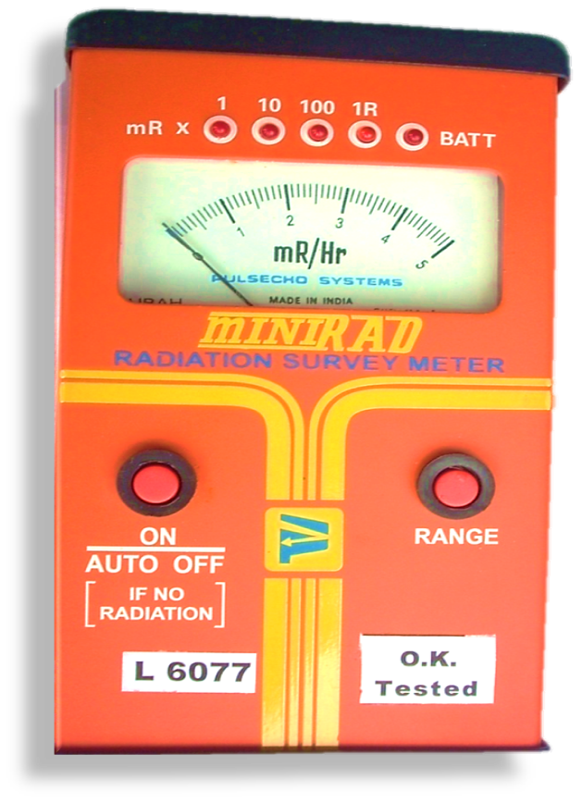
PORTABLE DEVICE TO MEASURE X-RAY & GAMMA RADIATION
PURPOSE : Gama / X-Ray detection
ADVANTAGE : Light, Portable, gives Fast & accurate measurement.
READING : 5 LED Display to indicate
* Range
*Instant Reading
PRINCIPLE : Gas Filled Detector (GMT)
WEIGHT : 450 Gm
HIGH RANGE : 0 – 5 R/Hr
ACCURACY : (+/-) 15 % with Cesium (Cs) 137 source
WORKING TIME : 02 min (otherwise switched off)
OPERATING TEMP. : 0 TO 50 Degree C
BATTERY : 05 Pencil Cell (1.5V)
WORKING TIME : 60 hrs Continuous
RADIATION SURVEY METER
(MINIRAD )
PPT 2 -

Slide 21
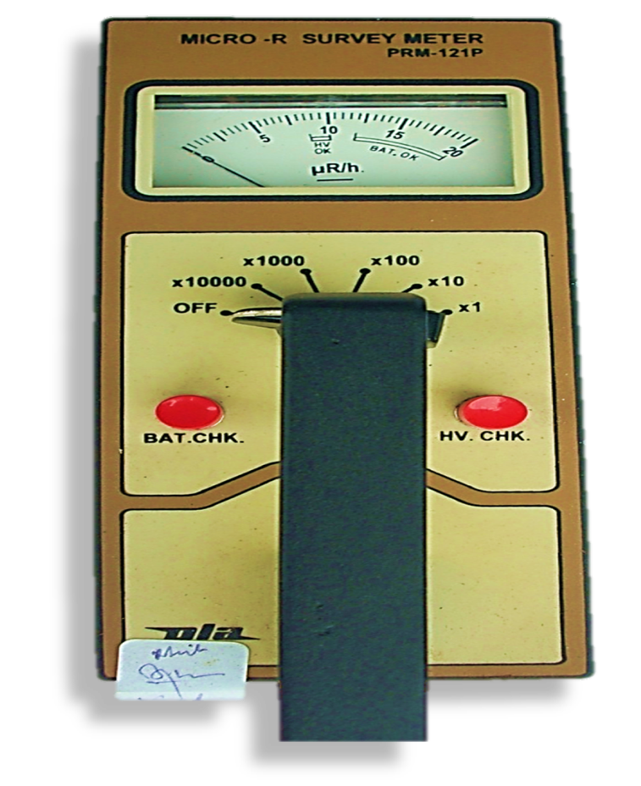
VERY EFFECTIVE, PORTABLE DEVICE TO MEASURE GAMMA RADIATION
PRINCIPLE:- Scintillation
ADVANTAGE: Hand held, portable , light weight and analog dose rate meter.
DETECTOR : Gamma & x-ray (PMT)
RANGE : 0 to 2,00,000 μR/h
ACCURACY : (+/-) 20 %
BATTERY : (1.5 V) 6 pencil battery
Before use always checkup the battery and its high voltage
If least range is selected & display show 2 to 10 µR/h, It is natural back ground. If reading exceeds more than 15 µR/h then some artificial Gamma radiation is present
MICRO “R” SURVEY METER
PPT 2 -

Slide 22
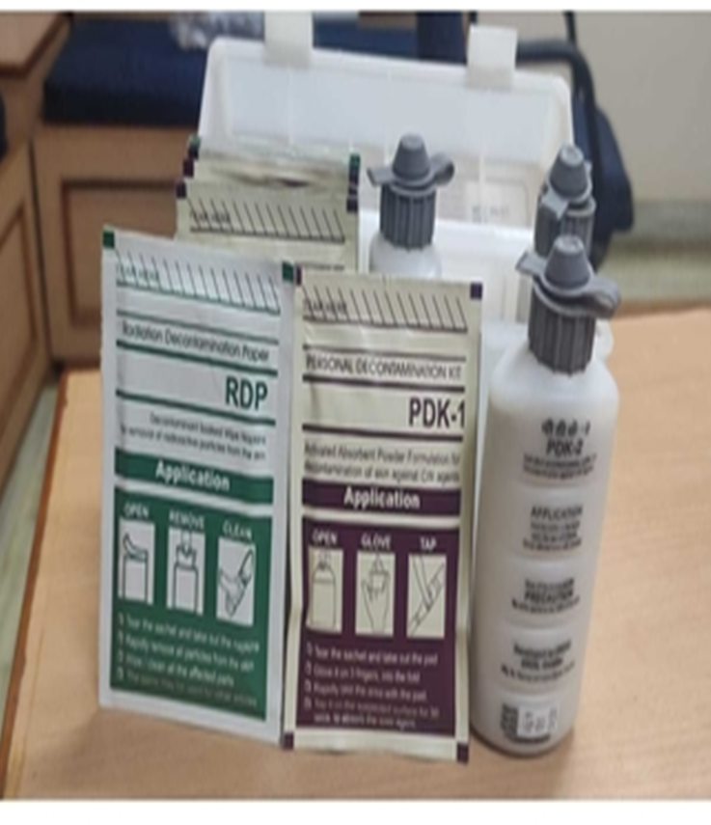
This kit consists three components:-
a) PDK-1
b) PDK-II
c) RDP (Radiation Decontamination Paper)
Used for decon of CW agents .
Dimensions : 230 + 2 X 135 + 2 x 45 + 2 mm
Weight : 0.480+15 Kg
Self Life : 5 Year (Packed Condition)
Temp : 25° C
Humidity : 50%
PERSONAL DECONTAMINATION KIT (PDK)
PPT 2 -

Slide 23
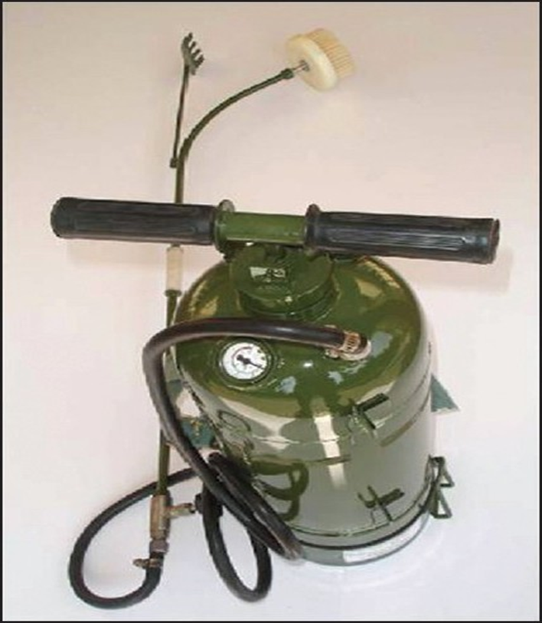
Very useful in small scale decon of NBC Agents
Made : Stainless steel
Capacity : 14 Litre
Fill capacity : 12 ltr.
Weight : 10.5 + 0.5 Kg
Operating Pressure : 5.5 + 0.5 Kg/cm (300 Bar Pressure)
Self Life : 5 Year (non metallic)
:10 Year (metallic)
Ratio:- 11:1 (Water & DS-2)
DS-2 :- Decontamination solution-2
PORTABLE DECONTAMINATION APPARATUS
PPT 2 -

Slide 24
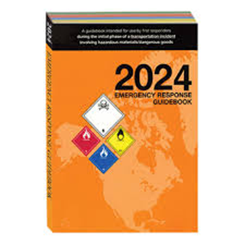
Emergency Response Guidebook (ERG)
Developed jointly by:
Transport Canada (TC)
The U.S. Department of Transportation (DOT)
The Secretariat of Transport and Communications of Mexico (SCT)
Used by fire fighters, police, and other emergency services personnel who may be the first to arrive at the scene of a transportation incident involving dangerous goods.
PPT 2 -

Slide 25

APPLICATION OF THE ERG
Primarily a guide to aid first responders in quickly identifying the specific or generic hazards of the material(s) involved in the incident, and protecting themselves and the general public during the initial response phase of the incident.
Assists first responders in making initial decisions upon arriving at the scene of a dangerous goods incident.
PPT 2 -

Slide 26
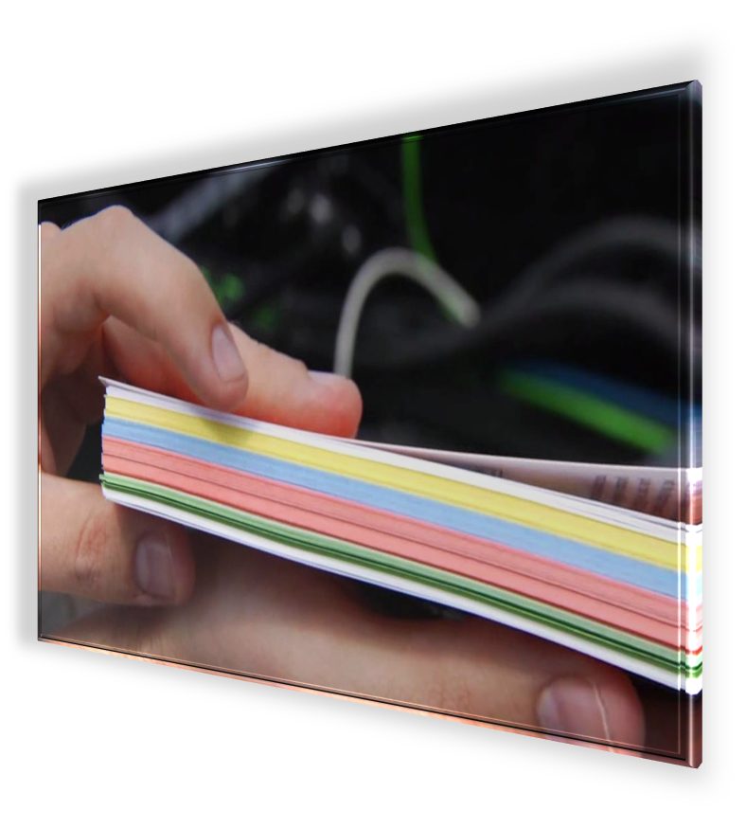
ERG FORMAT
The book is divided into sections by the page border colors
Yellow
Blue
Orange
Green
PPT 2 -

Slide 27

ERG FORMAT
ERG Sections:
Telephone numbers
Table of placards
Railcar and Road Trailer ID Charts
YELLOW Section (ID No.)
BLUE Section (Shipping Names)
ORANGE Section(Guide Pages)
GREEN Section (Initial Isolation and Protective Action Distances for highlighted substances)
PPT 2 -

Slide 28
ANY QUESTION ?
PPT 2 -

Slide 29


THANK YOU

