Slide 1





CADRE
Lesson 6
Dead Body Management
Presented By:- Pavan Dev Gaur,2IC

Slide 2



OBJECTIVES
List the common consequences of handling dead bodies.
List and describe the methods of handling dead bodies.
Describe the roles and responsibilities of Community Responders in handling dead bodies.
List the factors to consider in handling Dead Bodies.
1
Upon completion of this lesson, you will be able to :-
2
3
4

Slide 3
OBJECTIVES
Demonstrate the proper identification of dead bodies using Photography.
Demonstrate tagging.
Describe how to store dead bodies.
5
Upon completing of this lesson, you will be able to :-
6
7

Slide 4


  Assign a sequential, unique reference number to each body or body part
  Write the unique reference number on a waterproof label then securely attach it to the body or body part.
  Attached the same to the container for the body or body part.
  Photographs (mandatory)
PROCESS

Slide 5
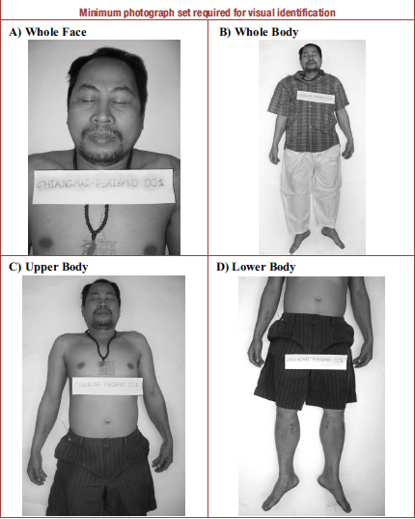
PROCESS

Slide 6
Bodies should be placed in body bags. Plastic sheets, shrouds, bed sheets, or other locally available material.
Body parts should be treated as individual bodies. Do not attempt to match body parts at the disaster scene.
Identify and take note of date and place where body was found.
Methods and Procedures

Slide 7


PLACE + RECOVERY TEAM/PERSON + BODY COUNT
BULACAN - A TEAM - 001

Slide 8
  Do not remove jewelry, personal belongings, and documents from the remains.
  Never use ambulances for dead body transport.
Methods and Procedures

Slide 9
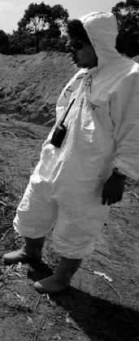
NOTE:
Body recovery teams should wear protective equipment (heavy-duty gloves and boots) and wash their hands with soap and water after handling dead bodies.

Slide 10
REVIEW
List the common consequences of handling dead bodies.
List and describe the methods of handling dead bodies.
Describe the roles and responsibilities of Community Responders in handling dead bodies.
List the factors to consider in handling Dead Bodies.
1
2
Now you are able to:-
3
4

Slide 11
REVIEW
Demonstrate the proper identification of dead bodies using Photography.
Demonstrate tagging.
Describe how to store dead bodies.
5
Now you are able to :-
6
7

Slide 12



THANK YOU

