Slide 1


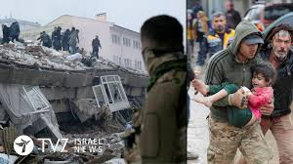
EMERGENCY MEDICALSERVICES (EMS)
AND
MEDICAL FIRST RESPONDER (MFR)
Presented by:- Dileep Kumar, 2IC

Slide 2
OBJECTIVES
  Upon completion of this lesson, you will able to :
Define EMS, purpose of EMS.
Define first aid and ambulance.
Define mfr, qualities and responsibility of mfr
Define negligence and abandonment.
Define what are the rights of a patient, consent and types of consent.
Use of ppe and equipment by mfr.

Slide 3
Emergency Medical Services (EMS )
The emergency medical Services is a network of resources linked together for the purpose of providing emergency care and transport to the victim of sudden illness or injury.
Emergency medical services (EMS), also known as ambulance services or paramedic services.
This treat illnesses and injuries that require an urgent medical response and transport to definitive care centre.

Slide 4
WHY EMS REQUIRED IN INDIA
Out of every one million people, 42,800 die every year from sudden cardiac arrest in India
Highest snakebite mortality almost 58,000 every year as per WHO ,2020
There are about 4,11,767 road accident in INDIA in year 2022 and 1,55,672 peoples are die
30% mortality due to delay in emergency care.

Slide 5
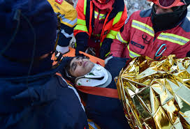
FIRST AID & AMBULANCE
FIRST AID: it is the first care given to a patient or victim.
It is given immediately after an injury or illness occurs.
It is one-time, short term treatment given such as; cleaning minor major cuts, treating minor burns, applying dressings, bandages and splints.

Slide 6
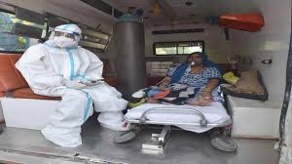
FIRST AID & AMBULANCE
Aims of First Aid: to prevent life of patient/ victim.
To prevent the worsening condition of patient.
To help in safe transportation of victim to the nearest health facility.

Slide 7
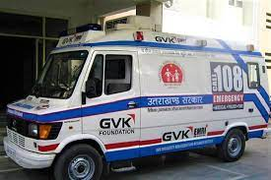
AMBULANCE
AMBULANCE: The term Ambulance is derived from latin word ‘AMBULARE’ meaning ‘to walk’ or ‘move ‘which is in reference to early medical care.

Slide 8
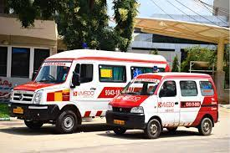
TYPE OF AMBULANCE
Normal ambulance/basic life support ambulance.
Advanced ambulance.

Slide 9




EMS NUMBERS
India - Dial Number (108)Now 102
England - Dial Number 999
U.S.A - Dial Number 911
Bhutan - Dial Number 112 1211

Slide 10
MEDICAL FIRST RESPONDER (MFR)
The First Person on the Scene of an incident With Emergency Medical Care Skill ,Typically Trained to the Most Basic EMS Level.

Slide 11

SOURCEFUL
RESPONSIBLE
DEMONSTRATE
ABILITY
SOCIABILE
GOOD PHYSICAL CONDITION
HONEST
PROFESSIONAL
DEMEANORS
EMOTIONAL STABILITY
PRIDE ( Hygiene, Uniform, Personal appearance )
QUALITIES OF THE MFR
Notes:
Focus on the EMS System.[ Next slide discusses this]

Slide 12
DUTIES OF THE MFR
Protect own safety and the safety of your crew, the patient and the bystanders
Gain access to the patient
Assess the patient to identify life threatening problems/conditions
Alert additional EMS resources
Provide care based on Assessment
Assist other EMS personnel

Slide 13
DUTIES OF THE MFR
Participate in record keeping and data collection as received
Acts as liaison with other public safety workers
Perform patient preparation for movement and transportation

Slide 14
SCOPE OF CARE
Actions that are legally allowed by the MFR when provided patient care .
Indian Penal Code Sec 92: Act done in good faith for benefit of a person without consent.
DUTY TO ACT : The medical first responder had a legal duty to provide care.

Slide 15
ABANDONMENT
Discontinuing emergency medical care without making sure that before another health care professional with equal or better training has taken over.
For such act of abandonment one may be liable to get punished by the rule of law, (court)

Slide 16
NEGLIGENCE
Failure to provide the expected standard of care , causing injury or death of the patient.
He /she will be tried for such negligence under rule of law

Slide 17
CONSENT
Before giving care to a
conscious adult you must take
permission “consent”
1. Identify yourself(Name & organization i.e, NDRF).
2. Tell them what you are
trained in(MFR).

Slide 18
CONSENT
it is a legal term that means to give formal permission for something happen or to do.
There are two types of consent.
Implied and Expressed.
Implied Consent: It is assumed on the part of an unconscious, confused or seriously injured patient or for a minor patient that cannot make decisions.

Slide 19
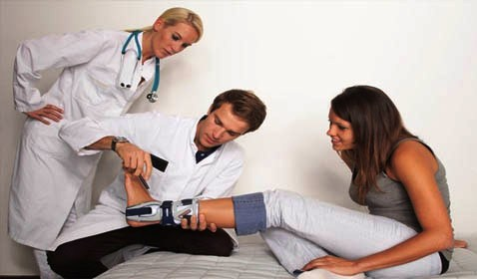
CONSENT
Expressed consent:- Permission obtained from every responsive, competent adult patient before providing emergency care.

Slide 20
RIGHTS OF THE PATIENT
To solicit and receive pre hospital care
Confidentiality regarding personal information and condition.
To pursue legal recourse for acts of negligence, abandonment and or violation of confidentiality
To denounce and demand reinstitution for improper care and /or any violation of privacy

Slide 21
RIGHTS OF THE PATIENT
In some situations the patient has the right to refuse care.
The patient may be required to sign a refusal form in the presence of a witness.
Such refusal form must be signed by the in-charge with date (team Comdr in case of NDRF).

Slide 22
BASIC PERSONAL PROTECTIVE EQUIPMENTS
Latex gloves
Personal mask
Eye protection
Gown
CPR mask

Slide 23
BASIC EQUIPMENT FOR PHT
Kit
Dressings
Bandages
Tape
Eye guard
Tourniquet
Blankets

Slide 24

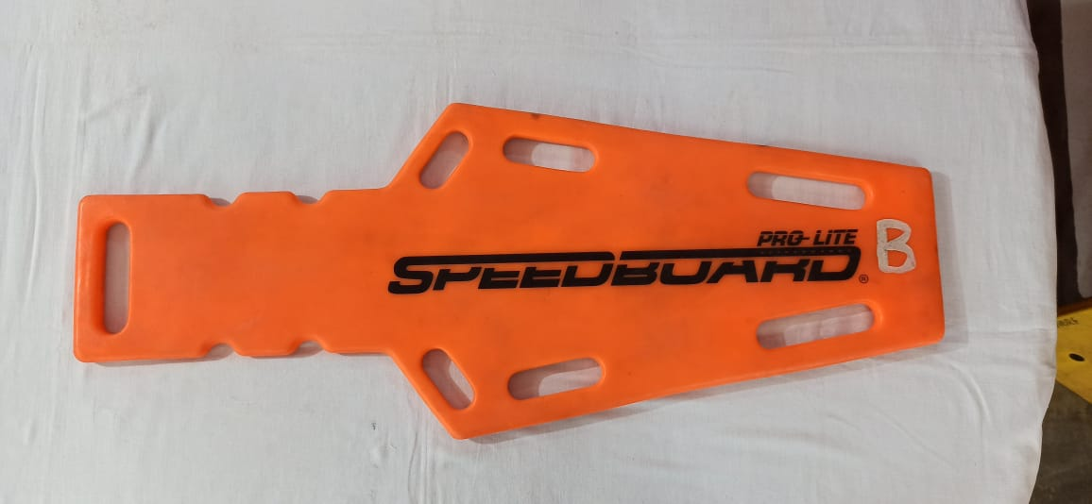
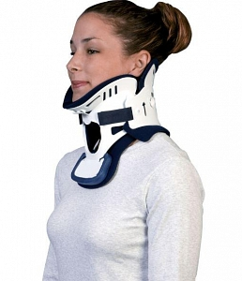
Basic Equipment for PHT
Sheets
Pillow
Backboard
Cervical collar

Slide 25
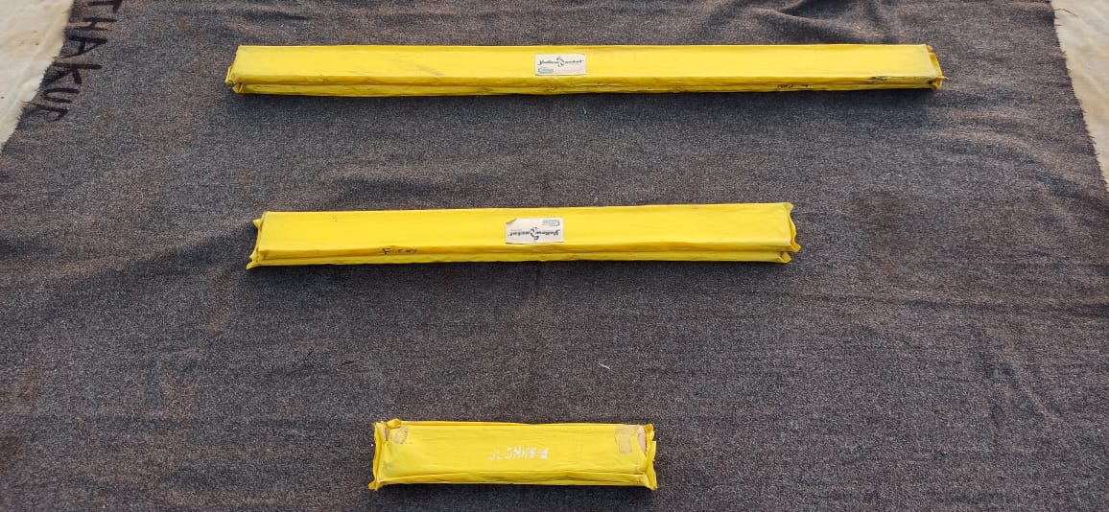
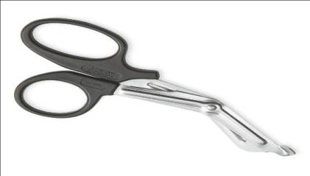
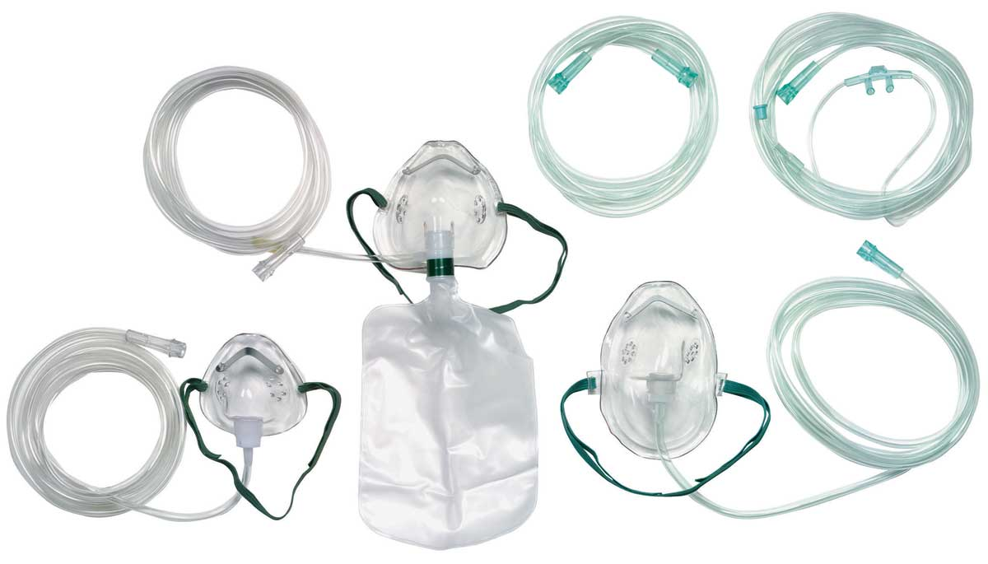
BASIC EQUIPMENT FOR PHT
Splints
Bandage shears or scissors
Oxygen and accessories

Slide 26
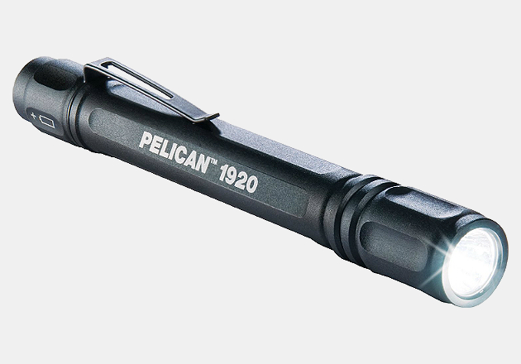
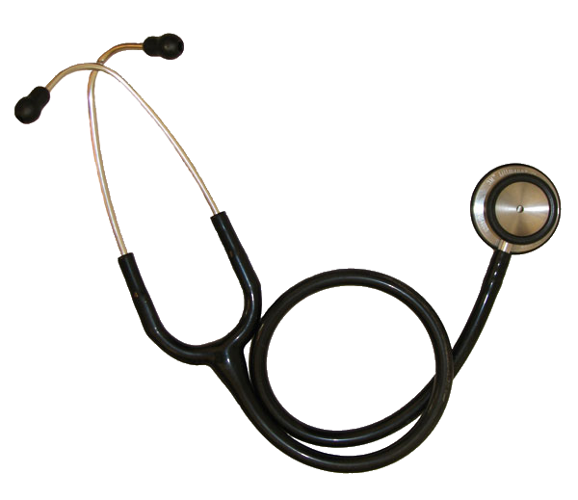
BASIC EQUIPMENT FOR PHT
Pen light
Stethoscope

Slide 27
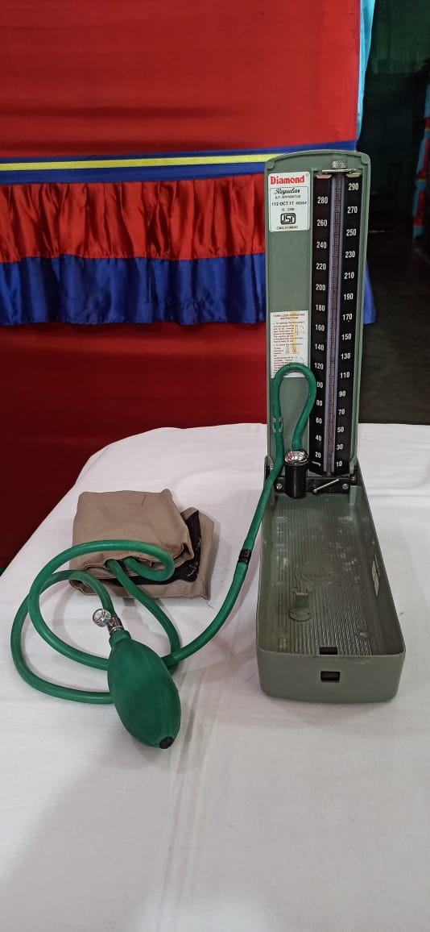
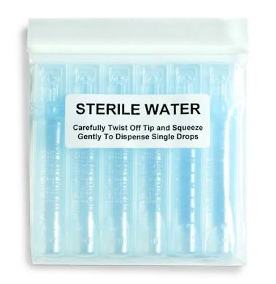
BASIC EQUIPMENT FOR PHT
Blood pressure cuff
Sterile water or normal saline

Slide 28

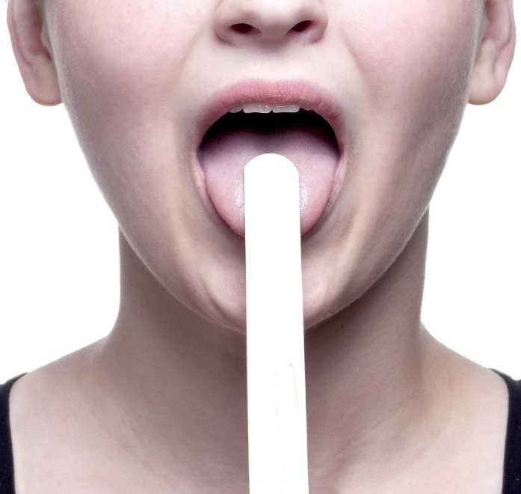
BASIC EQUIPMENT FOR PHT
Activated charcoal
Tongue depressor

Slide 29
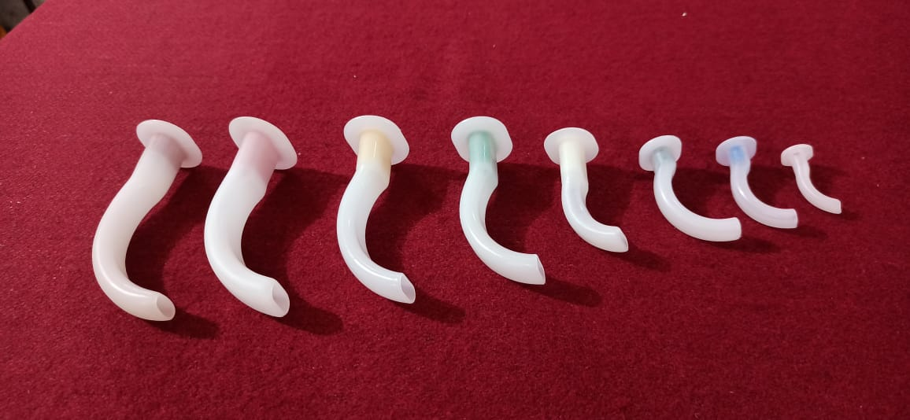
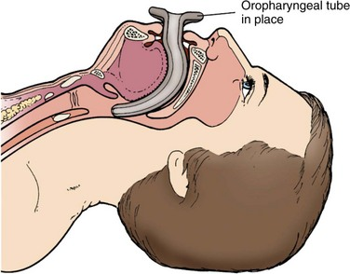
BASIC EQUIPMENT FOR PHT
ORPHARYNGEAL AIRWAYS ( ALL SIZES 0-7)

Slide 30
REVIEW
Define EMS its history and EMS in India.
First Aid and Ambulance.
Describe MFR , qualities and duties of MFR.
Right’s of an patient ,gaining consent and types of consent.
Abandonment and Negligence .
PPE & Equipment’s used by MFR.

Slide 31

ANY QUESTION

Slide 32
EVALUATION
Q.1.What is the universal EMS number in India?
a) 100
b) 108
c) 102
d) 911
ANS– 102.

Slide 33

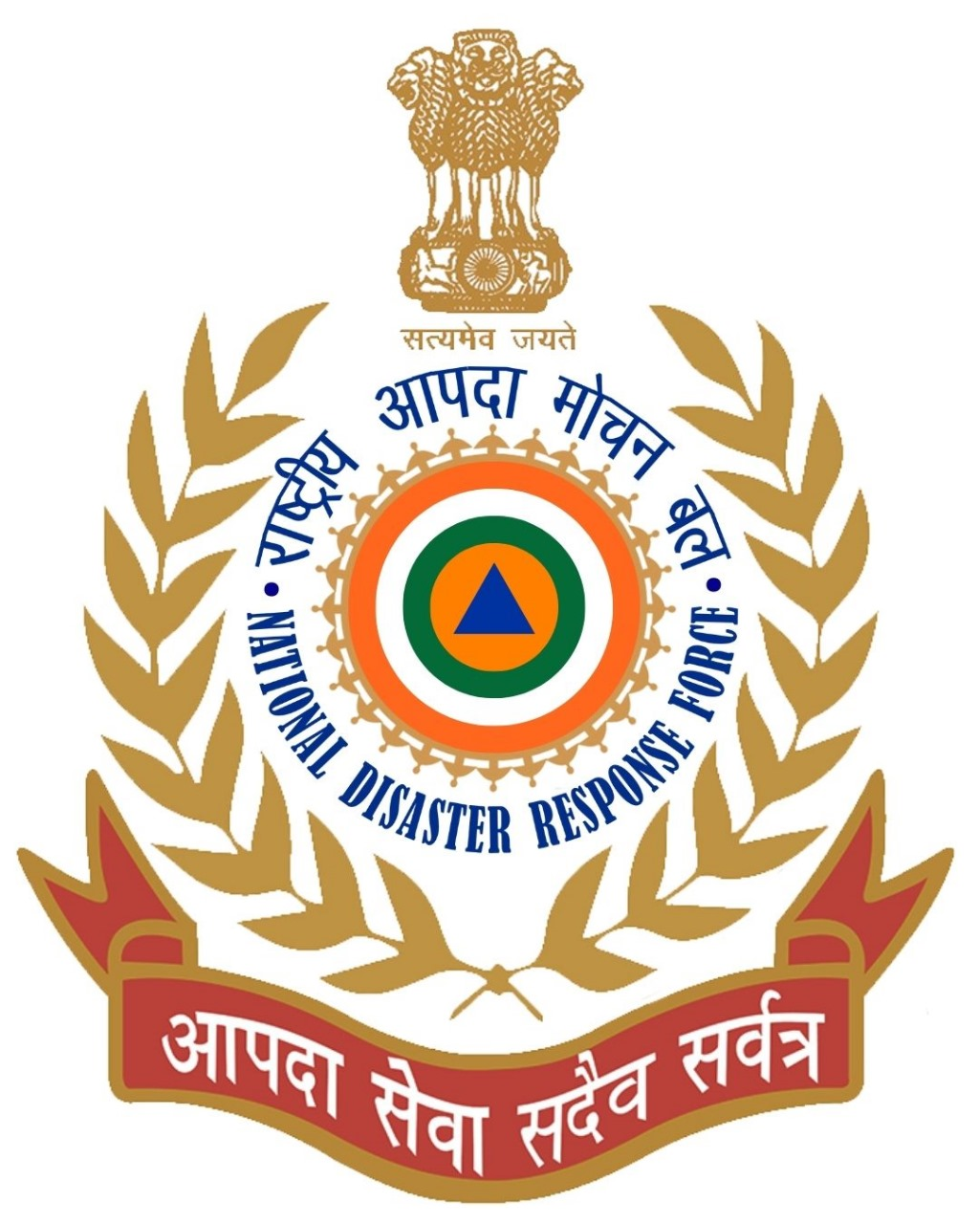
THANK YOU

