Slide 1


BORE WELL RESCUE OPS AT NADA CHARANWAS, SUB-TEH DANTA RAMGRAH, DISTT- SIKAR (RAJASTHAN)ON- 24-25/02/022
Presented by:- Sohel Lakhani, DC

Slide 2
PHASES OF BORE WELL RESCUE OPERATION
Preparation phase
Activation & Mobilization phase
Operation phase
Deactivation & Demobilization phase
Post operational Activities

Slide 3
PREPARATION PHASE
NDRF Team always keeps alert and team members divided and placed in sub teams. Accordingly team members depute in sub teams i.e CSSR team, Technical Search team , MFR Team and Adm. support team.
Team members always gone rotational basis training through out the year for any type of disaster .

Slide 4
Cont……
PPE :- MFR and CSSR PPE which have been permanently issued to team members.
Maintenance of equipments being Maintenance on daily/weekly basis.
Transportation :- Team having sufficient number of vehicles for transportation .

Slide 5
ACTIVATION & MOBILIZATION PHASE
On 24/02/2022 at 1640 Hrs. OC E/06 BN NDRF received information from Office of Relief Commissioner, Shri Vijender Singh (OSD),SDMA,& Shri Dhara singh (DM) Sikar (Rajasthan) that a boy child Name –Ravinder S/o Sh Girdhari lal age 05 years fallen in a bore well at about 1340 hrs near bijarniyo ki dhani close to village-nada charnawas ,sub-tah Danta ramgarh ,Distt-sikar (Raj.)
.

Slide 6
Cont……
approx 160 Kms. from E/06 BN coy HQr. Nareli Ajmer(Raj.).OSD SH. Vijender Singh SDMA Jaipur requested to 06th Bn. NDRF for rescue the Boy. Meantime requisition was also received from District Collector Sikar, (Raj) As per instructions of Shri A.K.Tiwari, Commandant 06 Bn NDRF, One team of E/06 Bn.
.

Slide 7
Cont……
. NDRF was marched for operation site which team was already on the way and returning to RRC Ajmer from Alwar after completion of mock exercise on CBRN emergencies. Besides, a another sub team also was departed from E/06 coy Nareli , Ajmer, along with all rescue equipment for Bore well rescue on 24/02/2022 at 1655 Hrs by road with Govt. Vehs. for incident site .

Slide 8
Cont…..
Briefing of team - Company commander Briefed all Team members about current situation reg .Bore well incident.
Composition of team - One team consisting Go’s-01, Insp- 02, Sub Insp -02,Asi-03, ORS -27,Total -35 and sub team insp-01 ,ors -07 total -08 G/total -43 U/C Sh. Yogesh Kumar Meena (A/C)along with Search and rescue equipment.

Slide 9
Pack & load – All special equips, Deep diving set, CSSR Eqpts, MFR items, sheltering items loaded in govt. vehicles Special Equipments :- VLC (Victim Locating Camera), LCD ,Bore wall rescue equipment, Slithering Eqpts, CSSR Equipts, Life Lines, Gen. -set, Emergency Lighting system, Full set of Medical First Response kits etc.
Cont…..

Slide 10
Weather- The weather was clean but winter wasmore. Transportation – Govt. Vehicles were used for transportation by the both team. Route- Coy loc nareli-to-bijarniyo ki dhani close to village-nada charnawas via.-Nawacity
Cont…..

Slide 11
NDRF TEAM REACHED THE INCIDENT SITE
After NDRF team reaching the incident site at 2130 hrs and reported to DM Sikar at incident site. DM Sikar briefed to Team commander reg. incident that Ravinder age 05 years was fallen in dry bore well stuck at approx 55 feet deep. Boy had been gone there in the bore well at about 1300 hrs when he was playing near by the bore well, he fallen in the bore well since 1340 hrs.

Slide 12
Cont…..
Team commander sh. Yogesh Kumar Meena (A/C) analyzed the situation the Boy was found in a dry bore well situated in a farm land & team unloading equipments. Team commander decided a rescue operation conducted by team

Slide 13
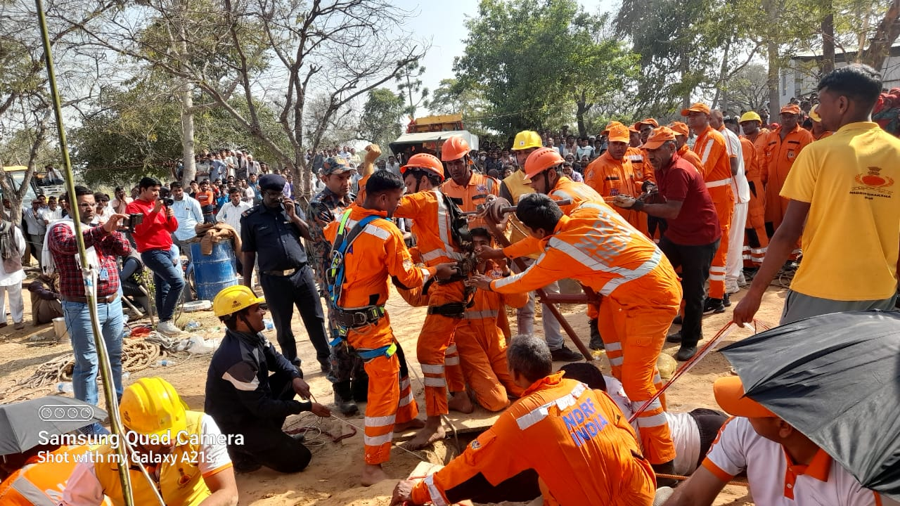
INCIDENT SITE

Slide 14
OPERATION PHASE
Securing the scene
Established command, communication and medical post
Medical assistance for boy
Technical search & locate
Approaching route/procedure
a)use of bore well rescue equipment
b)manually
Extricate of victim

Slide 15
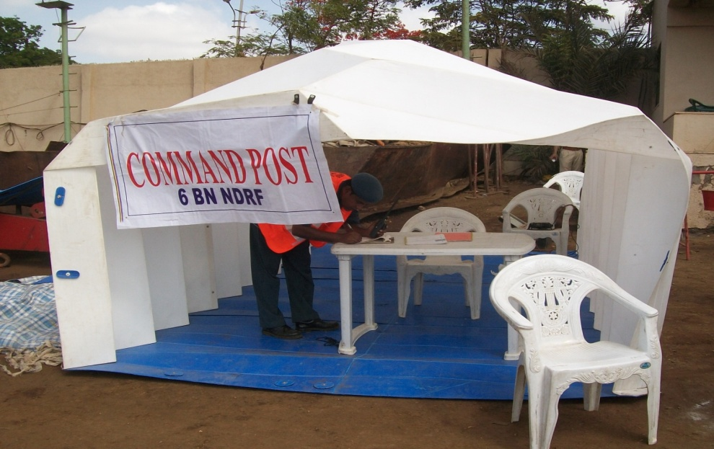
ESTABLISED COMMAND, COMM.& MEDICAL POST

Slide 16
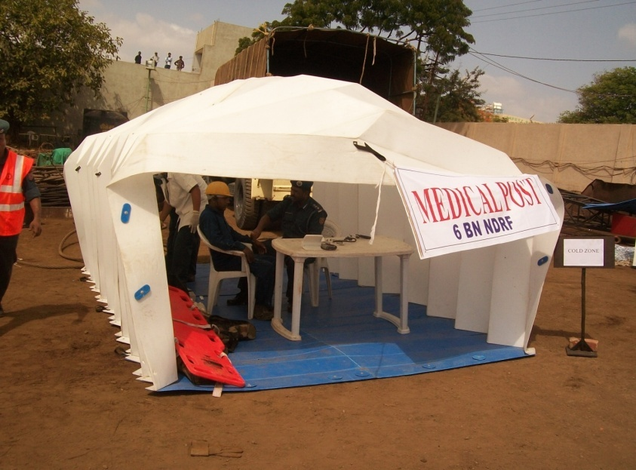
ESTABLISED COMMAND, COMM.& MEDICAL POST

Slide 17
MEDICAL ASSISTENCE
Ravindra was regularly monitor from top of the bore well . Our MFR Team and Govt Hospital Medical Staff khatoo shyam ji were regularly monitoring victim and supply of oxygen continuously giving to victim .Team Commander gives emotional support to victims parents and hid elder sister for safely rescue of Ravindra.

Slide 18
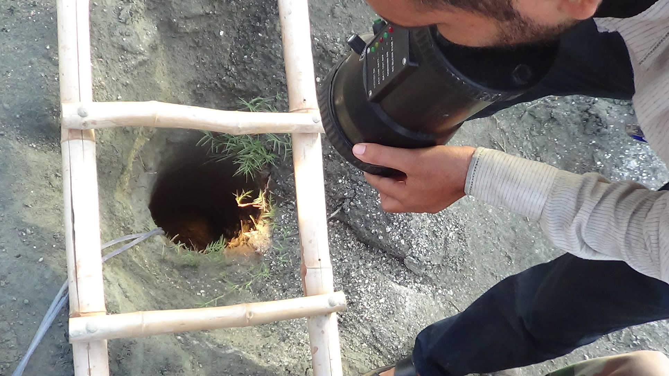
MEDICAL ASSISTENCE
Bore well
Ledar for measurement
Oxygen was supplied with help of two plastic pipe by medical team
Dragon light for watch movement of victim.

Slide 19
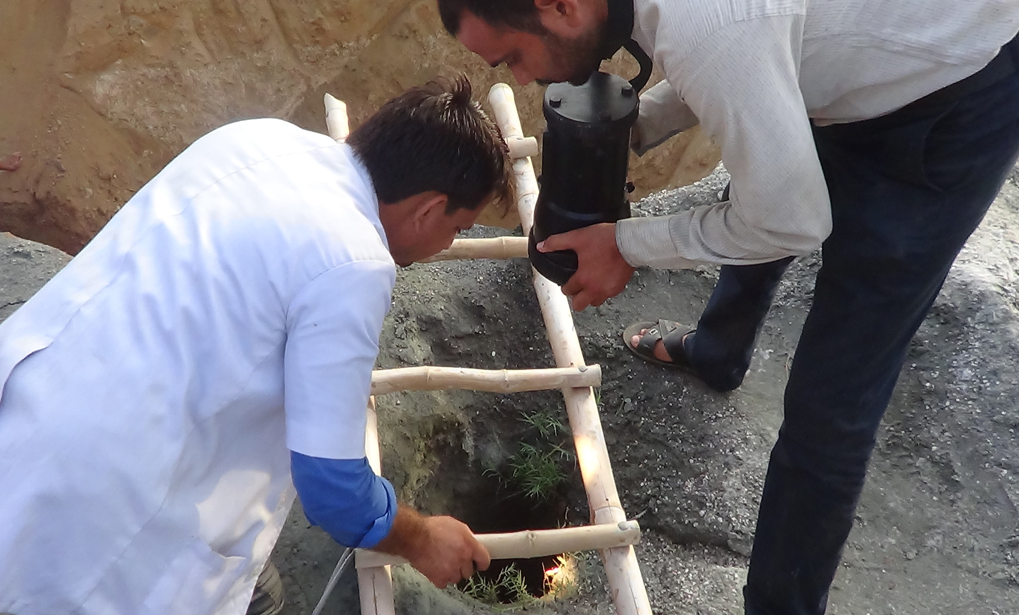
REGULAR MONITORING BY MEDICAL TEAM

Slide 20
TECHNICAL SEARCH AND LOCATE
It was decided by the Team commander to launch a technical search with help of VLC(Victim Locating Camera). A sub team under command Insp Kuldeep Singh started technical search operation with VLC After many efforts, team made approached halfway to the victim with the help of VLC and established verbal and visual contact with victim and assured civil administration to rescue boy safely.

Slide 21
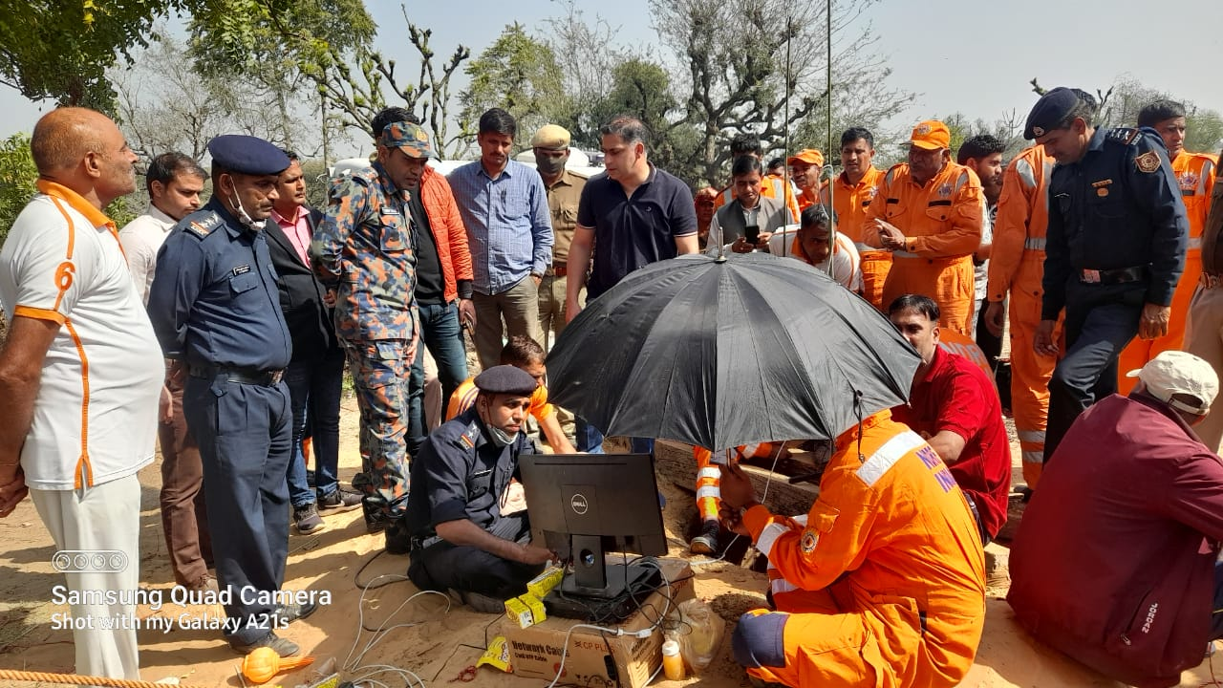
TECHNICAL SEARCH WITH HELP OF VLC

Slide 22
FEEDBACK OF TECHNICAL SEARCH TEAM
According to tech. search Team commander victim is live and in safe condition at about 52 feet depth in bore well and voice of victim also heard through VLC. Team commander ensure for regular oxygen supplied by medical team . The oxygen supplied by one plastic pipes with big oxygen cylinders. According to situation, team commander decided to go for making approach route with the help of man power and ordered to CSSR sub team commander accordingly.

Slide 23
APPROACHING ROUTE/ PROCEDURE
Previous digging approach route was not in proper way which was risky for both i.e rescuer and victim hence Team Commander decided for fresh approach route to victim . A Sub-Team u/c Insp.- Anil Dhadich go for proper digging for approach route pearlier of bore well with the available manpower at about 1610 hrs. Insp Anil Dhadich made a pearlier holl of 5 feet East side from bore well by a manually and gave it a proper approaching way.

Slide 24
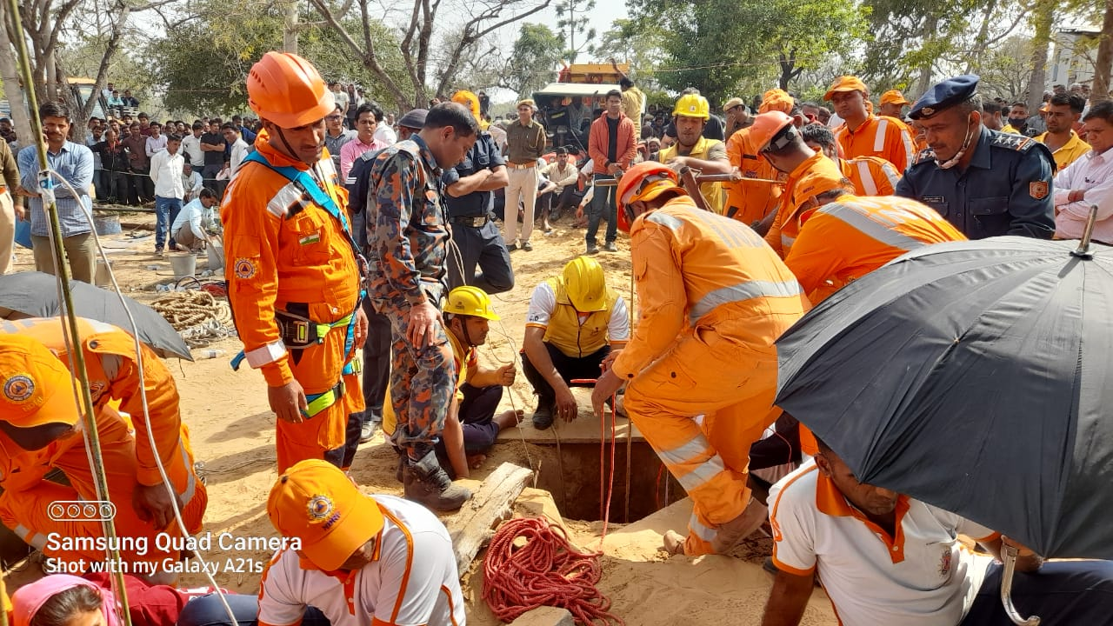
MAKING APPROACH ROUTE

Slide 25
APPROACHING ROUTE/PROCEDURE
A) Use Of Bore Well Rescue Equipment
After reaching the incident site team started rescue ops with camera and bore well rescue equipment. The child was small and genetic disorder down syndrome was not obeying the rescue workers and his parents only used and to do some movement on the words of his sister.

Slide 26
Cont…..
Size of the bore well(wide from the top and bottom to the narrow). Due to being child ,when there is a wide space in the lower side . The child would hide in it due to which the child could not come out of the L type ring and hook type device .

Slide 27
Cont…..
B) Manually
Rescue work was going on with the equipment as well as standing 2.5 feet dia at a distance of 6 feet parallel of the bore well (for vertical 55 feet deep approach the pit was being dug in which after 35-40 feet) iron drum(200 ltr oil) were attached to each other due to loose (soft) soil from welding, tied with ropes in the approach and dinging. The lower most drum was cut U shape to facilitate horizontal approach. After excavating 55 feet to make 6 feet horizontal approach.

Slide 28
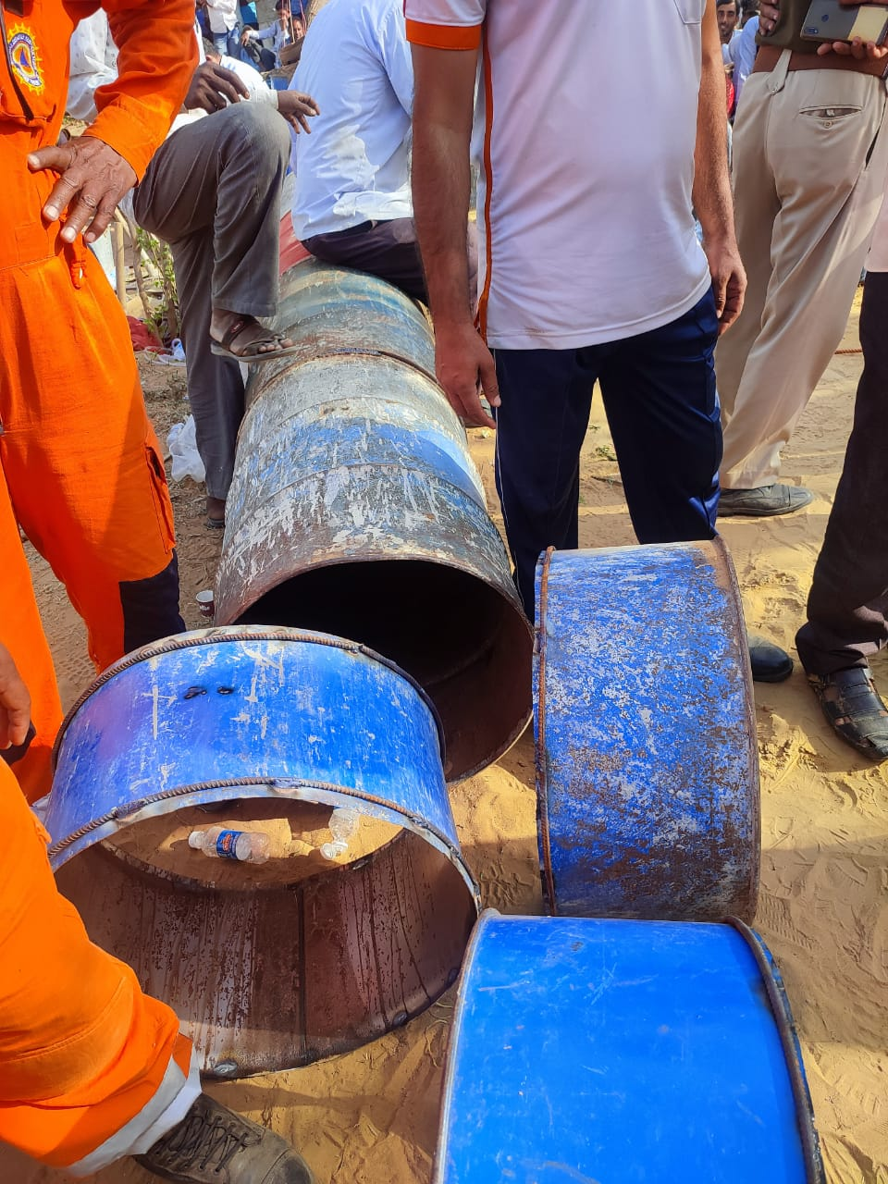
USE OF DRUM FOR MAKING APPROACH

Slide 29
FINAL ACTION OF RESCUE TEAM
Extricate of victim
Finally rescue team reached near the victim and made one small hole in the bore well .This time victim position was upwards from the hole .For safety of victim team inserted crowbar horizontally in the bore well and a drum also inserted on the crowbar, for more safety purpose of victim a wide wooden Board also placed on steel plate .

Slide 30
Cont…..
Now victim was fully safe . After than Rescuers made a big hole upward in bore well & rescue victim Ravinder in supine position. Team rescued victim Ravinder at 1730 hrs on Dated 25/02/022 .

Slide 31
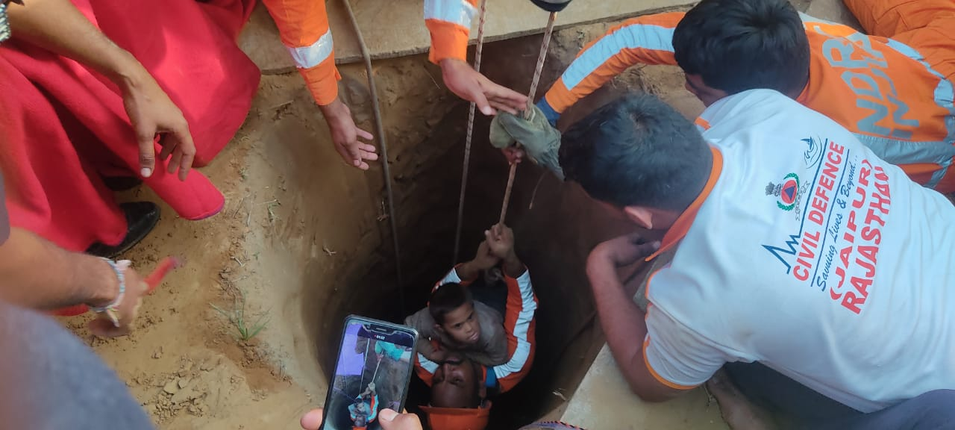
SAFELY RESCUE RAVINDER AND H/O TO CIVIL ADMINISTRATION BY NDRF TEAM.

Slide 32
DEACTIVATION & DEMOBILISA-TION
Team commander confirm no further operation is needed.
Team CQMH account and ensure of all TEA.
Team members account personnel items.
Team arrange and load all eqpts. for transportation and return to coy location Nareli, Ajmer(Raj.).

Slide 33
POST OPERATION ACTIVITIES
Critical Incident Stress Management (CISM) provided by DM sikar for all rescuers and civil administration.
After rescue operation NDRF team went for Medical Physical exam .
NDRF Team completed maintenance and rehabilitation their Equipment after rescue operation.

Slide 34
Cont…..
Team commander debriefed his team after rescue Operation.
After rescue operation team commander submitted report for institutional management i.e In written to Unit HQ , NDMA and Civil Administration .

Slide 35
MEDIA MANAGEMENT
Team commander made a media management after technical search.
Team commander detailed a team for media management under self supervision.

Slide 36
Cont…..
Team commander detailed 02 ORS for media management.
Team commander made Media Management time to time in rescue operation and interview with the press / media about successful rescue ops .

Slide 37
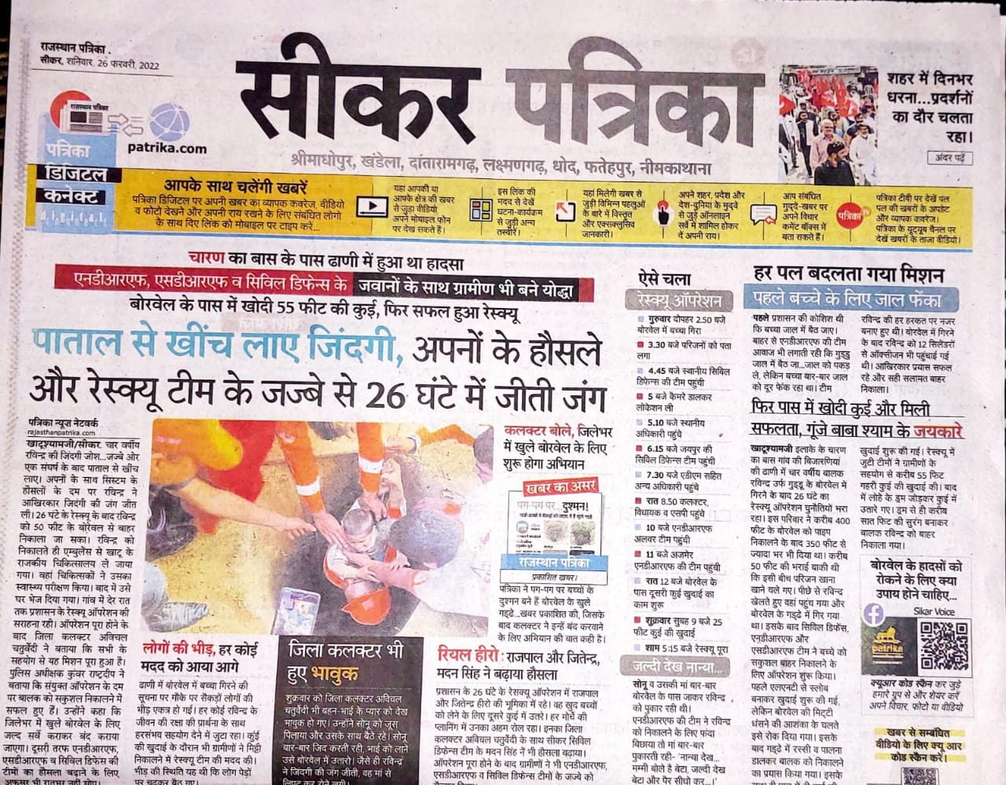
NEWS PAPER CUTTING REG.RESCUE OPS

Slide 38
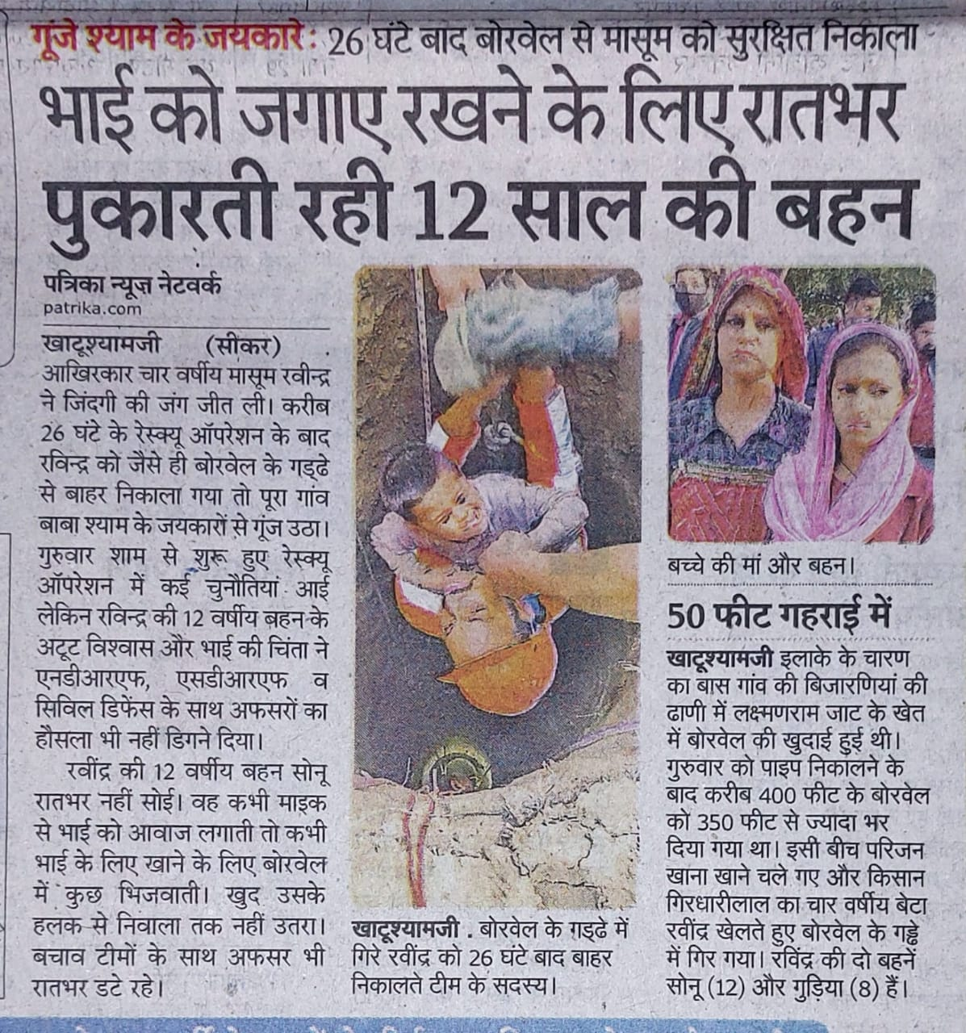
NEWS PAPER CUTTING REG.RESCUE OPS

Slide 39
LESSON LEARNT
The first assessment and quick decision on arrival at the operation site.
No matter how complex the rescue work is but the team struggle ability and determination definitely brings success.

Slide 40
Cont…..
Keeping in mind the luck of complete technical and experience with the local people rescuer always coordinating with them team and leading the NDRF team to large option with a secure cooperation OPS can be successfully complete .

Slide 41
REQUIREMENT/NECESSASITY OF NON AVAILABLE EQPTS
Each team should have at list one dragon light .
The team should have oxygen cylinder and 100m×10mm plastic pipes for providing oxygen to victim.
The team should have a Stair Aluminum Folding for rescue ops.
The team should have a measuring tap for measurement in operation .

Slide 42
Cont…..
Empty barrel should have with team for bore well operation .
Long Chisel nos 06 and medium hammer 06 nos should have in team.
Team should have souring material for soil slide i.e Iron plates /wooden plates size 4 × 4 04 Nos , 3 × 6 =04 Nos.
Air Compressor Rock Breaking Machine.

Slide 43

ANY QUESTION ?

Slide 44


THANK YOU

