Slide 1





CADRE
Lesson 5
Incident Command System
and CQRST
Presented By:- Pavan Dev Gaur,2IC

Slide 2



OBJECTIVES
Define what is an Incident
Identify factors to consider when responding to an incident
Define Incident Command System (ICS)
Describe where Community Response fits in the ICS
Describe and demonstrate Community- Quick Response Sorting Technique (C-QRST)
1
Upon completion of this lesson, you will be able to :-
2
3
4
5

Slide 3


…in the context of emergency response
“An event caused by a natural phenomenon or human activity that requires the intervention of emergency service personnel to prevent or mitigate loss of life and damage to property and the environment”
DEFINITION OF A DISASTER INCIDENT

Slide 4
Day of the week
Time of the day
Weather
Topography
Access routes
Others?
FACTORS TO CONSIDER IN ICS PLAN

Slide 5


BASIC ICS STRUCTURE
Incident Commander
Operations Section Chief
Logistics Section Chief
Planning Section Chief
Administration Section Chief
Community Responder

Slide 6
One of the most challenging situations for a community responder is the MCI.
Any event where three or more injured persons are involved
Exceeds the capabilities of the community resources
Multi Casualty Incident

Slide 7

Multi Casualty Incident

Slide 8
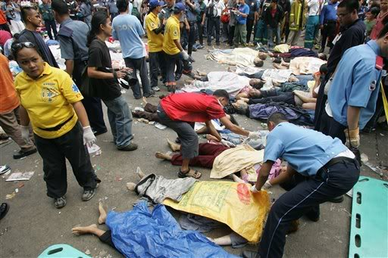
Multi Casualty Incident

Slide 9
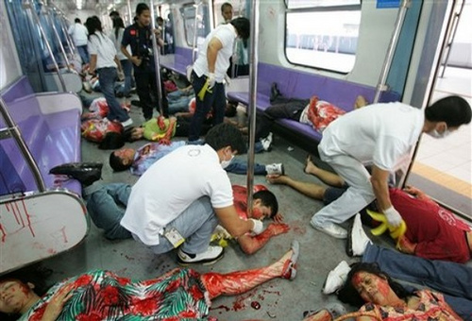
Multi Casualty Incident

Slide 10
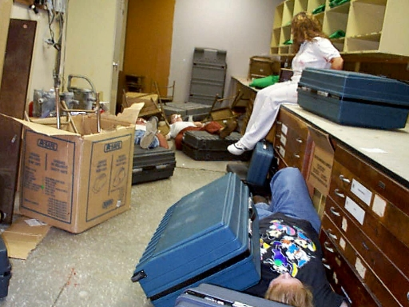
Multi Casualty Incident

Slide 11
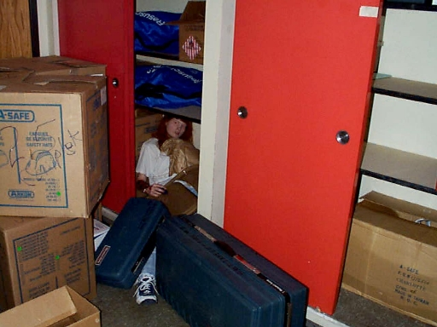
Multi Casualty Incident

Slide 12
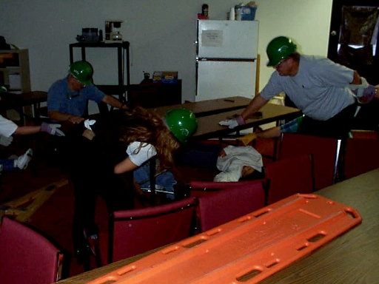
Multi Casualty Incident

Slide 13
A community approach of sorting many injured or ill people during an emergency or disaster.
A preliminary TRIAGE done at the impact site will help professional responders react accordingly once they arrive.
Community - Quick Response Sorting Technique - TRIAGE

Slide 14
No special benchmarks used.
Designed for lay community response.
Quick and easy to do.
No special tags needed.
STRENGTHS OF C-QRST

Slide 15
Re- sorting needed
No identification for dead
WEAKNESSES OF C-QRST

Slide 16
REVIEW
Define what is an Incident
Identify factors to consider when responding to an incident
Define Incident Command System (ICS)
Describe where Community Response fits in the ICS
Describe and demonstrate Community- Quick Response Sorting Technique (C-QRST)
1
Upon completion of the lesson, now you are able to :-
2
3
4
5

Slide 17



THANK YOU

