Slide 1
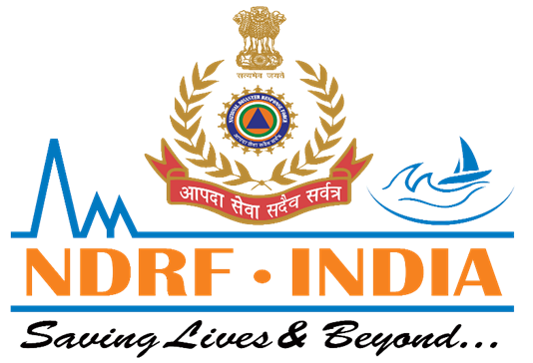

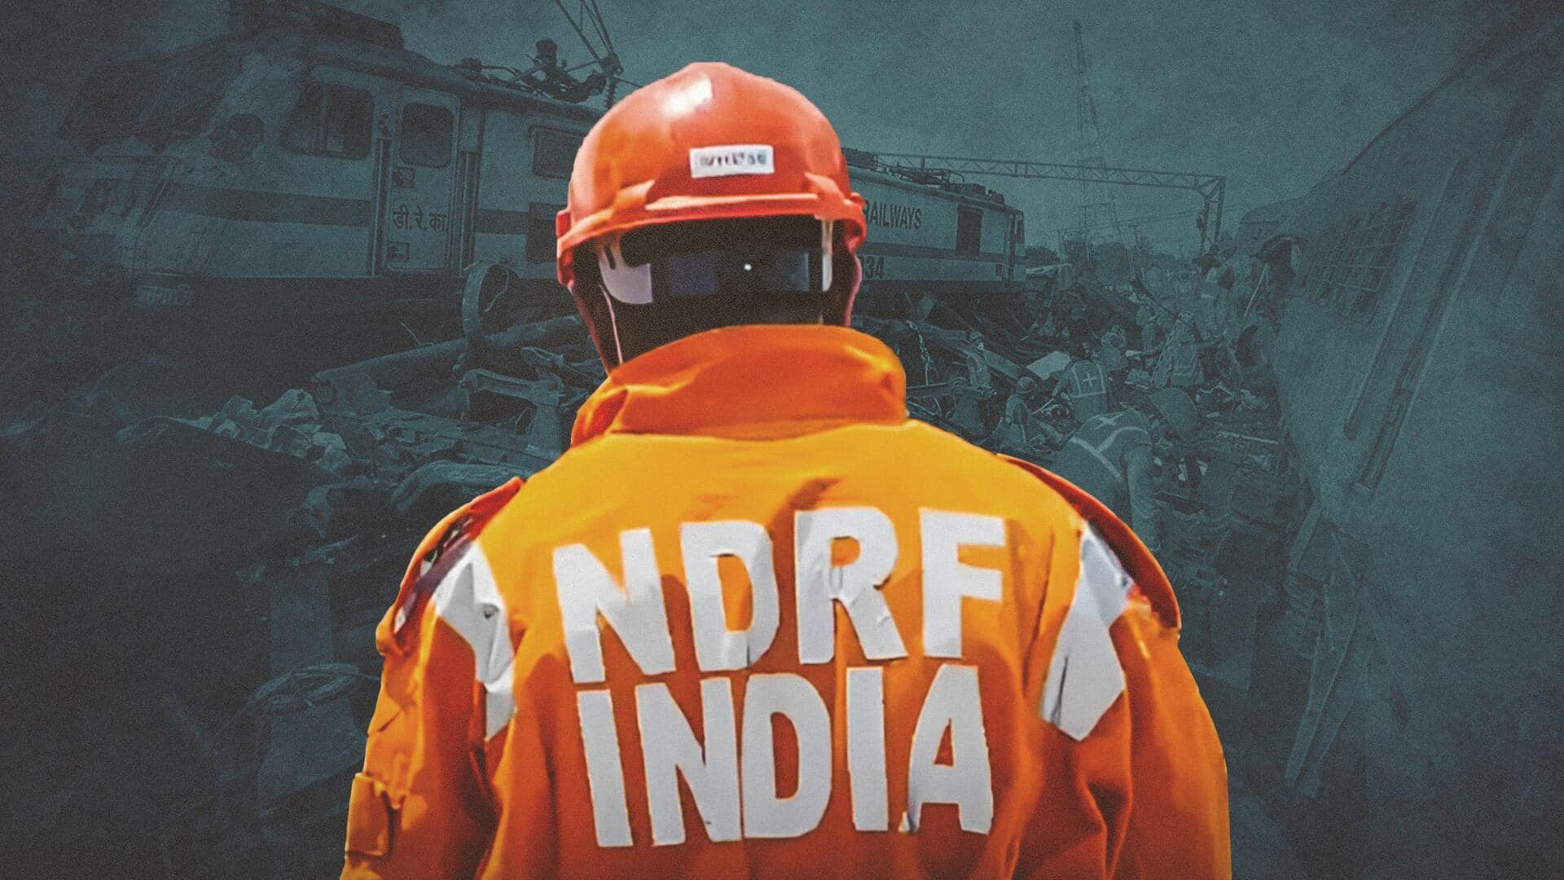

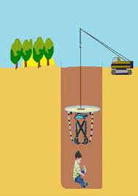
BOREWELL RESCUE
LESSON 05
Borewell Rescue , Heavy Earth Movers, Parallel Digging And Soil Strata
Presented By:- Pavan Dev Gaur,2IC

Slide 2

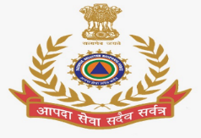
OBJECTIVES
Introduction
Use of Heavy Earth Movers
Heavy Earth Movers main Machines
Parallel Digging Technique
Upon completion of this lesson, you will be able to :-
1
2
3
4

Slide 3
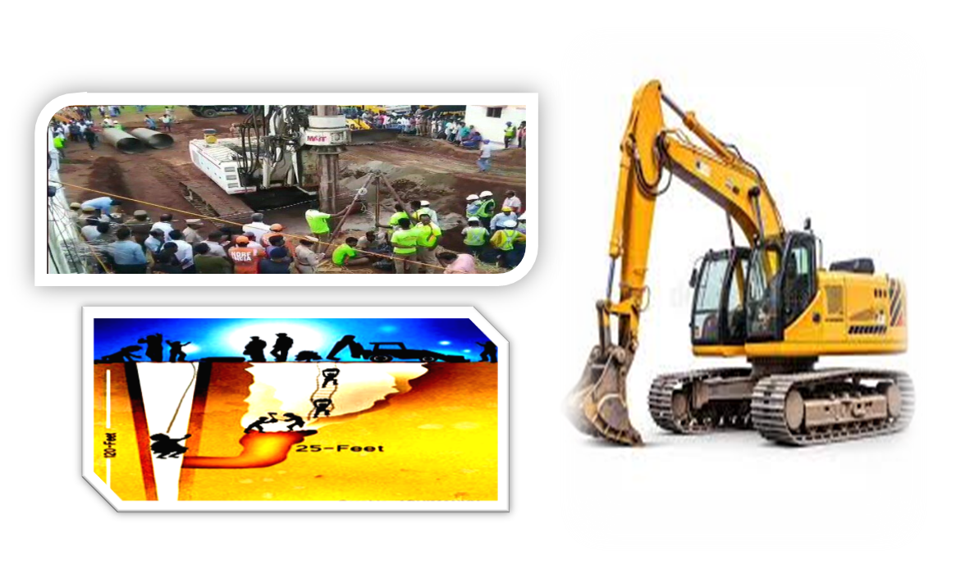
In India, incidents of small children falling into borewells (water wells) occur frequently.
In such a situation, rescue operation is extremely challenging. In this, correct planning, correct use of machines and correct understanding of soil strata are extremely important.
INTRODUCTION

Slide 4
These are machines that are used to remove soil, rocks or debris. These are engaged in :
1. Quick soil removal to save time.
2. Dig a parallel ( side) hole to reach the borewell.
3. Helping in digging big pits.
Heavy Earth Movers:-

Slide 5
Major Machines:
Excavator: Machine for removing and digging soil and stones.
JCB/Backhoe Loader: For digging and removing materials.
Crane: To lower pipes or other rescue equipment.
Dump Trucks: For removal of excavated soil.
Important precautions: The machine must be operated properly so that the vibrations do not harm the borewell and the person trapped in it. Time management is very important as delay in rescue may make it difficult.
Heavy Earth Movers:-

Slide 6
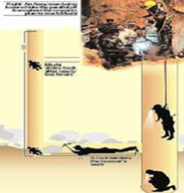

In borewell rescue , parallel digging is often done to save time, i.e. a parallel pit is dug next to the borewell.
Key points in Parallel Digging :
A new pit is dug near the borewell (2-3 feet away).
The depth of the pit is equal to the depth of the person trapped in the borewell
Or it is done a little below.
After reaching the depth, the horizontal tunnel
is made to reach the person.
Parallel Digging Technique

Slide 7
Benefit :
A safer method than extracting it directly from the borewell.
Because the pit is large, there is enough space to work.
Challenges :
The danger of soil collapse during excavation .
It is also important to provide oxygen support over time.
Parallel Digging Technique

Slide 8
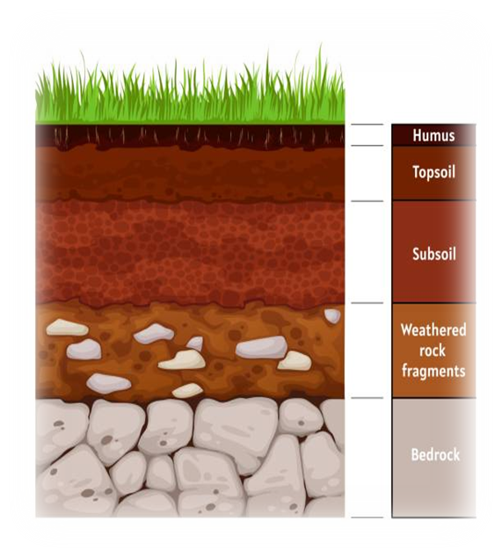
It is very important to have knowledge about soil layers during rescue operation .
Soil Strata is important :
If the soil is sandy then there is a danger of the walls collapsing during digging.
If the soil is hard ( hard soil or rock) , digging takes more time and effort. The type of soil also determines which techniques and tools should be used.
Importance

Slide 9
How to check:
Borehole testing reveals what kind of soil lies at what depth.
The help of old records and geological surveys is taken.
Example: If the top 10 feet of soil is soft, it can be dug quickly. But if there is rock strata below , then drilling machines have to be used.
Importance

Slide 10
Borewell Rescue is a very sensitive and time-tested job. It involves: fast and safe digging with the help of Heavy Earth Movers , creating a safe path to the trapped person through Parallel Digging , and making the digging safe and planned with the knowledge of Soil Strata. Caution, correct technique and team work are necessary at every step to save a precious life.
Conclusion

Slide 11

ANY QUESTION ?

Slide 12
Review
Introduction
Use of Heavy Earth Movers
Heavy Earth Movers main Machines
Parallel Digging Technique
Now you are be able to :-
1
2
3
4

Slide 13
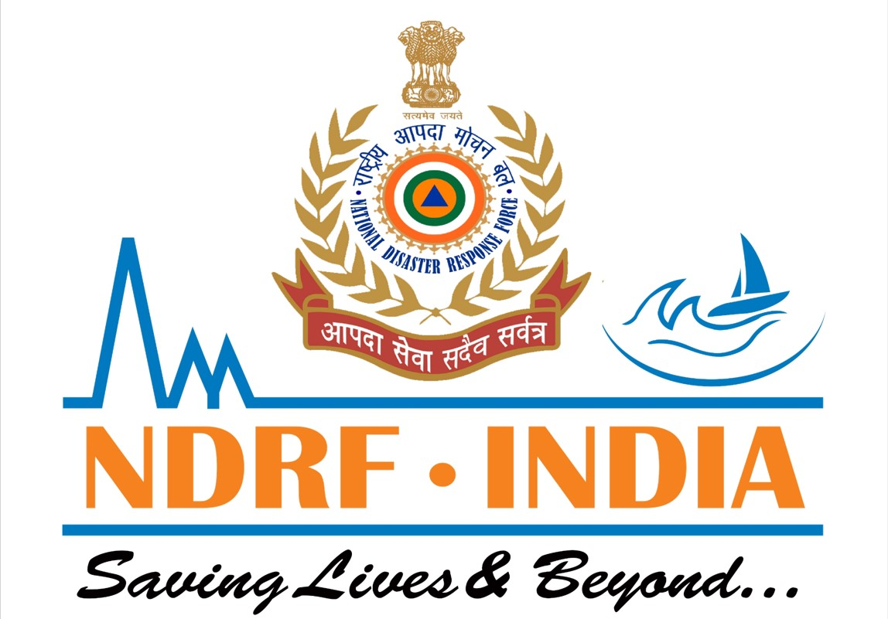
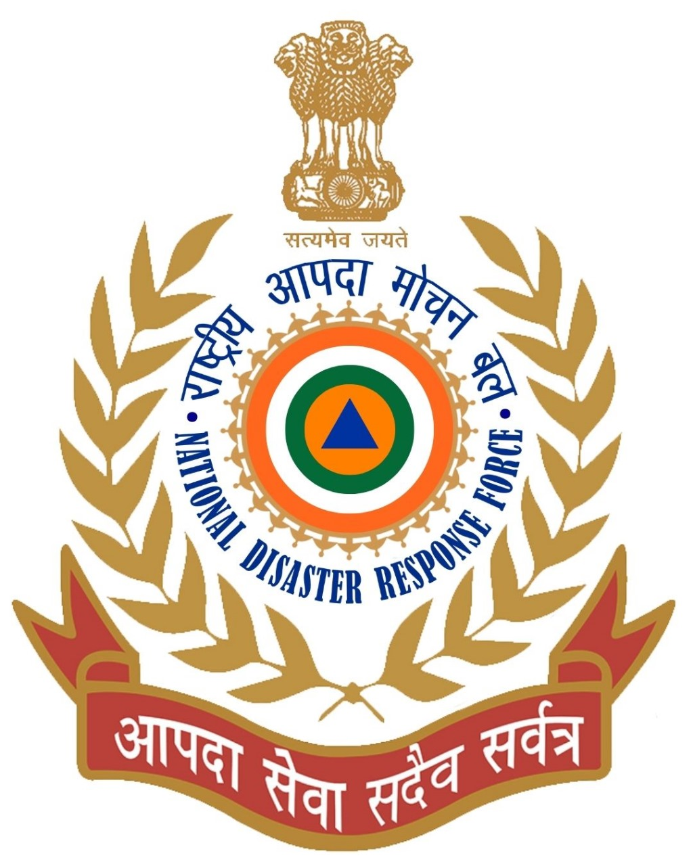

THANK YOU

