Slide 1


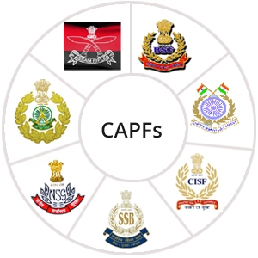

Aquatic Disaster Response Course
LESSON 5
KNOWLEDGE OF TERRAIN &FLOOD
Presented by:- Pavan Dev Gaur, 2IC
CAPF | ADRC | INDIA
-

Slide 2
OBJECTIVES
  Introduction of terrains
  Flood and their causes
  Flood management
  Types of damages
  Knowledge of Weather condition, Camping Ground .
  Knowledge of High and Low Ground.
  Video films on tropical flood situations..
1
Upon completion of this lesson, you will be able to:
2
3
4
5
6

Slide 3

INTRODUCTIONTERRAIN
Definition: Terrain is the term for an area of land. Terrain may include, flat plains, mountains, forests. Terrain.
In physical geography, terrain is the lay of the land. This is usually expressed in terms of the elevation, slope, and orientation of terrain features.
Terrain affects surface water flow and distribution. Over a large area, it can affect weather and climate patterns.
PPT 2 -

Slide 4
INTRODUCTIONTERRAIN
A floodplain is a flat area of land that is located next to a river or stream and is regularly flooded
Some floodplains are extraordinarily wide.
Some rivers have very narrow floodplains.
PPT 2 -

Slide 5
Geology of a Flood plain
There- are two major processes involved in the natural development of floodplains:
Erosion.
Aggradation / alluviation.
A river erodes a floodplain as it meanders, or curves from side to side.
PPT 2 -

Slide 6
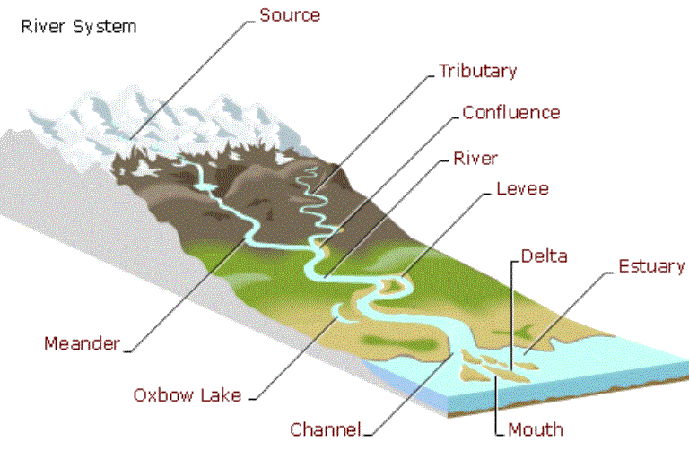
RIVER SYSTEMS
PPT 2 -

Slide 7
RIVER SYSTEMS
There- are two major processes involved in the natural development of floodplains:
Erosion.
Aggradation / alluviation.
A river erodes a floodplain as it meanders, or curves from side to side.
PPT 2 -

Slide 8
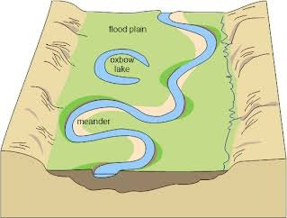
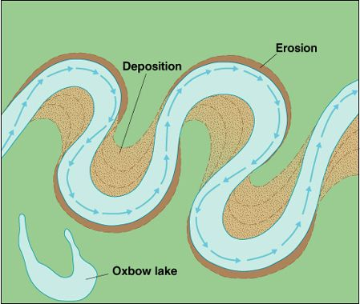
RIVER SYSTEMS
Meander: A meander is a curvy bend in a river or other body of water, often resembling a snake.
Oxbow: An oxbow lake is a U-shaped lake that forms when a river's meander is cut off from the main river, creating a separate body of water
PPT 2 -

Slide 9
TIPS FOR FLOOD IN CHALLENGING TERRAIN AND WEATHER CONDITION
5
Pace yourself
4
Stay hydrated and fueled
3
Know the trail
2
Check the weather
1
Choose the right equipment
PPT 2 -

Slide 10
Floods and cyclones can causes serious damage to property and infrastructure ,including livestock and crop loss, water contamination, increased susceptibility of livestock to disease and erosion.
Condition: Rate of water reception is Greater than the rate of draining out. Thus, accumulation occurs. Beyond a threshold, flood situation occurs, affecting human life.
FLOOD Introduction :
PPT 2 -

Slide 11
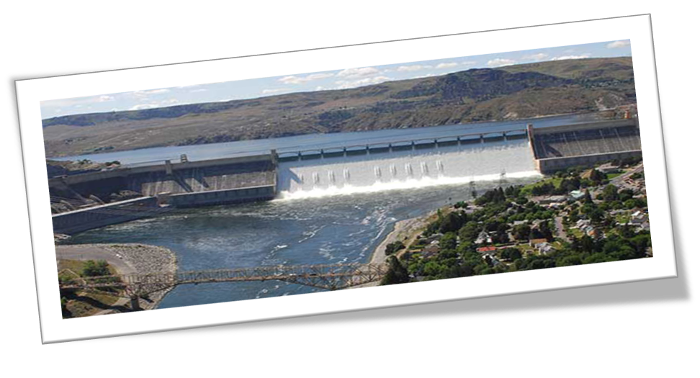
The flood occurs because of heavy rains, or melting of snow or both when the flow in the river is so high that its natural course is unable to contain it.
Apart from the overflow of rivers, the floods may be caused by the failure of some dam, with a sudden release of huge amounts of water, causing considerable damage to life and property.
FLOOD Introduction :
PPT 2 -

Slide 12
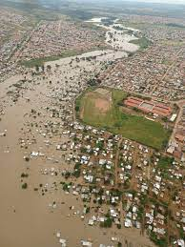
Floods are causing since ages because, major habitation clusters like- towns and cities been located near rivers since the beginning of civilization.
FLOOD Introduction :
PPT 2 -

Slide 13
CATEGORIES OF FLOODS
Flowing Floods
Stationary Floods
There is a fast flowing current coupled with water level rise
There is no current, only water level rises
FLASH
FLOODS
LONG-LASTING
FLOODS
PPT 2 -

Slide 14
Flood is the result of accumulation of water beyond a limit of tolerance.
Ground has a gradient. Gradient decides rate of flow of water.
Soils also have absorption capacities.
When rate of “in-flow” of water exceeds the rate of “out-flow”, accumulation results. We call this a flood.
Flood may be static or flowing.
FLOOD
IT’S Causes & TYPES
PPT 2 -

Slide 15
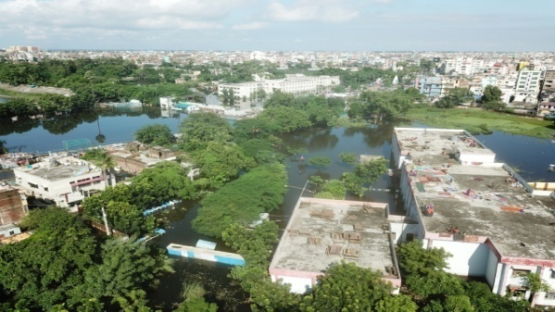
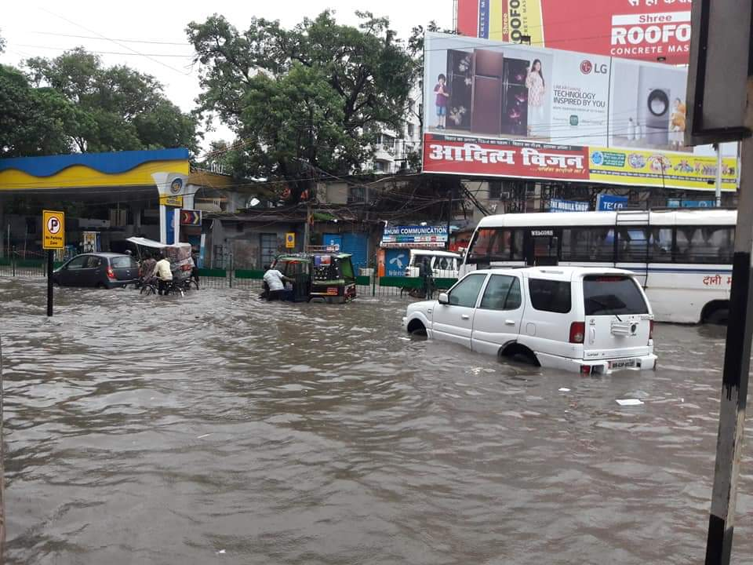
Intensity of rainfall in catchment area
Topography of catchment
Sedimentation of rivers and reservoirs
Obstruction in river flow
Contraction of river Section
Inadequate cross drainage work
FLOOD
IT’S Causes & TYPES
PPT 2 -

Slide 16
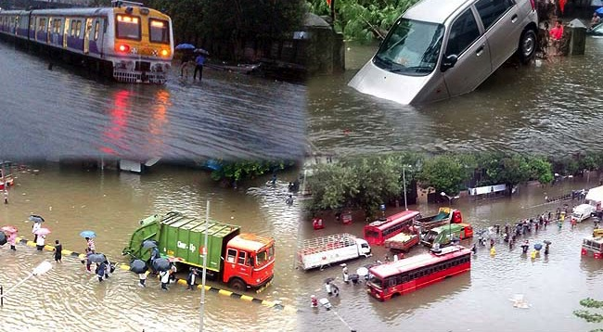
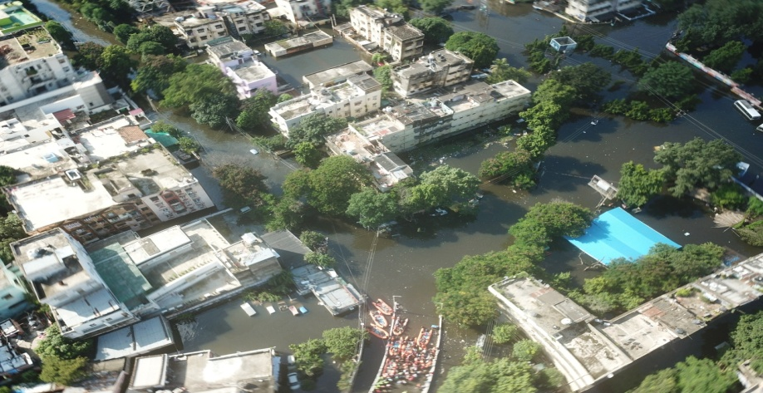
Heavy melting of snow and ice
Failure / Damage of dam
Earthquake / Tsunami
FLOOD
IT’S Causes & TYPES
PPT 2 -

Slide 17
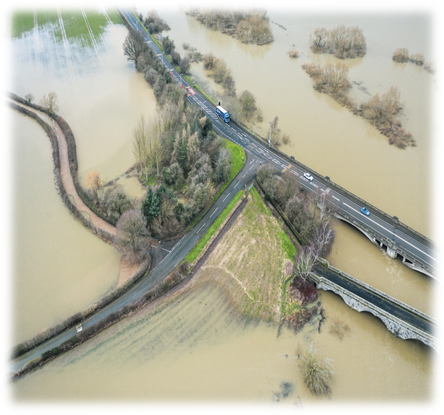
River Flooding
Flash floods
Coastal Flooding
Urban floods
Pluvial floods
Groundwater Flood
Drain and Sewer Flooding
TYPES OF FLOOD
PPT 2 -

Slide 18
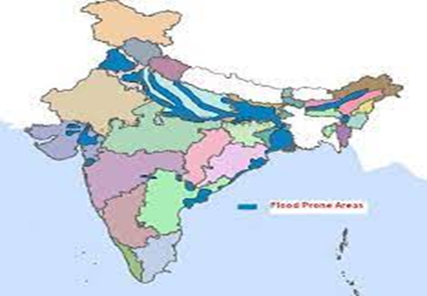
An average every year, 75 lakh hectares of land is affected, 1600 lives are lost and the damage caused to crops, houses and public utilities is Rs. 1805 crores due to floods.
In India, floods are most recurring in the Ganga-Brahmaputra Basin and cyclone often hit the coastal areas surrounding the Bay of Bengal and Arabian Sea.
FLOOD PRONE AREA OF INDIA
PPT 2 -

Slide 19
Rank | Year | Flood Event | States Affected
1 | 1954 | North India Floods | Uttar Pradesh, Bihar
2 | 1970 | Assam Flood | Assam
3 | 1978 | North India Floods | Bihar, West Bengal
4 | 1987 | Bihar Flood | Bihar
5 | 1998 | Gujarat Flood | Gujarat
6 | 2000 | North-East India Flood | Assam, Arunachal Pradesh
7 | 2005 | Mumbai Flood | Maharashtra
8 | 2008 | Kosi Flood | Bihar, Nepal
9 | 2013 | North India Flood | Uttarakhand, Himachal Pradesh
10 | 2018 | Kerala Flood | Kerala
MAJOR FLOOD IN INDIA
PPT 2 -

Slide 20
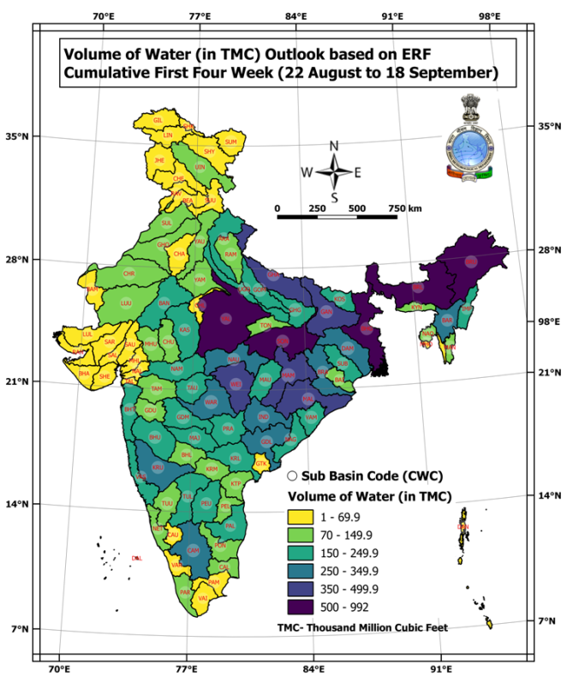
PPT 2 -

Slide 21
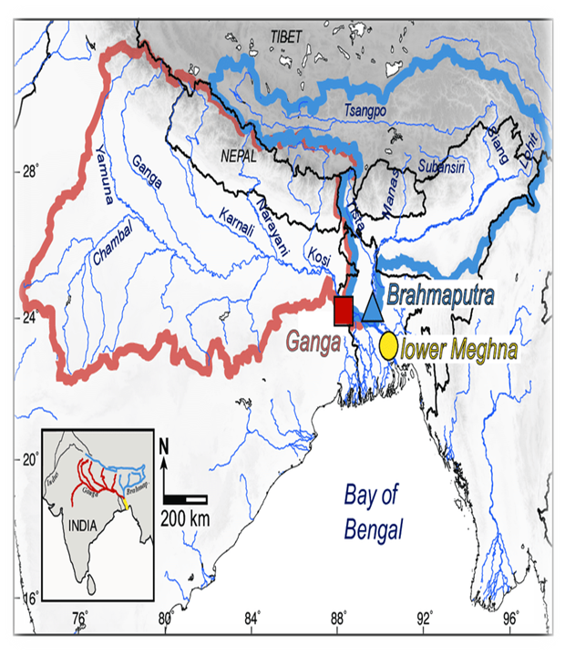
The rivers in India can be broadly divided into the following four regions for a study of flood problems:
Brahmaputra River Region
Ganga River Region
Northwest River Region
Central India and
Deccan Region
RIVERS & FLOOD
PPT 2 -

Slide 22
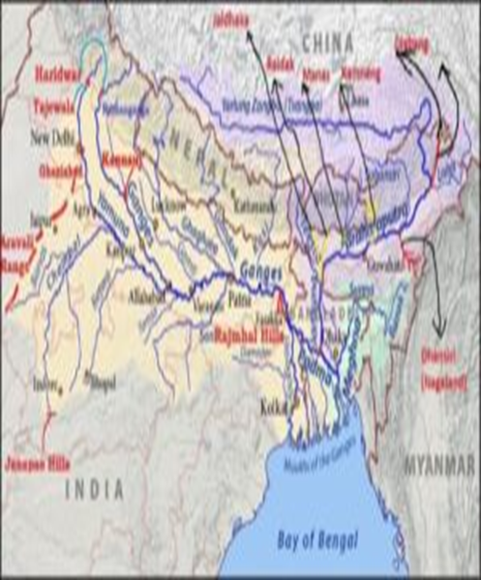
NORTHWEST RIVER REGION
Covers the States of Assam, Arunachal Pradesh, Meghalaya, Mizoram, Northern parts of West Bengal, Manipur, Tripura and Nagaland.
PPT 2 -

Slide 23
BRAHMAPUTRA RIVER REGION
Main rivers in this region are the Sutlej, Beas, Ravi, Chenab and Jhelum, tributaries of Indus, all flowing from the Himalayas.
Region covers the States of Jammu and Kashmir, Punjab, parts of Himachal Pradesh, Haryana and Rajasthan.
PPT 2 -

Slide 24
CENTRAL INDIA & DECCAN REGION
Important rivers in this region are Narmada, Tapti, Mahanadi, Godavari, Krishna and Cauvery
Andhra Pradesh, Karnataka, Tamil Nadu, Kerala, Orissa, Maharashtra, Gujarat and parts of Madhya Pradesh.
Annual rainfall in Western Ghats around 500cm, remaining 75 to 125 cm.
PPT 2 -

Slide 25
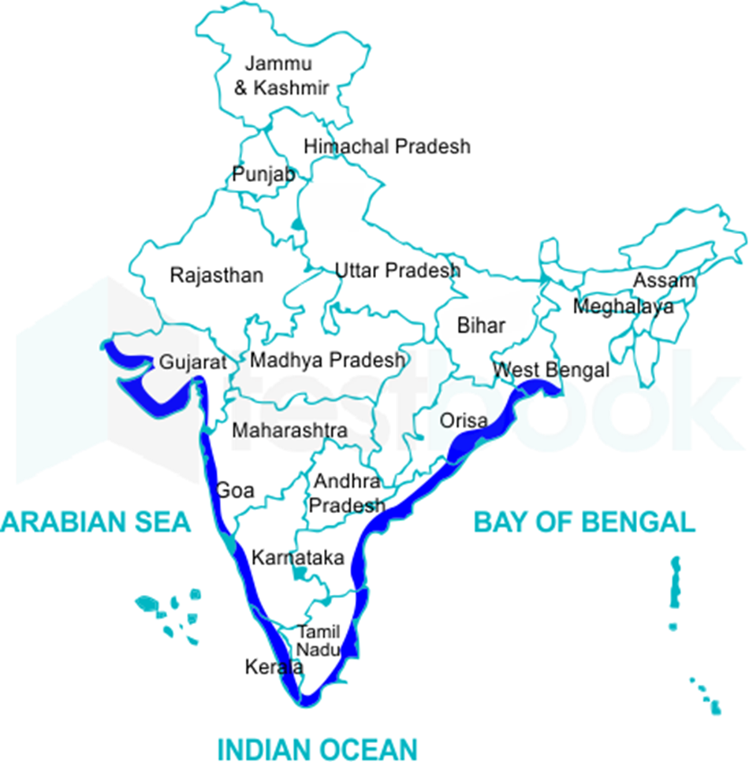
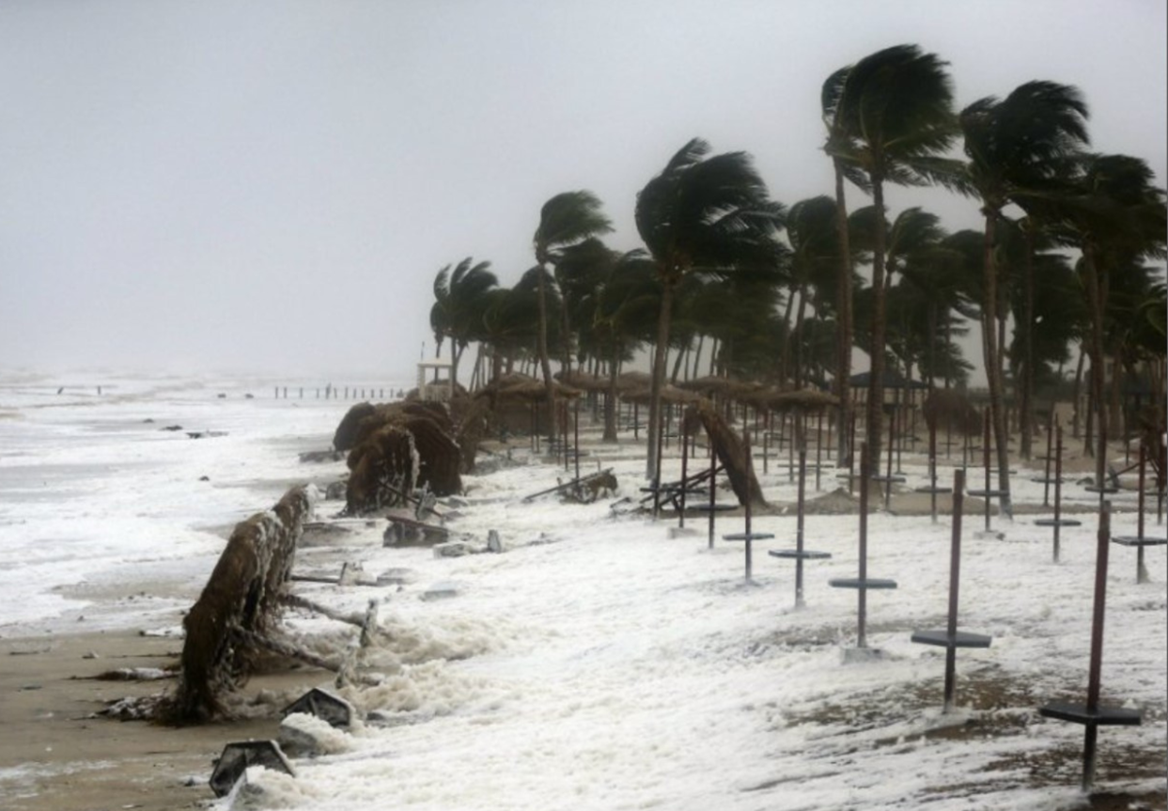
CYCLONIC FLOOD PRONE AREA OF INDIA
PPT 2 -

Slide 26
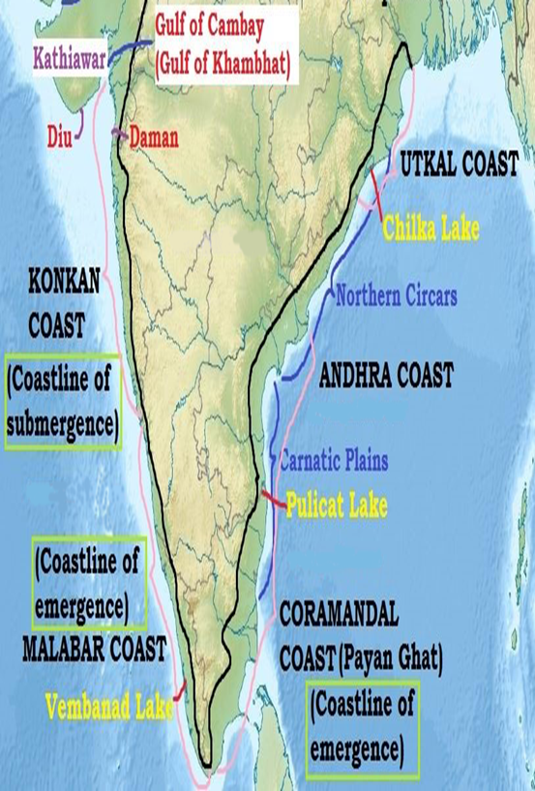
EAST COASTAL REGION
The eastern coastal plains stretch from West Bengal in the north to Tamil Nadu in the south and pass through Andhra Pradesh and Odisha.
Deltas of the rivers Mahanadi, Krishna, Godavari and Cauveri are present in the eastern coastal plain.
PPT 2 -

Slide 27
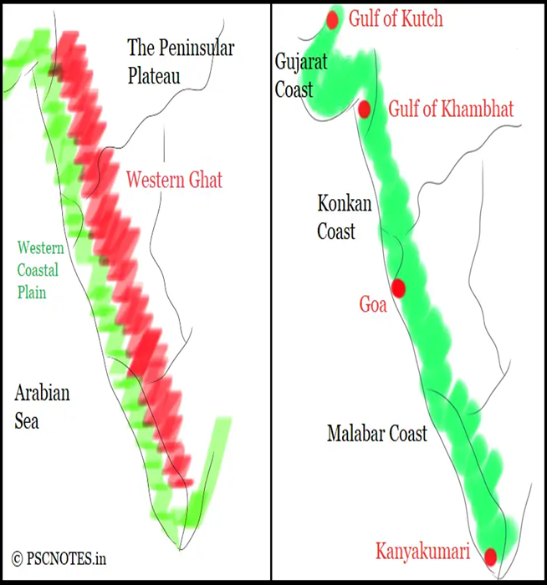
WEST COASTAL REGION
It includes the states of Gujarat, Maharashtra, Goa, Karnataka, Kerala, and Tamil Nadu.
The region consists of three sections: the Northern part of the coast is called the Konkan (Mumbai to Goa), the central stretch is called the Kanara or the "Karavali", while the southern stretch is referred to as the Malabar Coast.
PPT 2 -

Slide 28
FLOOD CONTROL MEASURE
Construction of protective works
Reduction of flood flows by storage
Modifying the susceptibility to flood damage
Soil conservation in catchment area
PPT 2 -

Slide 29
PROBLEMS OF FLOOD MANAGEMENT
Incessant heavy rainfall in particular area
Climate change
Population
Sudden change of river course
Uncontrolled and unplanned expansion of the town
Encroachment
Old drainage system
Improper Solid Waste Disposal
Lack of relief shelters
PPT 2 -

Slide 30
MITIGATION MEASURES
Embankments constructed parallel to river bank to continue the river water within a specified section.
Increase the discharge or velocity of stream or to decrease the stage and duration of flood
Increase in size of cross section by widening and excavating stream bed.
Increasing velocity by smoothing river bed.
Diversion method
PPT 2 -

Slide 31
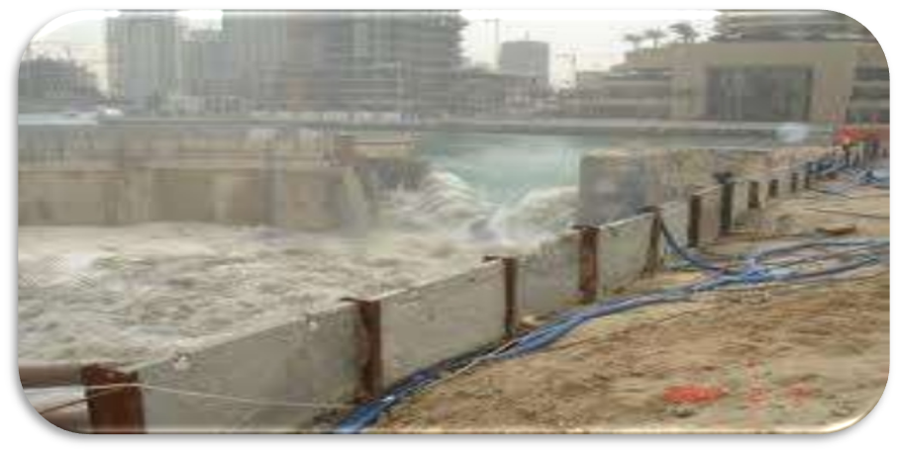
MITIGATION MEASURES
Flood wall: Concrete walls constructed just on the river bank.
Levees/ Embankments : An earth dyke or embankment used for flood control. River side protected by stone pitching and country side protected by turfing.
PPT 2 -

Slide 32
FLOOD MANAGEMENT
Installation and Implementation of Early Warning and alert System - SMS or App based alert
Identification of low lying and high raised places.
Preparedness of local authorities with rescue materials (bottles, ropes, thermocoal boats)
Distribution of first-aid material to community.
Broadcast of radio/TV news
Arrangement of temporary shelters
Flood Area Survey.
House Damage Survey
PPT 2 -

Slide 33
FLOOD MANAGEMENT
Monitor local television and radio stations
Evacuation of senior citizens, ladies, kids, sick people and livestock to higher places/ shelters
Government emergency relief operations
Water level monitoring and receding status.
Assessment (Quick and detailed) of Loss to Life and property.
PPT 2 -

Slide 34
FLOOD MANAGEMENT
Placement of Resources in flood affected area.
Pre-Hospital Technique (PHT) in case of drowning case.
Identify / Earmark the safe place / alternative place in case of flood.
Public to sensitize about previous flood situation
Availability of filtered drinking water
Early warning
Psycho Social Care to local population
PPT 2 -

Slide 35
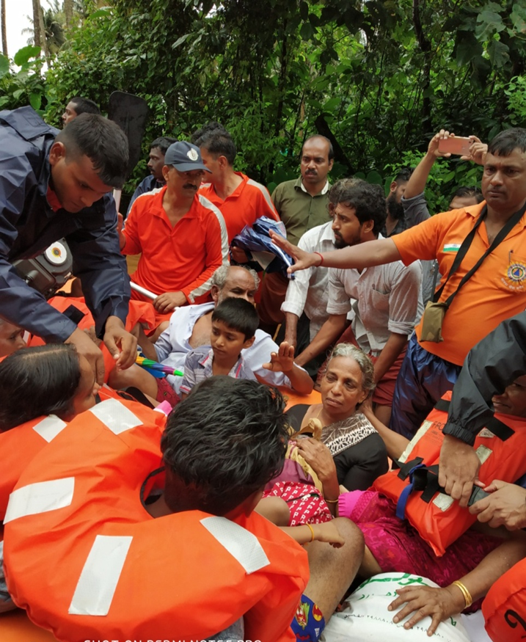
TYPES OF DAMAGES
Tangible
Direct
Indirect
2) Intangible
PPT 2 -

Slide 36
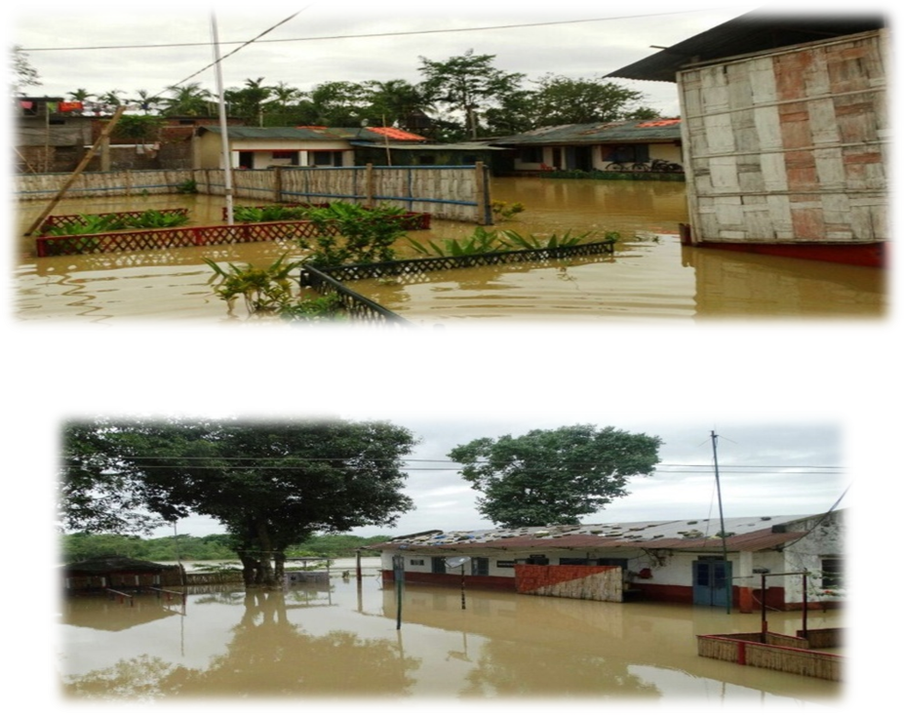
IMPACT OF FLOOD
Evacuation of Civil population & livestock.
Capsizing of boats / Drowning incident.
Snake Bite.
Impurity of water
PPT 2 -

Slide 37
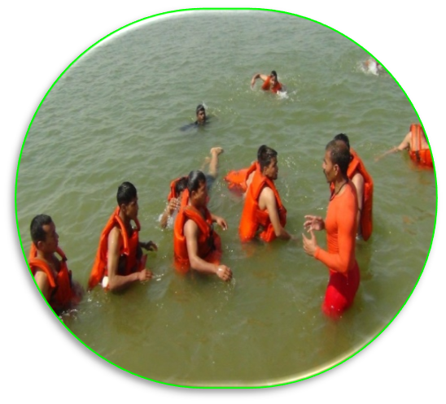
PREPARATION OF RESCUE AND RELIEF IN FLOOD
Rescuer should be trained in swimming as well as flood rescue techniques.
Every rescuer should know the handling and trouble shooting of Boat and OBM.
Use of improvised equipment's and modern equipment's.
PPT 2 -

Slide 38
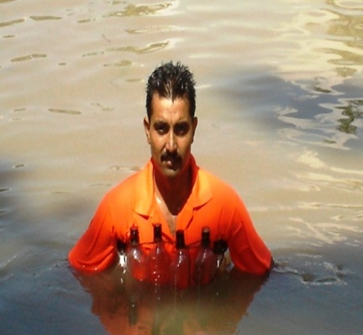
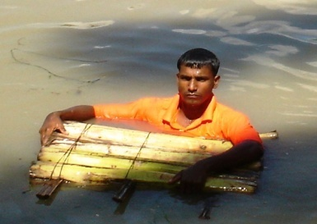
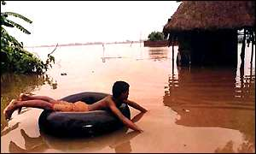
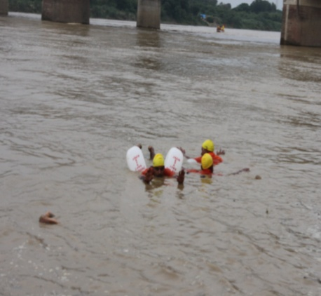
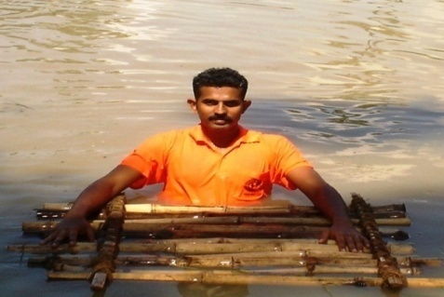
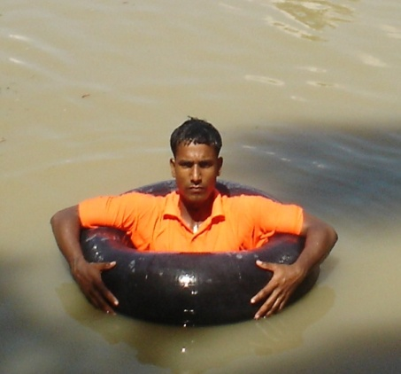
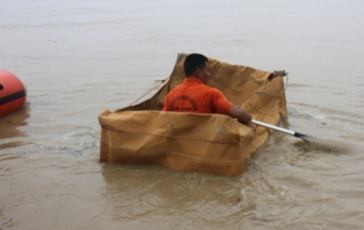
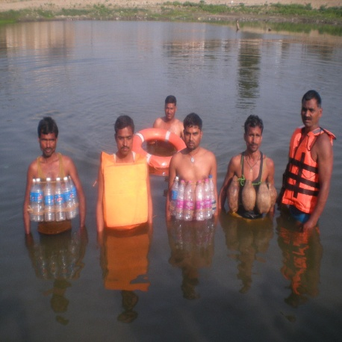
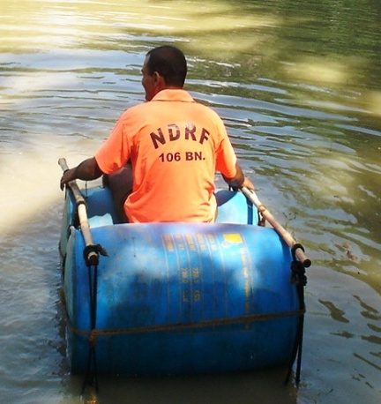
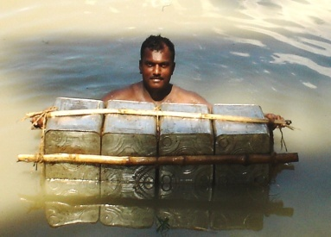
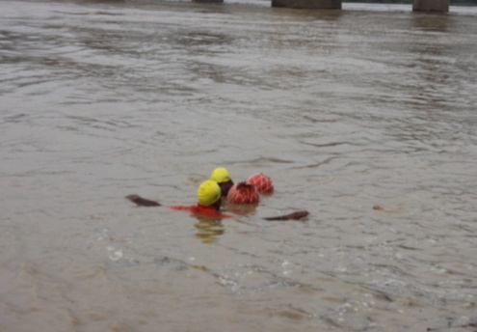
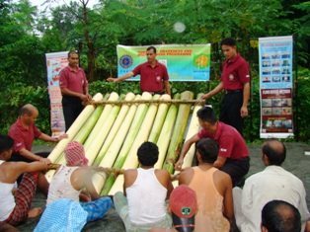
TRG ON IMPROVISED RAFTS
PPT 2 -

Slide 39
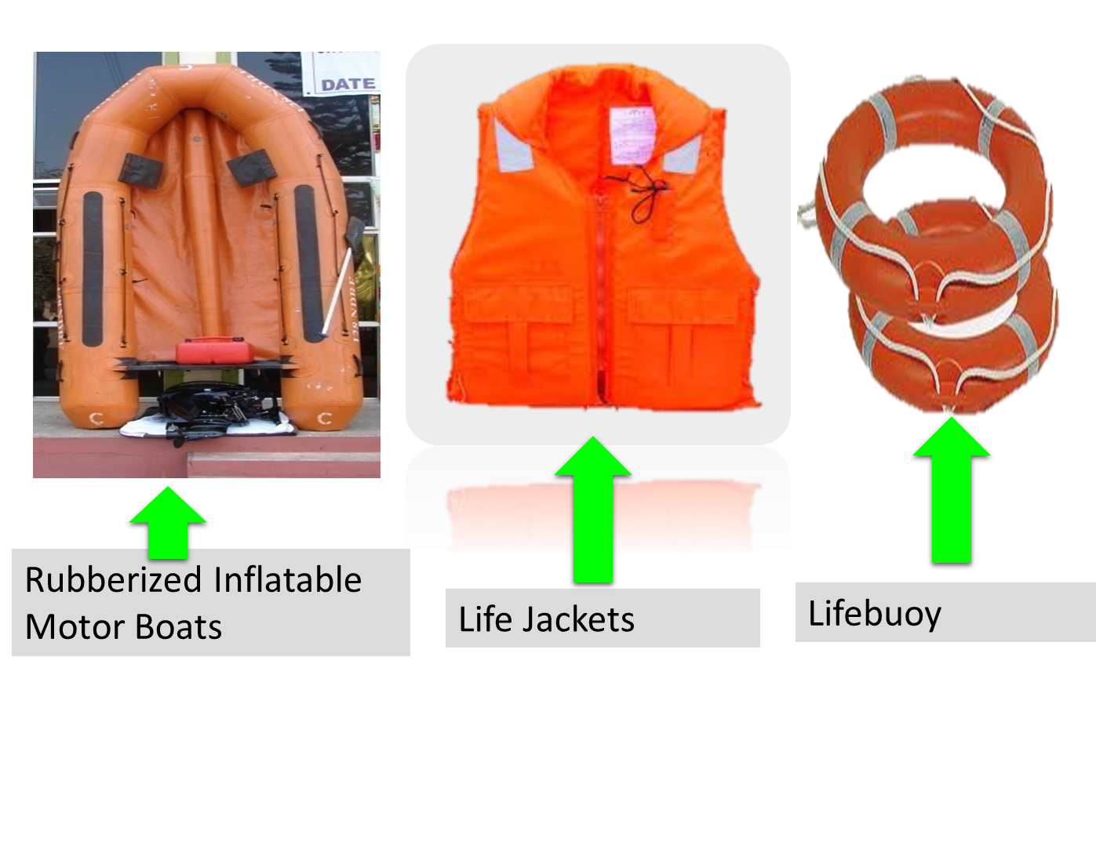
SUGGESTIVE RESOURCES
PPT 2 -

Slide 40
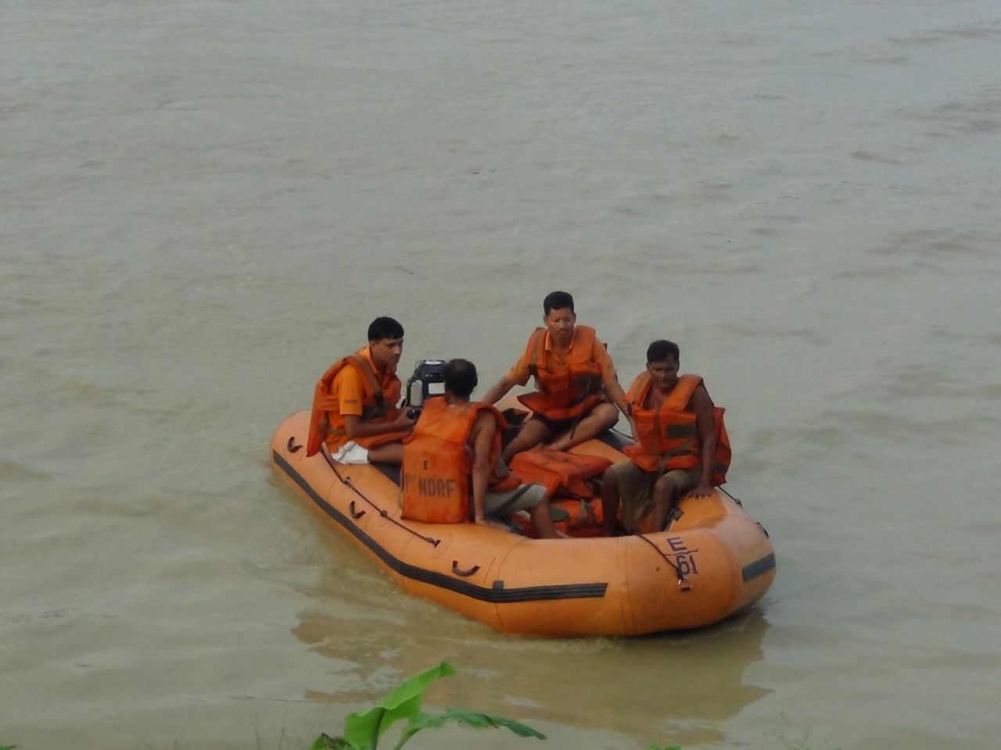
USE SAFETY ITEMS PROPERLY
PPT 2 -

Slide 41
USE OF INFO TECHNOLOGY
Constant monitor IMD Alert / Website.
Mobile Nos of senior officials may be registered to receive IMD Alert.
Emergency Operation Centre may constantly monitor these updates and further appraise to concern Comdrs.
PPT 2 -

Slide 42
DURING FLOOD
If evacuated secure your property
Take only necessities with you
Do not cross flooded areas on foot or vehicle
Collaborate with public safety bodies
PPT 2 -

Slide 43
AFTER THE FLOOD
Keep calm, do not panic
Check for injured and if possible help them
Listen to radio, TV. Use telephone sparingly
Collaborate with rescue and assistance services.
Collaborate in identification of bodies.
Make yourself available to help with rehabilitation work.
PPT 2 -

Slide 44
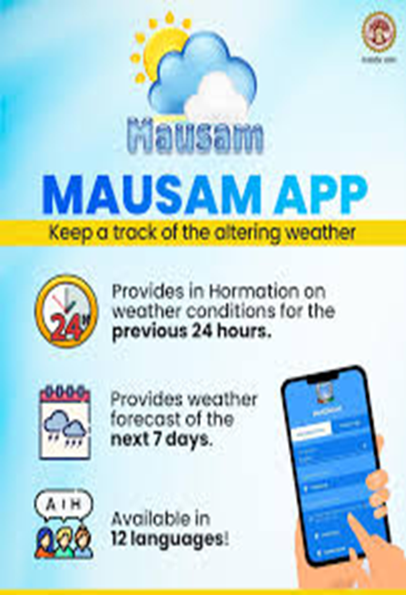
KNOWLEDGE OF WEATHER CONDITION
The India Meteorological Department (IMD) is the primary government agency responsible for providing weather information, including rainfall, cyclone, and wind forecasts in India. Their official website and the MAUSAM app are the primary sources for this information.
PPT 2 -

Slide 45
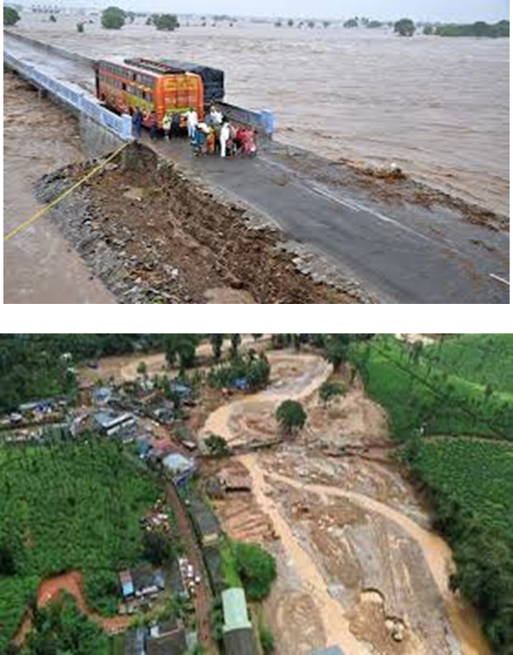
KNOWLEDGE OF CAMPING GROUND
Avoid Low Lying Areas
Seek Higher Ground
Check for Drainage
Stay Away from Damaged Infrastructure
Watch for Debris Path
PPT 2 -

Slide 46
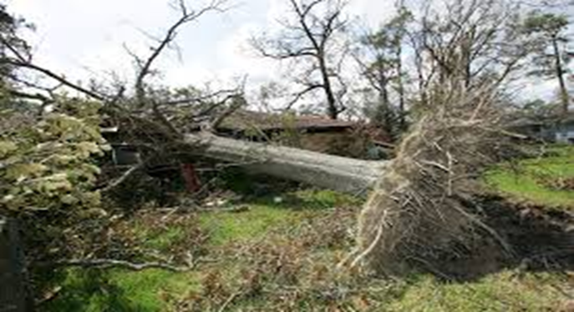
KNOWLEDGE OF CAMPING GROUND
Avoid Low Lying Areas
Seek Higher Ground
Check for Drainage
Stay Away from Damaged Infrastructure
Watch for Debris Path
PPT 2 -

Slide 47
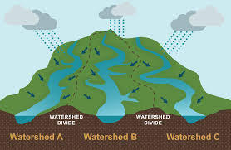

KNOWLEDGE OF HIGH AND LOW GROUND
Floodwater Flows to Low Ground:- Low ground collects water quickly, increasing risk of drowning or being swept away.
High Ground Offers Safety:- High areas are safer Shelter, Evacuation routes & Rescue operations.
PPT 2 -

Slide 48
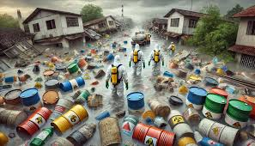
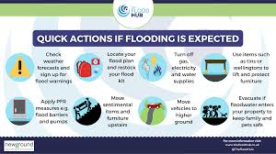
KNOWLEDGE OF HIGH AND LOW GROUND
Faster, Smarter Evacuation:- If you know where the nearest high ground is, you can escape danger faster.
Better Planning and Decision-Making:-Helps you, Pick safe places to camp or take shelter.
Avoid Traps and Hazards
PPT 2 -

Slide 49
Review
  Introduction of terrains
  Flood and their causes
  Flood management
  Types of damages
  Knowledge of Weather condition, Camping Ground .
  Knowledge of High and Low Ground.
  Video films on tropical flood situations..
1
Now You are able to define:
2
3
4
5
6

Slide 50


THANK YOU

