Slide 1





COLLAPSED STRUCTURE SEARCH AND RESCUE
LESSON 1
COURSE INTRODUCTION
LESSON 2
Organizing and Starting
a CSSR Operation
Tools and Location Techniques
Presented by:- Kamlesh Dhoundiyal, 2IC
NDRF | CSSR | INDIA
PPT 7-1

Slide 2
OBJECTIVES
Upon completing this lesson, you will be able to:
1
Define tools, equipment and accessories (TEA).
List four categories of TEA according to their use.
List five power sources for equipment and tools.
2
3
PEER | CSSR | INDIA
PPT 7 -
NDRF | CSSR | INDIA

Slide 3
OBJECTIVES
Upon completing this lesson, you will be able to:
4
List the general steps for use and maintenance of tools and equipment (before, during and after their use).
Demonstrate in four practical exercises the correct use of TEA.
5
PEER | CSSR | INDIA
PPT 7 -
NDRF | CSSR | INDIA

Slide 4
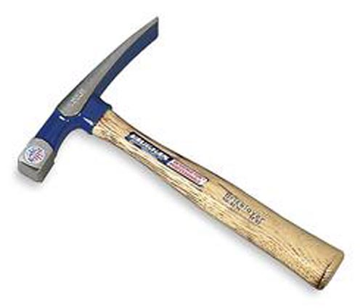
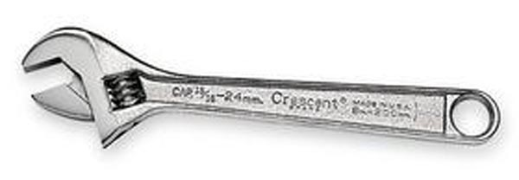
Tool
A device that is used to perform or facilitate manual or mechanical work, using only the strength of the operator.
PEER | CSSR | INDIA
PPT 7 -
NDRF | CSSR | INDIA

Slide 5

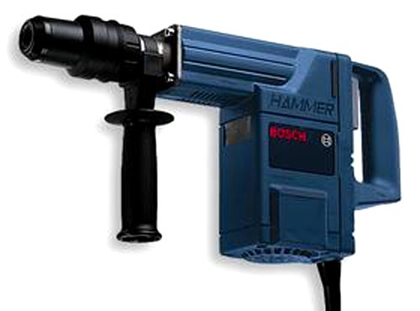
Equipment
A machine or device that performs
a physical task, whose operation depends on an outside power source in order to increase work capacity.
PEER | CSSR | INDIA
PPT 7 -
NDRF | CSSR | INDIA

Slide 6
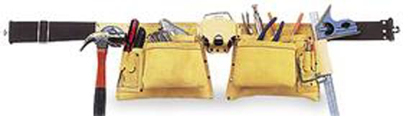
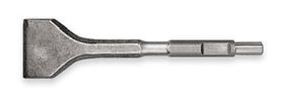
Accessory
A component that supplements or completes a tool or piece of equipment, and which increases the operator’s ability to perform a task.
PEER | CSSR | INDIA
PPT 7 -
NDRF | CSSR | INDIA

Slide 7
Classifying TEA by Use
1
2
3
4
Search
Rescue
Operations support
Personal protection
PEER | CSSR | INDIA
PPT 7 -
NDRF | CSSR | INDIA

Slide 8
Classifying TEA by Power Source
1
2
3
4
5
Electric
Pneumatic (air)
Internal combustion
Hydraulic
Other: mechanical advantage, etc.
PEER | CSSR | INDIA
PPT 7 -
NDRF | CSSR | INDIA

Slide 9
Use and Maintenance
Before
PPE, verify fuel/power source
During
proper operation
After
cleaning/maintenance
PEER | CSSR | INDIA
PPT 7 -
NDRF | CSSR | INDIA

Slide 10
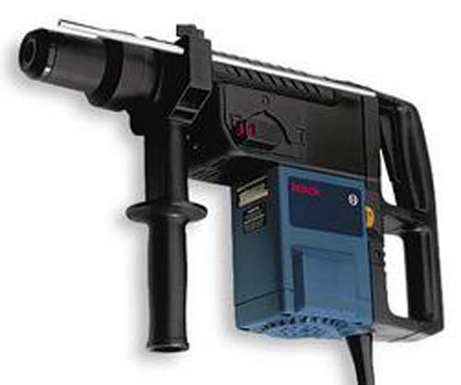

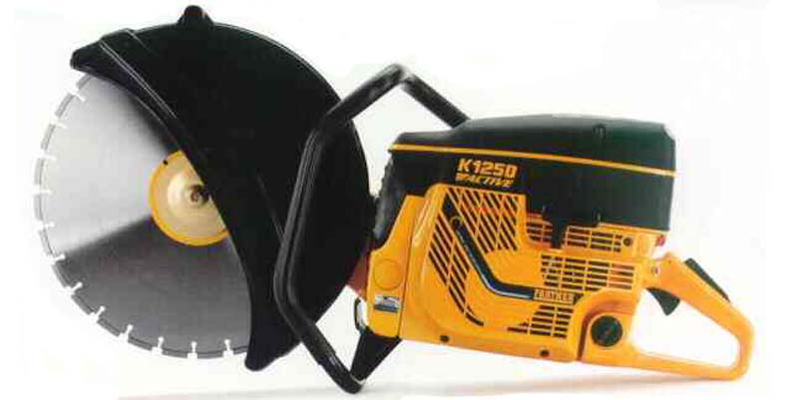
Before using
power tools,
read manufacturer’s instructions
PEER | CSSR | INDIA
PPT 7 -
NDRF | CSSR | INDIA

Slide 11

Define tools, equipment and accessories (TEA).
List four categories of TEA according to their use.
List five power sources for equipment and tools.
List the general steps for use and maintenance of tools and equipment (before, during and after their use).
Demonstrate in four practical exercises the correct use of TEA.
REVIEW

Slide 12

ANY QUESTION ?

Slide 13
1.How many types we can classify the tools in to according to their use?
Ans- 04 Types
EVALUATION

Slide 14
THANK YOU

