Slide 1




CBRN Module: CAPF
LESSON 05
Nuclear reactor in India
Presented by:- Pavan Dev Gaur, 2IC

Slide 2

OBJECTIVES
- Overview of Indian Nuclear Power Program
- Types of Nuclear Reactors & Principles
- Safety Systems in Nuclear Power Plants
- Nuclear Power Plant Emergencies
- Emergency Response: Onsite & Offsite
- Role of NDRF during NPP Emergencies
Review
Upon completing of this lesson, you will be able to :-

Slide 3
Nuclear power is a key component of India's energy strategy, offering a stable, low-carbon electricity source. With 24 reactors across 9 plants and a growing role in the national grid, India emphasizes stringent safety and regulatory oversight. This lesson equips first responders with essential knowledge of nuclear reactors, their operation, safety systems, and emergency response protocols.
INTRODUCTION

Slide 4
- Low-carbon energy source through nuclear fission
- India: 24 reactors, 8180 MW capacity (Nov 2024)
- 5th largest electricity source in India
- Regulated by AERB; operated by NPCIL
INTRODUCTION TO NUCLEAR ENERGY

Slide 5
- Atomic Energy Commission - 1948
- DAE formed in 1954 under Dr. Homi Bhabha
- Commercial program began with TAPS in 1969
DEVELOPMENT OF INDIAN NUCLEAR PROGRAM

Slide 6
3-STAGE INDIAN NUCLEAR POWER PROGRAM
- Stage 1: PHWRs (Natural Uranium)
- Stage 2: FBRs (U-238 to Pu-239)
- Stage 3: Thorium Reactors (U-233)
- Closed fuel cycle ensures high fuel efficiency

Slide 7
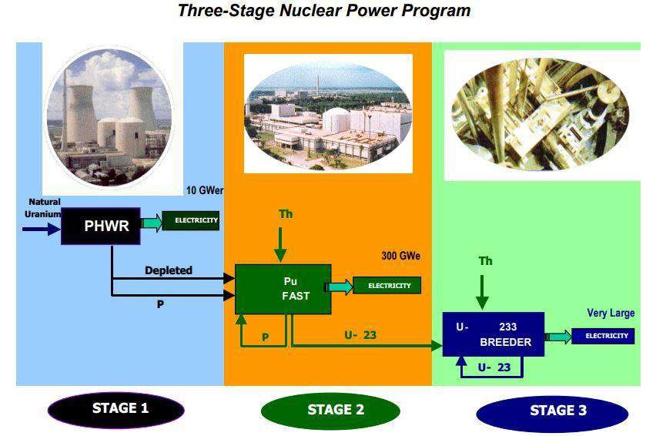
3-STAGE INDIAN NUCLEAR POWER PROGRAM

Slide 8
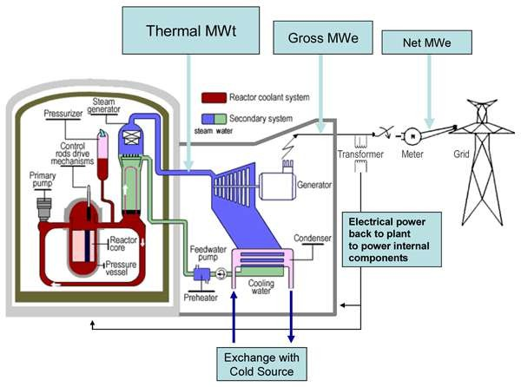
TYPES OF NUCLEAR REACTORS

Slide 9
- Boiling Water Reactors (BWRs)
- Pressurized Heavy Water Reactors(PHWRs)
- Fast Breeder Reactors (FBRs)
- Advanced Heavy Water Reactors (AHWRs)
TYPES OF NUCLEAR REACTORS

Slide 10

- Steam generated directly in reactor core
- Used in Tararpur Atomic Power Station
- Simpler design; lower pressure operation
BOILING WATER REACTORS (BWRS)

Slide 11
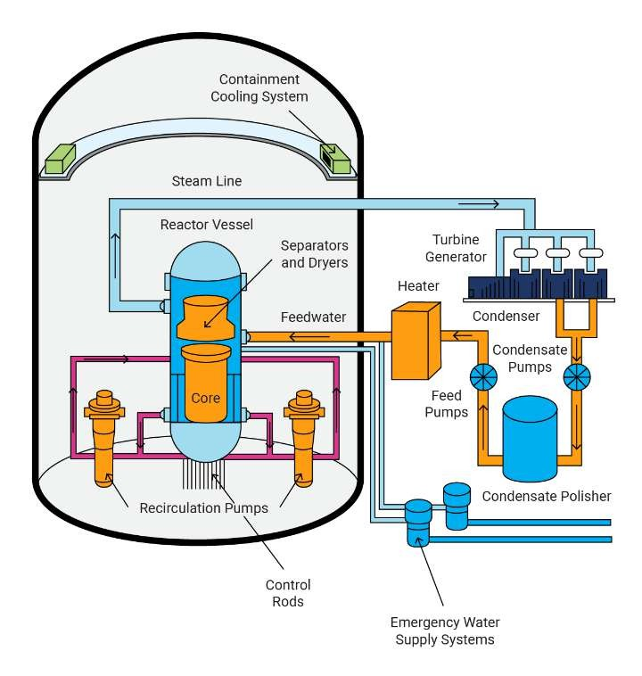
BOILING WATER REACTORS (BWRS)

Slide 12
- Advantages: Simple design, lower pressure
- Disadvantages: Steam radioactivity, void formation
ADVANTAGES & DISADVANTAGES OF BWRS

Slide 13
- Heavy water as coolant & moderator
- Uses natural uranium fuel
- Can be refueled during operation
PRESSURIZED HEAVY WATER REACTORS (PHWRS)

Slide 14
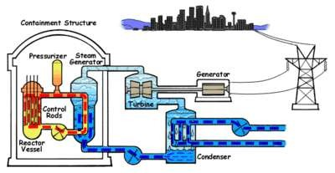
PRESSURIZED HEAVY WATER REACTORS (PHWRS)

Slide 15
- Pros: Fuel flexibility, on-power refueling
- Cons: Heavy water cost, higher spent fuel volume
PROS & CONS OF PHWRS

Slide 16
- Breed more fuel than consumed
- Use fast neutrons, no moderator
- PFBR at Kalpakkam is a key project
FAST BREEDER REACTORS (FBRS)

Slide 17
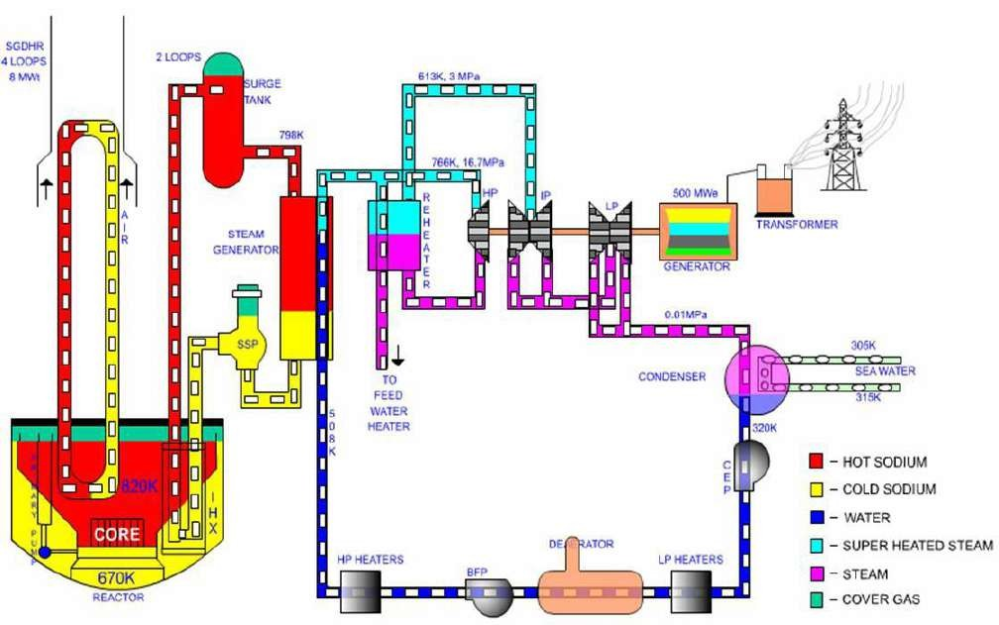
FAST BREEDER REACTORS (FBRS)

Slide 18
- Advantages: High fuel efficiency, waste reduction
- Challenges: Technical complexity, liquid metal coolant handling
FBR: ADVANTAGES & CHALLENGES

Slide 19
ADVANCED HEAVY WATER REACTORS (AHWRS)
- Use Thorium-232 and Plutonium-239
- Incorporates passive safety features
- Designed by BARC

Slide 20
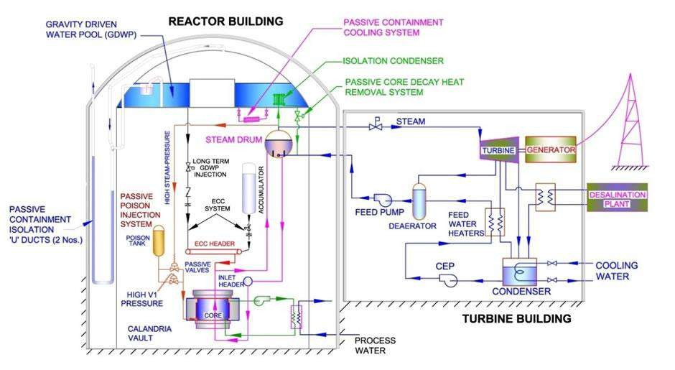
ADVANCED HEAVY WATER REACTORS (AHWRS)

Slide 21
- Advantages: Safe, waste-reducing, Thorium use
- Limitations: Under development, complexity
AHWR: ADVANTAGES & LIMITATIONS

Slide 22
- Defense-in-depth safety design
- Radiation protection & emergency preparedness
- Containment structures, waste management
NUCLEAR PLANT SAFETY SYSTEMS

Slide 23
- Emergency alert
- Personnel emergency
- Plant emergency
- Site emergency
- Off-site emergency
REACTOR EMERGENCY CLASSIFICATION

Slide 24
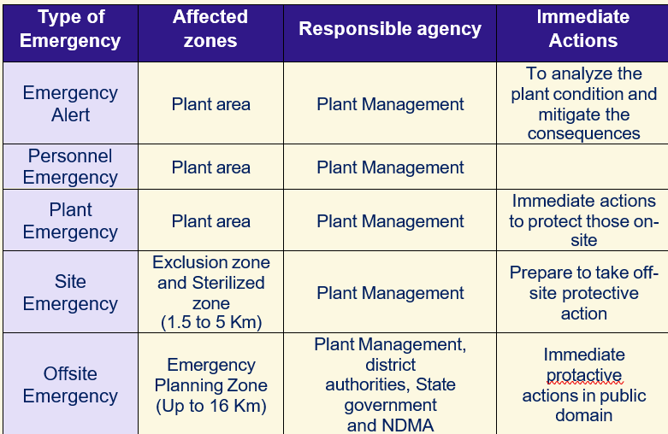
REACTOR EMERGENCY CLASSIFICATION

Slide 25
- Precautionary Action Zone (PAZ): 1.6 km
- Urgent Protective Action Zone (UPZ): 10 km
- Extended Planning Distance (EPD): 50 km
- Ingestion Planning Distance (ICPD): 100 km
EMERGENCY ZONES & PLANNING

Slide 26
- Initiating Conditions (ICs)
- Emergency Action Levels (EALs)
- Operational Intervention Levels (OILs)
EMERGENCY RESPONSE CRITERIA

Slide 27
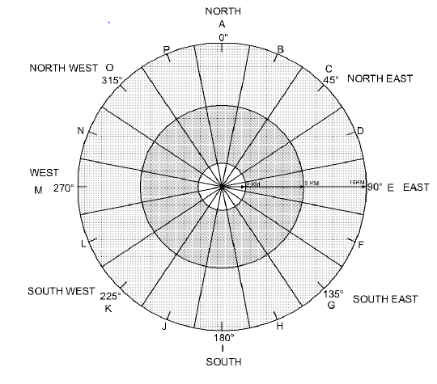
Based on reactor core damage or radiation release
Triggered by plant & environmental parameters
OFFSITE EMERGENCY DECLARATION

Slide 28
EMERGENCY PHASES
- Early Phase: Pre-release & Release
- Intermediate Phase: Exposure decline
- Late Phase: Recovery & remediation

Slide 29
ONSITE EMERGENCY RESPONSE
- Managed by Plant Emergency Handling Org.
- Focus on radiation control, containment, worker safety

Slide 30
- Led by DDMA & Collector
- Supported by CMG-DAE & BARC experts
OFFSITE EMERGENCY RESPONSE

Slide 31
KEY EMERGENCY RESPONSE TEAMS
- Warning & Advice Team
- Radiation Survey Team
- Traffic Control Team
- Evacuation & Prophylactics Teams

Slide 32
SPECIALIZED TEAMS & DUTIES
- Convoy Team: Transport evacuees
- Decontamination Team
- Rallying Post Team: Shelter setup
- Patrolling Team: Property security

Slide 33
- Information Team: Media liaison
- Service Support Team: Logistic & admin support
INFORMATION & SUPPORT TEAMS

Slide 34
- Low/intermediate waste: Stored & monitored
- High-level waste: Vitrified & stored
- Final disposal in Geological Facilities
NUCLEAR WASTE MANAGEMENT

Slide 35
- Search, Rescue, and Medical Aid
- Decontamination operations
- Evacuation and public safety assurance
ROLE OF NDRF IN NPP EMERGENCIES

Slide 36
- Supports DDMA for large scale evacuations
- Monitors contamination & organizes shelters
NDRF IN OFFSITE EMERGENCIES

Slide 37
Nuclear power is vital to India’s energy mix, but safety is paramount.
Understanding reactor principles and potential risks is key for first responders.
NDRF plays a crucial role in nuclear emergency preparedness and response.
CONCLUSION & KEY TAKEAWAYS

Slide 38
NDRF personnel are trained in:
Radiation safety
Decontamination procedures
Evacuation protocols
Their expertise ensures effective action in high-risk nuclear environments.
Integration of NDRF in response plans enables cohesive and comprehensive emergency management..
CONCLUSION & KEY TAKEAWAYS

Slide 39
Home:Nuclear Power Corporation of India Limited
(https://www.npcil.nic.in/content/328_1_AboutNPCIL.aspx)
Microsoft Word - Chapters Emergency preparedness for nuclear
and radiation facilities
(https://cag.gov.in/uploads/download_audit_report/2012/Union_Performance_Atomic_Energy_Regulatory_Board_Union_Government_Atomic_Energy_Department_9_2012_Chapter_7.pdf)
Bhabha Atomic Research Centre ( BARC ): Safety of Nuclear Reactors
(https://www.barc.gov.in/pubaware/snr.html)
REFERENCES

Slide 40
Preparation-of-site-emergency-preparedness-plans-for-nuclearinstallations. pdf
(https://aerb.gov.in/images/PDF/Preparation-of-site-emergencypreparedness- plans-for-nuclear-installations.pdf)
pagepublication SITE EMERGENCY PREPAREDNESS PLANS
(https://aerb.gov.in/images/PDF/Preparation-of-Off-site- Emergency-Plans-for-Nuclear-Facilities.pdf)
REFERENCES

Slide 41
REVIEW
Nuclear safety = design + regulation + response
- India's nuclear program: safety-focused
- NDRF plays key support role in emergencies
Conclusion
Upon completing of this lesson, you are able to learn about :-

Slide 42

Any question ?

Slide 43
Q. What is the role of NDRF in NPP Emergencies?
Ans. Search, Rescue, and Medical Aid
Decontamination operations
Evacuation and public safety assurance
Q What is the difference between onsite and off-site emergencies?
Ans. On-site emergencies occur within the premises of a nuclear facility and are managed by the plant's internal emergency response teams.
Off-site emergencies affect areas beyond the facility boundary and require coordinated response from external agencies like NDRF.
EVALUATION

Slide 44


THANK YOU

