Slide 1




MEDICAL FIRST RESPONDER
LESSON 5
Anatomical References
Presented by:- Pavan Dev Gaur, 2IC
CAPF | MFR | INDIA
-

Slide 2
OBJECTIVES
Upon completion of this lesson, you will be able to:
1
Define anatomical position.
Identify and describe the three anatomical planes.
Identify the five regions of the human body.
2
3

Slide 3
OBJECTIVES
Upon completion of this lesson, you will be able to:
4
List the five body cavities and the organs they contain.
Describe the location of a wound on a patient using anatomical references.
5

Slide 4
OBJECTIVES
Upon completion of this lesson, you will be able to:
6
Name the four abdominal quadrants.
Identify and label the main internal organs located in each abdominal quadrant.
7

Slide 5
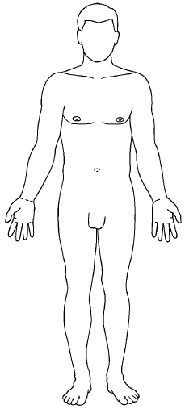
Anatomical Position
Definition: Patient Standing erect with arms down at the sides, palms facing forward. “Right” and Left” refers to the patient’s right and left.

Slide 6

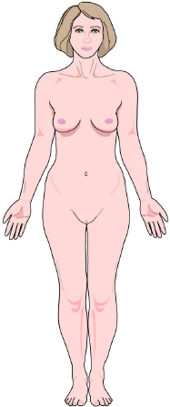
Anterior
Posterior
Right
Left
Conventional References
Proximal
TRANSVERSE
PLANE
Superior
Distal
Inferior
Proximal
Distal
FRONTAL PLANE
MEDIAL PLANE

Slide 7
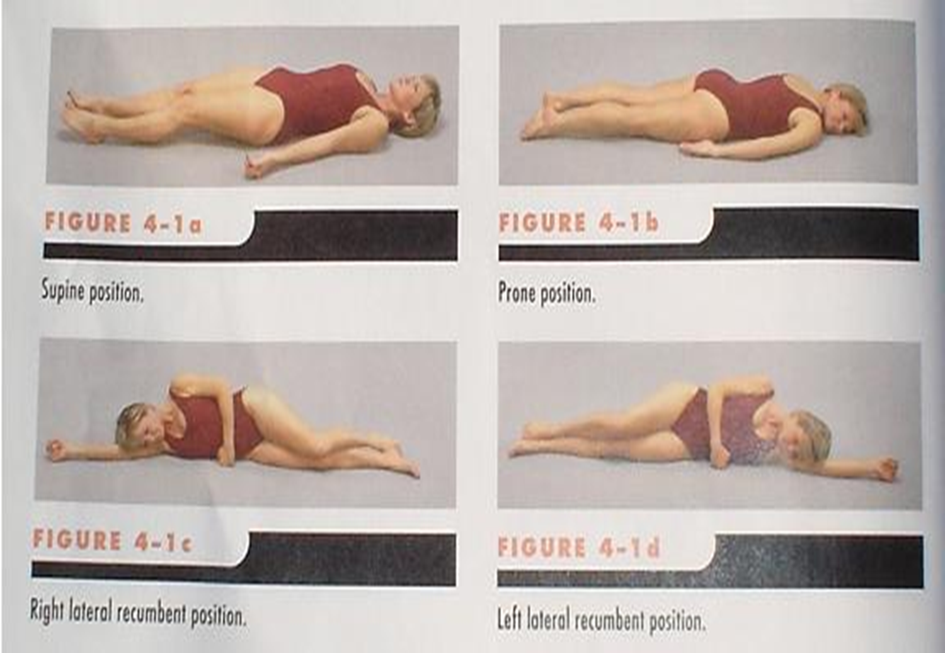
Positional Terms
Prone:
Lying face down, on the stomach
Supine:
Lying face up, on the back
Rt./Lt. lateral recumbent
position
(Recovery position)

Slide 8
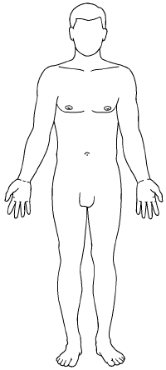
Head
Neck
Body
Regions
Upper
extremities
Trunk
Lower
extremities

Slide 9
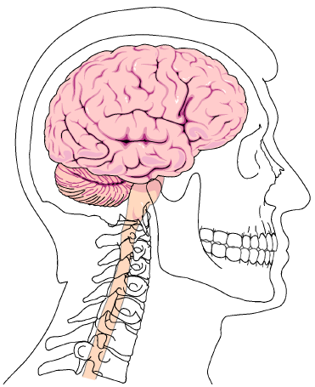
Head and Neck
Skull
Face
Neck

Slide 10
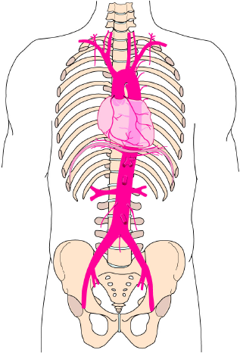
Trunk
Thorax
Abdomen
Pelvis

Slide 11
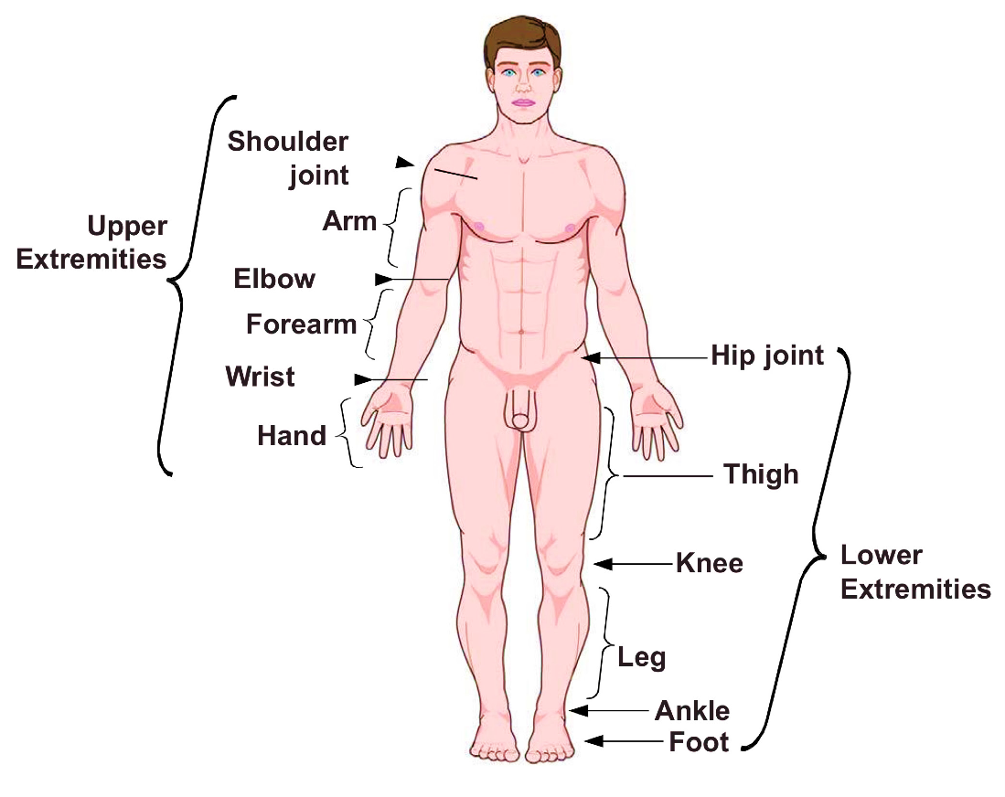
Upper and Lower Extremities

Slide 12

Cranial Cavity

Slide 13
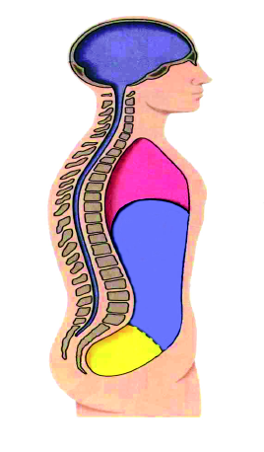
Thoracic, Abdominal and Pelvic Cavities
Thoracic
Abdominal
Pelvic

Slide 14
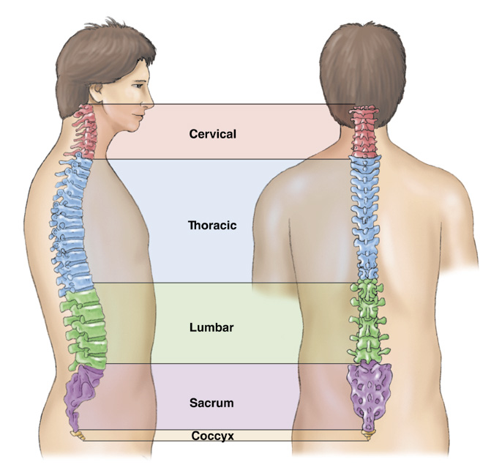

Spinal
Cavity

Slide 15
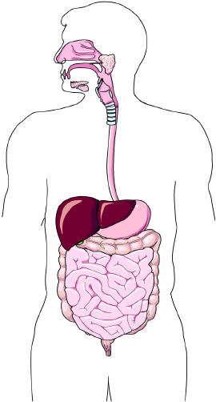
Abdominal Quadrants
Liver
Liver
Stomach
Large intestine / colon
Large intestine / colon
Small Intestine
Small Intestine
Right Upper Quadrant
Left Upper Quadrant
Right Lower Quadrant
Left Lower Quadrant
Large intestine / colon
Large intestine / colon
Small Intestine
Small Intestine

Slide 16
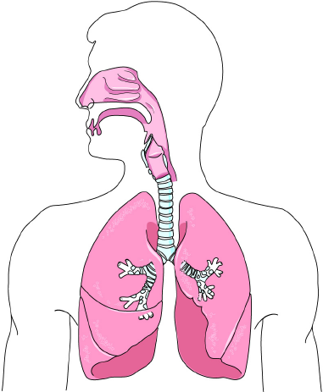
Respiratory System
Pharynx
Epiglottis
(oropharynx and
nasopharynx)
Larynx
Lungs
Trachea
Right main
bronchus
Left main
bronchus

Slide 17

Digestive System
Mouth
Oesophagus
Stomach
Large intestine
Liver
Small intestine
Anus

Slide 18
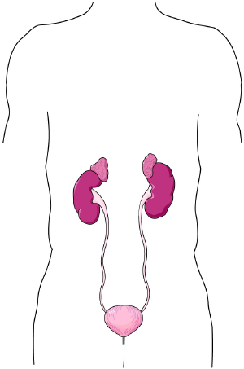
Urinary System
Kidneys
Ureters
Urinary bladder
Urethra

Slide 19
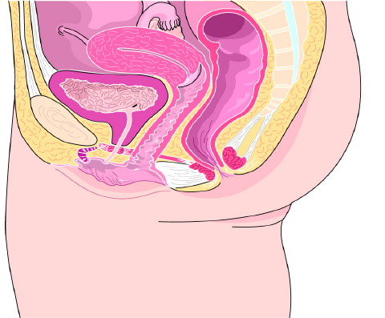
Fallopian Tube
Female Reproductive System
Ovary
Uterus
Vagina
External
genitals

Slide 20
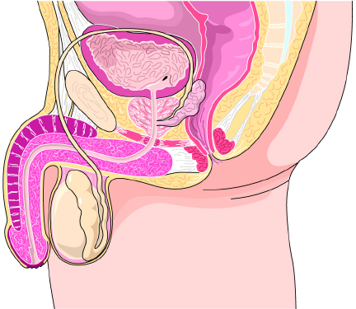
Seminal duct
Male Reproductive System
Penis
Testes

Slide 21
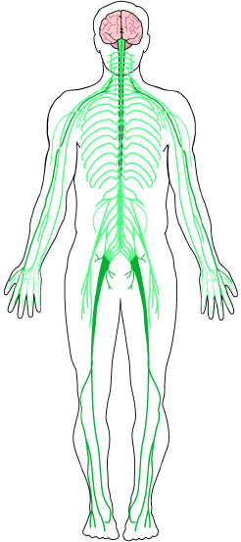
Brain
Central nervous system
Nervous System
Spinal cord
Peripheral
nervous
system

Slide 22
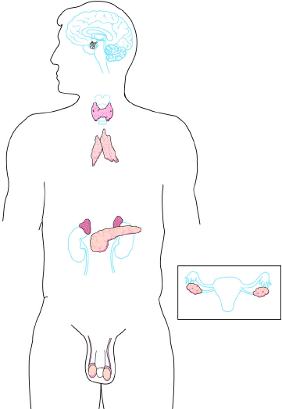
Pituitary
Endocrine System
Thyroid
Adrenals
Testes
(male)
Ovaries
(female)

Slide 23
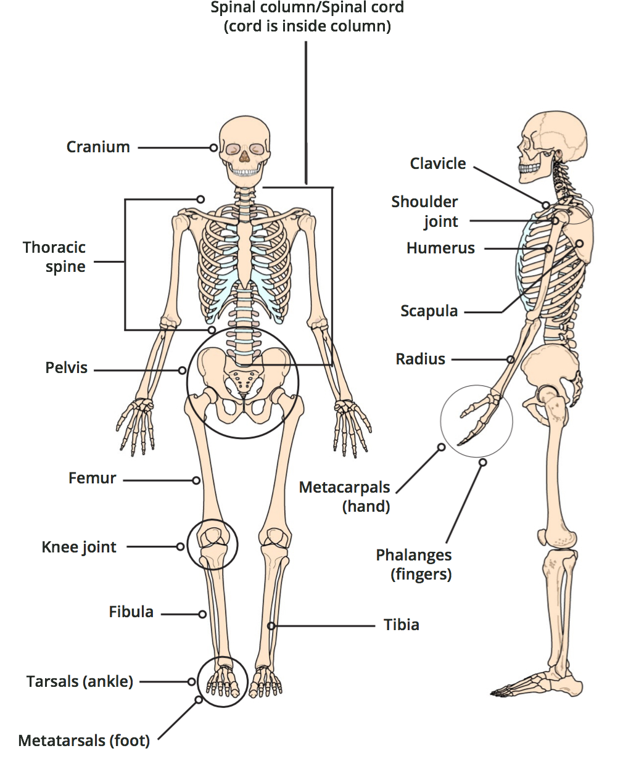
Skeletal System

Slide 24
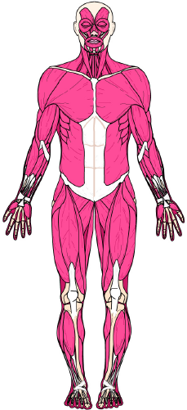
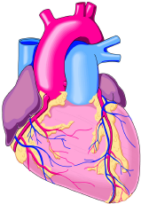
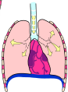
Major Muscle Types
Cardiac muscle
Smooth muscle
Skeletal muscle

Slide 25
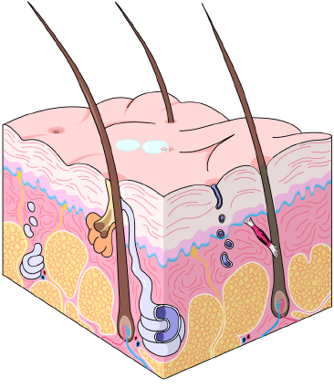
The Skin
Skin surface
Epidermis
Dermis

Slide 26
REVIEW
Now you are able to:
1
Define anatomical position.
Identify and describe the three anatomical planes.
Identify the five regions of the human body.
2
3

Slide 27
REVIEW
Now you are able to:
4
List the five body cavities and the organs they contain.
Describe the location of a wound on a patient using anatomical references.
5

Slide 28
REVIEW
Now you are able to:
6
Name the four abdominal quadrants.
Identify and label the main internal organs located in each abdominal quadrant.
7

Slide 29


THANK YOU

