Slide 1
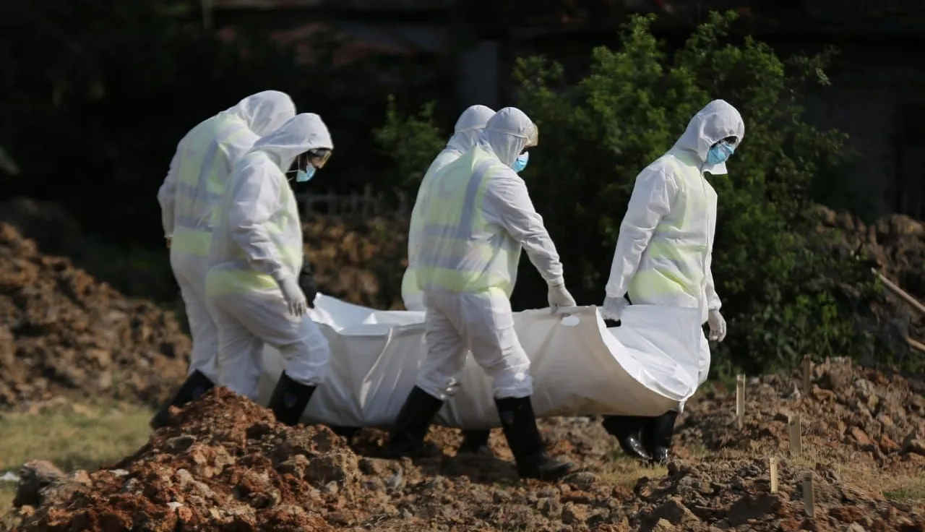


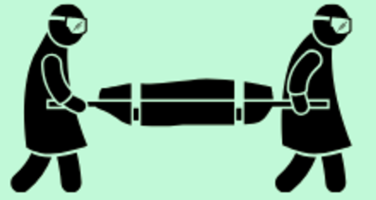
Dead Body Management and Caracas Management
LESSON 04
HANDLING OF DEAD BODIES
Presented By:- Kamlesh Dhoundiyal,2IC
NDRF | DBM-CM | INDIA
PPT 4 - 1

Slide 2
OBJECTIVES
Upon completing this lesson, you will be able to:
1
Acquaint with Dead Body Management and Related Challenges.
Know about 07 basic principle of Dead Body Management
Know about 05 stages of Dead Body Management Protocol
2
3

Slide 3
OBJECTIVES
Upon completing this lesson, you will be able to:
4
Know about retrieval, transport, storage, identification and disposal of Dead Body Management
Know About psychological support during Dead Body Management
5

Slide 4
DEAD BODY MANAGEMENT
The process of handling deceased / sufferer appropriately in a post disaster period to minimize the effect of incident associated with their religious and cultural issues.

Slide 5
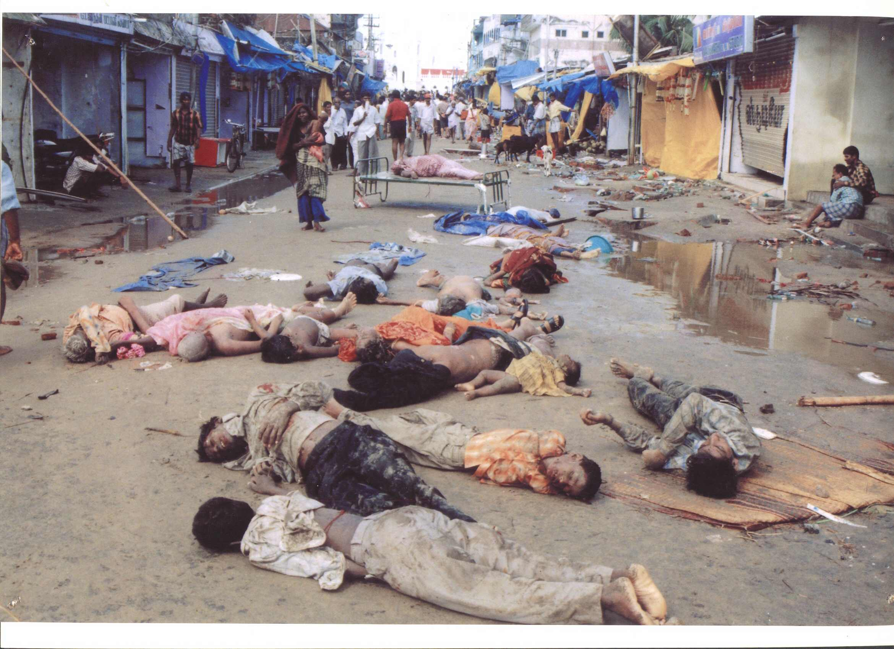
DEAD BODY MANAGEMENT
Most difficult aspects of disaster response
Big challenge for rescuers and administration
Absence of mass fatality plan
Absence of trained manpower
Lack of infrastructure facilities

Slide 6
CHALLENGES IN LARGE SCALE DEAD BODY MANAGEMENT
Lack of proper infrastructure
Absence of awareness
Inadequate facility for training
Disposal of unclaimed body
Diverse socio – cultural norms
PPT 4 -

Slide 7
BASIC PRINCIPLES
No discrimination in treatment of the body in any form
No physical exploitation
Decent and timely burial/ cremation
To receive justice, in case of death due to crime
PPT 4 -

Slide 8
BASIC PRINCIPLES
To carry out a legal will
No defamation after death
No breach of privacy
cont…
PPT 4 -

Slide 9
Responder Safety & PPE
N95/FFP2 mask, gloves (double), gowns, goggles, boots
Hand hygiene after handling bodies
Vaccinations: Tetanus, Hep B, COVID boosters

Slide 10
Scene Assessment & Coordination
Establish IRS and Activate district plan
Coordinate with police for forensic needs
Body collection points & documentation desks
Manage relatives/media
Central collection & information center
Use NDMA/WHO templates
Provide psychosocial support

Slide 11
Dead Body Management Protocol
Disposal
Recovery
5
1
DBM
4
Storage and
Preservation
2
3
Identification
Transportation

Slide 12
Dead Body Management Protocol
Ensure PPE/vaccination of search and rescue groups
Use of thermal sensors/trained dogs
Avoid heavy machinery for recovering dead.
Trained personnel at the scene for identification (Identification Form)
Recovery

Slide 13
Dead Body Management Protocol
Cont…
All body parts to be packed individually and labeled them with distinct numbers
Do not try to match body parts
Photography with level
Make sure that things Belonging to one body are not assigned to another
In case of CBRN – Recovery only after ensuring safety
Recovery

Slide 14
Dead Body Management Protocol
Identification is a process of comparing and matching the information of missing person
Standard method of Iden:
Relatives descriptions
Visual signs
Photographs
Personal description/Medical findings/evidence/clothing
Fingerprints, dental, DNA
Identification

Slide 15
Dead Body Management Protocol
Site to be marked for collection
Vehicles with wide space and canopy
Maintain privacy and dignity
Body only in body bag or plastic sheets
Do not carry manually, Use stretchers.
Transportation

Slide 16
Dead Body Management Protocol
Cont…
Do not remove the belongings
Bodies not to be put in layers
CBRN Decontamination before transport
Ambulance not to be used for TPT of dead bodies
Proper decontamination of vehicles
Transportation

Slide 17
Dead Body Management Protocol
Requirement of adequate space
Permanent Mortuaries
Temporary Mortuaries:
Viewing area
Examination area
Care to be taken against climatic condition, temperature, ventilation, cooling facility
Storage and Preservation

Slide 18
Dead Body Management Protocol
Cont…
Modes of preservation –
Refrigeration – 2°C to 4°C
Use of Dry Ice – 10 Kg of dry Ice per body
Use of Ice in emergency with drainage facility
Storage and Preservation

Slide 19
Dead Body Management Protocol
Cont…
Temporary Burial –
250m away from drinking water source
No mass burial in single ditch
Distance between two bodies: 0.5m
Bodies to be buried with identification number and waterproof levels
1.5m above ground water level
1m covering of soil
Storage and Preservation

Slide 20
Dead Body Management Protocol
Unidentified bodies to be disposed by the district authority
In case of body of foreigner MEA shall take necessary action
Final Rituals
Cremation – Funeral/ Electric Crematoriums
Burials
Specific Methods based on faith
Special circumstances such as CBRN
Disposal

Slide 21
DOCUMENTATION AND FORMS
Initial Registration of the Deceased
Photograph the Body
Record Physical Characteristics
Issuance of Death Certificates
Documentation of Final Disposition
PPT 4 -

Slide 22
ASSIGNING A UNIQUE IDENTIFICATION NUMBER
Each Body or Body Part must have a unique reference number. Following is recommended –
Tag wrist/ankle & body bag
Use waterproof markers
Place + Recovery Team+ Serial Number
Mundakkai – 4NDRFB6 – 001

Slide 23
Personal Belongings
Catalog & seal items
Attach or store with tag
Handover to police/family
Avoid pilferage

Slide 24
Need for Psychosocial Support
Helpdesks & counseling
Updates to relatives
Debrief responders
Honor dead respectfully

Slide 25
Media & Public Communication
Designated spokesperson
No unauthorized photos
Share verified lists
Respect family privacy

Slide 26
Environmental Concerns
No dumping in rivers
Follow PCB burial norms
Use lime/chlorine
Prevent scavenger access

Slide 27
Case Study: Kedarnath 2013
>4000 bodies recovered
Temporary morgues
DNA profiling used
Lessons: better tagging, refrigeration
Use of Social Media

Slide 28
Key references
NDMA (2010): Guidelines on Management of the Dead in the Aftermath of Disasters
MoHFW SOPs: COVID-19 & infectious disease dead body management
WHO (2020): Safe management of a dead body in the context of COVID-19
ICRC (2016): Management of Dead Bodies after Disasters
NHRC Advisory (2021)

Slide 29

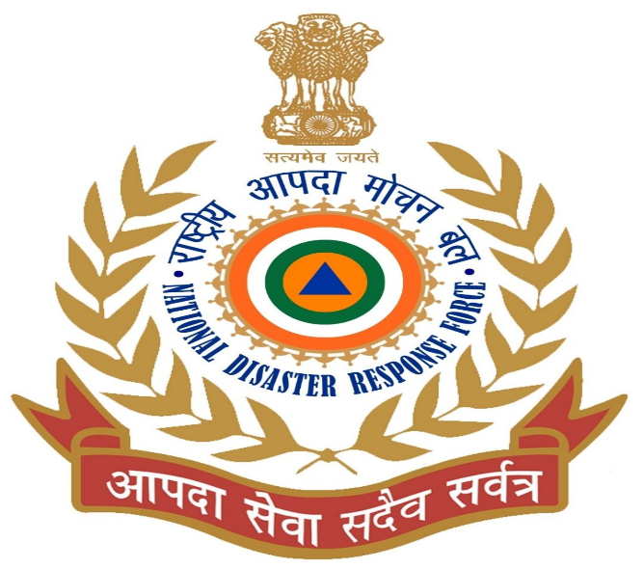

THANK YOU

